Slide 1
Mortality Shift & Compression Decomposition – Two Applications
Wen Su
Research Meeting 221109

Slide 2
Rationale:
for a econometrics course
the paper by Bergeron-Boucher et al., (2015) in Demographic Research
These are the extensions

Slide 3
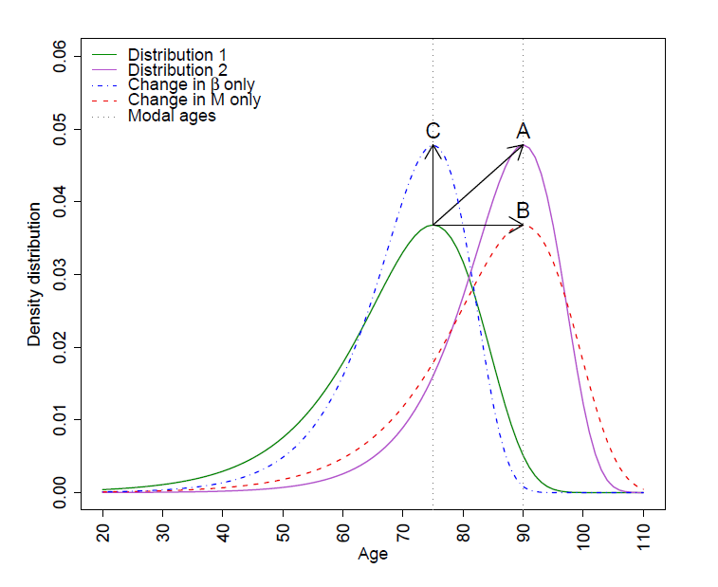
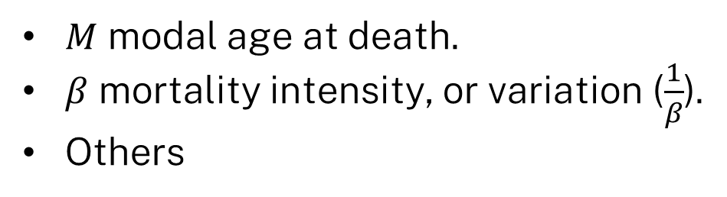
Methodology
$M$ modal age at death.
$β$ mortality intensity, or variation ($\frac{1}{β}$).
Others
Bergeron-Boucher et al., (2015) Basellini et al., (2019)

Slide 4
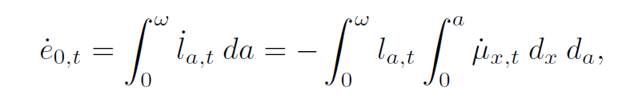
Methodology
Changes in Life expectancy

Slide 5


Methodology
Mortality modelling

Slide 6
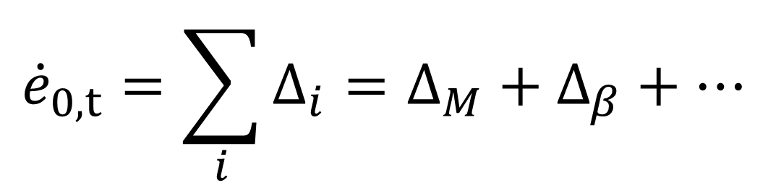
Methodology
$${\dot{e}}_{0,t}=\sum_{i}{Δ_{i}}=Δ_{M}+Δ_{β}+…$$

Slide 7
Data
Human Mortality Database
National Centre of Health Statistics (CDC Wonder)

Slide 8
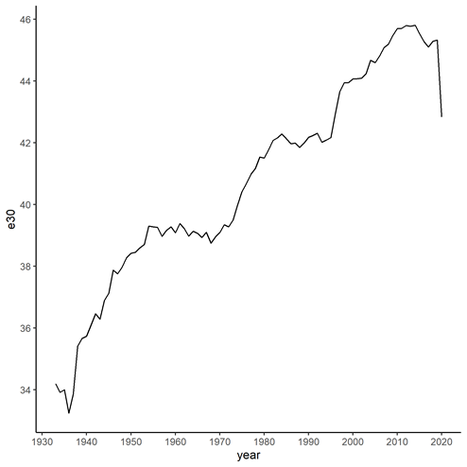
United States During COVID

Slide 9
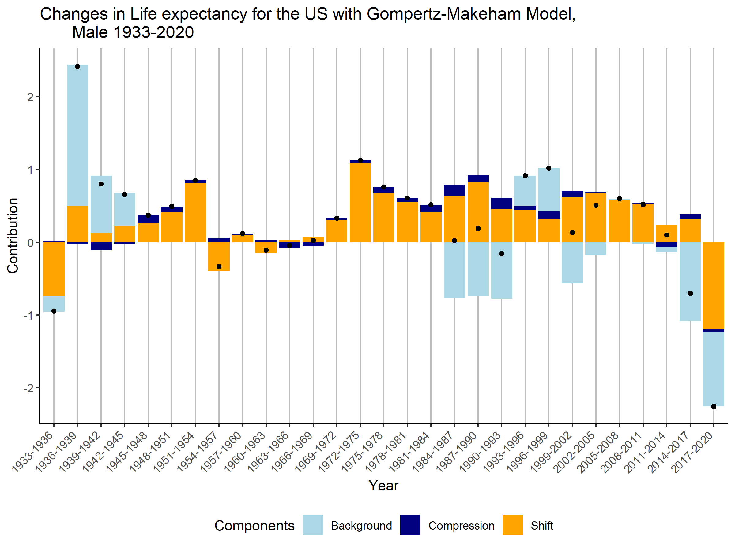
United States During COVID

Slide 10
United States During COVID
Table 1. Contributions from background mortality component (light blue), mortality compression component (navy blue), and mortality shift component (orange) to changes in life expectancy for different races of males in the US, 2011-2020.

Slide 11
United States During COVID
Discrepancies (big) between CDC data and HMD.
Reweight to HMD?
Categorical errors

Slide 12
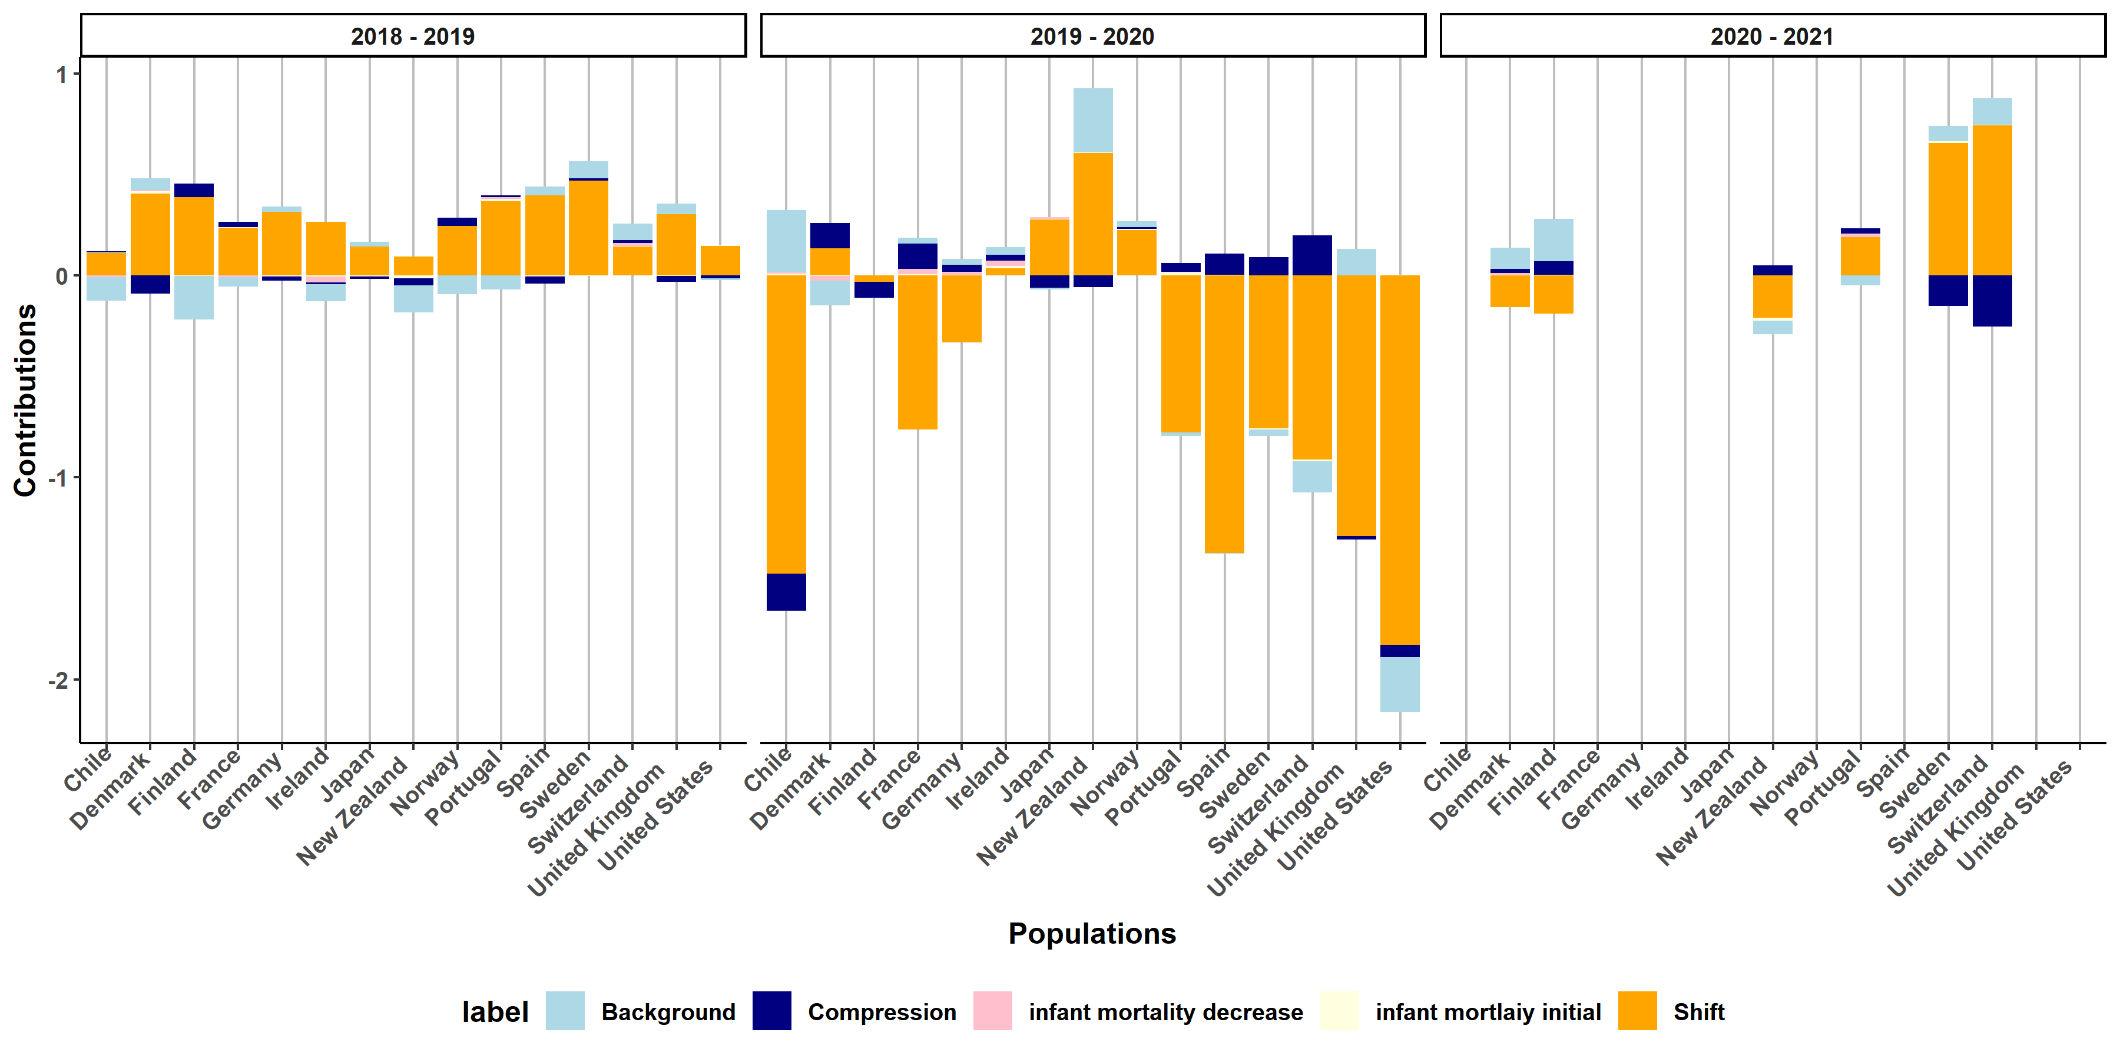

Slide 13
Eastern European Countries
Bergeron-Boucher focused on low-mortality countries.
Does Eastern European countries follow the same step?

Slide 14
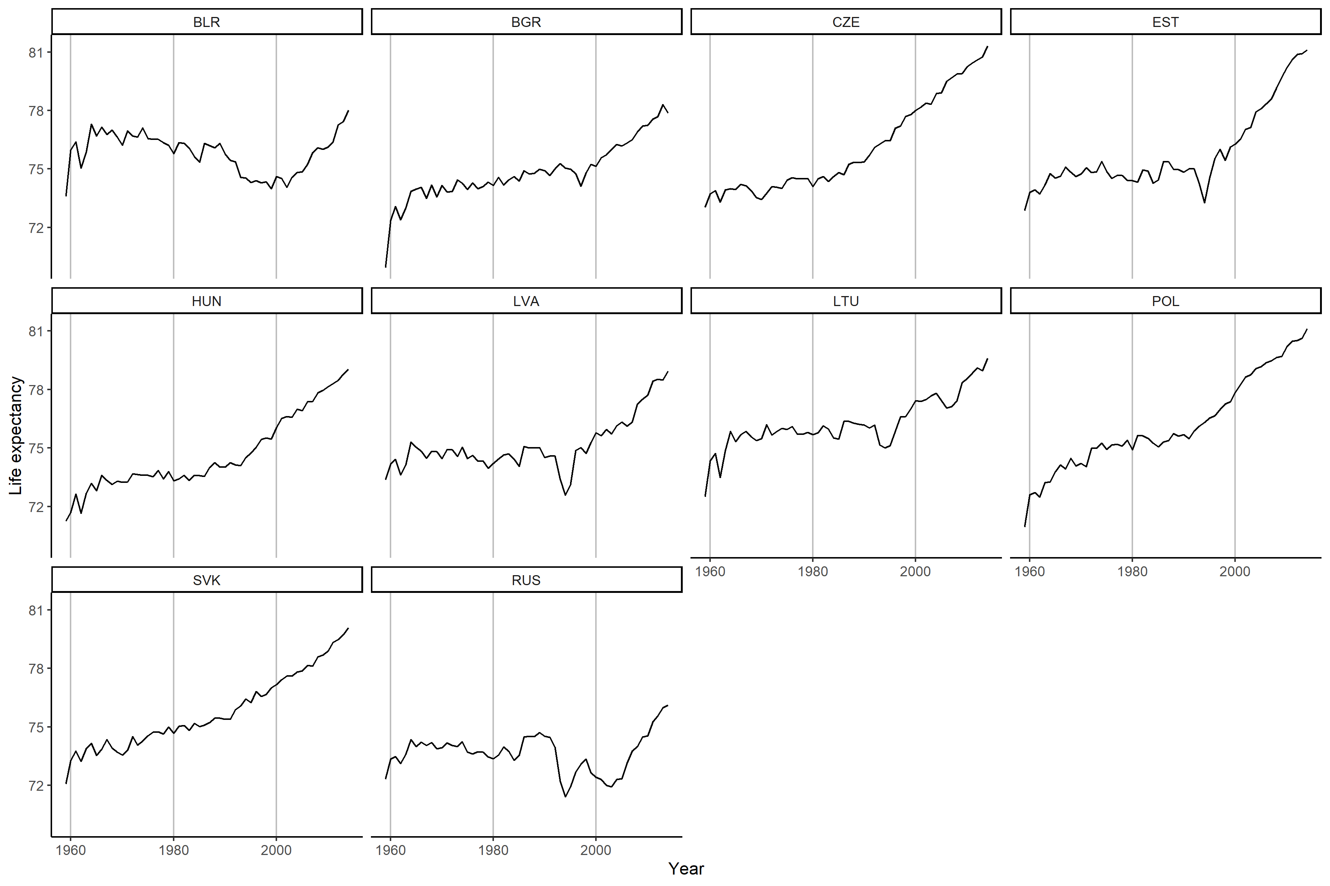

Slide 15
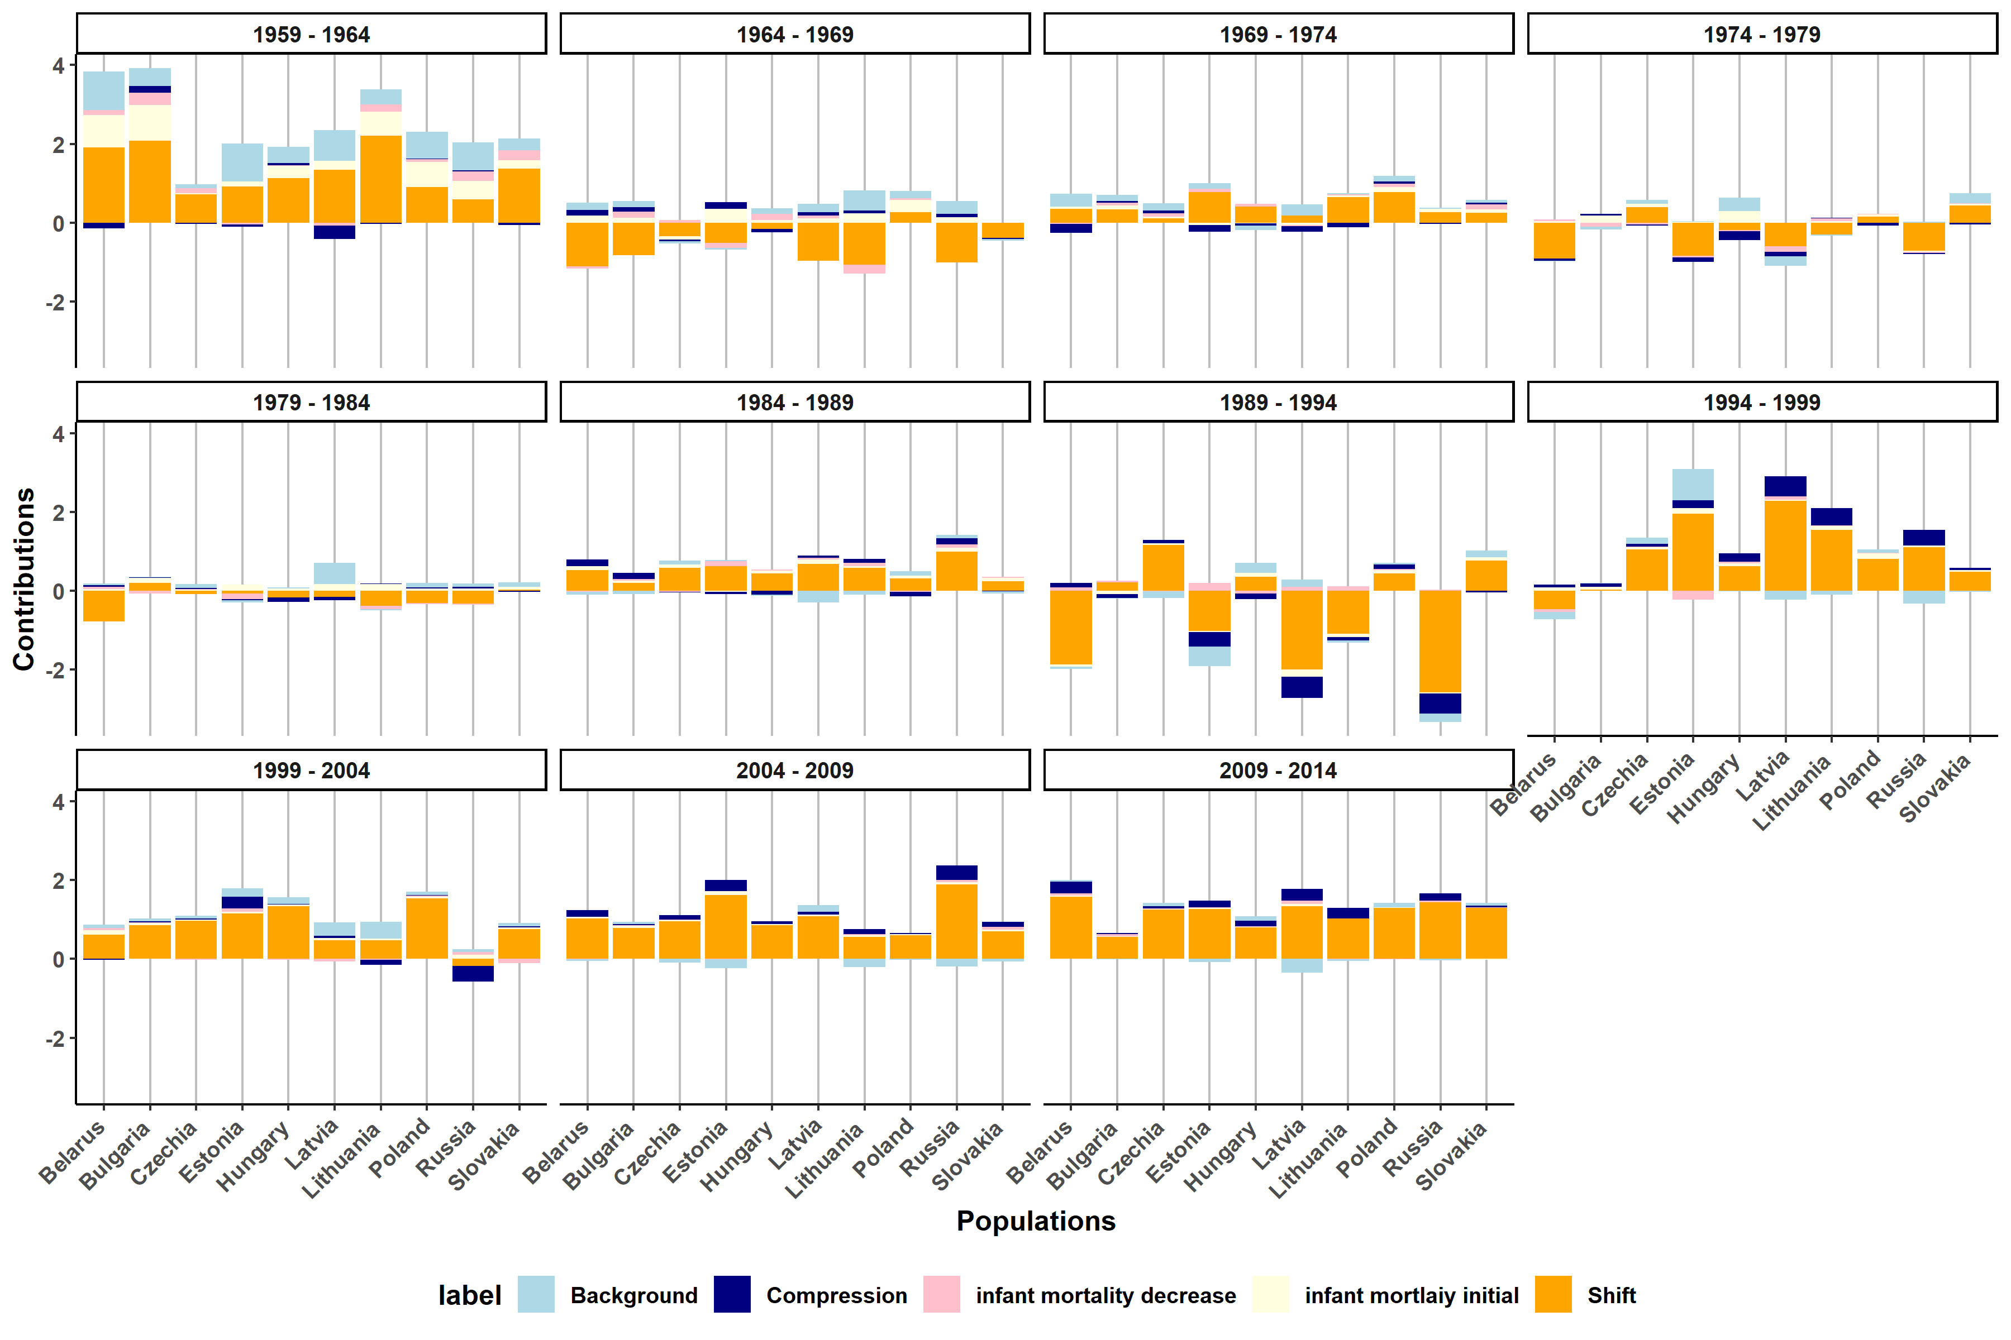

Slide 16

Next step, maybe lifespan variation?
$${\dot{e}}^{†}$$

Slide 17
https://github.com/WenSu221/Gompertz_Decomp

