Slide 2
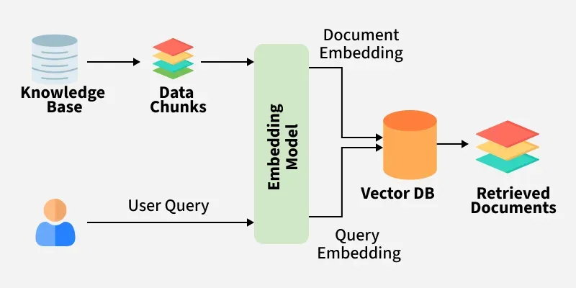
what is retrieval augmented generation (RAG)?

