Slide 1

Cap inspection and Preprocessing
Xiaowei Wen
Matricola: 982501
A.Y. 2020/2021

Slide 2
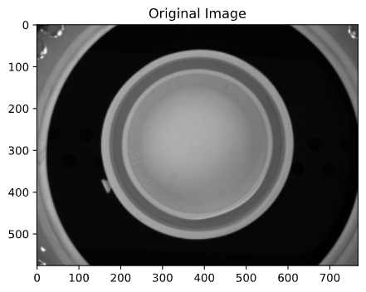
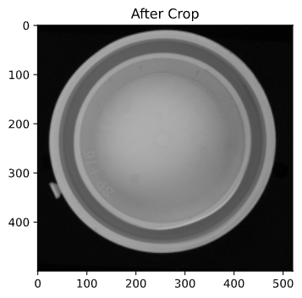

Preparing images
[50:550,130:650]
Gaussian Filter

Slide 3
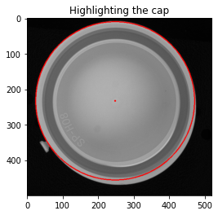
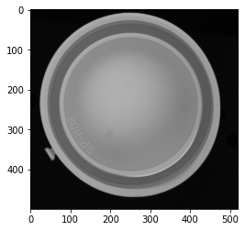
Task 1
Task 1: ✔

Slide 4
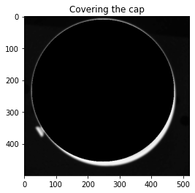
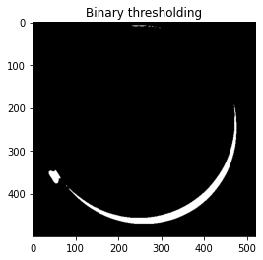
Looking for the tab - 1

Slide 5
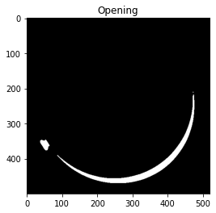
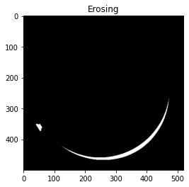
Looking for the tab - 2

Slide 6
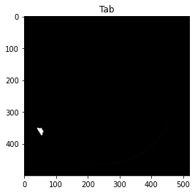
Looking for the tab - 3
area | perimeter | bbox-area | label | compactness | rectangularity
1 | 0 | 1 | 4 | 0 | 1
4 | 2 | 4 | 1 | 1 | 1
258 | 71.77 | 480 | 3 | 19.96 | 0.54
3370 | 910.06 | 65513 | 2 | 245.76 | 0.05

Slide 7
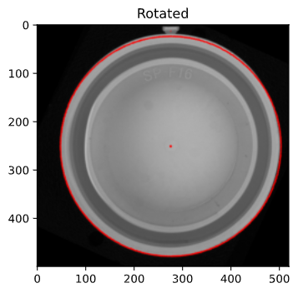
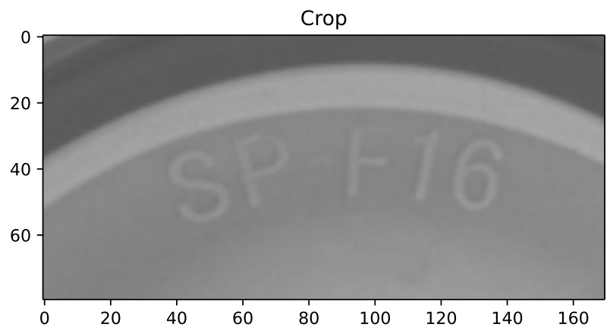
Task 2
Task 2: ✔

Slide 8
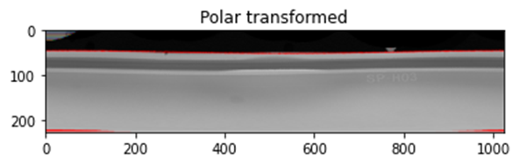
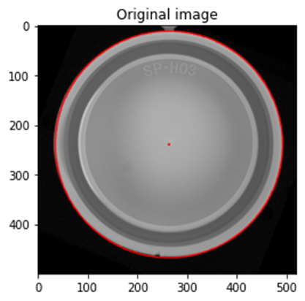
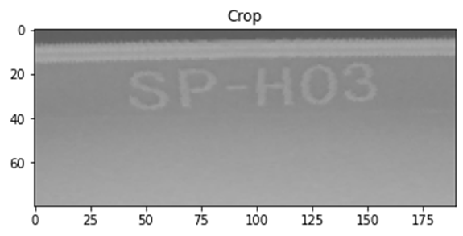
Polar transform & Crop
Task 3: ✔

Slide 9
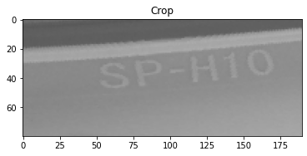
But!

Slide 10
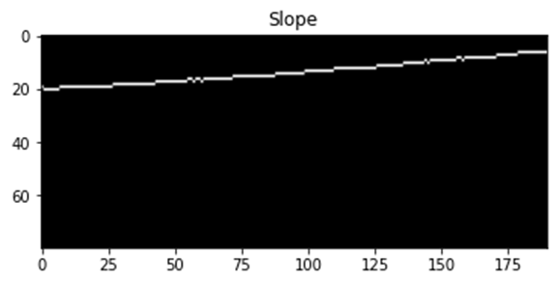
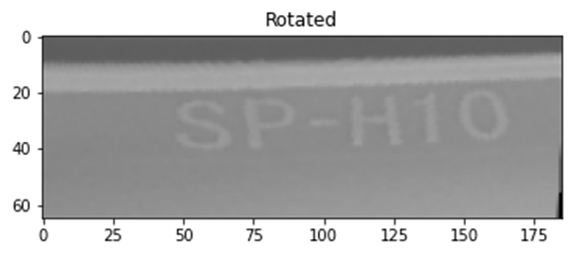
Rotation
Task 3: ✔

