Slide 1
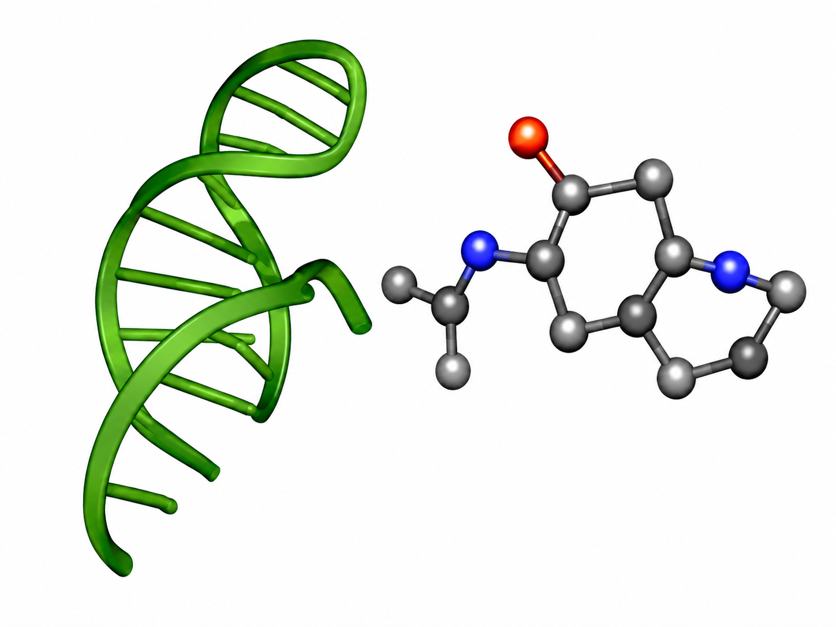
A. Inputs and Data Sources
B. DeepRSMA multiview backbone preserved
C. Contact prediction andstructural pretraining
D. Structural Contact Adapterfor affinity prediction
PDB
RNA-ligand complexes
Stage 1: PDB contact pretraining Input: RNA-ligand complex | Output: contact map | Loss: L_contact
Stage 2: R-SIM affinity fine-tuning with SCA (affinity loss only) Input: RNA sequence + ligand SMILES | Output: pKd | Loss: L_affinity No contact labels required

Slide 2
Figure 1. Overall architecture of StructRSMA.
A. Inputs and data sources
B. DeepRSMA multiview backbone preserved
C.
D. Structural Contact Adapter for affinity prediction
PDB RNA-ligand complexes
Original DeepRSMA backbone preserved
Stage 1: Contact pretraining
Stage 2: Affinity fine-tuning with SCA
RNA side
Ligand side
RNA sequence branch RNA sequence A U G C RNA sequence encoder H_RS
Molecule sequence branch Ligand SMILES SMILES: CCO... Molecule sequence encoder H_MS
PDB complexes only PDB-derived distance-defined contact labels
1) Pooled view vectors from backbone H = [h_RS, h_RG, h_MS, h_MG]
RNA 3D structure + ligand coordinates
Nucleotide embeddings r_i (i = 1,...,p)
Atom embeddings m_j (from graph / cross-fused atom stream) (j = 1,...,q)
distance < 4 A
RNA graph branch RNA secondary/contact graph RNA graph encoder H_RG
Molecule graph branch Molecular graph Molecule graph encoder H_MG
2) Contact prior inferred (no contact labels used)
Contact map C in {0,1}^{p x q} rows = RNA nucleotides columns = ligand atoms
Pretrained contact head predicts P on R-SIM pairs (no contact supervision) P in [0,1]^{p x q}
Contact prediction head [r_i, m_j, r_i * m_j] Pairwise MLP score_ij
Contact prior statistics c = [density, maxprob, rnafocus, atomfocus]
Structure supervision from PDB complexes
Cross-fusion module RNA-to-ligand attention Ligand-to-RNA attention
Structural Contact Adapter (SCA)
R-SIM affinity dataset
1. Contact-prior gate g = softmax(MLP_gate([H,c]))
RNA sequence
Token-level embeddings for contact prediction
Token-level embeddings for contact prediction
Predicted contact probability map P P in [0,1]^{p x q}
PDB-derived contact map C C in {0,1}^{p x q}
2. Contact-gated view attention H' = Attention(H,g)
A U G C
Nucleotide embeddings r_i r_1, r_2, ..., r_p
Atom embeddings m_j m_1, m_2, ..., m_q
3. Residual correction Delta y = MLP_res([z_contact,pool(H'),y_base])
Ligand SMILES
SMILES: CCO...
Base affinity path (preserved backbone)
SCA output (residual calibration)
pKd
Pooled view vectors for SCA and affinity prediction
L_contact = Focal Loss(P, C)
Affinity head y_base
Residual correction Delta y
Affinity supervision from R-SIM
h_RS
h_RG
h_MS
h_MG
+
Final prediction: y_hat = y_base + Delta y Final pKd
Stage 1: PDB contact pretraining Input: RNA-ligand complex | Output: contact map | Loss: L_contact
Stage 2: R-SIM affinity fine-tuning with SCA (affinity loss only) Input: RNA sequence + ligand SMILES | Output: pKd | Loss: L_affinity No contact labels required
Solid arrows = normal forward propagation
Dashed arrows = supervision / loss signal (Stage 1 only)
+
= residual addition (sum)

Slide 3
Figure 1. Overall architecture of StructRSMA.
A. Inputs and data sources
B. DeepRSMA multiview backbone preserved
C. Contact prediction and structural pretraining
D. Structural Contact Adapter for affinity prediction
PDB RNA-ligand complexes
Original DeepRSMA backbone preserved
Stage 1: Contact pretraining
Stage 2: Affinity fine-tuning with SCA
RNA side
Ligand side
RNA sequence branch RNA sequence A U G C RNA sequence encoder H_RS
Molecule sequence branch Ligand SMILES SMILES: CCO... Molecule sequence encoder H_MS
PDB complexes only PDB contact labels available
1) Pooled view vectors from backbone H = [h_RS, h_RG, h_MS, h_MG]
Nucleotide embeddings r_i (i = 1,...,p)
Atom embeddings m_j (j = 1,...,q)
RNA 3D structure + ligand coordinates
distance < 4 A
RNA graph branch RNA secondary / contact graph RNA graph encoder H_RG
Molecule graph branch Molecular graph Molecule graph encoder H_MG
2) Contact prior inferred (no contact labels used)
Contact map C in {0,1}^{p x q} rows = RNA nucleotides columns = ligand atoms
Contact prediction head [r_i, m_j, r_i * m_j] Pairwise MLP score_ij
Pretrained contact head predicts P on R-SIM pairs (no contact supervision) P in [0,1]^{p x q}
Contact prior statistics c = [density, maxprob, rnafocus, atomfocus]
Structure supervision from PDB complexes
Cross-fusion module RNA-to-ligand attention Ligand-to-RNA attention
Predicted contact map P in [0,1]^{p x q}
PDB-derived contact map C C in {0,1}^{p x q}
Structural Contact Adapter (SCA)
R-SIM affinity dataset
1. Contact-prior gate g = softmax(MLP_gate([H,c]))
RNA sequence
2. View-level attention H' = Attention(H,g)
A U G C
Nucleotide embeddings: r_1, r_2, ..., r_p
Atom embeddings: m_1, m_2, ..., m_q
3. Residual correction Delta y = MLP_res([z_contact,pool(H'),y_base])
Ligand SMILES
Base affinity path (preserved backbone)
SCA output (residual calibration)
SMILES: CCO...
pKd
L_contact = Focal Loss(P, C) (Focal loss)
Affinity head y_base
Residual correction Delta y
Pooled view vectors for SCA and affinity prediction
Affinity supervision from R-SIM
h_RS
h_RG
h_MS
h_MG
+
Final prediction: y_hat = y_base + Delta y Final pKd
Stage 1: PDB contact pretraining Input: RNA-ligand complex | Output: contact map | Loss: L_contact
Stage 2: R-SIM affinity fine-tuning with SCA (affinity loss only) Input: RNA sequence + ligand SMILES | Output: pKd | Loss: L_affinity No contact labels required
Solid arrows = normal forward propagation
Dashed arrows = supervision / loss signal (Stage 1 only)
+
= residual addition (sum)

