Slide 1

BKDR Hash
Two hashes equal ⬄ Two strings equal!
High-quality Hash Algorithm with Little Complexity!
For a string $s="c_{1}c_{2}…c_{n−1}c_{n}"$
$$BKDR\left(s\right)=\left(c_{1}⋅B^{n−1}+c_{2}⋅B^{n−2}+…+c_{n−1}⋅B+c_{n}\right) (mod M)$$
For a substring $s_{jk}="c_{j}c_{j+1}…c_{k−1}c_{k}" (1≤j≤k≤n)$
$$BKDR\left(s_{jk}\right)=BKDR\left(s_{1k}\right)−BKDR\left(s_{1\left(j−1\right)}\right)×B^{k−j}$$

Slide 2

Our Hash
Double BKDR
$B_{1}=131, B_{2}=13131, M_{1}=M_{2}=2^{32}−1$ (Mod => multiplication overflow)
Concatenate two 32-bit hash to form a 64-bit hash
How to hash a pattern/query ($n$ grams)
Pad a <space> at the end: "$gram_{1}□gram_{2}□…gram_{n}□$" ⬄ "$g_{1}g_{2}…g_{n}$"
Character-level scanning from right to left
For a query, save hash value of every last $k (1≤k≤n)$ grams
For a pattern, …

Slide 3


Multi-layered Pattern Indexing
1 gram
first_hash
key_hash
$2^{r} \left(2^{r}≤n<2^{r+1}\right)$ grams
full_hash
$n$ grams
For every pattern: A 3-level hash is built
first_hash
key_hash
full_hash

Slide 4
Multi-layered Pattern Indexing
concurrent_unordered_map< // thread-safe, find-by-key
int64 first_hash,
unordered_map< // enumerable
uint key_grams_length,
unordered_map< // find-by-key
int64 key_hash,
unordered_map< // enumerable
uint full_length,
unordered_set<int64 full_hash> // find-by-key
> > > >

Slide 5
Multi-layered Pattern Indexing
concurrent_unordered_map< // thread-safe, find-by-key
int64 first_hash,
unordered_map< // enumerable
uint key_grams_length,
unordered_map< // find-by-key
int64 key_hash,
unordered_map< // enumerable
uint full_length,
unordered_map<int64 full_hash, timestamp>
> > > >
struct timestamp {
int isValid: 1;
int lineNum: 31;
int batchNum: 32;
};

Slide 6
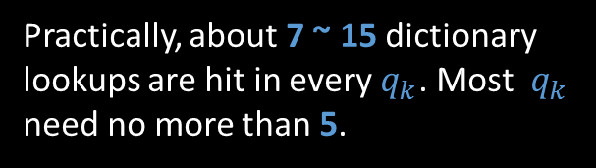
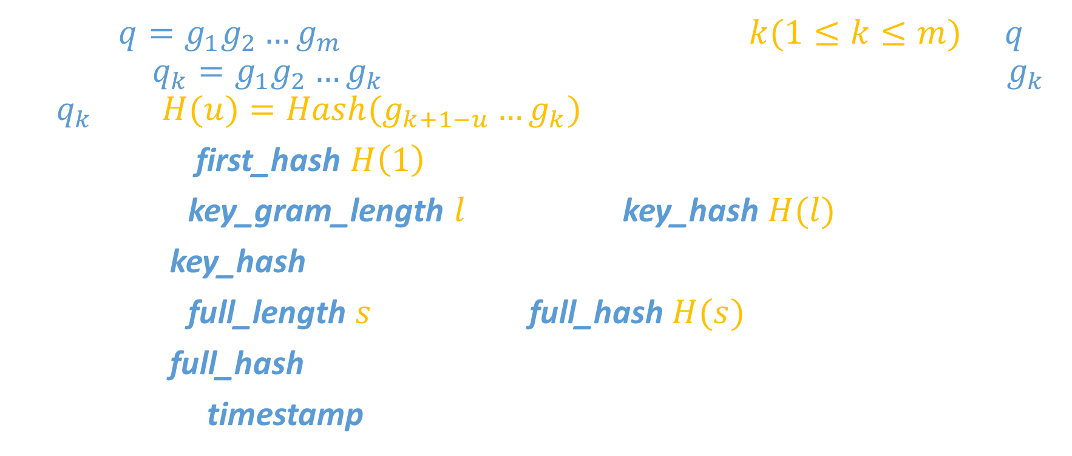
Query?
Query $q=g_{1}g_{2}…g_{m}$. Ending with every position $k(1≤k≤m)$ in $q$, consider $q_{k}=g_{1}g_{2}…g_{k}$. We are going to find patterns ending with $g_{k}$ in $q_{k}$. Let $H(u)=Hash(g_{k+1−u}…g_{k})$
1. Calculate first_hash $H\left(1\right)$; Lookup in the index (may fail)
2. For each key_gram_length $l$: Calculate key_hash $H(l)$
3. Lookup key_hash in index (may fail)
4. For each full_length $s$: Calculate full_hash $H(s)$
5. Lookup full_hash in index (may fail)
6. Check the timestamp
Practically, about 7 ~ 15 dictionary lookups are hit in every $q_{k}$. Most $q_{k}$ need no more than 5.

Slide 7
Some Thinkings…
Why do we hash from right to left?
To deal with a common case: "A A A A A" & "A A A A B"
Why do we need first_hash?
For concurrency control
For rough elimination
Why do we need key_gram_length & key_hash?
To reduce for-each enumeration: "Z Z Z D A A A" & "Y Y C A A A" & "X B A A A“
The base factor (currently 2) is flexible
How to deal with Unicode?
Just ignore it! No Unicode character contains <space> (byte 0x20)

Slide 8
How to process a batch?
Firstly, process all the patterns concurrently (insertion or deletion)
Insertion: isValid = 1; Deletion: isValid = 0
batchNum: Starting with 1 (Pre-known patterns’ batchNum = 0)
Just replace the timestamp if current value is larger!
Don’t actually delete the pattern from index!
Will create an invalid record if deleting a non-existing pattern!
Secondly, process all the queries concurrently
Every query may be processed by multiple threads
Query result: TLS Storage → Merge & Unique → Sort → Output
struct timestamp {
int isValid: 1;
int lineNum: 31;
int batchNum: 32;
};

Slide 9
Simple PV Lock
The lock supports…
P(1)
V(n)
Implementation:
Using Linux pipes + blocking read
P(1) – Read one character from pipe
V(n) – Write n characters to pipe
More efficient than mutex / pthread

Slide 10

Batch in each thread
while (ReadBatch()) {
while (pattern-indexing-not-done) { IndexOnePattern(); }
while (query-not-all-done) {
if (try-fetch-current-query()) {
while (current-query-not-done) { Match 32 $q_{k}$; }
if (I-am-the-last) { Output(); }
}
}
}

