Slide 1



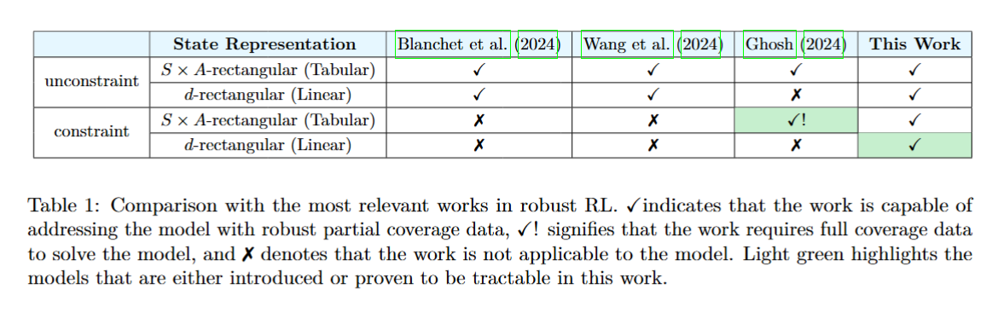


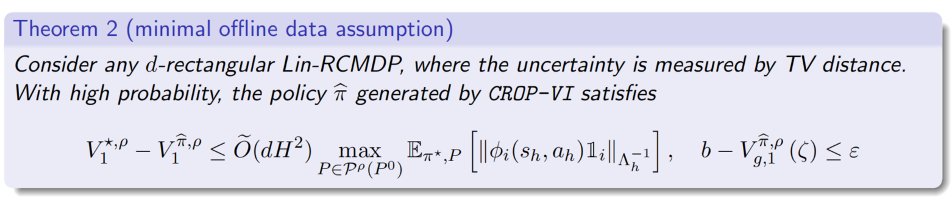
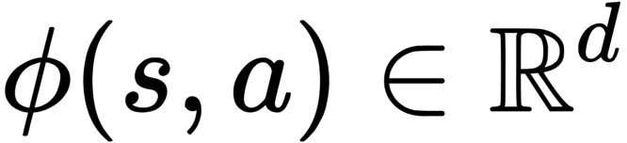
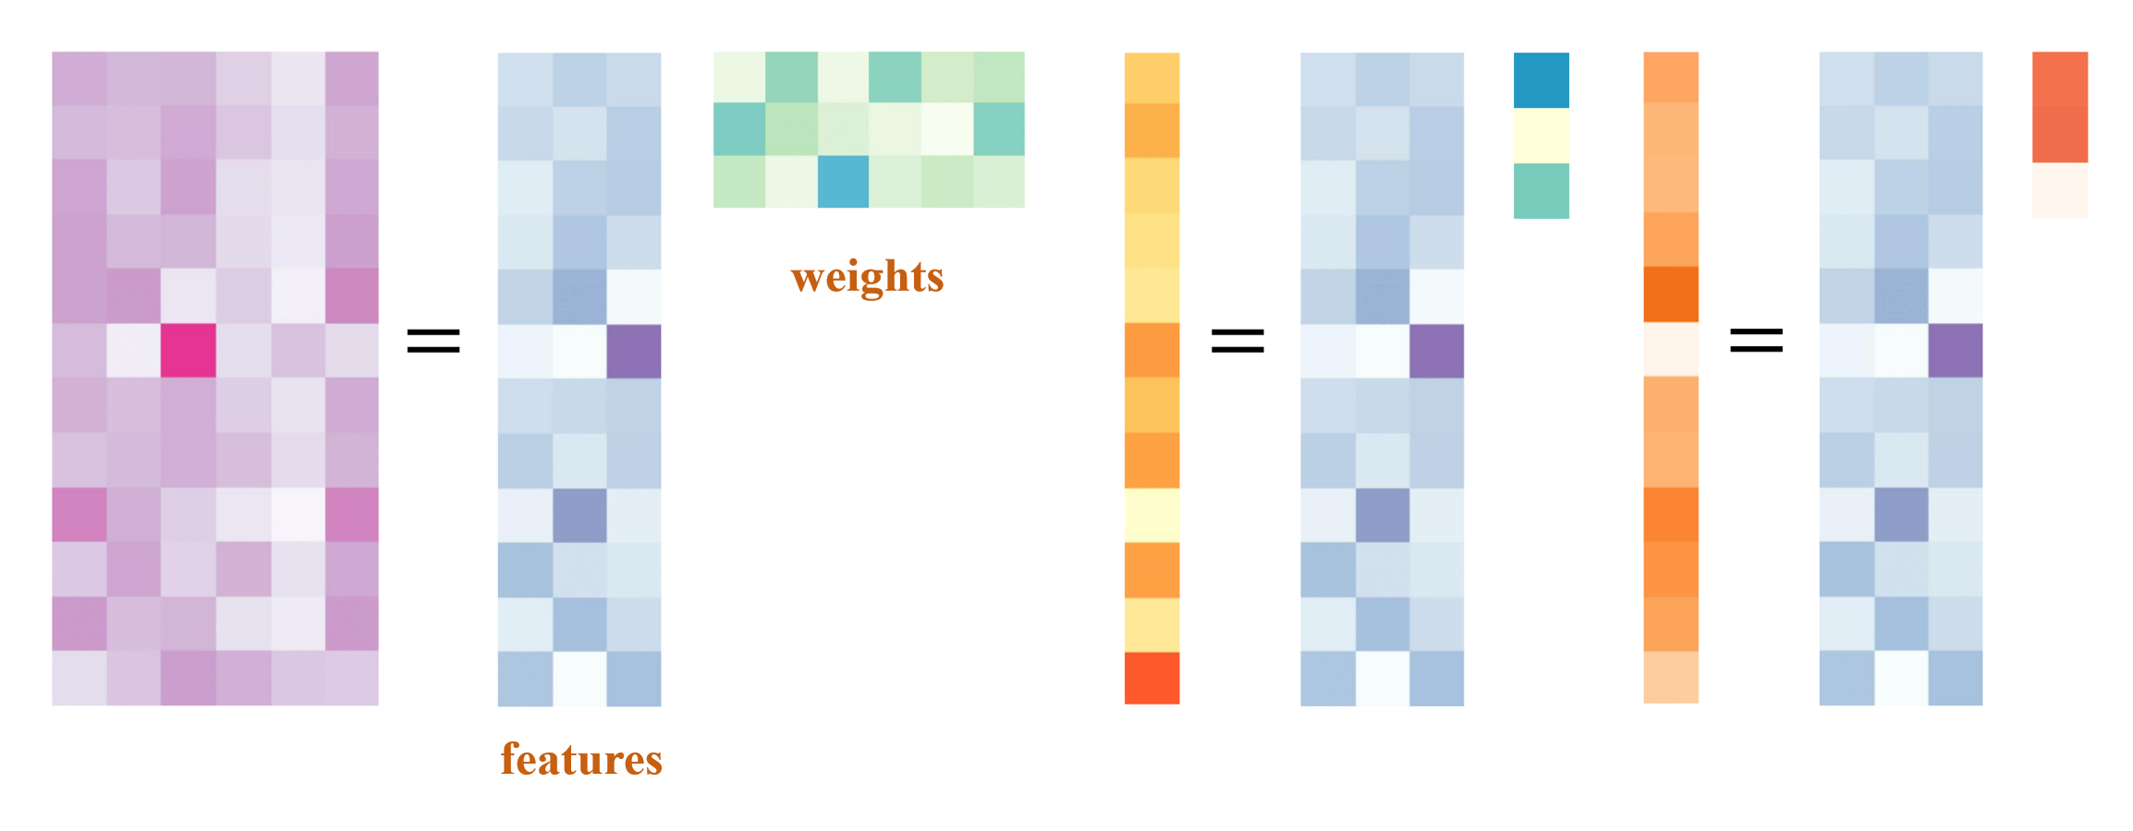

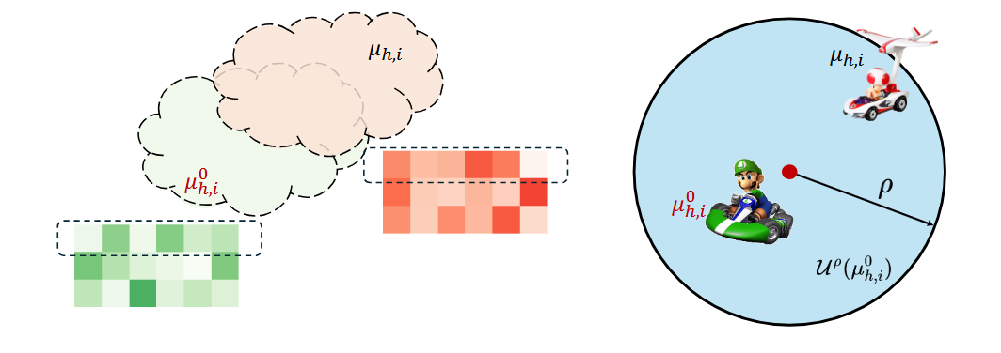
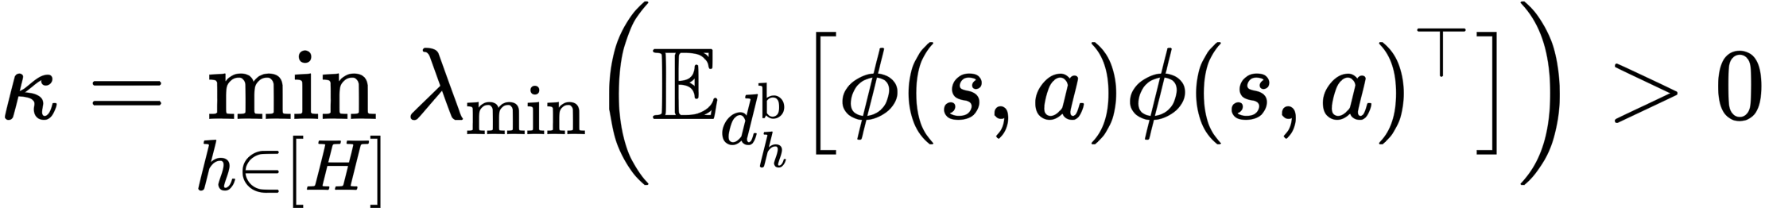

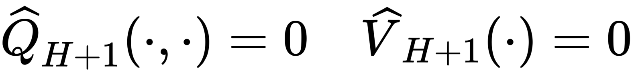
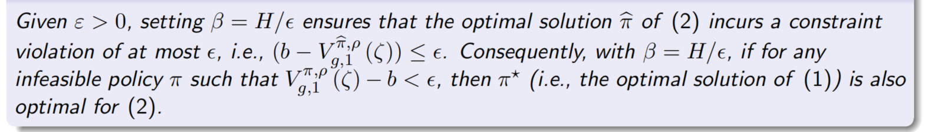
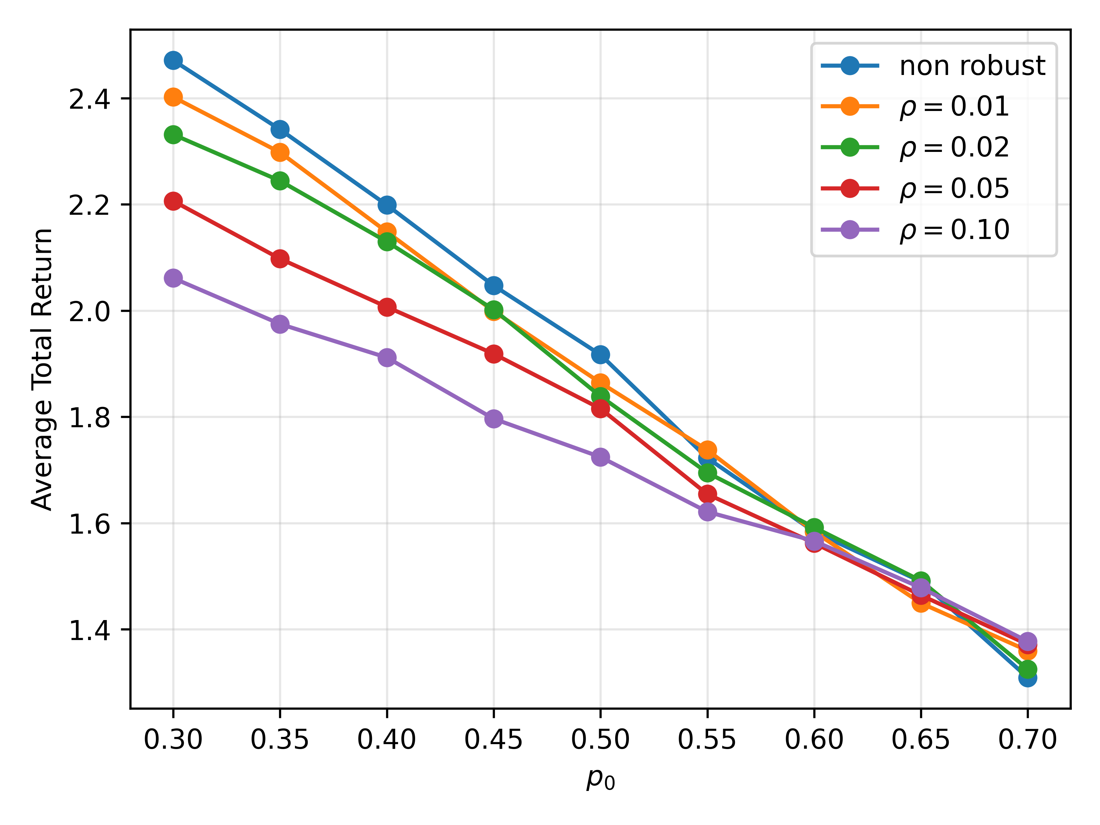
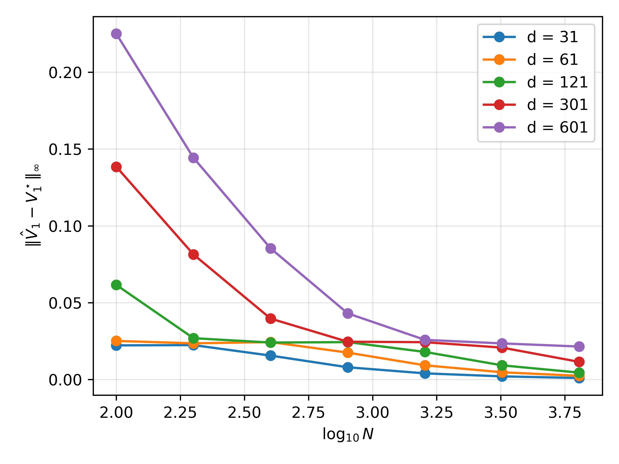
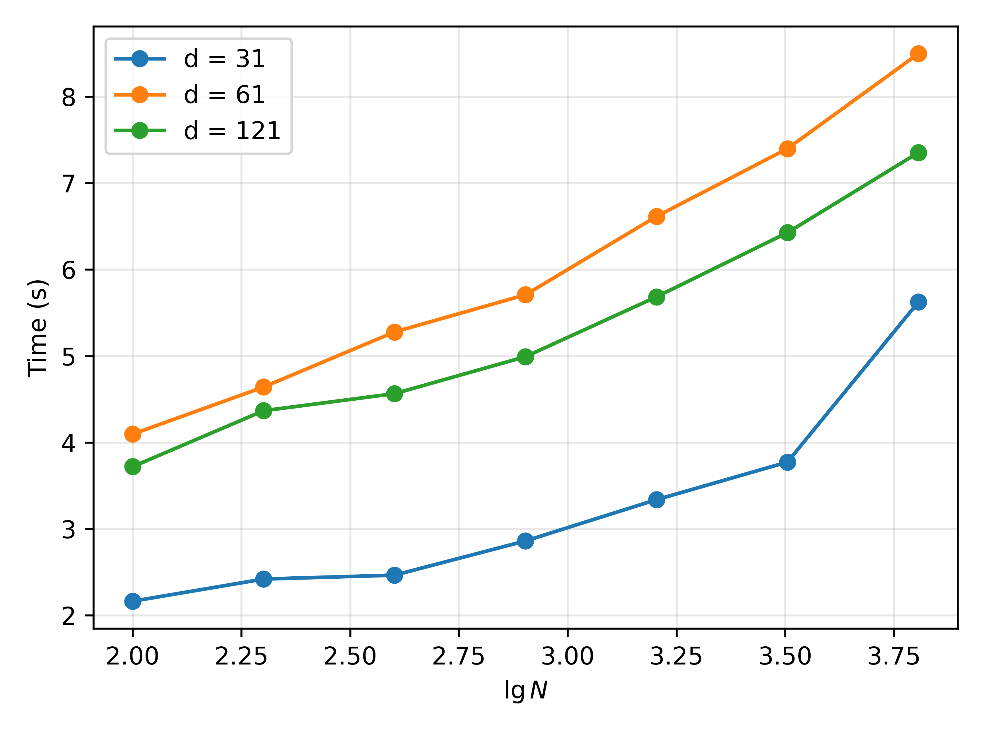

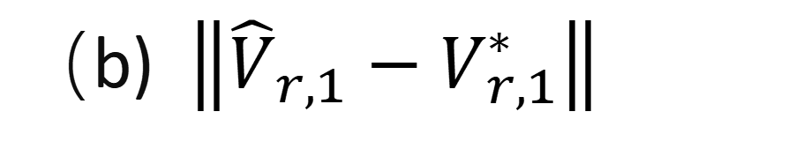
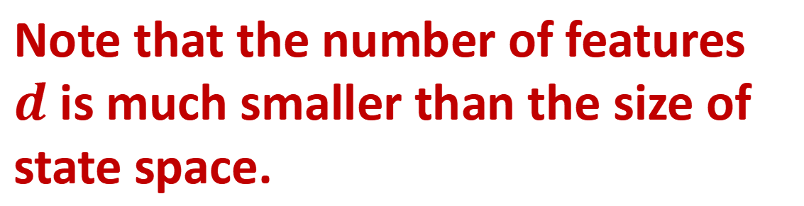
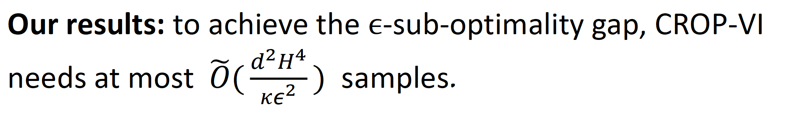
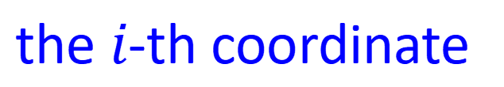
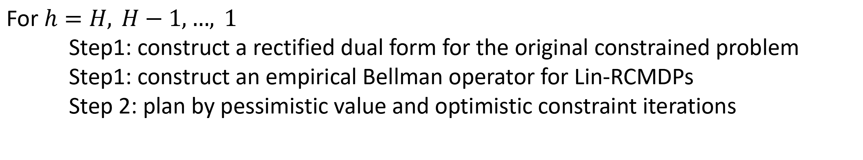
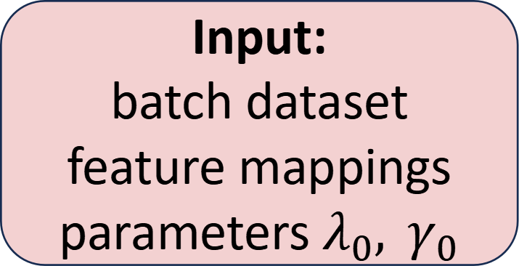
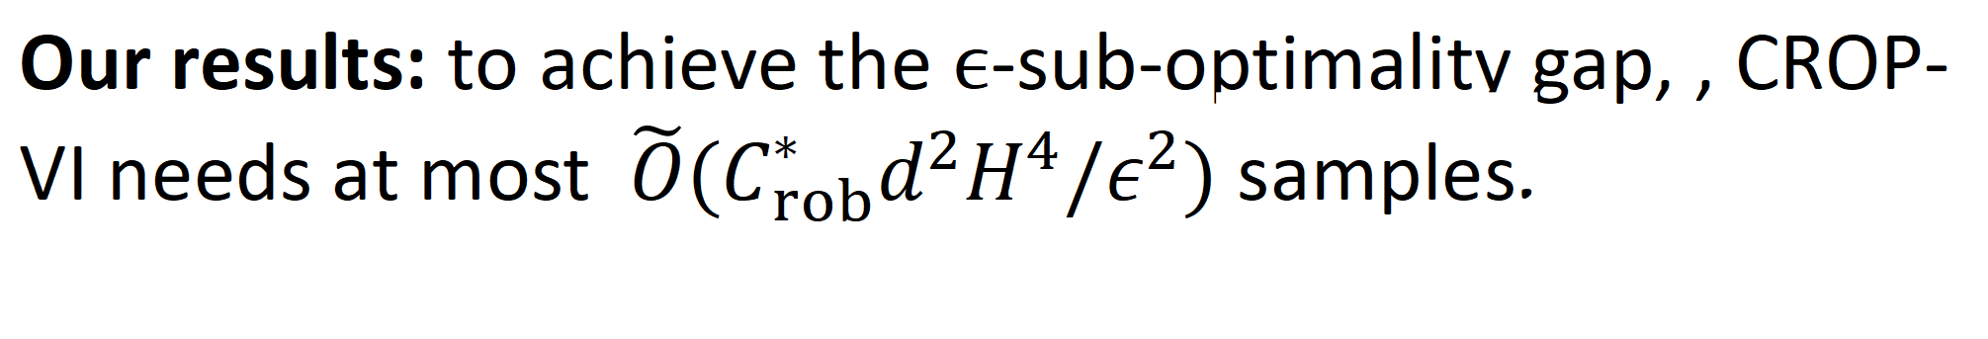
Robust Constrained Offline Reinforcement Learning
with Linear Function Approximation
wangwb2023@shanghaitech.edu.cn, hew2@andrew.cmu.edu
Find a PhD Position
Our paper is here!
Motivation
Comparison with the most relevant work
Offline RL: Learning a good policy from batch data
Challenge I: sim-to-real gaps
Standard Constrained RL: Learn the optimal policy of the nominal MDP under constraints?
Small change: transition/reward
Not arbitrary!
Nominal Transition kernel
Robust Constrained RL: Learn the robust and safe policy around the nominal MDP?
batch dataset
with batch dataset
from nominal
Challenge II: safety constraint
Challenge III: sample complexity blows up for large state space
Can we design a sample-efficient algorithm that is robust to the sim-to-real gap and ensures constraint satisfcation, even for large state space?
Performance Guarantees for DROP
Arbitrary: without any data coverage assumption
Problem Formulation
Lin-RCMDPs: distributionally robust linear CMDPs
We use the uncertainty set around the nominal transition kernel to characterize the sim-to-real gap.
Linear representations: The reward function and nominal transition kernel are decomposed as
Instance-dependent sub-optimality gap ← depending on the batch data quality
: feature mapping
Partial feature coverage
Note that the number of features $d$ is much smaller than the size of state space.
Assumption: robust single-policy clipped concentrability
clipping operation
The uncertainty set satisfies d-rectangularity assumption:
Decoupling the distribution shift into each feature dimension:
Our results: to achieve the $ϵ$-sub-optimality gap, , CROP-VI needs at most $\tilde{O}(C_{rob}^{∗}d^{2}H^{4}/ε^{2})$ samples.
batch dataset
Robust value/Q function: measure accumulative rewards in the worst case of performing in the transition kernel inside the uncertainty set.
Full feature coverage
feature space
Assumption:
Learning goal: Given the dataset from the nominal environment, find an $ε−$robust policy$\hat{π}$ such that
Samples can explore the feature space uniformly well.
batch dataset
Our results: to achieve the $ϵ$-sub-optimality gap, CROP-VI needs at most $\tilde{O}(\frac{d^{2}H^{4}}{κε^{2}})$ samples.
Sub-optimality gap:
feature space
CROP-VI : Constrained Robust Optimistic-Pessimistic Value Iteration
Input:
batch dataset
feature mappings
parameters $λ_{0}, γ_{0}$
Two-fold
subsampling
Preparation:
construct a temporally independent dataset
Initialization:
Empirical robust Bellman operator: approximate by ridge regression
For $h=H, H−1,…, 1$
Step1: construct a rectified dual form for the original constrained problem
Step1: construct an empirical Bellman operator for Lin-RCMDPs
Step 2: plan by pessimistic value and optimistic constraint iterations
Step 2: plan by pessimistic value iterations
Step 1: construct a rectified dual form for the original constrained problem
Following the pessimistic principle, we then estimate the reward Q-function as
Penalty function: address uncertainty in each dimension
lncentive function: balance exploration and exploitation trade-off
Experiment Results
Step 2: construct an emperical Bellman operator for Lin-RCMDPS
Original robust Bellman operator: by strong duality, we have
the $i$-th coordinate
However, we cannot directly have access to the ground-truth $θ_{j,h}$ and $μ_{h}^{0}$.
（a) Average return
（b) $\left\|{\hat{V}}_{r,1}−V_{r,1}^{∗}\right\|$
（c) Execution time

