Slide 1




1/16
Financial Computing Presentation
Evaluate the impact of earning report on stock price

Slide 2

CONTENTS
2/16
Team Introduction
Task allocation
Program Outlines
Group data from Excel
Software design process
Detail description of files
1
2
Implementation
Implement the program
Show the CAAR Excel graph
Conclusion
Conclusion on the CAAR graph
Perspectives from the program
3
4

Slide 3






3/16
OUR TEAM
Wencai Zheng
Jiaxun Li
Leader
Processing raw data;
Label the stocks;
Eliminate stocks without complete prices.
Design and test Class Stock;
Design and test sample functions;
Design and test ReturnMatrix.
Yidi Wang
Make team plan and assign the tasks;
Design the program structuring;
Parse data from Yahoo;
Deal with ExcelDriver;
Organize group meetings.
Xia Tu
Hangchi Li
Deal with the Excel;
Design return functions;
Design the menu;
Design the PowerPoint.
Design the structure;
Design AAR and CAAR functions; Clean the data;
Review and optimize codes.

Slide 4

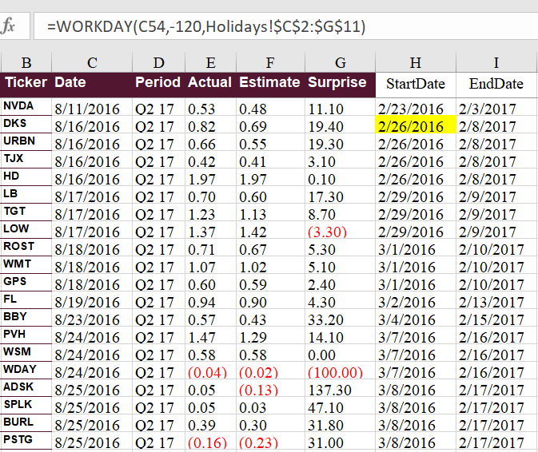


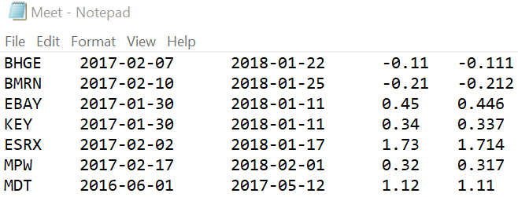
4/16
7.5%
Program Outlines
Bloomberg
1.5%

Slide 5
5/16
Program Outlines
GetData.h
GetTxt()
GetStockPrice() GetIWBPrice()
ShowData.h
ShowStockInfo()
ShowGraph()
Menu.h
Function1()
Function2()
Function3()
Function4()
Team.h
Class Team:
Map<ticker,Stock>Stocklist
RandSelect() GenAAR() GenCAAR()
GenReturnMatrix()
Stock.h
Class Stock:
vector<double>Price vector<double>Date
GenDailyReturn() GenAbnormalReturn()

Slide 6
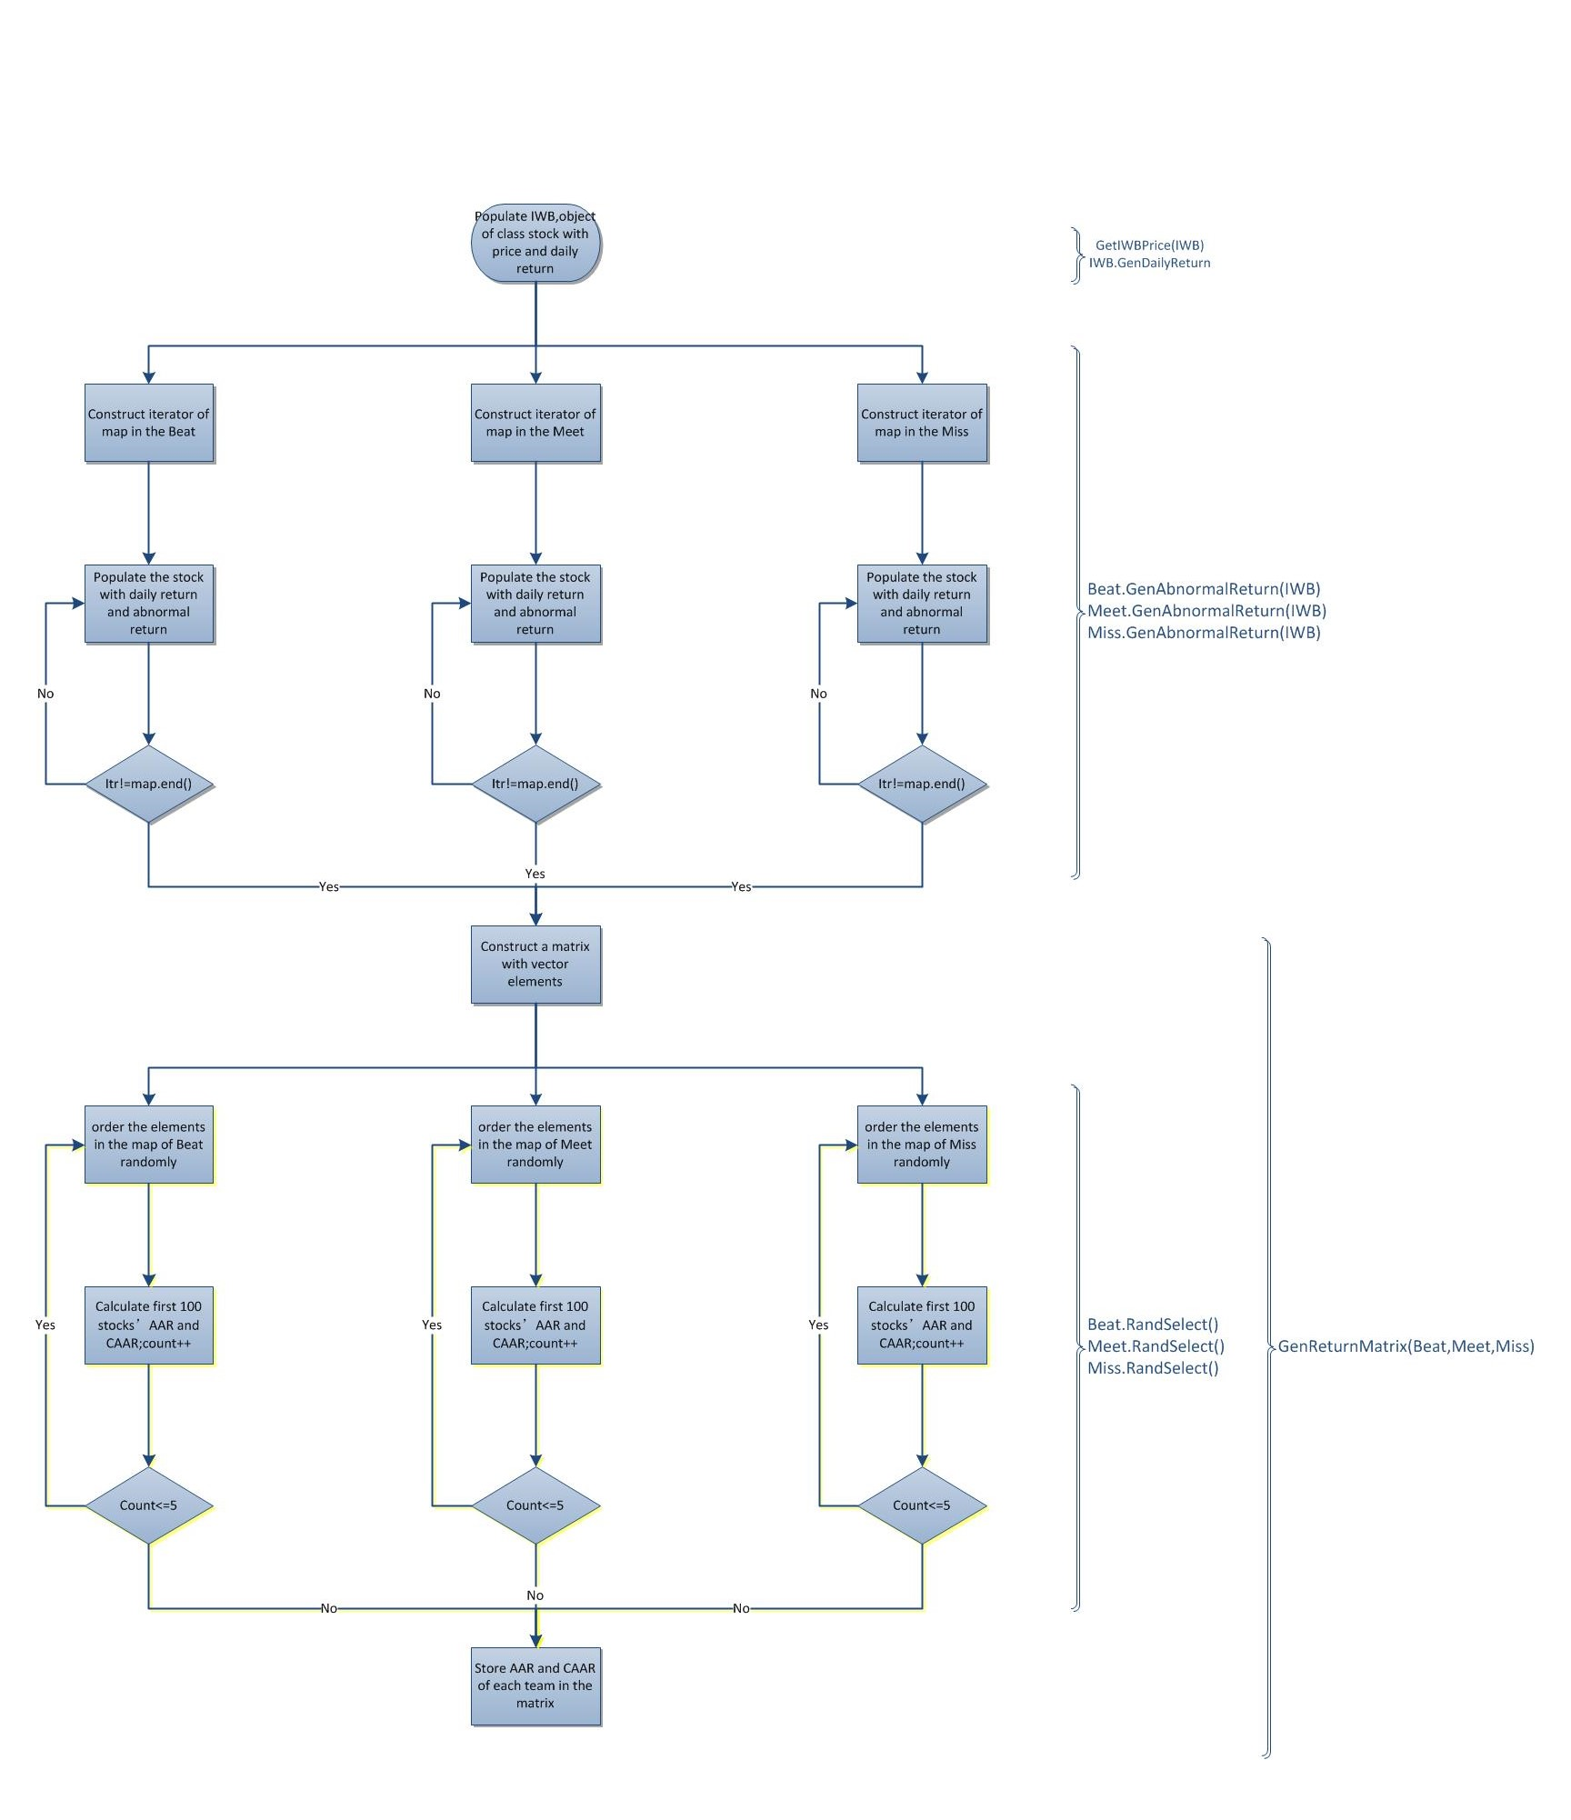
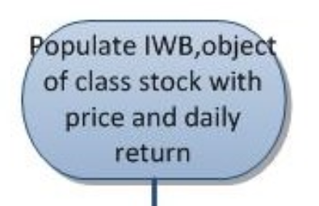
6/16
Program Outlines
GetIWBPrice(IWB)
IWB.GetDailyReturn()

Slide 7
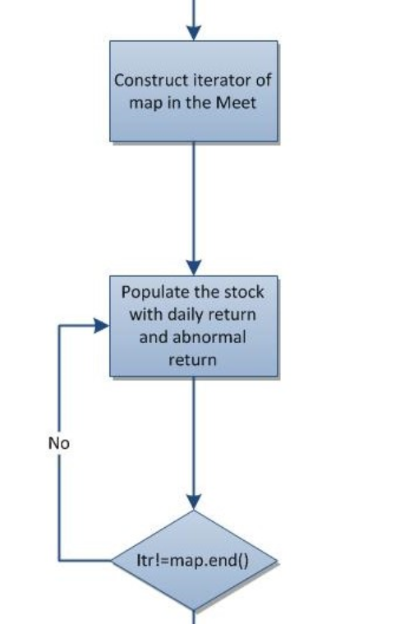
7/16
Program Outlines
Beat.GenAbnormalReturn(IWB)
Meet.GenAbnormalReturn(IWB)
Miss.GenAbnormalReturn(IWB)

Slide 8
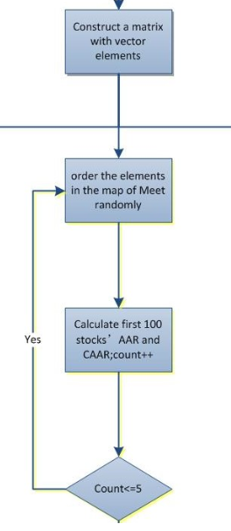
8/16
Program Outlines
Beat.RandSelect()
Meet.RandSelect()
Miss.RandSelect()
GenReturnMatrix(Beat,Meet,Miss)

Slide 9

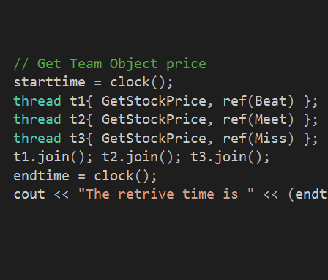


9/16
Program Highlights
Multi-Thread
Applied multithreading to increase retrieving
efficiency by 3 times
Call by reference
Made the parameters of function called by
reference, saving the copy time.
&
Overloading
Overloaded operator in vector calculation,
raised efficiency and simplified code
Typedef
We can use ReturnMatrix as a standard type
and just declare teamreturn.
<T>

Slide 10
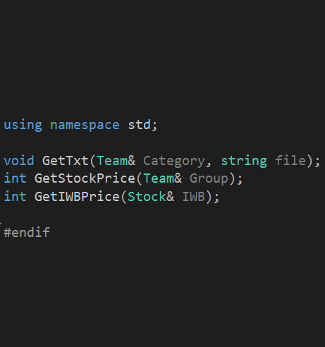
10/16
Program Highlights
Multi-Thread
Applied multithreading to increase retrieving
efficiency by 3 times
Call by reference
Made the parameters of function called by
reference, saving the copy time.
&
Overloading
Overloaded operator in vector calculation,
raised efficiency and simplified code
Typedef
We can use ReturnMatrix as a standard type
and just declare teamreturn.
<T>

Slide 11
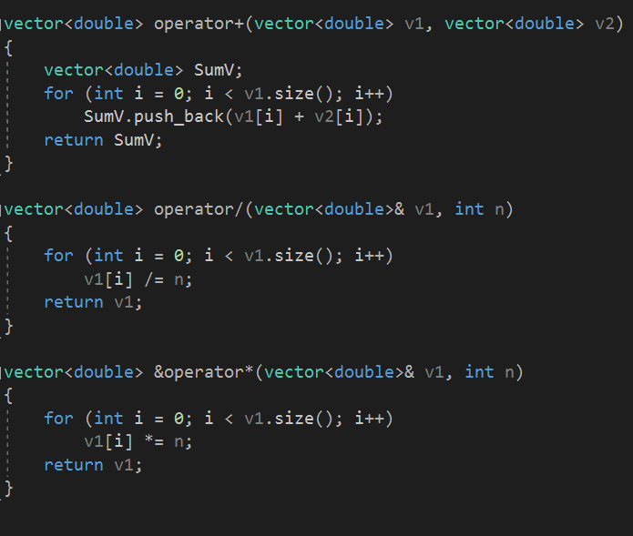
11/16
Program Highlights
Multi-Thread
Applied multithreading to increase retrieving
efficiency by 3 times
Call by reference
Made the parameters of function called by
reference, saving the copy time.
&
Overloading
Overloaded operator in vector calculation,
raised efficiency and simplified code
Typedef
We can use ReturnMatrix as a standard type
and just declare teamreturn.
<T>

Slide 12
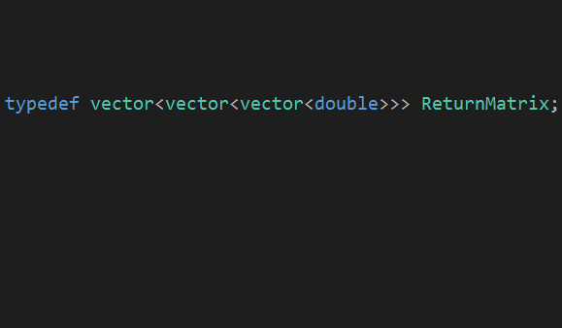

12/16
Program Highlights
Multi-Thread
Applied multithreading to increase retrieving
efficiency by 3 times
Call by reference
Made the parameters of function called by
reference, saving the copy time.
&
Overloading
Overloaded operator in vector calculation,
raised efficiency and simplified code
Typedef
We can use ReturnMatrix as a standard type
and just declare teamreturn.
<T>

Slide 13
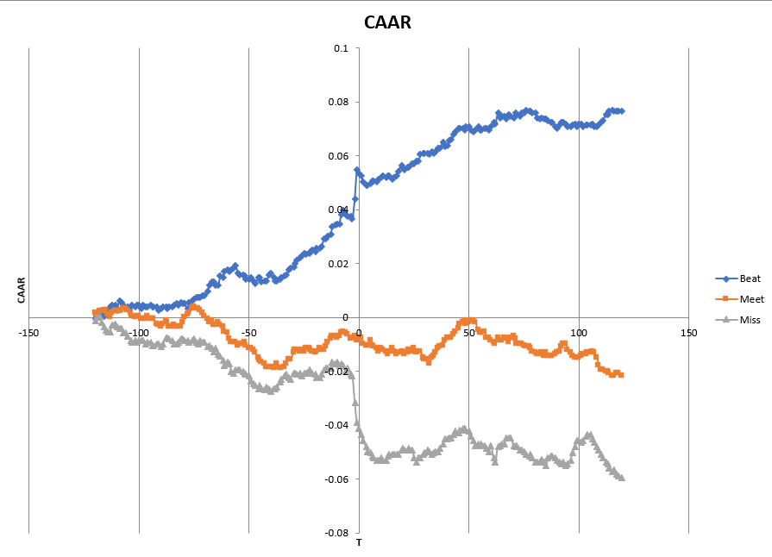
13/16
Conclusion
After 50 days before the released date, three CAAR lines begin to diverge due to the leading indicators of the company’s performances.
Several days before the released date, the prices change dramatically according to their groups which implies the inside trading may exist.
Shortly after the released date, the CAAR of three groups has a reversal effect, which is a normal adjustment from the previous dramatical change.
In the relatively long period after released day, CAAR of 3 groups would continue their trends in a vibrating way because of the information postponement of some investors in the market.
CAAR GRAPH

Slide 14
14/16
Perspectives
C++ is really efficient but complex, and I need more practical experience like this project
The most essential part of the OOP is how different objects are connected
Learning C++ gives me a totally new perspective for programming, and practice makes perfect
If you want to go fast, go alone; If you want to go further, go together
Structure designing is important and difficult, determining the efficiency and consumed time

Slide 15
15/16
Thank you !!!
Evaluate the impact of earning report on stock price

Slide 16
16/16
Reference
Financial Instrument Pricing Using C++, Daniel J. Duffy, ISBN 0470855096, Wiley, 2004.
Introduction to C++ for Financial Engineers: An Object-Oriented Approach, Daniel J. Duffy, ISBN 0470015381, Wiley, 2006
Quant Corner, quantcorner.wordpress.com/2012/04/08/
using-libcurl-with-visual-c-2010/
http://www.cplusplus.com/reference/list/list/erase
https://en.cppreference.com/w/cpp/container/vector

