Slide 1

Marketing Strategy
Chapter 2
Marketing Principle #1
All Customers Differ → Managing Customer Heterogeneity

Slide 2
Agenda
Introduction
Approaches for Managing Customer Heterogeneity
  Evolution of Approaches for Managing Customer Heterogeneity
  Segmenting, Targeting, and Positioning (STP) Approach
  Customer-Centric Approach
Framework for Managing Customer Heterogeneity
  Inputs to Managing Customer Heterogeneity Framework
  Outputs of Managing Customer Heterogeneity Framework
  Process for Managing Customer Heterogeneity
Takeaways
Examples/Case

Slide 3
All Customers Differ
Most basic issue facing managers, as they make strategic marketing decisions for their firms is that all customers differ
  Customer heterogeneity is variation among customers in terms of their needs, desires, and subsequent behaviors
In response, firms are targeting smaller & smaller segments
  Mass marketing → niche marketing → 1 to 1 marketing
  Competitive race as firms target smaller segments
  But it is hard to effectively compete in all segments
Drivers
  Matches inherent customer desires (real, perceived)
  Faster response to customer trends and changes
  Technology enabled (more economical to target/customize)
  Only limited by tradeoff in efficiency (cost) versus benefit of better match to need (solution)
Notes:
The first and most basic issue facing managers, as they make strategic marketing decisions for their firms is that all customers differ. It is a foundational assumption that customers vary widely in their needs and preferences, whether real or perceived. This may seem too basic to warrant mention, but consider the magnitude of the effects of this issue. From product or service categories in which customers exhibit careful choice process (e.g., there are over 19,000 mutual fund offerings for investors) to more routine purchases (e.g., a grocery store may offer over 50,000 different stock-keeping units), firms try to match their offerings to different customers’ preferences. Consumers’ desires vary even for so-called commodity products, such as bottled water, as evidenced by the dozens of configurations on store shelves involving different brands, sizes, bottle types, fizzy versus still, and so on.
Some firms assume away customer differences by offering a single product to the entire target market. This approach may work in peculiar circumstances, particularly if competition is weak or scarce, but it rarely works in the long run. Consider a stalwart model from the early days of the automotive industry. Ford found great success with the one-size-fits-all Model T, with its philosophy of “you can have any color you want, as long as it is black.” This approach worked at the beginning stages of the automobile’s product lifecycle, but as demand soared, competitors began offering differentiated products that better matched fragmenting customer desires, and it became obvious that Ford had to adapt.
Ford’s experience with the Model T is not unique. Across industries, as a category grows in size, competitors recognize untapped opportunity, identify niches of customers whose needs are poorly served by an incumbent product, and then target those customers with a tailored offering that is better aligned with those needs. Moreover, customers begin to express unique preferences for various forms of the product, after they come to understand its value. If the incumbent company fails to respond with new or refined offerings, then customers have a compelling reason to migrate to the competitor’s product. Would Ford still be a successful automotive manufacturer if it offered only black cars?
Thus, firms’ marketing strategies must cater to differences in customers’ preferences in a product
category, or else a competitor ultimately will take these customers away by satisfying their unmet
needs, at least for some valuable customer segments (i.e., those that are large, growing, and profitable).
However, a key question emerges from these examples: Why are customer preferences so
different? Why doesn’t every customer want the same coffee, car, or clothes? Understanding the
underlying sources of customer heterogeneity is important, because it provides compelling insights
into the ways that customers differ in their real and perceived preferences. Identifying and exploiting
customer heterogeneity is key to developing effective marketing strategies.

Slide 4
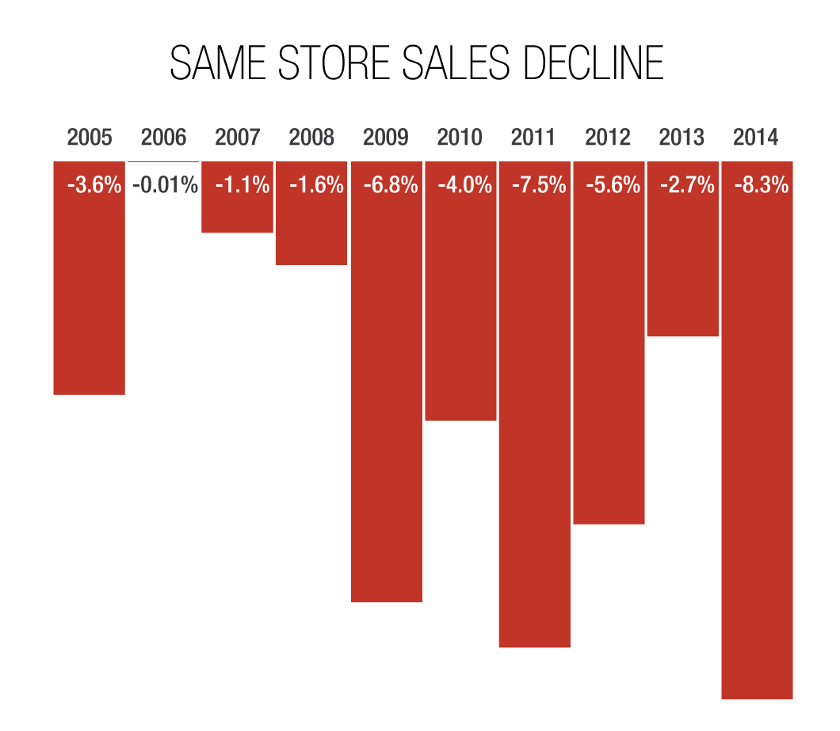

Example: Sears & Roebuck (US)
“Big Book” catalog
Once very successful broad line catalog operation, offering “something for everyone”
Over time, other firms identified and went after the best and most profitable sub-segments
This left Sears with a broad portfolio of diverse customers in less desirable segments that were often slow growing and less profitable, and ultimately, the end of the “Big Book”
Notes:
Sears & Roebuck once had a very successful broad-line catalog operation, printing 75 million catalogs every year that resulted in more than 180,000 daily orders at a peak moment, totaling annual sales of over $250 million. Through the iconic Sears “Big Book,” the company offered seeds and tools to rural farmers, household appliances to families, sports equipment and toys to kids, as well as clothing and shoes for virtually everyone. However, over subsequent years, other firms identified and attacked profitable subsegments of Sears’ customer base with more narrowly focused catalogs that were well-targeted to smaller, more homogenous customer groups, undermining Sears’ business. For example, Hammacher Schlemmer offered a catalog that specialized in tools and other innovative home products, Spiegel sold fashionable women’s clothes and accessories for stay-at-home moms and later businesswomen, and L.L. Bean sold clothes and supplies to outdoors enthusiasts. Not only did Sears lose sales revenue in these segments, but the competitors often went after the best and most profitable customer segments. This left Sears with a broad portfolio of diverse customers in less desirable segments that were often slow growing and less profitable. Furthermore, Sears found it hard to serve the remaining unprofitable customers, whose lower sales volume also prompted higher inventory and acquisition costs.
Thus, Sears found itself stuck between a rock and a hard place: If it stopped serving a category, it lost even more revenue, but if it continued to serve that category, it often had to do so at a net loss. This no-win situation, similar to situations faced by many firms, arose because Sears did not effectively manage its customer heterogeneity, or variation among customers in terms of their needs, desires, and subsequent behaviors. Ultimately, Sears stopped issuing its “Big Book” catalog, which was no longer profitable. Although this example focused on Sears’ catalog business, the situation parallels what has happened in its retail stores too.
Thus, firms’ marketing strategies must cater to differences in customers’ preferences in a product category, or else a competitor ultimately will take these customers away by satisfying their unmet needs, at least for some valuable customer segments (i.e., those that are large, growing, and profitable). However, a key question emerges from these examples: Why are customer preferences so different? Why doesn’t every customer want the same coffee, car, or clothes? Understanding the underlying sources of customer heterogeneity is important, because it provides compelling insights into the ways that customers differ in their real and perceived preferences. Identifying and exploiting customer heterogeneity is key to developing effective marketing strategies.

Slide 5
In Class Exercise on Customer Heterogeneity
Everyone take 2 minutes to list your favorite retailer, and why _____________________
  First reason _______________
  Second reason ____________
How could one retailer be the best at satisfying all of you?
What segment is each retailer targeting?
What are Walmart’s and Nordstrom’s target segments?
What happened to JC Penny and Gap?

Slide 6
5 Sources of Customer Heterogeneity
Individual differences
Life experiences
Functional needs
Self-identity/image
Marketing activities
Notes:
Customer preferences for one among multiple competing products or services is usually driven by the aggregation of that customer’s desires across various product or service attributes (e.g., price, time savings, durability). Customers make trade-off decisions (consciously or not) across differentially important attributes, resulting in a purchase choice. Variations in preferences (needs, desires, and subsequent choices) across customers for any product or service stem from several underlying sources. The different sources of customer heterogeneity combine and interact to generate widely diverging preferences across consumers, as summarized in Table 2.1.
First, probably the most fundamental source of customer heterogeneity is basic individual differences across people, defined as each person’s stable and consistent way of responding to the environment in a specific domain. There are innumerable ways in which people differ psychologically; one popular typology sums up these differences as the “Big 5” traits: openness, conscientiousness, extraversion, agreeableness, and neuroticism. Another example is consumers’ preference for color, a basic design feature of many products. Research shows that men’s favorite colors break down as 45% blue, 19% green, 12% black, and 12% red, while women’s favorite colors are 28% green, 25% blue, 12% purple, and 12% red. Ford thus could not maintain its cost-effective black-only color strategy: It would be matching the preferences of only 12% of all men and not even rank among the top five colors for women. Similarly, people vary in their favorite flavors, textures, sounds, and smells. Many individual difference preferences are ingrained at birth, due to random or genetic variation, such that this key source of customer heterogeneity applies even to the most homogenous of product offerings.
Second, a person’s life experiences capture events and experiences that are unique to her or his life and that have lasting impact on the value and preference the person places on products and services, affecting preferences independently of the individual differences. Some geographic and cultural environmental factors have systematic impacts; other factors have an impact but unclear directional effects. For example, a person’s exposure to certain television shows, events in the local neighborhood, or books by certain authors at an early life stage could have dramatic impacts on her world view, propensity to take risk, or proclivity for consuming certain luxury goods. Furthermore, some individual difference–based psychological factors likely interact with characteristics of an individual’s environment to cause varying reactions. Thus, life experiences are a source of customer heterogeneity, but their actual linkages to preferences are often difficult to predict.
Third, perhaps the most straightforward source of heterogeneity in preferences is an individual’s functional needs for a specific offering. These differences capture the weights a person applies in a decision, across functional attributes based on personal circumstances: What price can they afford to pay (income), how long does the product need to last (quality, warranty), when will they use the product or service (battery powered, size), and are there any special usage features that they need (waterproof)? Higher quality, more features, and additional capabilities are almost always desired, but they often come with a higher price or other physical trade-offs in size or weight, which prevent firms from making any single, “ideal” product that could match every customer’s preference. In addition, customer preferences for any attribute vary continuously across a range of values (price, battery life, weight), yet firms usually manufacture products at specific levels ($100, 3 hours, 4 oz.), so the firm cannot perfectly “match” many customers’ preferences with a reasonable assortment of products.
Fourth, consumers often want their purchases to support their actual or aspirational self-identity or image. Some sources of heterogeneity operate below the level of consciousness (e.g., individual differences, life experiences); consumers’ desire to buy products and services that match their self-identity or image instead tends to entail a more proactive, conscious decision process. Consumers actively seek products that they believe will support or promote their desired self-image and fulfill their need for uniqueness. A product’s image can come from a linkage to an iconic figure or celebrity or what is popular in a peer or aspirational social group. Some people instead search out products that are not popular but rather are noticeably unique, to match their desire for distinctiveness. The wide variety in consumers’ choices in fashion, housing, electronics, and cars is often driven by individuals’ desires to enhance or support their self-image or status. Thus for example, motorcycle riders often wear leather (which may be both functional and image driven), and Goths like the color black, reflecting their desire to identify with the image of a specific and distinctive user or social group.
Fifth, the last source of customer heterogeneity, persuasion from marketing activities, often results from firms’ attempts to build linkages between their brands and prototypical identities or meanings. By building a strong association between their product and a specific identity, marketers increase the likelihood that a consumer will purchase an offering that matches their aspirational self-image. For example, BMW paid $25 million to have James Bond drive a BMW in the movie Skyfall, based on the belief that Bond’s image would be aspirational to many potential target customers (e.g., men aged 30 to 50 years). In other cases, rather than linking to a popular or prototypical image (James Bond), marketers work to develop a new and unique brand identity or extend an existing brand image to help differentiate their offering from other firms’ products. J. Walter Thompson launched diamonds as a “token of love” after many years of failure to penetrate the Asian market by developing a brand image that represented a break with an Eastern past, in advertising that showed couples dressed in Western clothing and involved in Western pastimes. The resulting image of diamonds—as modern and Western rather than traditional and Eastern—appealed to many consumers in that market.
To the degree that marketing efforts are successful in persuading consumers that some unique characteristic is specific to their identity or is an important purchase attribute, customer heterogeneity increases. For example, Volvo’s advertising communications about automobile safety increased the weight that many consumers placed on safety when buying a car, which supported Volvo’s positioning strategy. A few decades ago, bottled still water was mostly an undifferentiated commodity (low heterogeneity); after millions of dollars of marketing, bottled water is now linked to a range of attributes, as in the examples of Aquafina’s “Pure Water, Perfect Taste,” Arrowhead’s “Born Better & 100% Mountain Spring Water,” Crystal Geyser’s “Naturally Good!,” Fiji Water’s “Natural Artisan Water,” or Evian’s “Live Young.”
Thus, marketing strategies not only attempt to match natural sources of variation in customer preferences (e.g., individual differences, life experiences, functional needs, self-identity) but also serve as significant sources of customer heterogeneity themselves. Marketers work to make “natural differences” in preferences more salient to consumers, as well as persuade consumers of the importance of new attributes (e.g., environmentally safe or green, blood diamonds, Made in the USA), to build new purchase preferences. Greek yogurt went from a 1 percent to a 36 percent share of the yogurt market between 2007 and 2013, largely because marketers made the health aspects of Greek yogurt more salient to U.S. consumers.
The growing heterogeneity of customer preferences in response to marketing that focuses on new or differentiated attributes also has been accelerated by technological advances. Modern marketers can communicate unique messages to smaller customer groups, account for geographic location or unique purchase situations, and offer more differentiated products in new and cost-effective ways. Mobile marketing technology means that geographic marketing can go beyond the zip code level to identify locations by latitude and longitude, then send push notifications according to users’ exact locations. Both Starbucks and 7-Eleven (large convenience store chain) use this technology to integrate customer preferences and location information. Chinese companies spend nearly one-third (28%) of their overall marketing budgets on modern mobile technologies.
These effects of technology are nothing new though. Returning to the Sears catalog example, advances in technology doomed the retailer’s strategy of mailing the same 600-page catalog to all its customers. Economies of scale from printing large batches of the same catalog were overwhelmed by small-run printing equipment that supported more low volume, cost-effective catalogs. Changes in print and manufacturing technology allowed niche firms to address narrow segments; the availability of detailed customer data supported more refined targeting; and easily searched online catalogs enabled small firms to serve very small, specialized customer segments while bypassing multiple middlemen

Slide 7
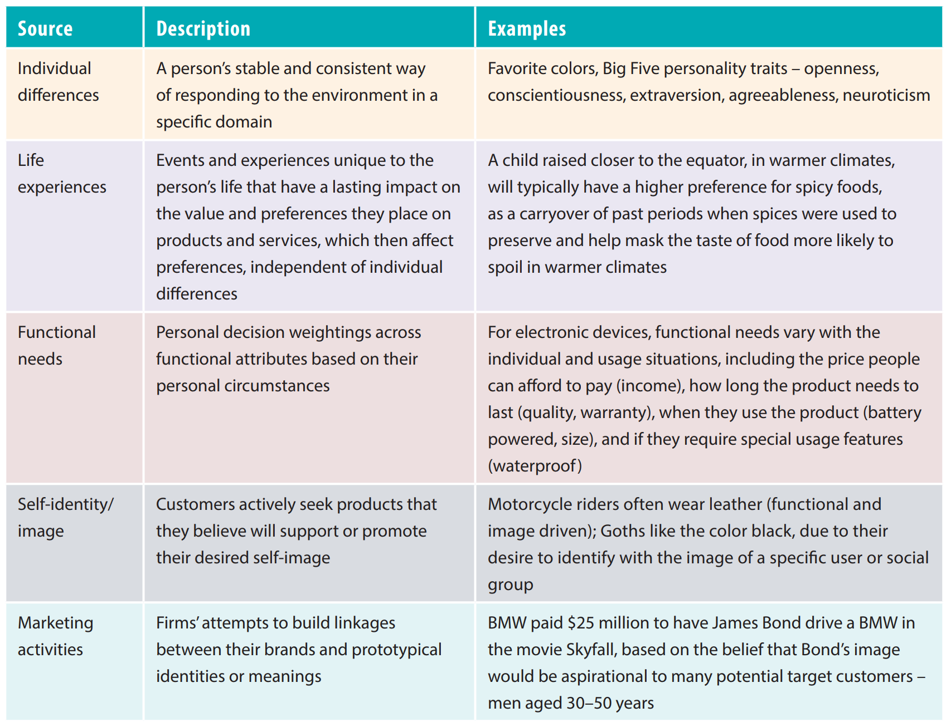
Five Sources of Customer Heterogeneity

Slide 8
Customer Heterogeneity: A Fundamental Assumption of Marketing Strategy
Customer heterogeneity is a fundamental “problem” that all firms must address when developing an effective marketing strategy
Customer heterogeneity may be latent or hidden
  Customers vary on some underlying preferences, but no firms are supplying offerings that fit their desires, so those preferences are not evident
  Customers might not even know of their diverse preferences, because they have no options to evaluate
Assuming all customers are the same is a recipe for failure, at least in the long term, as competitors will better satisfy subsegments with more aligned offerings, leading to a downward spiral in which the firm has fewer, less profitable customers that are more costly to serve
Marketing principle #1: all customers differ and an effective marketing strategy must manage ever-present customer heterogeneity
Notes:
As summarized in Table 2.1, there are multiple factors that work together in multifaceted ways to make all customers differ in their preferences for products and services, and thus, customer heterogeneity is a fundamental “problem” that all firms must address when developing an effective marketing strategy. Assuming all customers are the same is a recipe for failure, at least in the long term, as competitors will better satisfy subsegments with more aligned offerings, leading to a downward spiral in which the firm has fewer, less profitable customers that are more costly to serve (e.g., Sears). The variation in customers’ preferences that firms must account for in developing an effective marketing strategy represents an underlying assumption of marketing strategy, or a First Principle—one of “the fundamental concepts or assumptions on which a theory, system, or method is based.” The assumption that all customers differ and that an effective marketing strategy must manage ever-present customer heterogeneity is the first of the four Marketing Principles (MP#1).
The assumption that all customers differ and that an effective marketing strategy must manage ever-present customer heterogeneity is Marketing Principle #1.
Still, some situations allow marketers to ignore some elements of customer heterogeneity, such as electrical utilities’ one-size-fits-all offerings. The utilities can ignore differences in customers’ preferences due to their monopoly power. The government typically gives utilities the sole right to provide electrical services in a specific region, so by law, no competitor may encroach on their business, and they do not need to match their offerings to customers’ preferences. However, when a firm loses monopolistic power, it often finds it very difficult to start managing customer heterogeneity. The result tends to be a significant loss in both customers and sales.
Uber’s move into the highly regulated taxi market (regulated by city versus federal governments) might prove to offer a similar example. However, some firms can adapt after losing theirmonopoly position by increasing their focus on customers’ needs. Telstra, Australia’s largest telecommunications company, successfully turned around its struggling business in 2005 by implementing market-based management, as opposed to its previous product-based management. This effort involved a deeper understanding of its customers by adopting a multiple-segment approach based on consumer needs and providing offerings targeted to each segment.

Slide 9
Latent Customer Heterogeneity
Latent customer heterogeneity is defined as potential differences in desires that are unobserved and have not become manifest in customer purchase preferences or behaviors yet
Latent customer heterogeneity can stem from several constraints:
  Legal constraints (government regulations, patents)
  Economic constraints (prohibitive prices, due to the size of the market or the costs of providing)
  Technological constraints (only way known to make something)
  Innovative constraints (no firm has yet identified and satisfied the need)
Notes:
These examples reinforce an important point: In some markets, customer heterogeneity may be latent or hidden. Customers vary on some underlying preferences, but no firms are supplying offerings that fit their desires, so those preferences are not evident. In some cases, customers might not even know of their diverse preferences, because they have no options to evaluate. This latent customer heterogeneity, defined as potential differences in desires that are unobserved and have not become manifest in customer purchase preferences or behaviors yet, may stem from legal (government regulations, patents), economic (prohibitive prices, due to the size of market or the costs of providing), technological (only way known to make something), or innovative (no firm has yet identified and satisfied the need) constraints. Starbucks innovatively identified that customers had a wide assortment of latent needs, in terms of both coffee and the settings in which they could consume or experience it. By carefully identifying and matching customers’ heterogeneous needs, it developed a $56 billion company in a category that previously sold a seemingly low cost, commodity product. If firms hope to ignore latent customer heterogeneity, their long-term success is contingent on the constraints that keep the latent needs from emerging—a reliance that history suggests is a risky strategy.

Slide 10
Example: AT&T (US)
In 1984, AT&T lost its U.S. government–granted monopoly, so direct competition began
By 1991, the company lost 83% of its sales revenue
Deregulation of this market allowed for the entrance of many new competitors, determined to satisfy customer needs better
Western Electric (the subsidiary of AT&T) came to an end in 1995
Notes:
In 1984, AT&T lost its U.S. government–granted monopoly, so direct competition began, and within just two years, AT&T had to cut 27,400 employees and lost $3.2 billion in profits. By 1991, the company lost 83% of its sales revenue. Although AT&T’s subsidiary Western Electric had already moved beyond offering only the classic black rotary handset (the Model T Ford of phones), launching a new handset design about once every decade, the deregulation of this market allowed for the entrance of many new competitors, determined to satisfy customer needs better. Western Electric came to an end in 1995. This pattern, in which a transition from a public to private enterprise means an increasing focus on customers after breaking up a monopoly, has been replicated in many countries around the world, including Egypt in 2015.

Slide 11
Agenda
Introduction
Approaches for Managing Customer Heterogeneity
  Evolution of Approaches for Managing Customer Heterogeneity
  Segmenting, Targeting, and Positioning (STP) Approach
  Customer-Centric Approach
Framework for Managing Customer Heterogeneity
  Inputs to Managing Customer Heterogeneity Framework
  Outputs of Managing Customer Heterogeneity Framework
  Process for Managing Customer Heterogeneity
Takeaways
Examples/Case

Slide 12
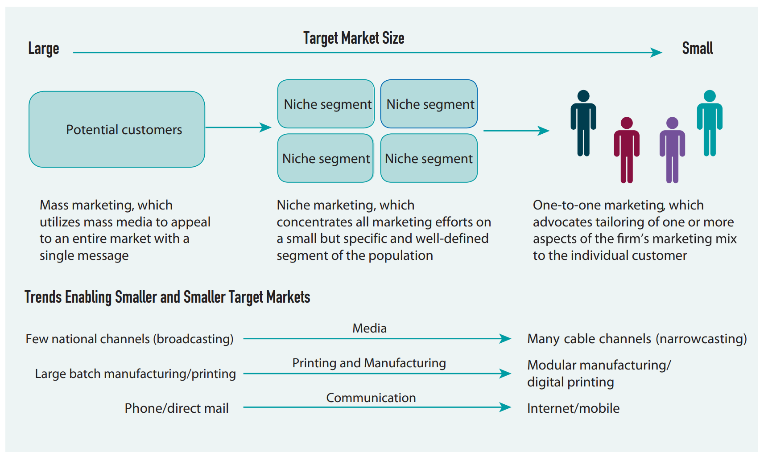
Evolution of Approaches for Managing Customer Heterogeneity

Slide 13
Evolution of Approaches for Managing Customer Heterogeneity
Mass marketing era used mass media to appeal to an entire market with a single message, is a marketing strategy in which a firm mostly ignores customer heterogeneity, with the assumption that reaching the largest audience possible will lead to the largest sales revenue
Niche marketing era focused marketing efforts on well-defined, narrow segments of consumers, and by specializing, this method seeks to give the firm a competitive advantage
One-to-one marketing era is marked by a shift towards one-to-one marketing, such that firms attempt to apply marketing strategies directly to specific consumers
Across all three eras, the underlying method for dealing with customer heterogeneity is the same: focus on smaller and smaller groups of customers, such that the needs of each group are more similar as they get subdivided into smaller units, until the focus reaches an individual customer
Notes:
Looking back over the past 60 to 70 years provides insights into the evolution of approaches for managing customer heterogeneity. The general approach of segmenting customers into segments, selecting target segments, and using marketing activities to improve a firm’s positioning in the target segment (or STP analysis) has been around since the 1950s, and firms have targeted smaller and smaller customer segments over time. Simultaneously, the segmentation criteria have been refined, starting with demographic factors, progressing in the 1960s to include geographical and behavioral factors, and adding psychological factors in the 1970s. Today all three types of data generally are merged, and firms’ “big data” efforts provide highly refined targeting information.
As a demonstration of these trends, much of the twentieth century can be broken down into three overlapping eras, according to the most popular, if not the most prevalent, approach to customer heterogeneity at the time: mass marketing, niche marketing, and one-to-one marketing. Figure 2.1 describes the evolution of these approaches for dealing with customer heterogeneity.
Mass Marketing Era. Mass marketing (undifferentiated marketing), which uses mass media to appeal to an entire market with a single message, is a marketing strategy in which a firm mostly ignores customer heterogeneity, with the assumption that reaching the largest audience possible will lead to the largest sales revenue. Mass marketing became popular with the emergence of radio and television media outlets, which had the potential to deliver the same message to a larger number of consumers than was ever possible before. For example, television advertising was $12.3 million in 1949; two years later it had grown tenfold. By 1960, televisions approached 90% household penetration. However, mass marketing is not individualized; it assumes everyone’s preferences are the same. Typically, mass marketing generates relatively lower profit margins and response rates, and it is often accompanied by high competitive intensity. In the 1950s and 1960s, companies such as P&G, Coca-Cola, McDonald's, General Motors, and Unilever Group were all dedicated mass marketers, but as the century came to a close, most of them were shifting to more targeted approaches. James R. Stengel, P&G's global marketing officer, argues that the company no longer mass markets any of its brands, “whether it's Tide or Old Spice or Crest or Pampers or Ivory. Every one of our brands is targeted.”
Niche Marketing Era. Niche marketing focuses marketing efforts on well-defined, narrow segments of consumers, and by specializing, this method seeks to give the firm a competitive advantage. Coming up against the limitations they confronted when they ignored customer differences, marketers recognized that a niche marketing strategy (micro marketing) could be more effective for driving profits and withstanding competition, especially if they deployed a niche strategy against a mass marketing firm. Niche firms often receive a price premium, because they offer a “scarce” product relative to mass marketers but target a segment that a mass marketer is serving only with a general offering, instead of something that matches the subgroup’s preferences. For example, Eurosport targets soccer enthusiasts with their favorite team’s jersey, cleats, shin guards, and even custom gear for local club teams, an assortment that is not available in department stores or even sports-focused chains like Sports Authority and Big Five Sports. Sports channels such as Fox Soccer Channel provide firms like Eurosport an excellent medium to target a relatively homogenous group of customers (at least as compared with NBC News or even ESPN) with advertisements for their offerings. Shifting from broadcast to cable television, with its ability to provide hundreds of channels, better supports niche communication strategies or "narrowcasting." Similar advances in printing technology and modular manufacturing processes also have enabled firms to execute niche marketing. In turn, some firms try to merge the benefits of mass marketing and niche marketing strategies. Department stores like Nordstrom and Galeries Lafayette carry a large assortment targeted to diverse, high-end customer preferences, but then they add “shop-within-a-shop” areas in their large department store formats to promote niche brands to specific customer subsegments.
Many firms successfully employ niche marketing strategies, such as Airwalk focusing on skaters in Southern California; Lululemon Athletica selling athletic wear and accessories to women; and Zumiez targeting young consumers interested in surfing, skateboarding, and snowboarding. In many case, finding and accessing specific customers who use Internet and online searches has enabled online retailers to target relatively small niche markets quite effectively.
One-to-One Marketing Era. The present era is marked by a shift towards one-to-one marketing, such that firms attempt to apply marketing strategies directly to specific consumers. One-to-one marketing tailors one or more aspects of the firm’s marketing mix to the individual customer, which is an extreme form of segmentation, with a single customer in the target segment. Amazon.com attempts to be a one-to-one marketer by remembering each customer’s preferences and recommending books and music targeted to their tastes. In a book predicting this era, The One to One Future: Building Relationships One Customer at a Time, Peppers and Rogers suggest that in this new business model, rather than the share of market, firms will focus on the share of customer, one at a time.
Theoretically, this strategy is the best one for dealing with customer heterogeneity, because it recognizes that all customers are different and provides a unique product or service to match each customer’s preference. Continued technological advances make this approach far more feasible, but for most offerings, the added costs of providing a truly one-to-one solution, reflected in the higher price to the consumer, outweigh the added benefits that the consumer receives from an optimally aligned offering, compared with a firm that targets a subgroup of multiple similar customers with a relatively well-targeted offering. Continuing the soccer example, the extra cost of a completely custom jersey or cleat designed for an individual, versus the semi-custom offering of selecting colors and printing applied to a range of existing products, likely is not worth the benefits of complete customizability.
However, technological advances continue to enable and advance this approach. The Internet provides a powerful platform for one-to-one marketing, because each customer can be separately targeted and retargeted on the basis of his or her browsing history. It also allows very small firms with very small marketing budgets to cover a large geographic area. Advanced search engines permit a single customer to find a unique offering from an unknown firm. Changes in media, communication, and logistic technologies are also enabling this approach. Comcast’s Spotlight service has the capability to deliver a unique advertisement to a specific user’s cable box; experimental cable boxes can even detect the number and body mass of people in the room to better differentiate messaging between children and adults. As Comcast puts it, “Reaching and engaging customers today means going beyond airing a traditional ad on television … target your ideal customers … inviting viewers to connect with you one-to-one.” One-to-one marketing techniques are also the focus of Amazon’s and Netflix’s “suggestions for you” campaigns, for which they collect, store, and analyze customers’ click histories to make specific book and movie recommendations.
Across all three eras, the underlying method for dealing with customer heterogeneity is the same: focus on smaller and smaller groups of customers, such that the needs of each group are more similar as they get subdivided into smaller units, until the focus reaches an individual customer. Why has this trend continued? First, it delivers a product or service that better matches a customer’s intrinsic preference (i.e., gives customers what they want). All else being equal, the smaller the target segment, the more closely a targeted offering will match the needs of the members of that segment.
Second, by focusing on a subsample of the overall market with mostly homogenous customers, firms can better anticipate future needs and detect emerging trends, which allows them to respond with well-targeted solutions before their more broadly focused competitors do. For example, if one equipment supplier deals with customers that function in multiple markets (medical, financial services, manufacturing), an emerging trend in one market (e.g., a new medical regulation) will be harder to detect and address, because this one type of customer is obscured by the large group of varied customers. However, if all of a firm’s customers are in this one segment, the firm can identify the emerging issue quickly, as it affects most of its customers, and thus can address it more quickly. The launch of its new offering also might be easier and more successful, because it will appeal to most of its customers, whereas broadly focused firms might change some aspect that is not desired by many other customers. Firms do not need to focus their entire organization on one customer group to gain these benefits though. A firm can consist of business units, each of which is focused on one customer segment (customer-centric structure), then further subdivide the business unit into multiple product market groups, each focused on a relatively narrow customer group.
In many markets, in an ongoing competitive race, firms target smaller and smaller segments, limited only by the trade-off in costs against benefit associated with providing better aligned solutions. As technology and cost trade-offs advance, marketers have responded by targeting the smallest groups feasible for a given cost–benefit ratio. Thus for example, McDonald’s is shifting from mass marketing to micro targeting, cutting its U.S. television advertising spending in half and moving those resources to micro-targeted campaigns, such as those using “closed-circuit sports programming piped into Hispanic bars, ads in Upscale, a custom-published magazine distributed to black barber shops, and Foot Locker Inc.'s (FL) in-store video network.”

Slide 14
Example: Spotify (Sweden)
The Swedish streaming service understands the significance of personalization. Its flagship feature, Discover Weekly, provides listeners with personalized content that reflects their listening history.
The tailor-made playlists attract 40 million users per month. Then Spotify capitalizes on this one-to-one ability to access customers and their preferences by selling advertising space within the playlists.
By identifying customer preferences, Spotify provides listeners with what they want while allowing firms to reach those customers on a more personal level.
Notes:
The Swedish streaming service understands the significance of personalization. Its flagship feature, Discover Weekly, provides listeners with personalized content that reflects their listening history. These tailor-made playlists attract 40 million users per month. Then Spotify capitalizes on this one-to-one ability to access customers and their preferences by selling advertising space within the playlists. According to Spotify’s Global Partner Solutions head, “Personalization has quickly gone from a nice-to-have to an expected consumer experience that delights audiences, and marketers are craving opportunities to be part of it.” By identifying customer preferences, Spotify provides listeners with what they want while simultaneously allowing firms to reach those customers on a more personal level.

Slide 15
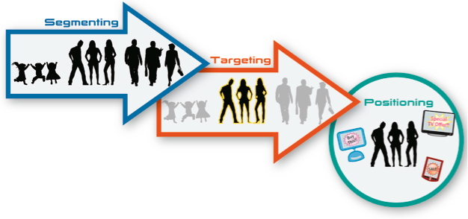
Segmenting, Targeting, and Positioning (STP) Approach
In order to better match heterogeneous customer needs, firms focus their efforts on small “homogenous” customer groups
Segmenting: Dividing market into groups of similar customers (slice the pie into pieces)
Targeting: Selecting best customer group to sell to (picking the slice to eat)
Positioning: Improve your relative advantage in the minds of your targeted customers (also addresses Marketing Principle 3 by building SCA)
See Business Model Analysis for Entrepreneurs for how to adapt this process for startups
Notes:
Segmenting, targeting, and positioning (STP) have been offered as a way to manage customer heterogeneity since the 1950s. However, the mechanics and analyses for executing STP have advanced significantly. In the earliest and most basic form, managers would describe each customer group according to their impressions after meeting potential and existing customers, often with a focus on the most observable customer demographics (segmenting). With this information, managers would select the segment they felt would produce the most sales and profits (targeting), then make product, pricing, channel, and promotion decisions (positioning) in relation to this target segment.
This process captures the essence of the STP approach, but it also has several weaknesses. If based on managers’ beliefs rather than empirical analyses, it may be biased:
Often, it is based on what managers want to be true versus what is actually true.
It is weighted more toward past customer preferences, reflecting when managers developed their beliefs, rather than present or trending preferences.
It assumes customers are more similar than is often the case.
It focuses on firms’ own customers while ignoring large, untapped groups of customers who the managers encounter less often.
It uses customer demographics (gender, age, income) or purchase history as primary segmentation variables, because these data are more readily observable by marketers.

Slide 16
Segmenting
Consists of dividing the market into groups of customers where:
  Customers within group have very similar needs
  Customers across groups have different needs
Needs: Needs and benefits desired by customers for your offering
  Segment on needs/benefits not descriptors
  Uses one of the “Cs” as input: customers
Descriptors: Observable customer characteristics that help you find and classify customers (e.g., gender, age, income, size, education, etc.)
See Customer Segmentation in B2B Markets
Notes:
Over time, techniques have evolved to deal with many of these potential sources of bias across each step in the STP process. Segmenting is the process of dividing the overall market into groups, such that potential customers in each group have similar needs and desires for a particular product or service category (e.g., high preference for quality and service warranties, low need for large assortments), but the differences across groups are maximal. The importance of segmentation is rarely questioned, but the mechanics of conducting a useful segmentation study also are poorly understood. The common use of demographic characteristics to describe customer segments (e.g., “that show captures the desirable 21- to 45-year-old viewer,” large versus small industrial customers) makes it easy to assume, mistakenly, that demographic groups are segments, rather than descriptors of the customers within those segments.
It important never to lose sight of a key point though: The core goal of segmentation is to identify groups of customers who have similar needs, desires, and subsequent behaviors. These customers are similar enough that marketers can design a solution targeted to win them. For some markets, customer needs align closely with demographic characteristics; if you sell baby formula, a simple lifecycle stage segmentation likely will be useful. But for most products, any single demographic characteristic fails to clarify who does or does not have the need or desire for that product. Customers in a specific age group thus might share some preferences for clothing, but the differences in their preferences—driven by personal tastes, experiences, functional goals, and so on—so far outweigh the shared preferences that age alone is of little use as a segmentation variable. In the same way, business customers (i.e., firms) in the same industry share some common preferences, due to industry standards and similar end-customer expectations. But one business customer’s unique strategy and context might cause it to emphasize cost control over all other attributes, whereas a second firm might make choices based on customer service, and a third focuses on the depth of its supplier relationship. Again, it is not that industry is unimportant, but the differences in preferences across firms within an industry far outweigh their similarities. The initial focus of segmentation therefore should be differentiating consumers according to their unique needs and desires (basis of segmentation), not demographic characteristics (the descriptor of a segment).
But how can firms that recognize this demand go to market through media and distribution channels that are structured to reach and serve demographically defined slices of the customer population? The ideal process follows a sequential set of steps. True customer segments are groups of customers with similar preferences (needs, desires, behaviors). Customer research thus might identify segments according to these preferences, such as through cluster analysis (i.e., a data-driven partitioning technique to segment large sets of heterogeneous customers into a few homogeneous groups). However, in the real world, firms rarely have the luxury, prior to making a sales pitch, of surveying every customer to determine their individual preferences. Instead, they might be able to capture a range of potentially relevant demographic characteristics. Once the “true” segment membership of each customer is known, a multivariate discriminant analysis can often predict segment membership reliably using just a few demographic characteristics.
Although a single, demographic variable alone cannot predict segment membership, a small set of variables might be able to do so, at least better than chance. If a useful model can be developed to classify respondents into the correct segment using only demographic factors, a little bit of magic can happen. If the research study is based on a sample of customers who truly represent the market, the researcher can have confidence applying the classification formula to real customers who were not part of the original research study. Demographic characteristics often can be observed or obtained from research vendors. With such data, firms can predict true segmentation membership, without surveying or reading the minds of their customers.

Slide 17
Segmentation Steps
Identify and refine “pool” of potential customers needs and descriptors (qualitative research)
Collect data from random assortment of potential customers on “importance” of needs/benefits to purchase decision
Use “needs/benefits” to segment the market into 3 to 7 homogeneous customer groups
    Often need to group like questions together using factor analysis before clustering customers
    # segments based on results, ability to manage, and actionable
Name segments (communication tool)
Notes:
Several key points in this process need to be highlighted. First, segmentation must start with a random sample of potential customers in the market, not just the firm’s existing customers, because that is the only way to understand what customers in the overall market for this product or service category want, and it is key to uncovering emerging or untapped markets. Second, customers should be divided into groups on the basis of their needs and desires in the product category, not demographic variables (age, gender) or size (annual sales revenue). Knowing customers’ preferences is critical to matching their needs to a solution. In many cases, demographics provide a poor indicator of a customer’s true preferences and are used only because they are readily observable. Third, it is important to ensure that customers in one group have similar preferences, but it is also ideal to maximize the differences between segments, to help the firm offer more clearly differentiated products, without facing spillover competition from other firms that are targeting neighboring segments.

Slide 18
Factor Analysis
Factor analysis is a data reduction technique that can be used to identify a small number of latent “factors” that explain the major variation in a large number of observed variables
When to use it?
  To condense a large “pool” of potential customer needs, wants, and preferences into a short set of similar characteristics
  To reduce high correlation among predictors
Factor analysis groups similar questions (purchase attributes) together to avoid biasing the further analyses; the cluster analysis groups similar customers together into segments; and the multiple discrimination analysis (MDA) predicts true segment membership using demographic variables to facilitate targeting and positioning decisions
Notes:
Statisticians will point out that the results of any cluster analysis are in uenced(i.e., weighted more heavily) by the inclusion of multiple attributes that capture the same underlying factor. Thus, an important preceding step for any cluster analysis, depending on the number of items included in a research study, is to conduct a factor analysis of all measures of customer preferences. For example, potential customers of a new shopping center may respond to survey questions about the importance of several factors, such as the number of parking spaces, distance from their homes, late shopping hours, and the number of retailers in the shopping center. If the results of all four questions were included in the cluster analysis, more weight might be given to the higher level factor of “conveni- ence,” as captured in the rst three questions, relative to the number of retailers. However, if the marketer rst performed a factor analysis on all the attributes, the results might show that the rst three questions are really capturing just one independent factor: convenience. In this case, just the two factors of convenience and number of retailers can be used in the cluster analysis to group potential customers into segments. The value of reducing potential customer preferences into smaller sets of independent factors, prior to conducting additional analyses, is that this step removes a potential source of bias by combining similar questions. It also makes the results more useful to managers, because the key factors become clear and are unlikely to be redundant.
Then, multiple discriminant analysis (MDA) can classify respondents into appropriate segments, using a set of demographic characteristics as predictors. If a prediction formula of suf cient accuracy can be developed, this classi cation process increases the overall utility of the segmentation exercise, because prospects–about whom the researcher only knows demographic characteristics–can be classi ed into appropriate need-based segments, using more visible demographic data. In turn, a more effective, likely to be chosen solution can be presented to the targeted customer.
In summary, the factor analysis groups similar questions (purchase attributes) together to avoid biasing the further analyses; the cluster analysis groups similar customers together into segments; and the classi cation analysis (MDA) predicts true segment membership using demographic variables to facilitate targeting and positioning decisions. Data Analytics Technique 2.1 offers more details about the factor analysis; Data Analytics Technique 2.2 gives a more detailed description of cluster analysis.

Slide 19

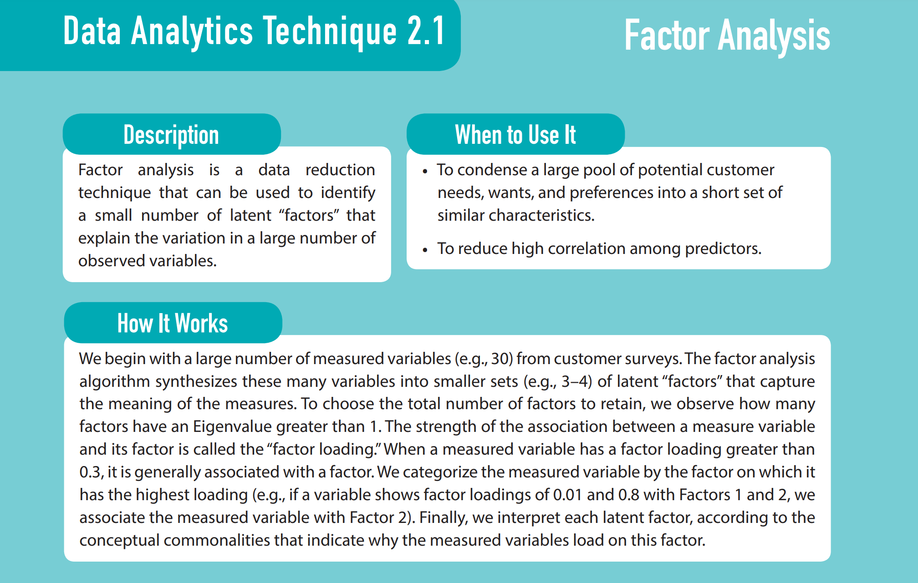
Description
19

Slide 20
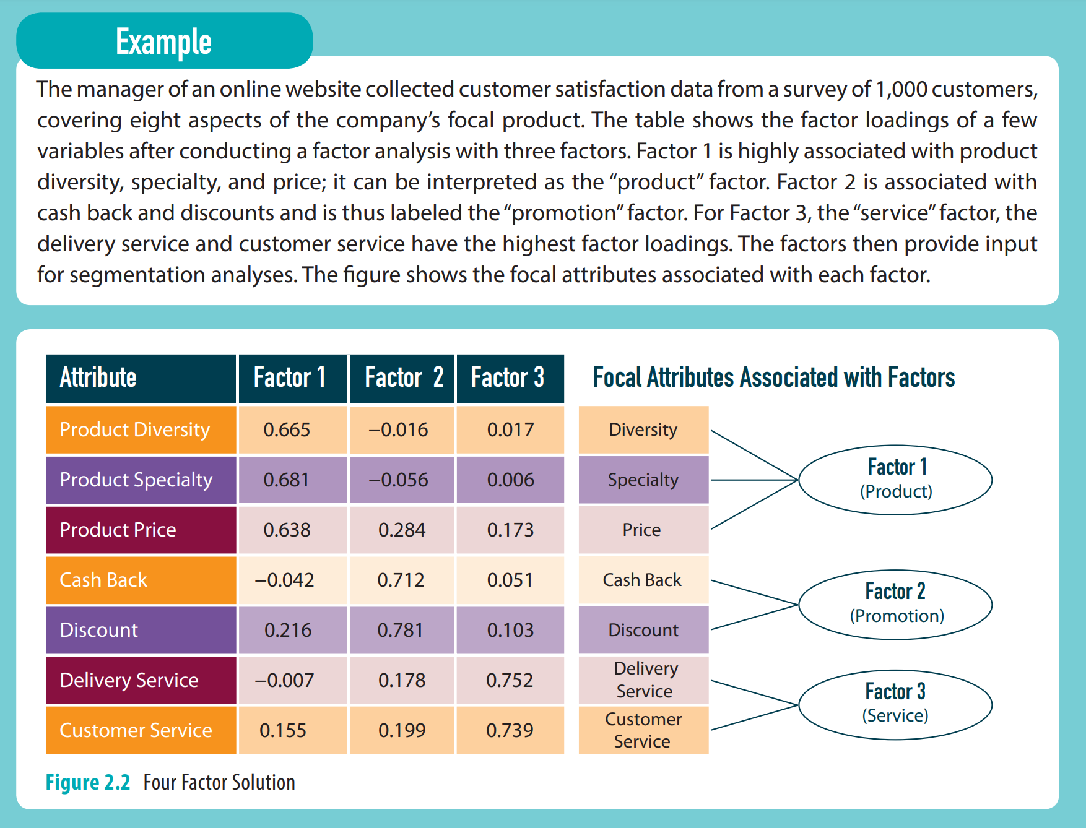
Description
20

Slide 21
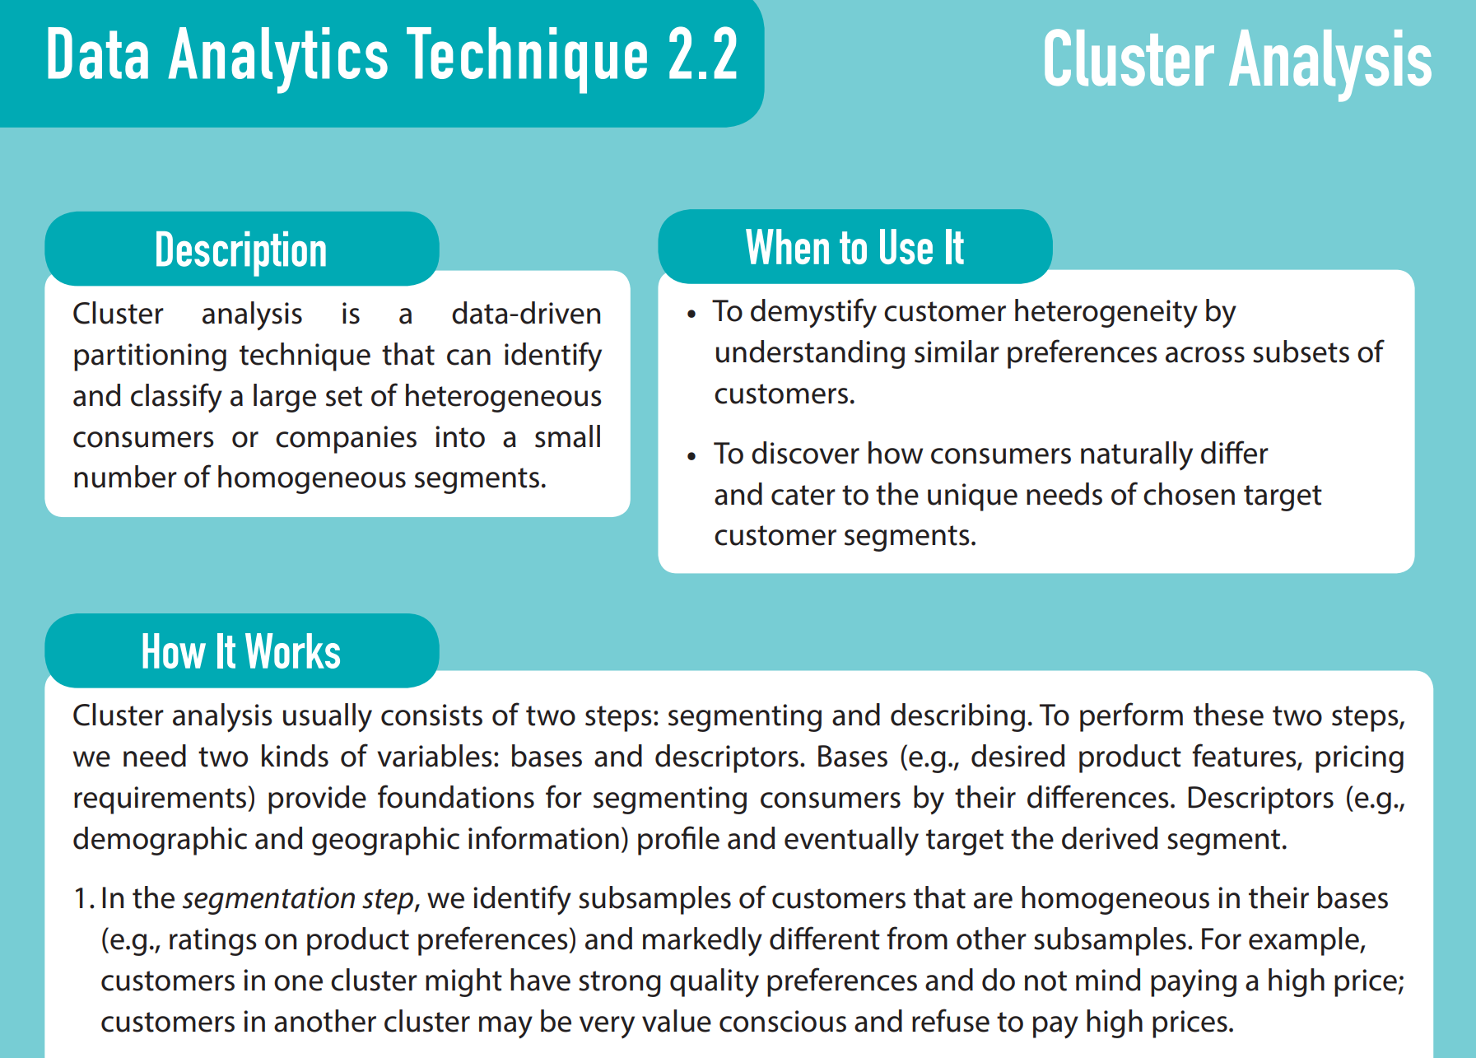
21
Notes:
Cluster analysis refers to the primary, data-driven partitioning technique that can identify and
classify a large set of heterogeneous consumers or companies into a few homogeneous segments. Although cluster analysis can rely on various attributes, here we can imagine a two-dimensional space. Let’s say a sports nutrition company determines that customers of nutrition bars care about protein content and taste. Some customers trade off taste for better performance; others prioritize taste over performance, and still others prefer to balance the two. Cluster analysis uses customer preferences to cluster individual customers into a given number of groups within this two-dimensional space by simultaneously minimizing the distance from each individual customer to the center of a cluster and maximizing the distance between the centers of all clusters. In the real, more complex world, the grouping process occurs in a multidimensional space, determined by the number of purchase attributes or preferences used (price, quality, size). With a completed cluster analysis, we can consider the segmentation results, to determine whether the derived clusters make intuitive sense.

Slide 22
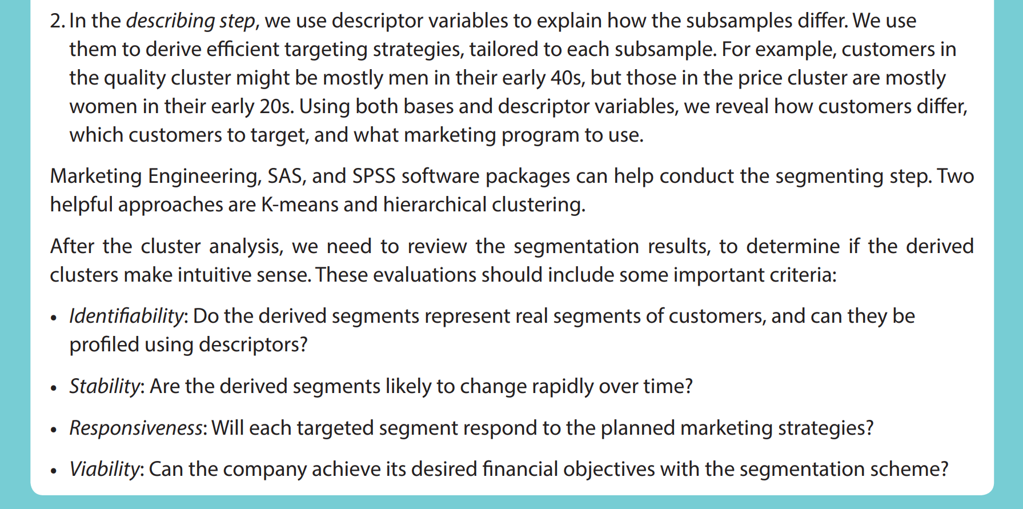
22
Notes:
Cluster analysis refers to the primary, data-driven partitioning technique that can identify and
classify a large set of heterogeneous consumers or companies into a few homogeneous segments. Although cluster analysis can rely on various attributes, here we can imagine a two-dimensional space. Let’s say a sports nutrition company determines that customers of nutrition bars care about protein content and taste. Some customers trade off taste for better performance; others prioritize taste over performance, and still others prefer to balance the two. Cluster analysis uses customer preferences to cluster individual customers into a given number of groups within this two-dimensional space by simultaneously minimizing the distance from each individual customer to the center of a cluster and maximizing the distance between the centers of all clusters. In the real, more complex world, the grouping process occurs in a multidimensional space, determined by the number of purchase attributes or preferences used (price, quality, size). With a completed cluster analysis, we can consider the segmentation results, to determine whether the derived clusters make intuitive sense.

Slide 23
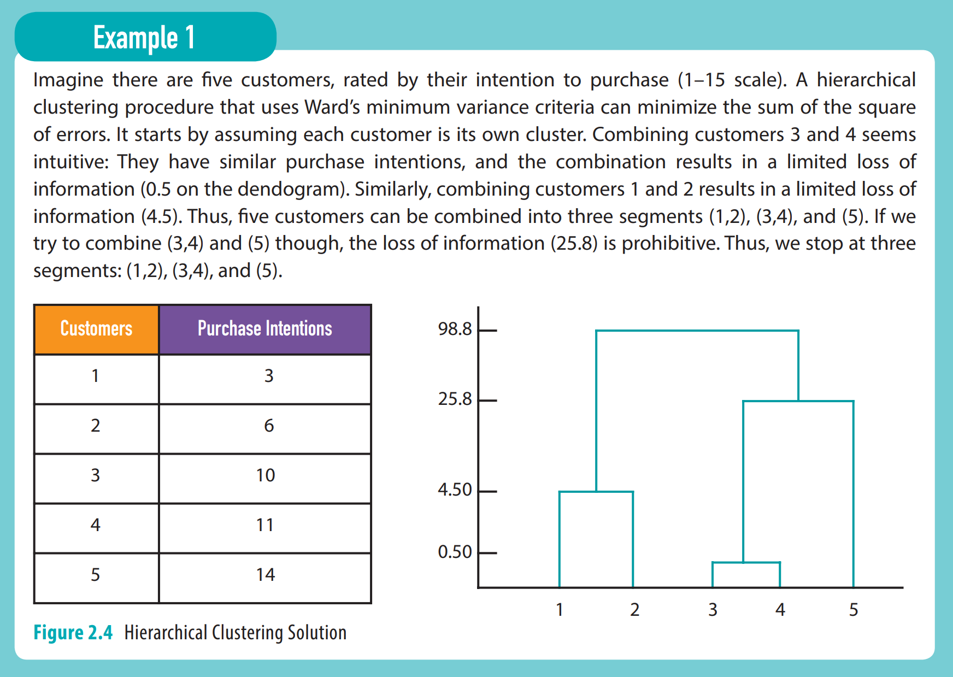
23

Slide 24
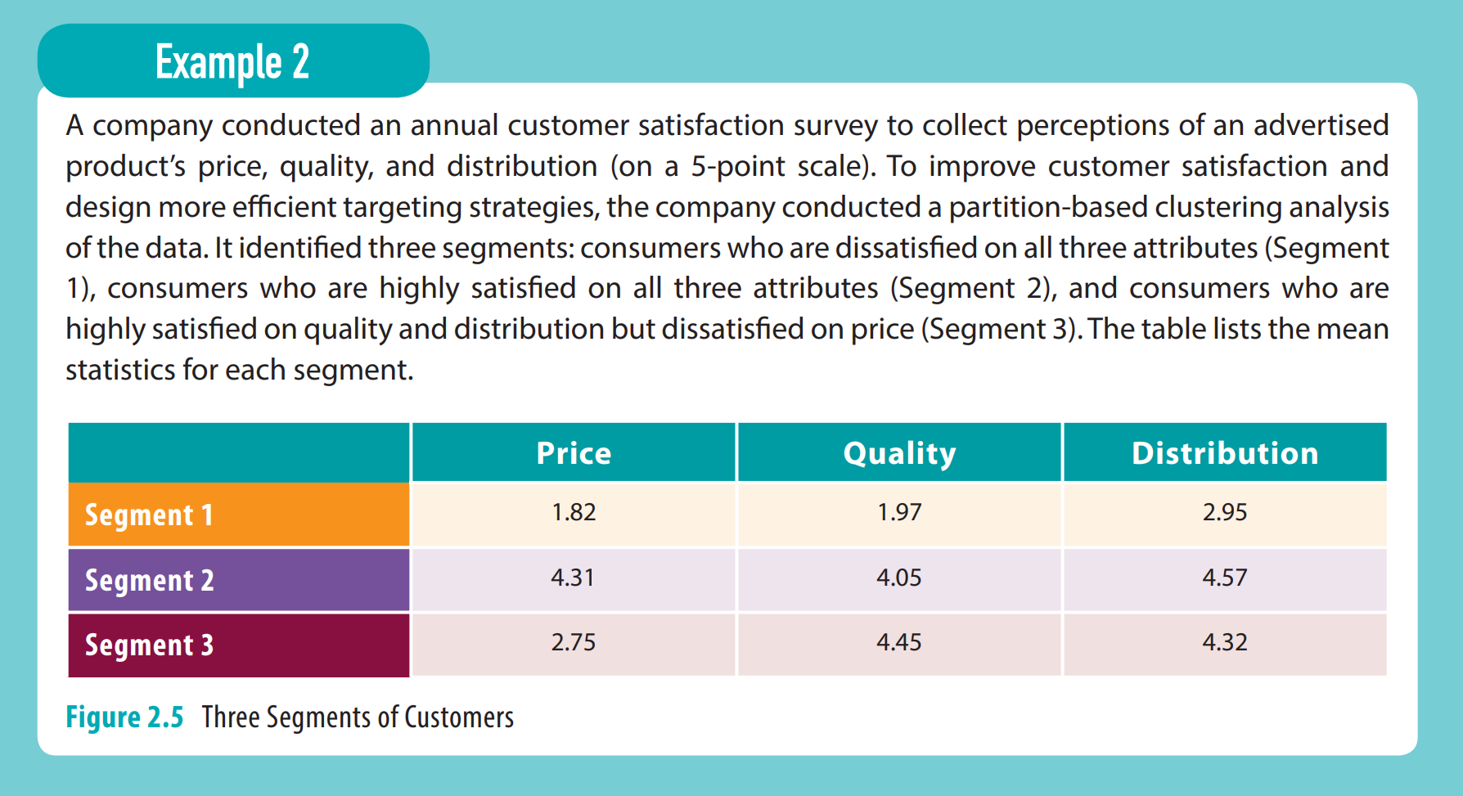
24

Slide 25
Cluster Analysis is a Good Tool To Group Customers
a = distance from member to cluster center
b = distance from I to III
•
•
Analysis: minimizes sum of a’s while maximizes sum of b’s
•
•
•
Dimension 2
III
Perceptions or ratings data
from one respondent
b
•
•
•
•
•
•
•
a
I
II
Dimension 1
(See Data Analytic Technique 2.2 for more details)
25
Notes:
Clustering refers to the primary, data-driven partitioning technique that can identify and classify a large set of heterogeneous consumers or companies into a few homogeneous segments. Although cluster analysis can rely on various attributes, here we can imagine a two-dimensional space. Let’s say a sports nutrition company determines that customers of nutrition bars care about protein content and taste. Some customers trade off taste for better performance; others prioritize taste over performance, and still others prefer to balance the two. Cluster analysis uses customer preferences to cluster individual customers into a given number of groups within this two-dimensional space by simultaneously minimizing the distance from each individual customer to the center of a cluster and maximizing the distance between the centers of all clusters. In the real, more complex world, the grouping process occurs in a multidimensional space, determined by the number of purchase attributes or preferences used (price, quality, size). With a completed cluster analysis, we can consider the segmentation results, to determine whether the derived clusters make intuitive sense.

Slide 26
Hierarchical Clustering Procedure Gives Dendogram
Numbers represent amount of variance explained (don’t worry about actual numbers but rather change)
Pick number of clusters where variance explained is relatively large
3 clusters look best since 4 clusters only gives “5” more units versus 99 and 25
But, look at 4 clusters to see what is different
(2 clusters)
98.80
25.18
(3 clusters)
5.00
(4 clusters)
0.50
A
B
C
D
E
(See Data Analytic Technique 2.2 for more details)
Notes:
Clustering refers to the primary, data-driven partitioning technique that can identify and classify a large set of heterogeneous consumers or companies into a few homogeneous segments. Although cluster analysis can rely on various attributes, here we can imagine a two-dimensional space. Let’s say a sports nutrition company determines that customers of nutrition bars care about protein content and taste. Some customers trade off taste for better performance; others prioritize taste over performance, and still others prefer to balance the two. Cluster analysis uses customer preferences to cluster individual customers into a given number of groups within this two-dimensional space by simultaneously minimizing the distance from each individual customer to the center of a cluster and maximizing the distance between the centers of all clusters. In the real, more complex world, the grouping process occurs in a multidimensional space, determined by the number of purchase attributes or preferences used (price, quality, size). With a completed cluster analysis, we can consider the segmentation results, to determine whether the derived clusters make intuitive sense.

Slide 27
Discriminant and Classification Analyses
Discriminant and classification analyses are multivariate statistical techniques used to determine how segments of consumers differ in their characteristics
When to use:
  To classify a large set of customers into small sub-groups that have different characteristics
  To predict or classify which sub-group a new customer belongs to, so as to better target marketing activities
(See Data Analytic Technique 2.4 for more details)
Notes:
If that accuracy level is acceptable, the discriminant function can be applied to the same demographic variables among other, non-surveyed customers to predict their segment in a classification analysis. This process is critical to effective acquisition strategies (see Chapter 3). Sidebar 2.4 provides an overview of discriminant and classification analysis techniques.

Slide 28
Targeting
A market needs to select segments to target based on certain selection criteria
  Market attractiveness (size, growth rate, price sensitivity, etc.)
  Competitive strength (captures the relative strength of a firm, versus competitors, at securing and maintaining market share in a given segment)
Uses all three “Cs” as input: customer, company, and competitors
An ideal target segment should meet six criteria:
  Based on customer needs (customer care)
  Different than other segments (little crossover competition)
  Differences match firm’s competences (firm can execute within resource constraints)
  Sustainable (can keep customers)
  Customers are identifiable (can find targeted customers)
  Financially valuable (valuable in the long term)
The GE matrix is one analysis tool designed to helps managers visualize and select target segments
Notes:
Targeting. After segmenting potential customers into homogenous groups on the basis of their purchase preferences for a specific product or service category, a marketer needs to select segments to target. If segmenting is like cutting the market into slices of pie, then targeting is deciding which slice you want to eat. Specifically, each market segment is rated on two dimensions to aid the choice: market attractiveness and competitive strength. Market attractiveness captures external market characteristics that make a given segment strategically and financially valuable to serve, such as size, growth rate, and price sensitivity. Generally speaking, an attractive segment is equally appealing to all firms competing in that market. Competitive strength captures the relative strength of a firm, versus competitors, at securing and maintaining market share in a given segment. Thus, this dimension is specific to each firm’s competitive situation. The two dimensions account for three key Cs (customers, competitors, and company), which are central to a situational analysis. By evaluating the market attractiveness and competitive strength of each segment of potential customers, a manager can weigh their desirability against the firm’s ability to win them, then select the segment or segments to target. An ideal target segment should meet six criteria:
Based on customer needs (customers care).
Different than other segments (little crossover competition).
Differences match firm’s competences (firm can execute within resource constraints).
Sustainable (can keep customers).
Customers are identifiable (can find targeted customers).
Financially valuable (valuable in the long term).
Firms often target multiple segments simultaneously with different offerings to match different customer preferences and gain access to a larger market space. In some cases, a firm can use similar or related brands with different offerings and price points. For example, Marriot targets price-sensitive, frequent business travellers with Courtyard Marriott properties but goes after high-income vacationers with Marriott Resort Club properties. In other situations, two segments might be mutually exclusive, making it difficult for one firm or brand to address them, as the failed example of Gallo Winery’s attempt to enter the high-end wine segment showed. Targeting helps a firm manage customer heterogeneity by purposely focusing its efforts on customers that are more similar and aligned with its own capabilities.
The GE matrix is one analysis tool designed to helps managers visualize and select target segments. Figure 2.2 provides an example of an analysis by an athletic wear firm, in which the y-axis indicates market attractiveness, the x-axis indicates the competitive strength of each segment, and the size of each “bubble” reflects the size of the market segment. Large segments in the upper-right corner of the graph are the “best,” and those in the lower-left corner represent the “worst” segments for this firm.

Slide 29
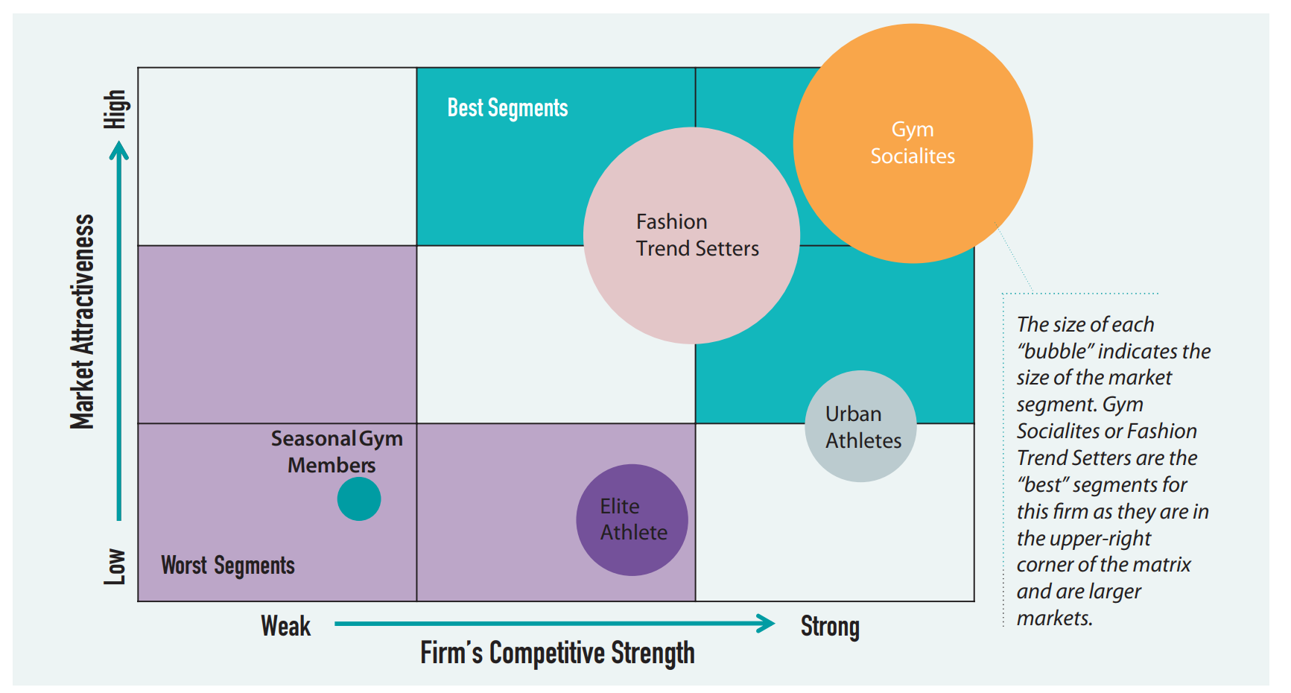
GE Matrix: Analysis Tool for Targeting

Slide 30
Positioning
Process of improving your relative advantage in the minds of your targeted customers
  Changing both your actual (e.g., innovation) and perceived offering (e.g., branding, relationships)
  Uses all three “Cs” as inputs: customer, company, competitors
Nearly everything you do impacts your positioning
  Channel (place): Samsung dropping Kmart
  Price: No discounts at Tiffany
  Promotion: Tiger Woods at Nike, Starbucks
  Product: Bose, Apple
Perceptual maps: analysis tool to aid in positioning decisions
Repositioning: process by which a firm shifts its target market
Notes:
Positioning. The last step in the STP approach involves the process of improving a firm’s relative advantage in the minds of its targeted customers. Positioning entails changing both the actual (innovating products or reducing manufacturing costs) and the perceived (building a new brand image) offering. Nearly every marketing mix decision, including product, price, place (channel), and product activities (often termed the 4Ps), that managers make affects the positioning of the firm’s offering in customers’ minds.
Product design and performance represent perhaps the most straightforward way to change an offering’s position. Firms like Apple and Bose have large R&D budgets to achieve the high-performance, cool images they strive for and that their target customers prefer. When Samsung wanted to shift the image of its electronics upmarket, it removed its products from Kmart stores, because its target customers’ perceptions of Kmart likely were inconsistent with the desired positioning strategy. Many high-end retailers (Gucci, Tiffany) never or infrequently have sales on their products; they want to maintain a brand image of exclusivity. Although they are often less tangible, promotional activities (e.g., advertising, public relations) also can change an offering’s position in customers’ minds, by informing customers of specific product attributes and changing customer perceptions of the product. For example, a tagline for an advertising campaign that Clairol ran years ago asked, “Does she … or doesn’t she? Hair color so natural only her hairdresser knows for sure.” The campaign not only expanded the hair coloring market significantly (eight-fold sales growth in a short period) and changed people’s perceptions about their own and others’ hair color, but it also positioned Clairol strongly in customers’ minds, a dominant position it continues to enjoy today.
Positioning also helps a firm manage customer heterogeneity because it can use the marketing mix variables to position or reposition both tangible and intangible elements of its offering to align with the target segment’s preferences. A well-positioned product should offer target customers the best fitting solution, relative to competitors; in many cases, it therefore provides a robust barrier to future competitive attacks. In essence, targeting is a coarse selection process: Firms select a customer segment that roughly matches their offering and existing brand image. But positioning is the fine-tuning adjustment process that firms can use to adjust perceptions of their own offering and change customers’ actual preferences or decision criteria to best align their offerings with the target segment’s preferences. Positioning strategies are implemented over time and may take years to achieve.
To visualize and develop effective positioning strategies, many marketers use perceptual maps, which depict customer segments, competitors, and a firm’s own position in a multidimensional space, defined by the purchase attributes identified during the segmentation process. Figure 2.3 is an example of a firm’s perceptual map, before and after a repositioning effort. Repositioning refers to the process by which a firm shifts its target market. Consider, for example, how Abercrombie & Fitch repositioned itself: “As a baby boomer, I remember Abercrombie & Fitch. It was a very traditional, outdoorsy, hunt club oriented brand. It felt a little bit like L.L. Bean or Orvis. Today, it is a completely different brand. It is hot and sexy and targets teens. In fact, not too long ago it was in the news for the controversy around its featuring semi-nude models at the entrances to its mall stores.” Faced with more recent sales declines, this retailer again is repositioning: removing logos from its clothing, turning up the lights in stores, and putting more clothing on models.
.

Slide 31
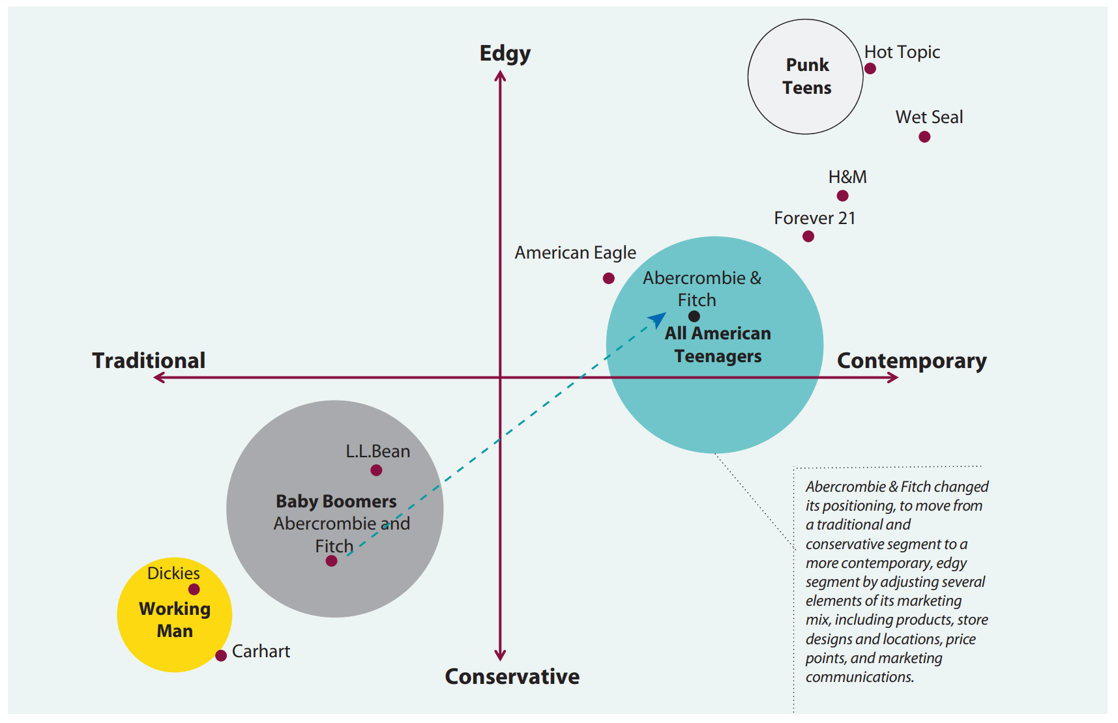
Perceptual Map: Analysis Tool for Positioning

Slide 32
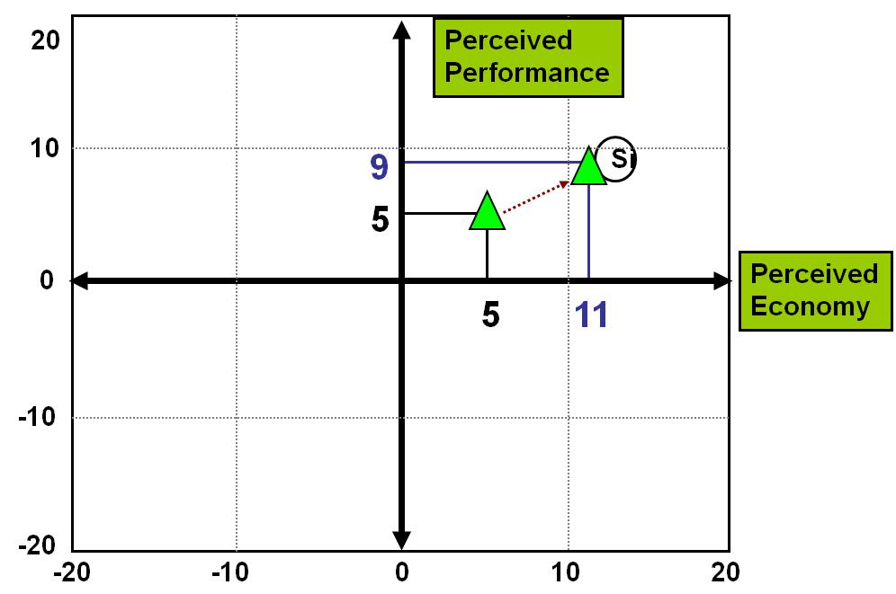
Perceptual Map (Markstrat Example)

Slide 33
Positioning Statement Must Address Three Key Questions
Who are the customers?
What is the set of needs that the product or service fulfills?
Why is this product/service the best option to satisfy your needs (relative to competition or substitute; support for why)?
This statement is the roadmap for a plethora of implementation decisions involved in marketing a product (both inside and outside the company)
See Positioning: The Essence of Marketing Strategy
Notes:
Firms often find it helpful to write a positioning statement, to capture the key marketing decisions to appeal to customers in the firm’s target segment. Three questions should be addressed in a positioning statement:
Who are the customers?
What is the set of needs that the product or service fulfills?
Why is this product/service the best option to satisfy customer needs (relative to the competition or a substitute)?
Thus a succinct template for a positioning statement might be, “For [target segment] the [product/concept] provides [benefit], which [compelling reasons for buying versus competition].” This statement then becomes the roadmap for a plethora of implementation decisions involved in marketing a product or service, both inside and outside the company. In larger firms, different groups of employees design, implement, or affect customer perceptions, so a clear positioning statement is critical to aligning everyone’s decisions and actions. Inconsistency across sales organizations, advertising materials, channel members, and product management has the potential to undermine the effectiveness of an otherwise well-designed positioning strategy. As a powerful external and internal communication tool, the positioning statement instead provides clear guidance to everyone involved, thereby minimizing the potential that any employee or outside vendor will make decisions incongruent with the firm’s positioning strategy.
For Kellogg’s Nutri-Grain cereal bars, the positioning statement reads, “For people on the go who want to eat healthy, Nutri-Grain is the cereal bar that is a healthy snack you can eat on the run. That’s because Nutri-Grain is made with real fruit and more of the whole grains your body needs and comes in individually wrapped packages that you can eat anywhere.” It addresses the three key questions: who, “For people on the go who want to eat healthy,” what, “Nutri-Grain is the cereal bar that is a healthy snack you can eat on the run,” and why, “Nutri-Grain is made with real fruit and more of the whole grains your body needs and comes in individually wrapped packages that you can eat anywhere.”
Thus, the STP approach allows a firm to address MP#1 by first segmenting potential customers into relatively homogenous groups based on individual preferences. In so doing, firms understand how customers’ preferences vary in the marketplace and develop a map of customer heterogeneity. The number and size of customer segments determines the precision of and resulting complexity of this map. The firm then selects segment(s) that are attractive to target, because the firm can build a strong position there. The selection of this relatively homogenous segment to target means the firm does not need to address customer preferences in other, non-targeted segments. Such focus enables the firm to deal effectively with customer variability. As an alternative, the firm could group all potential customers together and try to develop and launch an offering that matches the average needs of all customers’ preferences, though in this case, no single customer segment is well served. Finally, the firm develops and executes a positioning strategy that aligns all marketing activities surrounding the offering to match customers’ preferences and influence customers’ decision criteria. This final refinement ensures that the firm’s offering is the best fitting solution for targeted customers. Firms often start with relatively simple maps, which then become more precise and complex over time. The Royal Bank of Canada (RBC) started with just three segments in 1992. Today, it has more than 80 segments that are updated monthly and that guide nearly all marketing and business decisions.
The STP process also can be conducted at different levels of analysis within a firm. For example, a firm can undertake the process to define its position in the overall marketplace. It also can perform it for each of the firm’s major products or service categories, though these more detailed, lower-level STP analyses must be consistent and supportive of the firm’s overall position. For example, Honda should have an overall positioning strategy relative to all other automotive manufacturers, and it should have a positioning strategy for its minivan lines.

Slide 34
Evaluating a Positioning Statement
JC Penney: For [Modern Spenders and Starting-outs in mid-income levels who shop for apparel, accessories, and home furnishings] we offer [private-label, supplier exclusive, and national brands] that [deliver greater value than that of our competitors] because of [our unique combination of quality, selection, fashion, service, price, and shopping experience].
Who are the customers?
What is the set of needs that the product or service fulfills?
Why is this product/service the best option to satisfy your needs (relative to competition or substitute; support for why)?

Slide 35

MBA Program Segmentation Analysis
Identify and refine “pool” of potential customers needs and descriptors
    Needs: price, rankings, location, focus, facilities
    Descriptors: age, gender, income, zip, house, firm size
Collect data from “random” sample on importance of needs
    Sample: GMAT, mail list, contacts, undergrads (problems?)
    Example: “MBA program ranking is very important to my decision” (1 to 7, strongly disagree to strongly agree)
Do factor analysis to combine like questions if needed
Do cluster analysis to group like customers on these factors
Name clusters
Notes:
Most segmentation efforts fail due to segmenting on descriptors versus needs

Slide 36
Factor Analysis (Grouped 12 Questions into 5 Factors)
Convenience
Classes are taught within 45 minutes of my work or home.
The program is completed in one year or less.
Classes do not interfere with normal work hours (8:00 to 5:00 on M to F).
affordability
The price of the program is critical to my decision to attend a program.
The program is less expensive than other similar programs.
Content Fit
I can customize all of my course work based on my interests and goals.
The program is tailored to my specific job function (e.g., accounting, marketing, etc.).
The program is tailored to my specific industry (e.g., medical, technology, etc.).
prestige
The program is highly ranked by independent sources (i.e., Business Week, US News, Economist).
The program has a strong reputation.
Networking
The program facilitates frequent networking with other students.
The program offers frequent networking with local business contacts.

Slide 37
61% of Respondents Are Split Between Two Large Segments
Easy
Promotions
Mobility Minded
Analysis results
Young Status
Seekers
Relevant
Learners
Cheap and Easy
New Career
Networkers
© Palmatier

Slide 38
Easy Promotions
Interested in Degree
Sample Size: 515 (31%)
Age: 36 (+5%)
Income: $119,612 (+8%)
Preferences
Decision Criteria
24%
13%
19%
22%
21%
Top 5 industries:
Technology (20%)
Financial Services (8%)
Media & Entert (7%)
Consumer Prod. (7%)
Healthcare (7%)
Top 5 functional areas:
Strategy (23%)
Management (23%)
Entrepreneurship (9%)
Information Syst. (9%)
Finance (8%)
*For all segments, technology was top industry and strategy and management were top functional areas – results did not differ by group; % indicates proportion of boxes checked
Wants an easy (convenient and cost) MBA to get promoted at existing firm. They are often older, married, and fewer alumni.
Demographics
73% (+10) married
29% (+3.9) have kids <5 yrs
67% (-4.6) male
58% (+4.1) within 50 mi. of UW
Degree Timing
32% (+3.1) starting within 1 year
41% (+7.5) starting in 1-2 years
12% (+1.4) starting 2-3 years
3% (-4.0) starting 3+ years
12% (-11) already started
Attendance
Likely to attend UW? -0.08
What proportion of alumni fall into this segment? 24% (70% undergraduates)
Note: unless indicated as %, all reported scores are z-scores, where each increment of .5 represents 17% above average and each decrement (-.5) represents 17% below average.

Slide 39
Mobility Minded
Interested in Degree
Sample Size: 503 (30%)
Age: 33 (-5%)
Income: $106,084 (-4%)
Preferences
Decision Criteria
28%
27%
18%
15%
12%
Top 5 industries:
Technology (17%)
Consumer Prod.(9%)
Financial Services (8%)
Media & Entert. (7%)
Healthcare (7%)
Top 5 functional areas:
Strategy (23%)
Management (16%)
Entrepreneurship (11%)
Marketing (10%)
Int’l Business (10%)
*For all segments, technology was top industry and strategy and management were top functional areas – results did not differ by group; % indicates proportion of boxes checked
Wants a high impact MBA (status and networking) to enhance career. They are also interested in full time MBA/MS programs.
Demographics
51% (-11) married
22% (-3.2) have kids <5 yrs
73% (+1.8) male
48% (-6.2) within 50 mi. of UW
Degree Timing
26% (-2.4) starting within 1 year
36% (+2.9) starting in 1-2 years
6% (+3.9) starting 2-3 years
9% (-1.2) starting 3+ years
23% (+0.3) already started
Attendance
Likely to attend UW?: +0.09
What proportion of alumni fall into this segment? 31% (51% undergraduates)
Note: unless indicated as %, all reported scores are z-scores, where each increment of .5 represents 17% above average and each decrement (-.5) represents 17% below average.

Slide 40
MBA Example: Targeting Segments
Attractiveness
Size of segment: proportion of respondents in segment out of total respondents across segments
Growth rate: estimation using segment information
Price sensitivity: importance-weighted measure of affordability rating
Competitive strength
Likelihood to attend UW: self-reported likelihood to attend UW
Relative competitive strength: an index of segment needs met by UW that are unmet by top 3 best competitors; computed as difference between UW perception and segment need, summed for each need and compared to top 3 competitors, for each segment
Fit with current UW offerings: estimation based on segment preferences and UW current offerings

Slide 41
GE Matrix
MAP KEY
Attractiveness computed as average index of (1) willingness to pay, (2) price sensitivity, (3) market size, and (4) growth rate*; all values standardized
Competitive strength computed as average index of (1) likelihood to attend UW, (2) needs met by UW that are unmet by competition, and (3) fit with current UW offerings *
Note: all values based on survey responses except those indicated by asterisk (*)
Mobility
Minded
Easy
Promotions
Attractiveness
New Career
Networkers
Young Status
Seekers
Relevant
Learners
Cheap and Easy
Competitive Strength

Slide 42
Easy Promotion:
Perceptual Map
More Convenient
Easy Promotion
Segment
UW Bothell
Seattle U
UW Seattle
Less
Affordable
SPU
More
Affordable
UW Tacoma
Western Governor’s
UCLA
U Oregon
WSU
Berkeley
Cornell
MAP KEY
Diamonds are values on dimensions shown
Circle size represents relative size of segment
Proximity to axis endpoint represents higher or lower values on that axis
Questions used to form axes:
“[School] offers convenient business education programs.”
“[School] offers affordable business education programs.”
© Palmatier
Less Convenient

Slide 43
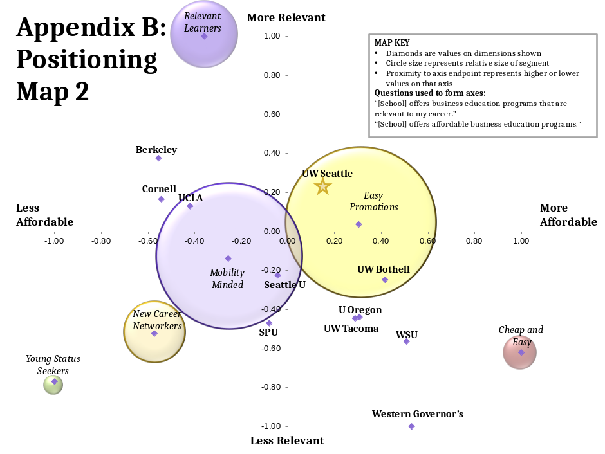
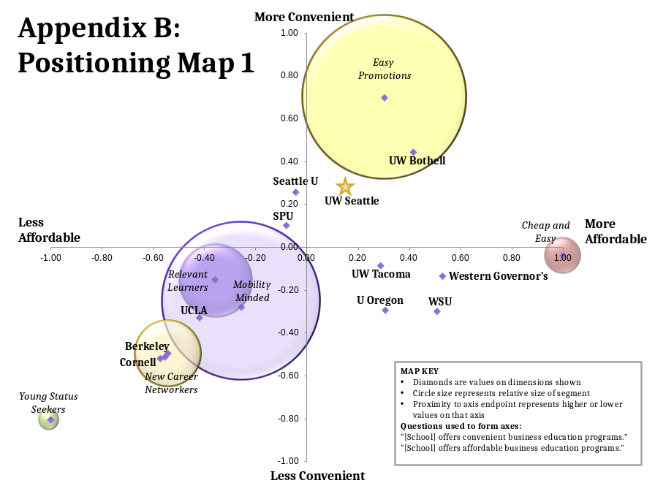
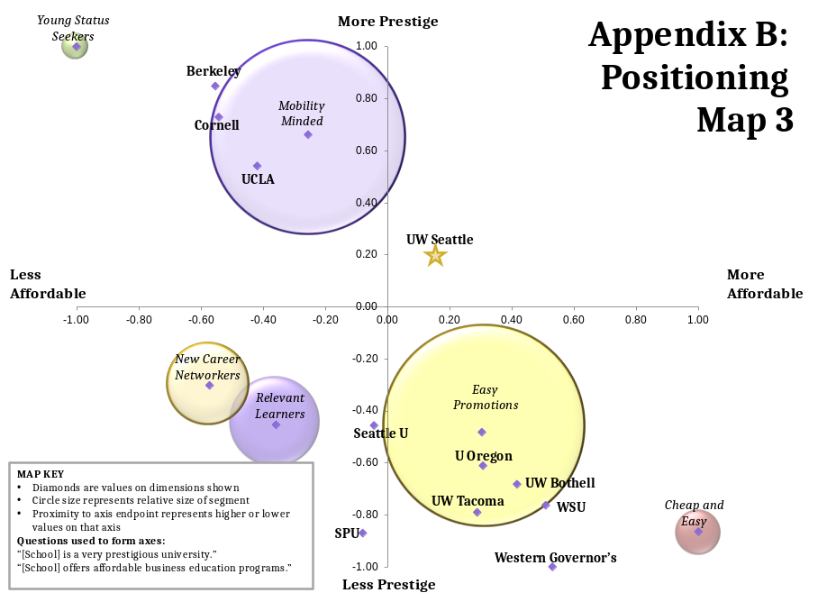
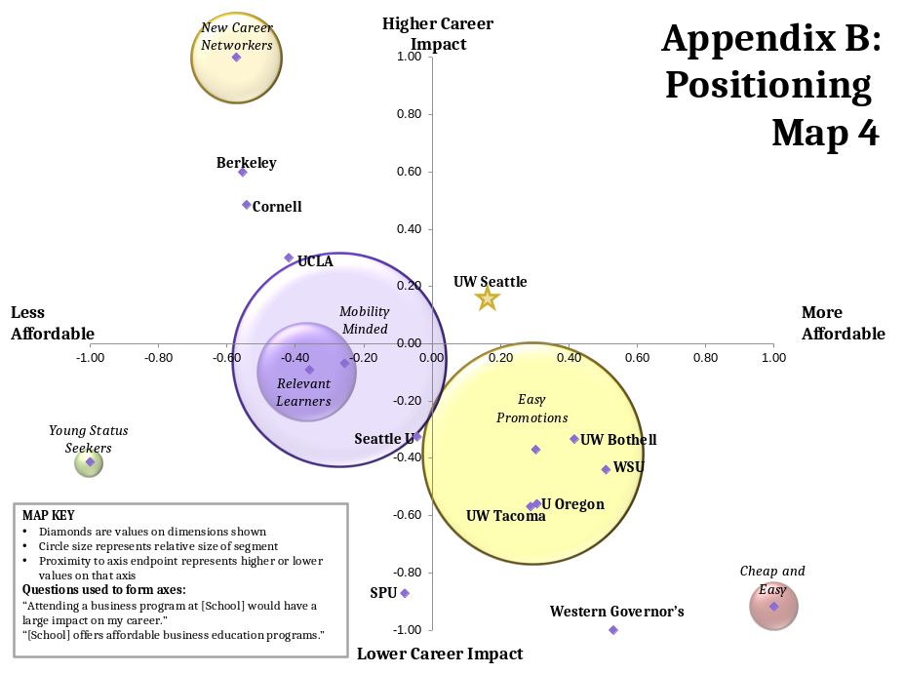

Slide 44
Exercise: Take 5 Minutes and Describe your Firm’s STP
Segmenting: (slices of the the pie): ____________________________________________________________________________________________________________________
Targeting: (your firm’s slice) ____________________________________________________________________________________________________________________
Positioning: (who, what, and why/support) ____________________________________________________________________________________________________________________

Slide 45
Customer-Centric Approach
The customer-centric approach to managing customer heterogeneity is a company-wide philosophy that places customers’ needs at the center of an organization’s strategic process and uses the insights to make decisions
Successful customer centricity depends on a strong market orientation
A marketing orientation comprises three dimensions:
  Intelligence generation (“We often meet with customers to understand their future needs”)
  Intelligence dissemination (“There is a high level of communication among our employees about customers”)
  Responsiveness (“We respond quickly to customers needs”)
Notes:
A more continuous, ongoing approach for managing customer heterogeneity, compared with conducting an STP analysis, is the customer-centric approach. The customer-centric approach is a company-wide philosophy that places customers’ needs at the center of an organization’s strategic process and uses the insights to make decisions

Slide 46
What Does it Mean for a Firm to be Customer Centric?
Places customer at center of organization's vision/mission/strategy/structure/culture/metrics
Input: uses customers’ needs to drive decisions
  Customer and channel councils
  USAA managers spend a day per month in call center
Output: measures success from customer's perspective
  Customer satisfaction
  Net Promoter Score (NPS), loyalty
Processes: systems to link customer data to all aspects of firm
  Compensation (Enterprise car rental)
  Scorecards and dashboards
(Kohli and Jaworski 1993)
Notes:
Being customer centric requires a firm to align multiple aspects of its organization to be consistent with this philosophy, including leadership, structure, culture, metrics, processes, and strategy. The critical first step is for senior leadership to adopt this perspective and make customer-centric decisions. Next, the firm organizes around homogenous customer groups (i.e., customer-centric structure) and uses the relatively homogenous input from customers to drive marketing decisions within each customer-centric business unit.
Whereas the STP approach promotes the notion that firms’ offerings should match customer preferences (external alignment), it does not address whether the firm’s internal organizational design enables or supports actions that align with target segments’ needs or positioning strategies. In essence, the customer-centric approach constitutes an enabler or execution step, promoting customer preferences throughout the organization in the aftermath of the STP process. It promotes internal alignment after the STP approach has established external alignment. The benefits from linking these two approaches—that is, aligning external and internal perspectives—is captured by an RBC executive: “While lots of companies claim they’re customer-centric, RBC is one of just a handful of organizations that segment customers based on customer needs, not their own. And by focusing its operations on addressing those needs, RBC has grown its market capitalization from $18 billion almost six years ago to close to $50 billion today.”
Accordingly, the use of customer-centric structures among Fortune 500 firms has grown by more than half. As shown in Figure 2.4 Intel made the shift in 2005, with the promise that “rather than relying on a structure focused on the company’s discrete product lines, Intel's reorganization will bring together engineers, software writers, and marketers into five market-focused units: corporate computing, the digital home, mobile computing, health care, and channel products—PCs for small manufacturers.” Customer-centric firms not only structure themselves around customers but also use customer-focused metrics (e.g., net promoter score, customer satisfaction) and seek to build processes to link customer data to all aspects of the firm. Andy Taylor, the CEO of Enterprise Rent-A-Car, argues that by measuring and reporting monthly net promoter scores (NPS) across the company’s 5000 branches and regions, it maintains a customer-centric focus.
Customer centricity offers both benefits and some disadvantages. A customer-centric approach aligns each business entity with a specific customer group, which increases the firm’s knowledge of and commitment to each customer segment. Shared customer-specific knowledge positions the firm favorably to identify any unmet needs and enables it to adapt quickly and effectively to changing needs. In contrast, organizations that lack alignment find it difficult to sense changes that might affect a targeted customer segment, which can reduce their speed in responding to emerging trends. Because customer-centric organizations develop richer customer knowledge and greater commitment to each targeted customer segment, they achieve improved customer satisfaction and loyalty. However, customer-centric organizations also need more resources to support their communication and decision-making processes, because of the complex relationships they enter into and the loss of economies of scale. Furthermore, the detrimental effects of duplication and complexity in customer-centric organizations usually lead to higher internal costs.
Successful customer centricity depends on a strong market orientation, or “the organization-wide generation of market intelligence, dissemination of the intelligence across departments and organization-wide responsiveness to it.” Market orientation is a popular way to capture an aspect of a firm’s customer centricity that enhances firm performance. According to one conceptualization, a market orientation comprises three dimensions: (1) intelligence generation (“We often meet with customers to understand their future needs”), (2) intelligence dissemination (“There is a high level of communication among our employees about customers”), and (3) responsiveness (“We respond quickly to customer needs”). Thus, a market orientation implies that a firm can capture customer preferences, communicate these needs throughout the organization, and use the information to target their needs, all of which allows the firm to match customer needs better.
In summary, customer centricity grants an organization deep knowledge about and commitment to a relatively homogenous group of customers, supporting faster detection and responses to changing market conditions. This continuous and real-time responsiveness is built into the organization’s structure, culture, and processes, and customer-centric metrics provide quick feedback to any misalignments. But focusing on a narrow customer group means that other changes, beyond this customer segment, often are not visible. A customer-centric organization even may grow so committed to a market segment that it becomes unable to evaluate alternative customer segments objectively. Along with the higher internal costs, these aspects constitute the clear weaknesses of this approach. With the STP approach, the firm instead gains a more holistic view and can better weight the pros and cons of targeted versus non-targeted market segments. Conducting an externally focused STP analysis every few years across customers and non-customers, then allowing for continuous and rapid internal adjustments by a customer-centric organization, represents a balanced way to manage customer heterogeneity.

Slide 47
Example: Sainsbury’s (UK)
UK’s second largest supermarket
By talking to customers, realized that customers’ purchase decisions were based on three key factors: product quality, ease of shopping, and access to multichannel interfaces
Invested in R&D, store location, and IT infrastructure
Notes:
By talking to customers and employees, Sainsbury’s, the UK’s second largest supermarket, realized that customers’ purchase decisions were based on three key factors: product quality, ease of shopping, and access to multichannel interfaces. The supermarket was then able to respond appropriately, by investing in R&D to improve product quality, store location as a key driver to shopping convenience, and IT infrastructure to improve customers’ seamless transition across channels

Slide 48
Firms are Shifting Toward a Customer-Centric Structure
“So rather than relying on a structure focused on the company’s discrete product lines, Intel's reorganization will bring together engineers, software writers, and marketers into five market-focused units: corporate computing, the digital home, mobile computing, health care, and channel products—PCs for small manufacturers.” (BusinessWeek).
Product
CEO
Customer
CEO
Analog Semiconductors
Digital Signal Processors
Wireless Devices
Government
Large Enterprise
Consumer
Sales
Sales
Sales
Sales
Sales
Sales
Marketing
Marketing
Marketing
Marketing
Marketing
Marketing
R&D
R&D
R&D
R&D
R&D
R&D
Accounting
Accounting
Accounting
Accounting
Accounting
Accounting
Operation
Operation
Operation
Operation
Operation
Operation
(Lee, Sridhar, Palmatier, and Henderson 2015)

Slide 49
Trend of Customer-Centric Structures in the Fortune 500 Firms
51% Growth
(Lee, Sridhar, Palmatier, and Henderson 2015)

Slide 50
How and When Does a Customer-Centric Structure Payoff
Competitive Environment
Competitors’ Customer-Centric Structure
Competitive Intensity
Industry
Profitability
(⎼)
(⎼)
(+)
Mediating Mechanisms
Customer Satisfaction
Firm Outcome
Customer-Centric Structure
Firm Performance
(+)
Coordinating Costs
(+)
(Lee, Sridhar, Palmatier, and Henderson 2015)

Slide 51
Dynamic Effects of Customer-Centric Restructuring on Firm Performance
Firm Performance
Improvement
Drop
Time
t₀
t₁
t₂
t₃
t₄
Pre-restructuring Period
Restructuring Period
Customer-Centric Learning Stage (H₆)
Customer-Centric
Pay-Off Stage (H₇)
On average, firms that switched to a customer-centric structure initially perform worse than before the restructuring (customer-centric learning stage), but after about 9 or 10 quarters, their performance exceeds pre-restructuring levels (customer-centric pay-off stage)
(Lee, Sridhar, and Palmatier 2015)

Slide 52
Agenda
Introduction
Approaches for Managing Customer Heterogeneity
  Evolution of Approaches for Managing Customer Heterogeneity
  Segmenting, Targeting, and Positioning (STP) Approach
  Customer-Centric Approach
Framework for Managing Customer Heterogeneity
  Inputs to Managing Customer Heterogeneity Framework
  Outputs of Managing Customer Heterogeneity Framework
  Process for Managing Customer Heterogeneity
Takeaways
Examples/Case

Slide 53
Marketing Principle #1: All Customers Differ ➔ Managing Customer Heterogeneity
Inputs (3Cs)
Managing Customer Heterogeneity
Outputs (STP)
All Potential Customers
Needs
Demographics
Size, growth, perceptions
Approaches & Processes
Segmenting, targeting, and positioning (STP)
Perceptual/positional maps
Customer-centric view
Analyses
Factor analysis
Cluster analysis
GE matrix
Discriminant analysis
Classification
Industry Segmentation
Customer segments
Needs, demographics, and opportunity of each segment
Your Company
Strengths and weaknesses
Opportunities and threats
Target Segment
Detailed needs, demographics, and value of target segment(s)
Discriminant function
Relative perceptions
Your Competitors
Strengths and weaknesses
Opportunities and threats
Positioning Statement
Who (target segments)
What needs/benefits
Why (relative advantage & support)
Notes:
Figure 2.5 contains an organizing framework for managing customer heterogeneity, which integrates the preceding approaches and analyses. Three key inputs to the framework are needed to conduct segmentation, targeting, and positioning on potential customers. The framework also generates three outputs, which then are used as inputs to the last two marketing principles. Specifically, this framework maps out the key customer segments for an industry or product category based on customer preferences, the firm’s selected target segments, and the positioning statement that defines its positioning strategy for each target segment. Finally, this section outlines a step-by-step process and example for using this framework to transform inputs into outputs.

Slide 54
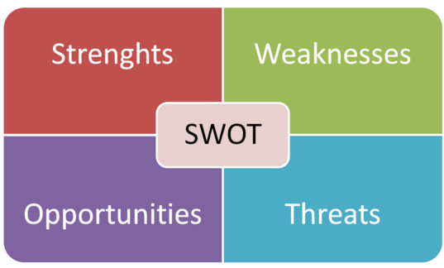
Inputs to the Managing Customer Heterogeneity Framework
  All potential customers -- needs, desires, and preferences across customers in an industry, geographic region, market segment, or product category
  Your company -- an inventory of the company’s strengths, weaknesses, opportunities, and threats (SWOT analysis)
  Your competitors -- an inventory of your competitor’s strengths, weaknesses, opportunities, and threats (SWOT analysis)
Notes:
The first input refers to needs, desires, and preferences across customers in an industry, geographic region, market segment, or product category. Firms often survey potential customers to capture customer preferences across relevant purchase attributes (basis for segmentation). When entering new markets or after dramatic market turbulence, firms should start with qualitative approaches (focus groups, interviews, market observations) to identify all relevant decision attributes, before capturing more detailed input about the importance of the various attributes. Demographic information (gender, age, income, zip codes) and descriptors of a segment then can identify targeted customers during the implementation of acquisition strategies (see Chapter 3). In larger markets or industries (e.g., cell phones, automotive, retail), market research consultants conduct generic segmentation analyses and sell the results to multiple industry participants.
Customers also might provide their perceptions of specific firms and brands in the marketplace across key attributes, for use in perceptual maps. Segmentation focuses on customer preferences for attributes, independent of specific firms or brands; perceptual maps capture customers’ perceptions of existing brands on the same key attributes. Finally, customer input helps the firm determine segment attractiveness, such as growth rate and price sensitivity information. Such attractiveness information often comes from multiple sources, including customer surveys, marketing industry reports, and other secondary sources.
The next sets of inputs are similar, but whereas one focuses on the focal company, the other pertains to its competitors in the relevant category or industry. In both cases, an inventory of the company’s and competitors’ strengths and weaknesses is needed to evaluate the firm’s relative competitive strength, in support of the targeting and positioning processes. Company and competitor strengths and weaknesses should span all relevant domains—manufacturing, technical, financial, marketing, sales, research, legal, or any other domain that could be leveraged as a relative competitive advantage. Company and competitor strengths and weaknesses should be collected together with opportunities and threats in a classic SWOT analysis (strengths, weaknesses, opportunities, and threats). All four factors can inform a firm’s targeting and positioning efforts. (Sidebar 2.3 describes the SWOTs and 3Cs analysis frameworks.) For example, if a firm sells in the consumer package goods (CPG) market, it may prefer to rate market segments smaller than $250 million higher than larger segments in the targeting process, recognizing the increased threat posed by the market leader P&G if it were to enter the larger segments.
Overall, the inputs to the managing customer heterogeneity framework represent the 3Cs of situation analysis. Customers, company, and competitors together represent the key contextual background in which a firm’s strategy must operate. A firm’s marketing strategy is embedded in this background and must both “fit” and “leverage” customers’ preferences and perceptions, market trends, and the firm’s relative strengths to be effective.

Slide 55
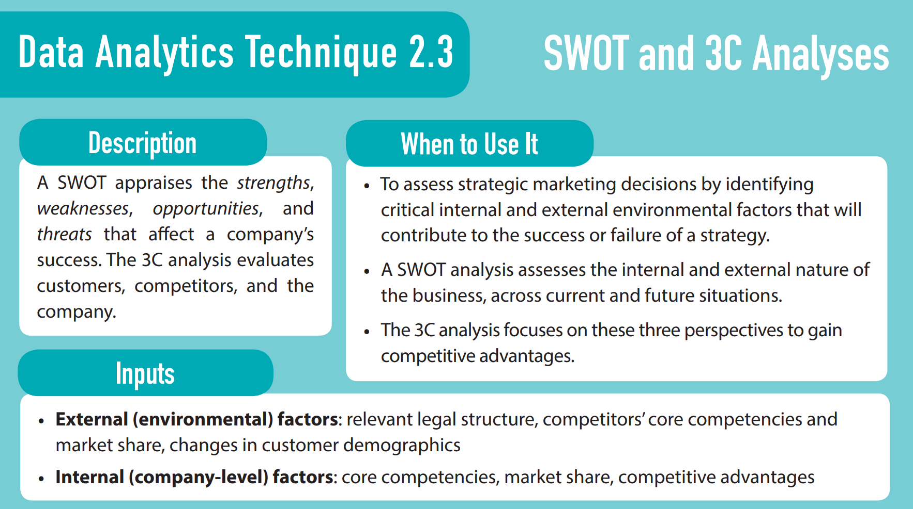
55

Slide 56
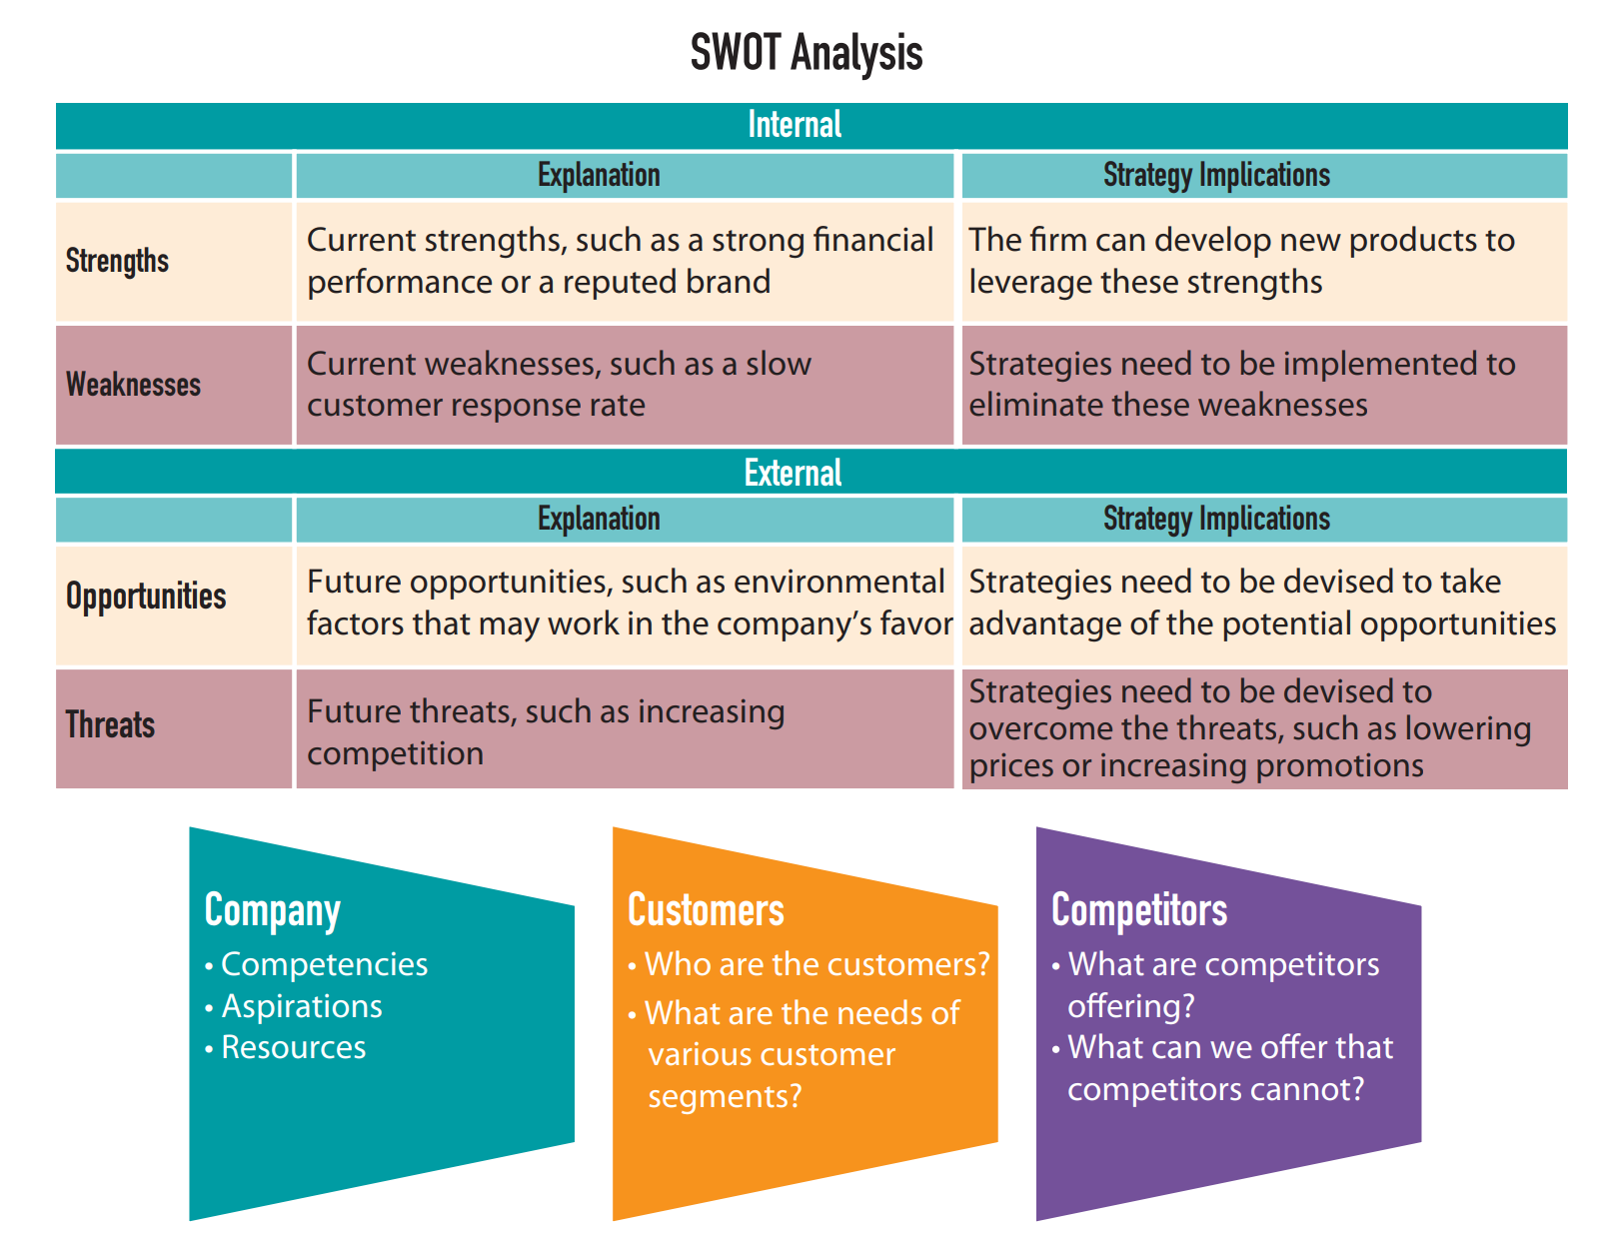
56

Slide 57
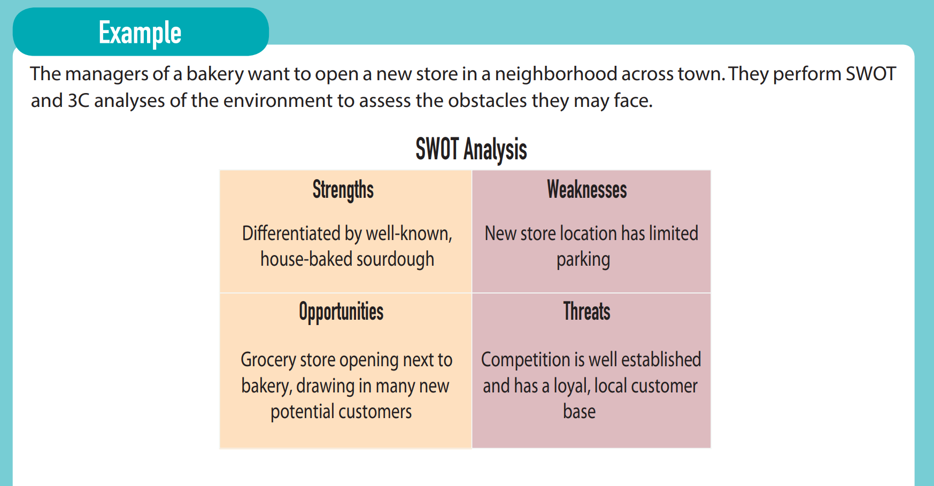
57

Slide 58
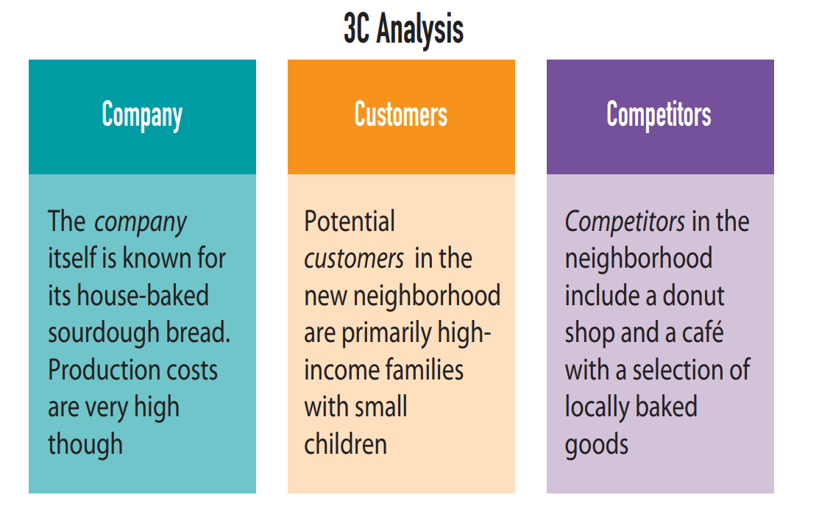
58

Slide 59
Outputs of Managing Customer Heterogeneity Framework
Industry Segmentation describes industry segments and includes, for each named segment, salient purchase preferences, demographic variables, and potential demand opportunities
    How can the marketplace be described using homogenous groups?
    What does each group of potential customers want?
Target Segmentation moves from the overall market landscape to the specific segment(s) of interest, such that it extends the first output by providing a very detailed description of each target segment.
    What set of segments will the firm pursue?
    How does the firm identify each group of target customers?
Positioning Statements encapsulate the three questions into one concise statement that firms use to direct their internal and external marketing activities: who should the firm target, what needs and benefits are being fulfilled, and why does this offering provide a relative advantage over competitive offerings
Notes:
The managing customer heterogeneity framework applies one or more different approaches to the three inputs to generate three outputs (see Figure 2.5). The first output, industry segmentation, describes industry segments and includes, for each named segment, salient purchase preferences, demographic variables, and potential demand opportunities. This output is critical; it maps the potential customer landscape according to two key questions:
How can the marketplace be described using homogenous groups?
What does each group of potential customers want?
The second output moves from the overall market landscape to the specific segment(s) of interest, such that it extends the first output by providing a very detailed description of each target segment. In so doing, it provides insight into the value or attractiveness of the focal segment and the firm’s relative strength, as well as how each target group perceives the firm and its competitors. Targeted customers can be identified on the basis of a detailed description of preferences and demographics, and this “story” transforms the customer segment into more than a list of statistics. Thus, the second output addresses two additional questions:
What set of segments will the firm pursue?
How does the firm identify each group of target customers?
Discriminant and classification analyses provide an empirical approach for identifying target customers, using publicly available data versus surveys or other techniques that are not viable for acquiring new customers (due to their lack of purchase history). Discriminant analysis uses the same segmentation sample to build a model and evaluate the firm’s ability to identify a customer’s cluster or segment on the basis of accessible demographic variables. Segmentation relies on customer purchase preferences; discriminant analysis tries to identify a customer’s segment according to a model of demographic variables. The technique produces an estimate percentage of accuracy for predicting a customer segment with a given set of demographic variables.
The third output is positioning statements, which encapsulate the three key questions into one concise statement that firms use to direct their internal and external marketing activities: who should the firm target, what needs and benefits are being fulfilled, and why does this offering provide a relative advantage over competitive offerings? Position statements should be developed for the firm overall, as well as for each key target segment it addresses. A positioning statement captures the essence of the firm’s positioning strategy for a target segment.
The process of converting the customer, company, and competitor (3Cs) input into industry segmentation, target segments, and positioning statement (STP) outputs is critical for developing a marketing strategy. It allows firms to make sense of the customer landscape by identifying a manageable number of homogenous customer groups, such that the firm can meaningfully evaluate its relative strengths and make strategically critical decisions about how to win these customers. Almost all subsequent decisions build on this first step, because it accounts for customer heterogeneity, customer attractiveness, and the company’s relative advantage.
The STP approach mirrors Sun Tzu’s ancient guidance in the Art of War: Segmenting, targeting, and positioning is the process for “finding” the best approach (target segment) to navigate the terrain (all customer segments) to fight the enemy (competitors) and gain relative advantage (differential advantage).

Slide 60
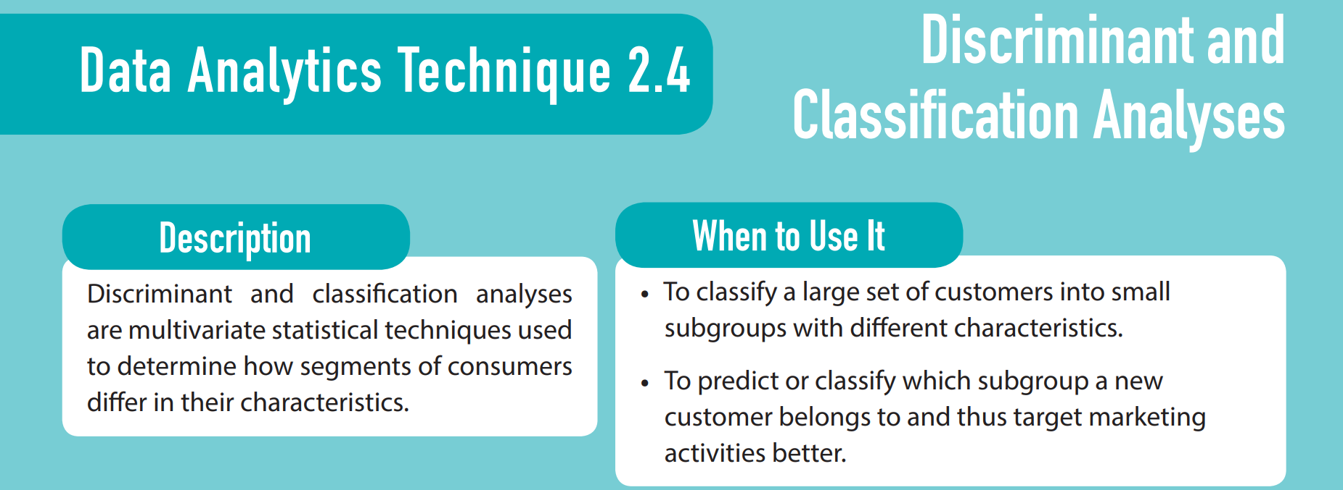
60
Notes:
Discriminant and classification analyses provide an empirical approach for identifying target customers, using publicly available data versus surveys or other techniques that are not viable for acquiring new customers (due to their lack of purchase history).
Discriminant analysis uses the same segmentation sample to build a model and evaluate the firm’s ability to identify a customer’s cluster or segment on the basis of accessible demographic variables. Segmentation relies on customer purchase preferences; discriminant analysis tries to identify a customer’s segment according to a model of demographic variables. The technique produces an estimated percentage of accuracy for predicting a customer segment with a given set of demographic variables. If that accuracy level is acceptable, the discriminant function can be applied to the same demographic variables among other, non-surveyed customers to predict their segment in a classification analysis. This process is critical to effective acquisition strategies (see Chapter 3). Data Analytics Technique 2.4 provides an overview of discriminant and classification analysis techniques.

Slide 61
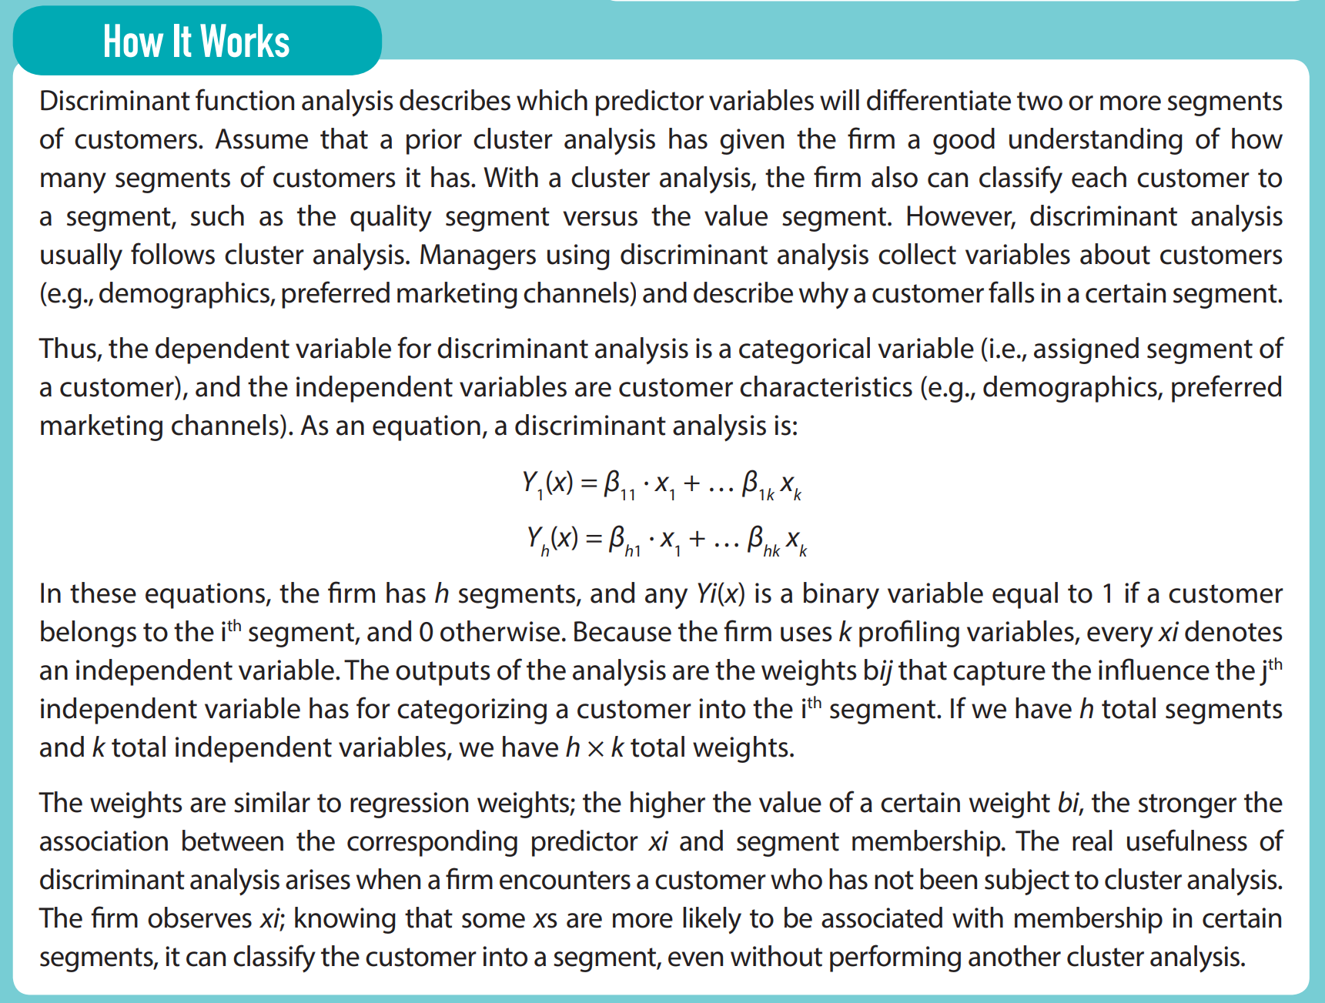
61
Notes:
Discriminant and classification analyses provide an empirical approach for identifying target customers, using publicly available data versus surveys or other techniques that are not viable for acquiring new customers (due to their lack of purchase history).
Discriminant analysis uses the same segmentation sample to build a model and evaluate the firm’s ability to identify a customer’s cluster or segment on the basis of accessible demographic variables. Segmentation relies on customer purchase preferences; discriminant analysis tries to identify a customer’s segment according to a model of demographic variables. The technique produces an estimated percentage of accuracy for predicting a customer segment with a given set of demographic variables. If that accuracy level is acceptable, the discriminant function can be applied to the same demographic variables among other, non-surveyed customers to predict their segment in a classification analysis. This process is critical to effective acquisition strategies (see Chapter 3). Data Analytics Technique 2.4 provides an overview of discriminant and classification analysis techniques.

Slide 62
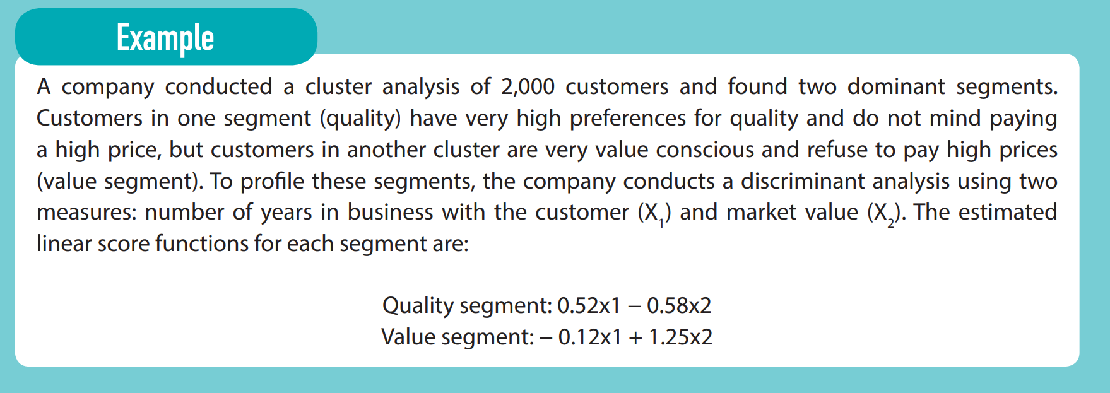
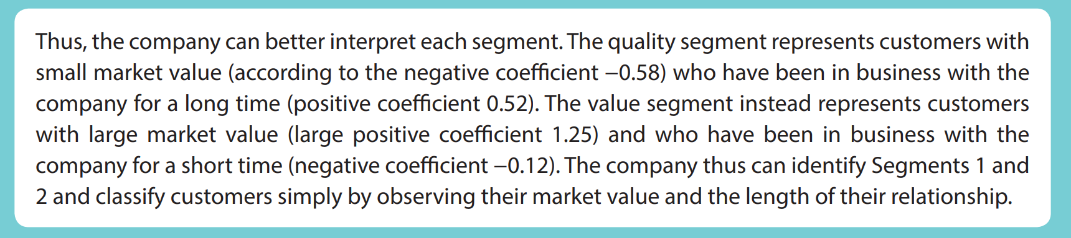
62

Slide 63
Process for Managing Customer Heterogeneity
To convert the inputs into outputs, marketers conduct a series of process steps
  Segmenting – To initiate the segmentation, managers need to identify the key purchase attributes, that is the needs and desires that a potential customer evaluates when making a purchase decision for this category
  Targeting – The targeting process follows naturally from segmentation, to identify which segments the firm wants to sell to, based on the attractiveness of each segment and the firm’s competitive strength in each segment
  Positioning – The separation between targeting and positioning is often blurry. Many of the factors used to evaluate competitive strengths to select a target segment also impact the difficulty of executing an effective positioning strategy for that segment
  Building Customer Centricity – Building a customer-centric organization is different from executing an STP process, in that it requires a top-down, enduring commitment from senior leaders to institute a customer-centric philosophy across the firm’s entire organization
Notes:
To convert the inputs into outputs, marketers conduct a series of process steps. We describe each step in detail here, but various trade-offs and analysis options make the process less straightforward than it might appear. A trade-off that occurs at each step is the need to balance precision with simplicity. For example, virtually every customer segment can be divided further into more subsegments, but at some point, doing so makes the overall STP analysis very complex to understand and communicate, such that it hinders the firm’s ability to develop feasible, executable marketing strategies. An initial STP analysis therefore should lean toward simplicity. Once the strategy is operating smoothly, a marketer can go back and refine it iteratively.
Furthermore, some steps in the STP and customer-centric processes for managing customer heterogeneity can be skipped, depending on the firm’s specific situation. The process also can be applied at multiple levels (firm, geography, product), throughout the organization. In this section, we outline the process for a firm competing in a single product category; larger organizations can duplicate this process for multiple business units or categories as needed. Figure 2.5 provides a visual depiction of the first three step of the process.
Step 1: Segmenting. To initiate the segmentation, managers need to identify the key purchase attributes, that is, the needs and desires that a potential customer evaluates when making a purchase decision for this category. It is important to focus not primarily on existing customers but rather on all potential customers of this product. The ideal approach depends on the stability of the category and the firm’s existing knowledge in it. If customer needs are constantly in turmoil or it is a new market, conducting focus groups with potential customers, interviews, or observational approaches can help ensure that no attributes or newly emerging preferences are missed, due to the firm’s preconceived ideas about what customers care about.
With the list of purchase attributes in hand, the manager should start collecting responses from a random sample of potential customers about the importance of these attributes to their purchase decision. In consumer and some business-to-business markets, this data collection often relies on an online survey, but it also can be done with face-to-face structured interviews or intercept surveys, depending on the type and availability of potential customers. The sample must be random and representative of the overall marketplace to ensure that the results can be generalized. If instead the sample is biased toward a firm’s existing customers or other types of respondents (e.g., certain incomes, ages, or genders), the results will not reflect the true marketplace. In business-to-business markets, responses from multiple decision makers in a buying center must be integrated to gain an overall picture of the purchase process.
Next, managers should analyze the data by grouping similar questions (factor analysis) and grouping similar customers (cluster analysis), which will reveal three to eight homogenous customer groups. The number of segments ultimately depends on the results and the firm’s ability to understand and communicate with multiple segments. Recall that Sidebars 2.1 and 2.2 provide detailed descriptions of factor and cluster analyses. These analyses pertain to customers’ needs and desires, not on demographic variables, but when completed, the demographics of each segment need to be evaluated to describe them comprehensively. This step also helps the firm name each segment, which makes it easier to communicate the category segmentation throughout the organization. In Figure 2.6, we provide a visual representation of how the athletic wear firm from Figure 2.2 groups its potential customers in five segments: Gym Socialites, Fashion Trend Setters, Urban Athletes, Elite Athletes, and Seasonal Gym Members.
Firms can collect and analyze customer data themselves, or they might engage an outside market research firm to design the instrument, collect data, and analyze customer responses. However, “outsourcing” the segmentation process creates some concerns. First, some market research firms specialize in specific industry or product markets, which allows them to spread the cost of their research across multiple firms. But they also offer the same results to competitive firms at the same time, so no single firm gains unique or timelier insights into customer segments or trends, relative to competitors. Second, market research firms have little insight into the trade-offs or potential subsegments that may not appear in aggregate reports but could be critical to a firm’s existing or future marketing strategy. Third, lack of access to a good sample of potential customers is a key reason that firms outsource segmentation studies, but market research firms face the same challenge. Because it is not in the interest of these firms to acknowledge the poor quality of their sample or results, they might not weight the robustness of the findings properly. Fourth, good marketing strategies typically require multiple iterations over time as the firm learns and integrates key insights into its strategy, then collects feedback on the effects of its new strategic initiatives, over and over again. This iterative learning process comes to a halt if the firm only receives packaged reports from a market research firm on different customer segments every few years.
Step 2: Targeting. The targeting process follows naturally from segmentation, to identify which segments the firm wants to sell to, based on the attractiveness of each segment and the firm’s competitive strength in each segment. The firm must choose the factors and weights of each factor to determine a rating of the attractiveness and competitive strength of the segments. In some cases, the ratings can be mined from secondary sources (e.g., census data on size and growth of certain groups); in other cases, questions in the segmentation survey aid the targeting (e.g., price sensitivity, growth rate, relative perceptions of firm’s brand). An average of managers’ rating of factors across each segment also might be informative. In turn, these ratings can be analyzed in the GE matrix described previously (see Figure 2.2).
Firms often want to select multiple segments to target, to access a larger share of the market, but the number of segments a firm can effectively target often is limited. First, customers’ preferences may be mutually exclusive, such that one segment wants low prices and few features (value segment) and another segment wants high status and exclusivity (status-seeking segment). It would be hard for a firm to develop a brand image consistent with each group’s preferences. Second, firms may be limited by their core competencies and available resources. A firm that has always been a follower in an industry and offers very good service and support may find it hard to become a technology leader, because it simply lacks the internal R&D capabilities to innovate radically. Third, firms can lose focus if they attempt to satisfy too many market segments; they end up not committed to or knowledgeable about any one segment, because they simultaneously target too many different segments. The ultimate judges of whether a firm is effectively targeting a segment are customers in that segment, who choose the firm’s product over a competitor’s. But it can be difficult to compete in multiple segments against multiple different firms, each of which might focus solely on that one segment. Returning to the visual representation of the athletic wear firm in Figure 2.6, we find that the firm targets two segments: Gym Socialites and Fashion Trend Setters. These segments were selected on the basis of their attractiveness, as well as the firm’s relative strengths versus competitors’.
Step 3: Positioning. The separation between targeting and positioning is often blurry. Many of the factors used to evaluate competitive strengths to select a target segment also impact the difficulty of executing an effective positioning strategy for that segment. In its simplest form, positioning involves adjusting a firm’s offering (tangible and intangible factors) to match the targeted segment’s preferences, so a key first step is to identify any existing gap between desired attributes and perceived attributes. If the gap is too large or too difficult to overcome, the firm may not want to target the segment, even if it seems very attractive. If it decides to target this segment, the firm must recognize that significant resources and time will need to be devoted to the execution of this strategy.
A positioning analysis can be facilitated by visual representations of customer perceptions. Perceptual maps are an excellent tool for visualizing both gaps in the offerings for a target market and the firm’s relative position (Figure 2.3). Some of the data for perceptual maps can come from the data collection used in the segmentation analysis, but they often require additional input. For example, critical purchase attributes are not known or refined until after the factor and cluster analyses, so new surveys need to be designed and executed. Additional data collections also can increase the sample size in the targeted segment. Ideally, only customers in a specific target segment should appear in the perpetual map for that segment. With additional data collections, it also is possible to keep the initial survey short, which should improve response rates, because it is often difficult to get enough people to complete very long surveys that attempt to perform segmentation, targeting, and positioning all at once.
To draw positioning maps, marketers need to ask the customers in a targeted segment about their perceptions of how well firms in this segment satisfy important attributes, and their overall preferences for purchasing from each firm. With this information, managers can draw perceptual maps and thereby (1) identify key competitors, (2) determine how much to change key product attributes to move products into more favorable positions, and (3) visually determine the impact of their communications programs on market perceptions.
Positioning or repositioning involves moving the firm or its offering to the center of the target segment, using marketing activities such as the 4Ps. Firms should account for both the benefits (i.e., moving closer to customers’ ideal points) and costs (i.e., resources spent to move) of repositioning. A firm that seeks to be positioned as a “young” brand may have to expend significant resources to advertise to customers, over months of time. In a final step, writing a positioning statement for each target segment encapsulates the essence of the segmenting, targeting, and positioning process, by addressing who customers are, what needs the offering satisfies (key purchase attributes), and why this offering or firm is best at satisfying the need (relative advantage). The three key points for the positioning statement for both target segments of the example athletic wear firm also appear in Figure 2.6.
Step 4: Building Customer Centricity. Building a customer-centric organization is different from executing an STP process, in that it requires top-down, enduring commitment from senior leaders to institute a customer-centric philosophy across the firm’s entire organization. For a customer-centric philosophy to be authentic, lead to transformational change, and affect day-to-day decisions, it must be instilled throughout the firm’s organizational elements, including leadership, culture, structure, metrics, processes, and compensation/rewards. In each element, the guiding criteria should focus on target customers, aligning decisions to continuously improve customer solutions and experiences. A firm might start with an internal audit of each design element, to identify where the firm has failed to focus on or align with its targeted customer segments.
Jeff Bezos’s 2013 letter to Amazon’s shareholders captures the essence of a customer-centric organization, as well as some of its benefits:
…it is a fact that the customer-centric way is at this point a defining element of our culture. One advantage—perhaps a somewhat subtle one—of a customer-driven focus is that it aids a certain type of proactivity. When we’re at our best, we don’t wait for external pressures. We are internally driven to improve our services, adding benefits and features, before we have to. We lower prices and increase value for customers before we have to. We invent before we have to. These investments are motivated by customer focus rather than by reaction to competition. We think this approach earns more trust with customers and drives rapid improvements in customer experience—importantly—even in those areas where we are already the leader.
As described in this letter, a customer-centric approach makes a firm “internally driven” to satisfy target customers, synergistic with the STP approach that “externally focuses” the firm on the right customers (i.e., target customer segment). Together, these two approaches allow firms to manage customer heterogeneity by disaggregating customers into homogenous groups, then narrowly focusing and motivating the total organization to address the needs of these select customer segments. The goal is to focus the vision of the firm on the specific needs of customers (rather than products). Improvements in the firm’s products and services over time then result from listening to the voice of the customer. Many firms pay consultants massive sums to conduct STP analyses—and then put the beautifully designed slides on a shelf in the market manager’s office, with little effect on day-to-day decisions. The STP process aims the marketing “gun,” but authentic customer centricity helps the firm pull the “trigger” in its everyday decisions. As Amazon’s famous CEO explains, the firm’s “investments are motivated by customer focus rather than by reaction to competition.”

Slide 64
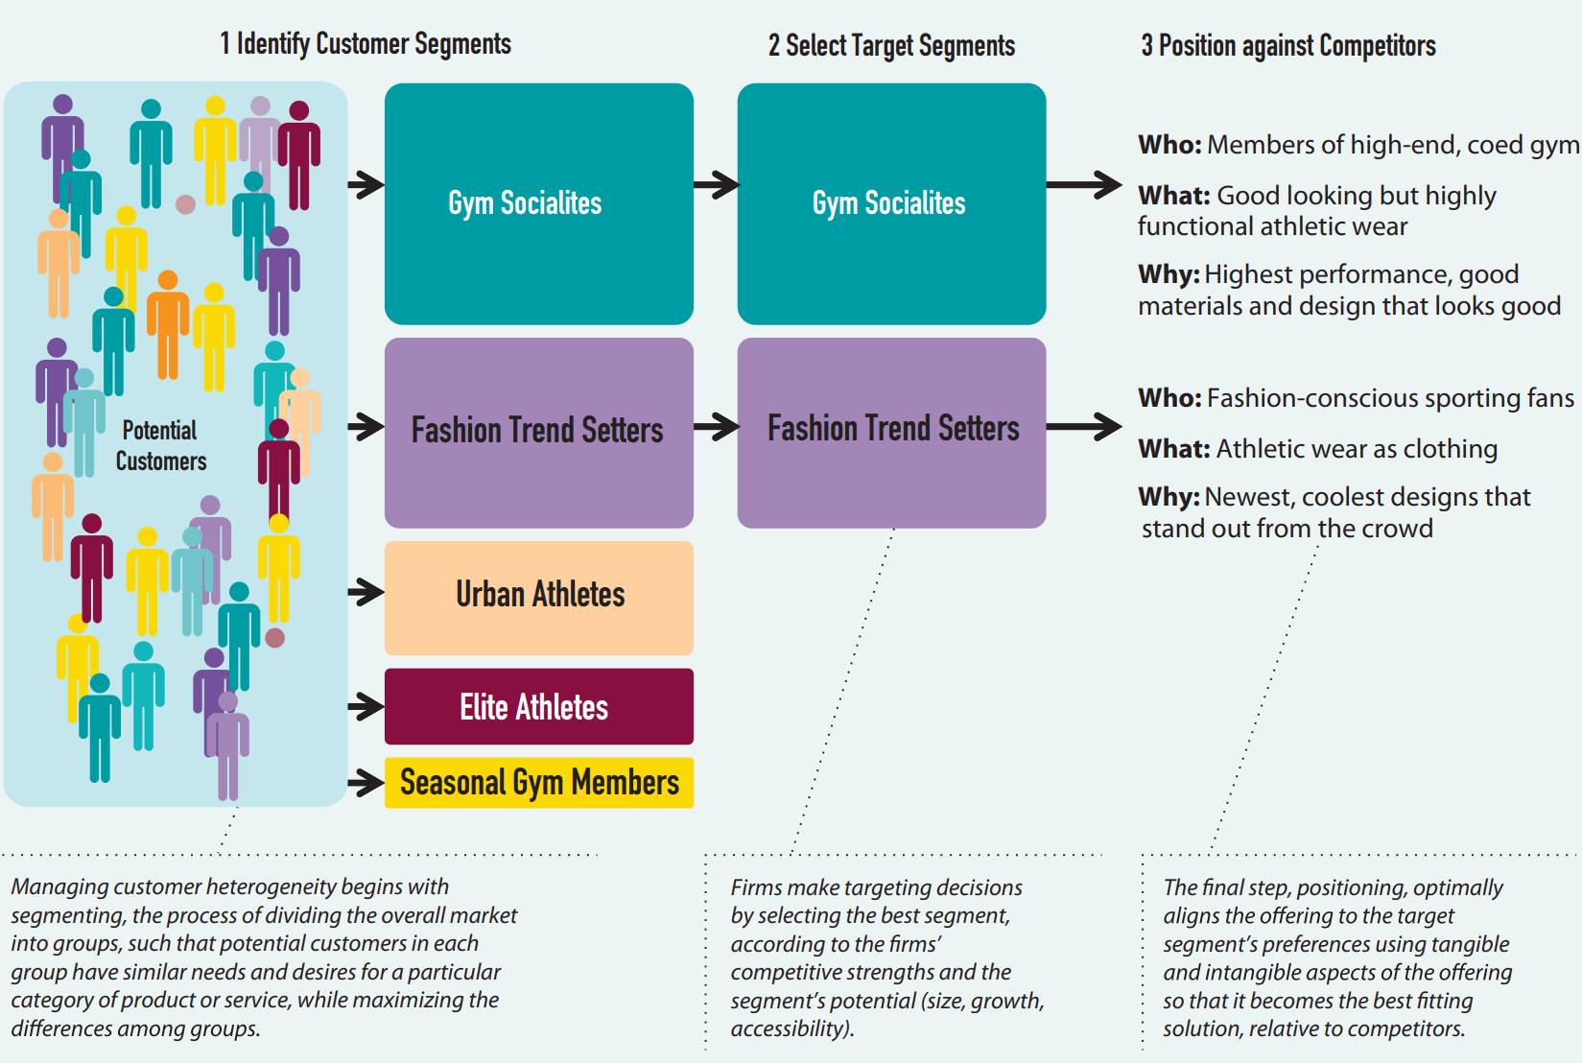
Example of Managing Customer Heterogeneity

Slide 65
Agenda
Introduction
Approaches for Managing Customer Heterogeneity
  Evolution of Approaches for Managing Customer Heterogeneity
  Segmenting, Targeting, and Positioning (STP) Approach
  Customer-Centric Approach
Framework for Managing Customer Heterogeneity
  Inputs to Managing Customer Heterogeneity Framework
  Outputs of Managing Customer Heterogeneity Framework
  Process for Managing Customer Heterogeneity
Takeaways
Examples/Case

Slide 66
Takeaways
A foundational assumption in marketing strategy is that all customers differ in their needs and preferences. A successful marketing strategy must manage and exploit customer heterogeneity, because if competitors identify niches of customers whose needs are poorly served and target them with a better offering, the incumbent firm risks losing its best customers.
Sources of customer heterogeneity include customers’ individual differences, life experiences, functional needs, and self-identity or image, as well as persuasion through marketing. These factors work together to create divergent preferences.
The STP approach allows a firm to manage customer heterogeneity by segmenting potential customers into relatively homogenous groups, based on individual preferences and needs. Then the firm selects attractive segment(s) in which it can build a strong position. Finally, the firm develops and executes a positioning strategy that aligns all marketing activities to move the offering such that it can match customers’ preferences.
Notes:
A foundational assumption in marketing strategy is that all customers differ in their needs and preferences. A successful marketing strategy must manage and exploit customer heterogeneity, because if competitors identify niches of customers whose needs are poorly served and target them with a better offering, the incumbent firm risks losing its best customers.
Sources of customer heterogeneity include customers’ individual differences, life experiences, functional needs, and self-identity or image, as well as persuasion through marketing. These factors work together to create divergent preferences.
The STP approach allows a firm to manage customer heterogeneity by segmenting potential customers into relatively homogenous groups, based on individual preferences and needs. Then the firm selects attractive segment(s) in which it can build a strong position. Finally, the firm develops and executes a positioning strategy that aligns all marketing activities to move the offering such that it can match customers’ preferences.

Slide 67
Takeaways
The evolution of approaches to managing customer heterogeneity indicates that firms have targeted smaller and smaller customer segments over time (mass marketing → niche marketing → one-to-one marketing)
Company and competitor strengths and weaknesses are collected in conjunction with opportunities and threats in a classic SWOT analysis; all four factors can inform a firm’s targeting and positioning efforts
A customer-centric approach to managing customer heterogeneity is more continuous and ongoing. This approach implies a company-wide philosophy that places customers’ needs at the center of an organization’s strategic process and uses the related insights to make decisions. The customer-centric approach promotes internal alignment; an STP approach promotes external alignment. Firms with customer-centric organizations develop richer customer knowledge and greater commitment to each targeted customer segment
Notes:
The evolution of approaches to managing customer heterogeneity indicates that firms have targeted smaller and smaller customer segments over time (mass marketing  niche marketing  one-to-one marketing)
Company and competitor strengths and weaknesses are collected in conjunction with opportunities and threats in a classic SWOT analysis; all four factors can inform a firm’s targeting and positioning efforts
A customer-centric approach to managing customer heterogeneity is more continuous and ongoing. This approach implies a company-wide philosophy that places customers’ needs at the center of an organization’s strategic process and uses the related insights to make decisions. The customer-centric approach promotes internal alignment; an STP approach promotes external alignment. Firms with customer-centric organizations develop richer customer knowledge and greater commitment to each targeted customer segment

Slide 68
Takeaways
Factor analysis groups similar questions (purchase attributes) together to avoid biasing further analyses; cluster analysis groups similar customers together into segments; and classification analysis used discriminate models to predict segment membership using only demographic variables
There are three key inputs and three key outputs of the framework for managing customer heterogeneity. The three inputs reflect the 3Cs of a situation analysis: customers (needs and desires), company, and competitors (strengths and weaknesses). The outputs are industry segmentation, target segments, and a positioning statement
Notes:
Factor analysis groups similar questions (purchase attributes) together to avoid biasing further analyses; cluster analysis groups similar customers together into segments; and classification analysis used discriminate models to predict segment membership using only demographic variables
There are three key inputs and three key outputs of the framework for managing customer heterogeneity. The three inputs reflect the 3Cs of a situation analysis: customers (needs and desires), company, and competitors (strengths and weaknesses). The outputs are industry segmentation, target segments, and a positioning statement

Slide 69
Agenda
Introduction
Approaches for Managing Customer Heterogeneity
  Evolution of Approaches for Managing Customer Heterogeneity
  Segmenting, Targeting, and Positioning (STP) Approach
  Customer-Centric Approach
Framework for Managing Customer Heterogeneity
  Inputs to Managing Customer Heterogeneity Framework
  Outputs of Managing Customer Heterogeneity Framework
  Process for Managing Customer Heterogeneity
Takeaways
Examples/Case

Slide 70
Marketing Engineering Demo: Steps for STP
Check survey data (reasonable means, ranges, distributions)
Factor analysis to group like questions
Cluster analysis to segment customers
GE matrix to select target segment
Perceptual map to position
Discriminant analysis to find target customers
Classification analysis to apply discriminant function to new list of customers
Notes:
Add comment to each that is funny?

Slide 71
EMBA Program Example
You are hired to develop a marketing program to increase enrollment in the EMBA program
What do you do (art or science)?
Process steps (this is like your project for class)
  Qualitative interviews
  Quantitative survey
  STP analyses (cluster, discriminant, GE matrix, positioning map)
  Develop and implement plan (4Ps)

Slide 72
Qualitative Questions: Probing for Important Attributes
Please discuss the process of deciding to get an Executive MBA.
How did you begin your search for an Executive MBA program?
What were important factors you considered when deciding on a specific EMBA program, and why were these factors important?
What made you choose the Executive program over the full-time program?
Of the schools you considered, what were the most compelling qualities of top choices?
general
specific

Slide 73
Segmentation Questions
Key attributes when making a decision (needs and benefits)
All potential customers report on importance of attributes
Please rate your agreement with the following statements: | Strongly Strongly
 | Disagree Agree | construct
A low-cost MBA program is very important to me. | 1 2 3 4 5 6 7 | cost
It is very important that an MBA program have a rigorous curriculum. | 1 2 3 4 5 6 7 | rigor
An easily accessible MBA program is important to me. | 1 2 3 4 5 6 7 | location
I think it is very important that an MBA program fits with my schedule. | 1 2 3 4 5 6 7 | convenience
It is very important that an MBA program is prestigious. | 1 2 3 4 5 6 7 | prestige
I feel it is very important that I am challenged by the coursework of an MBA program. | 1 2 3 4 5 6 7 | rigor
It is important that an MBA program is not expensive. | 1 2 3 4 5 6 7 | cost
I think it is very important that an MBA program be highly respected. | 1 2 3 4 5 6 7 | prestige

Slide 74
Discriminant/Classification Questions
Key demographics questions
What is your age? | ______
Please indicate your gender: | __male __female
What is your annual salary, including bonuses and commissions in US dollars? | __$0 - $25,000
 | __$25,001 - $50,000
 | __$50,001 - $75,000
 | __$75,001 - $100,000
 | __$100,001 - $125,000
How many miles is your home from the UW campus? | _____________
How many years of work experience do you have?
What was your undergraduate major? | ___________________

Slide 75
Data Needed For Target Market Selection
Segment Attractiveness
  Growth rate of segments
  Price sensitivity of segment
Competitive Strength
  UW relative advantage
  Fit to UW brand image
Where does this data come from?
  Survey
  Secondary sources
  SWOT and 3Cs

Slide 76
Perceptions and Preference Questions for Positioning Maps
Across key attributes what do they think of you and the competitors and preference
Can do on all potential customers or just target customers
Please evaluate each University’s EMBA program (repeat for UW, Berkeley, etc):
Measure perceptions…
 | Strongly disagree | Strongly Agree
Program is low cost | 1 2 3 4 5 6 7
This is a high rigor program | 1 2 3 4 5 6 7
The location is very good | 1 2 3 4 5 6 7
Program is very convenient | 1 2 3 4 5 6 7
Program is very prestigious | 1 2 3 4 5 6 7
Measure preferences…
 | low | high
Likelihood of selecting | 1 2 3 4 5 6 7

Slide 77
Segmentation: Create a Picture of Each Cluster
Segmentation variable / Cluster | Overall | Cluster 1 | Cluster 2 | Cluster 3
Low cost | 4.8 | 6.67 | 1.21 | 6.79
High rigor | 3.28 | 1.33 | 6.93 | 1.29
Good location | 3.2 | 1.33 | 1.21 | 6.79
Very convenient | 2.9 | 6.75 | 1.21 | 1.29
High prestige | 5.2 | 1.33 | 6.93 | 6.79
Cluster 1 (“young professionals”) is concerned with cost and convenience and is younger with lower income and less job experience.
Cluster 2 (“returning executives”) is primarily concerned with the rigor and prestige of the EMBA program. These customers tend to be older with higher salaries and more work experience.
Cluster 3 (“busy manager”) wants a prestigious program with a close location at a reasonable price. They’ve got a little more experience and are making a reasonable salary.
Discriminant variable / Cluster | Overall | Cluster 1 | Cluster 2 | Cluster 3
Age | 29.1 | 23.667 | 35.857 | 27
Gender | 1.325 | 1.167 | 1.286 | 1.5
Salary | 3.9 | 2.833 | 5.214 | 3.5
Miles from Campus | 7.7 | 3.25 | 13.214 | 6
Work Experience | 6.85 | 2.083 | 12.286 | 5.5
Notes:
Gender (1=m; 2=f). Salary (2-3=$25-75k; 3-4=$50-$100k; 5-6=$100k-$150k)

Slide 78
Targeting Using GE Matrix
Competitive Strength | Young Professional | Returning Executive | Busy Manager
Fit to UW strengths | 1.5 | 4.5 | 3
Fit to UW brand image | 1.5 | 4 | 4
Horizontal Axis
Vertical Axis
Segment Attractiveness | Young Professional | Returning Executive | Busy Manager
Growth rate of segment | 2 | 4 | 3
High margins | 2 | 4.5 | 1
Bubble Size
 | Young Professional | Returning Executive | Busy Manager
Market Size | 5 | 20 | 10
Notes:
First we figure out what market we should be in.

Slide 79
Which Segment Should You Target?

Slide 80
Chapter 2 Book Case: Managing Customer Heterogeneity at DentMax
DentMax is the market leader in digital imaging technology for dentists
Continuously ranked first for image quality and diagnostic flexibility, but over the past decade, has lost 10% of market share
Problem: understand how the needs, desires, and preferences across dentists differ in the entire industry
Data: RFID tracking data from DENTEXPO trade show (time spent at each booth)→ combined with past purchase behavior, X-ray imaging product needs and media trust (from post-expo survey)
  Cluster analysis identified 4 clusters:
    Loyalists (12%)
    Switchables (22%)
    Generalists (49%)
    Apathetics (17%)
Notes:
Managing Customer Heterogeneity at DentMax
Problem Background
Orthodontists rely on dental imaging technology to obtain dental radiographs, which help evaluate oral diseases in patients. In the last two decades, dentists appear to increasingly rely on digital- (rather than analog-) based intraoral sensors for dental diagnosis. Digital sensors have many advantages compared to their analog counterparts, which medical journals summarize as “the ability to view images on the screen, computerized archiving of images, ability to enhance acquired images, reduced exposure to radiation, and rapid acquisition of images without the need for chemical processing.” As a result, the global market for digital X-ray equipment was almost $2.12 bn in 2012 and set to reach $2.44 bn by 2017, where 66% of the current sales for the category comes from US. Part of the reason for the lion’s share of the sales coming from the US is that most educational conventions for dentists (where dentists are informed about how to use digital X-ray imaging) are held in the US, and peer influence among dentists gradually increased the popularity of the products.
The four key qualities of a good intraoral digital X-ray sensor include:
-Image quality: the ability to provide bold, crisp and clear images
-Diagnostic flexibility: the ability to reach every area of the oral cavity
-Software integration: the ability to send the images to an easy-to-use graphic interface that can be shared with the patient
-Technical support: the ability of the firm to clarify usage-related questions about intraoral radiography.
Founded in 1973, DentMax is a major player in the market for digital dental X-ray sensors. In 2004, DentMax was considered the unparalleled leader in the category, with a market share of 32%. DentMax’s dominance in the market arose because its products were widely considered to be of the highest quality. DentMax’s two key rivals are DentMed and OxyMax, who claim that their X-ray sensors have high image quality and diagnostic flexibility, but have not been able to match DentMax yet. Indeed, as third-party rankings summarize in Table 1, DentMax is ranked first in image quality and diagnostic flexibility. DentMed is considered a medium to high-quality firm in image quality but not diagnostic flexibility, while OxyMax is considered a medium to high-quality firm in diagnostic flexibility but not image quality. Consequently, DentMax had positioned itself as the premier-quality firm, and did not worry about lower price and lower quality competitors. As Table 1 shows, dentists did not rate DentMax as being price competitive However, in 2014, DentMax was convinced that it needed to revisit its marketing fundamentals.
Several trends prompted anxiety within the management ranks. First, perusing through the market share figures over the previous decade (see Figure 1), it realized that it had lost nearly 10% of its market share. The 10% loss in market share appeared to be a gain for its two key competitors (who gained about 5%), but also a gain for a multitude of small lower price players in the market (who gained about 5%). Second, it was worried about the smaller players’ growth since these competitors mainly offered lower quality, smaller lifetime products, aimed at capturing the “volume” business in the market. Third, it was bemused by the fact that its market share had declined alarmingly over the previous decade even though it was always rated as the highest quality player. Did this mean that DentMax was missing out on providing some other product needs that customers were receiving from competitors? Or that not all the customers in the market wanted high image quality and diagnostic flexibility? DentMax was not quite sure.
As DentMax pondered through its current issue, it was clear it needed a systematic approach to revisit the current state of the industry, its customers, and its competitors, given the changes in the past decade.
Problem Statement
DentMax’s problem appears to fit the first fundamental marketing problem that all firms face while formulating marketing strategy, that is, multiple factors were working together in multifaceted ways to make all dentists differ in the market. So DentMax had to step back to understand how the needs, desires, and preferences across dentists differed in the entire industry. Consequently, it needed to select attractive segment(s) in which it could build a strong position, and develop and execute a positioning strategy that aligns all marketing activities to move the offering such that it could match dentists’ preferences. Thus, DentMax launched a strategic initiative aimed at answering the following questions:
-How to effectively segment the market for dental X-ray intraoral sensors, based on the differing needs of dentists?
-What segment(s) of the market are we drawing our customers from? How can we position ourselves even more strongly in these segments?
-Given the needs that we can (and cannot) fulfill, are there segments we could be going after? How do we position ourselves to compete strongly in these new segments?
In 2015, DentMax decided to employ a segmentation and targeting project to answer the questions above, and manage customer heterogeneity. Through segmentation, it sought to determine the key purchase attributes, that is, the needs and desires that a potential dentist evaluates when making a purchase decision. Moreover, it sought to identify heterogeneity in the needs and desires in the population of dentist. Thus, it realized that it is important to focus not primarily on existing customers but rather on all potential customers of this product. Thus, it wanted to learn about heterogeneity in the entire market for dental X-ray intraoral sensors, not just its customers. The challenge therefore was in how it was going to build a database that represented the entire market.
Data
Interestingly for DentMax, the trade show DENTEXPO-2015 was scheduled three months later, in Chicago. DENTEXPO has historically been the premier annual marketing event for dentists, and firms serving the dental industry. Since 1982 DENTEXPO has been organized by the American Dental Association (ADA), with the aim of educating dentists about a variety of issues related to their professional development (including the best products in the market, the latest breakthrough techniques), while serving as an opportunity for dentists to engage in professional networking.
Surveys in the past revealed that dentists primarily visited DENTEXPO to learn about new products, network with other dentists, improve their knowledge about state-of-the-art dental procedures, and meet exhibitors with whom they shared a good business relationship. DENTEXPO has also been the marquee event for firms operating in the dental industry, to demonstrate their new products, build corporate image, train dentists, gather competitive information, and boost employee morale. DentMax collected data from three different sources to enable segmentation.
First, it obtained data from the trade show organizer, DENTEXPO. Using RFID technology, DENTEXPO could track the whereabouts of each of the visiting dentists whenever they were in the exhibition hall. This tracking technology could therefore let exhibitors know the total amount of time each visitor spent at their booth, as well as a rival’s booth. DENTEXPO believed that this data would be useful to exhibitors to better understand who visited their booth, and how long visitors spent at their booth. This would also help exhibitors devise strategies to maximize the time visitors spent at the booth, and thereby stay more engaged with the exhibitor. DentMax was aware that DentMed and OxyMed would also be exhibiting their X-ray imaging products this year, as they always did. Since 35% of the dentists in the city visited DENTEXPO for at least one day of the three-day event, and Chicago was representative of the average market for DentMax’s products, DentMax wished to capitalize on the opportunity offered by DENTEXPO to obtain a snapshot of the entire market. From the RFID-enabled technology, DentMax obtained the following variables for each of the show attendees (n = 2,300):
Time Spent at DentMax Booth captured by the minutes spent by each attendee at the DentMax Booth
Time Spent at DentMed Booth captured by the minutes spent by each attendee at the DentMed Booth
Time Spent at OxyMax Booth captured by the minutes spent by each attendee at the OxyMax booth.
Second, DentMax collected the first and last name of the dentist, and the dental practice location for the subsample of DENTEXPO dentists that visited its booth. It matched these details up with its own sales database, to obtain the sales records of the dentists that visited its booth. From this, it could determine whether a dentist who visited its booth had purchased from them in the past, and if so, how much they had purchased. DentMax collected the following variables: % Buying from DentMax in the past, coded as 1 if the dentist has ever bought from DentMax, 0 Otherwise
Historical Sales Index, coded as a scaled number from 0 to 100, where 100 represents the largest sales in dollars
Sales Frequency, coded as the yearly number of orders from DentMax
Length of Relationship, coded as 2016− earliest transacted year
Number of Referrals, coded as the total number of times the dentist provided a key referral for another sale.
Third, using the first and last name of the dentist for the subsample of DENTEXPO dentists who visited its booth, DentMax surveyed the dentists one week after the show. In the survey, it obtained answers to the following questions about the dentists. For each of the questions, 1 was scored as the lowest, 7 being the highest. The questions were as follows:
Importance of Image Quality
Importance of Diagnostic Flexibility
Importance of Software Integration
Importance of Technical Assistance
Importance of Price
Trust in TV Ads
Trust in Radio Ads
Trust in Internet Ads
Trust in Dental Magazine Ads
Trust in Peers
Industry Segmentation Exercise
The first question that DentMax sought to answer through the data was: “How to effectively segment the market for dental X-ray intraoral sensors, based on the differing needs of dentists?”
Cluster Analysis Overview
DentMax used cluster analysis to perform an industry segmentation, that is, it tried to identify underlying subsamples of dentists who are homogeneous in their behaviors and preferences and markedly different from other subsamples.
Number of Clusters
Accordingly, the results of the cluster analysis DentMax performed with the data are described. The first task is to decide the number of clusters. The model first considers each customer as a separate segment. Subsequently, it finds the two segments/customers that, if grouped together, would lead to the lowest loss of information. The model continues to merge segments/customers until such merging would lead to an unacceptable loss of information. The dendogram shown in Figure 2 shows the loss of information associated with grouping the data into different numbers of clusters ranging from two to eight. It appears that the most loss of information occurs when going from four to five clusters, therefore DentMax retained a four-cluster model. An alternative to clustering using all of the variables in the dataset would be to use only the survey data capturing preferences and then using sales and booth behavioral data as descriptors of the segments.
Description of Clusters
Having grouped all the dentists into one of four clusters, DentMax turned to profiling the clusters. By profiling, we mean that DentMax attempts to create a “picture” of the members of the clusters using all the variables of interest; dentists’ behaviors in the booth, their past sales histories with DentMax, and their answers on the survey. The profile of each cluster is best seen by the variable means in each cluster in Table 3. Next, we describe each of the clusters.
Table 3 Cluster Analysis Results
Loyalists
Dentists that comprised Cluster 1 (12%) spent a little over two hours on the trade show floor (130 minutes), but also spent nearly one-third of their time in DentMax’s booth (45 minutes), and only about 20% of their time at competitors’ booths (26 minutes). Thus, these dentists appear to be favorable to DentMax. Observing their sales records revealed that all the dentists in Cluster 1 had purchased from DentMax in the past, and the historical sales index for these dentists was very high (58), and so was their sales frequency (5.8). Moreover, the relationship between dentists in Cluster 1 and DentMax was 8.2 years on average, indicating that they were both loyal and strong customers. Turning to the survey results, dentists in Cluster 1 highly valued image quality (6.6), diagnostic flexibility (6.8), but only moderately valued software integration (4.4), technical assistance (5.5) and price (4.4). These dentists appeared to trust dental magazine ads (6.5) and peer feedback (6.1) more than TV (5.1), radio (4.2) and the Internet (3.6), for product information. Based on the strong sales records, fi t with DentMax’s positioning in the marketplace, and the revealed information about time spent at the booth, DentMax named this cluster “Loyalists.”
Switchables
Dentists that comprised Cluster 2 (22%) spent three hours on the trade show floor (180 minutes), but only spent 20% their time in DentMax’s booth (36 minutes), and about 43% of their time at competitors’ booths (78 minutes). Thus, these dentists appear to be favorable to competitors. Observing their sales records revealed that only 45% of all the dentists in Cluster 2 had purchased from DentMax in the past, but the historical sales index for these dentists was very high (64), and so was their sales frequency (4.4). Moreover, the relationship between dentists in Cluster 2 and DentMax was 8.8 years on average, indicating that they were also strong and loyal. Turning to the survey results, dentists in Cluster 2 highly valued image quality (6.1), and software integration (6.4), and perhaps price (5.9) but only moderately valued diagnostic flexibility (5.5), technical assistance (5.8). Like Cluster 1 dentists, these dentists also appeared to trust dental magazine ads (5.8) and peer feedback (6.8) more than TV (4.4), and radio (4.6), but did trust the Internet highly (6.1), for product information, unlike Cluster 1. Based on the strong sales records, fit with DentMax’s positioning in the marketplace, but revealed information about time spent at competitors’ booths, DentMax named this cluster “Switchables.”
Generalists
Dentists that comprised the largest cluster, Cluster 3 (49%), spent 150 minutes on the trade show floor, but only spent 8% their time in DentMax’s booth (12 minutes), and 14% of their time at competitors’ booths (21 minutes). Thus, these dentists appear to be favorable to neither DentMax nor the competitors. Observing their sales records revealed that only 32% of all the dentists in Cluster 3 had purchased from DentMax in the past, the historical sales index for these dentists was moderate (21), and so was their sales frequency (3.1). Moreover, the relationship between dentists in Cluster 2 and DentMax was only 4.3 years on average, indicating that they were not very loyal or strong customers. Turning to the survey results, dentists in Cluster 3 highly valued technical assistance (6.3), and price (6.7), but not image quality (5.1), software integration (4.8), or diagnostic flexibility (5.2). Like Cluster 1 dentists, these dentists also appeared to trust dental magazine ads (5.4) and peer feedback (5.6), but not TV (4.6), radio (4.5), or the Internet (3.8), for product information. Based on the lukewarm sales records, moderate fit with DentMax’s positioning in the marketplace, but revealed information about time spent at the booths, DentMax named this cluster “Generalists.”
Apathetics
Dentists that comprised the last cluster, Cluster 4 (17%), spent only 60 minutes on the trade show floor, spending 10% of their time in DentMax’s booth (6 minutes), and 18% of their time at competitors’ booths (11 minutes). Thus, these dentists appear to be favorable to neither DentMax nor the competitors. Observing their sales records revealed that only 6% of all the dentists in Cluster 4 had purchased from DentMax in the past, the historical sales index for these dentists was poor (9), and so was their sales frequency (0.8). Moreover, the relationship between dentists in Cluster 4 and DentMax was 4.8 years on average, indicating that they were not loyal or strong customers. Turning to the survey results, dentists in Cluster 4 highly valued technical assistance (6.8), and price (6.9), but did not value image quality (3.8), software integration (3.8), or diagnostic flexibility (4.2). Cluster 4 dentists only appeared to trust peer feedback (5.3) for product information. Based on the poor sales records, low fi t with DentMax’s positioning in the marketplace, and revealed information about time spent at the booths, DentMax named this cluster “Apathetics.”

Slide 81
Analytics Driven Case: Managing Customer Heterogeneity at DentMax
Targeting and Positioning for Competitive Advantage
  Loyalists – very appealing
    Value image quality and diagnostic flexibility, DentMax’s strengths → further correspond with dentists through magazine journals, and use peer feedback
  Switchables – good option to grow market share
    Value software integration and technical assistance highly → stress these qualities to dentists
    Care more about information from internet → use Internet marketing
  Generalists – not a good option
    Valued price and technical assistance highly → DentMax doesn’t want to compete on these dimensions
  Apathetics – not appealing
Notes:
Targeting and Positioning for Competitive Advantage
After segmenting potential dentists into homogeneous groups on the basis of their trade show booth behaviors, past purchase behaviors, and product preferences, DentMax needed to select which current segments to retain, and which new segments to potentially target. DentMax used two broad criteria to target each of the four market segments. First, it assessed the market attractiveness of each segment, that is, whether the segment appeared strategically and financially valuable to serve, based on dentists’ past purchase data. Second, it considered the competitive strength of each segment, which represented the relative strength of DentMax, versus competitors, at securing and maintaining market share in a given segment. Based on these two broad criteria, it assessed the value of each segment.
Loyalists
The Loyalists segment scored highly for DentMax on market attractiveness. Not only had Loyalists purchased from DentMax in the past, they also appear to purchase larger amounts than most segments, purchase at fairly frequent intervals, and maintained a long-standing relationship with DentMax. The Loyalists also scored highly for DentMax on competitive strength. Loyalists appear to spend more time at DentMax’s booth than competitors’, and valued image quality and diagnostic flexibility, the strengths of DentMax, more than other product attributes. How could DentMax further strengthen its positioning with Loyalists? It reasoned that it could further correspond with dentists through magazine journals, and use peer feedback to further strengthen its ties with Loyalists. However, the small segment size of Loyalists (12% of the market) meant that DentMax had to target other segments.
Switchables
One of the options to grow market share was to target the Switchables. Switchables also scored highly for DentMax on market attractiveness. Not only had Switchables purchased from DentMax in the past, they also appear to purchase larger amounts than most segments, purchase at fairly frequent intervals, and maintained a long-standing relationship with DentMax. However, Switchables also scored poorly for DentMax on competitive strength. Switchables appear to spend more time at competitors’ booth, even though they valued image quality and diagnostic flexibility, the strengths of DentMax, more than other product attributes. How could DentMax further strengthen its positioning with Switchables to win some of these customers back from competitors? First, DentMax noticed that Switchables valued software integration and technical assistance highly. While DentMax provided these attributes in its products, it reflected on the notion that it never mentioned these attributes in its product messages to dentists. Thus, one way to attract more Switchables would be to stress these qualities to dentists. Second, it realized that Switchables cared more about information from Internet-based sources, and hence DentMax decided to use these channels to attract more Switchables.
Generalists
The Generalists presented a potentially attractive, but tricky opportunity. Generalists scored moderately for DentMax on market attractiveness. While a moderate percentage of Generalists had purchased from DentMax in the past, they did not purchase large amounts, or purchase at frequent intervals, and maintained a fleeting relationship with DentMax. They also scored moderately on competitive strength. Generalists appear to spend more time at competitors’ booths, and did not value image quality and diagnostic flexibility, the strengths of DentMax, more than other product attributes. How could DentMax further strengthen its positioning with Generalists? First, DentMax noticed that Generalists valued price and technical assistance highly. While DentMax could mention technical assistance, it did not want to lower its price and compete on price in the marketplace. Thus, one way to attract more Generalists would be to stress technical assistance to dentists. Second, it realized that Generalists did not trust any of the information sources very highly, and perhaps DentMax needed to use personal selling to attract more Generalists.
Apathetics
Finally, DentMax decided to avoid the Apathetics. Apathetics scored poorly both on market attractiveness and competitive strength. They did not purchase large amounts, purchased infrequently and maintained a fleeting relationship with DentMax. They did not spend time at any booth, and did not value image quality and diagnostic flexibility, the strengths of DentMax, more than other product attributes. Finally, they value price heavily, which was not the focus of DentMax’s products in the marketplace.
Summary of Solution
The analytics exercise enabled DentMax to obtain a better grip of its current standing in the marketplace, by better understanding the needs of its customers:
1 The market was currently serving four types of customers who differed in their purchase behavior, needs and preferences for products, and trust in a variety of product information sources.
2 It had captured a strong loyal majority in the market (Loyalists, making up 12% of the market), who not only purchased regularly from it, but wanted exactly what DentMax was offering. It also uncovered tangible ideas to further strengthen its position in this market space.
3 It could potentially target a promising segment (Switchables) that wanted the same products DentMax was offering, but was currently interested in competitors’ products due to competitors offering better technical assistance and software integration. DentMax reasoned that the digital X-ray category was still fairly new, and spending more emphasis on educational efforts could help it win some customers back from DentMed and OxyMax. Moreover, it better understood the drop in 5% of their market share, and could devise strategies based on being the top player when it comes to providing technical assistance and software integration, to win back some of its customers.
4 Some of the customers in the Switchables segment were using the Internet as an important source of information and hence, it knows it could provide the right product message, to the right customer, through the right channel.
5 Apathetics and the Generalists represent the source of heterogeneity that they need not go after; these customers did not appear to stress quality over price, and also did not show any interest or product fit with DentMax’s mission in the market. So, DentMax learnt that it could potentially avoid sinking resources into segments that did not fi t its core value proposition. Thus, analytics-oriented efforts helped DentMax solve the first fundamental marketing problem, that all customers differ.

Slide 82
Readings
STP process, analyses, and examples
  Customer Segmentation in B2B Markets (excellent overview of STP, good for B2B, and how to pick variables)
  Positioning: The Essence of Marketing Strategy (provides guidance on writing a positioning statement, explains perceptual maps, examples)
Business Model Analysis for Entrepreneurs (insight into how to adapt this process for startups)
Marketing Strategy Book: Chapter 2
The victorious strategist only seeks battle after the victory has been won, whereas he who is destined to defeat first fights and afterwards looks for victory.
Sun Tzu

