Slide 1
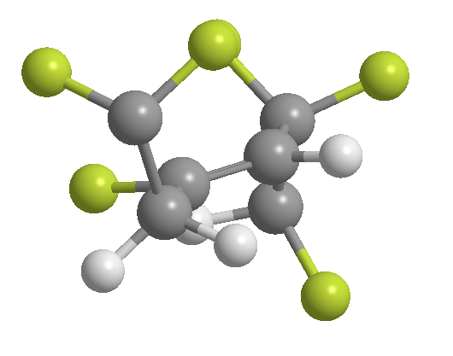
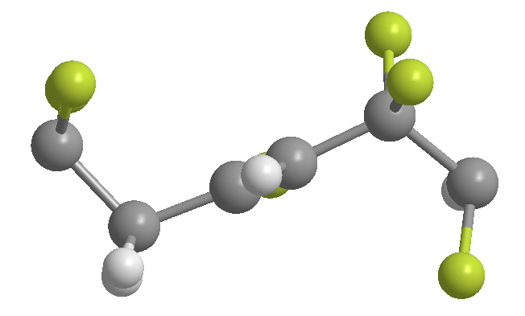
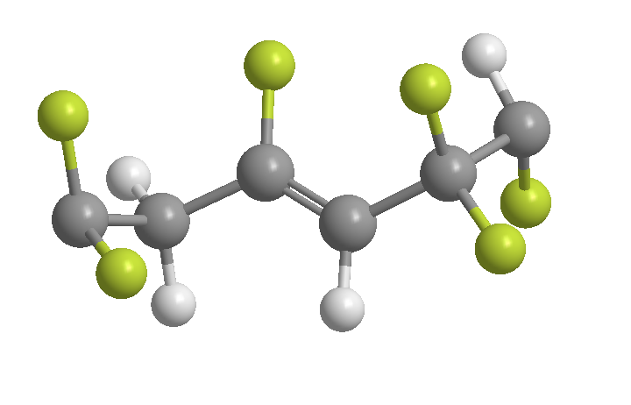
Splitting angle θ_{s}
θ_{s}
Typical PVDF
polymer chain
PVDF polymer chain pined by FA

Slide 2
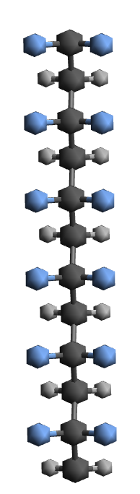
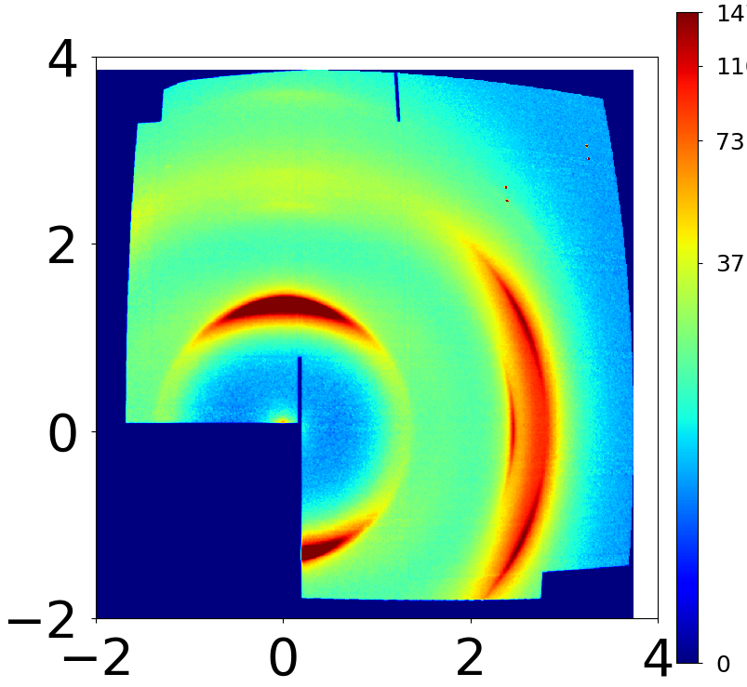
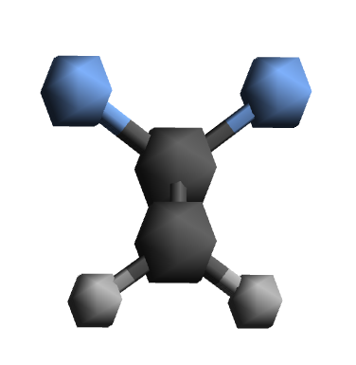
P(VDF-TrFE)
Classic all-trans chain conformation
tttt
(001)
view along chain

Slide 3
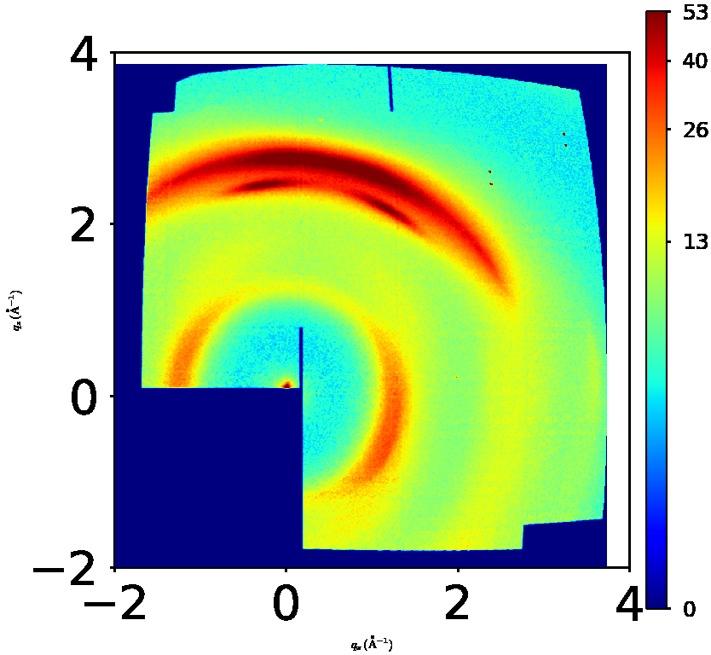
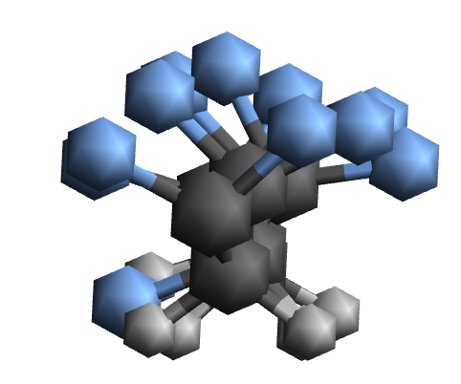
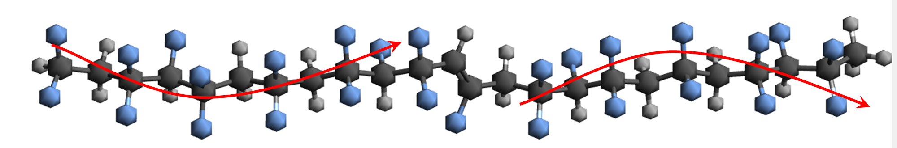
A new polymer conformation induced by double bond
P(VDF-TrFE-FA)
(001)
(001)_{T}
Electronic configuration
defect
θ
view along chain
θ

Slide 4
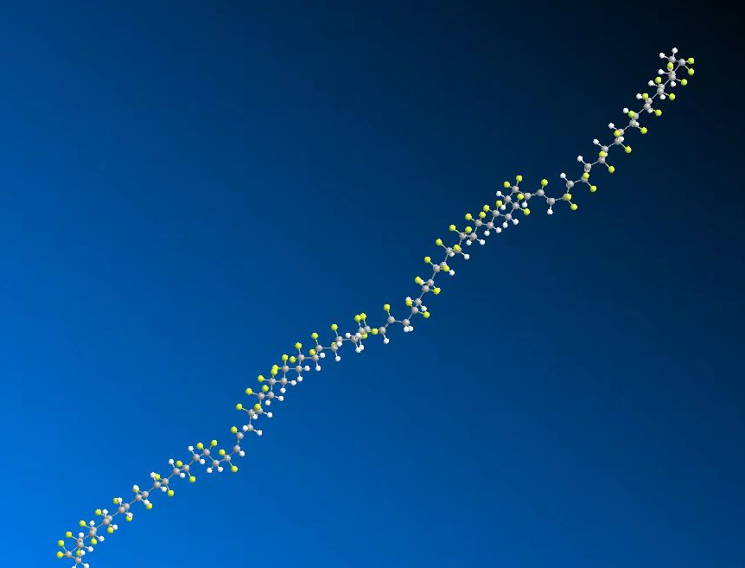
a relaxed example (force field MM2)

