Slide 1
Post-survey Data Preparation Using Jamovi
Wenchao Ma

Slide 2
Enter data
A codebook is a document describing each variable in your dataset.
A codebook includes the following:
Variable names and labels.
Values/codes assigned to the variables and their labels.
Missing data codes.
Special instructions on how to use data.
Other relevant information.
https://ies.ed.gov/ncee/rel/regions/central/pdf/CE5.3.2-Guidelines-for-a-Codebook.pdf

Slide 3
Enter data
Variable names must be unique and short. If you will analyze data with a statistical program, the variable names cannot contain spaces and special characters. Use underscores instead of spaces.
Variable labels describe the meaning of variables. A good label is concise but descriptive.
Values and labels represent the contents of a variable.
For example, 0=remote work and 1=onsite work.
As a general rule, give numeric codes to categorical variables, and assign a unique value to each category.

Slide 4
Enter data
Missing data usually have special codes and should be indicated in the codebook.
Missing data for continuous variables are represented with an impossible value such as −88, −99, or −999.
Different missing data may use different values.

Slide 5
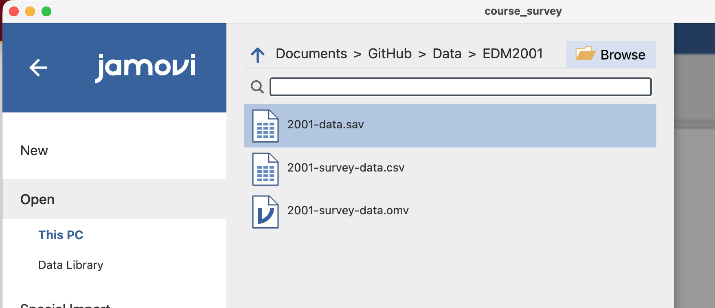
Open the data file
SPSS:
> Open > Browse > course_survey.xlsx

Slide 6
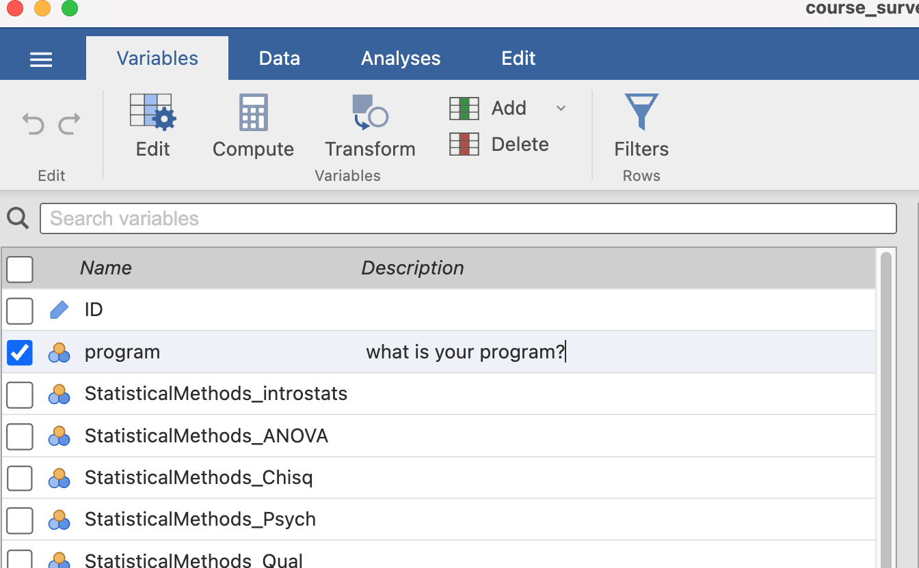
Variable Information: variable label
Variables -> Description

Slide 7
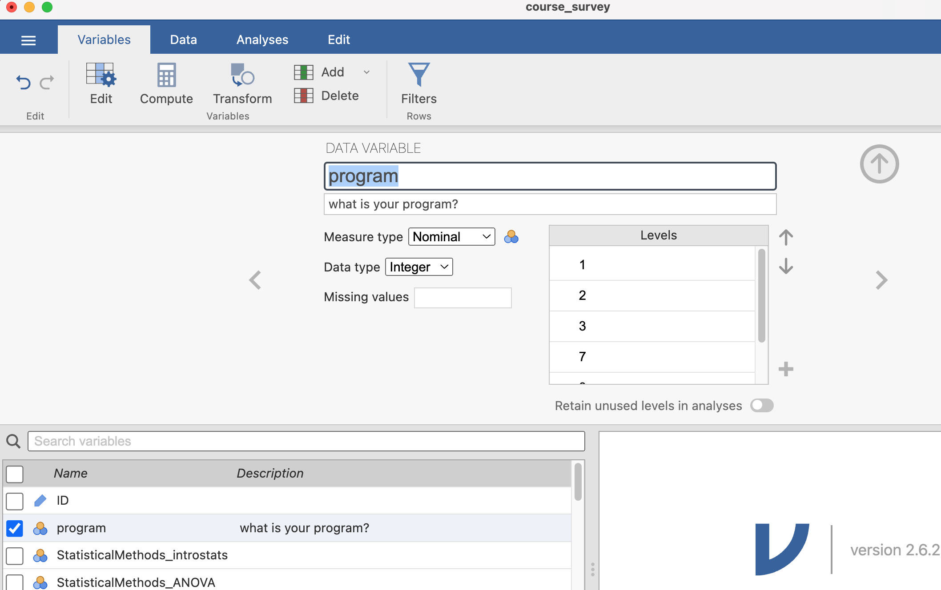
Variable Information
Variables -> Edit
Change variable name
Change scale of measurement
Add missing values

Slide 8
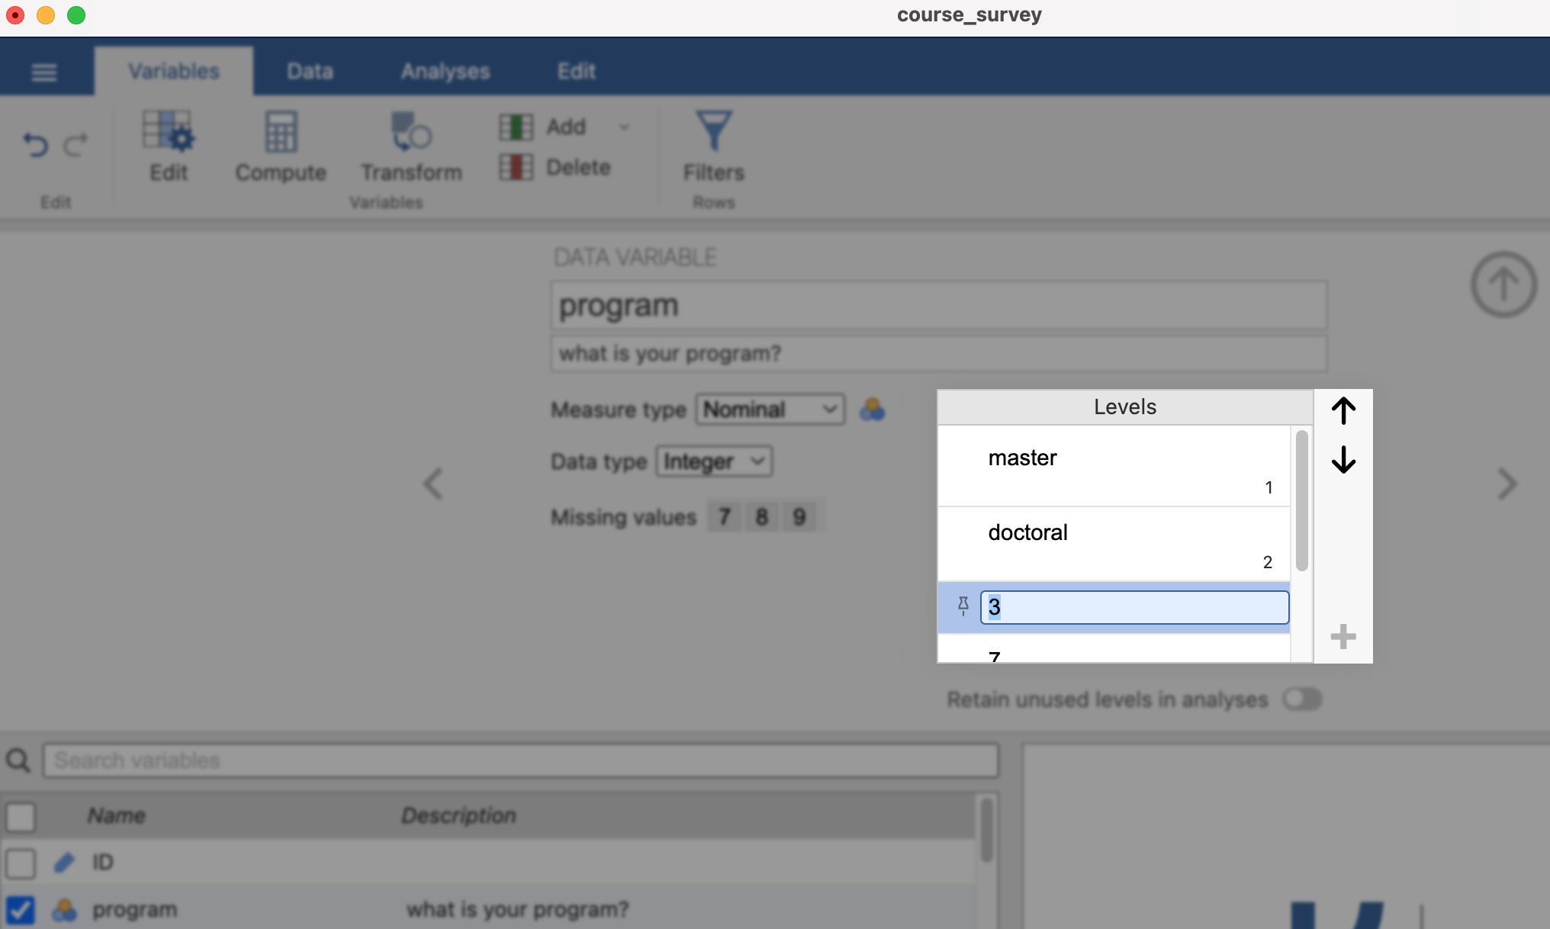
Variable Information
Add variable labels

Slide 9
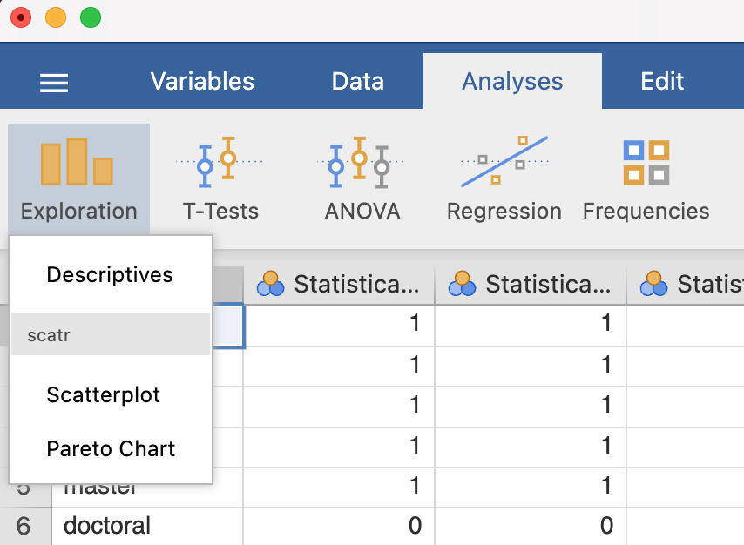
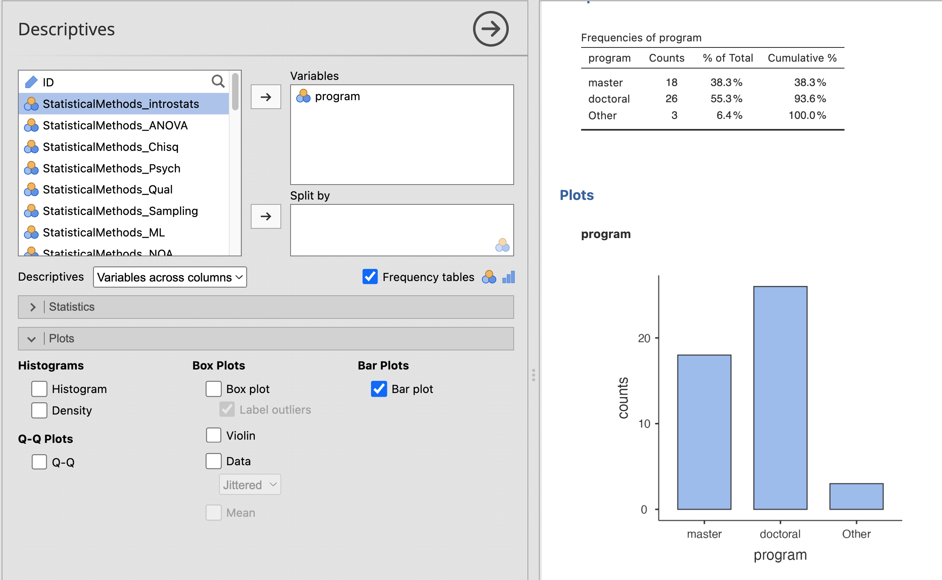
Frequency table and plots
Analyses -> Exploration -> Descriptives

Slide 10
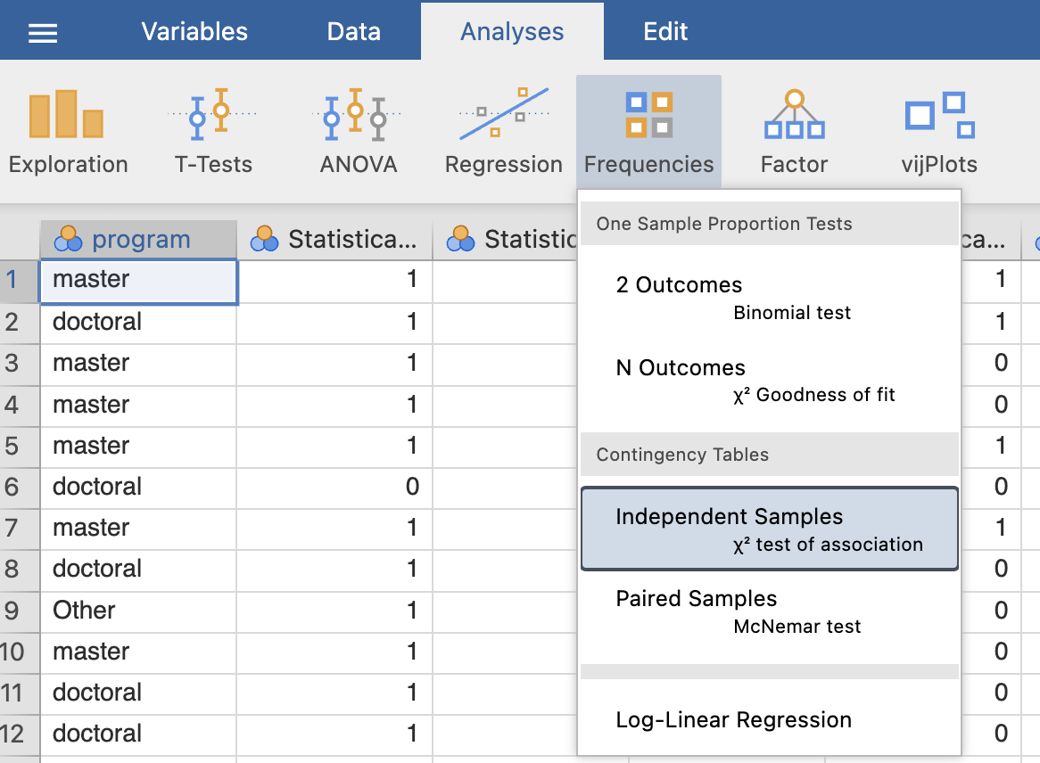
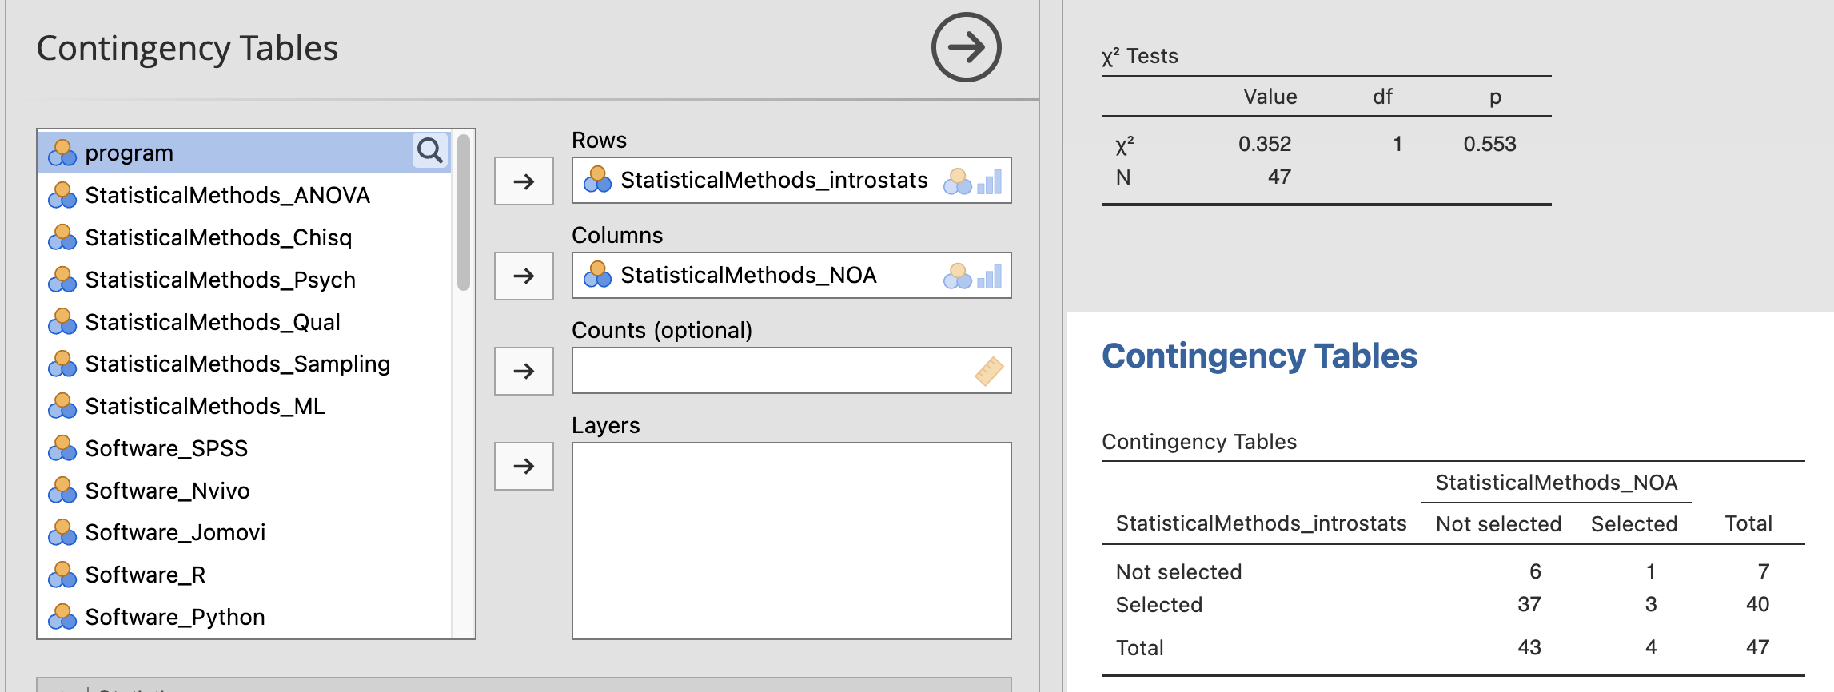
Bi-variable analysis
Frequencies ->
Contigency tables

