Slide 1
A Music Story: Want Your Music Sell Well?
A Guiding tool for composing popular music
Composer
Xiang Liu, Wenchen Li, and Kyungki Kim
Notes:
KK

Slide 2
What are we trying to do?
Predict the potential popularity of a piece of music during composition based on published music data.
Data prepossessing:
Reduce the data dimensionality.
Data analysis:
Predict the potential popularity.
Data visualization & user interface:
Demonstrate the popularity model based on features.
Notes:
KK

Slide 3
How is it done today?
Data prepossessing:
PCA:
Used polynomial function kernel-based PCA Convert data (10-D) to reduced (7-D) dimensions
Notes:
KK

Slide 4
How is it done today?
Data analysis:
SVM:
Classify/predict data using supportive vectors with low complexity.
Used as Genre prediction with Kernel SVM.
Ridge regression:
Reduce the over-fitting.
Used as Hotness prediction model.
Notes:
KK

Slide 5
How is it done today?
Data visualization
Visualization of music archives and genres
Visualization of music itself
Notes:
WL

Slide 6
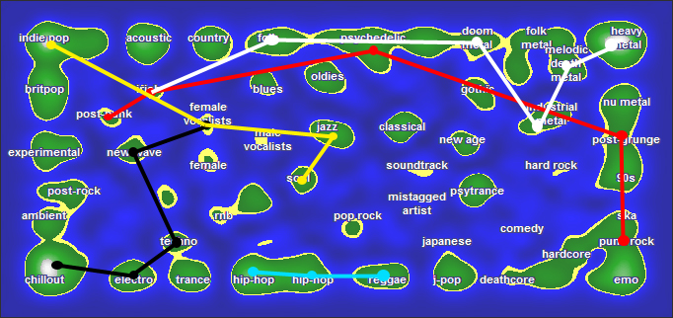
How is it done today?
Visualization of music archives and genres
Notes:
WL

Slide 7
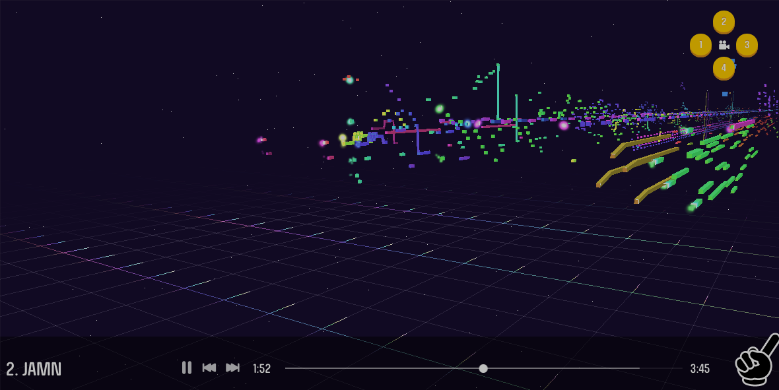
How is it done today?
Visualization of music itself
Notes:
WL

Slide 8
What is new in your approach?
An application from a new perspective:
Help the musicians know whether the music under composition is expected to be popular.
A new way of visualization:
Demonstrate the relationship between features and music hotness.
Notes:
KK

Slide 9
Who cares?
Musicians:
Assist them to compose music based on numerical analysis results.
Publishers:
Assist in decision making by predicting the music’s performance in the music market when it is published.
Notes:
KK

Slide 10
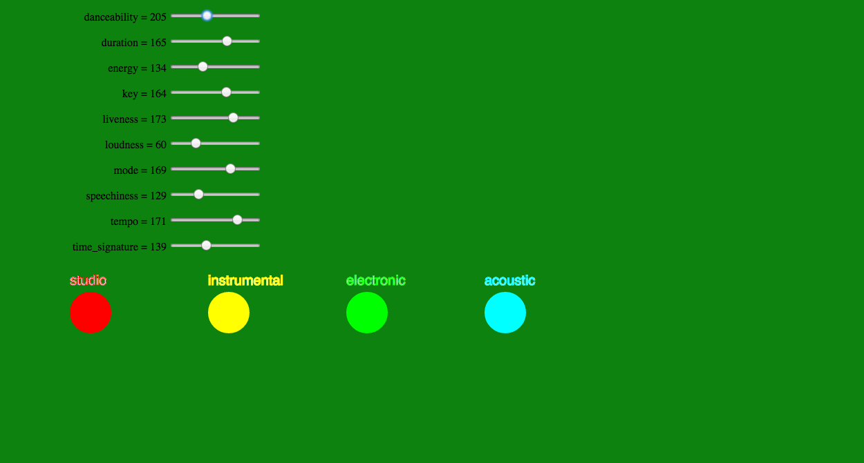
Visualize Music Popularity/Hotness
Choose genre corresponding to different background color.
Sliding the slides get a sense of music hotness.
Notes:
WL

Slide 11
What difference will it make?
The musicians will have a comprehensive sense of the trends in his/her genre of interest.
The publisher will make supported decision on market.
Notes:
KK

Slide 12
What are the risks?
Possibility of failure: preferences of individual persons not considered
The accuracy of numerical analysis could be bad with small training data.
A large amount of data is need to reduce the error rate
Notes:
KK

Slide 13
How much will it cost?
It costs nothing on money, but takes some time.
We plan to spend about six hours per week each on the project for about six weeks.
Notes:
KK

Slide 14
How long will it take?
Week 1:
Data extraction from a source.
Test methods for classification and prediction.
Finalize design for representation for features.
Week 2, 3:
Apply PCA to separate music’s genre.
Classify the pieces of music by using SVM.
Implement the visualization design.
Week 4, 5:
Apply Isomap for dimension reduction.
Predict the popularity by using kernel SVM.
Interact with real big data
Week 6:
Compare performance with other methods.
Write the final report, and prepare for the presentation.
Notes:
KK

Slide 15
What are the midterm/final exams?
Midterm exams:
Retrieve features from the music dataset.
Reduce the data dimensionality by using PCA.
Final exams:
Compare the performances between the data with/without being prepossessed.
Keep refining design and user interface
Notes:
KK

Slide 16
What are the effort distribution?
Xiang Liu:
Develop kernel SVM method for music classification/prediction.
Wenchen Li:
Design visualization strategy to represent the algorithm and result.
Kyungki Kim:
Develop the application of PCA method for dimension reduction.
Notes:
KK

Slide 17
Thank you. Q & A

