Slide 1
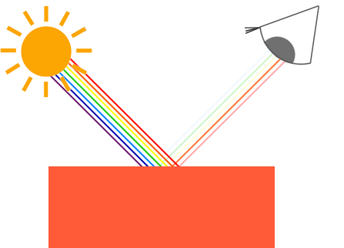
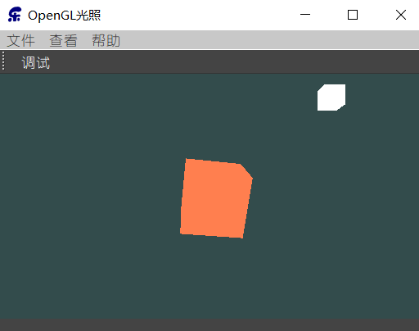
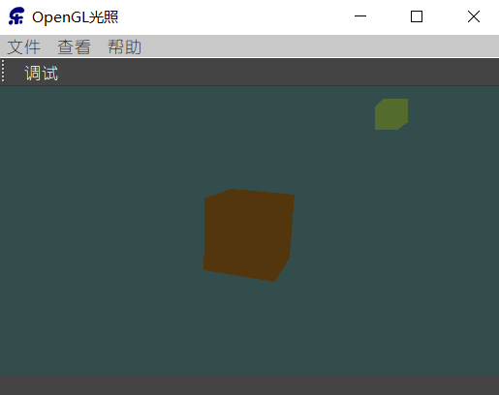
颜色
现实生活中看到物体的颜色并不是这个物体真正拥有的颜色，而是它所反射的颜色
太阳光能被看见的白光其实是由许多不同的颜色组合而成的
颜色可以数字化的由红色(Red)、绿色(Green)和蓝色(Blue)三个分量组成，它们通常被缩写为RGB珊瑚红(Coral)色：
QVector3D coral(1.0f, 0.5f, 0.31f)
分量相乘，不是点乘也不是叉乘
QVector3D lightColor(1.0f, 1.0f, 1.0f);
QVector3D toyColor(1.0f, 0.5f, 0.31f);
QVector3D result = lightColor * toyColor;//=(1.0f, 0.5f, 0.31f);
QVector3D lightColor(0.0f, 1.0f, 0.0f);
QVector3D toyColor(1.0f, 0.5f, 0.31f);
QVector3D result = lightColor * toyColor; //=(0.0f, 0.5f, 0.0f);
QVector3D lightColor(0.33f, 0.42f, 0.18f);
QVector3D toyColor(1.0f, 0.5f, 0.31f);
QVector3D result = lightColor * toyColor;//=(0.33f,0.21f,0.06f);

Slide 2
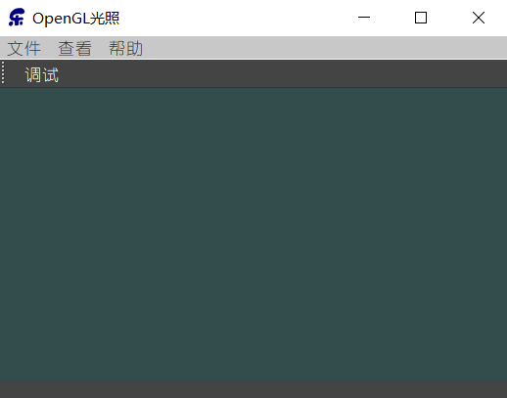
创建一个光照场景
#include <QOpenGLWidget>
#include <QOpenGLFunctions_3_3_Core> class AXBOpenGLWidget : public QOpenGLWidget,QOpenGLFunctions_3_3_Core
{
Q_OBJECT
public:
explicit AXBOpenGLWidget(QWidget *parent = nullptr);
protected:
virtual void initializeGL();
virtual void resizeGL(int w, int h);
virtual void paintGL();
};
#include "axbopenglwidget.h" AXBOpenGLWidget::AXBOpenGLWidget(QWidget *parent) : QOpenGLWidget(parent){
}
void AXBOpenGLWidget::initializeGL() {
initializeOpenGLFunctions();
} void AXBOpenGLWidget::resizeGL(int w, int h) { Q_UNUSED(w); Q_UNUSED(h); }
void AXBOpenGLWidget::paintGL() {
glClearColor(0.2f, 0.3f, 0.3f, 1.0f);
glEnable(GL_DEPTH_TEST);
glClear(GL_COLOR_BUFFER_BIT | GL_DEPTH_BUFFER_BIT);
}

Slide 3
#version 330 core
layout (location = 0) in vec3 aPos;
uniform mat4 model;
uniform mat4 view;
uniform mat4 projection;
void main() {
gl_Position = projection * view * model * vec4(aPos, 1.0);
}
顶点着色器
#version 330 core
out vec4 FragColor;
uniform vec3 objectColor;
uniform vec3 lightColor;
void main() {
FragColor = vec4(lightColor * objectColor, 1.0);
}
片段着色器
float vertices[] = {
-0.5f, -0.5f, -0.5f, 0.0f, 0.0f,
0.5f, -0.5f, -0.5f, 1.0f, 0.0f,
0.5f, 0.5f, -0.5f, 1.0f, 1.0f,
0.5f, 0.5f, -0.5f, 1.0f, 1.0f,
-0.5f, 0.5f, -0.5f, 0.0f, 1.0f,
-0.5f, -0.5f, -0.5f, 0.0f, 0.0f,
-0.5f, -0.5f, 0.5f, 0.0f, 0.0f,
0.5f, -0.5f, 0.5f, 1.0f, 0.0f,
0.5f, 0.5f, 0.5f, 1.0f, 1.0f,
0.5f, 0.5f, 0.5f, 1.0f, 1.0f,
-0.5f, 0.5f, 0.5f, 0.0f, 1.0f,
-0.5f, -0.5f, 0.5f, 0.0f, 0.0f,
-0.5f, 0.5f, 0.5f, 1.0f, 0.0f,
-0.5f, 0.5f, -0.5f, 1.0f, 1.0f,
-0.5f, -0.5f, -0.5f, 0.0f, 1.0f,
-0.5f, -0.5f, -0.5f, 0.0f, 1.0f,
-0.5f, -0.5f, 0.5f, 0.0f, 0.0f,
-0.5f, 0.5f, 0.5f, 1.0f, 0.0f,
0.5f, 0.5f, 0.5f, 1.0f, 0.0f,
0.5f, 0.5f, -0.5f, 1.0f, 1.0f,
0.5f, -0.5f, -0.5f, 0.0f, 1.0f,
0.5f, -0.5f, -0.5f, 0.0f, 1.0f,
0.5f, -0.5f, 0.5f, 0.0f, 0.0f,
0.5f, 0.5f, 0.5f, 1.0f, 0.0f,
-0.5f, -0.5f, -0.5f, 0.0f, 1.0f,
0.5f, -0.5f, -0.5f, 1.0f, 1.0f,
0.5f, -0.5f, 0.5f, 1.0f, 0.0f,
0.5f, -0.5f, 0.5f, 1.0f, 0.0f,
-0.5f, -0.5f, 0.5f, 0.0f, 0.0f,
-0.5f, -0.5f, -0.5f, 0.0f, 1.0f,
-0.5f, 0.5f, -0.5f, 0.0f, 1.0f,
0.5f, 0.5f, -0.5f, 1.0f, 1.0f,
0.5f, 0.5f, 0.5f, 1.0f, 0.0f,
0.5f, 0.5f, 0.5f, 1.0f, 0.0f,
-0.5f, 0.5f, 0.5f, 0.0f, 0.0f,
-0.5f, 0.5f, -0.5f, 0.0f, 1.0f
};
QWidget{
background-color:rgb(68, 68, 68);
color:rgb(255, 255, 255);
font: 10pt "幼圆";
}
QMenuBar{
background-color:rgb(200, 200, 200);
color:rgb(60, 60, 60);
}
QOpenGLWidget 提供了三个便捷的虚函数，可以重载，用来重新实现典型的OpenGL任务：
paintGL：渲染OpenGL场景。widget 需要更新时调用。
resizeGL：设置OpenGL视口、投影等。widget 调整大小（或首次显示）时调用。
initializeGL：设置OpenGL资源和状态。第一次调用 resizeGL() / paintGL() 之前调用一次。
QOpenGLFunctions_X_X_Core 提供OpenGL X.X版本核心模式的所有功能。是对OpenGL函数的封装：
initializeOpenGLFunctions：初始化OpenGL函数，将Qt里的函数指针指向显卡的函数。

Slide 4
initializeOpenGLFunctions(); //创建VBO和VAO对象，并赋予ID
glGenVertexArrays(1, &VAO);
glGenBuffers(1, &VBO); //绑定VBO和VAO对象
glBindVertexArray(VAO);
glBindBuffer(GL_ARRAY_BUFFER, VBO); //为当前绑定到target的缓冲区对象创建一个新的数据存储。
//如果data不是NULL，则使用来自此指针的数据初始化数据存储
glBufferData(GL_ARRAY_BUFFER, sizeof(vertices), vertices, GL_STATIC_DRAW); //告知显卡如何解析缓冲里的属性值
glVertexAttribPointer(0, 3, GL_FLOAT, GL_FALSE, 5 * sizeof(float), (void*)0);
//开启VAO管理的第一个属性值
glEnableVertexAttribArray(0);
bool success; shaderProgram.addShaderFromSourceFile(QOpenGLShader::Vertex,":/shaders/shapes.vert");
shaderProgram.addShaderFromSourceFile(QOpenGLShader::Fragment,":/shaders/shapes.frag");
success=shaderProgram.link();
if(!success) qDebug()<<"ERR:"<<shaderProgram.log();
shaderProgram.bind();
shaderProgram.setUniformValue("objectColor",lightColor);
shaderProgram.setUniformValue("lightColor",objectColor);
initializeGL()
makeCurrent();
glDeleteBuffers(1,&VBO);
glDeleteVertexArrays(1,&VAO);
doneCurrent();
析构函数
QMatrix4x4 model;
QMatrix4x4 view;
QMatrix4x4 projection; float time=m_time.elapsed()/50.0;
projection.perspective(m_camera.Zoom,(float)width()/height(),0.1,100); view=m_camera.GetViewMatrix(); glClearColor(0.2f, 0.3f, 0.3f, 1.0f);
glEnable(GL_DEPTH_TEST);
glClear(GL_COLOR_BUFFER_BIT | GL_DEPTH_BUFFER_BIT); shaderProgram.bind();
shaderProgram.setUniformValue("projection", projection);
shaderProgram.setUniformValue("view", view);
model.rotate(time, 1.0f, 5.0f, 0.5f);
shaderProgram.setUniformValue("model", model);
glDrawArrays(GL_TRIANGLES,0,36);
paintGL()

Slide 5
#version 330 core
out vec4 FragColor;
uniform vec3 lightColor;
void main() {
FragColor = vec4(lightColor,1.0);
}
unsigned int VAO,VBO,lightVAO;
QVector3D lightPos(1.2f, 1.0f, 2.0f);
QVector3D lightColor(1.0f, 1.0f, 1.0f);
QVector3D objectColor(1.0f, 0.5f, 0.31f);
对于新加入资源文件的shader文件，需要run qmake一下
lightShaderProgram.addShaderFromSourceFile(QOpenGLShader::Vertex,":/shaders/shaders/light.vert"); lightShaderProgram.addShaderFromSourceFile(QOpenGLShader::Fragment,":/shaders/shaders/light.frag"); success=lightShaderProgram.link(); if(!success) qDebug()<<"ERR:"<<lightShaderProgram.log();
model.setToIdentity();
model.translate(lightPos);
model.scale(0.2);
lightShaderProgram.bind();
lightShaderProgram.setUniformValue("projection", projection);
lightShaderProgram.setUniformValue("view", view);
lightShaderProgram.setUniformValue("model", model);
lightShaderProgram.setUniformValue("lightColor",lightColor);
glDrawArrays(GL_TRIANGLES,0,36);
glGenVertexArrays(1, &lightVAO);
glBindVertexArray(lightVAO);
// we only need to bind to the VBO, the container's VBO's data already contains the data.
glBindBuffer(GL_ARRAY_BUFFER, VBO);
// set the vertex attribute
glVertexAttribPointer(0, 3, GL_FLOAT, GL_FALSE, 5 * sizeof(float), (void*)0);
glEnableVertexAttribArray(0);
connect(&m_timer,SIGNAL(timeout()),this,SLOT(on_timeout()));
m_timer.start();

