Slide 1
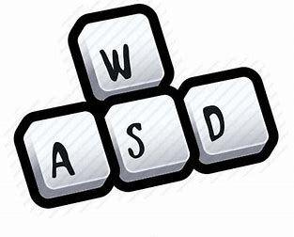
摄像机控制复习与完善
setFocusPolicy(Qt::StrongFocus);
//setMouseTracking(true);
…
float deltaTime=timeOutmSec/1000.0;
case Qt::Key_W: m_camera.ProcessKeyboard(FORWARD,deltaTime);break;
case Qt::Key_S: m_camera.ProcessKeyboard(BACKWARD,deltaTime);break;
case Qt::Key_D: m_camera.ProcessKeyboard(RIGHT,deltaTime);break;
case Qt::Key_A: m_camera.ProcessKeyboard(LEFT,deltaTime);break;
case Qt::Key_Q: m_camera.ProcessKeyboard(DOWN,deltaTime);break;
case Qt::Key_E: m_camera.ProcessKeyboard(UP,deltaTime);break;
case Qt::Key_Space: m_camera.Position=viewInitPos;break;
…
if(event->buttons() & Qt::RightButton){
static QPoint lastPos(width()/2,height()/2);
auto currentPos=event->pos();
QPoint deltaPos=currentPos-lastPos;
lastPos=currentPos;
m_camera.ProcessMouseMovement(deltaPos.x(),-deltaPos.y());
}
…
m_camera.ProcessMouseScroll(event->angleDelta().y()/120);
…

Slide 2
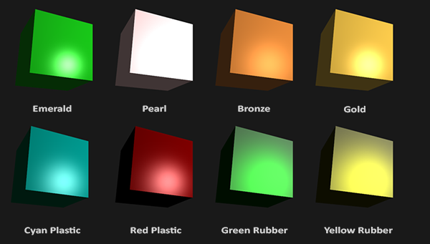
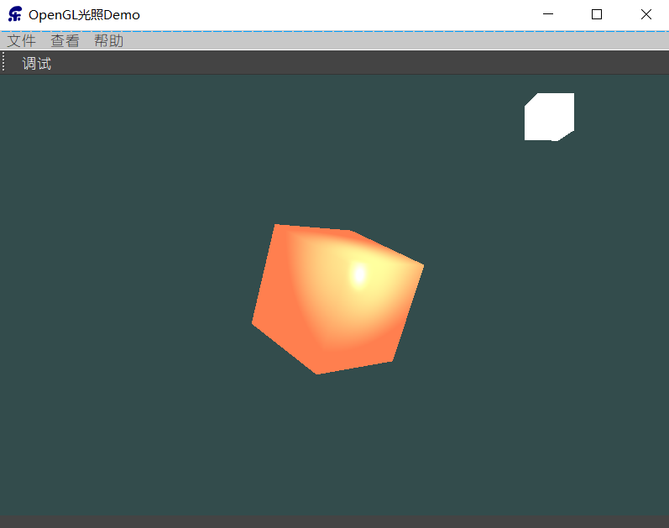
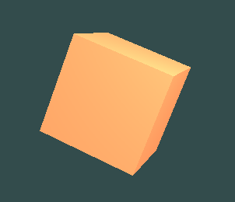
材质
在OpenGL中模拟多种类型的物体，必须为每种物体分别定义一个材质(Material)属性
#version 330 core
struct Material {
vec3 ambient;
vec3 diffuse;
vec3 specular;
float shininess;
};
uniform Material material;
主要用于替代前面的objectColor
在现实世界里，每个物体会对光产生不同的反应
void main() {
// ambient
vec3 ambient = lightColor * material.ambient;
// diffuse
vec3 norm = normalize(Normal);
vec3 lightDir = normalize(lightPos - FragPos);
float diff = max(dot(norm, lightDir), 0.0);
vec3 diffuse = lightColor * (diff * material.diffuse);
// specular
vec3 viewDir = normalize(viewPos - FragPos);
vec3 reflectDir = reflect(-lightDir, norm);
float spec = pow(max(dot(viewDir, reflectDir), 0.0), material.shininess);
vec3 specular = lightColor * (spec * material.specular);
vec3 result = ambient + diffuse + specular;
FragColor = vec4(result, 1.0);
}
m_ShaderProgram.setUniformValue("material.ambient", 1.0f, 0.5f, 0.31f);
m_ShaderProgram.setUniformValue("material.diffuse", 1.0f, 0.5f, 0.31f);
m_ShaderProgram.setUniformValue("material.specular", 0.5f, 0.5f, 0.5f);
m_ShaderProgram.setUniformValue("material.shininess", 32.0f);
这个物体太亮了。物体过亮的原因是环境光、漫反射和镜面光这三个颜色对任何一个光源都会去全力反射。

Slide 3
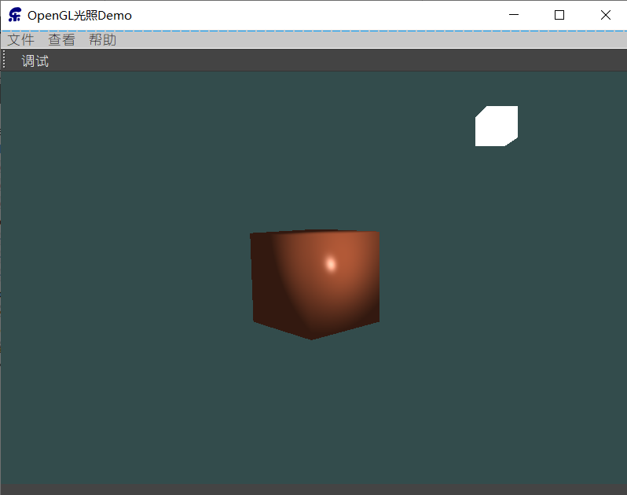
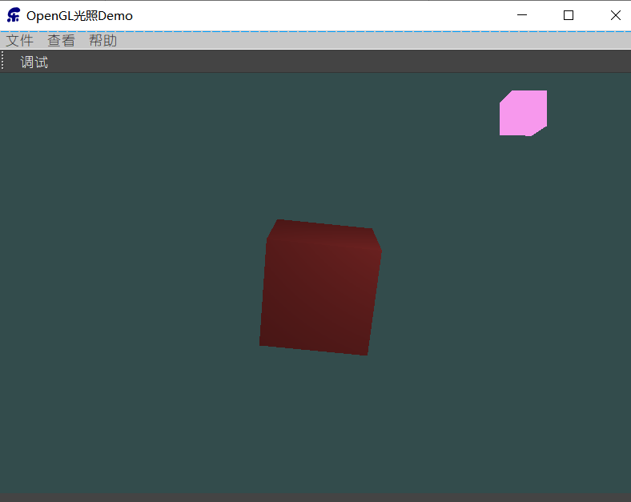
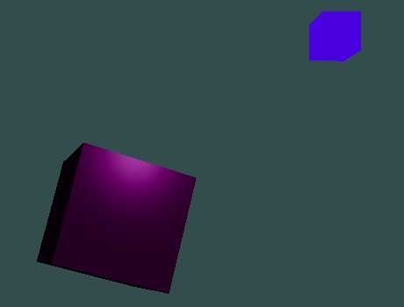
光的属性
如果我们假设lightColor是vec3(1.0)，代码会看起来像这样：
vec3 ambient = vec3(1.0) * material.ambient;
vec3 diffuse = vec3(1.0) * (diff * material.diffuse);
vec3 specular = vec3(1.0) * (spec * material.specular);
可是环境光分量实际上不应该对最终的颜色有这么大的影响（将光源的环境光强度设置为一个小一点的值），用同样的方式修改光源的漫反射和镜面光强度
struct Light {
vec3 position;
vec3 ambient;
vec3 diffuse;
vec3 specular;
};
uniform Light light;
vec3 ambient = light.ambient * material.ambient;
vec3 diffuse = light.diffuse * (diff * material.diffuse);
vec3 specular = light.specular * (spec * material.specular);
m_ShaderProgram.setUniformValue("light.ambient", 0.2f, 0.2f, 0.2f);
// darken diffuse light a bit
m_ShaderProgram.setUniformValue("light.diffuse", 0.5f, 0.5f, 0.5f);
m_ShaderProgram.setUniformValue("light.specular", 1.0f, 1.0f, 1.0f);
根据时间改变颜色：
lightColor.setX(sin(time/100 * 2.0f));
lightColor.setY(sin(time/100 * 0.7f));
lightColor.setZ(sin(time/100 * 1.3f));
QVector3D diffuseColor = lightColor *QVector3D(0.5,0.5,0.5);
QVector3D ambientColor = diffuseColor *QVector3D(0.2,0.2,0.2);
m_ShaderProgram.setUniformValue("light.ambient", ambientColor);
m_ShaderProgram.setUniformValue("light.diffuse", diffuseColor);
m_ShaderProgram.setUniformValue("light.specular", lightColor);

Slide 4
练习
你能像教程一开始那样，定义相应的材质来模拟现实世界的物体吗？参考解答，我做的是青色塑料(Cyan Plastic)的箱子。
// light properties, note that all light colors are set at full intensity
m_ShaderProgram.setUniformValue("light.ambient", 1.0f, 1.0f, 1.0f);
m_ShaderProgram.setUniformValue("light.diffuse", 1.0f, 1.0f, 1.0f);
m_ShaderProgram.setUniformValue("light.specular", 1.0f, 1.0f, 1.0f);
// material properties
m_ShaderProgram.setUniformValue("material.ambient", 0.0f, 0.1f, 0.06f);
m_ShaderProgram.setUniformValue("material.diffuse", 0.0f, 0.50980392f, 0.50980392f);
m_ShaderProgram.setUniformValue("material.specular", 0.50196078f, 0.50196078f, 0.50196078f);
m_ShaderProgram.setUniformValue("material.shininess", 32.0f);

