Slide 1
多光源
创建一个包含六个光源的场景。我们将模拟一个类似太阳的定向光(Directional Light)光源，四个分散在场景中的点光源(Point Light)，以及一个手电筒(Flashlight)。
out vec4 FragColor;
void main() {
// define an output color value
vec3 output = vec3(0.0);
// add the directional light's contribution to the output
output += someFunctionToCalculateDirectionalLight();
// do the same for all point lights
for(int i = 0; i < nr_of_point_lights; i++)
output += someFunctionToCalculatePointLight();
// and add others lights as well (like spotlights)
output += someFunctionToCalculateSpotLight();
FragColor = vec4(output, 1.0);
}
定向光
struct DirLight {
vec3 direction;
vec3 ambient;
vec3 diffuse;
vec3 specular;
};
uniform DirLight dirLight;
// directional light
m_ShaderProgram.setUniformValue("dirLight.direction", -0.2f, -1.0f, -0.3f);
m_ShaderProgram.setUniformValue("dirLight.ambient", 0.05f, 0.05f, 0.05f);
m_ShaderProgram.setUniformValue("dirLight.diffuse", 0.4f, 0.4f, 0.4f);
m_ShaderProgram.setUniformValue("dirLight.specular", 0.5f, 0.5f, 0.5f);
vec3 CalcDirLight(DirLight light, vec3 normal, vec3 viewDir) {
vec3 lightDir = normalize(-light.direction);
// diffuse shading
float diff = max(dot(normal, lightDir), 0.0);
// specular shading
vec3 reflectDir = reflect(-lightDir, normal);
float spec = pow(max(dot(viewDir, reflectDir), 0.0), material.shininess);
// combine results
vec3 ambient = light.ambient * vec3(texture(material.diffuse, TexCoords));
vec3 diffuse = light.diffuse * diff * vec3(texture(material.diffuse, TexCoords));
vec3 specular = light.specular * spec * vec3(texture(material.specular, TexCoords));
return (ambient + diffuse + specular);
}

Slide 2
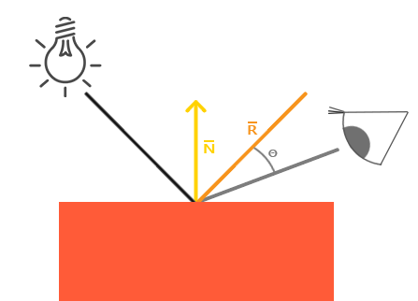
点光源
struct PointLight {
vec3 position;
float constant;
float linear;
float quadratic;
vec3 ambient;
vec3 diffuse;
vec3 specular;
};
#define NR_POINT_LIGHTS 4
uniform PointLight pointLights[NR_POINT_LIGHTS];
vec3 CalcPointLight(PointLight light, vec3 normal, vec3 fragPos, vec3 viewDir) {
vec3 lightDir = normalize(light.position - fragPos);
// diffuse shading
float diff = max(dot(normal, lightDir), 0.0);
// specular shading
vec3 reflectDir = reflect(-lightDir, normal);
float spec = pow(max(dot(viewDir, reflectDir), 0.0), material.shininess);
// attenuation
float distance = length(light.position - fragPos);
float attenuation = 1.0/(light.constant+light.linear*distance+light.quadratic*(distance*distance));
// combine results
vec3 ambient = light.ambient * vec3(texture(material.diffuse, TexCoords));
vec3 diffuse = light.diffuse * diff * vec3(texture(material.diffuse, TexCoords));
vec3 specular = light.specular * spec * vec3(texture(material.specular, TexCoords));
ambient *= attenuation;
diffuse *= attenuation;
specular *= attenuation;
return (ambient + diffuse + specular);
}

Slide 3
合并结果
void main() {
// properties
vec3 norm = normalize(Normal);
vec3 viewDir = normalize(viewPos - FragPos);
// phase 1: Directional lighting
vec3 result = CalcDirLight(dirLight, norm, viewDir);
// phase 2: Point lights
for(int i = 0; i < NR_POINT_LIGHTS; i++)
result += CalcPointLight(pointLights[i], norm, FragPos, viewDir);
// phase 3: Spot light
//result += CalcSpotLight(spotLight, norm, FragPos, viewDir);
FragColor = vec4(result, 1.0);
}
QVector3D pointLightPositions[] = {
QVector3D( 0.7f, 0.2f, 2.0f),
QVector3D( 2.3f, -3.3f, -4.0f),
QVector3D(-4.0f, 2.0f, -12.0f),
QVector3D( 0.0f, 0.0f, -3.0f)
};
QVector3D pointLightColors[] = {
QVector3D(1.0f, 1.0f, 0.0f),
QVector3D(0.3f, 0.3f, 0.7f),
QVector3D(0.0f, 0.0f, 0.3f),
QVector3D(0.4f, 0.4f, 0.4f)
};
// point lights
for(int i=0;i<4;i++){
QString iStr="pointLights["+QString::number(i)+"].position";
m_ShaderProgram.setUniformValue(iStr.toStdString().c_str(), pointLightPositions[i].x(), pointLightPositions[i].y(), pointLightPositions[i].z());
iStr="pointLights["+QString::number(i)+"].ambient";
m_ShaderProgram.setUniformValue(iStr.toStdString().c_str(), pointLightColors[i].x() * 0.1, pointLightColors[i].y() * 0.1, pointLightColors[i].z() * 0.1);
iStr="pointLights["+QString::number(i)+"].diffuse";
m_ShaderProgram.setUniformValue(iStr.toStdString().c_str(), pointLightColors[i].x(), pointLightColors[i].y(), pointLightColors[i].z());
iStr="pointLights["+QString::number(i)+"].specular";
m_ShaderProgram.setUniformValue(iStr.toStdString().c_str(), pointLightColors[i].x(), pointLightColors[i].y(), pointLightColors[i].z());
iStr="pointLights["+QString::number(i)+"].constant"; m_ShaderProgram.setUniformValue(iStr.toStdString().c_str(), 1.0f);
iStr="pointLights["+QString::number(i)+"].linear";
m_ShaderProgram.setUniformValue(iStr.toStdString().c_str(), 0.09f);
iStr="pointLights["+QString::number(i)+"].quadratic";
m_ShaderProgram.setUniformValue(iStr.toStdString().c_str(), 0.032f);
}

Slide 4
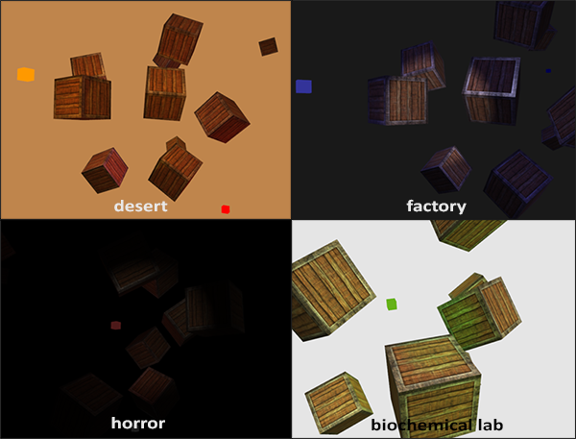
练习
你能通过调节光照属性变量，（大概地）重现最后一张图片上不同的氛围吗？参考解答
// desert
glClearColor(0.75f, 0.52f, 0.3f, 1.0f);
QVector3D pointLightColors[] = {
QVector3D(1.0f, 0.6f, 0.0f),
QVector3D(1.0f, 0.0f, 0.0f),
QVector3D(1.0f, 1.0, 0.0),
QVector3D(0.2f, 0.2f, 1.0f)
};
m_ShaderProgram.setUniformValue("dirLight.direction", -0.2f, -1.0f, -0.3f);
m_ShaderProgram.setUniformValue("dirLight.ambient", 0.3f, 0.24f, 0.14f);
m_ShaderProgram.setUniformValue("dirLight.diffuse", 0.7f, 0.42f, 0.26f);
m_ShaderProgram.setUniformValue("dirLight.specular", 0.5f, 0.5f, 0.5f);
// factory
glClearColor(0.0f, 0.0f, 0.0f, 1.0f);
QVector3D pointLightColors[] = {
QVector3D(0.2f, 0.2f, 0.6f),
QVector3D(0.3f, 0.3f, 0.7f),
QVector3D(0.0f, 0.0f, 0.3f),
QVector3D(0.4f, 0.4f, 0.4f)
};
m_ShaderProgram.setUniformValue("dirLight.direction", -0.2f, -1.0f, -0.3f);
m_ShaderProgram.setUniformValue("dirLight.ambient", 0.05f, 0.05f, 0.1f);
m_ShaderProgram.setUniformValue("dirLight.diffuse", 0.2f, 0.2f, 0.7);
m_ShaderProgram.setUniformValue("dirLight.specular", 0.7f, 0.7f, 0.7f);

Slide 5
// horror
glClearColor(0.0f, 0.0f, 0.0f, 1.0f);
QVector3D pointLightColors[] = {
QVector3D(0.1f, 0.1f, 0.1f),
QVector3D(0.1f, 0.1f, 0.1f),
QVector3D(0.1f, 0.1f, 0.1f),
QVector3D(0.3f, 0.1f, 0.1f)
};
m_ShaderProgram.setUniformValue("dirLight.direction", -0.2f, -1.0f, -0.3f);
m_ShaderProgram.setUniformValue("dirLight.ambient", 0.0f, 0.0f, 0.0f);
m_ShaderProgram.setUniformValue("dirLight.diffuse", 0.05f, 0.05f, 0.05);
m_ShaderProgram.setUniformValue("dirLight.specular", 0.2f, 0.2f, 0.2f);
// BIOCHEMICALLAB
glClearColor(0.9f, 0.9f, 0.9f, 1.0f);
QVector3D pointLightColors[] = {
QVector3D(0.4f, 0.7f, 0.1f),
QVector3D(0.4f, 0.7f, 0.1f),
QVector3D(0.4f, 0.7f, 0.1f),
QVector3D(0.4f, 0.7f, 0.1f)
};
m_ShaderProgram.setUniformValue("dirLight.direction", -0.2f, -1.0f, -0.3f);
m_ShaderProgram.setUniformValue("dirLight.ambient", 0.5f, 0.5f, 0.5f);
m_ShaderProgram.setUniformValue("dirLight.diffuse", 1.0f, 1.0f, 1.0f);
m_ShaderProgram.setUniformValue("dirLight.specular", 1.0f, 1.0f, 1.0f);

Slide 6
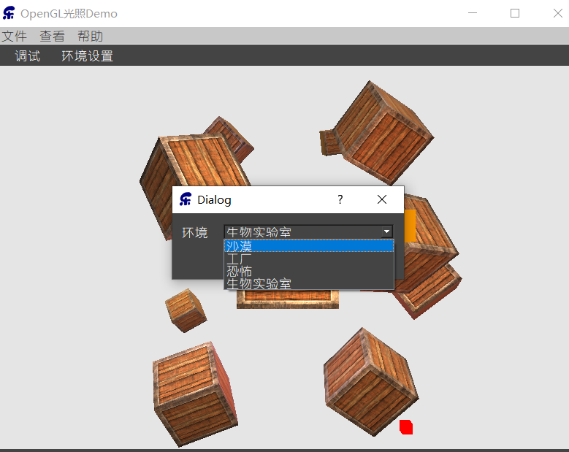
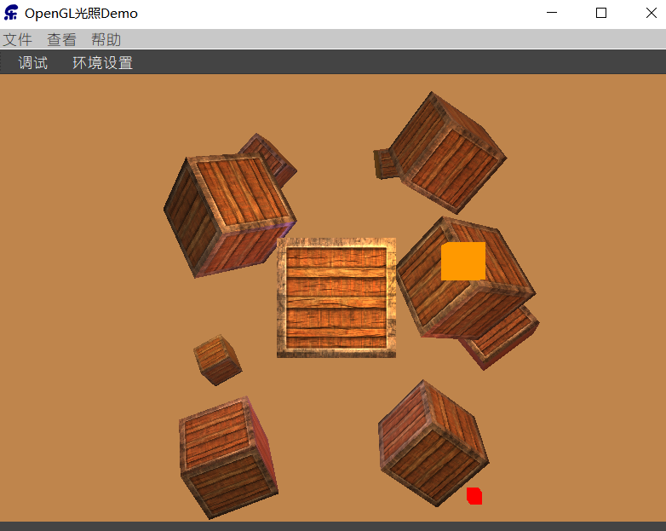
QT Action切换场景
QVector3D pointLightColors[4];
QVector3D pointLightColorsDesert[] = {
QVector3D(1.0f, 0.6f, 0.0f),
QVector3D(1.0f, 0.0f, 0.0f),
QVector3D(1.0f, 1.0, 0.0),
QVector3D(0.2f, 0.2f, 1.0f)
};
QVector3D pointLightColorsFactory[] = {
QVector3D(0.2f, 0.2f, 0.6f),
QVector3D(0.3f, 0.3f, 0.7f),
QVector3D(0.0f, 0.0f, 0.3f),
QVector3D(0.4f, 0.4f, 0.4f)
};
QVector3D pointLightColorsHorror[] = {
QVector3D(0.1f, 0.1f, 0.1f),
QVector3D(0.1f, 0.1f, 0.1f),
QVector3D(0.1f, 0.1f, 0.1f),
QVector3D(0.3f, 0.1f, 0.1f)
};
QVector3D pointLightColorsBiochemicalLab[] = {
QVector3D(1.0f, 0.6f, 0.0f),
QVector3D(1.0f, 0.0f, 0.0f),
QVector3D(1.0f, 1.0, 0.0),
QVector3D(0.2f, 0.2f, 1.0f) }
;
QVector3D m_clearColor;
QVector3D m_dirlight_ambient;
QVector3D m_dirlight_diffuse;
QVector3D m_dirlight_specular;

