Slide 1
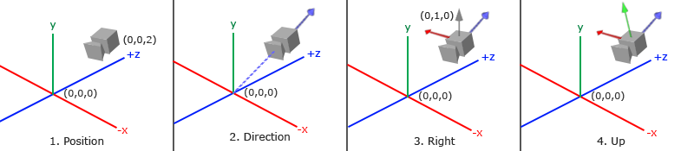
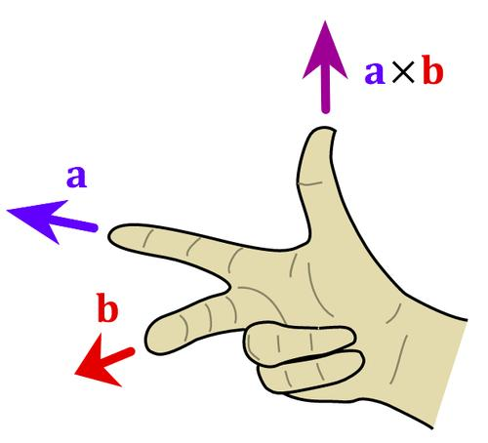
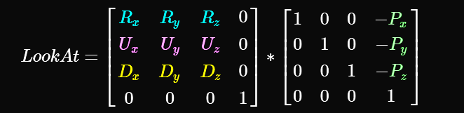

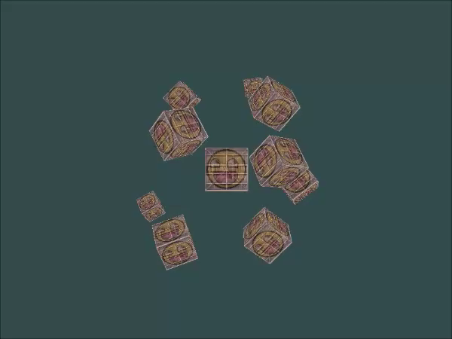
摄像机(Camera)
OpenGL本身没有摄像机(Camera)的定义，但我们可以通过把场景中的所有物体往相反方向移动的方式来模拟出摄像机，产生一种我们在移动的感觉。
方向向量并不是最好的名字，因为它实际上指向相反的方向
//Camera position
QVector3D cameraPos = QVector3D(0.0f, 0.0f, 2.0f);
//Camera direction
QVector3D cameraTarget = QVector3D(0.0f, 0.0f, 0.0f);
QVector3D cameraDirection = QVector3D(cameraPos - cameraTarget);
cameraDirection.normalize();
//Right axis
QVector3D up = QVector3D(0.0f, 1.0f, 0.0f);
QVector3D cameraRight = QVector3D::crossProduct(up, cameraDirection);
cameraRight.normalize();
//Up axis
QVector3D cameraUp = QVector3D::crossProduct(cameraDirection, cameraRight);
QMatrix4x4 view;
view.lookAt(cameraPos，cameraTarget, QVector3D(0.0f, 1.0f, 0.0f) );
const float radius = 10.0f;
float time=m_time.elapsed()/1000.0;
float camX = sin(time) * radius;
float camZ = cos(time) * radius;
view.lookAt(QVector3D(camX, 0.0, camZ),
QVector3D(0.0, 0.0, 0.0), QVector3D(0.0, 1.0, 0.0));

Slide 2

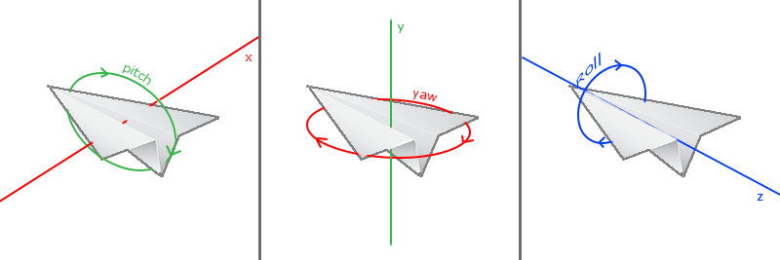
摄像机(Camera)自由移动
总盯着原点看视乎不太礼貌，也很枯燥。改为向前看。
cameraFront=QVector3D(0.0, 0.0, -1.0),
view.lookAt(cameraPos, cameraPos+cameraFront,QVector3D(0.0, 1.0, 0.0));
float cameraSpeed=2.5*deltaTime; case Qt::Key_W: cameraPos += cameraSpeed * cameraFront;break;
case Qt::Key_S: cameraPos -= cameraSpeed * cameraFront;break;
case Qt::Key_D: cameraPos += cameraSpeed * cameraRight;break;
case Qt::Key_A: cameraPos -= cameraSpeed * cameraRight;break;
void AXBOpenGLWidget::on_timeout() {
//因为我们timeout的时间是确定的，所以下面的代码可以不用
float currentFrame = m_time.elapsed()/1000.0;
deltaTime = currentFrame - lastFrame;
lastFrame = currentFrame; update();
}
为了能够改变视角，我们需要根据鼠标的输入改变cameraFront向量
欧拉角(Euler Angle)：俯仰角(Pitch)、偏航角(Yaw)和滚转角(Roll)：
void AXBOpenGLWidget::mouseMoveEvent(QMouseEvent *event) {
static float yaw=-90;
static float pitch=0;
static QPoint lastPos(width()/2,height()/2); auto currentPos=event->pos(); deltaPos=currentPos-lastPos;
lastPos=currentPos; float sensitivity = 0.1f; // change this value to your liking
deltaPos *= sensitivity;
yaw += deltaPos.x();
pitch -= deltaPos.y();// reversed since y-coordinates go from bottom to top
//qDebug()<<deltaPos.x()<<","<<deltaPos.y(); if(pitch > 89.0f) pitch = 89.0f;
if(pitch < -89.0f) pitch = -89.0f; cameraFront.setX(cos(yaw*PI/180) * cos(pitch*PI/180));
cameraFront.setY(sin(pitch*PI/180));
cameraFront.setZ(sin(yaw*PI/180) * cos(pitch*PI/180)); cameraFront.normalize(); update();
}

Slide 3
缩放
视野(Field of View)或fov定义了可以看到场景中多大的范围。当视野变小时，场景投影出来的空间就会减小，产生放大(Zoom In)了的感觉。我们会使用鼠标的滚轮来放大。
void AXBOpenGLWidget::wheelEvent(QWheelEvent *event) {
if(fov >= 1.0f && fov <= 75.0f)
fov -= event->angleDelta().y()/120;//一步是120
if(fov <= 1.0f) fov = 1.0f;
if(fov >= 75.0f) fov = 75.0f;
}
//要确保projection矩阵的值重新计算，也就是让fov生效

Slide 4
Camera封装
#include "camera.h"
class AXBOpenGLWidget : public QOpenGLWidget,QOpenGLFunctions_3_3_Core {
…
private: Camera m_Camera; };
projection.perspective(m_Camera.Zoom,(float)width()/height(),0.1,100);
view=m_Camera.GetViewMatrix();
…
case Qt::Key_W: m_Camera.ProcessKeyboard(FORWARD,deltaTime);break;
case Qt::Key_S: m_Camera.ProcessKeyboard(BACKWARD,deltaTime);break;
case Qt::Key_D: m_Camera.ProcessKeyboard(RIGHT,deltaTime);break;
case Qt::Key_A: m_Camera.ProcessKeyboard(LEFT,deltaTime);break;
…
m_Camera.ProcessMouseMovement(deltaPos.x(),-deltaPos.y());
…
m_Camera.ProcessMouseScroll(event->angleDelta().y()/120);
…

Slide 5
练习
看看你是否能够修改摄像机类，使得其能够变成一个真正的FPS摄像机（也就是说不能够随意飞行）；你只能够呆在xz平面上：参考解答
试着创建你自己的LookAt函数，其中你需要手动创建一个我们在一开始讨论的观察矩阵。用你的函数实现来替换LookAt函数，看看它是否还能一样地工作：参考解答
// Custom implementation of the LookAt function
QMatrix4x4 calculate_lookAt_matrix(QVector3D position, QVector3D target, QVector3D worldUp)
{
// 1. Position = known
// 2. Calculate cameraDirection
QVector3D zaxis = QVector3D(position - target);
zaxis.normalize();
// 3. Get positive right axis vector
worldUp.normalize();
QVector3D xaxis = QVector3D::crossProduct(worldUp, zaxis);
xaxis.normalize();
// 4. Calculate camera up vector
QVector3D yaxis = QVector3D::crossProduct(zaxis, xaxis); // Create translation and rotation matrix
QMatrix4x4 translation; // Identity matrix by default
QVector4D theVector4D;
theVector4D.setX(-position.x()); // Third column, first row
theVector4D.setY(-position.y());
theVector4D.setZ(-position.z());
theVector4D.setW(1.0);
translation.setColumn(3,theVector4D);
QMatrix4x4 rotation ;
theVector4D.setX(xaxis.x()); // First column, first row
theVector4D.setY(xaxis.y());
theVector4D.setZ(xaxis.z());
theVector4D.setW(0.0);
rotation.setColumn(0,theVector4D);
theVector4D.setX(yaxis.x()); // Secon column, second row
theVector4D.setY(yaxis.y());
theVector4D.setZ(yaxis.z());
theVector4D.setW(0.0);
rotation.setColumn(1,theVector4D);
theVector4D.setX(zaxis.x()); // First column, third row
theVector4D.setY(zaxis.y());
theVector4D.setZ(zaxis.z());
theVector4D.setW(0.0);
rotation.setColumn(2,theVector4D); // Return lookAt matrix as combination of translation and rotation matrix
return rotation * translation;
}

