Slide 1

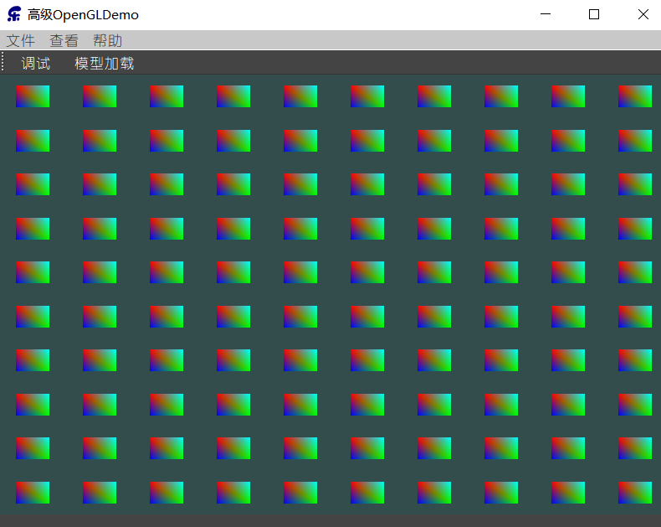
实例化(Instancing)
如果我们需要渲染大量物体时，代码看起来会像这样：
for(unsigned int i = 0; i < amount_of_models_to_draw; i++) {
DoSomePreparations(); // bind VAO, bind textures, set uniforms etc.
glDrawArrays(GL_TRIANGLES, 0, amount_of_vertices);
}
OpenGL在绘制顶点数据之前需要告诉GPU该从哪个缓冲读取数据，从哪寻找顶点属性。
这些都是在相对缓慢的CPU to GPU总线上进行的。
所以，渲染非常快，命令GPU去渲染却未必。
如果将数据一次性发送给GPU，然后使用一个绘制函数让OpenGL利用这些数据绘制多个物体，就会更方便了。这就是实例化(Instancing)。
float quadVertices[] = {
// positions // colors
-0.05f, 0.05f, 1.0f, 0.0f, 0.0f,
0.05f, -0.05f, 0.0f, 1.0f, 0.0f,
-0.05f, -0.05f, 0.0f, 0.0f, 1.0f,
-0.05f, 0.05f, 1.0f, 0.0f, 0.0f,
0.05f, -0.05f, 0.0f, 1.0f, 0.0f,
0.05f, 0.05f, 0.0f, 1.0f, 1.0f
};
gl_InstanceID会从0开始，在每个实例被渲染时递增1
#version 330 core
layout (location = 0) in vec3 aPos;
layout (location = 1) in vec3 aColor;
out vec3 fColor;
uniform vec2 offsets[100];
void main() {
vec2 offset = offsets[gl_InstanceID];
gl_Position = vec4(aPos , 1.0)
+vec4(offset,0.0,0.0);
fColor = aColor;
}
#version 330 core
out vec4 FragColor;
in vec3 fColor;
void main() {
FragColor = vec4(fColor, 1.0);
}
设置这些偏移位置：
QVector2D translations[100];
int index = 0;
float offset = 0.1f;
for(int y = -10; y < 10; y += 2) {
for(int x = -10; x < 10; x += 2) {
QVector2D translation;
translation.setX((float)x / 10.0f + offset);
translation.setY((float)y / 10.0f + offset);
translations[index++] = translation;
}
}
将数据转移到顶点着色器的uniform数组中
for(unsigned int i = 0; i < 100; i++) {
std::string str="offsets[" + std::to_string(i) + "]";
m_ShaderProgram.setUniformValue(str.c_str(), translations[i]);
}

Slide 2
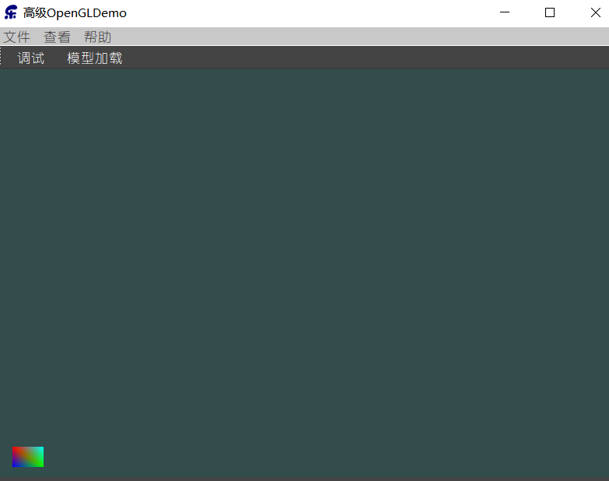
现在所有的准备工作都做完了，我们可以开始渲染四边形了。对于实例化渲染，我们使用glDrawArraysInstanced或glDrawElementsInstanced
glBindVertexArray(quadVAO);
glDrawArraysInstanced(GL_TRIANGLES, 0, 6, 100);
需要绘制的实例数量

Slide 3
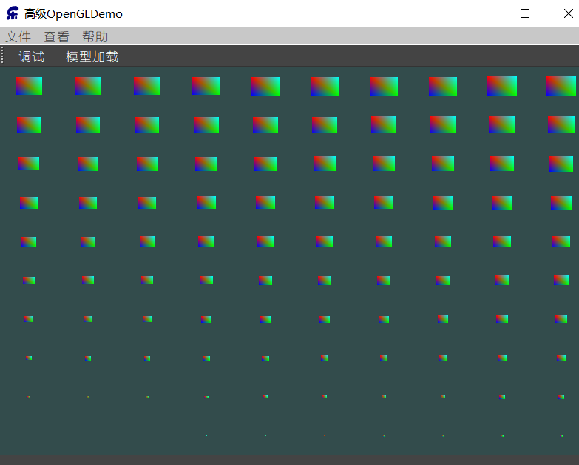
实例化数组
上面的方法， 受到uniform数量上限的限制。
它的一个代替方案:实例化数组(Instanced Array)
#version 330 core
layout (location = 0) in vec3 aPos;
layout (location = 1) in vec3 aColor;
layout (location = 2) in vec2 aOffset;
out vec3 fColor;
void main() {
gl_Position = vec4(aPos, 1.0)+vec4(aOffset,0.0,0.0);
fColor = aColor;
}
unsigned int instanceVBO;
glGenBuffers(1, &instanceVBO);
glBindBuffer(GL_ARRAY_BUFFER, instanceVBO);
glBufferData(GL_ARRAY_BUFFER, sizeof(QVector2D) * 100, &translations[0], GL_STATIC_DRAW);
glBindBuffer(GL_ARRAY_BUFFER, 0);
将偏移量数据存到一个新的缓冲对象中
置顶点属性指针，并启用顶点属性
glEnableVertexAttribArray(2);
glBindBuffer(GL_ARRAY_BUFFER, instanceVBO);
glVertexAttribPointer(2, 2, GL_FLOAT, GL_FALSE, 2 * sizeof(float), (void*)0);
glBindBuffer(GL_ARRAY_BUFFER, 0);
glVertexAttribDivisor(2, 1);
glVertexAttribDivisor函数告诉了OpenGL该什么时候更新顶点属性的内容至新一组数据：
它的第一个参数是需要的顶点属性
第二个参数是属性除数(Attribute Divisor)。
0：默认值，告诉OpenGL在顶点着色器的每次迭代时更新一次属性
1：告诉OpenGL在渲染一个新实例的时候更新一次属性
2：告诉OpenGL在渲染每2个实例的时候更新一次属性
以此类推。
void main() {
vec3 pos = aPos * (gl_InstanceID / 100.0);
gl_Position = vec4(pos, 1.0)+vec4(aOffset,0.0,0.0);
fColor = aColor;
}

Slide 4
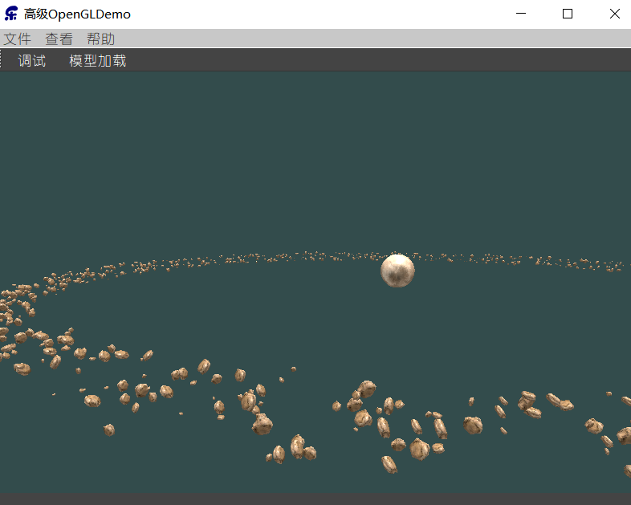
小行星带
为所有的小行星创建model矩阵：
unsigned int amount = 1000;
QMatrix4x4 *modelMatrices;
modelMatrices = new QMatrix4x4[amount];
QVector4D * qvector4d=new QVector4D[4*amount];
qsrand(QTime(0,0,0).secsTo(QTime::currentTime()));
float radius = 50.0;
float offset = 2.5f;
for(unsigned int i = 0; i < amount; i++) {
QMatrix4x4 model;
// 1. translation: displace along circle with 'radius' in range [-offset, offset]
float angle = (float)i / (float)amount * 360.0f;
float displacement = (qrand() % (int)(2 * offset * 100)) / 100.0f - offset;
float x = sin(angle) * radius + displacement;
displacement = (qrand() % (int)(2 * offset * 100)) / 100.0f - offset;
float y = displacement * 0.4f; // keep height of field smaller compared to width of x and z
displacement = (qrand() % (int)(2 * offset * 100)) / 100.0f - offset;
float z = cos(angle) * radius + displacement;
model .translate(QVector3D(x, y, z));
// 2. scale: scale between 0.05 and 0.25f
float scale = (qrand() % 20) / 100.0f + 0.05;
model.scale(scale);
// 3. rotation: add random rotation around a (semi)randomly picked rotation axis vector
float rotAngle = (qrand() % 360);
model.rotate(rotAngle, QVector3D(0.4f, 0.6f, 0.8f));
// 4. now add to list of matrices
modelMatrices[i] = model;
qvector4d[i*4+0]=model.column(0); qvector4d[i*4+1]=model.column(1); qvector4d[i*4+2]=model.column(2); qvector4d[i*4+3]=model.column(3);
}
m_planet=new
Model(QOpenGLContext::currentContext()->versionFunctions<QOpenGLFunctions_3_3_Core>() ,
"D:/Qt/4AdvanceOpenGL/Sampl_12_3/planet/planet.obj");
m_rock=new
Model(QOpenGLContext::currentContext()->versionFunctions<QOpenGLFunctions_3_3_Core>() ,
"D:/Qt/4AdvanceOpenGL/Sampl_12_3/rock/rock.obj");
m_planet->Draw(m_ShaderProgram);
for(unsigned int i = 0; i < amount; i++) {
m_ShaderProgram.setUniformValue("model", modelMatrices[i]);
m_rock->Draw(m_ShaderProgram);
}
当我们开始增加这个数字的时候，你很快就会发现场景不再能够流畅运行了，帧数也下降很厉害

Slide 5
#version 330 core
layout (location = 0) in vec3 aPos;
layout (location = 2) in vec2 aTexCoords;
layout (location = 3) in mat4 instanceMatrix;
out vec2 TexCoords;
uniform mat4 projection;
uniform mat4 view;
void main() {
gl_Position = projection * view * instanceMatrix * vec4(aPos, 1.0);
TexCoords = aTexCoords;
}
// vertex buffer object
unsigned int buffer;
glGenBuffers(1, &buffer);
glBindBuffer(GL_ARRAY_BUFFER, buffer);
glBufferData(GL_ARRAY_BUFFER, amount * 64, &qvector4d[0], GL_STATIC_DRAW);
for(unsigned int i = 0; i < m_rock->meshes.size(); i++) {
unsigned int VAO = m_rock->meshes[i].VAO;
glBindVertexArray(VAO); // vertex attributes
std::size_t vec4Size = sizeof(QVector4D);
glEnableVertexAttribArray(3);
glVertexAttribPointer(3, 4, GL_FLOAT, GL_FALSE, 4 * vec4Size, (void*)0); glEnableVertexAttribArray(4);
glVertexAttribPointer(4, 4, GL_FLOAT, GL_FALSE, 4 * vec4Size, (void*)(1 * vec4Size));
glEnableVertexAttribArray(5);
glVertexAttribPointer(5, 4, GL_FLOAT, GL_FALSE, 4 * vec4Size, (void*)(2 * vec4Size));
glEnableVertexAttribArray(6);
glVertexAttribPointer(6, 4, GL_FLOAT, GL_FALSE, 4 * vec4Size, (void*)(3 * vec4Size));
glVertexAttribDivisor(3, 1);
glVertexAttribDivisor(4, 1);
glVertexAttribDivisor(5, 1);
glVertexAttribDivisor(6, 1);
glBindVertexArray(0);
}
顶点属性最大允许的数据大小等于一个vec4。一个mat4本质上是4个vec4，需要为矩阵预留4个顶点属性
m_RockShaderProgram.bind();
m_RockShaderProgram.setUniformValue("projection", projection);
m_RockShaderProgram.setUniformValue("view", view);
for (unsigned int i = 0; i < m_rock->meshes.size(); i++) {
m_RockShaderProgram.setUniformValue("material.texture_diffuse1",0);
glBindTexture(GL_TEXTURE_2D, m_rock->meshes[i].textures[0].id);
glBindVertexArray(m_rock->meshes[i].VAO);
glDrawArraysInstanced(GL_TRIANGLES, 0,m_rock->meshes[i].vertices.size(),amount );
glBindVertexArray(0);
}
m_RockShaderProgram.release();

