Slide 1
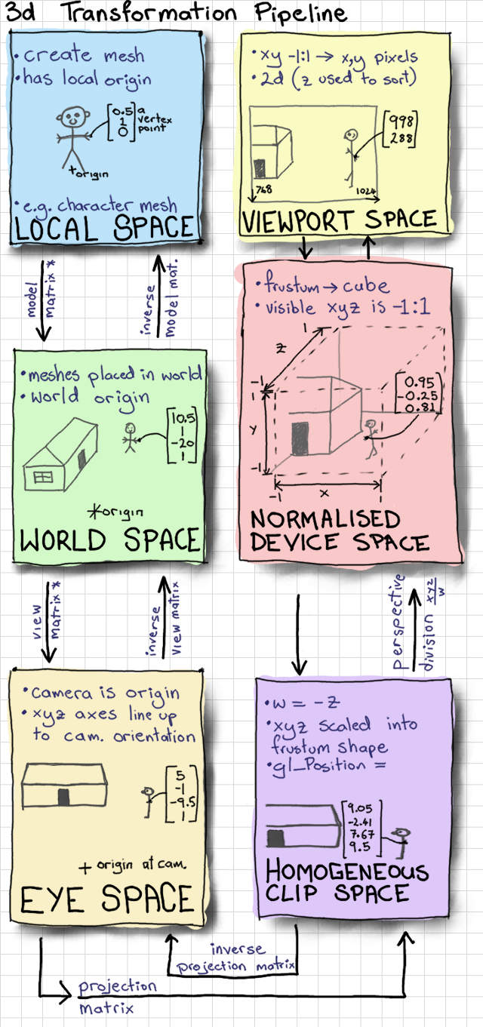
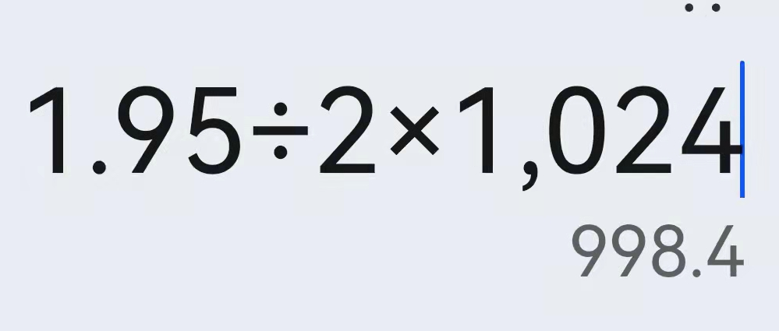
通过鼠标选择模型（理论基础）
网站地址：Mouse Picking with Ray Casting - Anton's OpenGL 4 Tutorials (antongerdelan.net)
float x = (2.0f * mouse_x) / width - 1.0f;
float y = 1.0f - (2.0f * mouse_y) / height;
glReadPixels - OpenGL 4 Reference Pages (khronos.org)
void glReadPixels( | GLint x,
 | GLint y,
 | GLsizei width,
 | GLsizei height,
 | GLenum format,
 | GLenum type,
 | void * data);
GL_DEPTH_COMPONENT
Specify the dimensions of the pixel rectangle. width and height of one correspond to a single pixel.
glReadPixels(
(int)mouse_x,
600-(int)mouse_y,
1,
1,
GL_DEPTH_COMPONENT,
GL_FLOAT,
&mouse_z
);
float z=2.0*mouse_z-1.0f;
//float w = (2.0 * near * far) / (far + near - z * (far - near));
float w=near*far/(near*winZ-far*mouse_z+far);

Slide 2
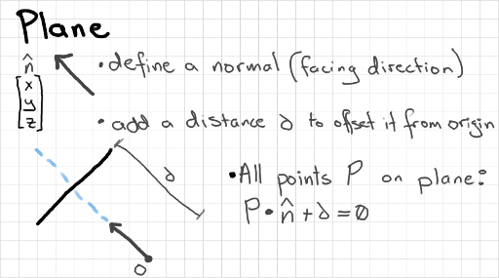
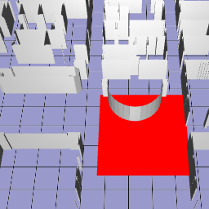
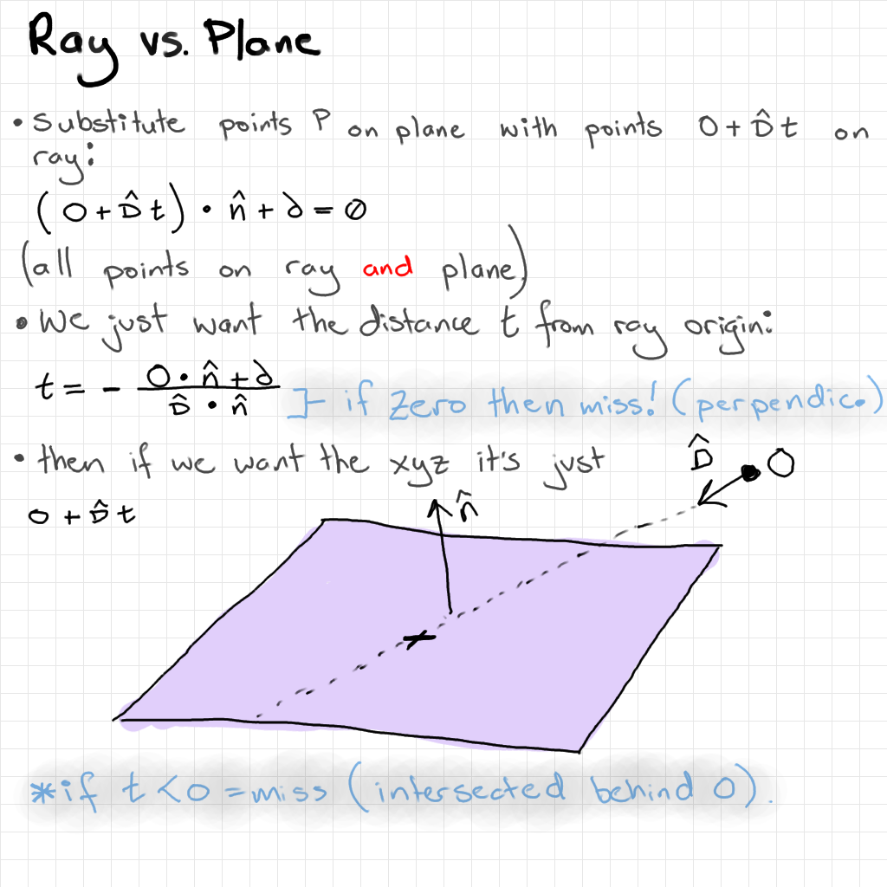
I do 2 ray-plane intersections to get the top-left and bottom-right corners of the box in xyz world coordinates.

Slide 3
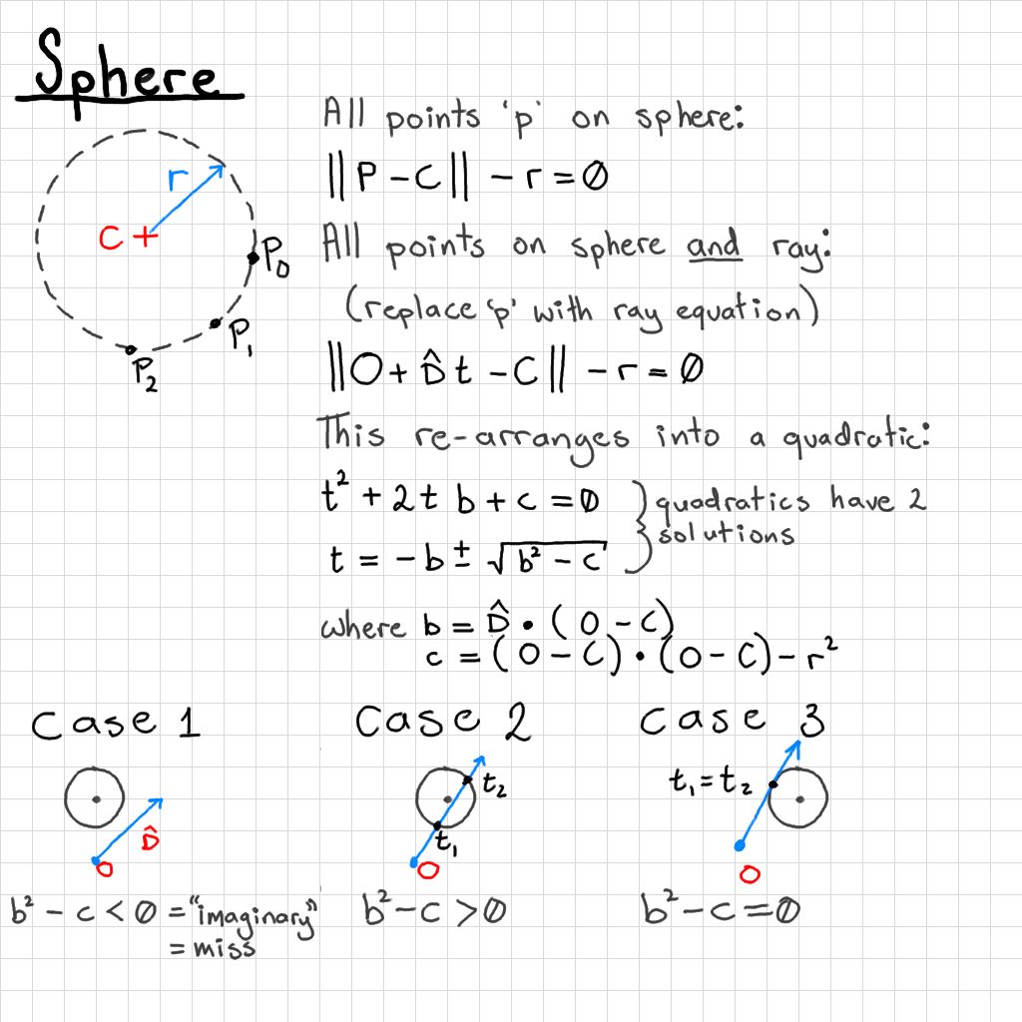

Slide 4
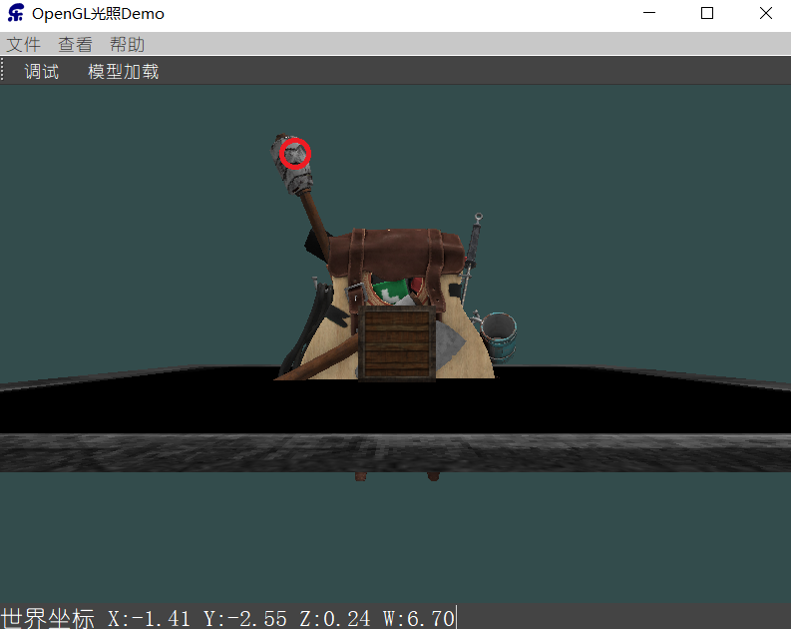
鼠标拾取
void AXBOpemglWidget::mousePressEvent(QMouseEvent *event) {
makeCurrent();
if(event->button()&Qt::LeftButton){
float winZ;
glReadPixels(
(int)event->pos().x(),
this->height()-(int)event->pos().y()
,1,1
,GL_DEPTH_COMPONENT,GL_FLOAT
,&winZ);
float x=(2.0f*event->pos().x())/this->width()-1.0f;
float y=1.0f-(2.0f*event->pos().y())/this->height();
float z=winZ*2.0-1.0f;
//有像素被点中
if(winZ<1.0f) {
float w = (2.0 * _near * _far) / (_far + _near - z * (_far - _near));
//float w= _near*_far/(_near*winZ-_far*winZ+_far);
QVector4D wolrdPostion(x,y,z,1);
wolrdPostion*=w;
wolrdPostion=view.inverted()*projection.inverted()*wolrdPostion;
qDebug()<<" x:"<<wolrdPostion.x()
<<" y:"<<wolrdPostion.y()
<<" z:"<<wolrdPostion.z()
<<" w:"<<w;
}else {
qDebug()<<"没有像素被选中";
}
}
doneCurrent();
}

Slide 5
代码整理、状态栏显示
代码整理：
QVector3D AXBOpemglWidget::worldPostionFromViewPort(int posX, int posY) {
makeCurrent();
float winZ;
glReadPixels(posX,this->height()-posY,1,1,GL_DEPTH_COMPONENT,GL_FLOAT,&winZ);
float x=(2.0f*posX)/this->width()-1.0f;
float y=1.0f-(2.0f*posY)/this->height();
float z=winZ*2.0-1.0f; float w = (2.0 * _near * _far) / (_far + _near - z * (_far - _near));
//float w= _near*_far/(_near*winZ-_far*winZ+_far);
QVector4D wolrdPostion(x,y,z,1);
wolrdPostion*=w;
wolrdPostion=view.inverted()*projection.inverted()*wolrdPostion;
return (QVector3D)wolrdPostion; doneCurrent();
}
点击鼠标后发出信号：
if(event->button()&Qt::LeftButton){
QVector3D wolrdPostion=worldPostionFromViewPort(event->pos().x(),event->pos().y());
mousePickingPos(wolrdPostion.x(),wolrdPostion.y(),wolrdPostion.z());
}
Qt状态栏显示世界坐标：
void MainWindow::getMousePickingPos(float x, float y, float z) {
ui->statusBar->setStyleSheet("font: 14pt ");
ui->statusBar->showMessage(" 世界坐标 X:"+QString::number(x,'f', 2)
+" Y:"+QString::number(y,'f', 2)
+" Z:"+QString::number(z,'f', 2)
);
}

