Slide 1
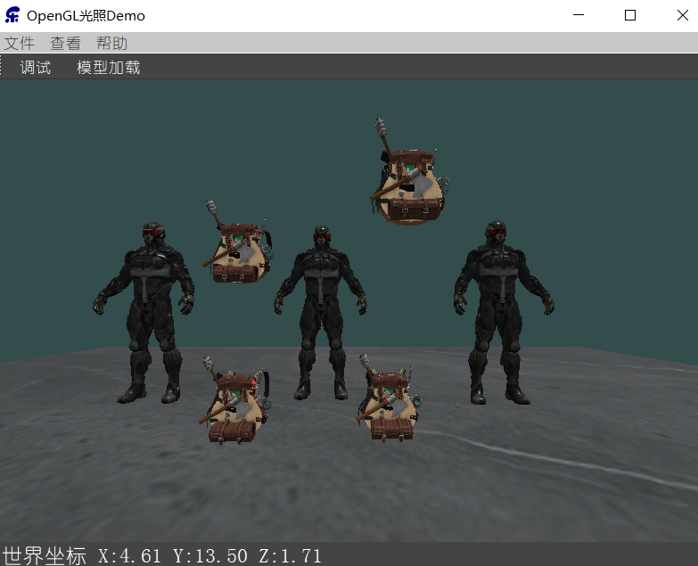
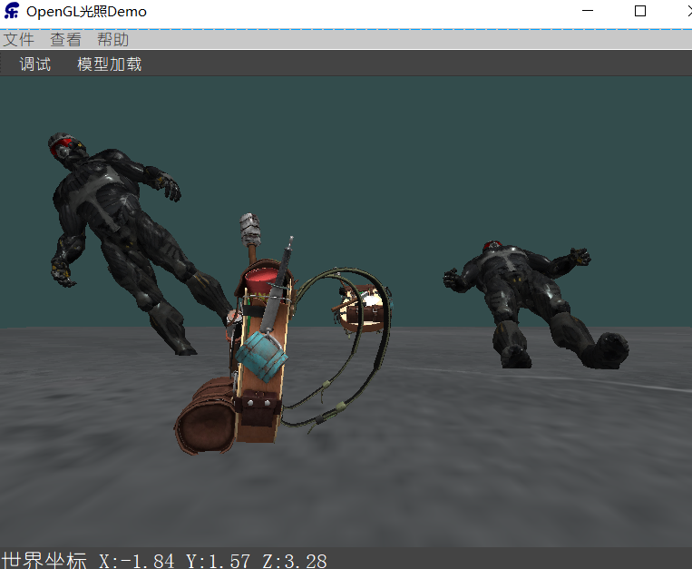
多模型加载
struct ModelInfo{
Model *model;
QVector3D worldPos;
float pitch;
float yaw;
float roll;
bool isSelected;
QString name;
};
QMap<QString, ModelInfo> m_Models;
多模型加载：
void AXBOpemglWidget::loadModel(string path) {
static int i=0;
makeCurrent();
Model * _model=new Model(
QOpenGLContext::currentContext()->versionFunctions<QOpenGLFunctions_3_3_Core>()
,path.c_str()); m_camera.Position.setY((_model->m_maxY-_model->m_minY)/2.0);
m_Models["张三"+QString::number(i++)]=
ModelInfo{_model,QVector3D(0,0,0),0.0,0.0,0.0,false,"张三"};
doneCurrent();
}
绘制模型：
….
foreach(auto modelInfo,m_Models){
model.setToIdentity();
model.translate(modelInfo.worldPos);
model.rotate(modelInfo.pitch,QVector3D(1.0,0.0,0.0));
model.rotate(modelInfo.yaw,QVector3D(0.0,1.0,0.0));
model.rotate(modelInfo.roll,QVector3D(0.0,0.0,1.0));
m_ShaderProgram.setUniformValue("model", model);
modelInfo.model->Draw(m_ShaderProgram);
}
回收内存：
AXBOpemglWidget::~AXBOpemglWidget() {
for(auto iter=m_Models.begin();iter!=m_Models.end();iter++){
ModelInfo *modelInfo=&iter.value();
delete modelInfo->model;
}
}

Slide 2
点击选择模型
for(QMap<QString, ModelInfo>::iterator iter=m_Models.begin();iter!=m_Models.end();iter++){
ModelInfo *modelInfo=&iter.value();
float r=(modelInfo->model->m_maxY-modelInfo->model->m_minY)/2;
if(modelInfo->worldPos.distanceToPoint(QVector3D(wolrdPostion))<r)
modelInfo->isSelected=true;
else
modelInfo->isSelected=false;
// qDebug()<<modelInfo->worldPos.distanceToPoint(QVector3D(wolrdPostion))
// <<"<"<<r<<"="<<modelInfo->isSelected;
}
选择模型
void AXBOpemglWidget::mouseDoubleClickEvent(QMouseEvent *event) {
Q_UNUSED(event);
if(m_modelMoving){
//再次双击取消移动
m_modelMoving=false;
return;
}
foreach(auto modelInfo,m_Models){
//双击启动移动
if(modelInfo.isSelected==true)
m_modelMoving=true;
//qDebug()<<modelInfo.name<<modelInfo.isSelected;
}
}
移动状态

Slide 3
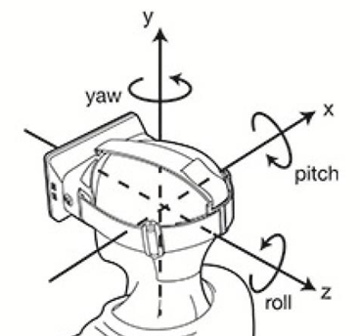
位移
void AXBOpemglWidget::mouseMoveEvent(QMouseEvent *event) {
makeCurrent();
……
if(m_modelMoving){
for(QMap<QString, ModelInfo>::iterator iter=m_Models.begin();
iter!=m_Models.end();iter++){
ModelInfo *modelInfo=&iter.value(); if(!modelInfo->isSelected) continue;
modelInfo->worldPos=
worldPostionFromViewPort(event->pos().x(),event->pos().y());
}
}
doneCurrent();
}
移动模型
旋转
struct ModelInfo{
Model *model;
QVector3D worldPos;
float pitch;
float yaw;
float roll;
bool isSelected;
QString name;
};
void AXBOpemglWidget::mousePressEvent(QMouseEvent *event) {
lastPos=event->pos();
……
}

