Slide 1
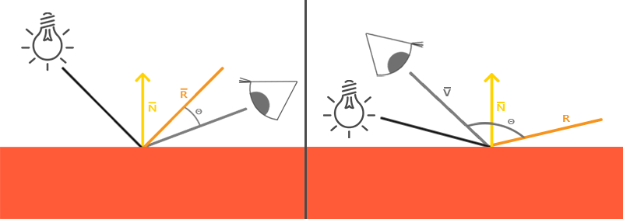
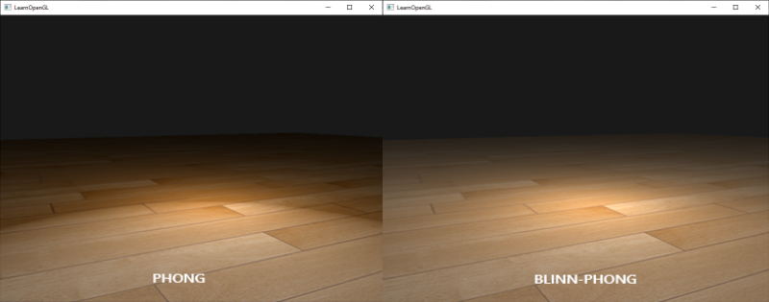
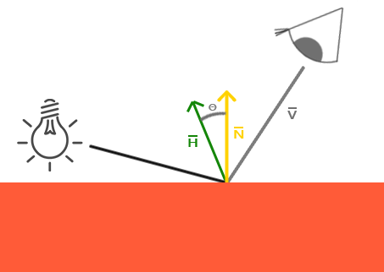
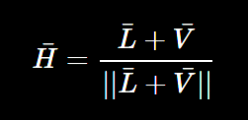
Blinn-Phong
冯氏光照：视线与反射方向之间的夹角不小于90度，镜面光分量会变为0.0
1977年，James F. Blinn在冯氏着色模型上加以拓展，引入了Blinn-Phong着色模型
Blinn-Phong模型采用了半程向量(Halfway Vector)，即光线与视线夹角一半方向上的一个单位向量。当半程向量与法线向量越接近时，镜面光分量就越大。
vec3 lightDir = normalize(lightPos - FragPos);
vec3 viewDir = normalize(viewPos - FragPos);
vec3 halfwayDir = normalize(lightDir + viewDir);
float spec = pow(max(dot(normal, halfwayDir), 0.0), shininess);

Slide 2
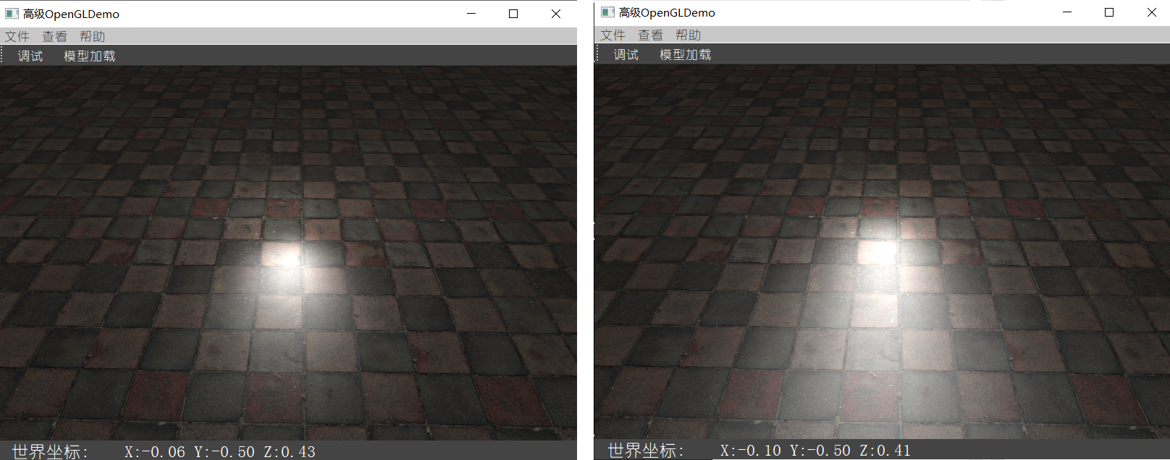
float planeVertices[] = {
// positions // normals // texcoords
10.0f, -0.5f, 10.0f, 0.0f, 1.0f, 0.0f, 10.0f, 0.0f,
-10.0f, -0.5f, 10.0f, 0.0f, 1.0f, 0.0f, 0.0f, 0.0f,
-10.0f, -0.5f, -10.0f, 0.0f, 1.0f, 0.0f, 0.0f, 10.0f,
10.0f, -0.5f, 10.0f, 0.0f, 1.0f, 0.0f, 10.0f, 0.0f,
-10.0f, -0.5f, -10.0f, 0.0f, 1.0f, 0.0f, 0.0f, 10.0f,
10.0f, -0.5f, -10.0f, 0.0f, 1.0f, 0.0f, 10.0f, 10.0f
};
void main() {
[...]
float spec = 0.0;
if(blinn) {
vec3 halfwayDir = normalize(lightDir + viewDir);
spec = pow(max(dot(normal, halfwayDir), 0.0), 16.0);
} else {
vec3 reflectDir = reflect(-lightDir, normal);
spec = pow(max(dot(viewDir, reflectDir), 0.0), 8.0);
}
}

