Slide 1
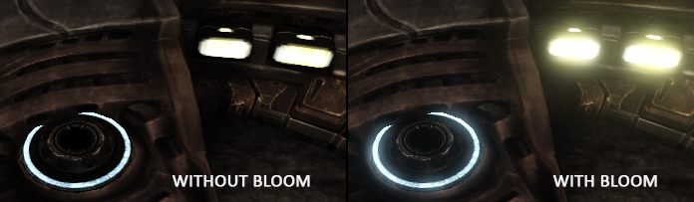
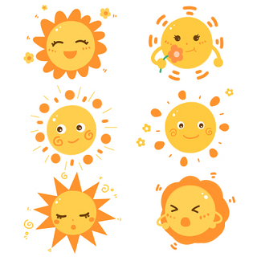
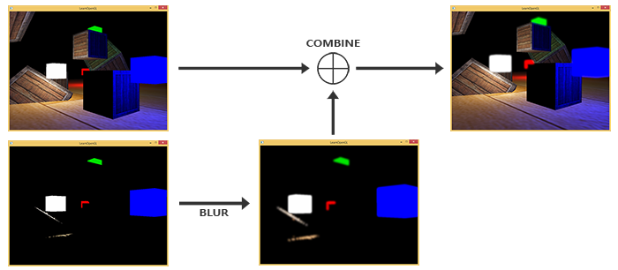
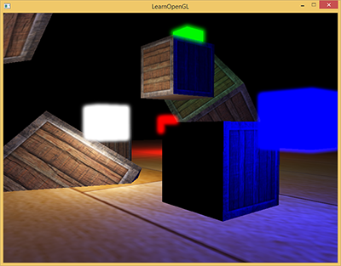
泛光（Bloom）
光源的光芒向四周发散
Bloom和HDR结合使用效果很好。HDR使得实现泛光变得更简单
渲染出来两张图片
对高亮的图片进行模糊处理
合并正常渲染、模糊处理后的高亮图片

Slide 2
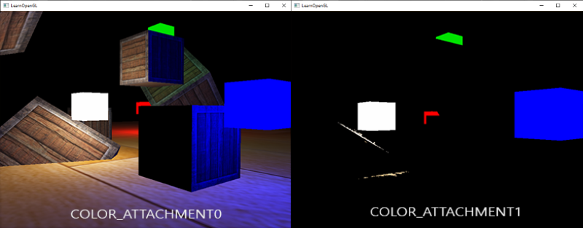
第一步我：渲染出来两张图片：
可以渲染场景两次，每次使用不同的着色器渲染到不同的帧缓冲区
也可以使用称为“多渲染目标”（MRT）的巧妙小技巧，指定多个片段着色器输出；这使我们可以在单个渲染过程中提取前两个图像。
通过在片段着色器的输出之前指定布局位置说明符，我们可以控制片段着色器写入哪个颜色缓冲区：
layout (location = 0) out vec4 FragColor;
layout (location = 1) out vec4 BrightColor;
到目前为止，在自定义帧缓冲中，我们一直只使用了GL_COLOR_ATTACHMENT0，通过使用GL_COLOR_ATTACHMENT1，就可以将两个颜色缓冲区连接到帧缓冲区对象：
// set up floating point framebuffer to render scene to
unsigned int hdrFBO;
glGenFramebuffers(1, &hdrFBO);
glBindFramebuffer(GL_FRAMEBUFFER, hdrFBO);
unsigned int colorBuffers[2];
glGenTextures(2, colorBuffers);
for (unsigned int i = 0; i < 2; i++) {
glBindTexture(GL_TEXTURE_2D, colorBuffers[i]);
glTexImage2D( GL_TEXTURE_2D, 0, GL_RGBA16F, WIDTH, HEIGHT, 0, GL_RGBA, GL_FLOAT, NULL );
glTexParameteri(GL_TEXTURE_2D, GL_TEXTURE_MIN_FILTER, GL_LINEAR);
glTexParameteri(GL_TEXTURE_2D, GL_TEXTURE_MAG_FILTER, GL_LINEAR);
glTexParameteri(GL_TEXTURE_2D, GL_TEXTURE_WRAP_S, GL_CLAMP_TO_EDGE);
glTexParameteri(GL_TEXTURE_2D, GL_TEXTURE_WRAP_T, GL_CLAMP_TO_EDGE);
// attach texture to framebuffer
glFramebufferTexture2D( GL_FRAMEBUFFER, GL_COLOR_ATTACHMENT0 + i, GL_TEXTURE_2D, colorBuffers[i], 0 );
}
默认情况下，OpenGL仅渲染到帧缓冲区的第一个颜色附件，而忽略所有其他颜色附件
unsigned int attachments[2] = { GL_COLOR_ATTACHMENT0, GL_COLOR_ATTACHMENT1 };
glDrawBuffers(2, attachments);
#version 330 core
layout (location = 0) out vec4 FragColor;
layout (location = 1) out vec4 BrightColor;
[...]
void main() {
[...]
// first do normal lighting calculations and output results
FragColor = vec4(lighting, 1.0);
// 检查片段输出是否高于阈值，如果高于阈值，则输出为亮度颜色
float brightness = dot(FragColor.rgb, vec3(0.2126, 0.7152, 0.0722));
if(brightness > 1.0)
BrightColor = vec4(FragColor.rgb, 1.0);
else
BrightColor = vec4(0.0, 0.0, 0.0, 1.0);
}

Slide 3
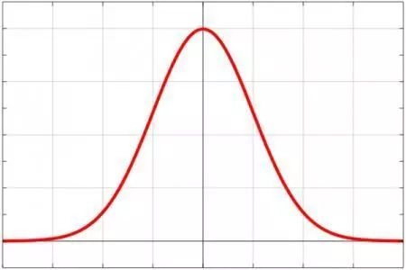
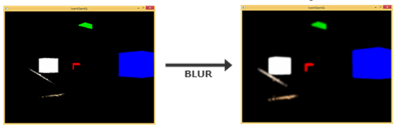
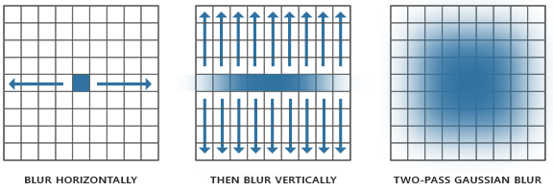
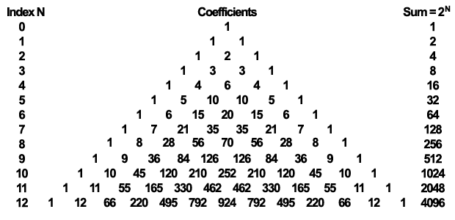




第二步：高斯模糊(Gaussian blur)
权重随着和fragment的距离变大逐渐减小
高斯模糊需要两个权重值
一个描述水平权重，一个描述垂直权重
乒乓帧缓冲区：一对帧缓冲区
先把高亮纹理放到第一个帧缓冲进行模糊，然后在把第一个帧缓冲的颜色缓冲放进第二个帧缓冲进行模糊，接着，将第二个帧缓冲的颜色缓冲放进第一个，循环往复
#version 330 core
out vec4 FragColor;
in vec2 TexCoords;
uniform sampler2D image;
uniform bool horizontal;
uniform float weight[5] = float[] (0.227027, 0.1945946, 0.1216216, 0.054054, 0.016216);
void main() {
vec2 tex_offset = 1.0 / textureSize(image, 0); // gets size of single texel
vec3 result = texture(image, TexCoords).rgb * weight[0]; //当前片段的贡献
if(horizontal) {
for(int i = 1; i < 5; ++i) {
result += texture(image, TexCoords + vec2(tex_offset.x * i, 0.0)).rgb * weight[i];
result += texture(image, TexCoords - vec2(tex_offset.x * i, 0.0)).rgb * weight[i];
}
} else {
for(int i = 1; i < 5; ++i) {
result += texture(image, TexCoords + vec2(0.0, tex_offset.y * i)).rgb * weight[i];
result += texture(image, TexCoords - vec2(0.0, tex_offset.y * i)).rgb * weight[i];
}
}
FragColor = vec4(result, 1.0);
}

Slide 4
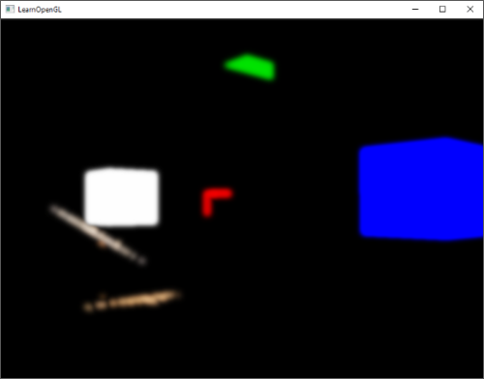
我们为图像的模糊处理创建两个基本的帧缓冲，每个只有一个颜色缓冲纹理：
unsigned int pingpongFBO[2];
unsigned int pingpongBuffer[2];
glGenFramebuffers(2, pingpongFBO);
glGenTextures(2, pingpongBuffer);
for (unsigned int i = 0; i < 2; i++) {
glBindFramebuffer(GL_FRAMEBUFFER, pingpongFBO[i]);
glBindTexture(GL_TEXTURE_2D, pingpongBuffer[i]);
glTexImage2D( GL_TEXTURE_2D, 0, GL_RGBA16F, width(), height(), 0, GL_RGBA, GL_FLOAT, NULL );
glTexParameteri(GL_TEXTURE_2D, GL_TEXTURE_MIN_FILTER, GL_LINEAR);
glTexParameteri(GL_TEXTURE_2D, GL_TEXTURE_MAG_FILTER, GL_LINEAR);
glTexParameteri(GL_TEXTURE_2D, GL_TEXTURE_WRAP_S, GL_CLAMP_TO_EDGE);
glTexParameteri(GL_TEXTURE_2D, GL_TEXTURE_WRAP_T, GL_CLAMP_TO_EDGE);
glFramebufferTexture2D( GL_FRAMEBUFFER, GL_COLOR_ATTACHMENT0, GL_TEXTURE_2D, pingpongBuffer[i], 0);
}
用高亮区纹理填充一个帧缓冲，对其模糊处理10次（5次垂直5次水平）：
bool horizontal = true, first_iteration = true;
int amount = 10;
shaderBlur.bind();
for (unsigned int i = 0; i < amount; i++) {
glBindFramebuffer(GL_FRAMEBUFFER, pingpongFBO[horizontal] );
shaderBlur.setUniformValue("horizontal", horizontal);
glBindTexture( GL_TEXTURE_2D, first_iteration ? colorBuffers[1] : pingpongBuffers[!horizontal] );
RenderQuad();
horizontal = !horizontal;
if (first_iteration)
first_iteration = false;
}
glBindFramebuffer(GL_FRAMEBUFFER, defaultFramebufferObject() );

Slide 5
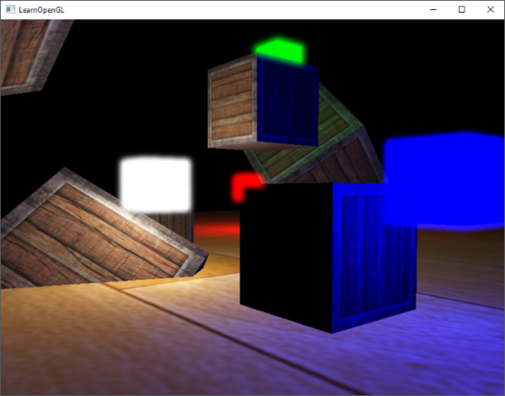
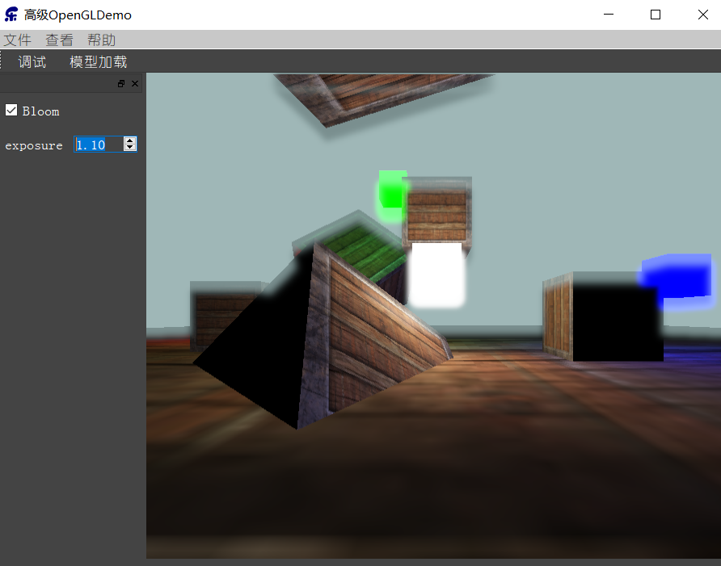
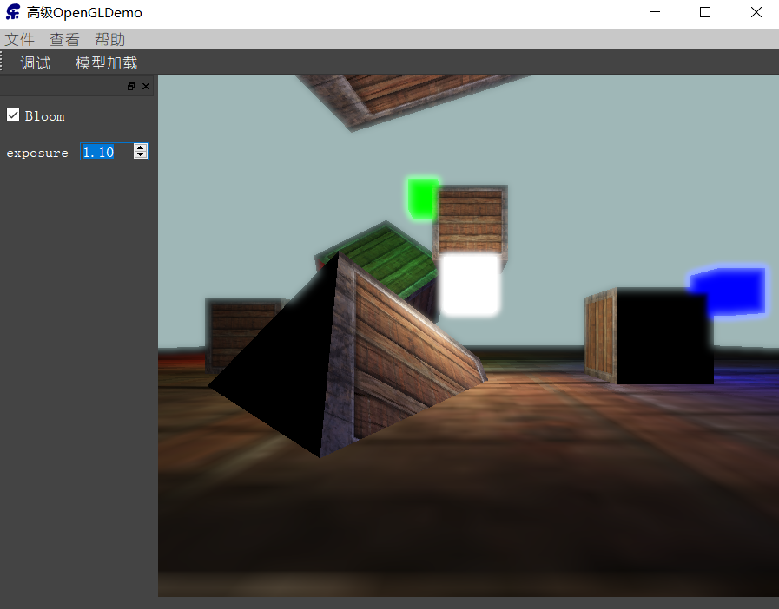
第三步：把两个纹理混合
有了场景的HDR纹理和模糊处理的亮区纹理，只需把它们结合起来就能实现泛光效果了：
#version 330 core
out vec4 FragColor;
in vec2 TexCoords;
uniform sampler2D scene;
uniform sampler2D bloomBlur;
uniform float exposure;
void main() {
const float gamma = 2.2;
vec3 hdrColor = texture(scene, TexCoords).rgb;
vec3 bloomColor = texture(bloomBlur, TexCoords).rgb;
hdrColor += bloomColor; // additive blending
// tone mapping
vec3 result = vec3(1.0) - exp(-hdrColor * exposure);
// also gamma correct while we're at it
result = pow(result, vec3(1.0 / gamma));
FragColor = vec4(result, 1.0);
}
帧缓冲Resize问题：
void AXBOpemglWidget::resizeGL(int w, int h) {
glViewport(0,0,w,h);
for (unsigned int i = 0; i < 2; i++) {
glBindTexture(GL_TEXTURE_2D, colorBuffers[i]);
glTexImage2D(GL_TEXTURE_2D, 0, GL_RGBA16F, w, h, 0, GL_RGBA, GL_FLOAT, NULL);
} for (unsigned int i = 0; i < 2; i++) {
glBindTexture(GL_TEXTURE_2D, pingpongColorbuffers[i]);
glTexImage2D(GL_TEXTURE_2D, 0, GL_RGBA16F, w, h, 0, GL_RGBA, GL_FLOAT, NULL);
} glBindRenderbuffer(GL_RENDERBUFFER, rboDepth);
glRenderbufferStorage(GL_RENDERBUFFER, GL_DEPTH_COMPONENT, w, h);
}

