Slide 1
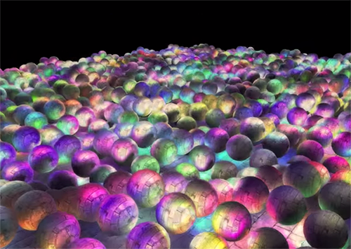
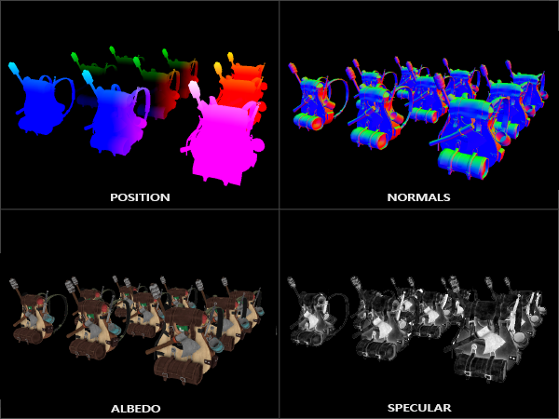
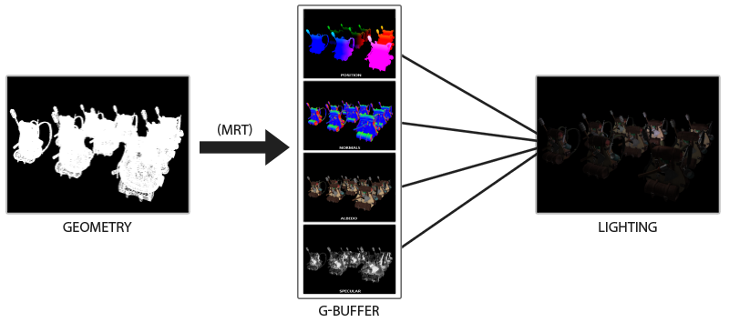
延迟着色(Deferred Shading)
一种对场景进行后期照明的技术，这种技术突破了以往渲染系统支持多重光源时，性能急剧下降的的限制。从而使得一个场景可以支持更多光源的效果。
我们现在一直使用的光照方式叫做正向渲染(Forward Rendering)或者正向着色(Forward Shading)
左边的场景有1874个点光源，如果采用正向渲染，将会是灾难性的。
延迟着色包含两个处理阶段：
几何处理阶段(Geometry Pass)：先渲染场景一次，获取对象的各种几何信息，并储存在一系列叫做G缓冲(G-buffer)的纹理中；
位置向量(Position Vector)、法向量(Normal Vector)、镜面值(Specular Value)
光照处理阶段(Lighting Pass)：使用G缓冲中的几何数据对每一个片段计算场景的光照；
由于G缓冲要求我们在纹理颜色缓冲中存储相对比较大的场景数据，这会消耗比较多的显存，尤其是类似位置向量之类的需要高精度的场景数据。 另外一个缺点就是他不支持混色(因为我们只有最前面的片段信息)

Slide 2
G缓冲(G-buffer)
复习一下在正向渲染中照亮一个片段所需要的所有数据：
一个位置向量
一个法线向量
一个RGB漫反射颜色向量，也就是反照率(Albedo)
一个镜面强度(Specular Intensity)浮点值
所有光源的位置和颜色向量
玩家或者观察者的位置向量
光源的位置，颜色，和玩家的观察位置可以通过uniform变量来设置
但是其它变量对于每个对象的片段都是不同的
整个过程在伪代码中会是这样的：
while(...) // render loop
{
// 1. geometry pass: render all geometric/color data to g-buffer
glBindFramebuffer(GL_FRAMEBUFFER, gBuffer);
glClearColor(0.0, 0.0, 0.0, 1.0); // keep it black so it doesn't leak into g-buffer
glClear(GL_COLOR_BUFFER_BIT | GL_DEPTH_BUFFER_BIT);
gBufferShader.bind();
for(Object obj : Objects) {
ConfigureShaderTransformsAndUniforms();
obj.Draw(gBufferShader);
}
// 2. lighting pass: use g-buffer to calculate the scene's lighting glBindFramebuffer(GL_FRAMEBUFFER, defaultFramebufferObject());
lightingPassShader.bind();
BindAllGBufferTextures();
SetLightingUniforms();
RenderQuad();
}
#version 330 core
layout (location = 0) out vec3 gPosition;
layout (location = 1) out vec3 gNormal;
layout (location = 2) out vec4 gAlbedoSpec;
in vec2 TexCoords;
in vec3 FragPos;
in vec3 Normal;
uniform sampler2D texture_diffuse1;
uniform sampler2D texture_specular1;
void main() {
gPosition = FragPos; // store the fragment position vector in the first gbuffer texture
gNormal = normalize(Normal); // also store the per-fragment normals into the gbuffer
// and the diffuse per-fragment color
gAlbedoSpec.rgb = texture(texture_diffuse1, TexCoords).rgb;
// store specular intensity in gAlbedoSpec's alpha component
gAlbedoSpec.a = texture(texture_specular1, TexCoords).r;
}

Slide 3
使用多渲染目标(Multiple Render Targets)一次渲染多个颜色缓冲：
unsigned int gBuffer;
glGenFramebuffers(1, &gBuffer);
glBindFramebuffer(GL_FRAMEBUFFER, gBuffer);
unsigned int gPosition, gNormal, gColorSpec;
// - position color buffer
glGenTextures(1, &gPosition);
glBindTexture(GL_TEXTURE_2D, gPosition);
glTexImage2D(GL_TEXTURE_2D, 0, GL_RGBA16F, width(),height(), 0, GL_RGBA, GL_FLOAT, NULL);
glTexParameteri(GL_TEXTURE_2D, GL_TEXTURE_MIN_FILTER, GL_NEAREST);
glTexParameteri(GL_TEXTURE_2D, GL_TEXTURE_MAG_FILTER, GL_NEAREST);
glFramebufferTexture2D(GL_FRAMEBUFFER, GL_COLOR_ATTACHMENT0, GL_TEXTURE_2D, gPosition, 0);
// - normal color buffer
glGenTextures(1, &gNormal);
glBindTexture(GL_TEXTURE_2D, gNormal);
glTexImage2D(GL_TEXTURE_2D, 0, GL_RGBA16F, width(),height() , 0, GL_RGBA, GL_FLOAT, NULL);
glTexParameteri(GL_TEXTURE_2D, GL_TEXTURE_MIN_FILTER, GL_NEAREST);
glTexParameteri(GL_TEXTURE_2D, GL_TEXTURE_MAG_FILTER, GL_NEAREST);
glFramebufferTexture2D(GL_FRAMEBUFFER, GL_COLOR_ATTACHMENT1, GL_TEXTURE_2D, gNormal, 0);
// - color + specular color buffer
glGenTextures(1, &gAlbedoSpec);
glBindTexture(GL_TEXTURE_2D, gAlbedoSpec);
glTexImage2D(GL_TEXTURE_2D,0,GL_RGBA,width(),height() ,0,GL_RGBA,GL_UNSIGNED_BYTE, NULL);
glTexParameteri(GL_TEXTURE_2D, GL_TEXTURE_MIN_FILTER, GL_NEAREST); glTexParameteri(GL_TEXTURE_2D, GL_TEXTURE_MAG_FILTER, GL_NEAREST); glFramebufferTexture2D(GL_FRAMEBUFFER,GL_COLOR_ATTACHMENT2,GL_TEXTURE_2D,gAlbedoSpec, 0);
// - tell OpenGL which color attachments we'll use (of this framebuffer) for rendering
unsigned int attachments[3] ={GL_COLOR_ATTACHMENT0, GL_COLOR_ATTACHMENT1, GL_COLOR_ATTACHMENT2 };
glDrawBuffers(3, attachments);
// then also add render buffer object as depth buffer and check for completeness.
[...]

Slide 4
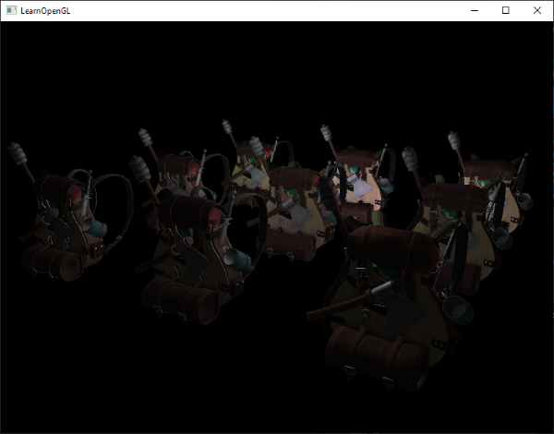
延迟光照处理
渲染一个2D矩形
glClear(GL_COLOR_BUFFER_BIT | GL_DEPTH_BUFFER_BIT);
glActiveTexture(GL_TEXTURE0);
glBindTexture(GL_TEXTURE_2D, gPosition);
glActiveTexture(GL_TEXTURE1);
glBindTexture(GL_TEXTURE_2D, gNormal);
glActiveTexture(GL_TEXTURE2);
glBindTexture(GL_TEXTURE_2D, gAlbedoSpec);
// also send light relevant uniforms
shaderLightingPass.bind();
SendAllLightUniformsToShader(shaderLightingPass);
shaderLightingPass.setUniformValue("viewPos", camera.Position);
RenderQuad();
从G缓冲中直接采样
#version 330 core
out vec4 FragColor;
in vec2 TexCoords;
uniform sampler2D gPosition;
uniform sampler2D gNormal;
uniform sampler2D gAlbedoSpec;
struct Light { vec3 Position; vec3 Color; };
const int NR_LIGHTS = 32;
uniform Light lights[NR_LIGHTS];
uniform vec3 viewPos;
void main() {
// retrieve data from G-buffer
vec3 FragPos = texture(gPosition, TexCoords).rgb;
vec3 Normal = texture(gNorgPositionmal, TexCoords).rgb;
vec3 Albedo = texture(gAlbedoSpec, TexCoords).rgb;
float Specular = texture(gAlbedoSpec, TexCoords).a;
// then calculate lighting as usual
vec3 lighting = Albedo * 0.1; // hard-coded ambient component
vec3 viewDir = normalize(viewPos - FragPos);
for(int i = 0; i < NR_LIGHTS; ++i) {
// diffuse
vec3 lightDir = normalize(lights[i].Position - FragPos);
vec3 diffuse = max(dot(Normal, lightDir), 0.0) * Albedo * lights[i].Color;
lighting += diffuse;
}
FragColor = vec4(lighting, 1.0);
}

Slide 5
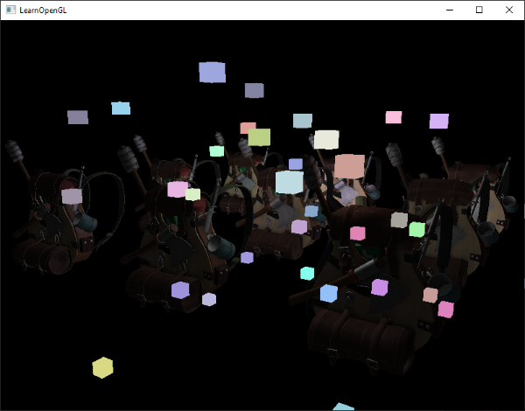
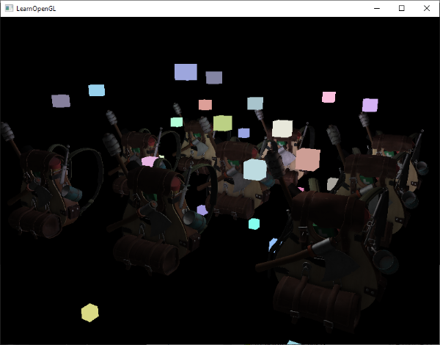
延迟渲染与正向渲染结合
使用正向渲染，渲染光源为立方体，光照立方体需要特殊的着色器(输出光照颜色)，只需要像正常情况下渲染立方体，只是会在我们完成延迟渲染操作之后进行
// deferred lighting pass
[...]
RenderQuad();
// now render all light cubes with forward rendering as we'd normally do
shaderLightBox.bind();
shaderLightBox.setUniformValue("projection", projection);
shaderLightBox.setUniformValue("view", view);
for (unsigned int i = 0; i < lightPositions.size(); i++) {
model.setToIdentity();
model.translate(lightPositions[i]);
model.scale(0.25f);
shaderLightBox.setUniformValue("model", model);
shaderLightBox.setUniformValue("lightColor", lightColors[i]);
RenderCube();
}
这些渲染出来的立方体并没有考虑到我们储存的延迟渲染中的几何深度(Depth)信息，结果它被渲染在之前渲染过的物体之上，这并不是我们想要的结果
复制整个读帧缓冲的深度缓冲信息到默认帧缓冲的深度缓冲
glBindFramebuffer(GL_READ_FRAMEBUFFER, gBuffer);
glBindFramebuffer(GL_DRAW_FRAMEBUFFER, defaultFramebufferObject()); // write to default framebuffer
glBlitFramebuffer(
0, 0, width(), height(), 0, 0, width(), height(), GL_DEPTH_BUFFER_BIT, GL_NEAREST
);
glBindFramebuffer(GL_FRAMEBUFFER, defaultFramebufferObject());
// now render light cubes as before
[...]

Slide 6
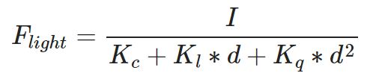
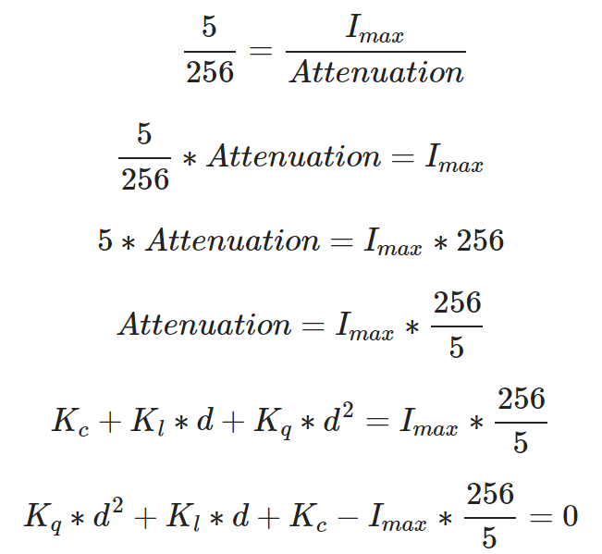
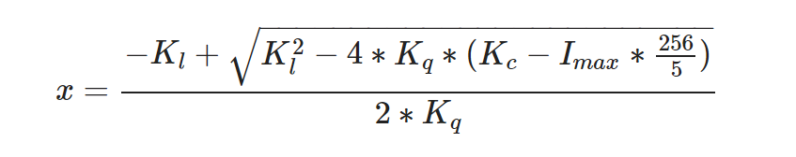
更多的光源
当渲染光照场景时，会计算场景中每一个光源的贡献，不管它们离片段有多远。很大一部分的光源根本就不会到达这个片段
计算一个光源的体积或半径：
这个方程永远不会真正等于0.0
我们选择5/256作为一个合适的光照值；除以256是因为默认的8-bit帧缓冲可以每个分量显示这么多强度值(Intensity)，我们要求的衰减方程会是这样：
光源最亮的颜色分量
距离 | 常数 | 一次 | 二次
7 | 1.0 | 0.7 | 1.8
13 | 1.0 | 0.35 | 0.44
20 | 1.0 | 0.22 | 0.20
32 | 1.0 | 0.14 | 0.07
50 | 1.0 | 0.09 | 0.032
65 | 1.0 | 0.07 | 0.017
100 | 1.0 | 0.045 | 0.0075
160 | 1.0 | 0.027 | 0.0028
200 | 1.0 | 0.022 | 0.0019
325 | 1.0 | 0.014 | 0.0007
600 | 1.0 | 0.007 | 0.0002
3250 | 1.0 | 0.0014 | 0.000007
float constant = 1.0;
float linear = 0.7;
float quadratic = 1.8;
float lightMax = std::fmaxf(std::fmaxf(lightColor.r, lightColor.g), lightColor.b);
float radius =
(-linear + std::sqrtf(linear * linear - 4 * quadratic * (constant - (256.0 / 5.0) * lightMax))) / (2 * quadratic);

Slide 7
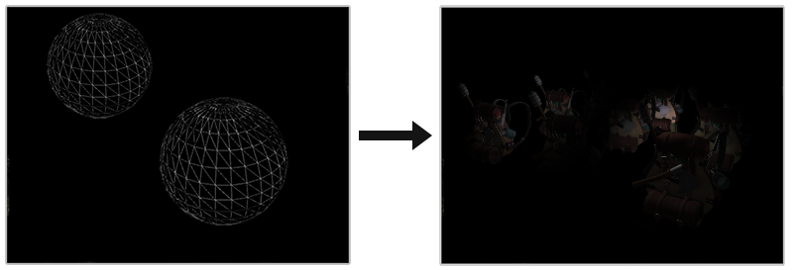
struct Light {
[...]
float Radius;
};
void main() {
[...]
for(int i = 0; i < NR_LIGHTS; ++i) {
// calculate distance between light source and current fragment
float distance = length(lights[i].Position - FragPos);
if(distance < lights[i].Radius) {
// do expensive lighting
[...]
}
}
}
仅展示如何使用灯光的半径来减少照明计算，实际上并不会这样执行
GPU和GLSL在优化循环和分支方面非常糟糕。因为GPU上的着色器执行是高度并行的，需要运行完全相同的着色器代码才能使其高效。
真正使用光半径
使用光半径的适当方法是渲染实际球体，按光体积半径缩放。使用大体相同的延迟片段着色器来渲染球体
//TexCoords = aTexCoords;
gl_Position = projection*view*model*vec4(aPos, 1.0);
// retrieve data from gbuffer
vec3 FragPos = texture(gPosition, gl_FragCoord.xy/textureSize(gPosition, 0)).rgb;
vec3 Normal = texture(gNormal, gl_FragCoord.xy/textureSize(gNormal, 0)).rgb;
vec3 Diffuse = texture(gAlbedoSpec, gl_FragCoord.xy/textureSize(gAlbedoSpec, 0)).rgb; float Specular = texture(gAlbedoSpec, gl_FragCoord.xy/textureSize(gAlbedoSpec, 0)).a;

