Slide 1
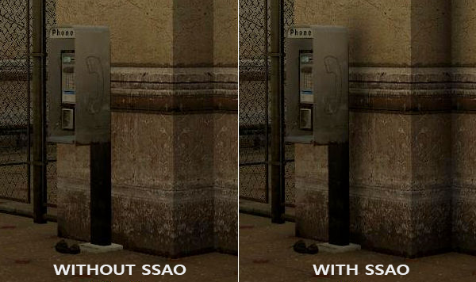
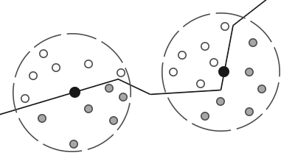
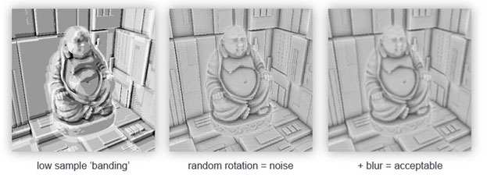
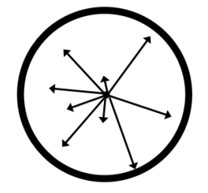
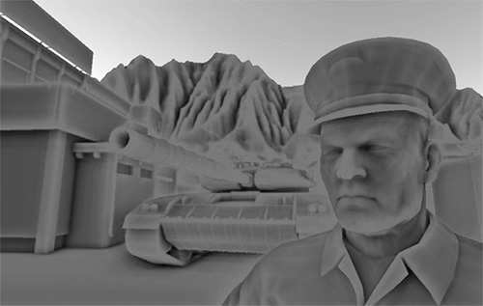
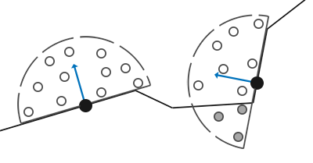
SSAO
屏幕空间环境光遮蔽(Screen-Space Ambient Occlusion)
实际上，灯光以不同的强度向各种方向散射，因此场景中间接照亮的部分也应具有不同的强度。简单来来说：环境光不应该是一成不变的
SSAO背后的原理很简单：对于铺屏四边形(Screen-filled Quad)上的每一个片段，我们都会根据周边深度值计算一个遮蔽因子(Occlusion Factor)。这个遮蔽因子之后会被用来减少或者抵消片段的环境光照分量。
内灰色的样本的深度值是高于片段深度值，他们会增加遮蔽因子数；几何体内这样的样本个数越多，片段获得的环境光照也就越少。
渲染效果的质量和精度与我们采样的样本数量有直接关系。如果样本数量太低，渲染的精度会急剧减少，我们会得到一种叫做波纹(Banding)的效果；如果它太高了，反而会影响性能：
因为使用的内核样本是一个球体，导致平整的墙面也会显得灰蒙蒙的，因为样本核中一半会在墙内：
因此，我们将不会使用球体的样本核，而使用一个沿着表面法向量的半球体样本核

Slide 2
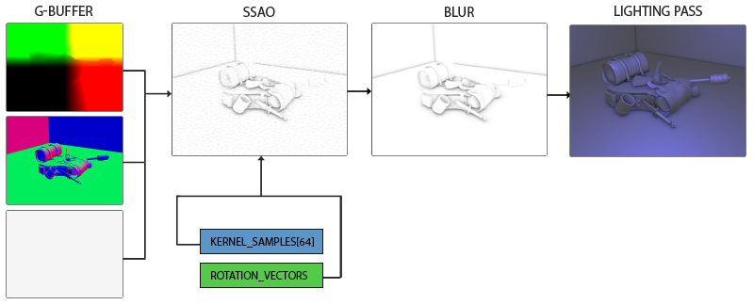
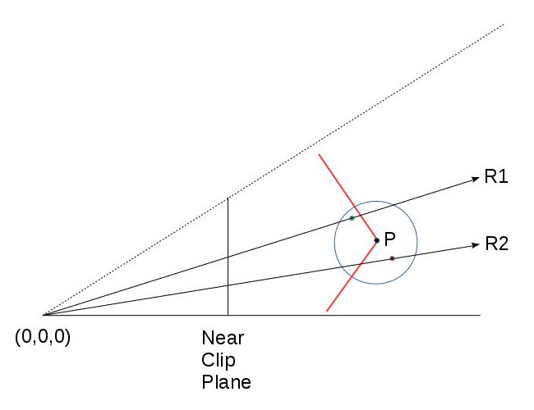
样本缓冲
SSAO需要一些几何信息，以便使用某种方法来确定片段的遮挡因子。对于每个片段，我们需要以下数据：
片段的位置向量。
片段的法线向量。
片段的反照率颜色。
片段的一个样本核。
片段的用于旋转样本核的随机旋转向量。
G-Buffer
#version 330 core
layout (location = 0) out vec4 gPosition;
layout (location = 1) out vec3 gNormal;
layout (location = 2) out vec4 gAlbedo;
in vec2 TexCoords;
in vec3 FragPos;
in vec3 Normal;
void main() {
// position vector in the first gbuffer texture
gPosition = FragPos;
// normals into the gbuffer
gNormal = normalize(Normal);
// color, ignore specular
gAlbedo.rgb = vec3(0.95);
}
view space
几何处理阶段：
void main() {
vec4 viewPos = view * model * vec4(aPos, 1.0);
FragPos = viewPos.xyz;
TexCoords = aTexCoords;
mat3 normalMatrix = transpose(inverse(mat3(view * model)));
Normal = normalMatrix * (invertedNormals ? -aNormal : aNormal);
gl_Position = projection * viewPos;
}

Slide 3
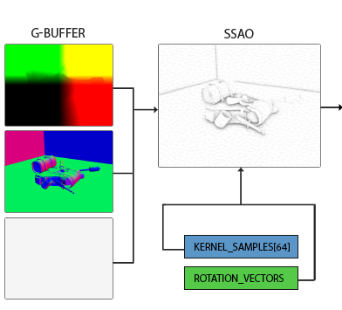
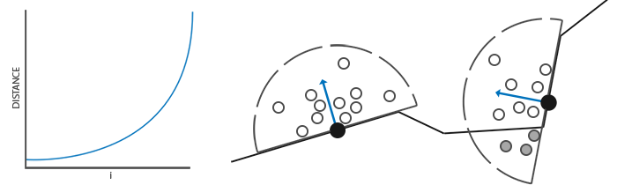
法线定向半球
由于为每个面法线方向生成一个样本核非常困难，我们将在切线空间中生成一个样本核
std::uniform_real_distribution<float> randomFloats(0.0, 1.0); // random floats between [0.0, 1.0]
std::default_random_engine generator;
std::vector<QVector3D> ssaoKernel;
for (unsigned int i = 0; i < 64; ++i) {
QVector3D sample(
randomFloats(generator) * 2.0 - 1.0,
randomFloats(generator) * 2.0 - 1.0,
randomFloats(generator)
);
sample.normalize();
sample *= randomFloats(generator);
ssaoKernel.push_back(sample);
}
z的范围是0到1（半球）
我们希望将更多的核样本布置到更靠近片段的位置。我们可以使用加速插值函数来实现这一点：
Lerp插值算法
float lerp(float a, float b, float f) { return a + f * (b - a); }
std::uniform_real_distribution<float> randomFloats(0.0, 1.0); // random floats between [0.0, 1.0]
std::default_random_engine generator;
std::vector<QVector3D> ssaoKernel;
for (unsigned int i = 0; i < 64; ++i) {
QVector3D sample(
randomFloats(generator) * 2.0 - 1.0,
randomFloats(generator) * 2.0 - 1.0,
randomFloats(generator)
);
sample.normlize();
sample *= randomFloats(generator);
float scale = float(i) / 64.0;
// scale samples s.t. they're more aligned to center of kernel
scale = lerp(0.1f, 1.0f, scale * scale);
sample *= scale;
ssaoKernel.push_back(sample);
}

Slide 4
随机核旋转
创建切线空间法线定向的4x4随机旋转向量阵列：
std::vector<QVector3D> ssaoNoise;
for (unsigned int i = 0; i < 16; i++) {
QVector3D noise(
randomFloats(generator) * 2.0 - 1.0,
randomFloats(generator) * 2.0 - 1.0,
0.0f
);
ssaoNoise.push_back(noise);
}
绕z轴旋转
unsigned int noiseTexture;
glGenTextures(1, &noiseTexture);
glBindTexture(GL_TEXTURE_2D, noiseTexture);
glTexImage2D(
GL_TEXTURE_2D, 0, GL_RGBA16F, 4, 4, 0, GL_RGB, GL_FLOAT, &ssaoNoise[0]
);
glTexParameteri(GL_TEXTURE_2D, GL_TEXTURE_MIN_FILTER, GL_NEAREST);
glTexParameteri(GL_TEXTURE_2D, GL_TEXTURE_MAG_FILTER, GL_NEAREST);
glTexParameteri(GL_TEXTURE_2D, GL_TEXTURE_WRAP_S, GL_REPEAT);
glTexParameteri(GL_TEXTURE_2D, GL_TEXTURE_WRAP_T, GL_REPEAT);
我们现在有了实现SSAO所需的所有相关输入数据。

Slide 5
SSAO shader
SSAO着色器在2D的铺屏四边形上运行，它对片段计算遮蔽值(为了在最终的光照着色器中使用)。由于需要存储SSAO阶段的结果，我们还需要在创建一个帧缓冲对象：
unsigned int ssaoFBO;
glGenFramebuffers(1, &ssaoFBO);
glBindFramebuffer(GL_FRAMEBUFFER, ssaoFBO);
unsigned int ssaoColorBuffer;
glGenTextures(1, &ssaoColorBuffer);
glBindTexture(GL_TEXTURE_2D, ssaoColorBuffer);
glTexImage2D(GL_TEXTURE_2D, 0, GL_RED, SCR_WIDTH, SCR_HEIGHT, 0, GL_RED, GL_FLOAT, NULL);
glTexParameteri(GL_TEXTURE_2D, GL_TEXTURE_MIN_FILTER, GL_NEAREST);
glTexParameteri(GL_TEXTURE_2D, GL_TEXTURE_MAG_FILTER, GL_NEAREST);
glFramebufferTexture2D(
GL_FRAMEBUFFER, GL_COLOR_ATTACHMENT0, GL_TEXTURE_2D, ssaoColorBuffer, 0
);
环境遮蔽的结果是一个灰度值
渲染SSAO完整的过程会像这样：
// geometry pass: render stuff into G-buffer
glBindFramebuffer(GL_FRAMEBUFFER, gBuffer);
[...]
glBindFramebuffer(GL_FRAMEBUFFER, defaultFramebufferObject());
// use G-buffer to render SSAO texture
glBindFramebuffer(GL_FRAMEBUFFER, ssaoFBO);
glClear(GL_COLOR_BUFFER_BIT);
glActiveTexture(GL_TEXTURE0); glBindTexture(GL_TEXTURE_2D, gPosition);
glActiveTexture(GL_TEXTURE1); glBindTexture(GL_TEXTURE_2D, gNormal);
glActiveTexture(GL_TEXTURE2); glBindTexture(GL_TEXTURE_2D, noiseTexture);
shaderSSAO.bind();
SendKernelSamplesToShader();
shaderSSAO.setUniformValue("projection", projection);
RenderQuad();
glBindFramebuffer(GL_FRAMEBUFFER, defaultFramebufferObject());
// lighting pass: render scene lighting
glClear(GL_COLOR_BUFFER_BIT | GL_DEPTH_BUFFER_BIT);
shaderLightingPass.bind();
[...]
glActiveTexture(GL_TEXTURE3);
glBindTexture(GL_TEXTURE_2D, ssaoColorBuffer);
[...]
RenderQuad();
We now have all the relevant input data we need to implement SSAO.

Slide 6

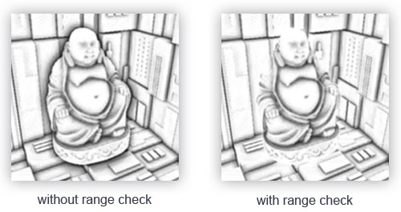
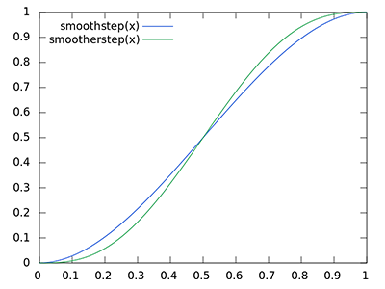
#version 330 core
out float FragColor;
in vec2 TexCoords;
uniform sampler2D gPosition;
uniform sampler2D gNormal;
uniform sampler2D texNoise;
uniform vec3 samples[64];
uniform mat4 projection;
// parameters (you'd probably want to use them as uniforms to more easily tweak the effect)
int kernelSize = 64;
float radius = 0.5;
float bias = 0.025;
uniform float _width;
uniform float _height;
void main() {
// tile noise texture over screen, based on screen dimensions divided by noise size
vec2 noiseScale = vec2( _width/4.0, _height/4.0); // screen =_widthx_height
// get input for SSAO algorithm
vec3 fragPos = texture(gPosition, TexCoords).xyz;
vec3 normal = normalize(texture(gNormal, TexCoords).rgb);
vec3 randomVec = normalize(texture(texNoise, TexCoords * noiseScale).xyz);
// create TBN change-of-basis matrix: from tangent-space to view-space
vec3 tangent = normalize(randomVec - normal * dot(randomVec, normal));
vec3 bitangent = cross(normal, tangent);
mat3 TBN = mat3(tangent, bitangent, normal);
// iterate over the sample kernel and calculate occlusion factor
float occlusion = 0.0;
for(int i = 0; i < kernelSize; ++i) {
// get sample position
vec3 samplePos = TBN * samples[i]; // from tangent to view-space
samplePos = fragPos + samplePos * radius;
// project sample position (to sample texture) (to get position on screen/texture)
vec4 offset = vec4(samplePos, 1.0);
offset = projection * offset; // from view to clip-space
offset.xyz /= offset.w; // perspective divide
offset.xyz = offset.xyz * 0.5 + 0.5; // transform to range 0.0 - 1.0
// get sample depth ,get depth value of kernel sample
float sampleDepth = texture(gPosition, offset.xy).z;
// range check & accumulate
float rangeCheck = smoothstep(0.0, 1.0, radius / abs(fragPos.z - sampleDepth));
occlusion += (sampleDepth >= samplePos.z + bias ? 1.0 : 0.0) * rangeCheck;
}
occlusion = 1.0 - (occlusion / kernelSize);
FragColor = occlusion;
}
当检测靠近表面边缘的片段时，将会考虑测试表面前面的表面的深度值；这些值将会(不正确地)音响遮蔽因子。
view space

Slide 7
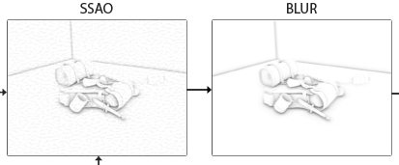
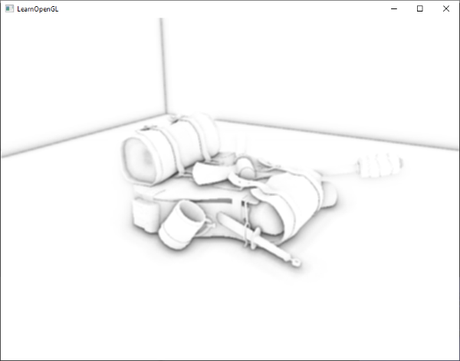
环境光遮挡模糊
在SSAO过程和照明过程之间，我们首先要模糊SSAO纹理。因此，让我们创建另一个帧缓冲区对象来存储模糊结果：
unsigned int ssaoBlurFBO, ssaoColorBufferBlur;
glGenFramebuffers(1, &ssaoBlurFBO);
glBindFramebuffer(GL_FRAMEBUFFER, ssaoBlurFBO);
glGenTextures(1, &ssaoColorBufferBlur);
glBindTexture(GL_TEXTURE_2D, ssaoColorBufferBlur);
glTexImage2D(GL_TEXTURE_2D, 0, GL_RED, width(), height(), 0, GL_RED, GL_FLOAT, NULL);
glTexParameteri(GL_TEXTURE_2D, GL_TEXTURE_MIN_FILTER, GL_NEAREST);
glTexParameteri(GL_TEXTURE_2D, GL_TEXTURE_MAG_FILTER, GL_NEAREST);
glFramebufferTexture2D(
GL_FRAMEBUFFER, GL_COLOR_ATTACHMENT0, GL_TEXTURE_2D, ssaoColorBufferBlur, 0
);
平铺随机向量纹理提供了一致的随机性，因此可以利用此属性创建简单的模糊着色器：
#version 330 core
out float FragColor;
in vec2 TexCoords;
uniform sampler2D ssaoInput;
void main() {
vec2 texelSize = 1.0 / vec2(textureSize(ssaoInput, 0));
float result = 0.0;
for (int x = -2; x < 2; ++x) {
for (int y = -2; y < 2; ++y) {
vec2 offset = vec2(float(x), float(y)) * texelSize;
result += texture(ssaoInput, TexCoords + offset).r;
}
}
FragColor = result / (4.0 * 4.0);
}

Slide 8
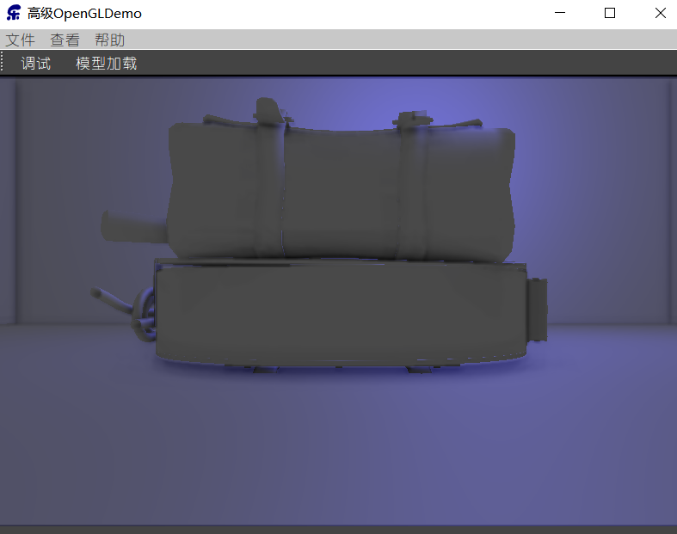
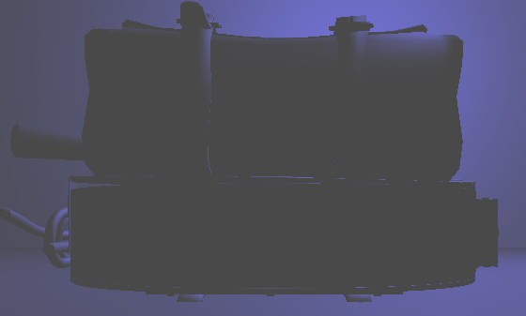
应用环境光遮挡
#version 330 core
out vec4 FragColor;
in vec2 TexCoords;
uniform sampler2D gPosition;
uniform sampler2D gNormal;
uniform sampler2D gAlbedo;
uniform sampler2D ssao;
struct Light { vec3 Position; vec3 Color; float Linear; float Quadratic; float Radius; };
uniform Light light;
void main() {
// retrieve data from gbuffer
vec3 FragPos = texture(gPosition, TexCoords).rgb;
vec3 Normal = texture(gNormal, TexCoords).rgb;
vec3 Diffuse = texture(gAlbedo, TexCoords).rgb;
float AmbientOcclusion = texture(ssao, TexCoords).r;
// blinn-phong (in view-space)
vec3 ambient = vec3(0.3 * Diffuse * AmbientOcclusion); // here we add occlusion factor
vec3 lighting = ambient;
vec3 viewDir = normalize(-FragPos); // viewpos is (0.0.0) in view-space
// diffuse
vec3 lightDir = normalize(light.Position - FragPos);
vec3 diffuse = max(dot(Normal, lightDir), 0.0) * Diffuse * light.Color;
// specular
vec3 halfwayDir = normalize(lightDir + viewDir);
float spec = pow(max(dot(Normal, halfwayDir), 0.0), 8.0);
vec3 specular = light.Color * spec;
// attenuation
float dist = length(light.Position - FragPos);
float attenuation = 1.0 / (1.0 + light.Linear * dist + light.Quadratic * dist * dist);
diffuse *= attenuation;
specular *= attenuation;
lighting += diffuse + specular;
FragColor = vec4(lighting, 1.0);
}
没有SSAO
SSAO
视觉欺骗：左边的背包其实更暗

