Slide 1
TuX²: Distributed Graph Computation for Machine Learning
Wencong Xiao*◊, Jilong Xue◊†, Youshan Miao◊, Zhen Li*◊, Cheng Chen◊, Ming Wu◊, Wei Li*, Lidong Zhou◊
*SKLSDE Lab, Beihang University; ◊Microsoft Research; †Peking University
NSDI’17, Boston, MA

Slide 2
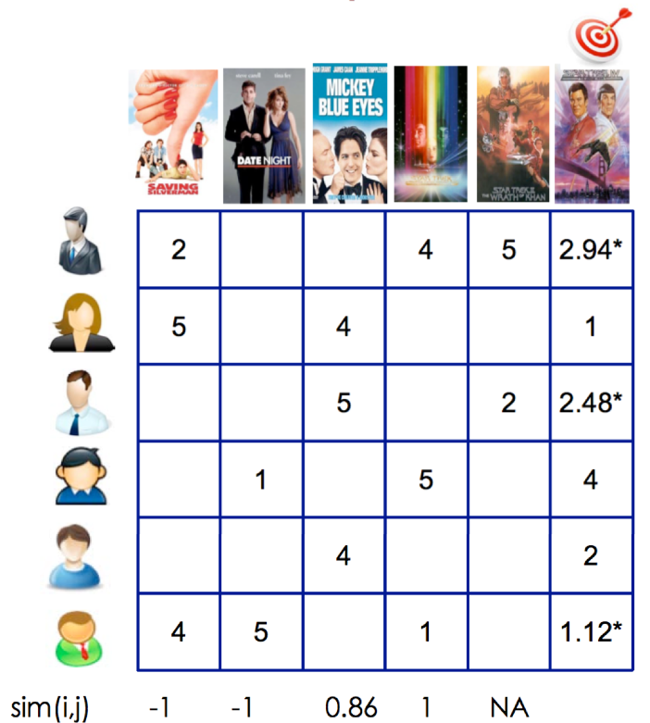
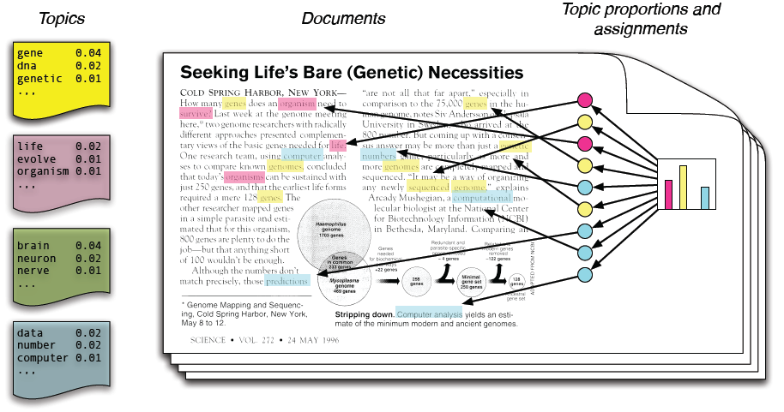
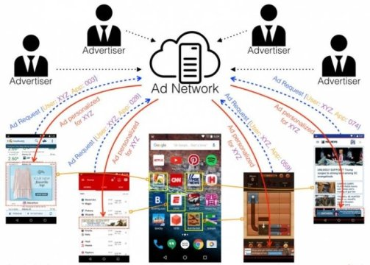

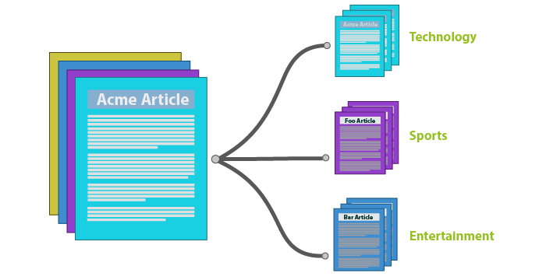

Machine Learning(ML) in real world
Recommendation
Topic Model
Click Prediction
Notes:
As we all know, machine learning is widely used to address the real world production challenge. For example, recommendation system drives movie website like Netflix. Topic model is helping the news classification. The click prediction algorithm supports the advertisement display in search engine.
Recommendation figure from Netflix: https://ffp4g1ylyit3jdyti1hqcvtb-wpengine.netdna-ssl.com/ux/files/2014/04/recommendationExample-1.png
Topic model figure from: https://rpubs.com/rain10241/63854
CTR from sciencedaily: https://images.sciencedaily.com/2016/02/160223171432_1_540x360.jpg

Slide 3








Graph Structures in Machine Learning
Recommendation
Topic Model
Click Prediction
Feature
Sample
Notes:
Many machine learning tasks have inherent graph structure. In recommendation system, users rate the items. User and item can be considered as vertices, therefore the rating behavior can be modeled as the edges in graph. The same in the topic model problem, a document naturally contains a lot of words. Such a inclusion relationship can be modeled into a graph. In the click prediction problem, the training data usually contains many samples. Each sample is related to multiple features. Therefore, the samples, features, and their relationship construct a graph.

Slide 4
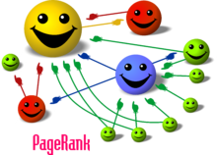
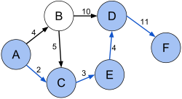
Advantages of Graph Engine
Simple programming model (e.g. GAS)
PageRank, Shortest path, etc.
Graph-aware optimization
Data layout [Grace(ATC’12), Naiad(SOSP’13)]
Partitioning [PowerLyra(EuroSys’15)]
Scalability to trillion-edge
GraM (SoCC’15)
Chaos (SOSP’15)
One Trillion Edges (VLDB’15)
Application
Shortest path
Gather
Apply
Scatter
Framework
PowerGraph/PowerLyra
*GAS figure from PowerLyra slides
Notes:
To address such machine learning problems with the graph structure, distributed graph engine could be a good choice. It has several advantages:
First, graph engine typically adopts simple programming model like GAS. User only needs to write the gather, apply, scatter functions. System will schedule these three phases in order and apply the user-define functions to all vertices. It’s proved to be a good abstraction to write graph applications like page rank, shortest path and so on.
The second advantage is that graph engine can apply a lot of graph-aware optimizations in many aspects. Several previous works have demonstrated those optimizations for data layout, which benefits memory access, and partitioning, which balances the workload and reduce the network traffic.
Note that, those optimizations are usually transparent to the users, while well utilized by a lot of graph applications.
The third one, scalability.
In 2015, three papers proved the great scalability of graph engine in trillion-edge graphs

Slide 5





Gaps for ML on Graph Engine
1. Heterogeneous vertices
PageRank
for WebPage Ranking
Matrix Factorization(MF)
for Recommendation
Notes:
However, we observe the problems supporting ML on existing Graph Engine.
Firstly, when modeling machine learning as graph structure, it often introduces heterogeneity in vertices. Recommendation problems in machine learning naturally contain user and item vertices, which have different properties.
However, existing graph engines mainly support homogeneous graph, which is common for the traditional graph workloads. For example, in PageRank, each vertex represents a web page, and all the vertices have the same property in the computation.
Directly applying the homogeneous graph model to such heterogeneity algorithms will introduce overhead in both programming and efficiency.

Slide 6
Gaps for ML on Graph Engine
2. Mini-Batch
PageRank
for WebPage Ranking
Matrix Factorization(MF)
for Recommendation
Notes:
Secondly, Mini-batch is an important concept in machine learning, while it’s missing in graph engine. In ML, mini-batch means to use just a subset of training samples to update the whole model within one batch. In graph, supporting mini-batch means the graph engine should have the capability to enumerate and update just a subset of graph for a batch in arbitrary number of vertices and edges. However, existing graph engines do not support such an important feature.

Slide 7
Gaps for ML on Graph Engine
3. Flexible consistency
PageRank
for WebPage Ranking
Matrix Factorization(MF)
for Recommendation
Hard Barrier
Notes:
Thirdly, ML workload may desire different consistency model. In distributed graph engine, several workers will work together to process the whole graph and wait at the end of iteration for a hard barrier. While in machine learning, hard barriers in every mini-batch will introduce too much synchronization overhead.

Slide 8
Gaps for ML on Graph Engine
3. Flexible consistency
“Soft” Barrier
PageRank
for WebPage Ranking
Matrix Factorization(MF)
for Recommendation
Hard Barrier
Notes:
Since machine learning algorithms are typically error-tolerance, they can converge even with the stale state. it’s good to support flexible consistency, using “soft” barrier, allowing faster workers to continually make progress.

Slide 9

We propose: TuX²
Bridge Graph and ML research in one system
Extend for distributed machine learning
Scheduling: Stale Synchronous Parallel (SSP) based scheduling
DataModel: Heterogeneous data model
Programming: MEGA (Mini-batch, Exchange, GlobalSync, and Apply) graph model
Outperform both Graph and ML systems on ML algorithms
10x vs. PowerGraph/PowerLyra
Mainly due to MEGA model and heterogeneity optimization
48% vs. Petuum/Parameter-Server(P-S)
Mainly due to graph-based optimization
Notes:
To address these problems, we propose TuX2, to bridge Graph and ML research in one system, using a unified model.
We extend graph engine for distributed machine learning mainly in three aspects, scheduling, data modeling, and programming.
In scheduling, we adopts stale synchronous parallel for graph engine, allowing user to trade-off between convergence and efficiency
In data modeling, we support heterogeneous data model, and apply specific optimizations on it.
In programming abstraction, we extend GAS model to a brand new MEGA model. It allows expression of mini-batch and the flexible stage composition for efficient execution of machine learning algorithms.
With those new features, TuX2 outperforms both Graph and ML system in the representative machine learning algorithms.
TuX2 outperform PowerGraph/PowerLyra for over an order of magnitude. The great improvement is mainly due to our MEGA model and heterogeneity optimization.
Comparing with ML system, Petuum and ParameterServer, TuX2 achieves at least 48% speed up thanks to the graph-based optimization.

Slide 10





System Architecture
Overview
Partition 0
Partition n
Server role
Vertex-cut approach
Effective for power-law graph
Naturally fits P-S model
Master vertices as the global state
Mirror vertices as the local cache
Master vertices
…
…
…
…
$$V_{i}$$
$$V_{j}$$
Vertex array
Mirror vertices
…
$$V_{i}^{′}$$
$$V_{j}^{′}$$
…
…
…
$$V_{i}^{′}$$
…
Edge array
Worker role
Edge link
Master-mirror link
Notes:
Before discussing the design details, I will at first introduce the system architecture of TuX2 as the background.
This figure shows the overview;
In TuX2, the graph is partitioned into n partitions. Each server typically owns a partition. In each partition, TuX2 maintains vertices and edges in separate arrays. Edges in the edge array are grouped by source vertex.
TuX2 uses the vertex-cut approach. The edge set of a high-degree vertex can be split into multiple partitions. Each partition maintains a replica of the vertex. One of these replicas is designated the master; it maintains the master version of the vertex’s data. All remaining replicas are called mirrors, and each maintains a local cached copy.
We adopt vertex-cut mainly because it is proven to be effective in handling power-law graphs and it also naturally connects to the parameter-server model: The master versions of all vertices’ data can be treated as the global state stored in the server side of parameter server.

Slide 11
Key designs
Scheduling: Stale Synchronous Parallel (SSP) based scheduling
DataModel: Heterogeneous data model
Programming: MEGA graph model
Notes:
In the next several slides, I will introduce our three key designs in scheduling, data modeling, and programming.
Let’s at first look at how SSP being applied in TuX2 to provide a configurable consistency model for users.

Slide 12
Stale Synchronous Parallel in TuX²
Slack of 1 clock as an example
All servers finish clock1
0
1
2
3
clock
Server 0
Working set of current mini-batch
Updates guaranteed visible to all servers
…
Server n
Visible Task
Completed Task
Ongoing Task
Notes:
Here’s a figure using slack of one clock as an example to show how SSP works in TuX2.
In TuX2, the clock of SSP is defined on server level for each mini-batch.
And here, in the figures, the dotted rectangle means the working set of current mini-batch.
As figure shows, now all servers finish clock 1, so the updates of task are guaranteed visible to all servers.
Question: it seems like a bipartite graph? If it’s not a bipartite graph, how ssp works?
Basically ssp is defined in mini-batch level, not related to graph structure. Here I use bipartite graph as an example to show how ssp works with graph structure.

Slide 13
Stale Synchronous Parallel in TuX²
Slack of 1 clock as an example
Slowest server (n) is in clock2
Fastest server (0) finishes clock2
0
1
2
3
clock
Server 0
…
Server n
Visible Task
Completed Task
Ongoing Task
Notes:
Then they continue. In clock 2, not all servers finish at the same time, which is also common in BSP model. Here, the case is that, the slowest server, which is server n in this figure, is still in clock2. However, server 0 already complete all the tasks in clock 2.

Slide 14
Stale Synchronous Parallel in TuX²
Slack of 1 clock as an example
Slowest server (n) is in clock2
Fastest server (0) finishes clock2
within the staleness bound
continue
0
1
2
3
clock
Server 0
…
Server 0 continues
Server n
Visible Task
Completed Task
Ongoing Task
Notes:
Because SSP tolerate 1 clock slack, server 0 continue to work on the clock 3, processing the data of the third mini-batch.

Slide 15
Stale Synchronous Parallel in TuX²
Slack of 1 clock as an example
Slowest server (n) is in clock2
Fastest server (0) finishes clock3
reaching the max slack bound
blocked
0
1
2
3
clock
Server 0
Server 0 is blocked
…
Server n
Visible Task
Completed Task
Ongoing Task
Notes:
When server 0 finish clock 3, it’s possible that the slowest server n is still in clock 2, therefore they reach the max slack bound defined by user. The fastest server is blocked.

Slide 16
Key designs
Scheduling: Stale Synchronous Parallel (SSP) based scheduling
DataModel: Heterogeneous data model
Programming: MEGA graph model
Notes:
Our second major extension is to enable TuX2 to be aware of the heterogeneity in ML using a heterogeneous data model.

Slide 17
Heterogeneity in ML
Heterogeneous Vertices
Different properties
E.g. Logistic Regression
Sample: Label; Feature: Weight, Gradient
Benefit
Heterogeneity for compact data structure
Heterogeneity for efficient execution
Heterogeneity for less network traffic
Feature
Sample
Notes:
For example, Logistic Regression in graph model has sample and feature vertices. Different vertices typically contain different properties. Sample vertices have label field, while feature vertices have weight and gradient field.
In the data model of TuX2, we allow user to define their own vertices and specify the vertices with different types. Such heterogeneity awareness has several benefits.
One obvious benefit is that it’s possible to arrange the data into more compact data structure, resulting in better data locality. Besides, heterogeneity can help efficient execution and reduce the network traffic.
Due to the limited time, I will only talk about the case for compact data structure and efficient execution.

Slide 18
Heterogeneity for compact data structure
E.g. Logistic Regression
Sample: Label; Feature: Weight, Gradient
Feature
Feature
Sample
Sample
Vertex array:
Sample array:
Feature array:
Useless data fields
Homogeneous Vertex Data Structure
Heterogeneous Vertex Data Structure
Notes:
Here, for compact data structure, I will continue to use Logistic Regression as an example.
In existing graph engine, the vertices are usually placed in only one vertex array, assuming the homogeneous data type of all vertices. In this figure, the green field of sample vertices and yellow field of feature vertices are considered useless and harmful to data locality.
In TuX2, we arrange different types of vertices into different data arrays. For example, in this case, the sample vertices are in sample array, and feature vertices are in feature array. Therefore the data structure is more compact.
Question:
Why not use “union” in C program to pack the data?
First, It implicitly requires user to have advanced programming skill. Second, It’s hard to make two types of vertices with different needed properties but happen to be in the same data size. Therefore, in that case, the “big” vertex can be consider compact, however, the “small” one is still suffering from the performance lost for uncompact.

Slide 19
Heterogeneity for efficient execution
E.g. Mini-Batch MF for recommendation
Benefits of scanning items
Sequential access for locality when syncing
Less overhead tracing the updated vertices
Server role
Server role
Master vertex
Master vertex
Updated item vertices in a M-B
Updated user vertices in a M-B
Items
Items
Edge link
Users
Users
Master-mirror link
Worker role
Worker role
Scan user vertices
Scan item vertices
Notes:
Furthermore, heterogeneity also benefits execution a lot. Here I will use mini-batch MF for recommendation as a case to explain. In recommendation, the items are usually in high-degree. For example, a movie can be watched by millions of people. therefore they are partitioned into multiple servers through vertex-cut, while the user nodes are typically in low-degree, therefore they are only maintained in local.
To access the edge for model training, we can either choose to enumerate from the user node , or from the item node. These two approaches look similar but the performances are different.
If we scan the edge from user vertices, the items are updated accordingly. After the enumeration, the items are needed to sync-up between master-mirror vertices to apply the update. Considering the case to enumerate from the item side, The items will be access one by one, in contract, the user nodes are updated separately.
So there are benefits exist in syncing phase when scanning edge from the item side. In syncing phase, the item nodes are in sequential access for better locality. Besides, we don’t need to trace the updated vertices, because they are aligned in a continual array.
To conclude, scanning items will help to avoid random memory access and reduce tracing overhead, therefore making execution more efficient.
In TuX2, with heterogeneity, we allow user to choose a proper side for enumeration.

Slide 20
Key designs
Scheduling: Stale Synchronous Parallel (SSP) based scheduling
DataModel: Heterogeneous data model
Programming: MEGA graph model
Notes:
Our third key design is the MEGA model.

Slide 21















MEGA: e.g. Mini-batch MF for recommendation
Graph View
$$U_{i}$$
$$I_{j}$$
$$Model: \hat{R_{i,j}}=I_{j}^{T}U_{i}$$
$$U_{0}$$
$$U_{1}$$
…
$$U_{i}$$
…
$$U_{m}$$
$$U_{i}$$
$$I_{j}$$
Rating
$$I_{0}$$
$$I_{1}$$
…
$$I_{j}$$
…
$$I_{n}$$
$$U_{i}$$
$$I_{j}$$
Exchange(v_user, v_item, edge, a_user, a_item, context)
pred=PredictRating(v_user, v_item);
loss=edge.rating–pred;
context.loss+=loss^2;
(a_user, a_item)+=Gradient(loss, v_user, v_item);
Apply(ver, accum, context)
ver.data +=accum;
Notes:
Here I use mini-batch MF for recommendation as an example to show you how to program using MEGA model and how MEGA model works.
In the graph view of recommendation problem, users are modeled into vertices from U0 to Um, and items from I0 to In. The rating behavior of a user to an item is considered to be an edge between that user and item. The goal of this algorithm is to come up with a model that the predicted rating of each edge, calculating by related user and item parameters, is similar to the ground truth rating.
In MEGA model, user programs Exchange function for each edge like this. In the exchange function, at first, the parameters of user and item are read to calculate the predicted value. Then, with the predicted value, loss is calculated and sum up in worker level context. With the loss of current rating, the gradient can be calculated and it is used to update the weight of both user and item vertices.
This exchange function shows a typical case for machine learning in graph. The computation needs to read and write both two vertices of one edge. It will introduce two GAS phase if it is written in GAS model, resulting in unavoidable overhead from barriers and extra stages.
Apply function is simple here. Just to sum up the accumulated delta weight.
Question:
Concurrent update?

Slide 22
Example: Mini-batch MF
Partition 0
Partition n
Server role
Compose stage
…
Apply
Mini-Batch
Exchange
Exchange
Exchange
Apply
Apply
Worker role
StageSequenceBuilder(ExecStages)
mbStage = new MiniBatchStage();
mbStage.SetBatchSize(100, asEdge);
mbStage.Add(ExchangeStage);
mbStage.Add(ApplyStage);
ExecStages.Add(mbStage);
ExecStages.Add(GlobalSyncStage);
GlobalSync
Iteration Stage
Mini-batch Stage
Notes:
In addition to programming for edges and vertices, in TuX2, user needs to compose the stages to build a execution flow for their own algorithm. Here I continue to use mini-batch MF as an example.
The left figure shows the execution flow while the right figure shows how it will be executed in our TuX2. To enable mini-batch, we certainly should have the mini-batch stage.
At first, let’s look at the first mini-batch, the exchange function in the last slide will be applied on each edge of this mini-batch. After the exchange phase is done, apply phase will sync up master-mirror and update the delta weight to global state. Then it moves to the second mini-batch, doing exchange and apply stages again. So there’s loop in mini-batch stage, it will iterate until all mini-batches are done. After the mini-batches stage is done, the loss of current epoch for one worker is calculated in the worker-level context data. We can use a GlobalSync phase to sum up the loss result, and compare it with the total loss of last epoch to determine whether the model is converged or not.
To compose the execution stage, user just needs to write several lines of codes listed here. TuX2 provides simple and straight forward interface in StageSequenceBuilder function to link all stages.
The arbitrary stage composition makes MEGA model more flexible to express the complicated machine learning algorithms efficiently.

Slide 23
Experiment setup
Machine information
16 CPU cores, 256GB memory, 54Gbps InfiniBand NIC
Typical ML algorithms
MF, LDA, BlockPG
Large-scale dataset
Up to 64 billion edges graph
Dataset name | # of users/ docs/samples | # of items/ words/features | # of edges
NewsData(LDA) | 7.3M | 418.4K | 1.4B
AdsData(BlockPG) | 924.8M | 209.3M | 64.9B
Netflix(MF) | 480.2K | 17.8K | 100.5M
Synthesized(MF) | 30M | 1M | 6.3M
Notes:
We carefully verify our design and compare to other related systems on an exclusive cluster with modern architecture.
We implement MF, LDA, BlockPG, three typical machine learning algorithms, which are identical to the compared systems.
We evaluate the performance using large-scale dataset, up to 64 billion edges graph from public dataset and private production dataset.
Due to the limited time, here I will show you some representative results.

Slide 24
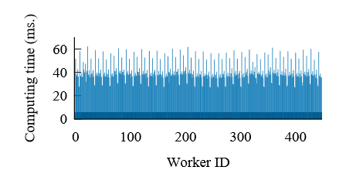
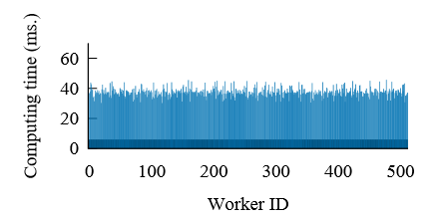
Evaluation
Compare to Parameter Server
48% improvement on 32 servers!
Algorithm: BlockPG
Dataset: Microsoft private AdsData (64B edges)
Balance workload with vertex-cut!
Imbalance in Parameter Server
Balance in TuX2
Notes:
We compare TuX2 with Parameter Server on 32 servers, and achieve 48% speed up!
Here, the left figure is parameter server, while the right one is TuX2. Here the x-axis is the thread-id of all servers and y-axis is the runtime of mini-batch.
From the figures we can clearly see that the great improvement is mainly from the awareness of graph structure to balance the workload with vertex-cut.
Such an experiment also supports our points that machine learning algorithms should be implemented on top of graph engine, which can easily benefit from the optimization technology of graph community.

Slide 25
Evaluation
Compare to PowerGraph, PowerLyra
Algorithm: Matrix Factorization
Dataset: Netflix
Notes:
We compare TuX2 with state of art graph engine, powergraph and powerlyra on Matrix Factorization.

Slide 26
Evaluation
Compare to PowerGraph, PowerLyra
Algorithm: Matrix Factorization
Dataset: Netflix
10x!
Notes:
The comparison shows that we achieve more than an order of magnitude performance improvement, which meanly comes from our MEGA model and heterogeneity optimization.

Slide 27
Conclusion
TuX²: advocates the convergence of graph computation and distributed machine learning
Introduce important machine learning concepts to graph computation
Define a new, flexible graph model to express ML algorithms efficiently
Demonstrate TuX² outperform existing Graph and ML systems in representative ML algorithms respectively
Notes:
In conclusion, TuX2 advocates the convergence of graph computation and distributed machine learning. We make a critical step towards this direction by
introducing important machine learning concepts to graph computation,
defining a new, flexible graph model to express machine learning algorithm efficiently,
and demonstrating the benefits through extensive evaluations on representative machine learning algorithms.
Going forward, we hope that TuX2 will provide a common foundation for further research in both graph computation and distributed machine learning, allowing more machine learning algorithms and optimizations to be expressed and implemented easily and efficiently at scale.

Slide 28
Thanks! Q&A

