Slide 1


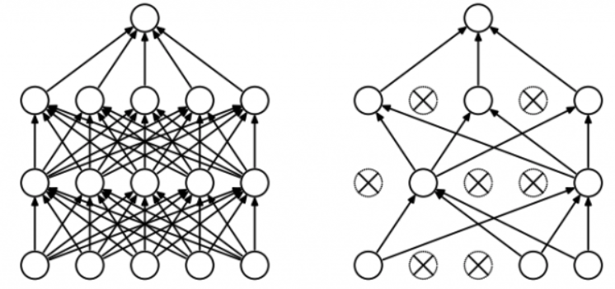
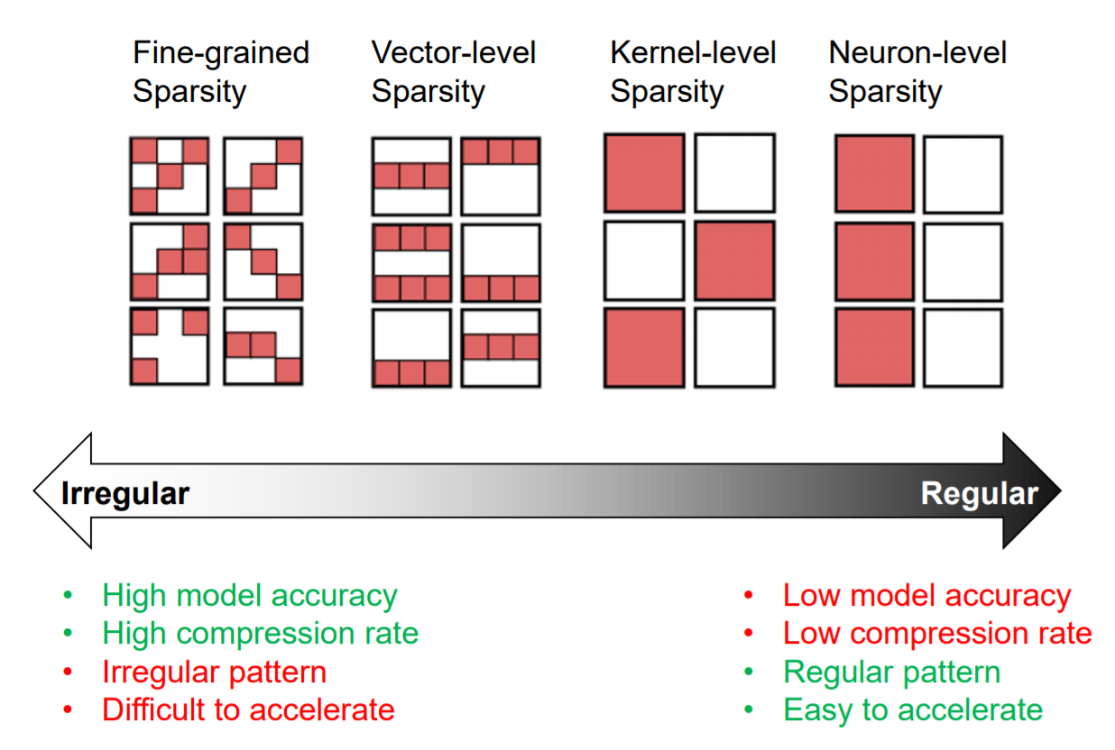
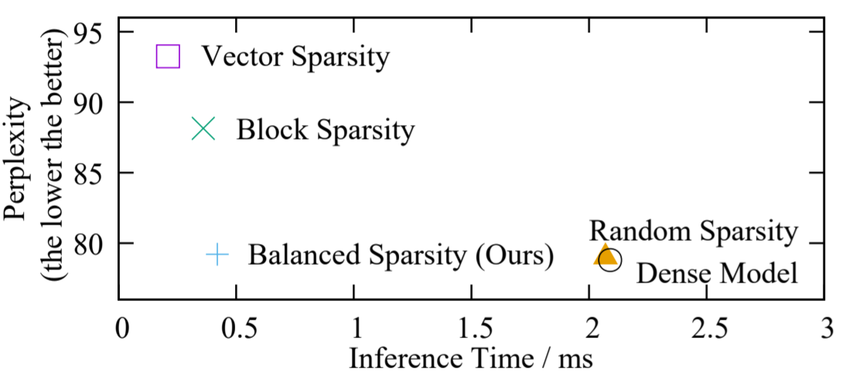
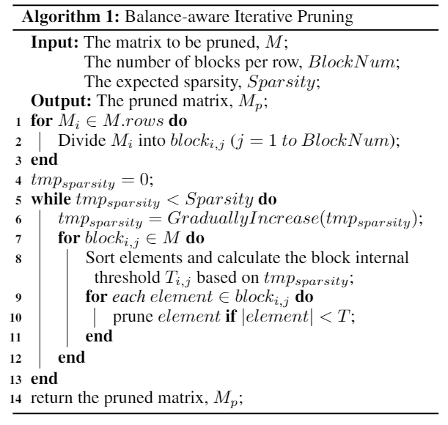
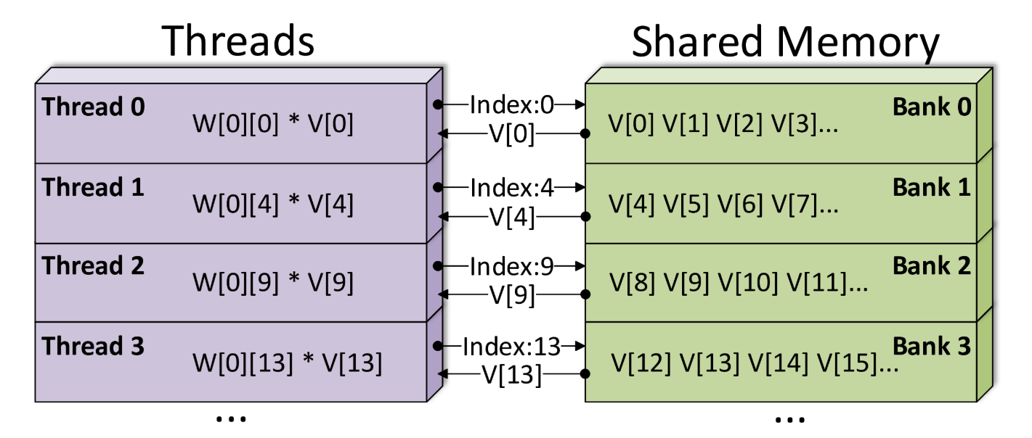


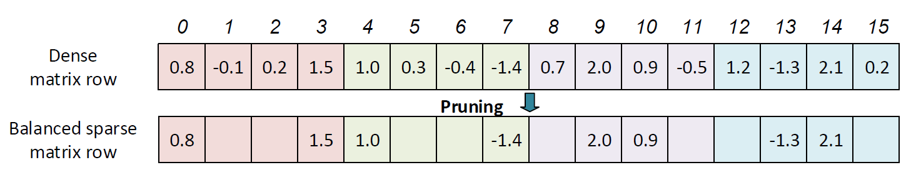
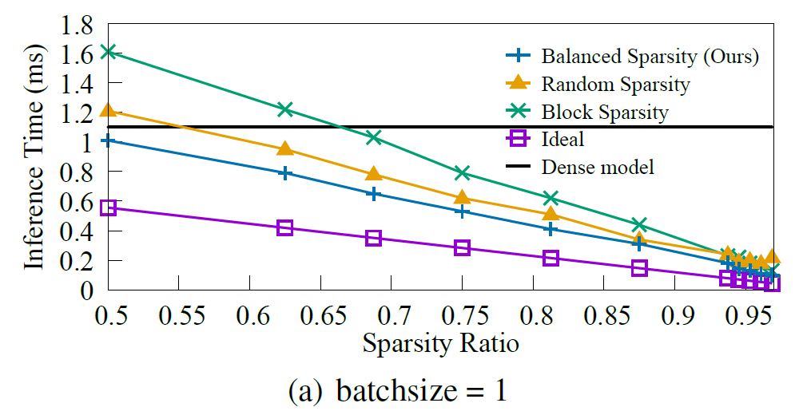
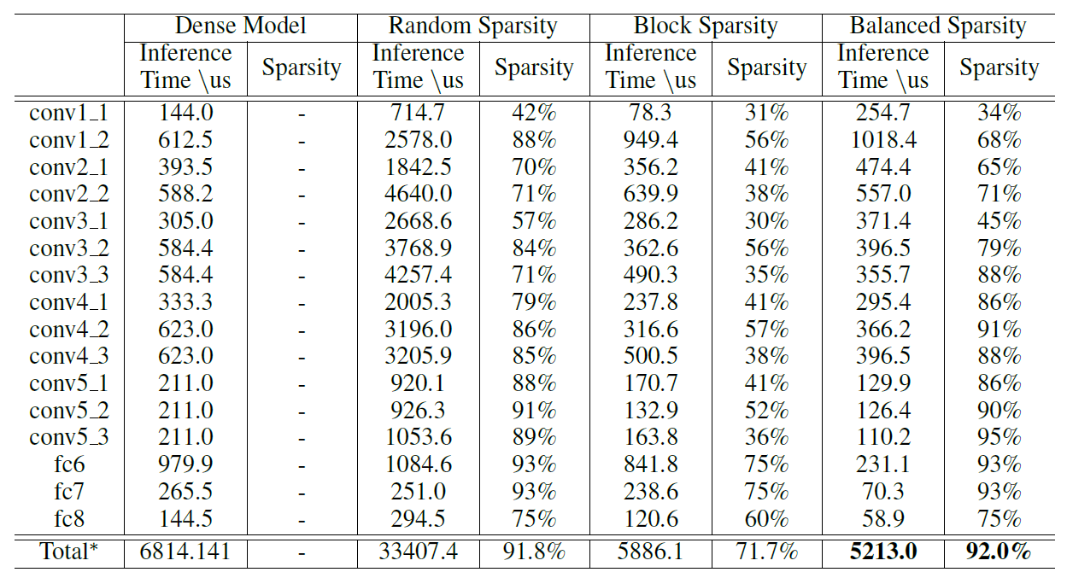
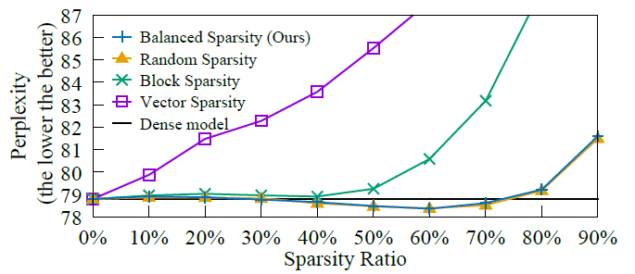
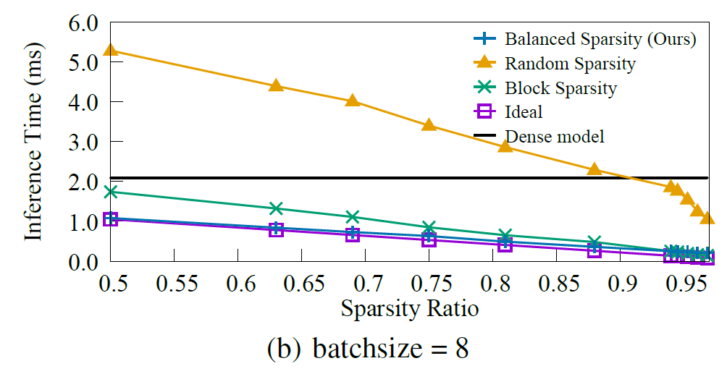
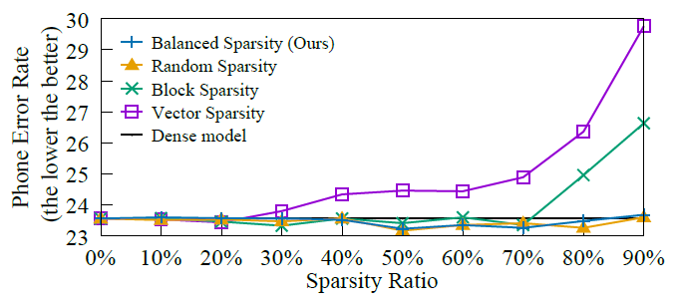
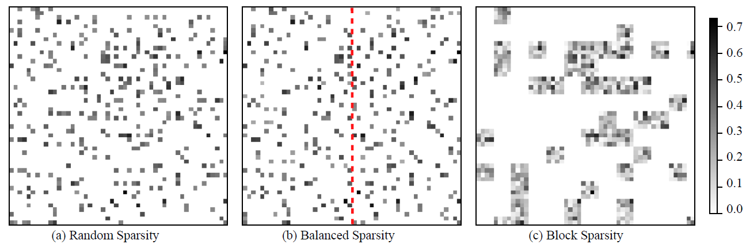
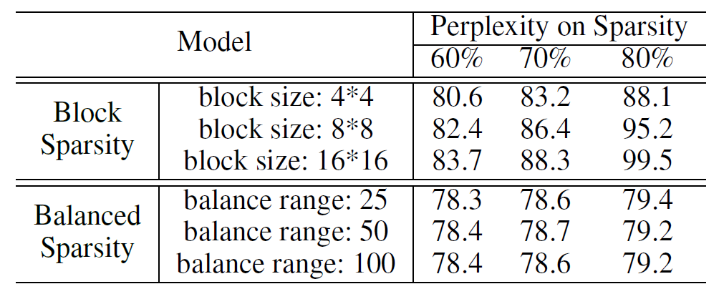
Balanced Sparsity for Efficient DNN Inference on GPU
Zhuliang Yao♠†*, Shijie Cao ♣†*, Wencong Xiao ♦†, Chen Zhang†, Lanshun Nie ♣
♠ Tsinghua University, † Microsoft Research, * Equal Contribution
♣ Harbin Institute of Technology, ♦ Beihang University
Sparsity in Deep Learning
Redundancy in DNNs
Speedup and Accuracy Tradeoff
Our Method
“Dead” / little activation
Uncorrelated with output
Correlated with other neurons
Maintain model accuracy
Achieve significant practical speedup
Flexible for any kinds of networks
Methodology
Balanced Sparsity
Iterative Pruning
Efficient GPU Implementation
Dense Matrix
Dense Matrix
(Bank Split)
Bank Split
Load balancing between threads
Single Instruction Multiple Data (SIMD)
Conflict-free shared memory access
Traverse each row in Dense Matrix
Experimental Results
Benchmark
Real Workloads
Matrix Vector Product
VGG on ImageNet
LSTM on PTB
294.1us
326.3us
370.9us
120.2us
CTC on TIMIT
All methods achieve top-5 accuracy of 90.3%, but under different sparsity ratio.
Time cost of other layers (such as Pooling, Batch Normalization) is less than 230us.
Always faster than RS and BS
Almost reach ideal bound when batchsize = 8
12x model compression rate
6x faster inference time
117.9us
212.8us
190.5us
83.9us
Further Explorations
Visualization of Sparse Weight Maps
Hyper Parameter Sensitivity

