Slide 1




Efficient and Effective Sparse LSTM on FPGA with Bank-Balanced Sparsity
Shijie Cao¹, Chen Zhang², Zhuliang Yao³, Wencong Xiao⁴, Lanshun Nie¹,
Dechen Zhan¹, Yunxin Liu², Ming Wu², Lintao Zhang²
¹Harbin Institute of Technology, ²Microsoft Research Asia,
³Tsinghua University, ⁴Beihang University
Notes:
Thanks for the introduction, Dr. Ling (chair)
Good Afternoon, everyone. I am shijie cao, a joint PhD student at Harbin Institute of Technology and Microsoft Research Asia.
(Or Yunxin)
Today I am going to talk about our work ‘Efficient and Effective Sparse LSTM on FPGA with Bank-Balanced Sparsity’

Slide 2
Outline
Motivation
Design
Bank-Balanced Sparsity Pattern (BBS)
Sparse Matrix Computation and Format for BBS
BBS FPGA Accelerator
Evaluation
Model Accuracy
Hardware Efficiency
Conclusion
Notes:
First, I’d like to introduce some background and our motivation, why we undertook this work.
Next, I will describe the proposed design in our work, including the bank-balanced sparsity pattern , BBS, and its customized acceleration on FPGA.
I will then present experimental results on both the model accuracy of BBS and the hardware efficiency of our FPGA accelerator.
Finally, I will conclude the talk.

Slide 3
Outline
Motivation
Design
Bank-Balanced Sparsity Pattern (BBS)
Sparse Matrix Computation and Format for BBS
BBS FPGA Accelerator
Evaluation
Model Accuracy
Hardware Efficiency
Conclusion

Slide 4

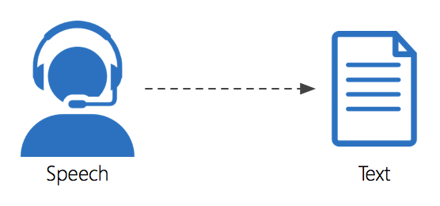

Real-time Inference of LSTM
Machine Translation
Speech Recognition
Speech Synthesis
Notes:
Neural networks based on Long Short-Term Memory (LSTM) have been widely used in language and speech applications such as machine translation, speech recognition and speech synthesis.

Slide 5
Real-time Inference of LSTM
Machine Translation
Speech Recognition
Speech Synthesis
User-interactive and latency-sensitive applications
Notes:
On the one hand, these applications are usually user-interactive. So low latency inference of a single batch is required to provide smooth user experiences.

Slide 6
Real-time Inference of LSTM
Machine Translation
Speech Recognition
Speech Synthesis
User-interactive and latency-sensitive applications
Model size continues to grow to achieve higher accuracy
Notes:
On the other hand, the size of these LSTM models continues to grow in order to achieve higher model accuracy.

Slide 7
Real-time Inference of LSTM
Machine Translation
Speech Recognition
Speech Synthesis
User-interactive and latency-sensitive applications
Model size continues to grow to achieve higher model accuracy
Low latency inference of large LSTM model with no batching
Notes:
Therefore, achieving low latency for LSTM with no batching is important and challenging.

Slide 8
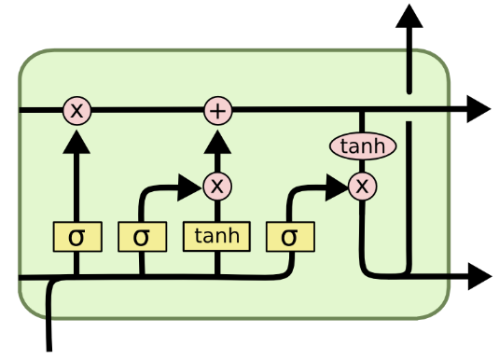
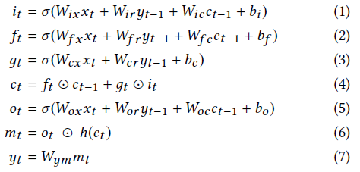




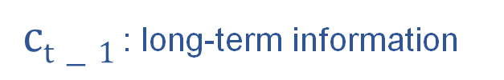

Quick Intro to LSTM
A popular type of RNN
The most computation-heavy part:
Matrix-Vector Multiplication (MxV)
$$yt$$
$$ct−1$$
$ct−1$ : long-term information
$$yt−1$$
$$yt$$
$$xt$$
Notes:
LSTM is a popular type of RNN. The core idea behind LSTM is adding a cell state, in order to mitigate the problem that previous RNN can not remember long-term information.
(Click)
The most computation-heavy part is MxV (matrix-vector multiplication) . As the size of the LSTM network
grows, the inference cost increases significantly.

Slide 9
Weight Pruning
Han, Song, et al. Learning both Weights and Connections for Efficient Neural Networks, NIPS’15
Notes:
Weight pruning is an effective technique to reduce the model size and computational complexity.

Slide 10
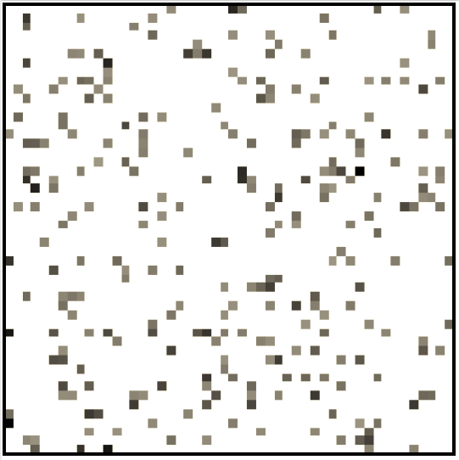
Weight Pruning
Difficult to accelerate
Prune away small weights
Unstructured sparse matrices
MxV → SpMxV
Han, Song, et al. Learning both Weights and Connections for Efficient Neural Networks, NIPS’15
Notes:
Previous work provides a threshold-based weight pruning technique. This method prunes away small weights whose
absolute values are less than a predefined threshold and retrains the remaining weights.
(click)
This fine-grained pruning method is good at preserving accuracy as well as achieving higher compression rates. However, it converts dense weight matrices to unstructured sparse matrices. And the most significant part of LSTM inference changes from dense MxV to SpMxV (sparse matrix-vector multiplication). Although requiring less computation, SpMxV is difficult to accelerate on hardware due to irregular computation and memory accesses.

Slide 11
Accuracy and Speedup Tradeoff
Fine-grained Coarse-grained
Irregular Regular
Pros:
High model accuracy
High compression ratio
Cons:
Irregular pattern
Difficult to accelerate
Cons:
Low model accuracy
Low compression ratio
Pros:
Regular pattern
Easy to accelerate
Notes:
To address this issue, further works propose coarser-grained pruning methods to increase the regularity of sparse weight matrices. Coarse-grained pruning methods prune weights in the granularity of blocks, making it easier to accelerate on hardware. Unfortunately, when coarse-grained pruning is applied, it becomes challenging to maintain high model accuracy and high compression rate.
Existing work often needs to search a range of block sizes to find a trade-off between model accuracy and speedup.

Slide 12
How to Achieve Both?
Model accuracy
Add few constraints on the sparsity pattern
Speedup
Matrix partitioning for parallel computing
Eliminating irregular computation and memory access
Notes:
So, is there a better sparsity pattern for weight pruning to achieve both high model accuracy and high speedup, and how to achieve both?
(click)
In terms of model accuracy, we think that we should add very few constraints on the sparsity structure to preserve the randomness of non-zero weights.
(click)
In terms of speedup sparse matrix computation, we should partition the weight matrix for parallel computing and eliminate irregular computation and memory access.

Slide 13
Outline
Motivation
Design
Bank-Balanced Sparsity Pattern (BBS)
Sparse Matrix Computation and Format for BBS
BBS FPGA Accelerator
Evaluation
Model Accuracy
Hardware Efficiency
Conclusion
Notes:
So in this work, we propose a new sparsity pattern BBS (bank-balanced sparsity) for weight pruning that can maintain model accuracy at a high sparsity level while still enable an efficient FPGA implementation.

Slide 14
Outline
Motivation
Design
Bank-Balanced Sparsity Pattern (BBS)
Sparse Matrix Computation and Format for BBS
BBS FPGA Accelerator
Evaluation
Model Accuracy
Hardware Efficiency
Conclusion
Notes:
I will first describe the pattern of BBS and the motivation for designing it.

Slide 15
Bank-Balanced Pruning
Bank Split
Dense
Matrix
Notes:
We propose a bank-balanced pruning method to induce the BBS sparsity pattern on weight matrices.
(click)
First, we have a dense weight matrix.
(click)
In our pruning method, each matrix row is first split into multiple equal-sized banks (that is, sub-rows). Here, different color indicates different banks.

Slide 16
Bank-Balanced Pruning
Bank Split
Dense
Matrix
Traverse all rows
Dense
Matrix Row
Fine-grained pruning inside each bank
BBS
Matrix Row
Threshold percentage to obtain identical sparsity ratio among banks
Notes:
And then for each weight matrix row, we adopt fine-grained pruning inside each bank independently.
(click)
Instead of using a predefined threshold value, we use a threshold percentage to obtain identical sparsity ratio among banks.

Slide 17
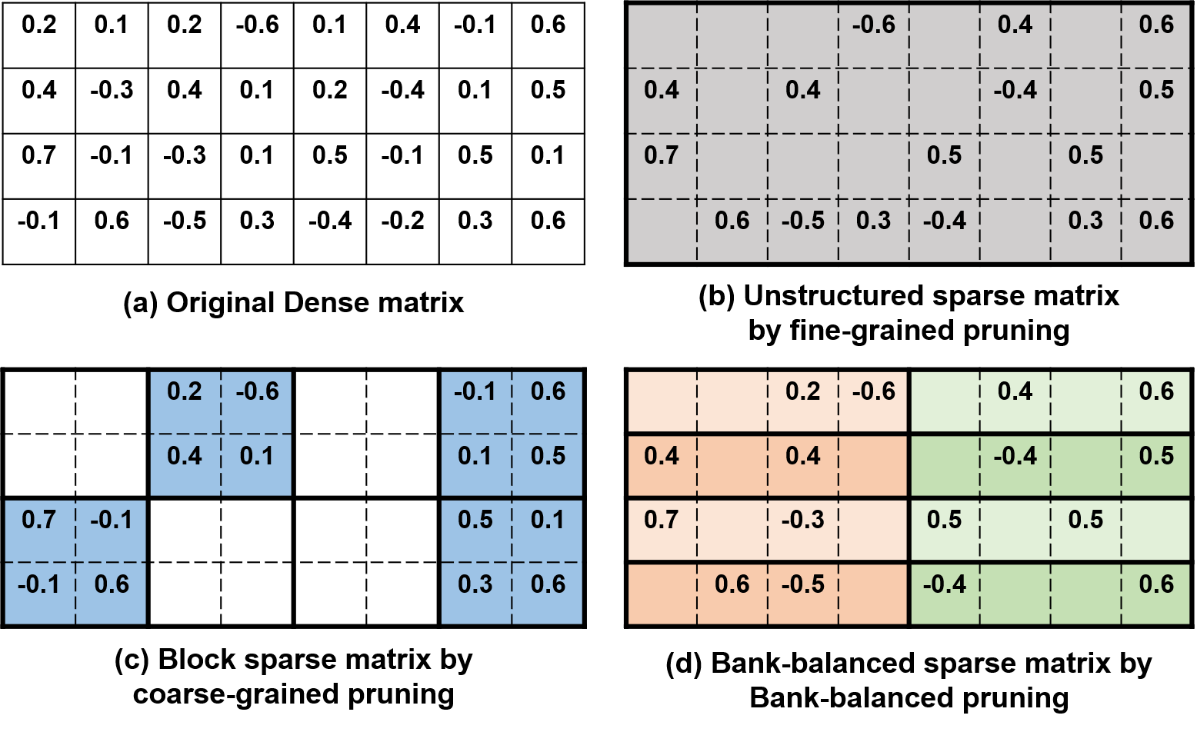
Bank-Balanced Sparsity (BBS)
Bank partitioning for parallel computing
Fine-grained pruning inside each bank for maintaining accuracy
Notes:
This figure demonstrates BBS with an example and compares it with unstructured sparsity by fin-grained pruning and block sparsity by coarse-grained pruning.
(click)
We design this BBS sparsity pattern with consideration of both hardware efficiency and model accuracy. This bank-balanced partitioning enables an efficient SpMxV design to exploit both inter-row parallelism and inter-bank parallelism. In addition, since BBS applies fine-grained pruning within each bank independently, the relatively large weights which contribute more to model accuracy in each bank can be preserved.

Slide 18
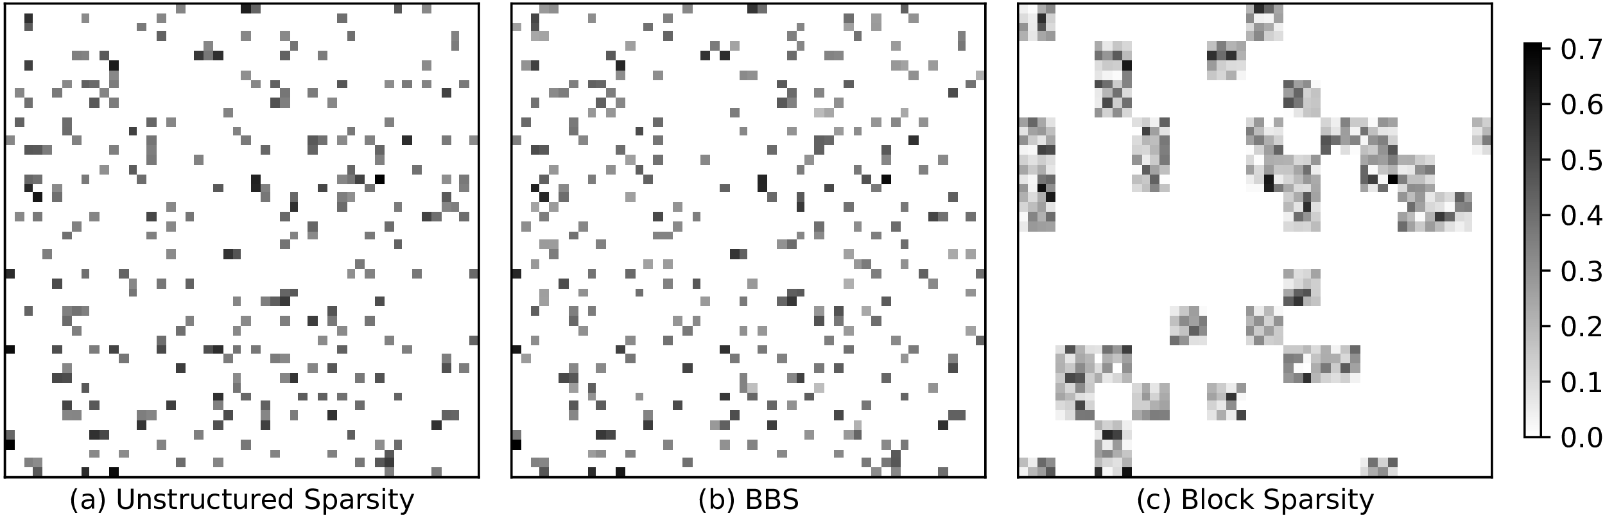
Weight map visualization
Visual comparison
Notes:
To verify the pruning effectiveness of BBS and compare it with unstructured sparsity and block sparsity, we capture a small part of the weight matrix in a real LSTM model and visualize the weight matrices after various pruning methods.
In this figure, grey grids indicate non-zero parameters and the grey level indicates the weight magnitude.

Slide 19
Weight map visualization
Visual comparison
Bank 0 Bank 1
Notes:
For the second matrix represented in BBS, each row has two banks (that is, the left and right sides of the dashed line). Each bank has 3 non-zero weights.
We can see that the weight map of BBS is very similar to the weight map of unstructured sparsity, but the weight map of block sparsity is quite different because of the locality constraint.

Slide 20
Weight map visualization
Visual comparison
Bank 0 Bank 1
Effect on model accuracy in evaluation results
Notes:
In terms of achievable accuracy and sparsity on real models, experimental results will be described in evaluation results later.

Slide 21
Outline
Motivation
Design
Bank-Balanced Sparsity Pattern (BBS)
Sparse Matrix Computation and Format for BBS
BBS FPGA Accelerator
Evaluation
Model Accuracy
Hardware Efficiency
Conclusion
Notes:
Since SpMxV becomes the most computation-intensive part in real-time LSTM inference, we introduce a highly parallel SpMxV design for BBS and its associated sparse matrix format.

Slide 22
Sparse MV Multiplication (SpMxV)
Inter-row parallelism: multiple PEs
Vector
Matrix
PE 0
PE 1
PE 2
PE 3
PE 4
PE 5
Notes:
SpMxV consists of multiple dot product operations, one for each sparse matrix row and the dense vector.
The standard practice of using multiple PEs can parallelize dot products across matrix rows

Slide 23
Sparse MV Multiplication (SpMxV)
Intra-row (inter-bank) parallelism:
Vector
Matrix
V₀
V₁
V₂
V₃
V₄
V₅
V₆
V₇
V₈
V₉
V₁₀
V₁₁
A | 0 | B | C | D | 0 | 0 | E | F | G | 0 | H
PE 0
PE 1
PE 2
PE 3
PE 4
PE 5
Notes:
In addition to inter-row parallelism, BBS further enables to exploit inter-bank parallelism through the bank-balance partitioning.
Here we use an example to illustrate how to exploit inter-bank parallelism in computing a dot product of a BBS matrix row and the dense vector.

Slide 24
Sparse MV Multiplication (SpMxV)
Intra-row (inter-bank) parallelism:
BSB matrix row
Dense vector
A | 0 | B | C | D | 0 | 0 | E | F | G | 0 | H
V₀
V₁
V₂
V₃
V₄
V₅
V₆
V₇
V₈
V₉
V₁₀
V₁₁
Bank 0
Bank 1
Bank 2
Bank 3
A | C | E | G
Notes:
In this example, the BBS matrix row is divided into 4 banks, shown in different colors.
The multiplications for the non-zero elements inside each bank are performed serially, while the multiplications in different banks are performed in parallel.
So in this example ACEG are accessed first.

Slide 25
Sparse MV Multiplication (SpMxV)
Intra-row (inter-bank) parallelism:
BSB matrix row
A | 0 | B | C | D | 0 | 0 | E | F | G | 0 | H
Bank 0
Bank 1
Bank 2
Bank 3
Dense vector
V₀ | V₁ | V₂
Bank 0
A | C | E | G
V₃ | V₄ | V₅
Bank 1
V₆ | V₇ | V₈
Bank 2
V₉ | V₁₀ | V₁₁
Bank 3
Notes:
In order to supply vector elements simultaneously, the multiplied dense vector is divided into 4 banks accordingly.

Slide 26
Sparse MV Multiplication (SpMxV)
Intra-row (inter-bank) parallelism:
BSB matrix row
A | 0 | B | C | D | 0 | 0 | E | F | G | 0 | H
Bank 0
Bank 1
Bank 2
Bank 3
Dense vector
V₀ | V₁ | V₂
Bank 0
V₀ | V₃ | V₇ | V₉
A | C | E | G
V₃ | V₄ | V₅
Bank 1
Partial dot product: V₀•A+V₃•C+V₇•E+V₉•G
S1
V₆ | V₇ | V₈
Bank 2
Accumulate
V₉ | V₁₀ | V₁₁
Bank 3
Notes:
According to the indices of ACEG, V0, V3, V7 and V9 are accessed at the same time.
(click)
In computing the dot product, multiplications of four pairs of elements are executed in parallel.
And we obtain the partial dot product, s1

Slide 27
Sparse MV Multiplication (SpMxV)
Intra-row (inter-bank) parallelism:
BSB matrix row
A | 0 | B | C | D | 0 | 0 | E | F | G | 0 | H
Bank 0
Bank 1
Bank 2
Bank 3
Dense vector
V₀ | V₁ | V₂
Bank 0
V₂ | V₄ | V₈ | V₁₁
B | D | F | H
V₃ | V₄ | V₅
Bank 1
Partial dot product: V₂•B+V₄•D+V₈•F+V₁₁•H
S2
V₆ | V₇ | V₈
Bank 2
Accumulate
V₉ | V₁₀ | V₁₁
S1+S2
Bank 3
Notes:
In the next step, BDFH and V2,V4,V8 and V11 are accessed similarly.
(click)
The partial dot product s2 is accumulated with the previous partial dot product s1 to get the complete dot product.

Slide 28
Sparse MV Multiplication (SpMxV)
Both inter-row and inter-bank parallelism
Load balancing across rows and banks
Bank 0
Bank 1
Bank 2
Bank 3
Row 0
A | 0 | B | C | D | 0 | 0 | E | F | G | 0 | H
Row 1
I | J | 0 | K | 0 | L | M | N | 0 | O | P | 0
Dense vector
V₀ | V₁ | V₂
Bank 0
Conflict-free vector accesses
V₃ | V₄ | V₅
Bank 1
V₆ | V₇ | V₈
Bank 2
V₉ | V₁₀ | V₁₁
Bank 3
Notes:
In summary,
taking advantage of the bank balanced property of BBS, this SpMxV design can easily exploit both inter-row and inter-bank parallelism.
(click)
In BBS, every row and every bank has the same number of elements which automatically guarantees the load balance across rows and banks in SpMxV.
(click)
When accessing the vector elements, BBS ensures one and only one element is accessed in each bank. Therefore, storing each vector bank in an independently block RAM can supply vector elements simultaneously with high bandwidth and without memory access conflicts.

Slide 29
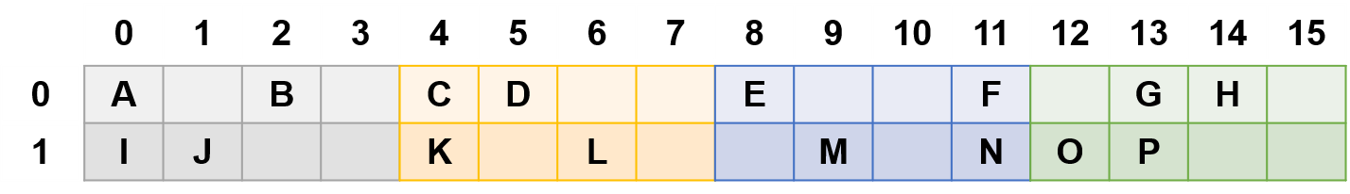
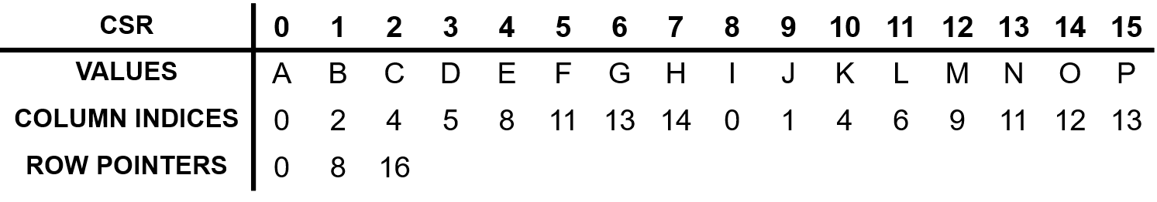
CSR (Compressed Sparse Rows)
Notes:
Compressed Sparse Row (CSR) is a commonly used sparse matrix format.
However, it introduces decoding overheads when implementing our SpMxV design on FPGA.

Slide 30
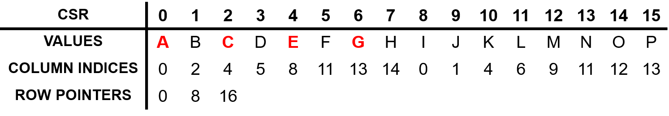
CSR (Compressed Sparse Rows)
Decoding overhead in BBS
Rearrange the order
Notes:
First, CSR format encodes all non-zero elements in a row-major order. Rearranging the non-zero elements are inevitable in order to exploit inter-bank parallelism in our SpMxV design.

Slide 31
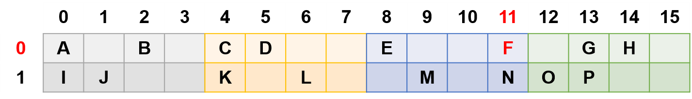
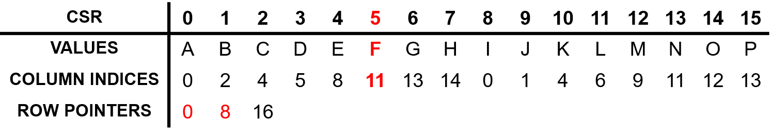
CSR (Compressed Sparse Rows)
Decoding overhead in BBS
Rearrange the order
Compute the index in bank
Notes:
Second, CSR format stores column indices and row pointers to track the location of each non-zero value. Thus, computing its index in the bank is required to fetch its corresponding vector element.

Slide 32
Our CSB (Compressed Sparse Banks)
CSB
VALUES
0 | 1 | 2 | 3 | 4 | 5 | 6 | 7 | 8 | 9 | 10 | 11 | 12 | 13 | 14 | 15
A | C | E | G | B | D | F | H | I | K | M | O | J | L | N | P
0 | 0 | 0 | 1 | 2 | 2 | 3 | 2 | 0 | 0 | 1 | 3 | 1 | 2 | 3 | 1
BANK INTERNAL
INDICES
Specifically designed for BBS to eliminate decoding overheads
Notes:
In order to eliminate decoding overheads, we introduce a sparse matrix format called Compressed Sparse Banks (CSB) that is specifically designed
for BBS.

Slide 33
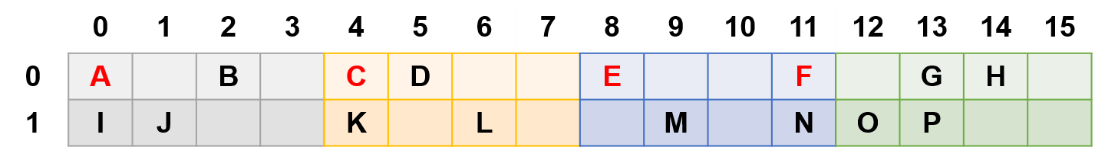
Our CSB (Compressed Sparse Banks)
Data rearrangement for
inter-bank parallelization
CSB
VALUES
0 | 1 | 2 | 3 | 4 | 5 | 6 | 7 | 8 | 9 | 10 | 11 | 12 | 13 | 14 | 15
A | C | E | G | B | D | F | H | I | K | M | O | J | L | N | P
0 | 0 | 0 | 1 | 2 | 2 | 3 | 2 | 0 | 0 | 1 | 3 | 1 | 2 | 3 | 1
BANK INTERNAL
INDICES
Specifically designed for BBS to eliminate decoding overheads
Notes:
In CSB, the order of non-zero elements are rearranged in advance.

Slide 34
Our CSB (Compressed Sparse Banks)
0 | 1 | 2 | 3 | 0 | 1 | 2 | 3 | 0 | 1 | 2 | 3 | 0 | 1 | 2 | 3
Data rearrangement for
inter-bank parallelization
CSB
VALUES
0 | 1 | 2 | 3 | 4 | 5 | 6 | 7 | 8 | 9 | 10 | 11 | 12 | 13 | 14 | 15
A | C | E | G | B | D | F | H | I | K | M | O | J | L | N | P
0 | 0 | 0 | 1 | 2 | 2 | 3 | 2 | 0 | 0 | 1 | 3 | 1 | 2 | 3 | 1
BANK INTERNAL
INDICES
Physical BRAM addresses
Specifically designed for BBS to eliminate decoding overheads
Notes:
And CSB lists the bank internal indices directly instead of column indices.
The bank internal indices can be directly regarded as physical addresses to fetch the vector elements.

Slide 35
Outline
Motivation
Design
Bank-Balanced Sparsity Pattern (Pruning Method)
Sparse Matrix Computation and Format for BBS
BBS FPGA Accelerator
Evaluation
Model Accuracy
Hardware Efficiency
Conclusion
Notes:
Then, we introduce the FPGA accelerator for LSTM networks with bank-balanced sparsity.

Slide 36
Accelerator Overview
Notes:
Similar to other heterogenous accelerators on FPGA, the BBS accelerator receives data and instructions from the host server and return results after FPGA execution.
BBS accelerator mainly consists of a sparse matrix-vector multiplication unit (SpMxV Unit), an element-wise vector operation unit (EWOP Unit), on-chip memories for matrices and vectors, and a central controller.

Slide 37
Accelerator Overview
Notes:
The SpMxV unit implements the highly parallel SpMxV design described before.
It includes a PE array to exploit inter-row parallelism, while each PE is designed to exploit inter-bank parallelism as we described before.

Slide 38
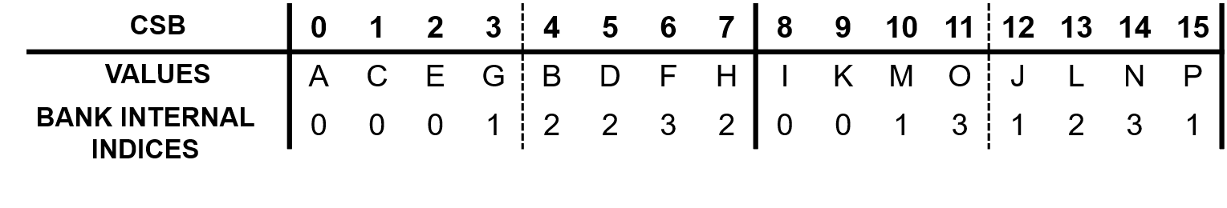
Accelerator Overview
Notes:
The matrix memory stores weight represented in CSB format.

Slide 39
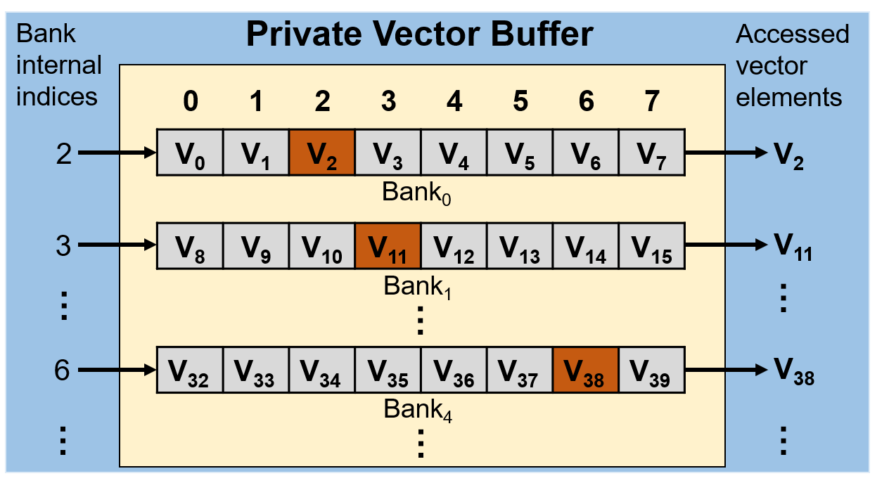
Accelerator Overview
Notes:
For the private vector buffer inside each PE, each bank of the multiplied vector is stored in multiple BRAMs. Therefore, the private vector buffer can provide multiple vector elements simultaneously through bank internal indices.

Slide 40
Outline
Motivation
Design
Bank-Balanced Sparsity Pattern (BBS)
Sparse Matrix Computation and Format for BBS
BBS FPGA Accelerator
Evaluation
Model Accuracy
Hardware Efficiency
Conclusion
Notes:
Our evaluation centers around two aspects: the model accuracy of BBS and the hardware efficiency of BBS accelerator.

Slide 41
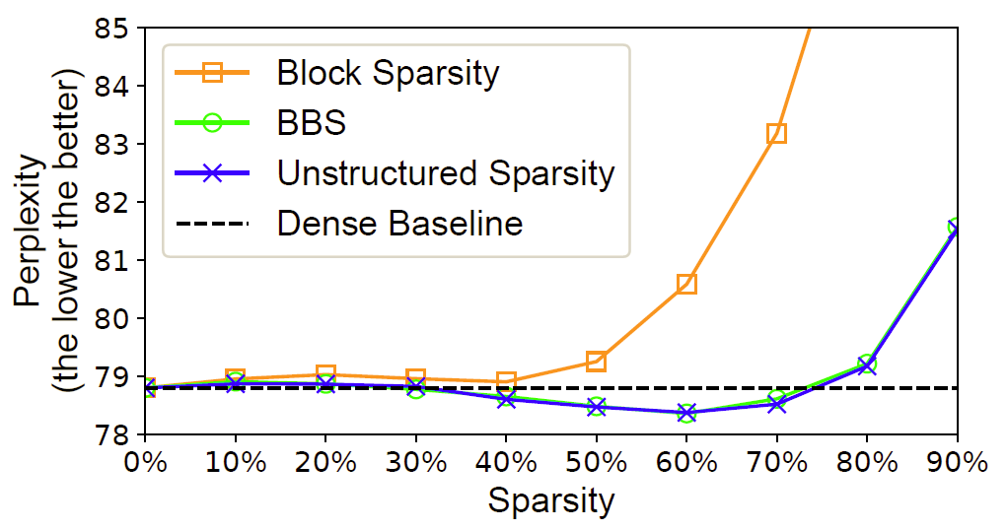
Model Accuracy
Language model
PTB dataset
Speech Recognition
on TIMIT dataset
Notes:
We evaluate the model accuracy of BBS with an LSTM language model of the PTB dataset and an LSTM speech recognition model on the TIMIT dataset.
(click)We compare bank-balanced sparsity with the dense baseline, unstructured sparsity by fine-grained pruning and block sparsity by coarse-grained pruning.

Slide 42
Model Accuracy
Language model
PTB dataset
Very close
Speech Recognition
on TIMIT dataset
Notes:
As shown in first Figure, the perplexity curve of our BBS is very close to the perplexity curve of unstructured sparsity.
Perplexity is a metric to quantify language model quality. The lower the better.
Both unstructured sparsity and BBS can preserve the perplexity until around 80% of weights are pruned away.
However, the perplexity of block sparsity starts to increase significantly at 40% sparsity.

Slide 43
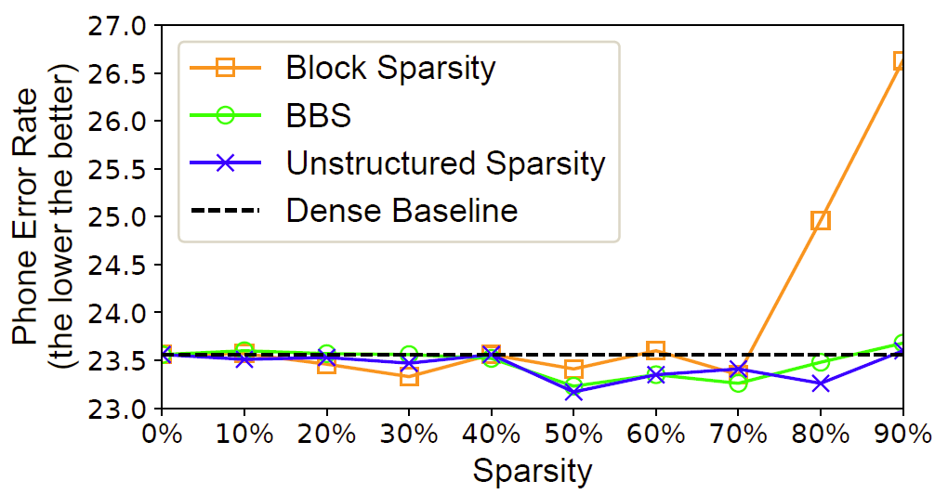
Model Accuracy
Language model
PTB dataset
Very close
Speech Recognition
on TIMIT dataset
Notes:
Experiments on the LSTM speech recognition model show similar results. These experimental results demonstrate that BBS has almost the same effectiveness as random sparsity and outperforms block sparsity in terms of achievable accuracy or sparsity during pruning.

Slide 44
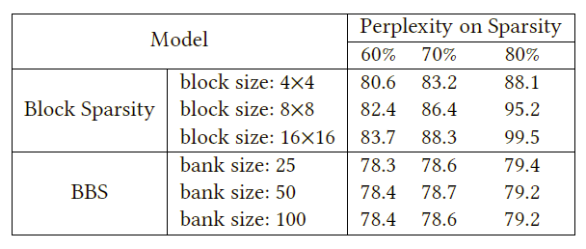
Sensitivity to Bank Size
LSTM model on PTB dataset
Comparisons
Different bank size in BBS
Different block size in Block sparsity
Accuracy drop
Almost the same
Notes:
We further explore the accuracy sensitivity of BBS to the bank size (or the number of banks). As a comparison, we also explore the accuracy sensitivity of block sparsity to the block size.
(click)As shown, BBS achieves almost the same model accuracy regardless of the change of bank size.
(click)For block sparsity, however, increasing the block size adversely affects model accuracy.

Slide 45
Hardware Efficiency
FPGA platform
Catapult[1] with Intel Arria 10
Architecture setting
M = 64 (64 PEs in the SpMxV unit)
N = 64 (each PE has 64 multipliers)
16-bit data precision
Model and Dataset
LSTM on TIMIT dataset
[1] Caulfield, Adrian M., et al. A loud-Scale Acceleration Architecture, MICRO’16.
Notes:
In order to evaluate the hardware efficiency, we implemented the BBS accelerator on catapult platform with an Intel-Arria 10 FPGA.
The BBS accelerator sets to M = 64, N = 64, and thus the accelerator contains 64 PEs in the SpMxV unit, and each PE has 64 multipliers executing in parallel.
The operator bits is 16-bit since 16-bit is accurate enough to maintain model accuracy. The detailed experimental results on quantization are shown in our paper.
The LSTM speech recognition model on TIMIT dataset is used in order to be consistent with previous work.

Slide 46
Hardware Efficiency
FPGA platform
Catapult[1] with Intel Arria 10
Architecture setting
M = 64 (64 PEs in the SpMxV unit)
N = 64 (each PE has 64 multipliers)
16-bit data precision
Model and Dataset
LSTM on TIMIT dataset
Comparisons
ESE[2] : improves throughput through batching
C-LSTM[3] : block-circulant matrices
Delta-RNN[4] : skip dispensable neuron activations
[1] Caulfield, Adrian M., et al. A loud-Scale Acceleration Architecture, MICRO’16.
[2] Han, Song, et al. ESE: Efficient Speech Recognition Engine with Sparse LSTM on FPGA, FPGA’17
[3] Gao, Chang, et al. DeltaRNN: A Power-Efficient Recurrent Neural Network Accelerator, FPGA’18.
[4] Wang, Shuo, et al. C-LSTM: Enabling Efficient LSTM using Structured Compression Techniques on FPGAs, FPGA’18.
Notes:
We compare our BBS accelerator with three state-of-the-art LSTM/RNN accelerators on FPGA: ESE, C-LSTM and DeltaRNN.
These three studies adopt different optimization techniques to reduce computation requirements.
ESE improves inference throughput of sparse LSTMs through batching multiple samples.
C-LSTM represents weight matrices with block-circulant matrices and proposes an accelerator with an FFT-based computing kernel.
DeltaRNN reduce computational operations and corresponding weight fetches by skipping dispensable neuron activation changes.

Slide 47
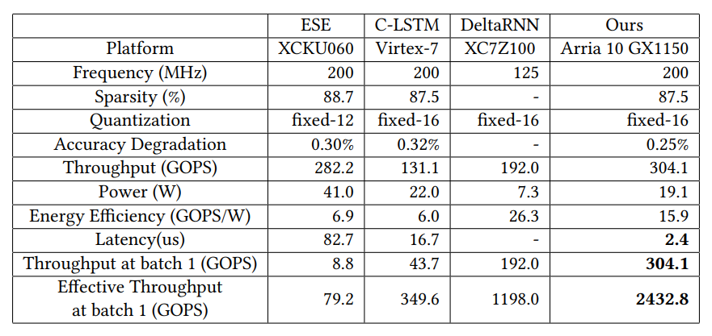
Hardware Efficiency
Notes:
This table shows the comparison results.
We use the accuracy and performance numbers of ESE, C-LSTM and DeltaRNN reported in their papers.
DeltaRNN presents experimental results on an GRU network which is simpler than LSTM. So the performance number of DeltaRNN is an optimistic estimation

Slide 48
Hardware Efficiency
Notes:
With the same model on the same data set, BBS achieves comparable compression rate and model accuracy as ESE and C-LSTM.
DeltaRNN utilizes activation sparsity which is a different optimization approach, so we don’t have the weight sparsity ratio and accuracy change.

Slide 49
Hardware Efficiency
~34x
~7x
Notes:
Our accelerator achieves slightly better throughput and energy efficiency than previous work.
But in terms of inference latency or throughput at a single batch, our accelerator achieves around 34x speedup compared to ESE and 7x speedup compared to C-LSTM.

Slide 50
Hardware Efficiency
Much better single batch performance because
Enabling extra inter-bank parallelism
Addressing the irregular memory access in SpMxV
Notes:
In summary, BBS accelerator can achieve much better single batch performance because it enables the extra dimension of inter-bank parallelism and addresses the low memory bandwidth issue of irregular memory access in SpMxV.

Slide 51
Conclusion
Bank-balanced sparsity (BBS)
Maintains model accuracy
Enables a highly parallel SpMxV design
BBS FPGA accelerator
Eliminates irregular computation and memory accesses
2.3 ~ 3.7x improvement on energy efficiency
7.0 ~ 34.4x reduction on latency
Notes:
To conclude this work,
We propose bank-balanced sparsity (BBS), a sparsity pattern can both maintain model accuracy and enable a highly parallel SpMxV design.
We implement an FPGA accelerator for BBS that eliminates irregular computation and memory accesses. Compared to previous LSTM FPGA accelerators, we achieve 2.3 ~ 3.7x improvement on energy efficiency and 7.0 ~ 34.4x reduction on latency.

Slide 52
Thank you! Contact: caoshijie0501@gmail.com

