Slide 1
Classification of Raisin Grains Using Machine Learning and Data Science
Yiran Li
Xinyu Wang

Slide 2
Method used: Classification
Classification in supervised Machine Learning (ML) is the process of predicting ‘labled’ data
Labeled data
Unlabeled data
Notes:
Classification in supervised Machine Learning (ML) is the process of predicting the class or category of data based on predefined classes of data that have been ‘labeled’.
Labeled data is data that has already been classified
Unlabeled data is data that has not yet been classified

Slide 3
Types Of Classification
There are two main types of classification:
Binary Classification – sorts data on the basis of discrete or non-continuous values (usually two values). For example, a medical test may sort patients into those that have a specific disease versus those that do not.
Multi-class Classification – sorts data into three or more classes. For example, medical profiling that sorts patients into those with kidney, liver, lung, or bladder infection symptoms

Slide 4
Popular ML Packages used in the project
Machine learning
Scikit-learn
Data Science:
Pandas
NumPy
Seaborn
Notes:
Machine learning
Scikit-learn (machine learning algorithms)
Data Science:
Pandas (data analysis)
NumPy (multidimensional arrays)
Seaborn(data visualization)

Slide 5
How to Do Classification with Scikit-Learn
Naive Bayes
Explores the relationship betweenprobability and possibility.
K-Nearest Neighbors (KNN)
K -- the square root of the number of training records.
Notes:
we can use scikit-learn to perform classification using two classification algorithms (which is also known as classifiers), including:
Naive Bayes – a family of classifiers based on a Bayesian model that is comparatively fast and accurate. Bayesian theory explores the relationship between probability and possibility.
K-Nearest Neighbors (KNN) – a classification algorithm, where K refers to the square root of the number of training records.

Slide 6
Data Set Information
Images of Kecimen and Besni raisin varieties grown in Turkey were obtained with CVS. A total of 900 raisin grains were used, including 450 pieces from both varieties. These images were subjected to various stages of pre-processing and 7 morphological features were extracted. These features have been classified using three different artificial intelligence techniques.
Notes:
Data Set Information: Images of Kecimen and Besni raisin varieties grown in Turkey were obtained with CVS. A total of 900 raisin grains were used, including 450 pieces from both varieties. These images were subjected to various stages of pre-processing and 7 morphological features were extracted. These features have been classified using three different artificial intelligence techniques.

Slide 7
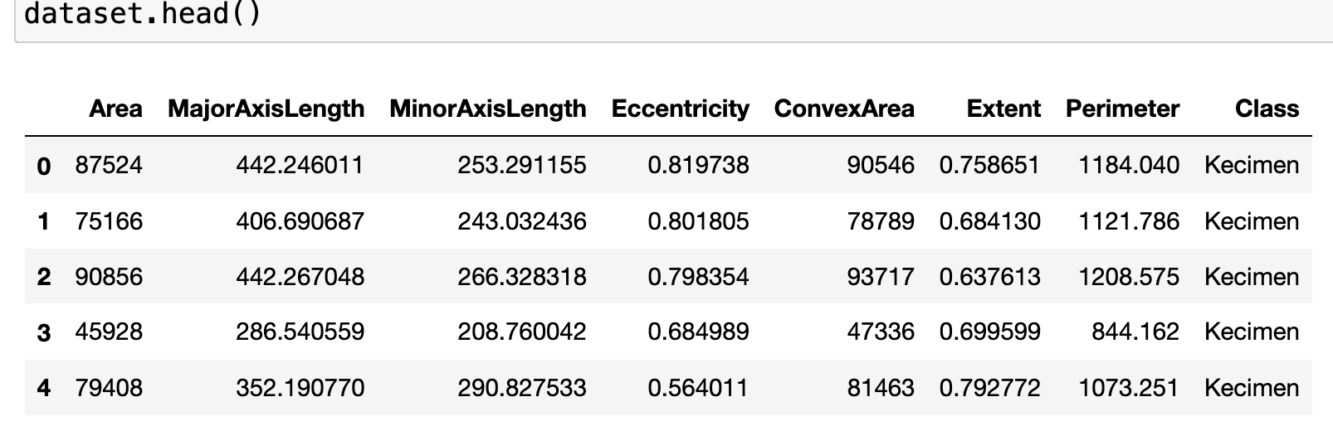
Attribute Information:
Notes:
Attribute Information:
Area: Gives the number of pixels within the boundaries of the raisin.
Perimeter: It measures the environment by calculating the distance between the boundaries of the raisin and the pixels around it.
MajorAxisLength: Gives the length of the main axis, which is the longest line that can be drawn on the raisin.
MinorAxisLength: Gives the length of the small axis, which is the shortest line that can be drawn on the raisin.
Eccentricity: It gives a measure of the eccentricity of the ellipse, which has the same moments as raisins.
ConvexArea: Gives the number of pixels of the smallest convex shell of the region formed by the raisin.
Extent: Gives the ratio of the region formed by the raisin to the total pixels in the bounding box.
Class: Kecimen and Besni raisin.

Slide 8
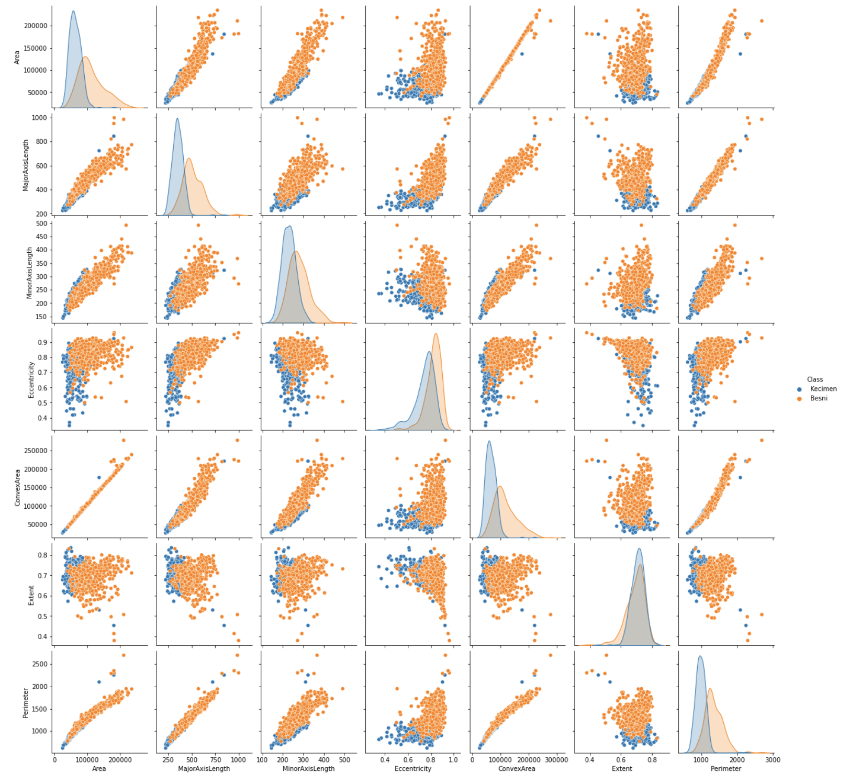
Data Visualization using Seaborn

Slide 9
1
2
3
Notes:
Pairing diagram, which shows us the relationship between all variables.
According to the above icons, we can find that there is a clear linear correlation between ConvexArea and Area. And, again, there is a clear correlation between them and Perimeter. Therefore, to ensure that our model can be more accurate, we may need to selectively remove a few of them. Of course, these depend on our subsequent model training, which we currently do not do for the time being.

Slide 10

K-Nearest Neighbors (K-NN)
Brief Introduction and Model Evaluation

Slide 11
K-Nearest Neighbors (KNN) Algorithm
k-NN is a type of classification where the function is only approximated locally, and all computation is deferred until function evaluation. Since this algorithm relies on distance for classification, if the features represent different physical units or come in vastly different scales then normalizing the training data can improve its accuracy dramatically
# Use the KNN classifier to fit data:
classifier = KNeighborsClassifier(n_neighbors=5)
classifier.fit(X_train, y_train)
# Predict y data with classifier:
y_predict = classifier.predict(X_test)
Notes:
k-NN is a type of classification where the function is only approximated locally, and all computation is deferred until function evaluation. Since this algorithm relies on distance for classification, if the features represent different physical units or come in vastly different scales then normalizing the training data can improve its accuracy dramatically.
And here is the sample code of how to use KNN in Python

Slide 12
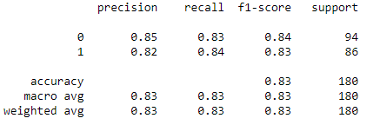
Model Evaluation: K-NN
# - Parameters:
# test: Test Value
# predict: Predict Value
# - Return: the accuracy calculated
# by the test and predict
def calModelAccuracy(test, predict)
#
# evaluate model
print(calModelAccuracy(y_test, y_predict))
print(classification_report(y_test, y_predict))
Console Output:
0.8333333333333334
Notes:
To evaluation the performance of K-NN, we defined a function `calModelAccuracy` to calculate the model accuracy and also use the classification_report from the metics package.
From the console output, we could find that the K-NN algorithm is good for this problem, its accuracy is about 83%. And the next thing is to fine-tune the model such that it could achieve the best performance.

Slide 13

Parameter Tuning
Looking for the Best Feature Group and Optimal Value of N-Neighbors
Notes:
As we mentioned easier, there are some parameters that may have a strong linear correlation, which we may need to remove them from our model parameters. And here it is...

Slide 14
Find All Possible Feature Group
from itertools import combinations
possible_paramter_pairs = []
paramters_to_be_removed = [0,4,6]
# Get all combinations of the parameters_to_be_removed
for i in range(len(paramters_to_be_removed)):
cbs = combinations(paramters_to_be_removed, i+1)
for cb in cbs:
possible_paramter_pairs.append(list(cb))
# Remove elements from dataset.columns indices
for pIndex in range(len(possible_paramter_pairs)):
tmp = list(range(len(dataset.columns)-1))
tmp = [i for j, i in enumerate(tmp) if j not in possible_paramter_pairs[pIndex]]
possible_paramter_pairs[pIndex] = tmp
Notes:
The most simple or stupid method is to list all possible parameter pairs and then compute the model accuracy to filter the best groups. And here is the code of find all possible feature group.

Slide 15
Compute Accuracy for Feature Group
# Train KNN Classifier and return the
# predict & test data
def trainKNNAndPredict(indices, n=5):
…
return y_predict, y_test
accuracyList = []
for pair in possible_paramter_pairs:
predict, test = trainKNNAndPredict(pair)
accuracyList.append(
calModelAccuracy(test, predict)
)
accuracyList
Console Output
[0.8111111111111111,
0.8111111111111111,
0.8444444444444444,
0.8444444444444444,
0.8,
0.8111111111111111,
0.8388888888888889]
Notes:
So, from the accuracyList, we could find that the best one is the second and third feature group. However, for KNN, the number of neighbor would also influence the accuracy, so we may keep the possible_paramter_pairs and find the best of all cases.

Slide 16
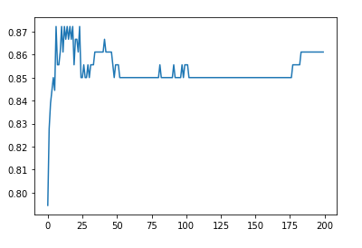
Find the Optimal Number of Neigbors
accuracyListGroup = []
maxN = 0
maxP = 0
maxAccuracy = 0
for p, pair in enumerate(possible_paramter_pairs):
tmpList = []
for i in range(200): # find number of neighbors between [1,200]
y_predict, y_test = trainKNNAndPredict(pair,i)
crtAccuracy = calModelAccuracy(y_test, y_predict)
if maxAccuracy < crtAccuracy:
maxAccuracy = crtAccuracy
maxN = i + 1
maxP = p
tmpList.append(crtAccuracy)
accuracyListGroup.append(tmpList)
# maxN = 6, maxP = 3, maxAccuracy = 0.872
Notes:
From the code here, we could find the best KNN model that have the highest accuracy and the corresponding number of neighbors and the index of the feature group.

Slide 17
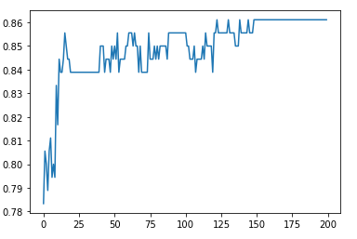
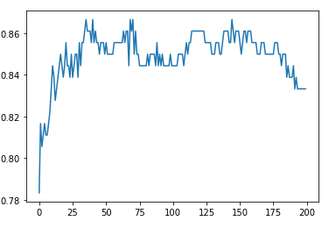
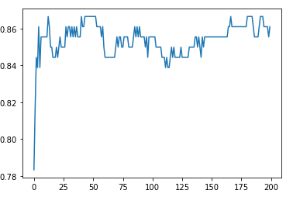
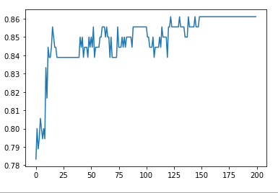
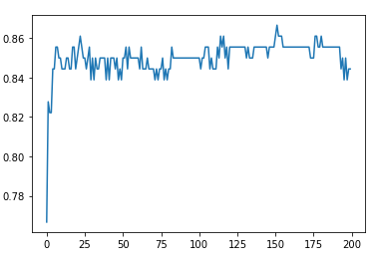
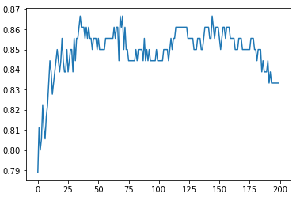
Notes:
Therefore, the best K-NN model is when we remove Area(0), ConvexArea(4), and set the number of neighbors to 7. And the best classifier code is as below

Slide 18
Conclusion
Result & Summary

Slide 19
Conclusion
The best combination of parameters is [1,2,3,5,6] or [“MajorAxisLength”, “MinorAxisLength”, “Eccentricity”, “Extent”, “Perimeter”], which has achieved the best accuracy in both models
K-NN has more desirable results for the two models we have used. However, the accuracy is not very different for both, and the choice needs to be made according to the actual scenario.
There are many other classification methods that can be applied to this problem, such as clustering, SVM, etc.
Notes:
The best combination of parameters is [1,2,3,5,6] or [“MajorAxisLength”, “MinorAxisLength”, “Eccentricity”, “Extent”, “Perimeter”], which has achieved the best accuracy in both models
K-NN has more desirable results for the two models we have used. However, the accuracy is not very different for both, and the choice needs to be made according to the actual scenario.
There are many other classification methods that can be applied to this problem, such as clustering, SVM, etc

