Slide 1

MY INNER

Slide 2
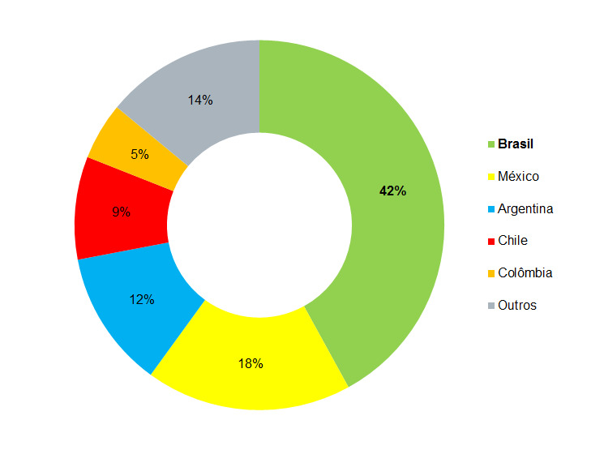


Slide 3
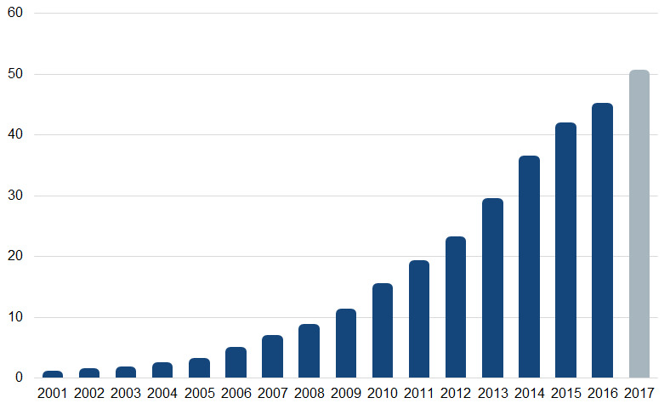

Slide 4


Slide 5











Slide 6
