Slide 1
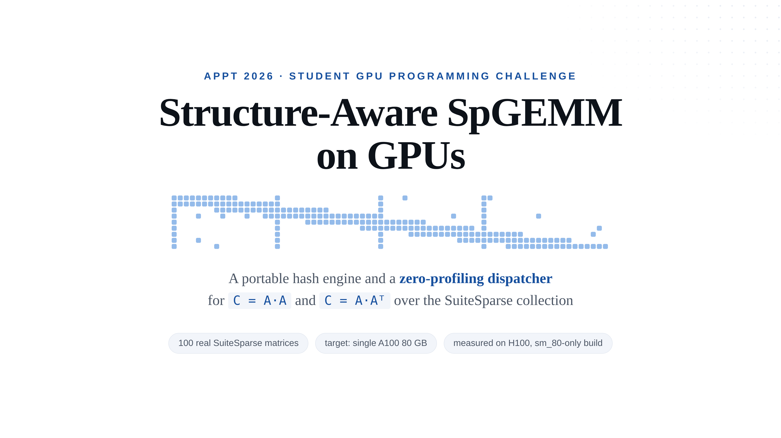
Notes:
— Title —
Good afternoon, and thanks for having me. //
We were asked to multiply sparse matrices on a GPU — a hundred real matrices from SuiteSparse, two products each: A times A, and A times A-transpose. //
We built two things: a hash-based kernel of our own, and a small piece of logic that looks at a matrix and decides whether to run our kernel or hand the work to cuSPARSE. That second piece is what this talk is really about. //
One note on the setup. We compile for S-M eighty and target an A100, but we measured on an H100 with those same binaries. I'll come back to that.

Slide 2
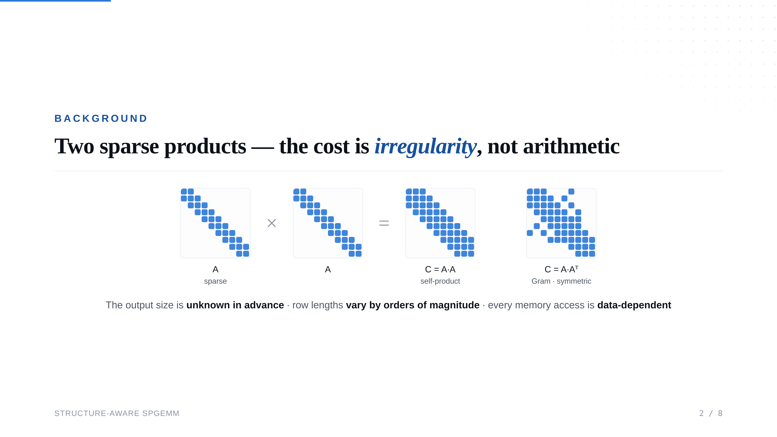
Notes:
— Background —
Both our products come out of the same row-wise merge: A times A, and the Gram product, A times A-transpose. //
Why is this hard on a GPU? Three reasons, and none of them is the arithmetic. You don't know how big the answer is until you have computed it, so you cannot allocate up front. Row lengths are wildly uneven — in one matrix, one row merges three rows and another merges thirty thousand. And which memory you touch depends on the values, so nothing prefetches. All three are the same thing, and the word for it is irregularity. //
And the challenge scores generality across the whole suite: brilliant on ten matrices and terrible on ninety scores badly.

Slide 3
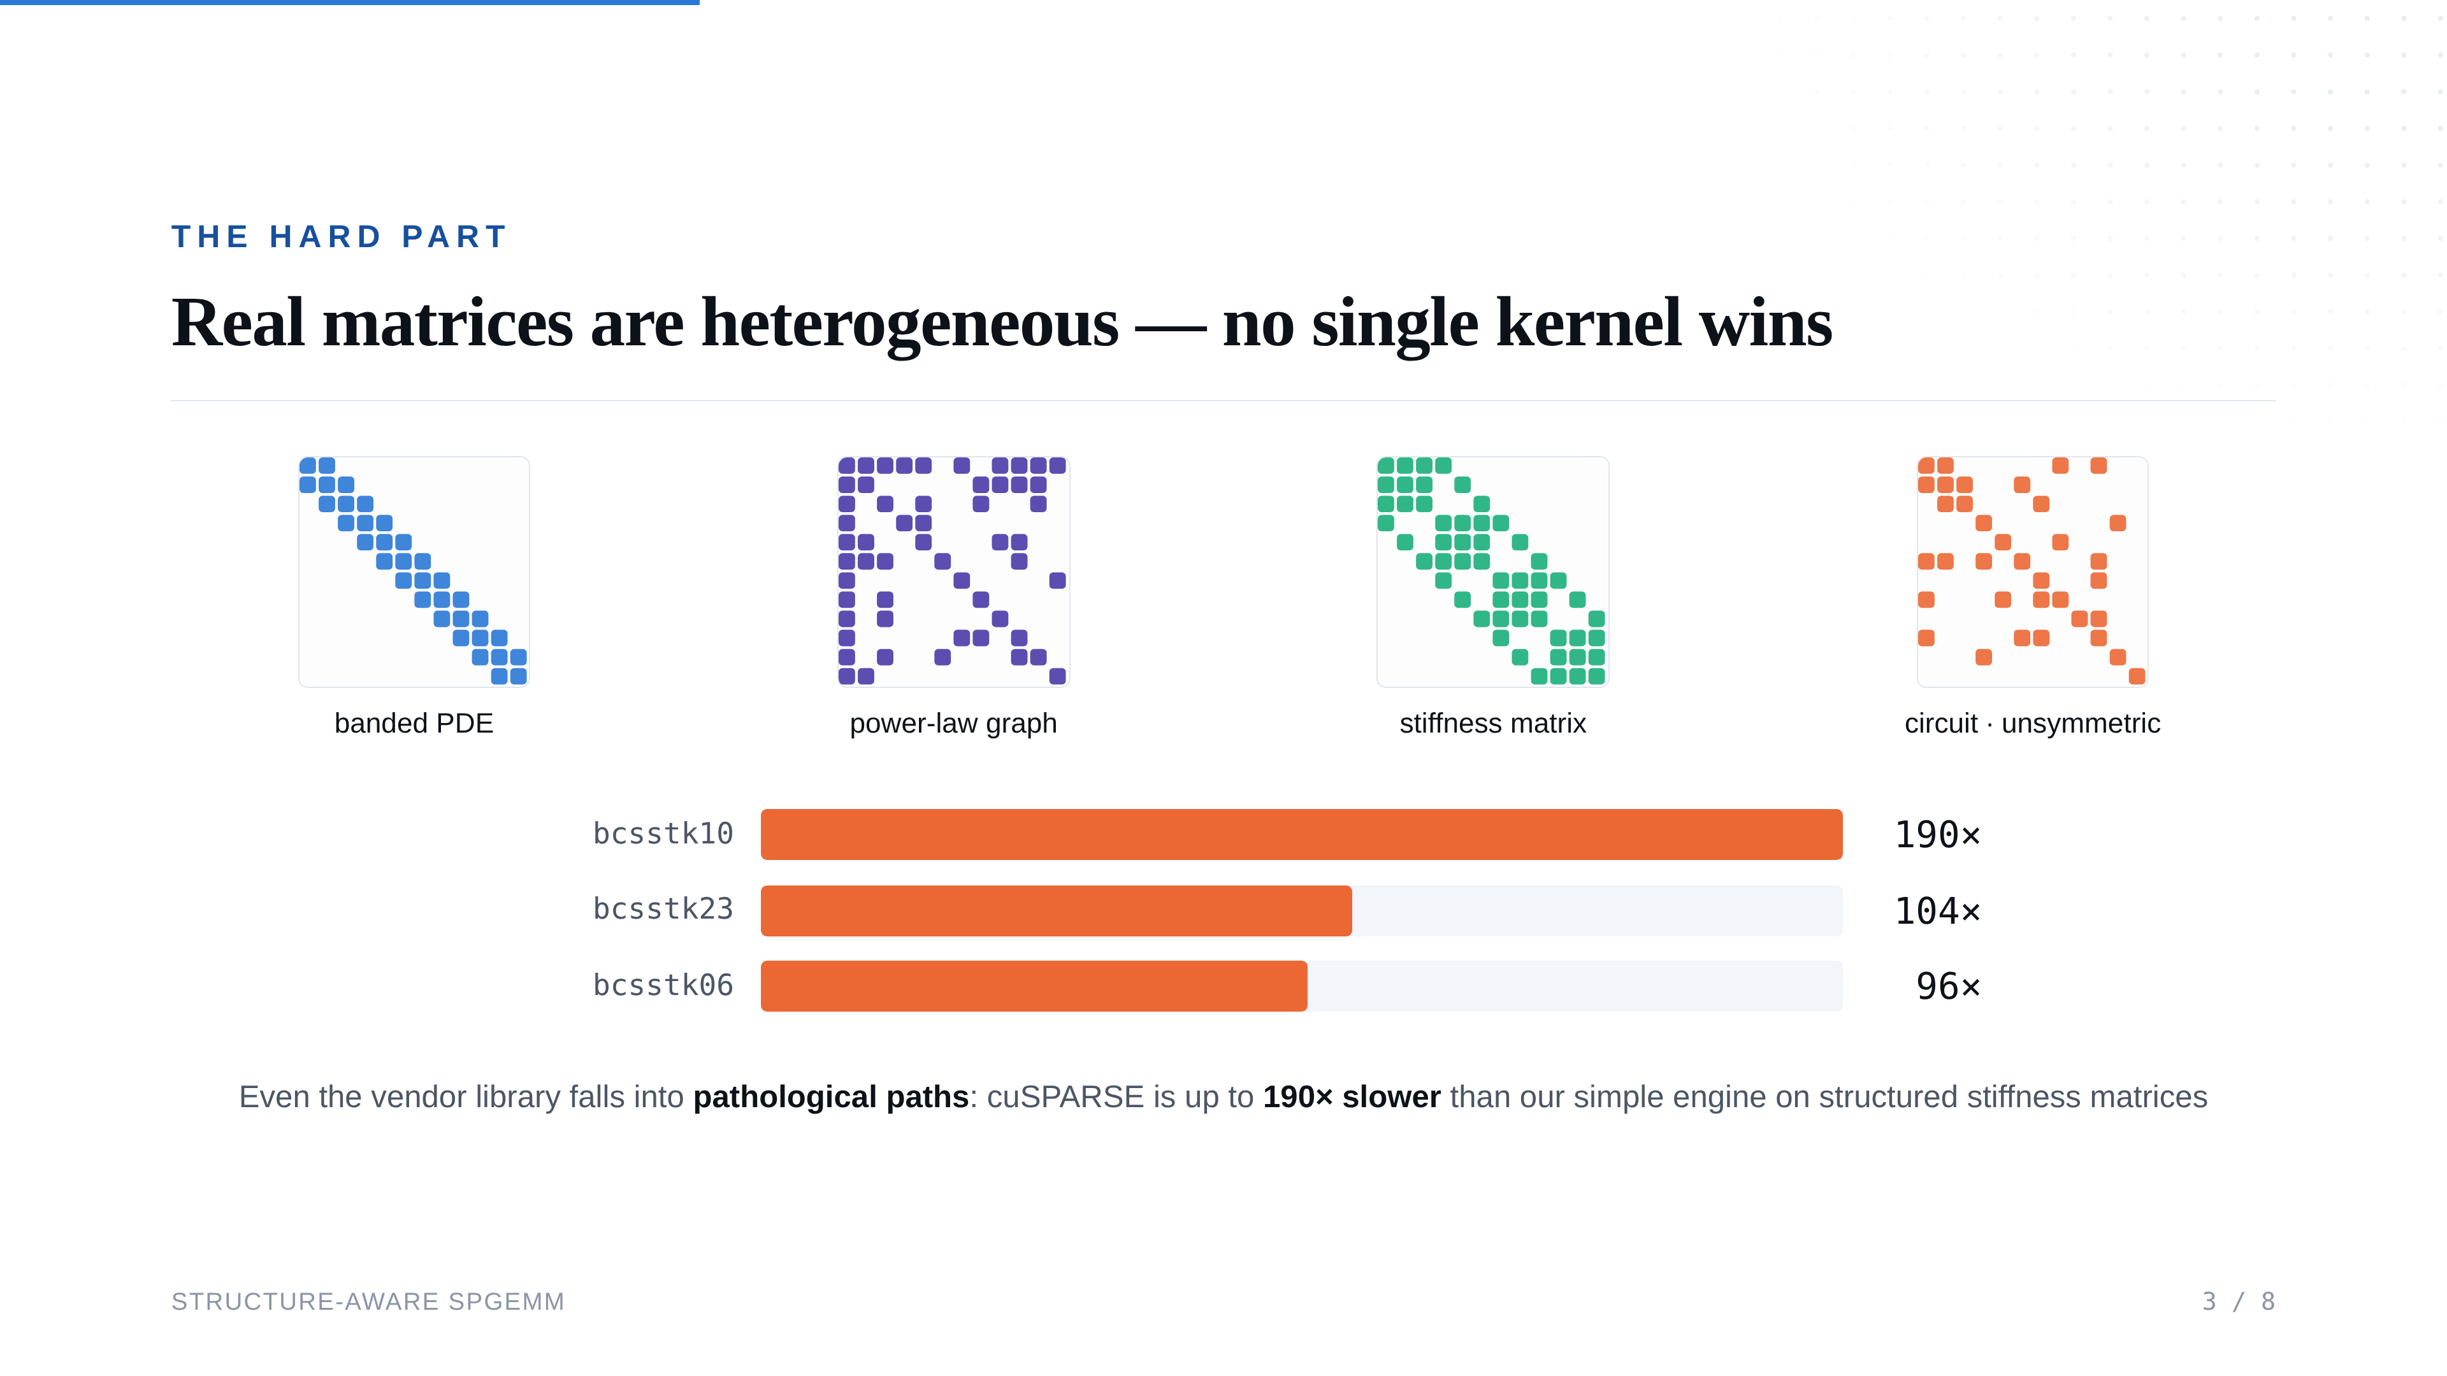
Notes:
— The hard part —
Here is what the suite looks like. A banded matrix from a P-D-E solver. A power-law graph, where a few rows hold most of the entries. A stiffness matrix, with dense little blocks down the diagonal. A circuit matrix with no symmetry at all. //
Tune a kernel for any one of these and you lose on the others. We measured that — on our kernel, and on the vendor's. //
Look at these three, all stiffness matrices. cuSPARSE picks a pathological code path here — one that goes badly wrong — and our very simple hash kernel beats it by ninety-six, a hundred and four, and a hundred and ninety times. //
So we stopped asking which kernel is fastest. The useful question turned out to be: given this matrix, which kernel should run?

Slide 4
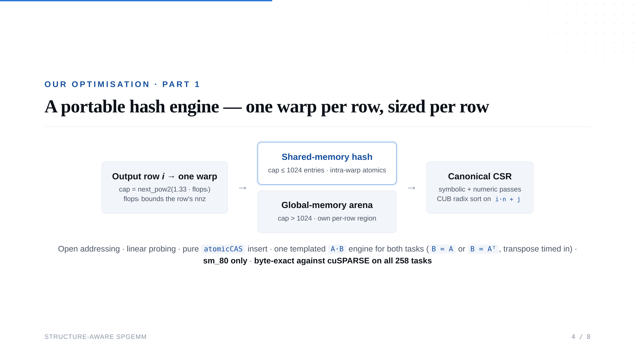
Notes:
— Our engine —
Our kernel hands each output row to one warp, which merges the incoming rows into a small hash table — all of its lanes writing at the same time. Every insert is an atomic compare-and-swap, so the result never depends on which lane gets there first. //
The interesting decision is how big to make that table. Here is the trick: before computing a row, we can already put a ceiling on it. Walk that row of A, add up the lengths of the rows you are about to merge, and the answer cannot have more entries than that sum. It is a loose ceiling — but it is free, and it is a ceiling, which is what we need. //
We allocate a third more than that, so the table stays at most three-quarters full and probes stay short, and we round up to a power of two so wrapping around is a bit-mask instead of a division. //
That same number decides where the table lives. Small enough for shared memory — about a thousand entries — and the row is accumulated entirely on-chip. Bigger, and it gets its own private slice of a scratch buffer in global memory. Short rows get the fast path, long rows get a safe one, and no row can run over into its neighbour's. //
We walk each row twice. The first pass, the symbolic pass, only counts distinct columns, so we know exactly how big the output is before allocating a byte of it. The second does the arithmetic. //
Then one sort. We pack each entry's row and column into a single sixty-four-bit number, so sorting on that one key sorts by row first and column second — which is exactly CSR. One radix sort from CUB, scratch space allocated once and reused. //
For the Gram product we build the transpose explicitly and feed it to the same kernel, and that transpose is inside our timing. //
None of this uses anything Hopper-specific, and it matches cuSPARSE entry for entry on all two hundred and fifty-eight tasks.

Slide 5
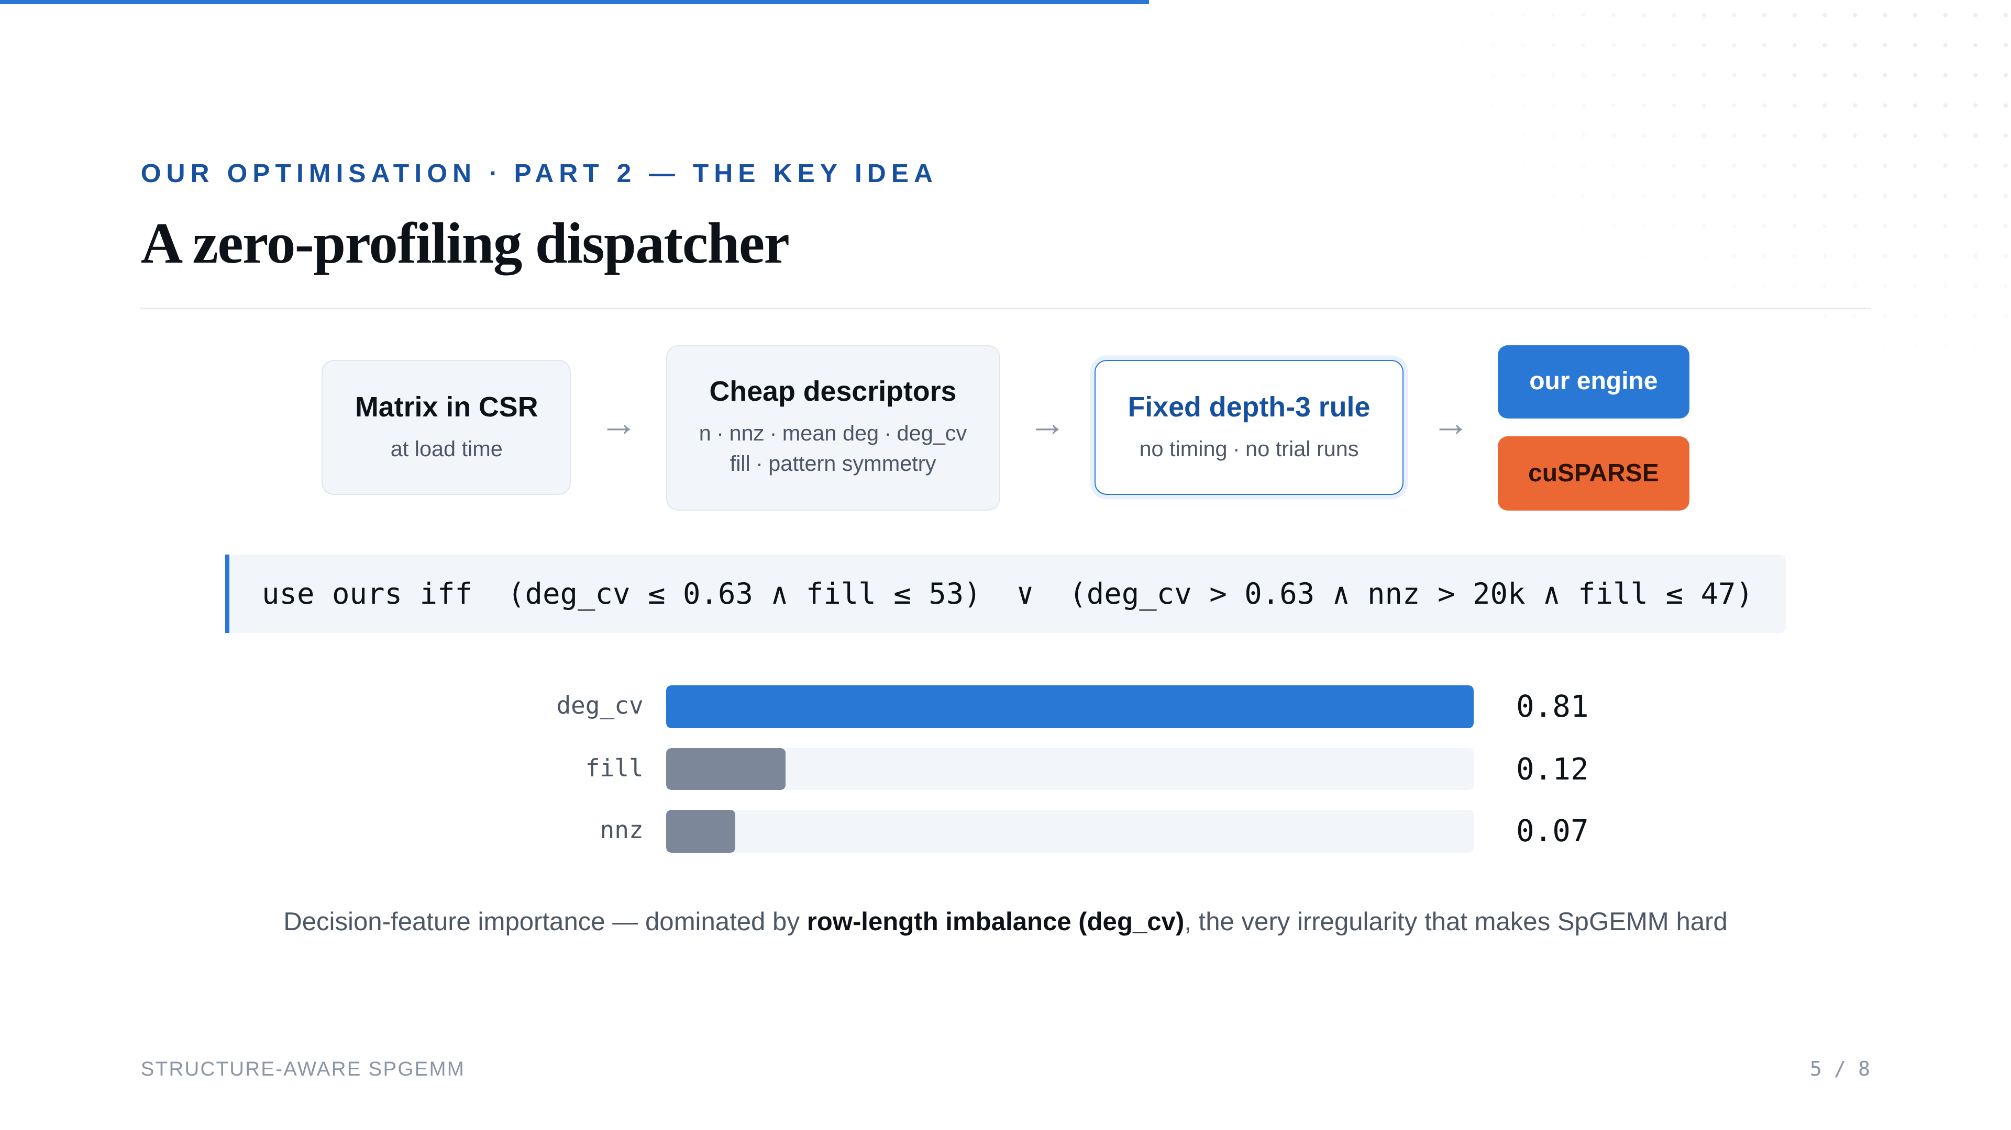
Notes:
— The dispatcher —
So neither implementation wins everywhere. Rather than pick one and live with it, we look at the matrix and choose. //
When a matrix loads we compute six numbers from its structure: how big it is, how many nonzeros, the average row length, how uneven the row lengths are, roughly how dense the output will be, and how symmetric the pattern is. All six come from one pass over the indices. We never run either kernel to find out. //
The rule is three comparisons deep — it is written out on the slide — and its shape is simple. Rows fairly even: use ours. Rows wildly uneven: use ours only when the matrix is big enough to be worth it and the output will not be too dense. Otherwise, cuSPARSE. //
Which of the six carries that decision? The one that measures how uneven the rows are — eighty percent of it, on its own. I like that, because row-length imbalance is what made this problem hard in the first place. The feature that breaks the kernel is the feature that tells you which kernel to use. //
One pass over the structure, three comparisons, and we profile nothing.

Slide 6
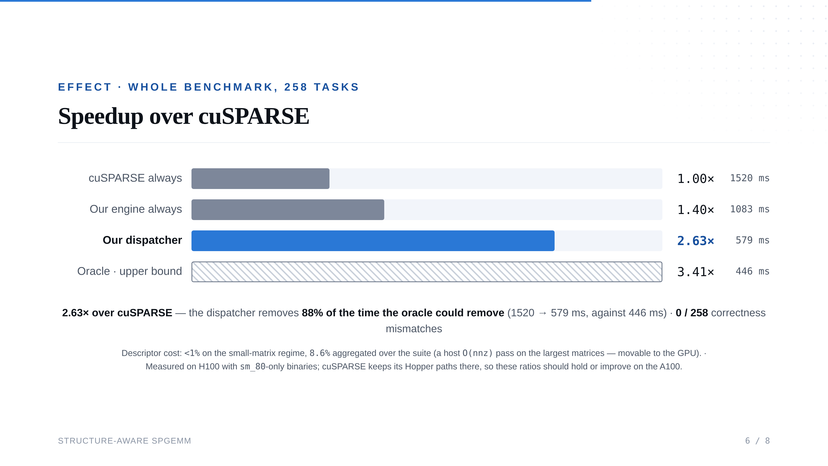
Notes:
— Results —
Whole benchmark, two hundred and fifty-eight tasks, everything relative to cuSPARSE. //
cuSPARSE takes fifteen hundred and twenty milliseconds. Our kernel on everything takes one thousand and eighty-three — one point four times, but dragged down by the matrices it is bad at. The dispatcher takes five hundred and seventy-nine: two point six three times. //
The bottom bar is the oracle: four hundred and forty-six. So there were about a thousand and seventy milliseconds on the table, and we take nine hundred and forty of them. Eighty-eight percent. And all two hundred and fifty-eight results are still correct, entry for entry. //
Two caveats. Those six numbers cost under one percent on the small matrices, eight point six percent over the whole suite — almost all of it one host-side pass over our biggest matrices, which belongs on the GPU. And these are H100 numbers — cuSPARSE uses its Hopper paths there and we use none, so on an A100 we would expect the gap to widen.

Slide 7
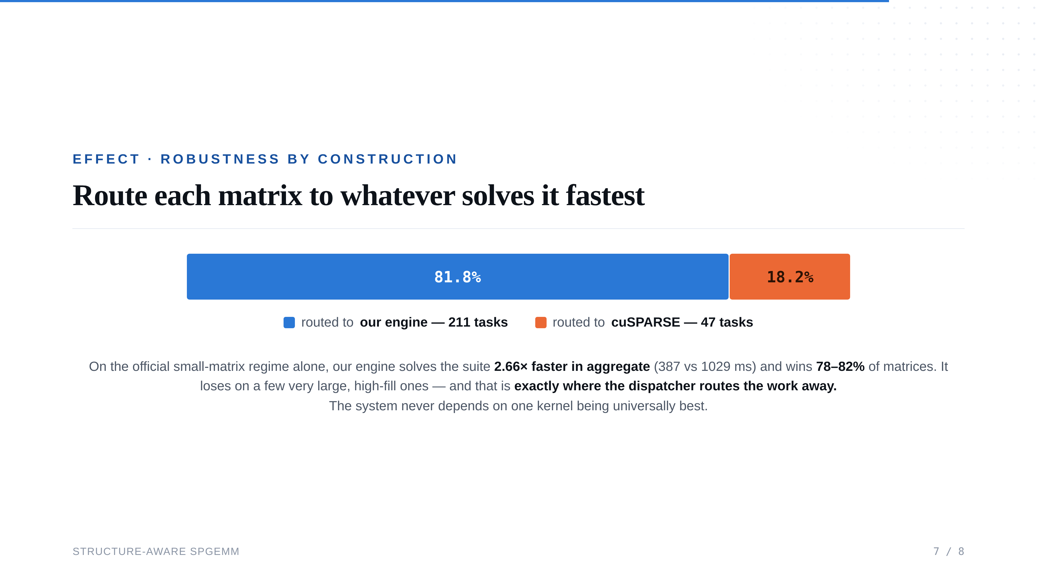
Notes:
— Robustness —
In practice the dispatcher sent two hundred and eleven tasks to our kernel and forty-seven to cuSPARSE. //
On the small matrices, our kernel on its own is already two point seven times faster in aggregate, winning on about eight matrices in ten. //
Where it loses is the very large cases with dense output. One hash strategy is the wrong tool there; you want a merge-based accumulator, and we do not have one yet. Those are exactly the forty-seven the dispatcher hands off. //
That is what makes the system robust by construction, and it is the property I would like to leave you with: we don't need our kernel to be the best kernel. We need to know when it isn't.

Slide 8
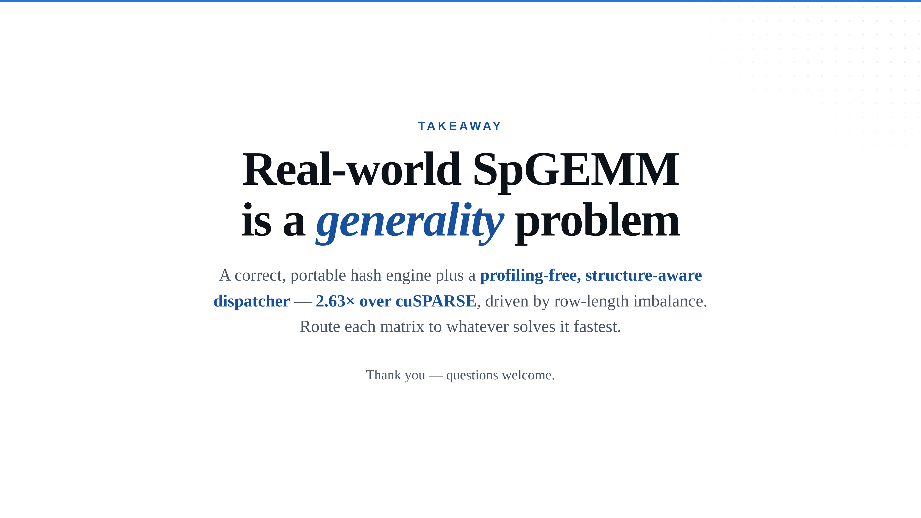
Notes:
— Conclusion —
The hard part of real-world SpGEMM is generality. //
We built a hash kernel that sizes itself per row and is correct everywhere, and a rule that reads six structural numbers and picks the right implementation without ever running a timing experiment. Two point six three times over the vendor library, driven by row-length imbalance. //
Route each matrix to whatever solves it fastest. //
Thank you — happy to take questions.

