Slide 1
AI-Powered Tax Research: Enhancing Efficiency and Accuracy in
Navigating Complex Tax Law
A Retrieval-Augmented Generation Approach for Enhanced Accuracy
Wendy Tian
University of California, Berkeley
xtian9@berkeley.edu
Omar Zu’bi
University of California, Berkeley
ozubi@berkeley.edu

Slide 2



PROJECT OVERVIEW
Addressing Hallucinations in Tax Q&A with RAG Models
WHAT'S THE PROBLEM?
Tax professionals, especially junior accountants, face challenges due to tight deadlines, limited research resources, and the complexity of tax law.
OBJECTIVES
&
MOTIVATION
OUR GOAL (PROBLEM STATEMENT)
Developing a reliable AI assistant for tax Q&A is essential to streamline research, enhance decision-making accuracy, and provide trustworthy, fact-based answers.
CHALLENGES
Traditional LLMs struggle with hallucination and lack of domain specificity, leading to inaccurate responses in complex tax queries. In addition, lack of curated datasets and dynamic tax law updates make this topic challenging.

Slide 3
EXISTING LITERATURE
Previous research on large language models (LLMs) in the tax and legal domains
Key Papers
Innovation Gap
Classification of tax laws (Elliot Ash Et al. 2021)
Dataset for tax law entailment (Holzenberger et al., 2020).
Frameworks for tax code classification (Kondadadi et al., 2022).
Decision rule extraction from legislation (Michel et al., 2022).
Prior works lack dynamic adaptability and reasoning-based Q&A for the tax domain:
Context Limitations: Poor understanding of nuanced, jurisdiction-specific tax laws.
Complex Query Struggles: Difficulty handling multi-part, long-form tax questions.
Trust Issues: Lack of reliable mechanisms to ensure accurate, factual answers.

Slide 4
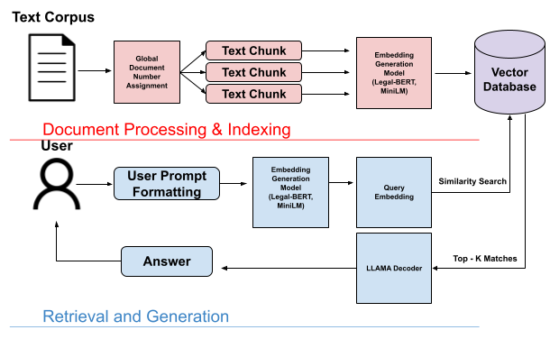
OUR APPROACH
Framework: Retrieval-Augmented Generation (RAG)
Retrieval-Augmented Generation (RAG)
Embedding Models
Corpus Sources
Optimal Selection
LLaMA-3.2-1B combined with Legal-BERT and MiniLM embedding models
Use of RAG to combine domain-specific tax data for more accurate Q&A
IRS tax guidelines
Internal Revenue Code (IRC)
Education tax resources from TurboTax
We developed prompt templates structured for concise, context-relevant answers
Optimal:
Chunk size (128)
Overlap (32)
Temperature (0.9)
Integration with LangChain for modularity
Figure 1: RAG flowchart we’ve implemented

Slide 5
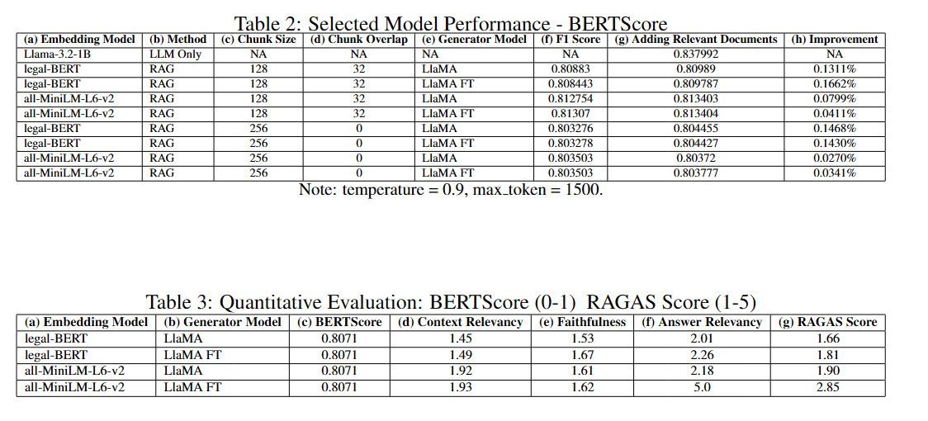
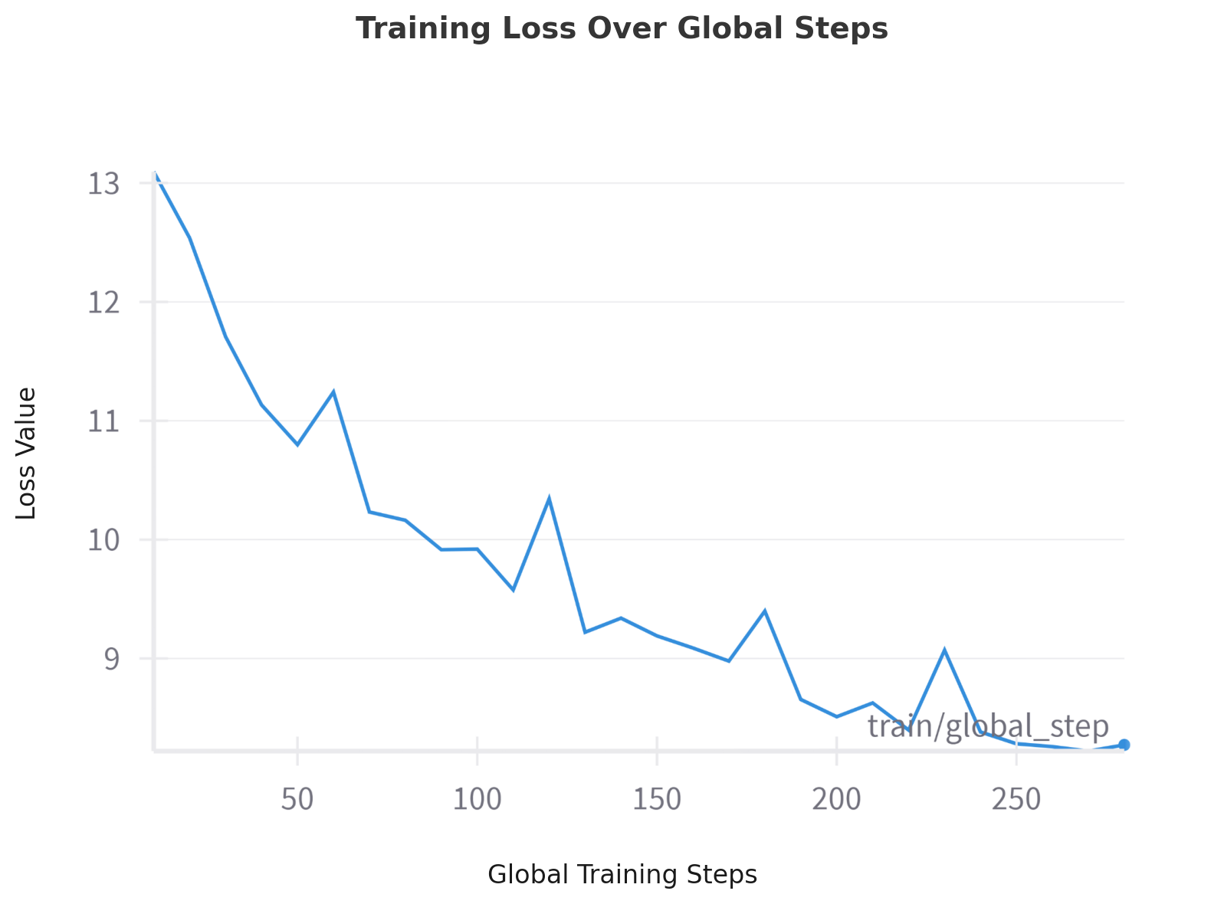
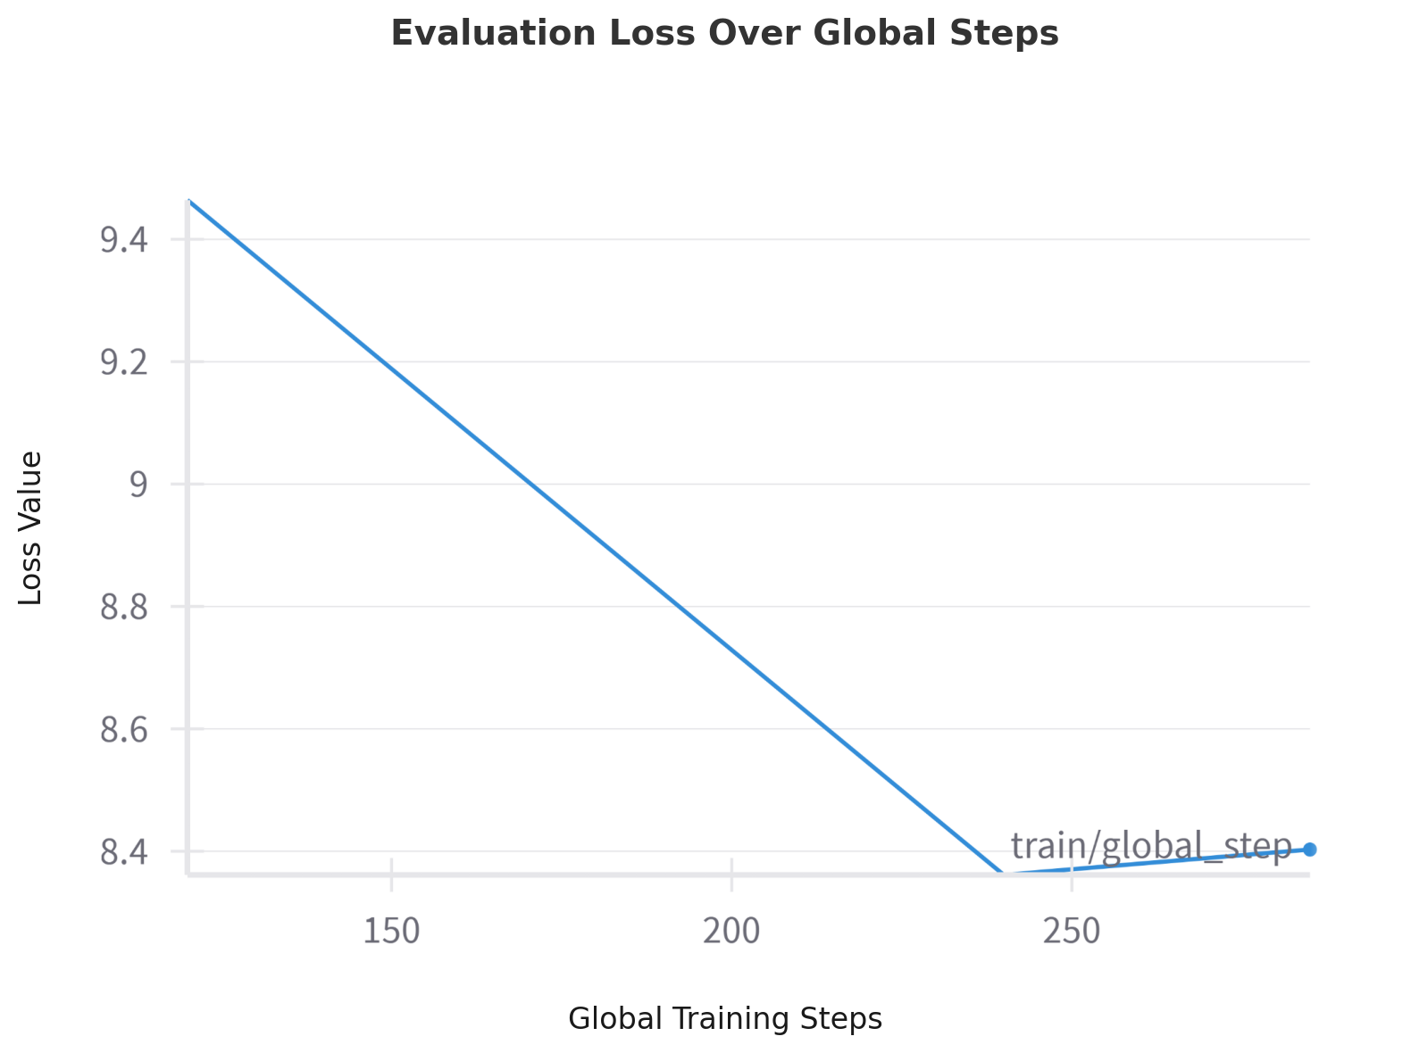
EXPERIMENT DESIGN
Models & Metrics
Retrieval-Augmented Generation (RAG)
Models Compared
Metrics
Hyperparameters
Combinations of LLaMA (with and without fine tuning) with Legal-BERT vs. MiniLM
Experimentation with LLM temperatures and retrieval parameters
F1 Scores: Evaluates semantic similarity.
RAGAS Scores: Measures answer relevance and faithfulness
Human Evaluation: Assess fluency, coherence and trustworthiness of responses
LLM Fine-tuning:
Training epochs (2, 5)
batch size (1,2,3)
RAG Experiments:
Chunk sizes (128, 256, 500).
Overlap: (0, 8, 32)
Temperatures (0.3–0.9).

Slide 6
RESULTS & FINDINGS
Reduction of Hallucinations
1
RAG models reduce hallucination and improve faithfulness
2
MiniLM + LLaMA provided the best performance on complex queries
KEY FINDINGS
3
Superior F1 and RAGAS scores compared to the baseline

Slide 7
FUTURE WORK & CONCLUSIONS
Further Considerations
DATASET CURATION
Expansion of Dataset
MODEL
Enhancements to Model
CONCLUSIONS
Wrap up and Discussion
Incorporate a broader rage of tax topics (beyond individual income tax)
Explore additional tax Q&A sources like IRS FAQs and CPA firm internal records
Exploring larger datasets and more embedding models.
Expanding to global tax systems.
Experiment with advanced fine-tuning techniques for improved domain adaptation and risk assessment
Further development of retrieval database to increase model accuracy and coverage
RAG enhances the faithfulness and accuracy of tax-specific LLMs
MiniLM proves superior for memory efficiency and performance

