Slide 1

Final Project - Group 17
R11943153 朱柏誠
R12921068 吳凱濠
M11202162 王薇婷

Slide 2
Implementation
SDRAM prefetch
MM implementation with hardware design
FIR implementation with hardware design
Gcc argument -Os

Slide 3
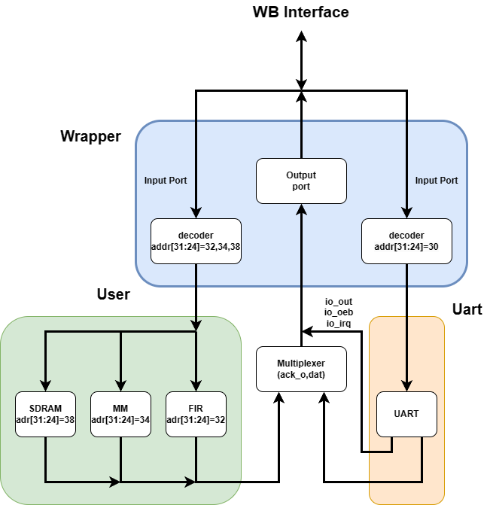
Block Design

Slide 4
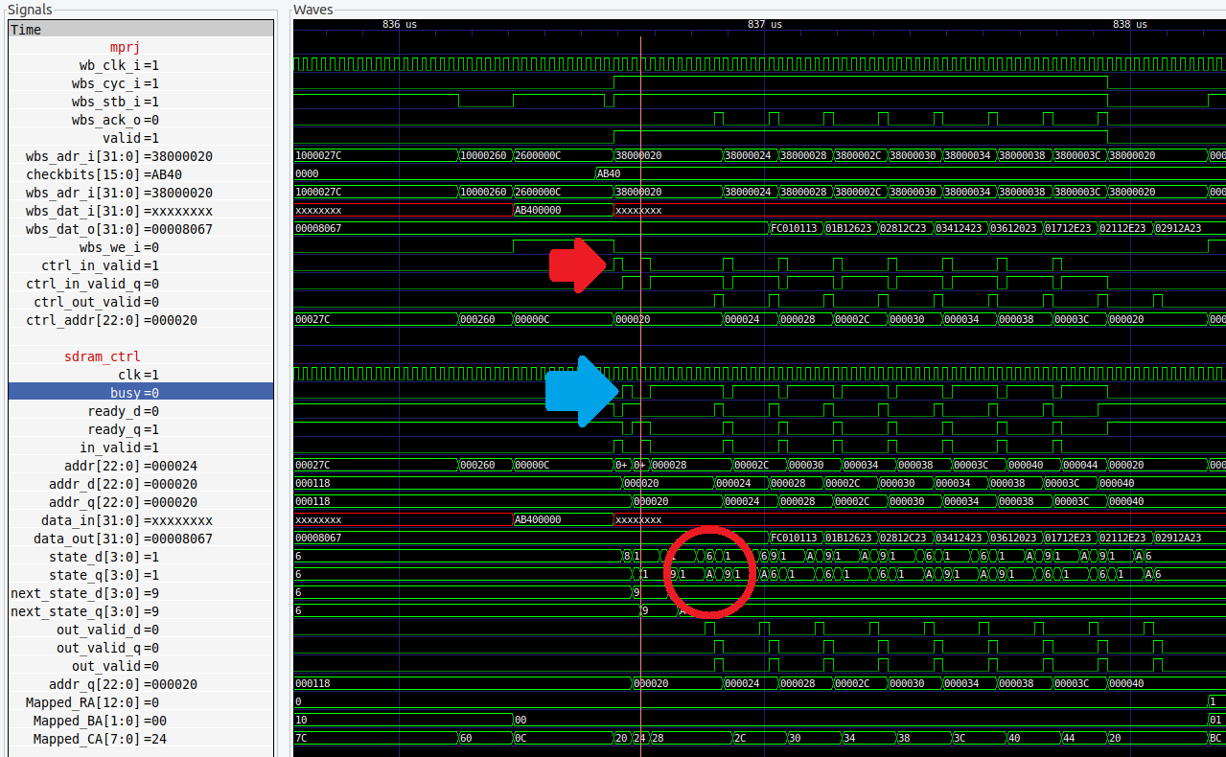
SDRAM prefetch
Controller stay in idle state only 1 cycle , guess next addr is +4

Slide 5
MM
Computing the result by hardware
Set up matrix when reset is insert
Directly output the data by wishbone rather than AXI interface

Slide 6
FIR
Change for loop from int i = 0 ~ 63 to int i = 1 ~ 64, can reduce cycles
Without checking x and y in software
From y ready to send next x about 14T

Slide 7
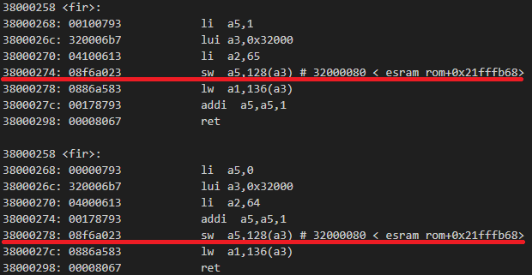
FIR
for (i = 1; i <= 64; i++)
{
reg_x = i;
outputsignal[i - 1] = reg_y;
}
for (i = 0; i < 64; i++)
{
reg_x = i + 1;
outputsignal[i] = reg_y;
}

Slide 8
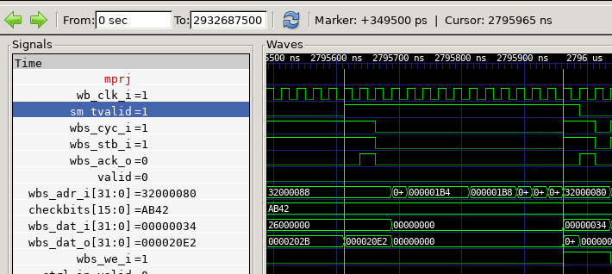
FIR
350 ns (14T)

Slide 9
Gcc argument -Os
Optimize argument for gcc compiler
-Os is optimize for embedded system or memory limited environment

Slide 10
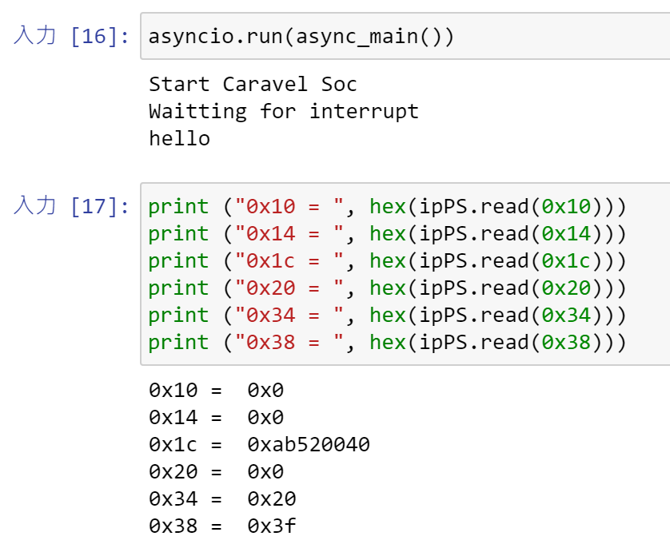
FPGA
Jupyter Notebook Execution Results

Slide 11
Execution time
Each task execution time
Task | Lab6 | Lab6 + sdram | Lab6 + sdram + fir | Lab6 + sdram + fir + mm
Fir | 418357 | 273181 | 7429 | 7929
Qsort | 17835 | 13254 | 14097 | 13048
Matmul | 46472 | 29653 | 28078 | 2241
Overall | 564654 | 396884 | 116907 | 93749
-Os argument
With Os | Without Os
~93749 | ~358109

Slide 12
Thank you!

