Slide 1
Wrap Up
Content Review and More R

Slide 2
Geospatial Modeling with Earth Observations
We covered : Data Collection, Model Training, Variable Selection, with a brief look at model evaluation tools
We did not cover: considerations regarding sampling method, integrating existing presence absence data, and a lot more

Slide 3
A good Model should
Be based on ecological understanding
Be as simple as possible, but no less
Provide information beyond what is currently available
Reproducible
Value is in the details
Something you believe in

Slide 4
GEE or R
Why use the Software?
You don’t want to download imagery
Your applying a process to a large area
Very easy to share your work
Supportive of exploration
Great options for Reporting
Extensive community and support
Very easy to engage with many data types
Free and open source
Notes:
Add flow chart for deciding which is the better option. Probably more just a list ,but…
Splits:
- large about of raster data
- Large about of tabular data
- Do you need to produce a report
- Who can take over your

Slide 5
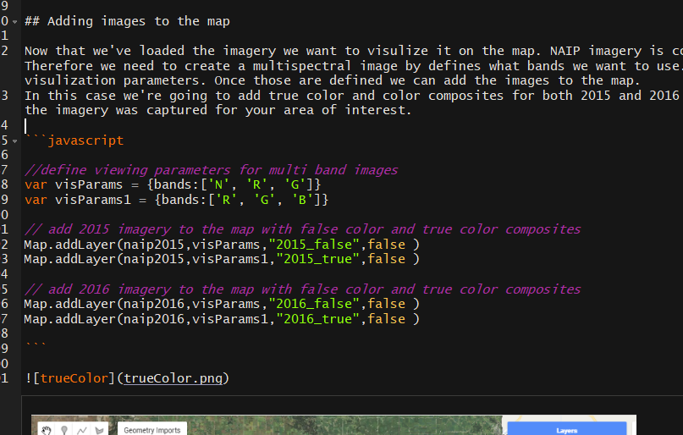
R is a Great Resource Because
All documents in this presentation were produce using Rmarkdown
Excellent method for reproducible reports

Slide 6
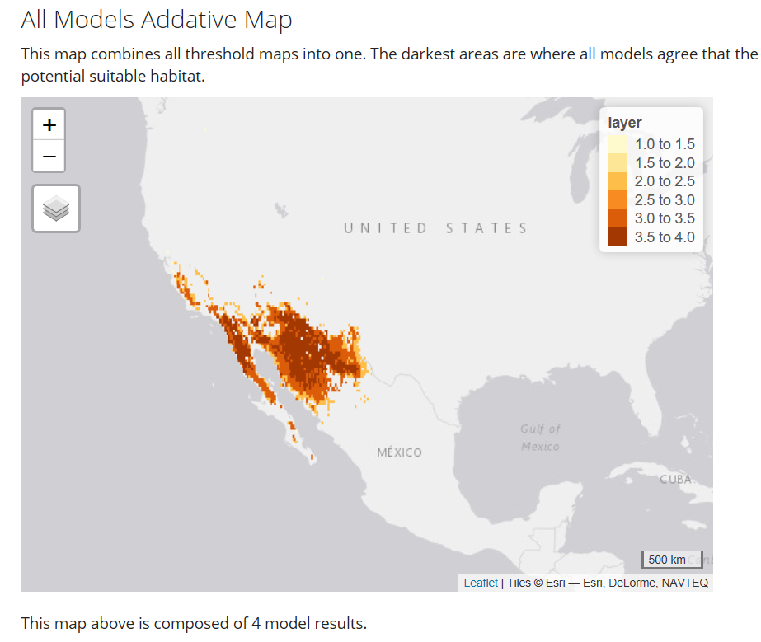
R is a Great Resource Because
Rmarkdown Support interactive elements such as easy maps and interactive tables
View HTML doc

Slide 7
R is a Great Resource Because
https://github.com/fortCollinDev/modelingShortCourse

Slide 8
Feedback
Check your inbox
A four question survey seeking your opinion of this training.
We’re looking to improve it and your input is necessary

Slide 9
Thank you

