Slide 1
scgan-2d

Slide 2
scgan-2d discriminator_all

Slide 3
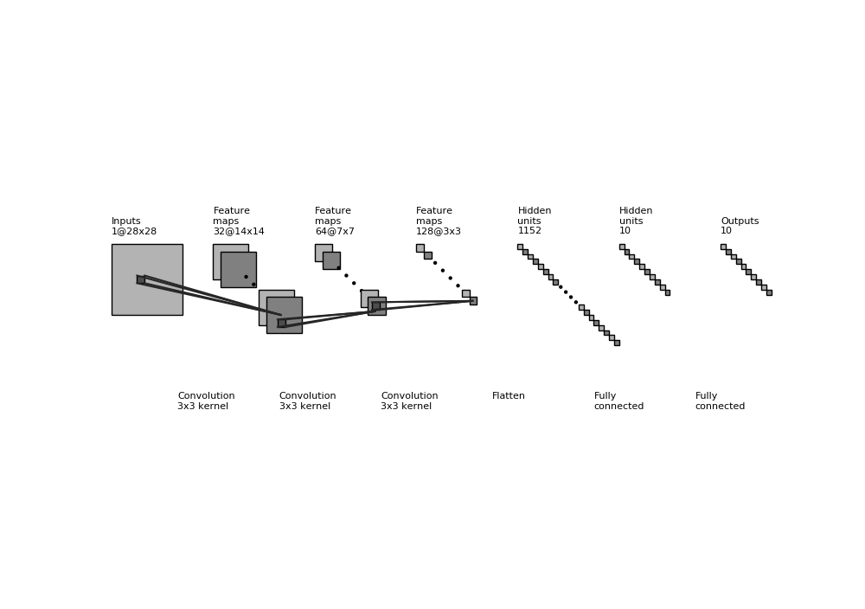
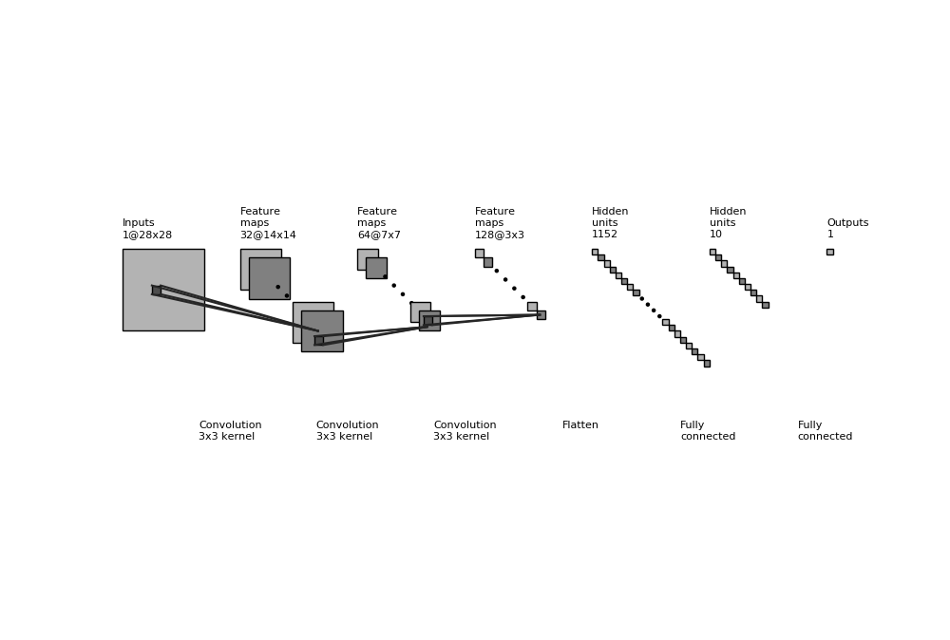

Slide 4
scgan-2d discriminator_basic

Slide 6
scgan-2d discriminator_realOrFake

Slide 8
scgan-2d discriminator_class

Slide 10
scgan-2d generator

Slide 11
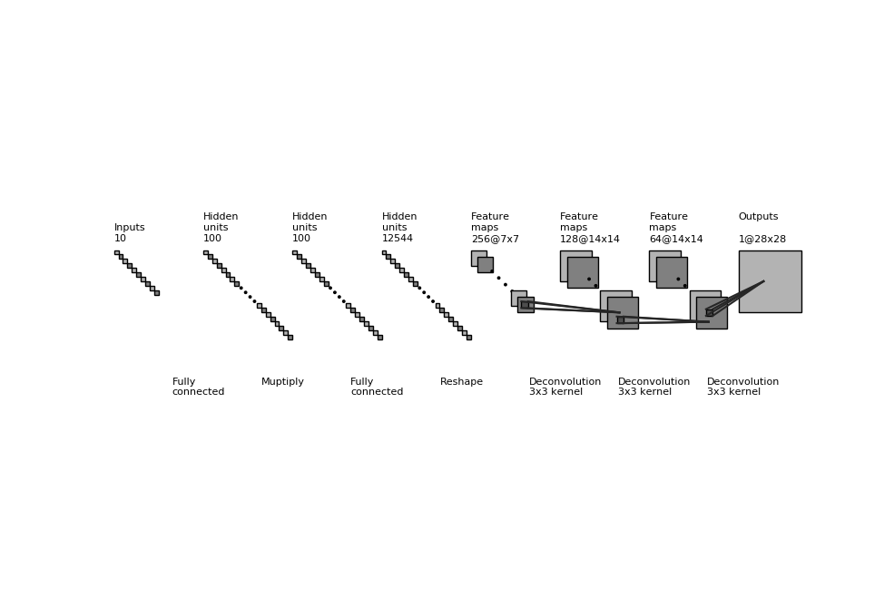


Slide 12
scgan-3d

Slide 13
scgan-3d discriminator_all

Slide 14
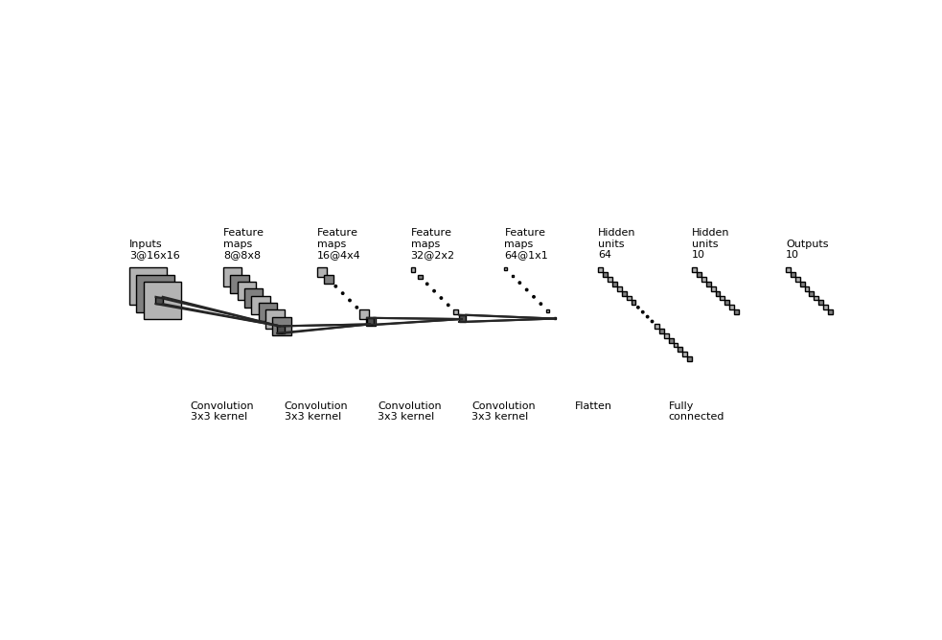
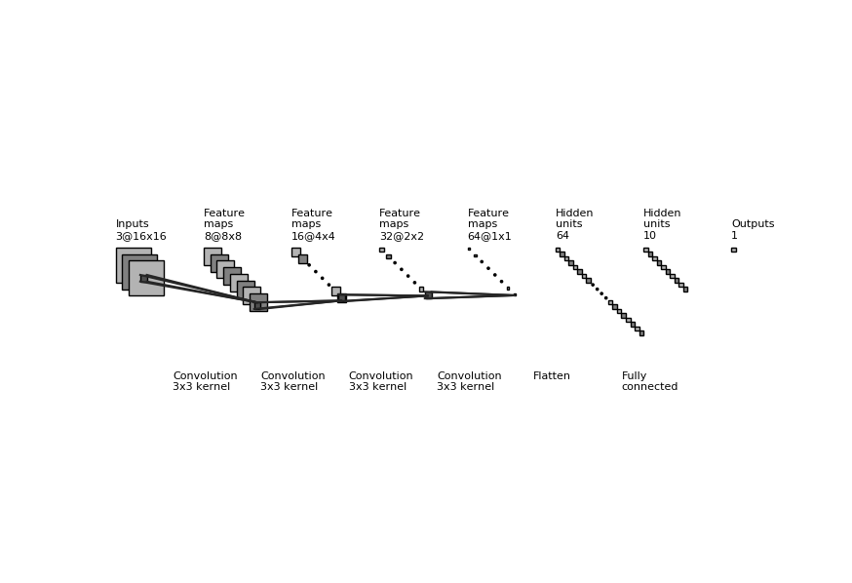

Slide 15
scgan-3d discriminator_basic

Slide 17
scgan-3d discriminator_class

Slide 19
scgan-3d discriminator_realOfFake

Slide 21
scgan-3d generator

Slide 22
