Slide 1

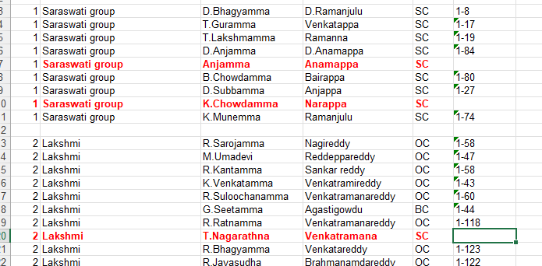

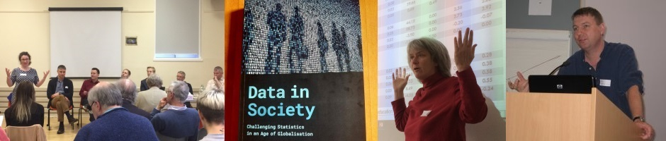
Problem: Four Challenges 1) List the Various Stakeholders 2) Multilevel Power Analysis → Sampling Problems It is also hard to link the Phase 1 ID number with the questionnaire of Phase 2 3) Gender of the Interviewers! → The safety and training of interviewers; → accuracy and completeness of responses …difficult to know which respondent is a boy in advance …costly to match gender of interviewer and students
A Radical Approach to Social Intervention with Evaluation
Prof. Wendy Olsen, Department of Social Statistics, University of Manchester
Radical Statistics Conference 2025 – Manchester Metropolitan University
Solution:
Mixed-Methods Teams, Working Collectively International development can use stakeholder co-researching, not just RCT treatment models.
Using Texts and Numbers
(eg Focus Groups)
Mixed-methods projects are a useful part of your career.
Avoid a fetish of ‘control versus intervention’ groups.
Keep attention on engaged learning.
Fig. 2 Missing data at Level 1
(An Indian example is shown. Level 1 individuals are grouped in Level 2 loaner-groups, but some addresses are missing from bank records)
4) What’s the Intervention?!
… from 6 to 25 different activities
Who gets it?
The treated group gets all 25 events over 2 years.
Why others don’t get it?
The control group gets 6 of the events. Who decides which 6 they do get?
Student
School ID
Region Id
6 Regions
20 Schools
2655 Students
Justice! Fairness! Engagement!
Further Reading
This poster has a GITHUB https://github.com/WendyOlsen/HelpRCTwithMixedMethods
Creswell, John W., and Vicki L. Plano Clark (2018), Designing and Conducting Mixed Methods Research, 3rd ed., London: Sage.
Deaton, Angus, and Nancy Cartwright (2018), Understanding And Misunderstanding Randomized Controlled Trials, Social Science & Medicine 210, 2–21, https://doi.org/10.1016/j.socscimed.2017.12.005.
Downward, P. and A. Mearman (2007). "Retroduction as Mixed-Methods Triangulation in Economic Research: Reorienting economics into social science." Camb. J. Econ. 31(1): 77-99.
Jihye Kim, Wendy Olsen, Mohammed Ibrahim (2023), Effect of Social Engagements (Child Clubs, Mentoring) on the Reduction of Teenage Pregnancy In … Ghana, with Good Neighbors Ghana. URL https://www.goodneighbours-uk.org/wp-content/uploads/2024/02/Final-report-for-baseline-study_25May2023.pdf
Olsen, W.K. (2022), Systematic Mixed Methods Research for Social Scientists. London: Palgrave.
Olsen, Wendy (2012) Data Collection: Key Trends and Methods in Social Research, London: Sage.
Olsen, Wendy (2019) “Social Statistics Using Strategic Structuralism and Pluralism”, in Contemporary Philosophy and Social Science: An Interdisciplinary Dialogue, eds. Nagatsu and Ruzzene. London: Bloomsbury.
Olsen, Wendy, and Jamie Morgan (2005) “A Critical Epistemology Of Analytical Statistics: Addressing the sceptical realist”, Journal for the Theory of Social Behaviour, 35:3, 255–284.
The Magenta Book – UK Government, HM Treasury, URL https://www.gov.uk/government/publications/the-magenta-book (2025)
Figure 1: Unmatched Phase 2 Students (see Kim, 2023)
PRACTICAL PROBLEM: Multilevel Case ID Numbers
Privacy
Fig. 3: Clustered Sampling Prep; Level 2 Populations Shown
SchoolID | NumofClasses | NumBoys | NumGirls | NumToilets
1 | 3 | 52 | 42 | 10
2 | 3 | 26 | 20 | 4
3 | 3 | 24 | 19 | 10
4 | 3 | 47 | 37 | 6
5 | 3 | 11 | 18 | 0
6 | 3 | 25 | 21 | 8
7 | 3 | 23 | 34 | 0
8 | 3 | 17 | 17 | 2
9 | 5 | 122 | 88 | 6
10 | 5 | 74 | 69 | 11
11 | 0 | 18 | 27 | 6
12 | 3 | 41 | 32 | 4
13 | 3 | 22 | 12 | 6
14 | 0 | 22 | 28 | 7
15 | 4 | 57 | 34 | 0
16 | 3 | 18 | 13 | 4
17 | 3 | 23 | 28 | 4
18 | 3 | 24 | 18 | 0
19 | 3 | 19 | 15 | 0
20 | 22 | 932 | 932 | 16
Ethics

