Slide 1

Women’s Invisibilised Childcare Work:
Indian PATTERNs in 2019
February 24, 2024 -- radical statistics -- London
https:\\Radstats.org.uk
Using statistics to support progressive social change
By Wendy Olsen and Jihye Kim
Social Statistics Department
2024
We acknowledge very helpful inputs in the past on data processing and analysis from: Sonny McCann, Yizang Zhou, Prof Arkadiusz Wisniowski, Prof Amaresh Dubey, Dr. Ioana Macoveciuc, Dr Manasi Bera, and Dr Diego Perez Ruiz, among others.

Slide 2
Overview:
Section | Topics
Start | Introduction, definitions, and the context of challenging patriarchy whilst accepting the local norms of each area.
Middle | Description of the childcare work, the gender norms, the social groups in India 2019
Concluding part | Discussion
References
Data Sources
 | Note: we put code chunks on open access at: https://github.com/WendyOlsen/excessworkhoursindia , A Report on India's Time-Use Survey 2019 at https://mospi.gov.in/sites/default/files/publication_reports/Report_TUS_2019_0.pdf , accessed Feb 2024.

Slide 3
Research question what new factors explain childcare hours per day, across India?
(beyond number-of-children, marital status, hhsize) hypotheses
1 social group matters, but we are not clear about why that is so
(therefore control for demographics);
2 state matters because of varying gender norms
Both hypotheses were falsified, and instead, education and gender norms were very important!
The context is, challenging patriarchy whilst accepting the local norms of each area.
Going beyond demography

Slide 4

ONE Key book was Agarwal, a field of one’s own, 1995
How to get this book today:
Cambridge University Press Online publication date: January 2010 Print publication year:1995 Online ISBN:9780511522000 DOI: https://doi.org/10.1017/CBO9780511522000 This book had an immense influence. Bina Agarwal found that localities and local cultures vary within each South Asian country including India.
This is the first major study of gender and property in South Asia. In a pioneering and comprehensive analysis Bina Agarwal argues that the single most important economic factor affecting women's situation is the gender gap in command over property. In rural South Asia, the most significant form of property is arable land, a critical determinant of economic well-being, social status, and empowerment. But few women own land; fewer control it. Drawing on a vast range of interdisciplinary sources and her own field research, and tracing regional variations across five countries, the author investigates the complex barriers to women's land ownership and control, and how they might be overcome. The book makes significant and original contributions to theory and policy concerning land reforms, 'bargaining' and gender relations, women's status, and the nature of resistance.

Slide 5
Definitions First
What is a patriarchal standpoint? It is one which favours the control over social decisions by the elders and particularly male elders.
How we measure gender norms – use attitude and opinion questions – make a factor to smooth out the variations and gain the central tendency (Kim, et al., 2022)-WES journal
Here we use 2019 Asian Barometers - India
Sexism was embedded in questions ←→ desirability bias of a patriarchal gender norm

Slide 6
Operationalised measures
The word childcare is defined by the International Labour Organisation in its ‘labour-force status’ statements from the International Conference of Labour Statisticians.
When operationalising it, we now use the ICATUS, an international time-use diary category list which has 1-digit, 2-digit, and 3-digit details.
We used “time spent cooking in a household with co-resident children of age 16 or below” + childcare + tutoring child(ren) +
travelling with children or family members; waiting while accompanying members…
Aggregated childcare is the total of all these.
We merged the ‘NORMS’ to the ‘CHILDCARE’ data.
Sex recorded as female or male; age range from 18 upward, plus spouses in agegroups 16, 17 years
Social Groups = scheduled caste people, people in scheduled tribes, Muslims not SC nor ST, other

Slide 7
We merged the Asian Barometers data on gender norms onto the Indian Time-Use Diary survey 2019
Data combining!
First we create sub-groups, similar to when doing poisson modelling.
We optimise the matching of sub-groups between the two surveys.
We avoid using sex here, because gender norms here did not vary by sex.
We also may avoid using state but this is more empirically questionable.
So, match on
Rural > age-group 16-35, 36-65, 65+ > Education
Ordinal in five groups
  below primary, primary, incomplete secondary, complete secondary, and higher levels of formal education
These match exactly the available measures in the Asian barometers survey 2019 → merging at level 2.

Slide 8
Dataset 1 – Asian barometers – Table 1
Confirmatory factor,
Based on 3 questions
- prefer boy or girl, if 1 child
-should man only do politics
-and a third likert scale about
The man’s mother dominating
Boy-preferring;
man only in politics etc.
Not Boy-preferring;
NOT man only in politics etc.

Slide 9
Findings – Asian barometers – Table 2

Slide 10
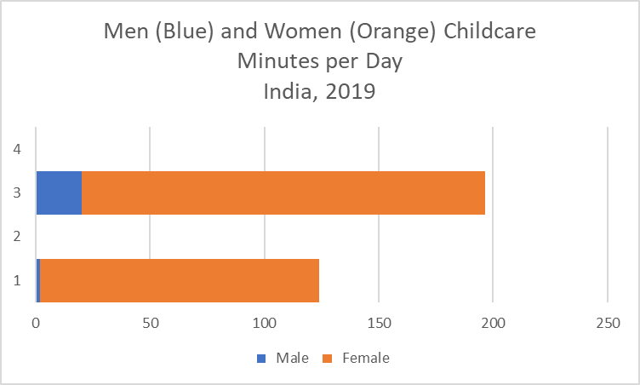
Dataset 2 – Indian time-use survey 2019
See also our paper in Development & Practice 2023 (extreme working hours of child labourers)
Table 2
Mean of the Cooking Variable and the Overall Total Childcare Time
India Time-Use 2019 |  |  |  | TABLE 3
All adult respondents
Please note the adults were aged 18+, or were married age 16 or 17 years.
 |  |  | Mean (Minutes On Recall Day) | Mean
 |  |  | Cooking time | cooktime | All child care time | allchildcaretime
 |  | Male | 2.0 | 2.0 | 20.1 | 20.1
 |  | Female | 121.9 | 121.9 | 176.3 | 176.3
 |  | Total | 61.9 | 61.9 | 98.1 | 98.1

Slide 11
Findings – Indian time-use survey 2019
See also our paper in Development & Practice 2023 (extreme working hours of child labourers)
Mean of the cooking variable and the overall total childcare time |  |  |  |  |  | TABLE 3 | - details
India Time-Use 2019
All adult respondents
Please note the adults were aged 18+, or were married age 16 or 17 years.
 |  |  | Mean (Minutes) |  | Standard deviation |  | Count
 |  |  | Cook time | All child care time | Cook time | All child care time | Cook time | All child care time
 |  | Male | 2.0 | 20.1 | 18.7 | 50.9 | 179093 | 179093
 |  | Female | 121.9 | 176.3 | 141.9 | 194.5 | 178895 | 178895
 |  | Total | 61.9 | 98.1 | 117.6 | 162.2 | 357988 | 357988

Slide 12
Findings: regarding whether the gender norms affected the childcare work time
No significant difference across social groups
Differences by state are very small, just a few minutes of work
But differences by ‘gender norms index’ at the small group level are large.
1 unit rise in GN index is associated with 66 minutes more!
This is where a cultural group norm is associated with women doing more childcare in terms of time spent on the various activities, including cooking with children around.
socialgroup2
Others | ST | SC | OBC | Muslim Non SC/ST | Total

Slide 13
Findings 2 regarding whether the gender norms affected the childcare work time after allowing for state location
Critical assessment of Asian barometers sampling methods
  Good treatment of dropouts, non-replacement
  Had a high sampling fraction to allow for non-replaced dropouts
The very long interview had a lot of older people responding relative to young.
  Introduced weights within Asian barometers released survey data
  They tested these weights carefully
    So young people got higher weight each
Lastly, the poor choice of a geographic cluster sampling method within state has weakened the generality and representativeness (often, 2 to 4 assembly constituencies)

Slide 14
Findings 2: TABLE 4. the gender norms affected childcare work time after allowing for state location? Yes. Female = +301 minutes. + if Group Gender norms progressive = +> 55 minutes average!
State effects were discerned once the gender norms were allowed for.
A few of the state effects are large.
EXAMPLES: |  |  |  | MEASUREMENT IN MINUTES PER DAY OF CHILDCARE
 |  |  | Coefficient | Std. error | T | P(t) | Lower Bound | Upper Bound
Rajasthan |  |  | -37.9 | 5.7 | -6.7 | 0 | -49.1 | -26.7
Haryana |  |  | -27.5 | 6.1 | -4.5 | 0 | -39.5 | -15.6
Delhi |  |  | -25.0 | 7.0 | -3.6 | 0 | -38.7 | -11.4
Uttar Pradesh |  |  | -21.8 | 5.5 | -3.9 | 0 | -32.7 | -11.0
Jharkhand |  |  | 38.1 | 6.1 | 6.2 | 0 | 26.1 | 50.1
Uttarakhand |  |  | 38.2 | 8.4 | 4.5 | 0 | 21.6 | 54.7
Odisha |  |  | 39.6 | 6.3 | 6.3 | 0 | 27.2 | 52.0
West Bengal |  |  | 54.5 | 5.8 | 9.4 | 0 | 43.2 | 65.8
Bihar |  |  | 59.8 | 5.7 | 10.6 | 0 | 48.7 | 70.9
Assam |  |  | 81.8 | 5.8 | 14.1 | 0 | 70.4 | 93.2
The base case state was Andhra Pradesh and controls were social group, rural, has someone
in a teaching or computing profession in the household, number of children, agegroup, gender.

Slide 15
The regression results ( tests )
 | Sample: | Overall Test: |  | Pseudo R-squared is good.
Tobit regression Number of obs = 357,988 | Uncensored = 146,163 Limits: Lower = 0 Left-censored = 211,825 (Zero Childcare) | F(48, 357940) = 2722.73 Prob > F = 0.0000 | Log pseudolikelihood = -1262639.4 | Pseudo R2 = 0.1011

Slide 16
Discussion
Women do most of the childcare Certain kinds of women do the most Education is a protective factor against widespread pro-male sexism. But Progressive Norms are also associated with high levels of hours-per-week of childcare work | Gender norms vary by education, not by state Childcare work time does vary by state, And even more so by local group gender norms (Progressive = MORE work) As a result, one should treat India like European Union, not like a small island state (Large spatial residuals) | Scientific method Has had 3 key hypotheses. We tested each one. We were surprised sometimes by the findings, eg in the background, non-difference of gender norms by sex contrasts with naïve expectations.

Slide 17
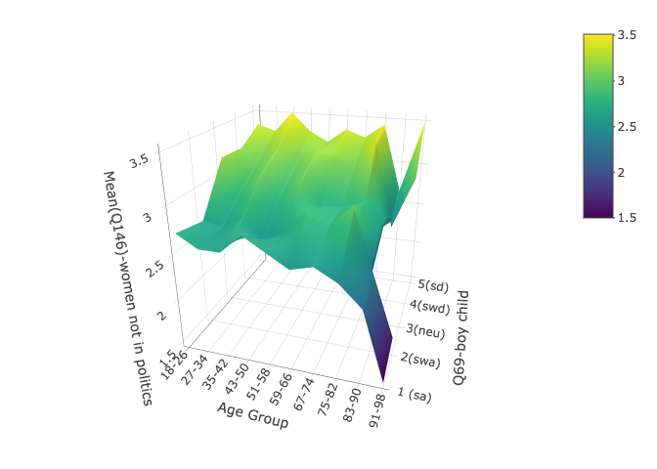
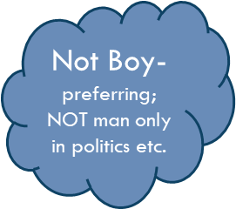
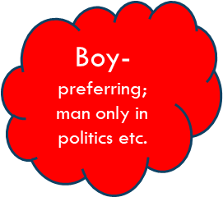
Graphical Approach to the findings
Asian barometers shown⇒
Gender norms HIGHLY correlated ⇓
| Robust
allchildcaretime | Coefficient std. err. t P>|t| [95% conf. interval]
------------------------+----------------------------------------------------------------
gender | 301.1068 1.076889 279.61 0.000 298.9961 303.2174
|
agegroup |
2 | -75.91933 .9860008 -77.00 0.000 -77.85186 -73.98679
3 | -143.7858 2.78459 -51.64 0.000 -149.2435 -138.3281
|
numchild | 225.0759 2.315317 97.21 0.000 220.538 229.6139
numchild2 | -30.32982 .64938 -46.71 0.000 -31.60258 -29.05705
numadult | -13.97016 .34863 -40.07 0.000 -14.65347 -13.28686
hasteach | 6.698178 4.288748 1.56 0.118 -1.707642 15.104
hascompoccup | 16.17882 3.158329 5.12 0.000 9.988592 22.36906
sc | -4.82571 1.272034 -3.79 0.000 -7.31886 -2.332559
st | -12.0681 1.625505 -7.42 0.000 -15.25404 -8.882157
muslim | -3.599906 1.561779 -2.31 0.021 -6.660948 -.5388646
gngroupmean | 55.57491 4.922029 11.29 0.000 45.92788 65.22194
rural | 3.363136 1.548991 2.17 0.030 .3271591 6.399113
|
state |

Slide 18
Beware of issues with the Indian data
Indian time-use survey 2019
Indian time-use survey 2019
The hours worked in the one recall day were measured out in 30-minute blocs
Has had few users relative to its importance
Was rather difficult to use initially
  Category codes are not in the documentation
  (Use the ITUS report for these)
  can look up icatus (2016) document
  These codes change from time to time!
It had a Good sampling method
30 minute blocks give a large error bar
Hidden measurement error such as masking all the <15 minute activities like brushing the child’s teeth
  Changing a diaper
Likely to lead to underestimating childcare time
Has had few users relative to its importance
Was rather difficult to use initially
  Category codes are not in the documentation
  can look up icatus (2016) document
  These codes change from time to time!
Good sampling methods
30 minutes blocks give a large error bar
Hidden measurement error such as masking all the <15 minute activities like brushing the child’s teeth
  Changing a diaper
Likely to be underestimates of childcare time

Slide 19
Summary and Pointers Forward
Survey of the main points today
Pointers to how time-use data will be organised in future, in many countries
Data combining can increase the cost-effectiveness of the time-use survey
Gender norms
  Multi stage random sampling
  Cluster sampling stage is a risk zone for non-representativeness
  Costs rise, so statisticians can argue the case for timeuse spending if…
    A they get in the room
    B they can show benefits from the data
    C they say clearly who benefits
    D policy-practitioners directly, and childcare workers and fathers indirectly, benefit from the info.

Slide 20
Some References
Indian data and early studies
Empirical research studies
S. Rao and Vijayamba R., online document on "Using the India TUS Unit Level Data: Some notes on method", URL https://fas.org.in/using-the-india-tus-unit-level-data-some-notes-on-method-and-some-stata-code/, accessed March 2022.
Full Open Access Methods:
github.com/WendyOlsen/combining-cmie-itus-data
Dev’t In Practice Paper Methods:
github.com/WendyOlsen/excessworkhoursindia
Kim, Jihye, and Wendy Olsen (2023), Harmful Child Labour in India from a Time-Use Perspective, Development in Practice, 33:2, DOI Https://www.tandfonline.com/doi/full/10.1080/09614524.2022.2155620, Open access.

Slide 21
Further information sources
*for icatus codes used at 1-digit level, see UN (2021), International Classification of Activities for Time-Use Statistics 2016, Department of Economic and Social Affairs Statistics Division, Statistical Papers Series M No. 98, New York: United Nations. URL accessed Feb 2023, https://unstats.un.org/unsd/gender/timeuse/23012019%20ICATUS.pdf
Specific codes are in the report published 2021
Indian Time Use Survey (ITUS) microdata 2019 (NSS, 2020) Available at: *https://mospi.gov.in/web/mospi/download-tables-data/-/reports/view/templateTwo/20702?q=TBDCAT. Accessed Sept. 15, 2022.
There is a login stage at MOSPI website.
  Text Data Layout for Time Use Survey : Schedule-10.6, URL https://mospi.gov.in/sites/default/files/README_TUS106.pdf, available via https://mospi.gov.in/time-use-survey-0
NIC info is at:
  https://www.ncs.gov.in/Documents/NIC_Sector.pdf

