Slide 1
Social Statistics Away Day
May 16th 2024
What is Sample Representativeness?
Natalie Shlomo
Natalie.Shlomo@manchester.ac.uk

Slide 2
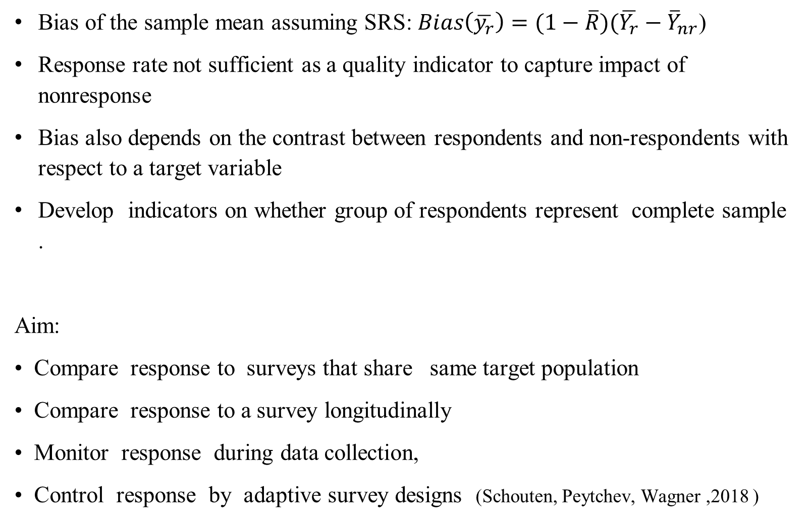
Sample Representativeness
Bias of the sample mean assuming SRS: $Bias\left(\overline{y_{r}}\right)=(1−\overline{R})(\overline{Y_{r}}−{\overline{Y}}_{nr}$)
Response rate not sufficient as a quality indicator to capture impact of nonresponse
Bias also depends on the contrast between respondents and non-respondents with respect to a target variable
Develop indicators on whether group of respondents represent complete sample .
Aim:
• Compare response to surveys that share same target population
• Compare response to a survey longitudinally
• Monitor response during data collection,
• Control response by adaptive survey designs (Schouten, Peytchev, Wagner ,2018 )
Project RISQ
(Representativeness Indicators for Survey Quality, www.risq-project.eu )

Slide 3
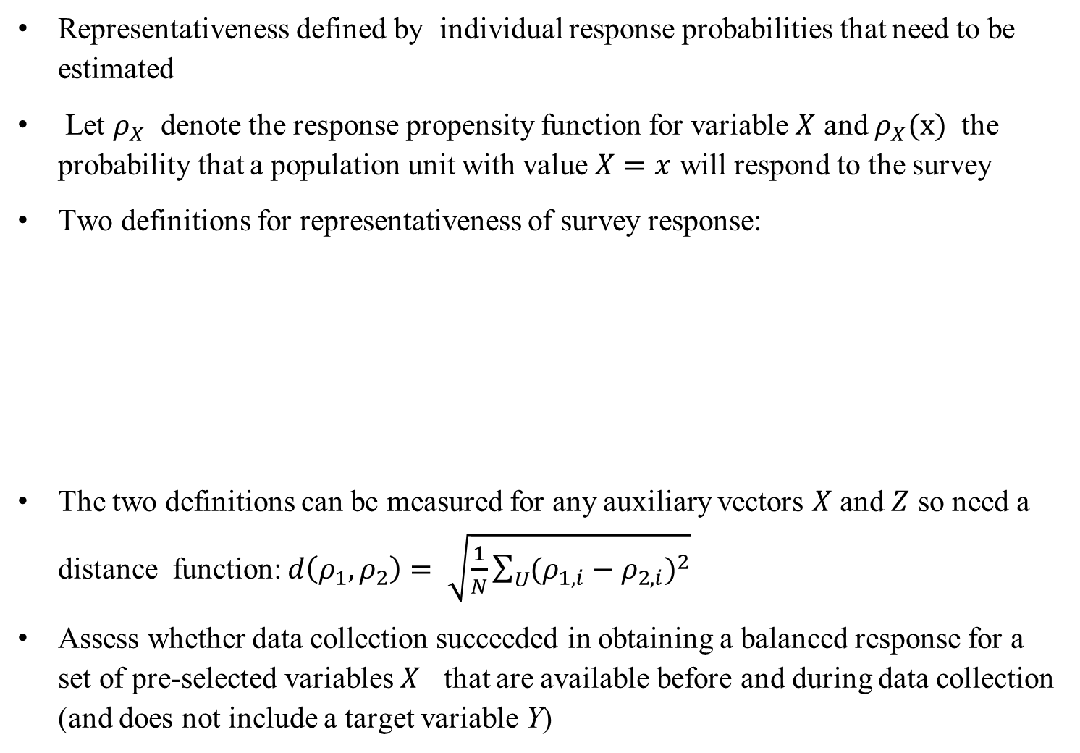
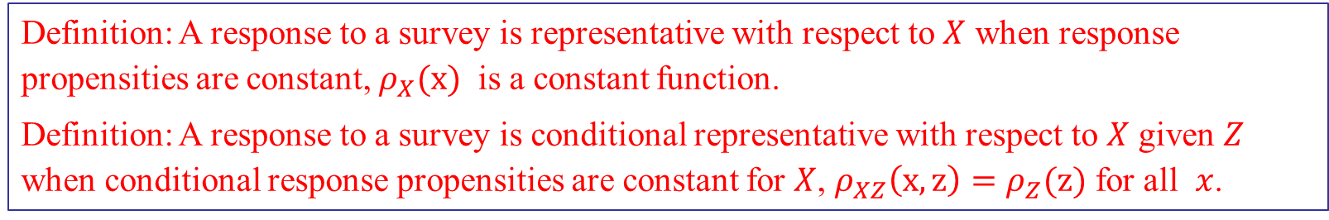
What is representativeness?
Representativeness defined by individual response probabilities that need to be estimated
Let $ρ_{X}$ denote the response propensity function for variable $X$ and $ρ_{X}(x)$ the probability that a population unit with value $X=x$ will respond to the survey
Two definitions for representativeness of survey response:
The two definitions can be measured for any auxiliary vectors $X$ and $Z$ so need a distance function: $d\left(ρ_{1},ρ_{2}\right)= \sqrt{\frac{1}{N}\sum_{U}{{(ρ_{1,i}−ρ_{2,i})}^{2}}}$
Assess whether data collection succeeded in obtaining a balanced response for a set of pre-selected variables $X$ that are available before and during data collection (and does not include a target variable Y)
Definition: A response to a survey is representative with respect to $X$ when response propensities are constant, $ρ_{X}(x)$ is a constant function.
Definition: A response to a survey is conditional representative with respect to $X$ given $Z$ when conditional response propensities are constant for $X$, $ρ_{XZ}\left(x,z\right)=ρ_{Z}(z)$ for all $x$.

Slide 4
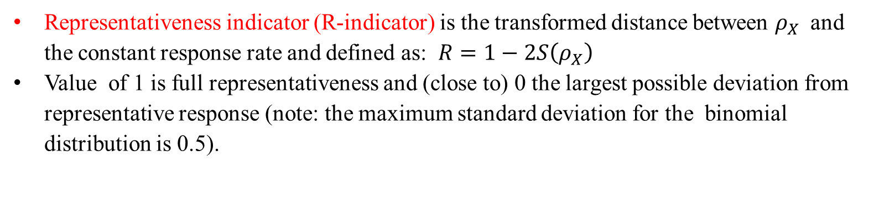
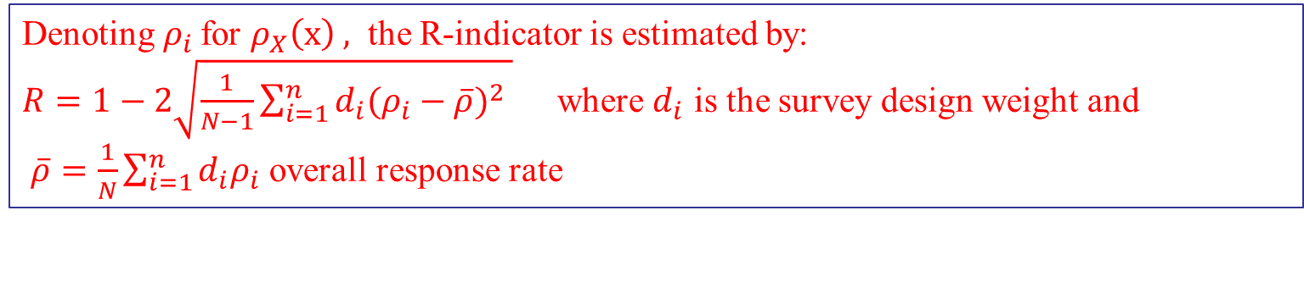
Sample Representativeness
Representativeness indicator (R-indicator) is the transformed distance between $ρ_{X}$ and the constant response rate and defined as: $R=1−2S\left(ρ_{X}\right)$
Value of 1 is full representativeness and (close to) 0 the largest possible deviation from representative response (note: the maximum standard deviation for the binomial distribution is 0.5).
Denoting${ ρ}_{i}$ for $ρ_{X}\left(x\right) ,$ the R-indicator is estimated by:
$R=1−2\sqrt{\frac{1}{N−1}\sum_{i=1}^{n}{{d_{i}(ρ_{i}−\overline{ρ})}^{2}} }$ where $d_{i}$ is the survey design weight and
$\overline{ρ}=\frac{1}{N}\sum_{i=1}^{n}{d_{i}ρ_{i}}$ overall response rate

Slide 5

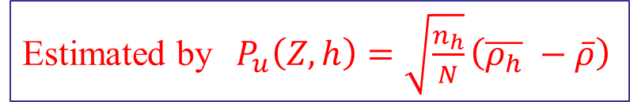

Sample Representativeness
Unconditional Partial R-indicator with respect to one variable Z defined as $P_{u}\left(Z\right)=S{(ρ}_{Z})$
Assume Z has H categories and let $∆_{h,i }$ the 0-1 indicator function for $Z=h$ so $n_{h}=\sum_{i=1}^{n}{d_{i}}∆_{h,i }$. Let $\overline{ρ_{h}}$ be the mean of response probabilities for category $h$ in $Z$
It holds that $P_{u}\left(Z\right)≤0.5$ , the larger the value the stronger the impact of variable Z on lack of representativeness
Unconditional categorical-level Partial R-indicator with respect to one category h of Z
Negative signed $P_{u}\left(Z,h\right)$ is a lack of representativeness sand positive signed $P_{u}\left(Z,h\right)$ over-representativeness
Can build profiles of individuals to target data collection
Estimated by$P_{u}\left(Z\right)=\sqrt{\frac{1}{N}\sum_{h=1}^{H}{n_{h}{(\overline{ρ_{h}} −\overline{ρ})}^{2 }}}$
Estimated by$P_{u}\left(Z,h\right)=\sqrt{\frac{n_{h}}{N}}\left(\overline{ρ_{h}} −\overline{ρ}\right)$

Slide 6
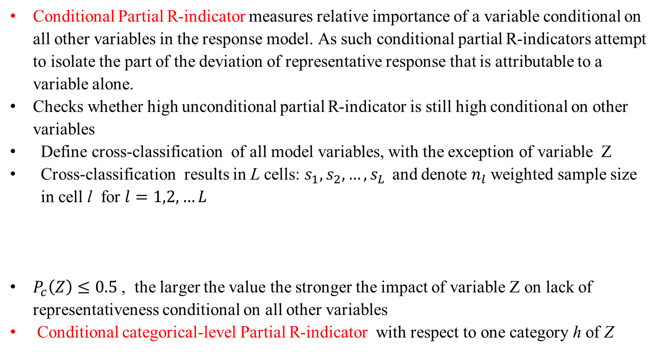
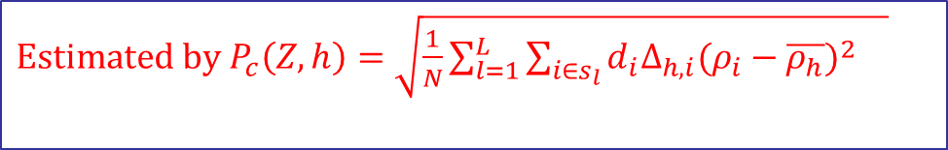
Sample Representativeness
Conditional Partial R-indicator measures relative importance of a variable conditional on all other variables in the response model. As such conditional partial R-indicators attempt to isolate the part of the deviation of representative response that is attributable to a variable alone.
Checks whether high unconditional partial R-indicator is still high conditional on other variables
Define cross-classification of all model variables, with the exception of variable Z
Cross-classification results in L cells: $s_{1},s_{2},…, s_{L }$ and denote $n_{l}$ weighted sample size in cell l for $l=1,2,…L$
$P_{c}\left(Z\right)≤0.5$ , the larger the value the stronger the impact of variable Z on lack of representativeness conditional on all other variables
Conditional categorical-level Partial R-indicator with respect to one category h of Z
Estimated by$P_{c}\left(Z\right)=\sqrt{\frac{1}{N}\sum_{l=1}^{L}{\sum_{i∈s_{l}}{{d_{i}(ρ_{i}−\overline{ρ_{h}})}^{2}} }}$
$Estimated by P_{c}\left(Z,h\right)=\sqrt{\frac{1}{N}\sum_{l=1}^{L}{\sum_{i∈s_{l}}{{d_{i}∆_{h,i}(ρ_{i}−\overline{ρ_{h}})}^{2}} }}$

Slide 7
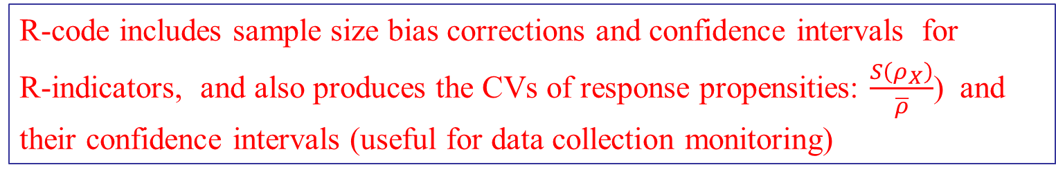
R-indicators
Software and User Manual
www.risq-project.eu
R-code – currently being re-instated on the website but can be found at various websites:
https://www.practicalsignificance.com/posts/r-indicators-in-r/
https://github.com/addinall/RISQ
Manual: https://hummedia.manchester.ac.uk/institutes/cmist/risq/RISQ-manual-v21.pdf
R-code includes sample size bias corrections and confidence intervals for R-indicators, and also produces the CVs of response propensities: $\frac{S\left(ρ_{X}\right)}{\overline{ρ}}$) and their confidence intervals (useful for data collection monitoring)

