Slide 1

Entropy of Ordinal Inputs in A Social Data Science Context: Ontic and Statistical Options By Wendy Olsen & Ziyang Zhou
Sept. 9-11, 2024 –British society
for population Studies
Bath, UK
https://github.com/WendyOlsen/entropyOrdinalData2024
We acknowledge the Asian Barometers data for India for 2019.
Our open-source code is on Github.

Slide 2
Typical Research question what factors explain outcomes or associations, when some variables are ordinal? This paper’s questions: what is the appropriate ontic way to deal with ordinal information at stage 1 of a project? & what impact does cumulative coding have on results?
Going beyond data science to social data science

Slide 3
Review of literature
Retroduction from data to an ordinal or cardinal reality

Slide 4
Review of literature
Two possible encodings
In r we used one-hot encoding to gain cumulative coding
(10 pages)
In stata it is just 20 lines of code for each 10 ordered levels

Slide 5
Gaps in the literature
Data science – no studies of cumulative encoding
Natural science – needs entropy measures to suit ordinal inputs.
Social science – uses SEM, MCA, etc. (VERY GOOD).

Slide 6
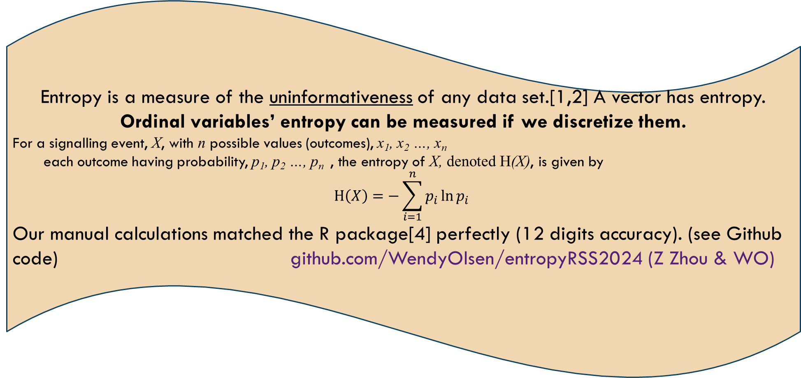
* supervised learning: aim for explaining some outcomes. * unsupervised learning: aim for discerning associations, without losing the ordinal status of input signals.
Entropy is a measure of the uninformativeness of any data set.[1,2] A vector has entropy. Ordinal variables’ entropy can be measured if we discretize them.
For a signalling event, X, with n possible values (outcomes), x₁, x₂ …, x_{n}
each outcome having probability, p₁, p₂ …, p_{n} , the entropy of X, denoted H(X), is given by
$$H\left(X\right)=−\sum_{i=1}^{n}{p_{i}{\ln{p}}_{i}}$$
Our manual calculations matched the R package[4] perfectly (12 digits accuracy). (see Github code) github.com/WendyOlsen/entropyRSS2024 (Z Zhou & WO)

Slide 7
Statistical methods to use the discretized ordinal signals
Start with a model of a distribution
Multinomial distribution or an ordered distribution of levels
Regularize and shrink
Hausser & Strimmer, 2009, 2022 (R package entropy)
(see Github code and notice discretization routines in R base, arules, etc.)
github.com/WendyOlsen/entropyRSS2024 (Z Zhou & WO)

Slide 8
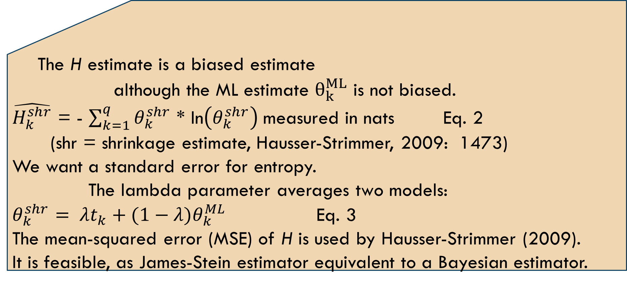
Statistical methods in hausser-strimmer
The H estimate is a biased estimate
although the ML estimate $θ_{k}^{ML}$ is not biased.
$\hat{H_{k}^{shr}}$ = - $\sum_{k=1}^{q}{θ_{k}^{shr}}$ * ln$\left(θ_{k}^{shr}\right) \text{measured} \text{in} \text{nats}$ Eq. 2
(shr = shrinkage estimate, Hausser-Strimmer, 2009: 1473)
We want a standard error for entropy.
The lambda parameter averages two models:
$θ_{k}^{shr}= λt_{k}+(1−λ)θ_{k}^{ML}$ Eq. 3
The mean-squared error (MSE) of H is used by Hausser-Strimmer (2009).
It is feasible, as James-Stein estimator equivalent to a Bayesian estimator.

Slide 9
Data and Methods Used here
Method 1: Entropy estimation (exact match to the entropy package james-stein estimates)
Method 2: Regression estimates with a variety of ordinal variables
Method 3: Simulation and mSE

Slide 10
Likert scales are distinct-ordinal
The entity is an attitude. Each Attitude is distinctive. The ontology of attitudes is unlike that of education.
See paper with references in our Github.
See our earlier publications on gender norms
Note: In the 2019 Asian Barometers - India
Sexism was embedded in questions ←→ desirability bias of a patriarchal gender norm

Slide 11
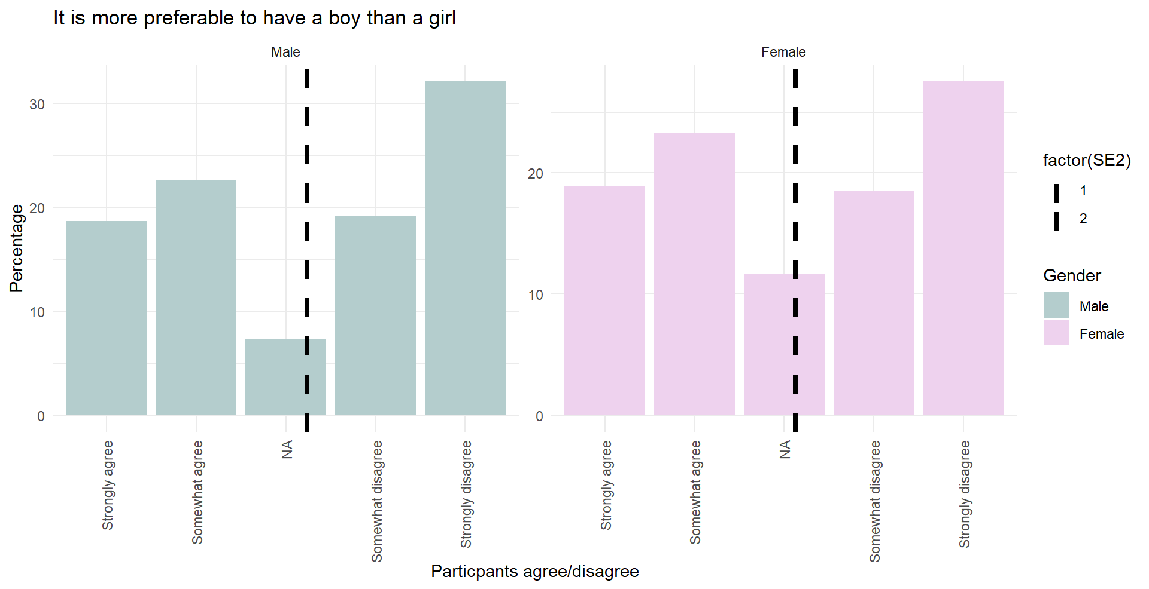
Likert scale – Asian barometers – figure 1
Does the respondent prefer a boy or a girl, if just 1 child is to be born?
The entropy measures deviations from uniform.
Boy-Preferring
Not Boy-preferring

Slide 12
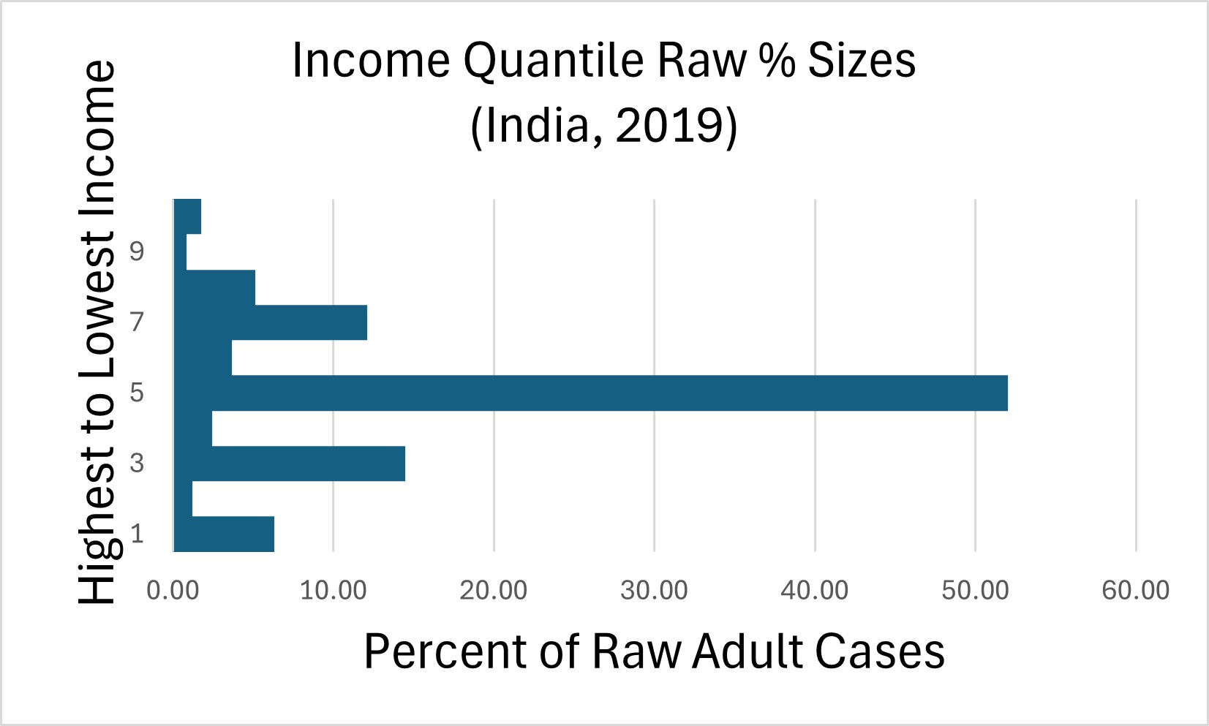
Sample is widely distributed; covers 19 states

Slide 13
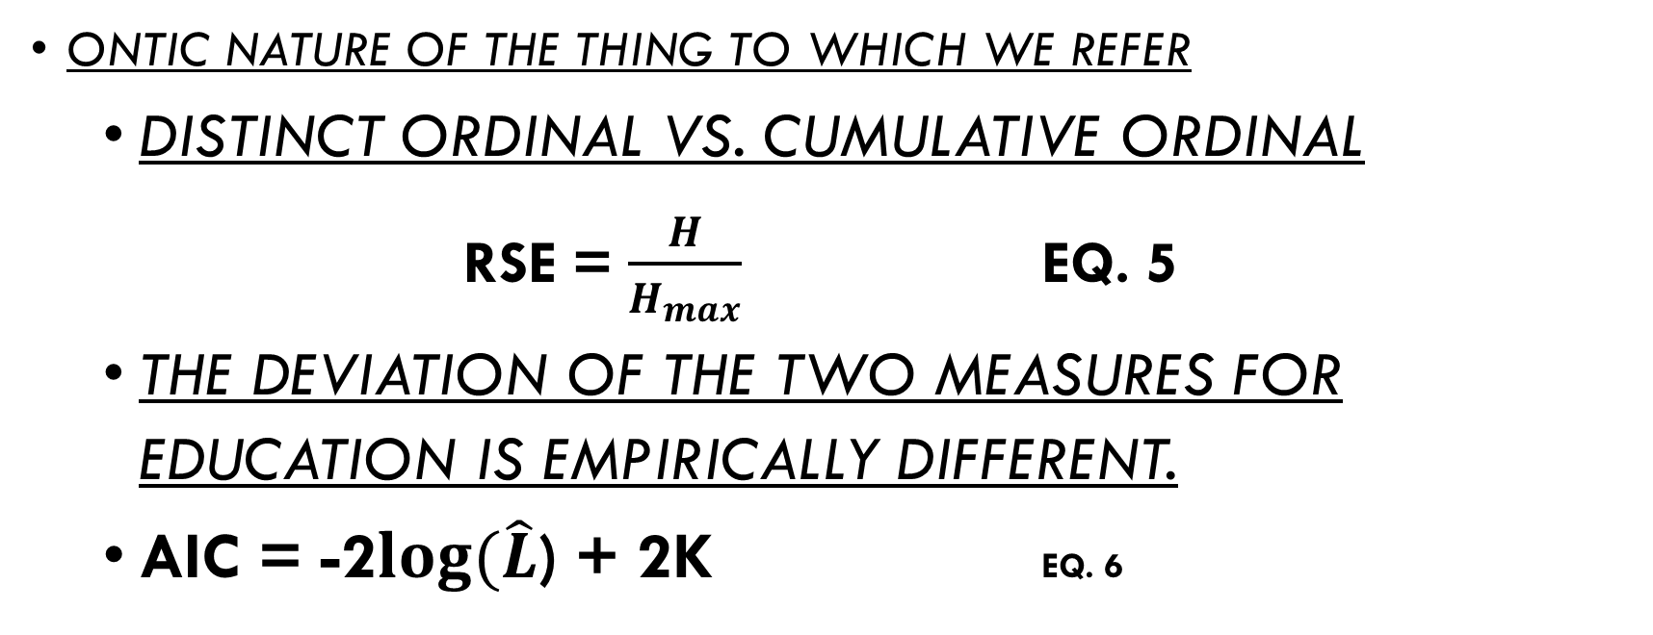
“Cumulative ordinal” reflects the reality of combining primary, secondary, and optional later schooling.
Ontic nature of the thing to which we refer
Distinct ordinal vs. Cumulative ordinal
RSE = $\frac{H}{H_{max}}$ Eq. 5
The deviation of the two measures for education is empirically different.
AIC = -2$log⁡(\hat{L}$) + 2k Eq. 6

Slide 14
The results ( entropy tests )
Methods Used | Sample: | Overall Test: | If One Vector: | If Multiple Vectors:
First entropy measures. | N=5,318 Adults only 19 states of India | Relative entropy differed by 4-5% between the group of binaries for the distinct vs cumulative coding. Distinct coding’s entropy was lower. But in groups of variables, this result switched. | Higher entropy implied less informative education data. Cumulative coding was less informative. | The dataframe entropy depends in part on mutual entropy. The results were switched.

Slide 15
The results ( Simulation test on education )
Methods Used | Sample: | H for Discrete Education | H for Cumulative Education | Relative Entropy Tests
Simulation Repeat 1000 samples with replacement from 5,318 Multinomial distribution | N=5,318 | The 95% interval for H, the entropy, around the mean 1.52885, was: {1.5384, 1.5171} This range is about 2% of the raw H value in nats. H’s MSE was 0.027. | H mean estimate was 1.2411 95% Interval: {1.2258, 1.2563} This range is about 3% H’s MSE was 0.059 | We divide by the same constant. RSI distinct = 0.950 RSI cumul =.771 In range {0.761, 0.780) RSI distinct’s MSE was 0.01 RSI cumul’s MSE was 0.23
 |  | Next run: mean 1.52883 {1.5397 , 1.5175}, and H’s MSE 0.030 |  | FYI ln(5) is 1.609; Notice that cumulative has higher entropy, with more uncertainty.

Slide 16
The results ( regressions )
Methods Used | Sample: | Overall Test: | Results:
Ordered probit. Cumulative coding vs. distinct coding. | N=5,318 | Income by Edu, base Edu1_1. Educ by Age, base Age1=lowest, 18-25 Income by Age, both in ten deciles, age distinct vs age cumulative Likert 1 ‘boy’ by income, by educ, and by age; All distinct then cumulative | We compare AIC using the Δdf as a ChiSquared.
 |  | Ran 6 sets of 2 regressions | No change in Degrees of Freedom
Compare the AIC | N is same, but p rises to q and differs. | AIC test is for the distinct coding of X and for the cumulative coding. | So AIC could be the same. And it is.

Slide 17
Sample regression result: Income quantile by age decile Model 3A by 3B
Number of observations | 3A, N=5318, distinct coding | 3B, N=5318, cumulative coding
Akaike Information Criterion | 17181.78 | 17181.78
Bayes Information Criterion | 17300.20 | 17300.20
Log likelihood | -8572.89 | -8572.89

Slide 18
Summary and Pointers Forward
Survey of the main points today
Pointers to how to carry out supervision
Entropy is slightly different for cumulative ordinal vs distinct ordinal variables.
& can introduce ranked levels. Apply Chebyshev’s inequality. Multiple times (sum of indep. R.v.s)
+Obv. Supervision is needed.
Stage 1 ontic
& consider REFERENT
Stage 2 discretize
Stage 3 re-group

Slide 19
Future research
Entropy of waste flows vs. metal ingots
Entropy in a multi-stage analysis
Stage 1 apply philosophical knowledge to data science
Ordinalise and cardinalize the input data
Rank 1< rank 2 < rank 3
This is not a multinomial distribution
Stage 2 discretize after encoding in a novel way
Stage 3 then re-group the variable to get the whole picture
Entropy is different for cumulative ordinal vs distinct ordinal variables
Chemistry, physics, medical & radiography can use the solutions

Slide 20
References 1
ENTROPY
Software package entropy in r
Open Source Code –thanks to Ziyang Zhou - for Entropy Calculations – uses one-hot encoding.
github.com/WendyOlsen/entropyOrdinalData2024
Borsboom, Mellenbergh, and van Heerden (2003) The Theoretical Status of Latent Variables, Psychological Review, DOI 10.1037/0033-295X.
Watts, S., & Crow, L. (2019), Big variates — visualising and identifying key variables in a multivariate world, Nuclear Instruments and Methods in Physics Research Section A, 940, 441-447. https://doi.org/10.1016/j.nima.2019.06.060
Hausser, Jean, and Korbinian Strimmer (2022), Package ‘entropy’ (sic), October 13. CRAN repository, https://strimmerlab.github.io/software/entropy/.
See web-page Estimation of Entropy, Mutual Information and Related Quantities, https://strimmerlab.github.io/, accessed September 2024.

Slide 21
References 2
Hausser, Jean, and Korbinian Strimmer (2009) Entropy Inference and the James-Stein Estimator, with Application to Nonlinear Gene Association Networks, Journal of Machine Learning Research, 10, 1469-1484. URL https://jmlr.csail.mit.edu/papers/v10/hausser09a.html, accessed Aug. 2024.

Slide 22
Further information source
*Source: Asian Barometer Project (2018-2021), India, URL https://www.lokniti.org/page/accessing-data and https://www.asianbarometer.org/datar?page=d10, available for academic purposes only on an open access basis. Write to the data providers personally to get access [online dataset], (accessed Aug 2024; scroll down to the bottom to see the form which you will fill in.)
acknowledgement:
Data analyzed in this article were collected by the Asian Barometer Project (2018-2021), co-directed by Professors Yun-han Chu and received funding from the National Science and Technology Council, Academia Sinica and National Taiwan University. The Asian Barometer Project Office (www.asianbarometer.org) is solely responsible for data distribution. The author(s) appreciate the assistance in providing data by the institutes and individuals aforementioned. The views expressed herein are the authors' own.
Documentation of the dataset for India
The technical report will arrive inside the dataset zip file, after you register for the data.
If in doubt, contact Email: asianbarometer@ntu.edu.tw

