Slide 1
QCA and Fuzzy Set Goodness –of-Fit Tests by Wendy Olsen
Thanks to John McLoughlin for programming help in Python.
Funded by British Academy: Innovation in Global Labour Research Using Deep Linkage and Mixed Methods
See also https://www.facebook.com/groups/mixednetwork/
Integrated Mixed Methods Network
And www.compasss.org
And JISCMAIL QUAL-COMPARE (185 members)

Slide 2
Contents of Presentation
1 Defining our terms and conceptual framework
2 Empirical measure of Csuff (consistency) (s.7)
3 Empirical measure of Goodness-of-fit (F) (s.10)
See https://github.com/WendyOlsen/fsgof
4 Empirical findings
5 Discussion

Slide 3
1 Defining our terms and conceptual framework
QCA=Qualitative Comparative Analysis
QCA and fuzzy set comparative analysis is a set of systematic ways of studying causality.
We make a simple data table of binary or ordinal variables.
QCA helps discern necessary causality as well as sufficient causality.
Any Sample Size, or whole population.
QCA offers formal methods for analyzing contingency.

Slide 4
A Conjunctural Logic Reflects The Nature Of The World
QCA, ... is conjunctural in its logic, examining the various ways in which specified factors interact and combine with one another to yield particular outcomes. “ (Cress and Snow, 2000: 1079)
However... the world’s conjunctures are subject to change at greater/lesser speeds ...
So our claims are definite with respect to the past/present
But conjectural and contingent with regard to the future.
In these ways, the QCA analyst uses qualitative methods and assumes fluidity in the social world. “X affects Y” is also contingent on Z.
STRUCTURE DOXA HABITUS INSTITUTIONS EVENTS AGENCY
→ OUTCOMES
→ other changes in long run.

Slide 5
How QCA Data Are Organised
The Truth Table.
Crisp-Set Truth Table. All 0s and 1s.
Fuzzy sets involve measuring the degree of membership of a case in a set.
If any column is fuzzy, the whole thing is fuzzy.
One column can be used to count cases which are of the same overall configuration.
One column is set aside as the ‘outcome’.
The NVIVO Approach.
The “casebook” in NVIVO.
The concept of multilevel cases.

Slide 6
Appendix: A Fuzzy Set Interim Truth Table (Olsen, 2009)
Y | X1 | X2 | X3 | X4 | X5 | X6 | Number | Configuration
Fuzzy | Fuzzy | Fuzzy | Crisp | Crisp | Fuzzy | Crisp | Of Cases
0 | 0 | 0 | 1 | 0 | 1 | 0 | 1 | 1
0 | 0 | 0 | 1 | 1 | 0 | 0 | 4 | 2
0 | 0 | 1 | 0 | 0 | 0 | 1 | 1 | 3
0 | 0 | 1 | 1 | 0 | 0 | 0 | 2 | 4
0 | 1 | 0 | 0 | 0 | 1 | 1 | 3 | 5
0 | 1 | 1 | 0 | 0 | 0 | 0 | 1 | 6
0 | 1 | 1 | 0 | 1 | 1 | 0 | 1 | 7
0 | 1 | 1 | 1 | 1 | 1 | 1 | 1 | 8
1 | 0 | 0 | 0 | 0 | 0 | 1 | 1 | 9
1 | 1 | 0 | 0 | 1 | 1 | 1 | 4 | 10
1 | 1 | 0 | 1 | 0 | 0 | 0 | 1 | 11
1 | 1 | 0 | 1 | 0 | 1 | 1 | 1 | 12
1 | 1 | 0 | 1 | 1 | 0 | 1 | 1 | 13
1 | 1 | 0 | 1 | 1 | 1 | 1 | 1 | 14
1 | 1 | 1 | 0 | 0 | 1 | 0 | 2 | 15
1 | 1 | 1 | 0 | 0 | 1 | 1 | 4 | 16
1 | 1 | 1 | 0 | 1 | 0 | 0 | 1 | 17
1 | 1 | 1 | 0 | 1 | 1 | 1 | 1 | 18
 |  |  |  |  |  | SUM: | 31

Slide 7
2 Empirical measure of Csuff (consistency) An Example. Cress and Snow ethnographic research in USA
In 2000 the American Journal of Sociology published a QCA article which has become a standard reference work.
The topic is the mobilisation of resources to help homeless people in USA.
Their paper uses QCA very creatively by first of all noting (from their literature review) that four outcomes, not one, need to be taken into account. R1 R2 R3 R4 take up four columns of the data table.
These outcomes are qualitatively compiled based on a series of ethnographic interactions with homelessness activists, homeless people, politicians and officials in 17 US cities. From the 17 cities of their research work, 8 were chosen for this paper’s QCA analysis. Among these 8 cities, 15 cases of Social Movement Organisations cover homelessness.
The crisp-set QCA data table has 4 outcomes, 15 cases (rows), and about 8 causal factors. (12 columns in total)

Slide 8
Snow and Cress’s Findings Used Crisp Sets
‘Rights’ was one of the four outcomes, R1. This diagram illustrates necessary cause.
None
Several (7)
Rights for Homeless People (Y1)
0 1
X
Few (4)
Several (4) Cases
Making a Detailed Prognosis of Homelessness and SMO Viability, X1∩X3
0 1

Slide 9
Snow and Cress’s Findings
There was no single pathway for a single outcome
There was no universal causal pathway for the whole set of positive outcomes.
Each pathway deserved, and got, ethnographic, observational (shadowing, buddying) treatment.
In this paper we offer software to measure the impact of X1 X2 X3 X4 X5 X6 on either Y1 Y2 Y3 or Y4.
JUST PUT YOUR DATA IN AND YOU GET GRAPHS AND CONSISTENCY VALUES OUT.

Slide 10
Eliason & Strycker 2009 offered a test of fit to a hypothesis, e.g. that X is sufficient for Y.
3 Empirical measure of Goodness-of-fit (F)
(3.1 is Dsuff, and 3.2 is F test)
Do the case-study research first,
Then crisp- or fuzzy-set QCA analysis,
Then notice which are the causal pathways
(A) Necessary causes (B) Sufficient pathways
Thirdly statistical testing.

Slide 11
A WARNING ABOUT COMPLETENESS OF CAUSAL MODELS
(A) Necessary causes (B) Sufficient pathways
You could practically remove the ‘necessary causes’ (call this X7 and X8) from the test for ‘sufficient causes’.
That’s because the necessary causal factor is practically present in every case. So it does not affect the measurement or testing of X being sufficient for Y.

Slide 12
Appendix: A Fuzzy Set Interim Truth Table (Olsen, 2009)
Y | X1 | X2 | X3 | X4 | X5 | X6 | Number | Configuration
Fuzzy | Fuzzy | Fuzzy | Crisp | Crisp | Fuzzy | Crisp | Of Cases
0 | 0 | 0 | 1 | 0 | 1 | 0 | 1 | 1
0 | 0 | 0 | 1 | 1 | 0 | 0 | 4 | 2
0 | 0 | 1 | 0 | 0 | 0 | 1 | 1 | 3
0 | 0 | 1 | 1 | 0 | 0 | 0 | 2 | 4
0 | 1 | 0 | 0 | 0 | 1 | 1 | 3 | 5
0 | 1 | 1 | 0 | 0 | 0 | 0 | 1 | 6
0 | 1 | 1 | 0 | 1 | 1 | 0 | 1 | 7
0 | 1 | 1 | 1 | 1 | 1 | 1 | 1 | 8
1 | 0 | 0 | 0 | 0 | 0 | 1 | 1 | 9
1 | 1 | 0 | 0 | 1 | 1 | 1 | 4 | 10
1 | 1 | 0 | 1 | 0 | 0 | 0 | 1 | 11
1 | 1 | 0 | 1 | 0 | 1 | 1 | 1 | 12
1 | 1 | 0 | 1 | 1 | 0 | 1 | 1 | 13
1 | 1 | 0 | 1 | 1 | 1 | 1 | 1 | 14
1 | 1 | 1 | 0 | 0 | 1 | 0 | 2 | 15
1 | 1 | 1 | 0 | 0 | 1 | 1 | 4 | 16
1 | 1 | 1 | 0 | 1 | 0 | 0 | 1 | 17
1 | 1 | 1 | 0 | 1 | 1 | 1 | 1 | 18
 |  |  |  |  |  | SUM: | 31

Slide 13
3.1 Empirical measure of Goodness-of-fit (F) A Basic measure, C_{suff}
1. Is there a random sample? If you, consider statistical methods of testing. Sociological Methodology 2015 debated this question.
Follow Rihoux and Ragin’s protocol.
2a) find what’s Necessary. 2b) then Sufficient. 2c) then Converses.
For tests of sufficiency, you are now looking at joint membership in sets, known as X1∩X2 ∩X3 = X etc.
The sufficiency triangle is the upper left area.
MIN(X1, X2, X3) is the same as X1∩X2 ∩X3.
C. Strycker and Eliason advise to recalibrate into normal distributions.
You are now looking at individual X’s first, and then at configurations that embed these. Thus the effects are found to occur in combinations, known as configurations.

Slide 14
Rihoux and Ragin offer this measure of goodness of fit:
C_{suff} = Consistency = Sum(X ∩ Y) / Sum(X)
You sum over the cases. If Y>X , then the numerator, ∑Min(X, Y), is less than the denominator.
For patterns with many cases lying in the Sufficiency Triangle, C_{suff} is =1 or close to 1. The cutoff point recommended by Ragin is 0.8, or 0.75.

Slide 15
Visualising the Csuff Criterian
The Consistency measure depends on the slopes of the lines that reach each point in the lower triangle. So it uses the vertical distances to the Diagonal in a crucial way.
S
N

Slide 16
A Fuzzy Set Measure of Fit, C_{suff}
Point A adds 1 unit to the numerator and denominator of Csuff. At Point B, the Y value is less than X. So it only adds to the denominator.
Notice the fuzzy set space {0,0} to {1,1}. This conceptual space is not Euclidean.
A point represents a case.
From B to the diagonal is a non-zero distance. C_{suff} < 1 because of B.
Suppose C is a case at (1,0)
From C to the Diagonal is 1 unit! Huge.
Suppose D is a case at (0,0)
From D to the Diagonal is distance 0.
D counts as ‘in’ the triangle S.
A
B
D
C

Slide 17
Sufficiency of low availability of early childhood education for high level of social inequality
High scores in Y are usually caused by high scores in X, but low scores in X can also cause high scores in Y
Thanks Patricio Troncoso-Ruiz. He helped prepare these data for re-use. See our Github area, to do this estimate yourself!

Slide 18
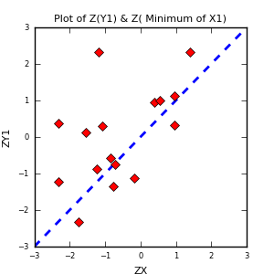
A German-Regions Education Illustration Using our Python Freeware Program
Freitag, M., & Schlicht, R. (2009). Educational Federalism in Germany
caseid | Late Education | Social Inequality
SH | 0.2 | 0.28
HH | 0 | 0.65
NI | 0.22 | 0.09
HB | 0.24 | 0.23
NW | 0.65 | 0.83
HE | 0.43 | 0.13
RP | 0.83 | 0.87
BW | 0.71 | 0.84
BY | 0.92 | 1
SL | 0.83 | 0.63
BE | 0 | 0.11
BB | 0.04 | 0
MV | 0.14 | 0.62
SN | 0.11 | 0.19
ST | 0.12 | 1
TH | 0.06 | 0.55
The pattern suggests that X is sufficient for Y with 5 exceptions. The consistency Csuff is .876. This meet’s Ragin and Rihoux’s criterion.

Slide 19
A More Advanced Measure of Fit, D_{suff}
Will you consider that the fuzzy-set measurements could have measurement error?
If so: frequentist discourse
Ragin suggested softening the C_{suff} criterion for this very reason. See Ragin (2000).
If not: qualitative and realist discourse.
A realist however can also use the frequentist discourse. Measurement error can be modelled.
If sampling cases: then in a probabilistic way, as descriptive of the data. We can reveal patterns in the population.
If not sampling cases: then in a hypothetical way.

Slide 20
Stryker and Eliason allow for 0.1 average deviation at the middle of the fuzzy set space
The basis for this is that there could be error in any point in the graph, ie any case could have measurement error. They mention this could arise from inter-rater disagreement or from not having a firm basis for the fuzzy set membership score.

Slide 21
Another illustration of Eliason & Stryker’s concept of measurement error

Slide 22
FAR LEFT: Avg. Error=0. MIDDLE: Avg Error=E(η_{i}) = 0.1 . FAR RIGHT: Avg. Error=0.
How to Set up Random Errors for Bootstrap Programme to get a credible interval around C_{suff} and D_{suff} See also Appendix Code.
TOP: Avg. Error=0.
MIDDLE: Avg Error=E(ε_{i} ) = 1
BOTTOM: Avg. Error=0.
Y_{i} + ε_{i}
X_{i} + η_{i}

Slide 23
Next Activity (Stryker & Eliason):
Create gaussian variables for the configuration X = X1∩X2 ∩X3 and for Y.
Using STATA or Excel, calculate the D value: is the case in the sufficiency triangle, or not?
-- if so, then D=0. If not, then D=1.
--Multiple D by the distance to the “diagonal”.
--The ‘diagonal’ in Fuzzy Set space is being moved to a new diagonal line in Zx-Zy space.

Slide 24
A transformation
Here some data is shown in the fuzzy set space (left) and the Z score space (right)
We are now working in a Euclidean space. Here the sum of distances works using the usual measures, e.g. Pythagorean theorem.
But we also added the Damper and the Measurement Error, and used InvCumNormal

Slide 25
Eliason & Strycker Tricks
Trick A: they convert the fuzzy set membership scores into normal distribution scores (Z-scores). To do this manually, you could subtract the mean and divide by the standard deviation.
In a programme we use the inverse cumulative normal distribution to read off from Z score range the Z value that corresponds to this fuzzy set membership score. The X axis is read as a cumulative probability. Those cases with X<0.5 get a Z value <0, and those on the right get a larger Z value.
Trick B: they measure the distance from a case (Zx, Zy) to the diagonal line where x=y, and they note that (y-x)² gives this distance.
Sum up these distances to get a measure of how far the cases disconform to the Suff hypothesis. The sum is called D_{suff}.

Slide 26
3.2 Empirical estimate of distance: Strycker’s measure: (1-D)*(zy-zx)²
D is 1 if the case lies in the upper lefthand triangle.
D is 0 otherwise.
In PYTHON language:
if ( ylist[ XL ] > xlist[ XL ] ): d = 1 else: d = 0
Sum up the D_{suff} measure for all the cases in the group below the diagonal.
(If D=1 we multiply the distance by 1-D so that it is cancelled out.)
For example, if N=30 and 20 are above the diagonal, we are adding up 10 items to give the Dsuff measure. D_{suff}i is zero where D=1.
(NOTE: Also, if X=0 for certain cases in a configuration, then cases should add nothing! ! !!) (By implication, if X is 0 for all cases, then that configuration is not causal on Y.)

Slide 27
Illustration 1 for Sufficiency
When Dsuff is large, the evidence for a large F causes us to reject the null hypothesis of sufficiency of X for Y.
Standard F test
Variance explained
________
Variance that would exist if random
Null hypothesis: all Y’s are predicted at exactly the mean, Y-bar, given each actual X.
These count. But under null hypothesis, Y=X, and only the error counts (observed e_{i})
“Sheldon Stryker F test”
Empirical Distance Dsuff/df1
________
Distance (minimum) under Sufficiency / N
Alternative hypothesis: The Dsuff measures the Y’s lying below the Y=X line
Df1 is the count of the cases that lie on or below the Y=X line.

Slide 28
Illustration 2 for Sufficiency Testing
If the mean of Y and the mean of X give a point low down in the diagram, we tend to get a low Consistency level, depending on the skewness of the two variates.
If the mean of Y and mean of X give a point high up in the diagram, the Csuff tends toward being large, and the Dsuff tends toward being small.
When Csuff is small, there’s no need to reject the null hypothesis of X is sufficient for Y.
A “Csuff large” can be tested using the idea that the credible interval must not include 0.8.
B “Dsuff small” can be tested using the F test claim that F is greater than the F cutoff. [OR that the c.i. for Dsuff is small.
C We do not have a cutoff criterion for Dsuff. Further research may suggest such a criterion value. The issue of measurement error must be taken into account, as well as the spread of X along the X axis.]

Slide 29
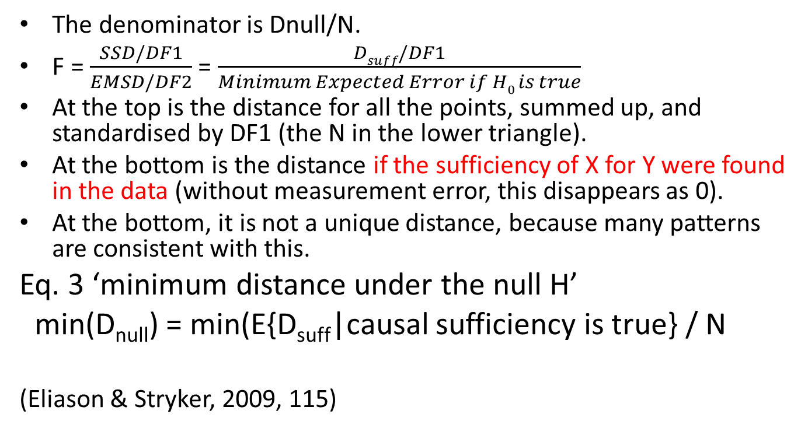
Here is the formula and a description of the denominator of the F test in Eliason and Stryker (2009)
The denominator is Dnull/N.
F = $\frac{SSD/DF1}{EMSD/DF2}$ = $\frac{Dsuff/DF1}{Minimum Expected Error if H0 is true}$
At the top is the distance for all the points, summed up, and standardised by DF1 (the N in the lower triangle).
At the bottom is the distance if the sufficiency of X for Y were found in the data (without measurement error, this disappears as 0).
At the bottom, it is not a unique distance, because many patterns are consistent with this.
Eq. 3 ‘minimum distance under the null H’
min(D_{null}) = min(E{D_{suff}|causal sufficiency is true} / N
(Eliason & Stryker, 2009, 115)

Slide 30
Reminder: what sufficiency means.
If X is sufficient for Y,
Then whenever X is non zero, Y will be =X or greater.
Thus if X is 0, it is an irrelevant case for consistency in this sense.

Slide 31
Eliason and Strycker say to consider measurement error.
If the zy and zx are considered to be stochastic then they may have both sampling error and measurement error. The idea of error here is that the sample may not give a perfect idea of the population. Then the true relationship cannot be known perfectly.
Probability theory helps us know something about the pattern with a ‘confidence level’.
P values are 100% - the conf. level
E.g. 5% if the conf. level is 95% over repeat samples

Slide 32
F statistic
A ratio of two r.v.s follows an F distribution if both r.v.s follow chi-squared distribution.
We see this in ANOVA and in the F test of Regression: If F is large, P is near 0 and we reject the null hypothesis, because the numerator exceeds the denominator more than it would by chance.
For our F statistic, the H₀ is: X is sufficient for Y.
Rejecting H₀ means we have X is NOT sufficient for Y. “Accepting” H₀ means we have not falsified H₀.

Slide 33
What is the total distance in the numerator of the F?
It’s the sum of the individual distances from the point to the diagonal line, each squared before they’re added up.
The formula uses D_{suff}
Σ(1-d)( zy – zx )²

Slide 34
This particular F Statistic
When we take Zx, this now becomes a point in space, so it does add something. The algebraic rules shift from Boolean to Euclidean.
F = msd/emsd on df1, df2 degrees of freedom.
= mean of the sum of Distance from Sufficiency / Expected Mean under Null Hypothesis
= (∑Dsuff / df1 ) / E(ε_{i})
WHERE: msd = D_{suff}/df1
And emsd = nullsd
D_{suff} = the sum of all ( 1 - d ) * ( zy- zx )²
E (ε_{i}) = nullsd = df2 * error_value²
The numerator arises as a measure of the observed distances from the hypothesized sufficiency relationship (which is independent of the denominator).
The denominator is a measure of the expected value of the error in the model. The expectation of the sum of squared errors.
This error must be independent of X and Y. It is a piecewise linear function. Actually from a scalar ‘Error_value’ we want to generate the errors for each X but we have not allowed this correlation of X and error in this model. We follow Huang, R. https://r-forge.r-project.org/scm/viewvc.php/pkg/QCA3/R/fsgof.R?view=markup&root=asrr with error_value=0.05

Slide 35
Interpretation of the denominator
It is an innocuous feature, based on a null assumption.
If F is large, there’s a lack of support for the null hypothesis.
If F is small, there’s no way to reject the SUFF hypothesis. We want F small! ☺
If F =0 and X is always zero, you can’t test causality of X.
Watch out for remainders.

Slide 36
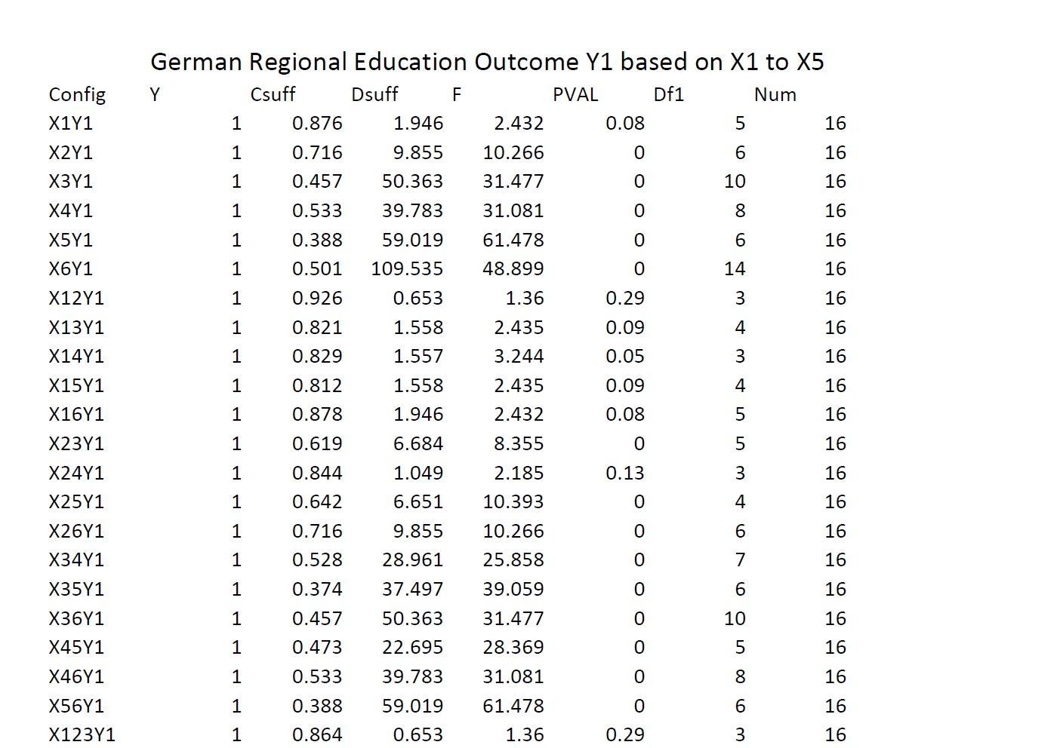
Illustrations
Note how Df1 gives a signal about coverage.
Config | Y | Csuff | Dsuff | F | PVAL | Df1 | Num
X1Y3 | 3 | 1 | 0 | 0 | 0 | 0 | 15
X2Y3 | 3 | 0.622 | 64.943 | 144.317 | 0 | 3 | 15
In such a case, ignore configuration X1X3 because X1∩X3 is always 0 so no test can occur.
These are looking good.

Slide 37
4 Empirical findings Real data illustrations
Aims of this section:
Show the graphs that our program makes.
See https://github.com/WendyOlsen/fsgof
Show that the Dsuff matches the Csuff in measuring the degree of deviation of the pattern from what would be expected if X were sufficient for Y.
Show how an F test is interpreted for different sample sizes.
Show how the degree of measurement error affects the test of goodness of fit.

Slide 38
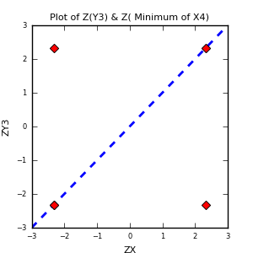
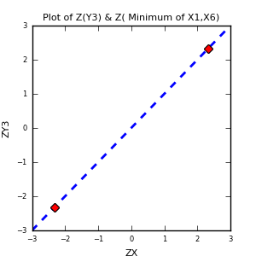
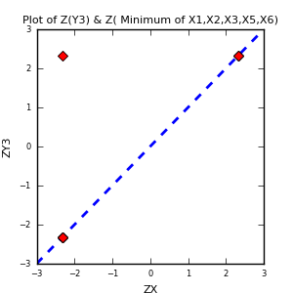
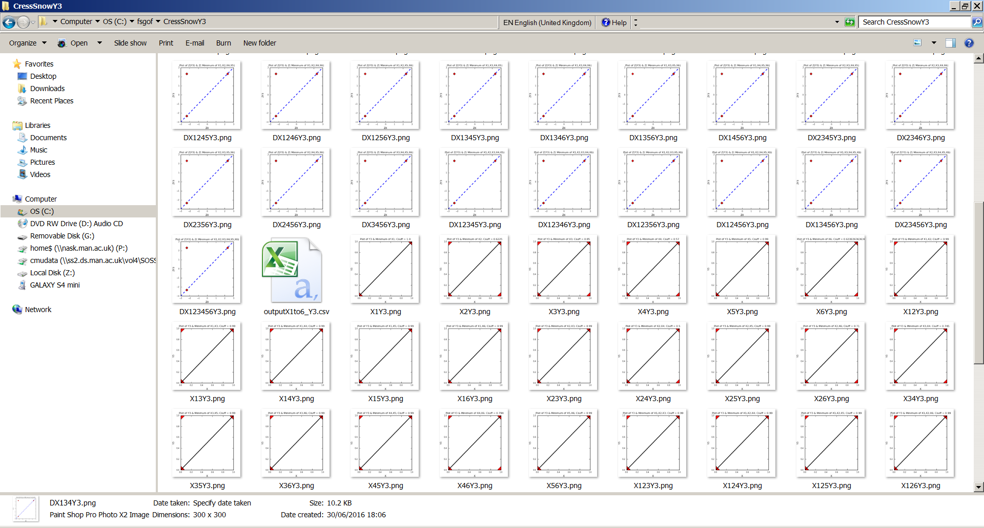
Cress & Snow (2000) Homeless Organisations Data

Slide 39
Indian village people’s resistance to the landlord-employer’s dictates
Y4 is the key outcome reported on in Chapter by Olsen (2009) in Byrne & Ragin, eds. Handbook. Data sample:
Results (Sorted by Significance = Low)
hhid | worker | farmerll | assets | education | tenancy | wetaccess | havecows | conformn | innovaten | resistfz
1 | 0 | 0 | 0.87 | 0.17 | 1 | 1 | 1 | 1 | 0 | 0
2 | 0 | 0 | 0.5 | 0.5 | 1 | 0 | 1 | 0 | 3 | 0.87
3 | 0 | 0 | 0.5 | 1 | 0 | 1 | 1 | 3 | 1 | 1
4 | 0 | 0 | 0.67 | 0.33 | 0 | 0 | 0 | 1 | 0 | 0.87
5 | 0 | 0 | 0.33 | 0.17 | 1 | 0.87 | 0 | 3 | 1 | 0
6 | 0 | 0 | 1 | 0.67 | 1 | 1 | 1 | 2 | 0 | 0

Slide 40
Do Boolean Algebra? Df1 is the number of exceptions.
(or use fsQCA freeware, see http://www.u.arizona.edu/~cragin/fsQCA/software.shtml
Config | Y | Csuff | Dsuff | F | PVAL | Df1 | Num
X13Y1 | 1 | 0.927 | 1.883 | 4.828 | 0.03 | 1 | 39
X45Y1 | 1 | 0.963 | 1.883 | 4.828 | 0.03 | 1 | 39
X134Y1 | 1 | 0.88 | 1.883 | 4.828 | 0.03 | 1 | 39
X345Y1 | 1 | 0.963 | 1.883 | 4.828 | 0.03 | 1 | 39
X456Y1 | 1 | 0.955 | 1.883 | 4.828 | 0.03 | 1 | 39
X3456Y1 | 1 | 0.955 | 1.883 | 4.828 | 0.03 | 1 | 39
X1Y1 | 1 | 0.4 | 129.885 | 55.507 | 0 | 6 | 39
X2Y1 | 1 | 0.623 | 64.943 | 55.507 | 0 | 3 | 39
X3Y1 | 1 | 0.769 | 72.701 | 23.302 | 0 | 8 | 39
X4Y1 | 1 | 0.581 | 119.836 | 20.485 | 0 | 15 | 39
X5Y1 | 1 | 0.925 | 21.648 | 55.507 | 0 | 1 | 39
X6Y1 | 1 | 0.798 | 76.864 | 49.272 | 0 | 4 | 39
X12Y1 | 1 | 0 | 0 | 0 | 0 | 0 | 39

Slide 41
Boolean algebra rules
If AB and Ab are associated with Y, then
A(B or b) are associated with Y, so
A → Y is justified as a simplification. (? Check your remainders, and your N and df1!). Boolean reduction.
If AB and AC are associated with Y, then
A(B or C) is a similar way to express this association. So A(B or C) can be tested for its overall sufficiency for Y. Commutative, symmetrical? NO… if you again test using Not-Y your results may surprise you.

Slide 42
Config | Y | Csuff | Dsuff | F | PVAL | Df1 | Num
X13Y1 | 1 | 0.927 | 1.883 | 4.828 | 0.03 | 1 | 39
X45Y1 | 1 | 0.963 | 1.883 | 4.828 | 0.03 | 1 | 39
X134Y1 | 1 | 0.88 | 1.883 | 4.828 | 0.03 | 1 | 39
X345Y1 | 1 | 0.963 | 1.883 | 4.828 | 0.03 | 1 | 39
X456Y1 | 1 | 0.955 | 1.883 | 4.828 | 0.03 | 1 | 39
X3456Y1 | 1 | 0.955 | 1.883 | 4.828 | 0.03 | 1 | 39
X1Y1 | 1 | 0.4 | 129.885 | 55.507 | 0 | 6 | 39
X2Y1 | 1 | 0.623 | 64.943 | 55.507 | 0 | 3 | 39
X3Y1 | 1 | 0.769 | 72.701 | 23.302 | 0 | 8 | 39
X4Y1 | 1 | 0.581 | 119.836 | 20.485 | 0 | 15 | 39
X5Y1 | 1 | 0.925 | 21.648 | 55.507 | 0 | 1 | 39
X6Y1 | 1 | 0.798 | 76.864 | 49.272 | 0 | 4 | 39
X12Y1 | 1 | 0 | 0 | 0 | 0 | 0 | 39
X1X3 + X4X5 + X1X3X4 + X3X4X5 + X4X5X6 + X3X4X5X6 → Y.
The measures suggest each is sufficient, so the grouped (Equifinal) pathway is also sufficient. No single term is necessary in this group.
X6, for example, is not necessary overall.
But X6 is an INUS condition!

Slide 43
Conclusions
If not a random sample, but purposive sampling, then it’s unlikely that you should use a statistical test in an inferential framework. Use Ragin’s Consistency measure.
If it’s a random sample, use both measures – Ragin’s Consistency and the F test that Eliason and Stryker ( 2003, 2009) developed.
If it’s a whole population, you may use both, again, because there won’t be a bias. You are allowing for measurement error or inter-rater disagreement. This is Eliason & Stryker’s argument.

Slide 44
Appendix 1A: A Fuzzy Set Interim Truth Table (Olsen, 2009)
Y | X1 | X2 | X3 | X4 | X5 | X6 | Number | Configuration
Fuzzy | Fuzzy | Fuzzy | Crisp | Crisp | Fuzzy | Crisp | Of Cases
0 | 0 | 0 | 1 | 0 | 1 | 0 | 1 | 1
0 | 0 | 0 | 1 | 1 | 0 | 0 | 4 | 2
0 | 0 | 1 | 0 | 0 | 0 | 1 | 1 | 3
0 | 0 | 1 | 1 | 0 | 0 | 0 | 2 | 4
0 | 1 | 0 | 0 | 0 | 1 | 1 | 3 | 5
0 | 1 | 1 | 0 | 0 | 0 | 0 | 1 | 6
0 | 1 | 1 | 0 | 1 | 1 | 0 | 1 | 7
0 | 1 | 1 | 1 | 1 | 1 | 1 | 1 | 8
1 | 0 | 0 | 0 | 0 | 0 | 1 | 1 | 9
1 | 1 | 0 | 0 | 1 | 1 | 1 | 4 | 10
1 | 1 | 0 | 1 | 0 | 0 | 0 | 1 | 11
1 | 1 | 0 | 1 | 0 | 1 | 1 | 1 | 12
1 | 1 | 0 | 1 | 1 | 0 | 1 | 1 | 13
1 | 1 | 0 | 1 | 1 | 1 | 1 | 1 | 14
1 | 1 | 1 | 0 | 0 | 1 | 0 | 2 | 15
1 | 1 | 1 | 0 | 0 | 1 | 1 | 4 | 16
1 | 1 | 1 | 0 | 1 | 0 | 0 | 1 | 17
1 | 1 | 1 | 0 | 1 | 1 | 1 | 1 | 18
 |  |  |  |  |  | SUM: | 31

Slide 45
Appendix 1B: A Fuzzy Set Raw Truth Table (Olsen, 2009) (White=X1-X6) (Purple=Y1-Y4)
hhid | worker | farmerll | assets | education | tenancy | wetaccess | havecows | conformn | innovaten | resistfz
1 | 0 | 0 | 0.87 | 0.17 | 1 | 1 | 1 | 1 | 0 | 0
2 | 0 | 0 | 0.5 | 0.5 | 1 | 0 | 1 | 0 | 3 | 0.87
3 | 0 | 0 | 0.5 | 1 | 0 | 1 | 1 | 3 | 1 | 1
4 | 0 | 0 | 0.67 | 0.33 | 0 | 0 | 0 | 1 | 0 | 0.87
5 | 0 | 0 | 0.33 | 0.17 | 1 | 0.87 | 0 | 3 | 1 | 0
6 | 0 | 0 | 1 | 0.67 | 1 | 1 | 1 | 2 | 0 | 0
7 | 0 | 0 | 0.5 | 0.87 | 0 | 0 | 1 | 2 | 1 | 1
8 | 0 | 0 | 0.87 | 0.67 | 0 | 0.87 | 1 | 0 | 1 | 0
9 | 0 | 1 | 0.87 | 1 | 0 | 1 | 0 | 0 | 0 | 0.87
10 | 0 | 0 | 1 | 1 | 0 | 1 | 1 | 0 | 1 | 0.87
11 | 0 | 0 | 0.87 | 0.17 | 1 | 1 | 1 | 2 | 0 | 0.87
12 | 0 | 1 | 1 | 0.17 | 1 | 1 | 1 | 0 | 1 | 0.87
13 | 0 | 1 | 1 | 0.33 | 1 | 1 | 1 | 0 | 1 | 0
14 | 0 | 0 | 0.17 | 0 | 1 | 0 | 1 | 1 | 0 | 0.87
15 | 0 | 0 | 0.87 | 0.67 | 0 | 0 | 0 | 0 | 0 | 0
16 | 1 | 0 | 0.33 | 0.87 | 0 | 0 | 1 | 1 | 2 | 0
17 | 0 | 1 | 0.87 | 1 | 0 | 1 | 0 | 0 | 0 | 0.87
18 | 0 | 0 | 0.87 | 0.33 | 1 | 0 | 1 | 2 | 3 | 1
19 | 1 | 0 | 0 | 0.33 | 0 | 0 | 0 | 2 | 1 | 0
20 | 0 | 0 | 1 | 0.33 | 1 | 0.87 | 1 | 0 | 1 | 1
21 | 0 | 0 | 0.5 | 0 | 1 | 0 | 1 | 0 | 2 | 0.87
22 | 0 | 0 | 0.87 | 0.87 | 0 | 0 | 0 | 0 | 2 | 0.87
23 | 1 | 0 | 0 | 0.17 | 0 | 0 | 0 | 0 | 0 | 0
24 | 1 | 0 | 0 | 0.17 | 0 | 0 | 0 | 2 | 0 | 0.87
25 | 0 | 1 | 0.87 | 0.87 | 0 | 1 | 0 | 0 | 1 | 0
26 | 0 | 1 | 1 | 0.87 | 0 | 1 | 1 | 0 | 0 | 0.87
27 | 1 | 0 | 0.33 | 0.5 | 0 | 0 | 1 | 3 | 0 | 0.87
28 | 1 | 0 | 1 | 0.33 | 1 | 1 | 1 | 4 | 0 | 0.87
29 | 0 | 1 | 1 | 0.87 | 1 | 1 | 1 | 1 | 0 | 0.87
30 | 0 | 0 | 0.87 | 0.17 | 1 | 1 | 1 | 0 | 0 | 0.87
31 | 1 | 0 | 0 | 0.5 | 0 | 0 | 0 | 0 | 0 | 0
32 | 0 | 0 | 0 | 0.67 | 0 | 0 | 0 | 5 | 0 | 0.87
33 | 0 | 0 | 0 | 0.87 | 0 | 0 | 0 | 0 | 0 | 0
34 | 0 | 0 | 0.87 | 0.17 | 1 | 1 | 1 | 5 | 3 | 1
35 | 1 | 0 | 0.17 | 0.17 | 0 | 0 | 0 | 0 | 0 | 0
36 | 1 | 0 | 0.5 | 0.17 | 0 | 0 | 1 | 4 | 0 | 0.87
37 | 1 | 0 | 0 | 0.5 | 0 | 0 | 0 | 0 | 1 | 0
38 | 0 | 0 | 0.87 | 0.17 | 0 | 1 | 1 | 0 | 1 | 0
39 | 0 | 1 | 1 | 0.87 | 0 | 1 | 1 | 0 | 0 | 0.87

Slide 46
Appendix 2: Ragin gave a Z score with a p value
(Fuzzy Set Social Science, 2000)
The p value is the risk of being wrong in rejecting a null hypothesis – here, the null is that the X is not sufficient for the Y.
Each case has a p value.
Each group of cases has a p value.
Few scholars have emulated his Z test.
Stryker and Eliason (2009) comment on a weakness of this test.

Slide 47
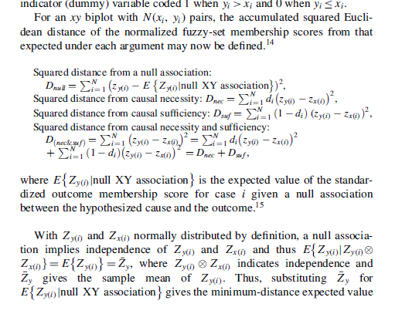
Appendix 3: Snippet from Eliason and Stryker 2009

Slide 48
Appendix 4: Pseudo Code for Programs for Csuff, Dsuff
A. input the parameters that are scalars
Input the data as a rectangle without missing values.
B. Label the permutations (ie X configurations), calculate fuzzy X = min(Xk) for each configuration, count the length of Y and the Number of instances in each X configuration (N in set for X where Yi>Xi)
C. Calculate Consistency for Sufficiency
Calculate Distance for Sufficiency
D. Output plots of the X and Y as fuzzy scores
Output plots of the rescaled ZY by ZX, and a table of Csuff, Dsuff
E. Test for sensitivity to the parameters by looping around, changing either the damping factor or the measurement error.

Slide 49
Appendix 4: Pseudo Code for Programs With Bootstrap
Input S the scale of the bootstrap activity.
Start loop.
Create S=1000 resamples with replacement
These have some repeats of cases.
Each case in each sample is a replica of the original data.
Some cases in the data may not appear, at random in a particular sample.
End loop. Average the Csuff over all the S samples.
Average the Dsuff over all the S samples.
Empirically compare the mean of Csuff with the original Csuff (Bias of consistency measure)
Empirically compare the mean of Dsuff with the original Dsuff (Bias of distance measure)
Create a table or graph showing the empirical distribution of the S Csuff’s, 95% of which forms a credible interval.
Create a table or graph showing the empirical distribution of the S Dsuff’s, 95% of which forms a credible interval.
A. input the parameters that are scalars
Input the data as a rectangle without missing values.
B. Label the permutations (ie X configurations), calculate fuzzy X = min(Xk) for each configuration, count the length of Y and the Number of instances in each X configuration (N in set for X where Yi>Xi)
C. Calculate Consistency for Sufficiency
Calculate Distance for Sufficiency
D. Output plots of the X and Y as fuzzy scores
Output plots of the rescaled ZY by ZX, and a table of Csuff, Dsuff
E. Test for sensitivity to the parameters by looping around, changing either the damping factor or the measurement error.

Slide 50
References
For Qualitative folks: Hodson, R. (2004). "A meta-analysis of workplace ethnographies - Race, gender, and employee attitudes and behaviors." Journal of Contemporary Ethnography 33(1): 4-38.
Ragin, C. C. (1987). The comparative method : moving beyond qualitative and quantitative strategies. Berkeley ; Los Angeles ; London, University of California Press.
For Quantitative Folks: Ragin, C.C. (2008). Redesigning social inquiry: Set relations in social research. Chicago: Chicago University Press.
Rihoux, B. (2006). Qualitative Comparative Analysis (QCA) and related systematic comparative methods: recent advances and remaining challenges for social science research. International Sociology, 21(5 ), 679-706.
Rihoux, B., & Ragin, C. C. (2009). Configurational comparative methods. Qualitative Comparative Analysis (QCA) and related techniques (Applied Social Research Methods). Thousand Oaks and London: Sage.
Byrne, D., and C. Ragin, eds. (2009), Handbook of Case-Centred Research Methods, London: Sage.
Cooper, B. & Glaesser, J. (in press 2011) Using case-based approaches to analyse large datasets: a comparison of Ragin’s fsQCA and fuzzy cluster analysis, in International Journal of Social Research Methodology.
Olsen, W.K. (2009), Non-Nested and Nested Cases in a Socio-Economic Village Study, chapter in D. Byrne and C. Ragin, eds. (2009), Handbook of Case-Centred Research Methods, London: Sage.
Olsen, W.K., and J. Morgan (2005) A critical epistemology of analytical statistics: Addressing the sceptical realist, Journal for the Theory of Social Behaviour, 35:3, September, pages 255-284.
SAMPLE DATA SETS:
1) the website of my course for some past years:
http://Course-data.ccsr.ac.uk/qca
2) the COMPASSS web site (sic) www.compasss.org (They have a lot of CSV files there)

Slide 51
Background References to Works Cited
Ragin, C. C. (2000). Fuzzy-set social science. Chicago; London, University of Chicago Press.
Snow, D. and D. Cress (2000). "The Outcome of Homeless Mobilization: the Influence of Organization, Disruption, Political Mediation, and Framing." American Journal of Sociology 105(4): 1063-1104.
Freitag, M., & Schlicht, R. (2009). Educational Federalism in Germany: Foundations of Social Inequality in Education. Governance: An International Journal of Policy, Administration, and Institutions, 22(1), 47–72.

