Slide 1


Customer
Segmentation Using
RFM, K-Means, Cohort Analysis
Ruoxin WANG (2030026150)
Zhen HUANG (2030026066)
Wenhao LI (2030026075)
Ailing HOU (2030026052)
Mincong ZHU (2030031273)

Slide 2


CONTENTS
01
Introduction
02
Exploratory Data Analysis
03
Data Preprocessing
04
RFM ANALYSIS
05
K-Means Analysis
06
COHORT ANALYSIS

Slide 3

01
Introduction
Notes:
5 1 P P T 模 板 网 w w w.5 1 p p tmoban.c om

Slide 4

01
Introduction
Online retail dataset obtained from the UCI Machine Learning Repository
Exploratory data analysis, customer segmentation, Recency-Frequency-Monetary (RFM) analysis, K-Means Clustering, and Cohort analysis
Transaction patterns and customer behaviors
A UK-based online retailer
Non-store
Distinctive gifts for all occasions.
01/12/2010 and 09/12/2011.
Wholesale buyers.

Slide 5
01
Introduction
Anticipate and understand customer actions is a significant way to improve retention rates
Each individual row signifies a unique customer, while each column holds attributes of the customer as defined by the column’s metadata descriptor.
Customer attrition in the preceding month
Catalog of services
Detailed customer account metrics
Demographic information of customers

Slide 6
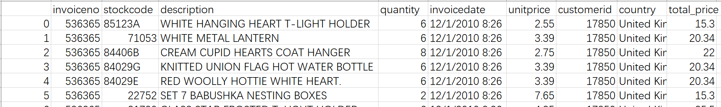
01
Introduction
Features
InvoiceNo: A unique identifier for each transaction. Transactions that begin with ‘c’ are cancellations.
StockCode: Assigned to each product to identify it.
Description: The name of each product.
Quantity: Number of units of each product.
InvoiceDate: The exact date and time.
UnitPrice: each unit of the product, listed in sterling.
CustomerID: A unique identifier for every customer.
Country: The country the customer is located.

Slide 7
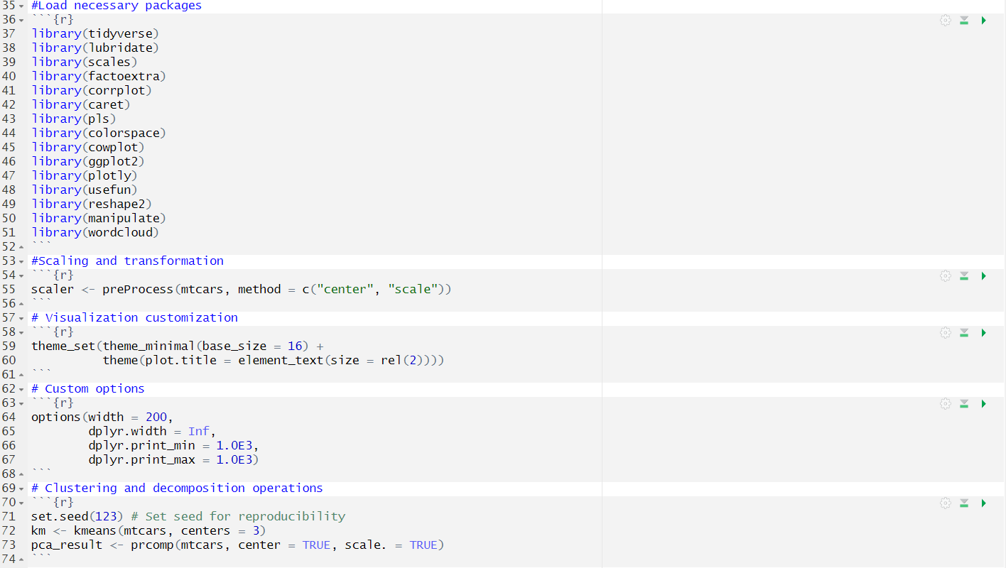
01
Introduction

Slide 8
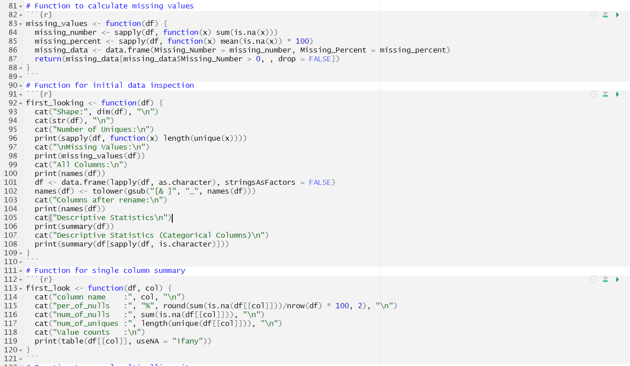
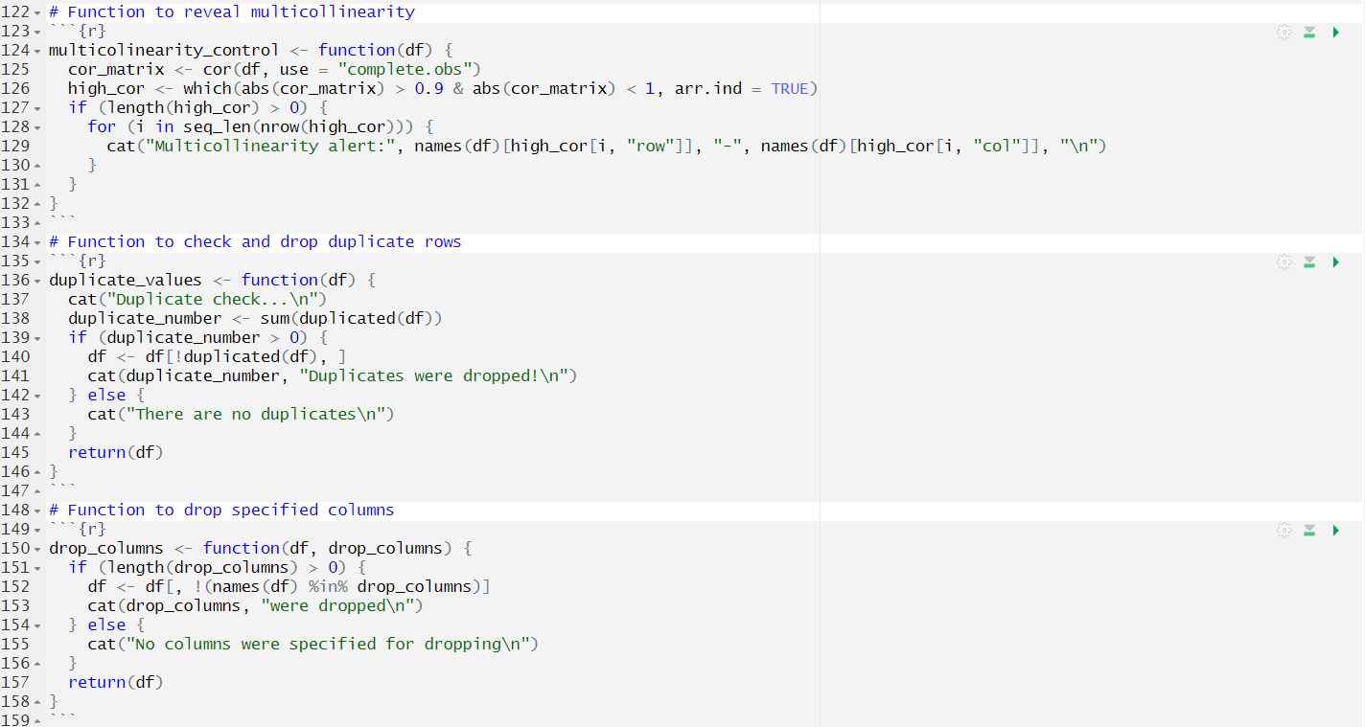
01
Introduction
Users Defined Functions

Slide 9
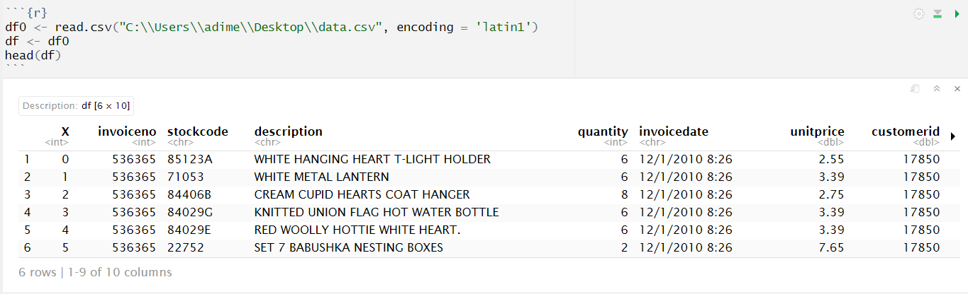
01
Introduction
Reading the data

Slide 10
02
Exploratory Data Analysis
Notes:
5 1 P P T 模 板 网 w w w.5 1 p p tmoban.c om

Slide 11
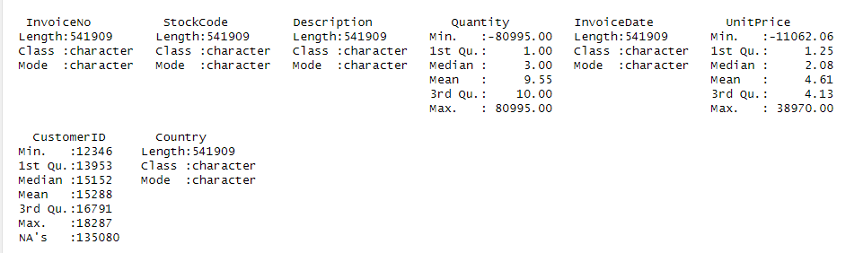
01
Descriptive Statistic
Data Overview
- 5 catagorical variable & 3 numerical varibale

Slide 12
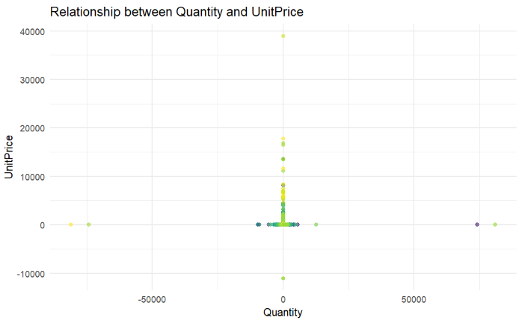
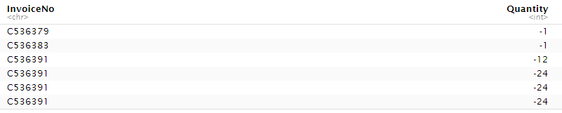

02
Quantity vs. UnitPrice

Slide 13
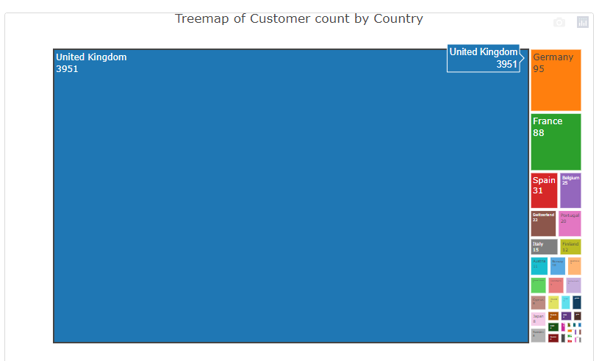
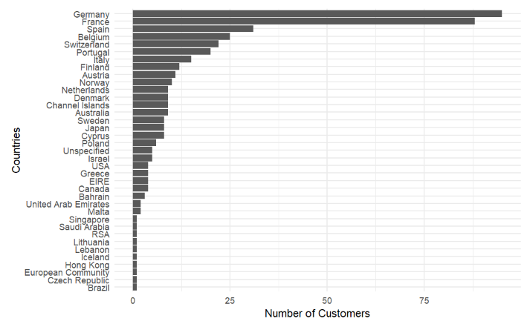
04
Customers Exploration
UK Dominent

Slide 14
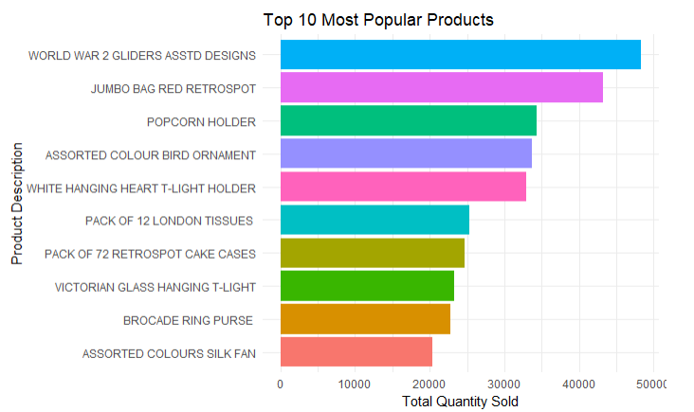
05
UK Market Exploration

Slide 15
03
Data Preprocessing

Slide 16
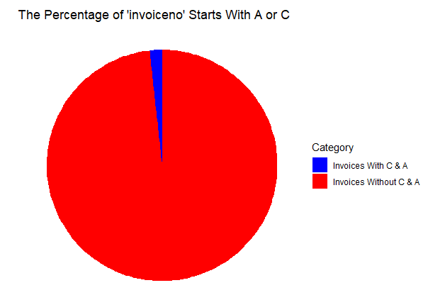

02
Data Transformation
Create new variable
Delete the Invoiceno starts with A or C

Slide 17
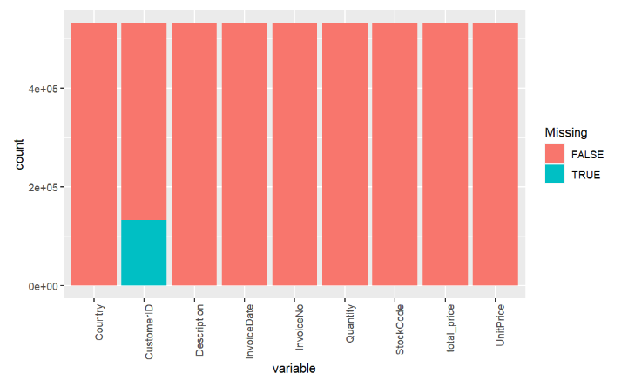
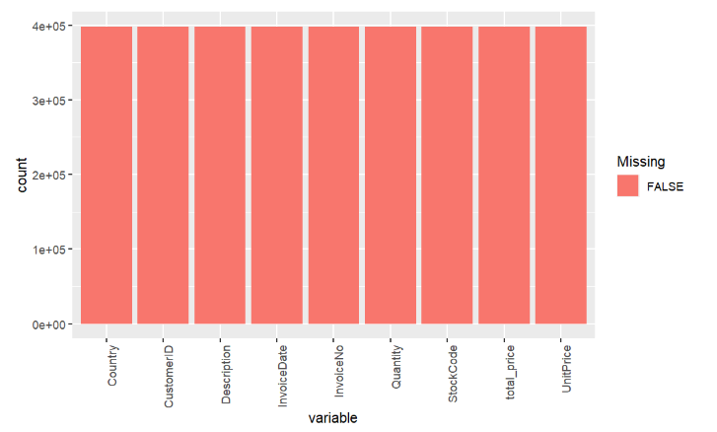
02
Missing Value

Slide 18
04
RFM ANALYSIS
Notes:
5 1 P P T 模 板 网 w w w.5 1 p p tmoban.c om

Slide 19
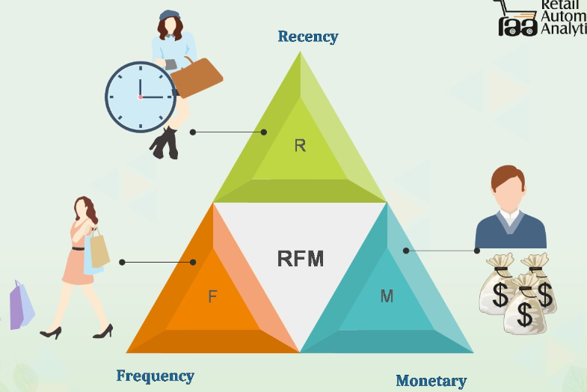
01
What is RMF
Recency (R)
Time since the last purchase.
Monetary (M)
Total number of purchases.
Frequency (F)
Total monetary value of purchases.

Slide 20
02
Why we do RMF Analysis
Recognize who are our most valuable customers.
Increase revenue
M
F
R
Learn more about the trends and behaviors of our customers
Increase customer retention

Slide 21
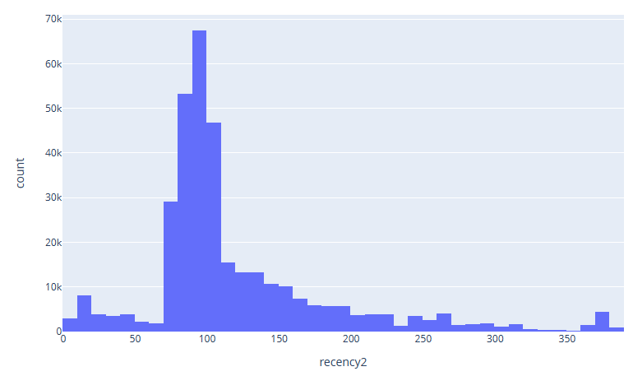
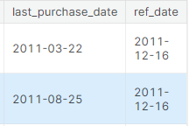

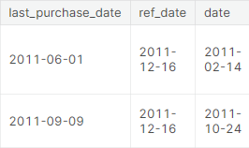
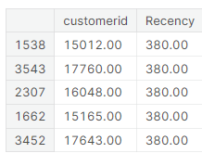
03
Calculating Recency
Plot RFM Distribution
Select a Reference Date
Group by Customer ID and Find Last Purchase Date
Create a Date Column
Calculate Days Since Last Purchase

Slide 22
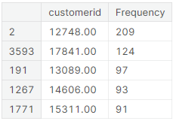
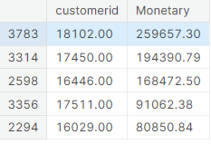
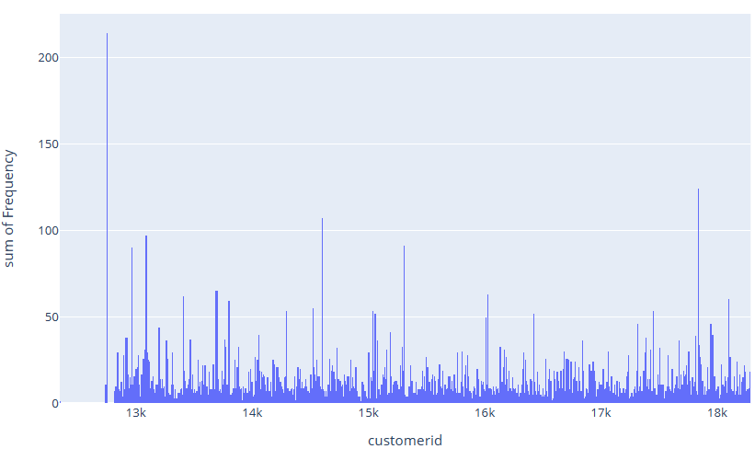
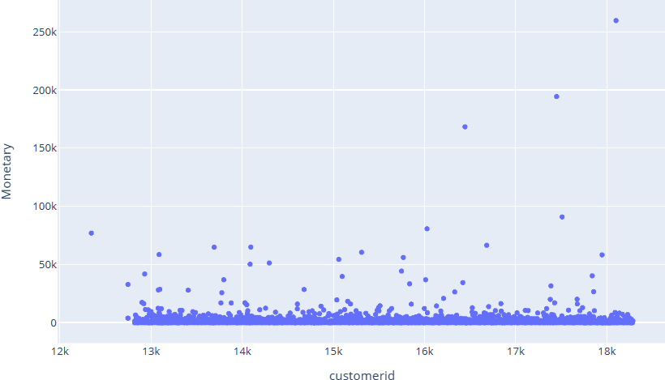
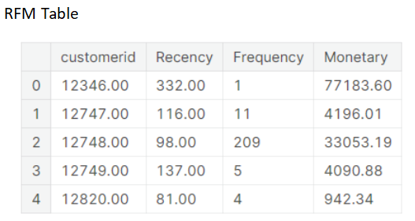
04
Calculating Frequency and Monetary Values
Calculate the frequency of purchases
Calculate sum total cost by customers

Slide 23
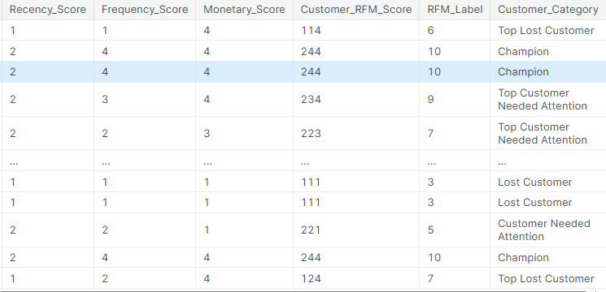

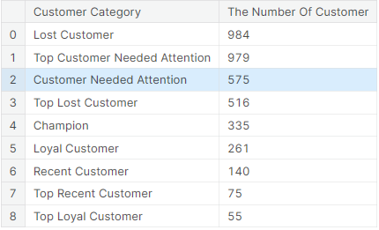

05
CUSTOMER SEGMENTATION WITH RFM SCORES
Calculating RFM Scoring
Creating the RFM Segmentation Table
Plotting RFM Segments (next page)

Slide 24
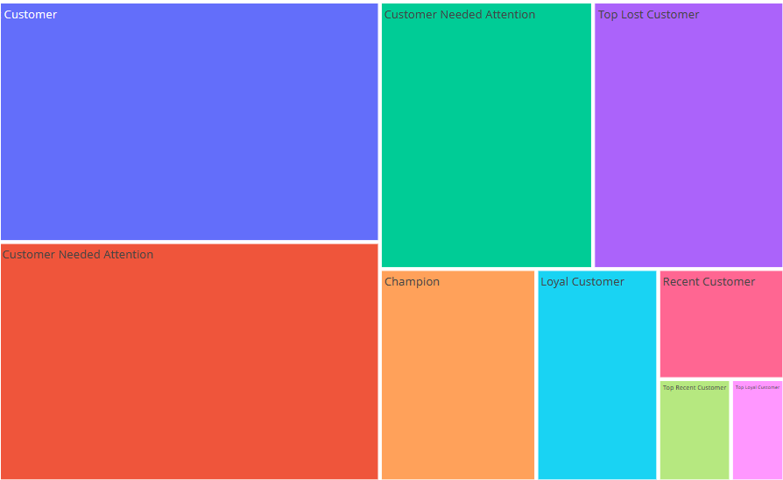
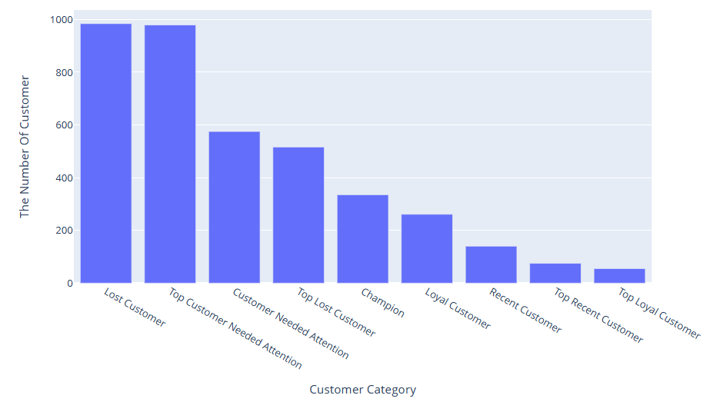
01

Slide 25
05
K-Means Analysis
Notes:
Now that we have our customers segmented into 6 different categories, we can gain further insight into customer behavior by using predictive models in conjunction without RFM algorithms. Here we use K-Means since we already have our distinct groups determined. K-means has also been widely used for market segmentation and has the advantage of being simple to implement.

Slide 26
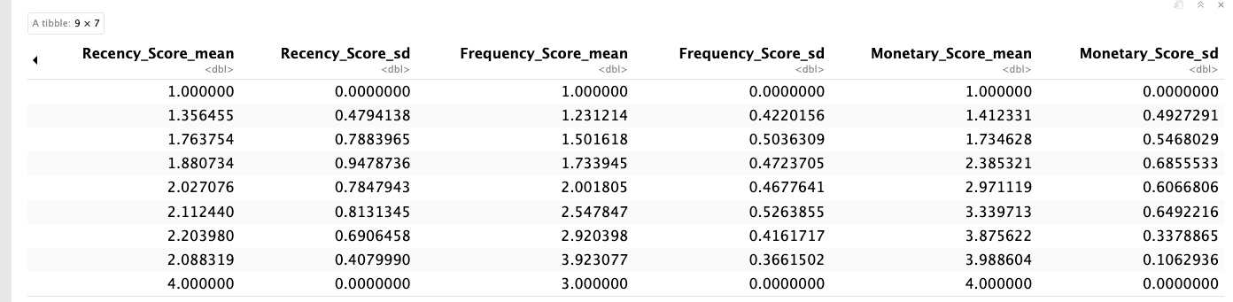
01
Data Pre-processing & Exploring

Slide 27
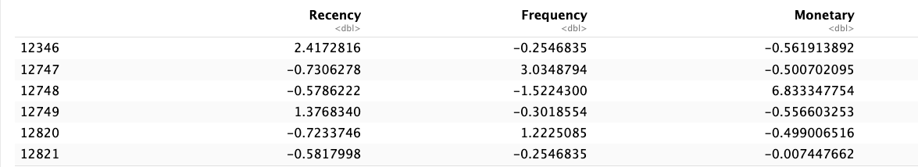
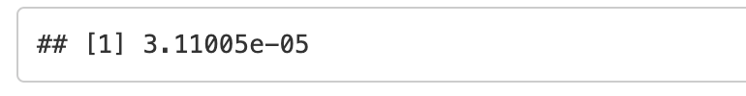
05
Defining Optimal Number of Clusters
Normalization
Hopkins Statistic
A way of measuring the cluster tendency of a dataset.
Close to 1 -- highly clustered (not clusterable)
Close to 0 -- uniformly distributed data (clusterable)

Slide 28
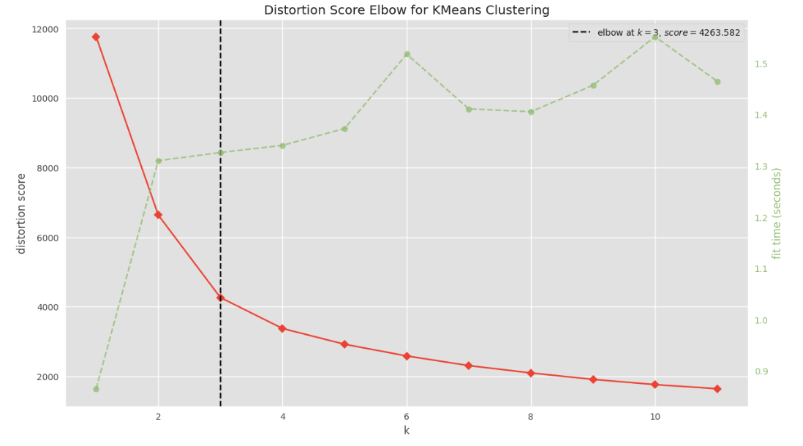
06
Find the best Clusters: Elbow Method
Elbow
K = 3

Slide 29
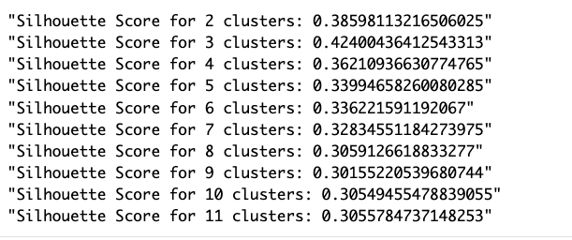
07
Validation: Silhouette Coefficient
The Silhouette Coefficient
Computes the density of clusters.
The difference between the average intra-cluster distance and the mean nearest-cluster distance for each sample.
Normalized by the maximum value.
Range: (-1, 1)
-1: completely incorrect clustering
1: highly dense clusters
K = 3
The highest score -- best choice!

Slide 30
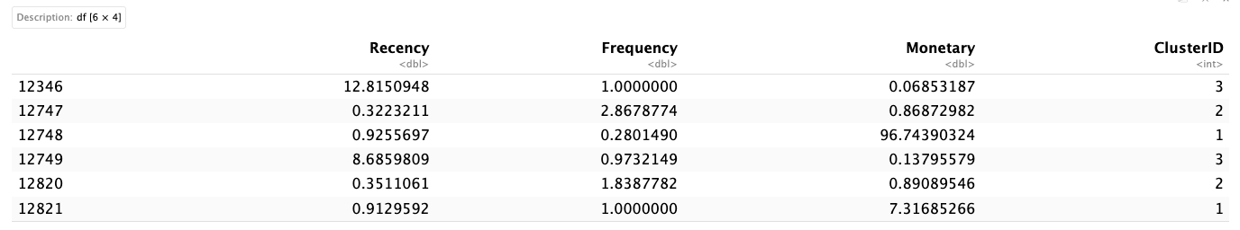
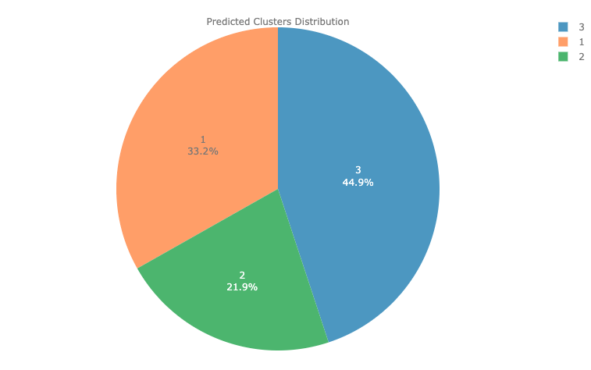
08
Model Fitting

Slide 31
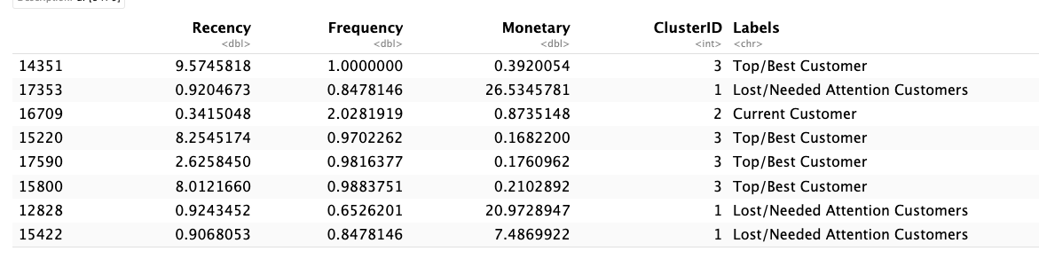
09
Assign the Label
- Cluster 1: "Lost/Needed Attention Customers”
- Cluster 2: "Current Customer"
- Cluster 3: "Top/Best Customers"

Slide 32
10
Conclusion
- Cluster 1: The first cluster is more related to the "Lost/Needed Attention Customers" who used to visit and shopping at different frequencies or who are still customer but haven’t been visiting recently. The store/department should bring them back with relevant personalized promotions, and run surveys to find out what went wrong and avoid losing them to a competitor.
- Cluster 2: The second cluster belongs to the "Current Customer" who have been shopping at different frequencies and spending in varying amounts. The store/department should offer membership or loyalty programs or recommend related products to upsell them and help them become its Loyalists or Champions, and offer renewals and helpful products to encourage another purchase.
- Cluster 3: The third cluster can be interpreted as "Top/Best Customers" who have been shopping in average frequency or most recently, but spent a good amount. The store/department should reward or offer membership or loyalty programs them to become its Loyalists or Champions.

Slide 33
06
COHORT ANALYSIS

Slide 34
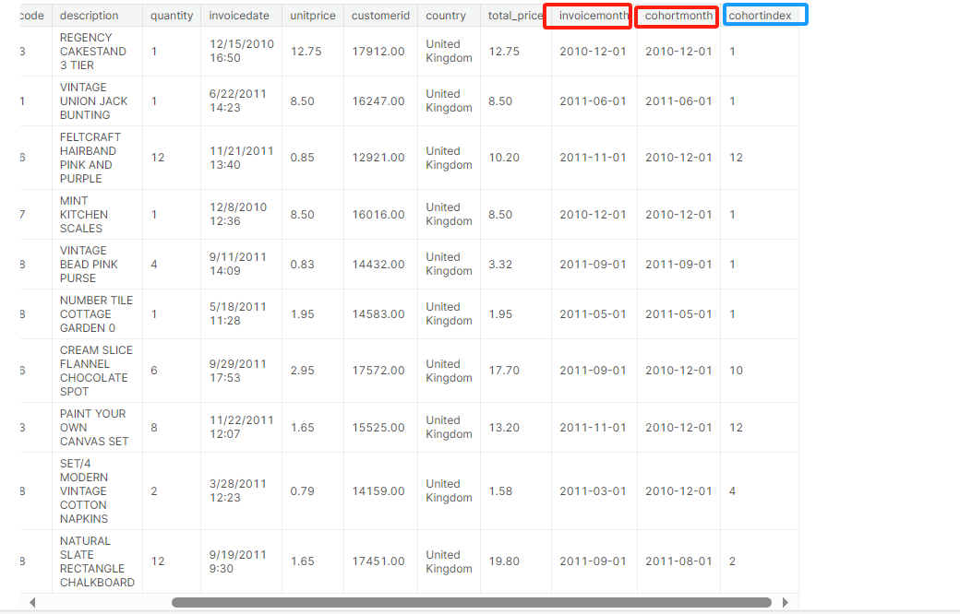
01
Feature Engineering
(invoicemonth.year-invoicemonth.year)*12
+
(invoicemonth.month-invoicemonth.month)
Cohortindex

Slide 35
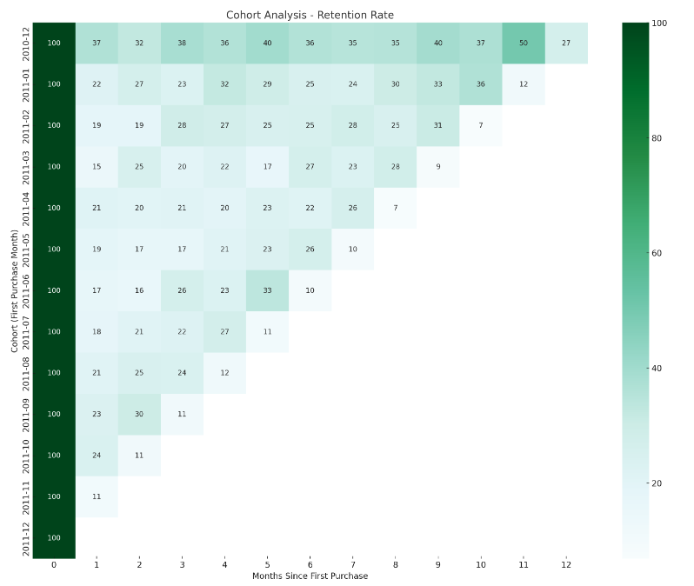
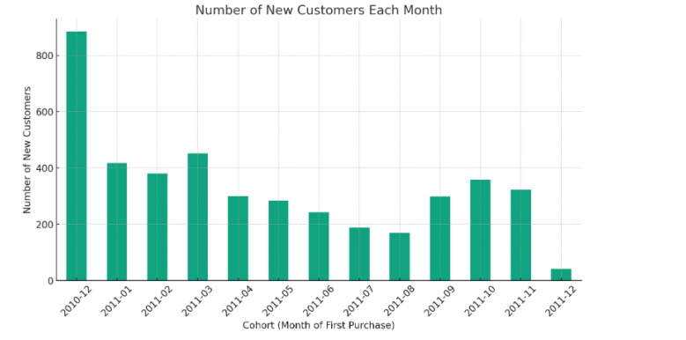
02
1st Cohort
Retention Rate
New user Number

Slide 36
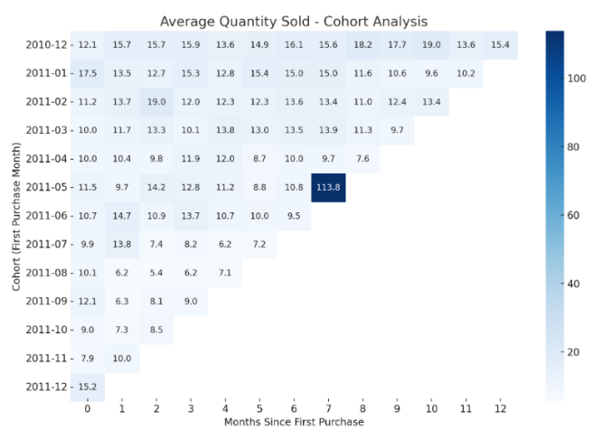
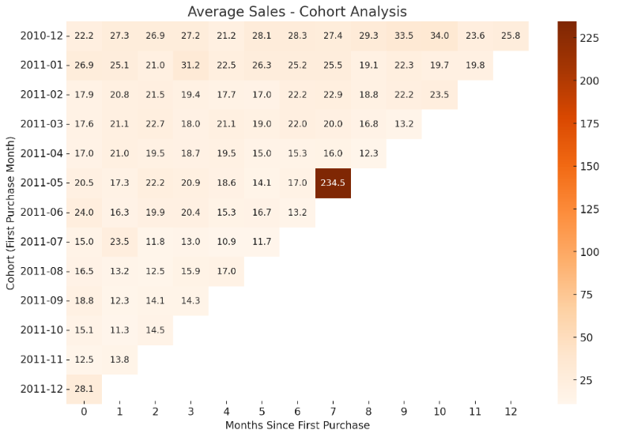
03
2nd & 3rd Cohorts
Average Quantity Sold
Average Sales

Slide 37
04
Suggestions
- Strengthen customer retention strategy:
The analysis shows that there are some cohorts with high retention rates in the months after the initial purchase, such as the December 2010 cohort. This may indicate high customer satisfaction and loyalty in this segment at the beginning. Companies should deeply study the characteristics and purchasing behavior of these cohorts to replicate successful strategies.
For cohorts with progressively decreasing retention, targeted marketing and CRM strategies need to be developed, such as regular promotional campaigns, loyalty programs, or personalized communication strategies.
- Use seasonal buying patterns to manage inventory:
Through seasonal analysis, the company should better plan inventory management and promotion activities. For example, increase inventory in the peak period before the Chinese New Year, and conduct promotion or clearance in the low period of the third quarter. Consider developing product ranges for specific holidays or seasons to entice customers to buy during those times.

Slide 38
THANKS
Notes:
51PPT模板网 www.51pptmoban.com

