Slide 1


Lecture 3 – Tutorial
2023
EBIS3103 Introduction to
Business Analytics
Descriptive Statistics II
Dr. Jingzhi Zhang
Department of Management (EBIS programme)
Faculty of Business and Management

Slide 2
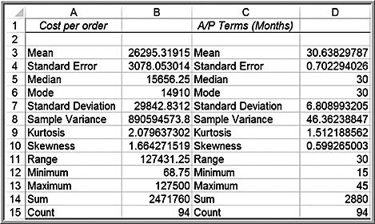
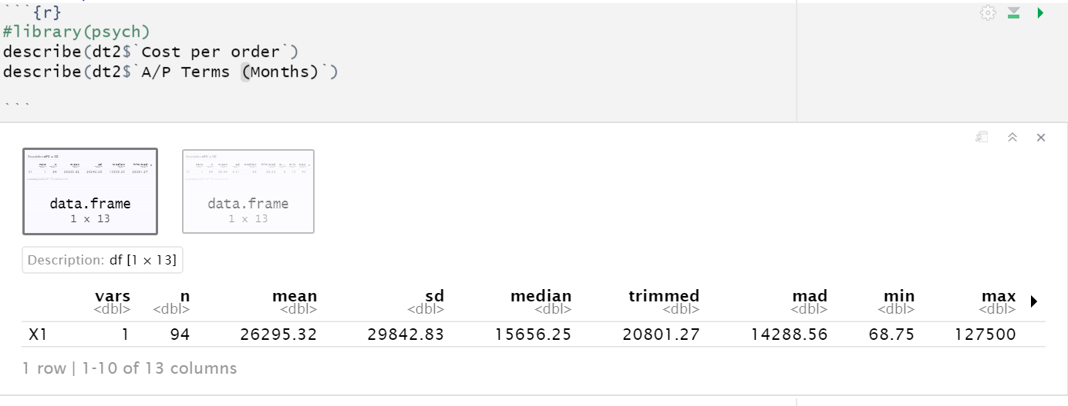
Using the Descriptive Statistics Tool
R (req. psych package)：
describe(data)

Slide 3
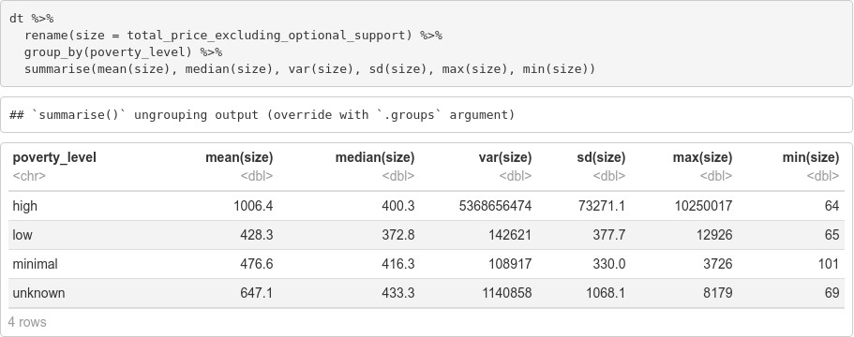
Descriptive Statistics for Grouped Data
You can also use psych package:
describeBy(data, group = group data)

Slide 4
Measures of Association

Slide 5

Pearson，Spearman and Kendall (1/4)
For the Pearson r correlation, both variables should be normally distributed (normally distributed variables have a bell-shaped curve).
What if the variables are not normally distributed?
Spearman rank correlation is a non-parametric test that is used to measure the degree of association between two variables. The Spearman rank correlation test does not carry any assumptions about the distribution of the data and is the appropriate correlation analysis when the variables are measured on a scale that is at least ordinal.
di= the difference between the ranks of corresponding variables n= number of observations

Slide 6
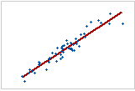
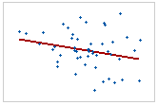
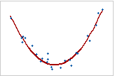
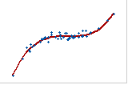
Pearson，Spearman and Kendall (2/4)
A perfect Spearman correlation indicates monotonic relationship, whereas a perfect Pearson correlation indicates a linear relationship.
Strong linear Relationship
Weak linear Relationship
Non-linear Relationship
Pearson ρ = 0.843，Spearman ρ = 0.948
Linear relationship is also a monotonic relationship
monotonic relationship

Slide 7
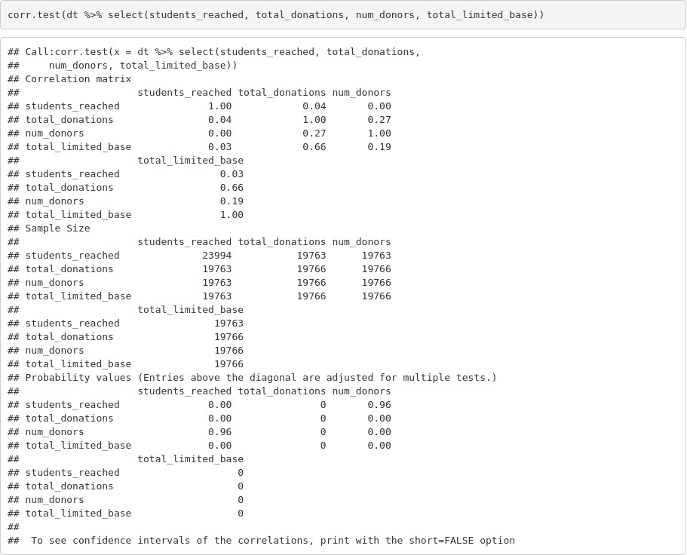
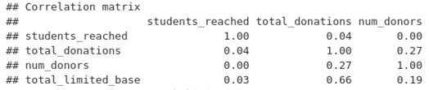
Computing Correlation of Multiple Variables
Also called a “Correlation Matrix”

Slide 8
Outliers

Slide 9
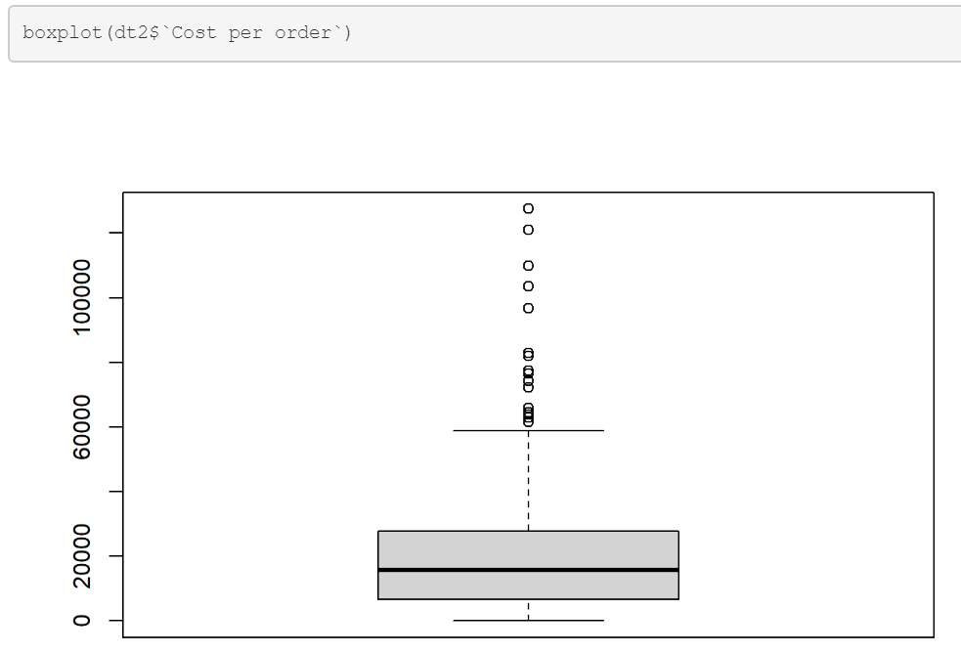
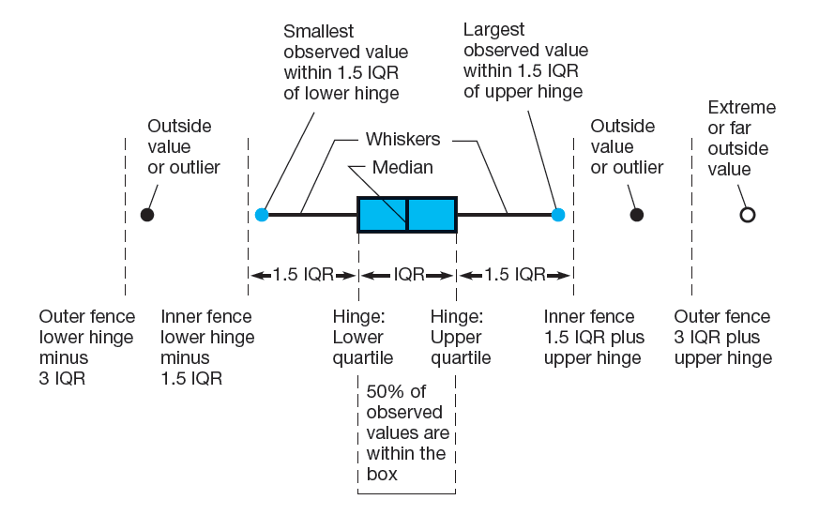
Investigating Outliers – Use Boxplot
outliers

Slide 10
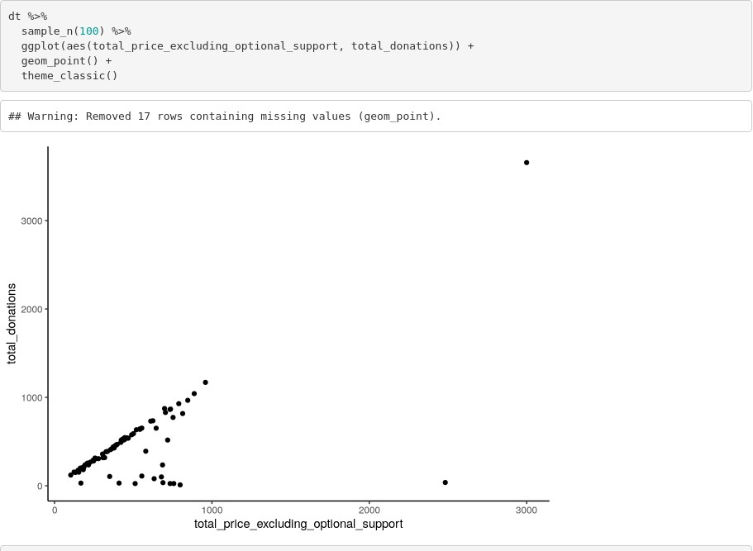
Investigating Outliers – Use Scatterplot

Slide 11
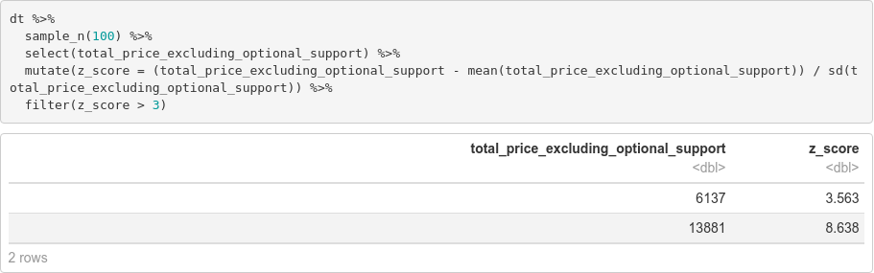
Investigating Outliers – Use Z-scores

Slide 12
What do you do with outliers?
Leave them in the data if it is important
Remove them if they are (significantly) different from the rest
Correct error in data entry

Slide 13
Thank You For Listening

