Slide 1
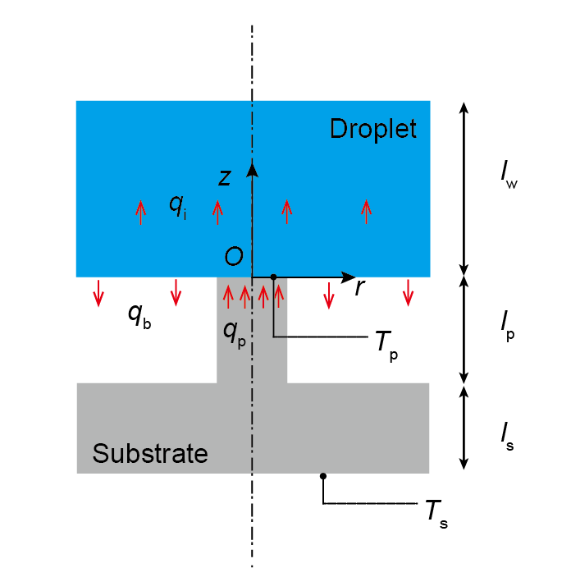
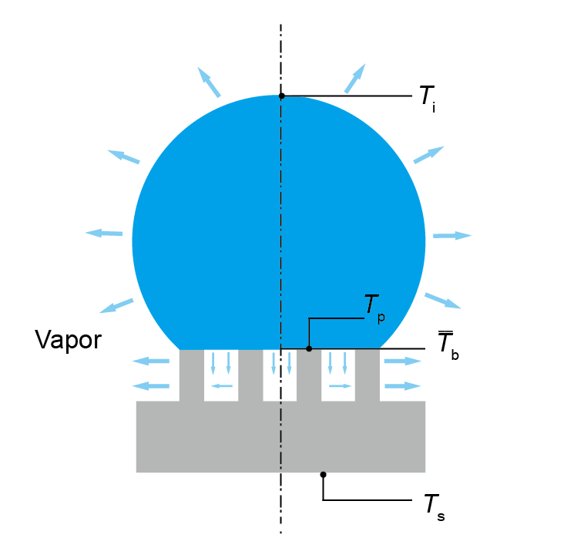
Evaporation from droplet spherical cap interface and droplet base

Slide 2

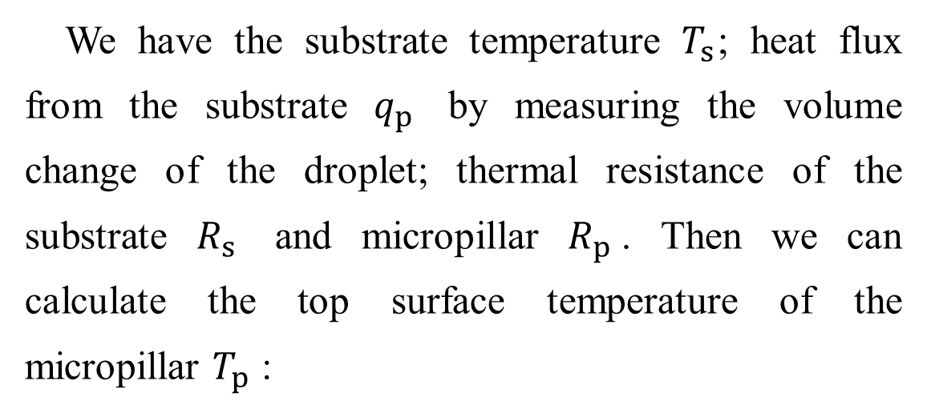

Heat transfer from substrate
We have the substrate temperature $T_{s}$; heat flux from the substrate $q_{p}$ by measuring the volume change of the droplet; thermal resistance of the substrate $R_{s}$ and micropillar $R_{p}$. Then we can calculate the top surface temperature of the micropillar $T_{p}$ :
$$T_{p}=T_{s}−\frac{q_{p}}{R_{p}+R_{s}}$$

Slide 3


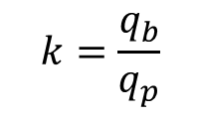
Droplet base average temperature
Temperature at the droplet base at z=0 is calculated as:
$$T_{b}=T_{w}+\frac{q_{p}l_{w}}{k_{w}}\left\{\frac{a^{2}}{b^{2}}\left(1+k\right)−k+\frac{2a\left(1+k\right)}{l_{w}}\sum_{n=1}^{∞}{\left[J_{1}\left(\frac{a}{b}α_{n}\right)J_{0}\left(\frac{r}{b}α_{n}\right){/\left(α_{n}^{2}J_{0}^{2}\left(α_{n}\right)\right)}\right]}\tanh\left(\frac{α_{n}}{b}l_{w}\right)\right\}$$
k is the ratio of evaporation from the droplet base:
$$k=\frac{q_{b}}{q_{p}}$$
Average temperature of the water-pillar interface part is:
$$T_{b,p}=\frac{\int_{0}^{a}{2πr}T_{b}\left(r\right)dr}{πa^{2}}$$
Average temperature of the droplet base is:
$${\overline{T}}_{b}=\frac{\int_{0}^{b}{2πr}T_{b}\left(r\right)dr}{πb^{2}}$$

Slide 4
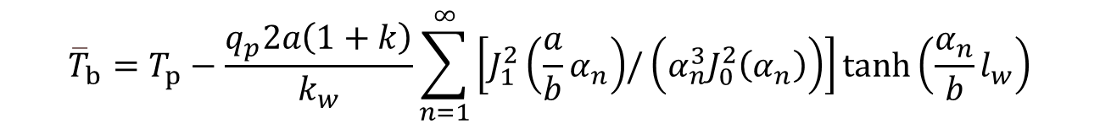

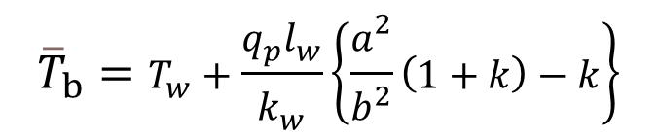
Droplet base average temperature
We can calculate the average temperature:
$${\overline{T}}_{b}=T_{w}+\frac{q_{p}l_{w}}{k_{w}}\left\{\frac{a^{2}}{b^{2}}\left(1+k\right)−k\right\}$$
$T_{b,p}=$ ${\overline{T}}_{b}+\left\{\frac{q_{p}2a\left(1+k\right)}{k_{w}}\sum_{n=1}^{∞}{\left[J_{1}^{2}\left(\frac{a}{b}α_{n}\right){/\left(α_{n}^{3}J_{0}^{2}\left(α_{n}\right)\right)}\right]}\tanh\left(\frac{α_{n}}{b}l_{w}\right)\right\}$
With the boundary condition, we know that:
$$T_{b,p}=T_{p}$$
Thus, we can obtain the base average temperature of the water droplet :
$${\overline{T}}_{b}=T_{p}−\frac{q_{p}2a\left(1+k\right)}{k_{w}}\sum_{n=1}^{∞}{\left[J_{1}^{2}\left(\frac{a}{b}α_{n}\right){/\left(α_{n}^{3}J_{0}^{2}\left(α_{n}\right)\right)}\right]}\tanh\left(\frac{α_{n}}{b}l_{w}\right)$$

Slide 5
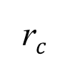







Thermal resistance of the water droplet
Conductive thermal resistance of the water droplet is:
$$R_{w}=\frac{arctan⁡(\frac{H}{r_{c}})}{2πk_{w}r_{c}}$$
$$T_{i}$$
Droplet surface temperature is then calculated as:
$$H$$
$${T_{i}={\overline{T}}_{b}−(1−k)q_{p} R}_{w}$$
Evaporation from droplet surface is calculated as:
$${\overline{T}}_{b}$$
$$q_{e}=\frac{πr_{c}D\left(c_{s1}−c_{∞}\right)f\left(θ\right)}{h_{fg}}$$
$$(1−k)q_{p}$$
r$c$

Slide 6
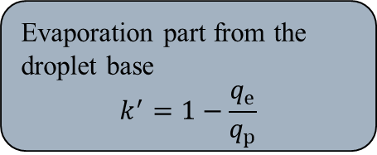
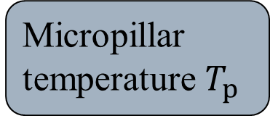
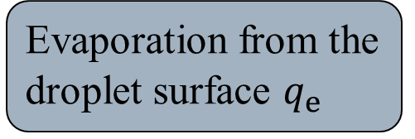
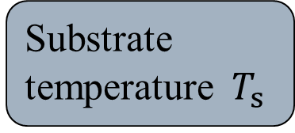
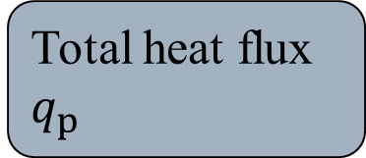
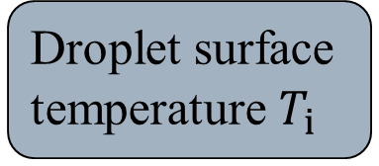
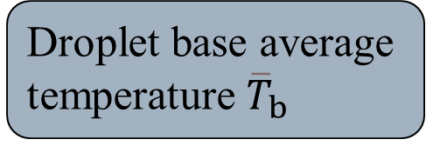
Substrate temperature$T_{s}$
Micropillar temperature $T_{p}$
Droplet base average temperature ${\overline{T}}_{b}$
Total heat flux $q_{p}$
Evaporation part from the droplet base k
Droplet surface temperature $T_{i}$
Evaporation part from the droplet base
$$k^{′}=1−\frac{q_{e}}{q_{p}}$$
Evaporation from the droplet surface $q_{e}$

Slide 7
Substrate information
Sample 1: cylinder micropillar diameter 20 um, micropillar height 40um, periodicity 40um.
Sample 2: cylinder micropillar diameter 20 um, micropillar height 40um, periodicity 50um.
Sample 3: cylinder micropillar diameter 20 um, micropillar height 40um, periodicity 60um.

Slide 8
Model temperature and IR camera temperature of sample 1

Slide 9
Model temperature and IR camera temperature of sample 2

Slide 10
Model temperature and IR camera temperature of sample 3

Slide 13
