Slide 1
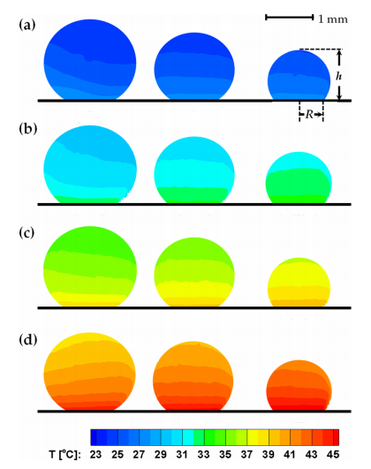
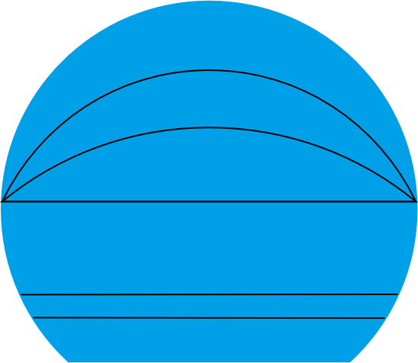
Thermal Resistance in Water Layer
Spatiotemporal infrared measurement of interface temperatures during water droplet evaporation on a nonwetting substrate. Aditya et al. Applied Physics Letters, 2017

Slide 2
Calculating Surface Temperature and Experimental Surface Temperature
Sample 1
Sample 2
Sample 3

Slide 3
Evaporation Rate
Sample 1
Sample 2
Sample 3

Slide 4
Evaporation Ratio
Sample 1
Sample 2
Sample 3

Slide 5
High Temperature Prediction
Sample 1
Sample 2
Sample 3

Slide 6
（a）
（b）
（c）

Slide 7
（a）
（b）
（c）
Figure 1. Temporal evolution

Slide 14
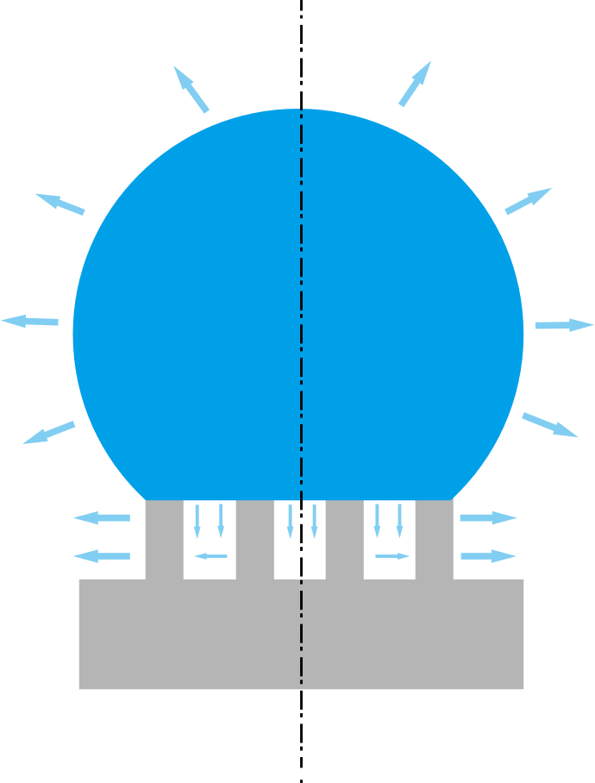
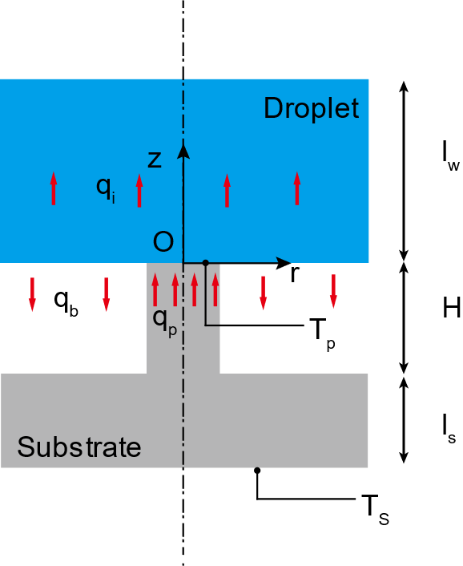
(a)
(b)

Slide 15
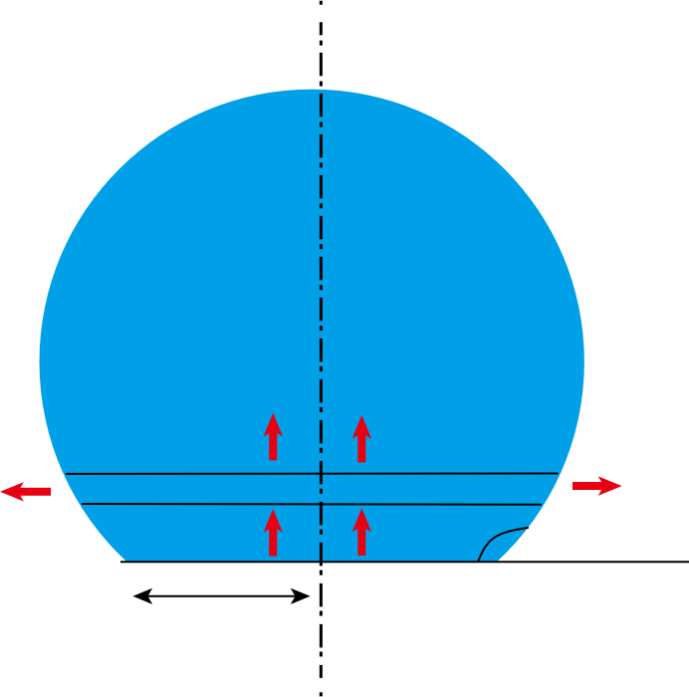








$$J(r)∙h_{fg}∙dS$$
$$q_{i+1}$$
$$T_{i+1}$$
$$q_{i}$$
$$T_{i}$$
$$θ$$
$${\overline{T}}_{b}$$
$$r_{c}$$

Slide 16
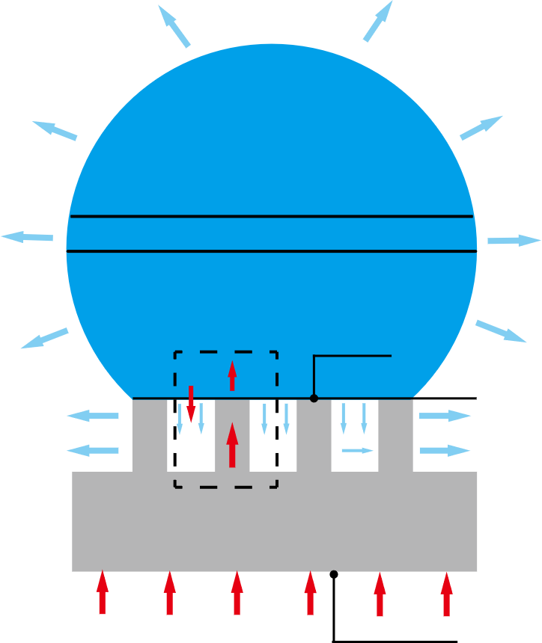









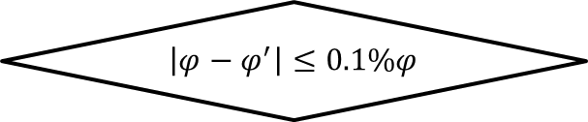







Algorithm for Interface Temperature and Evaporation Ratio
Input $T_{s}$, $q_{s}$, $φ$
Solve the heat transfer equation at droplet base
$$q_{e}$$
$$T_{i+1}$$
Calculate ${\overline{T}}_{b}$
$$T_{i}$$
$φ$= $φ^{′}$
Calculate droplet cap surface evaporation rate
$$T_{c}$$
$$q_{i}$$
$$q_{b}$$
$${\overline{T}}_{b}$$
Calculate${ q}_{e}$ and ${ φ}^{′}$
$$q_{p}$$
No
$$\left|φ−φ^{′}\right|≤0.1\%φ$$
$$q_{s}$$
$$T_{s}$$
Yes
$$φ=\frac{q_{b}}{q_{p}}$$
Output $T_{model}$, $φ$

Slide 17




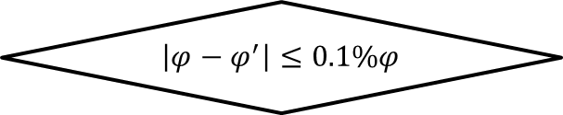













Algorithm for Interface Temperature and Evaporation Ratio
Input $T_{s}$, $q_{s}$, $φ$
$$T_{model}$$
Solve the heat transfer equation at droplet base
$$q_{e}$$
Calculate ${\overline{T}}_{b}$
$$T_{i+1}$$
Calculate droplet cap surface evaporation rate
$$T_{i}$$
$φ$= $φ^{′}$
$$q_{i}$$
$$T_{c}$$
$$q_{b}$$
$${\overline{T}}_{b}$$
Calculate${ q}_{e}$ and ${ φ}^{′}$
$$q_{p}$$
No
$$\left|φ−φ^{′}\right|≤0.1\%φ$$
$$q_{s}$$
$$T_{s}$$
Yes
$$φ=\frac{q_{b}}{q_{p}}$$
Output $T_{model}$, $φ$

