Slide 1
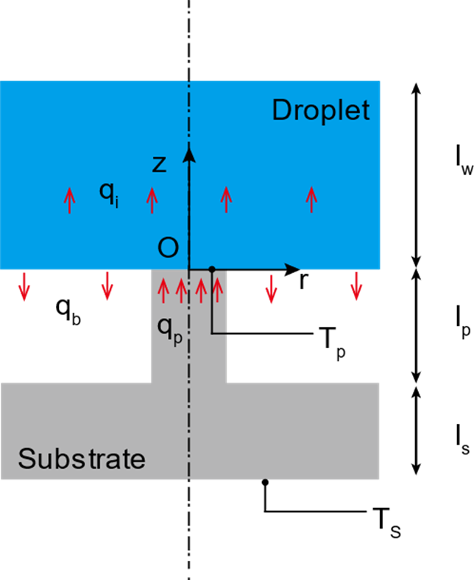
Evaporation from droplet spherical cap interface and droplet base

Slide 2

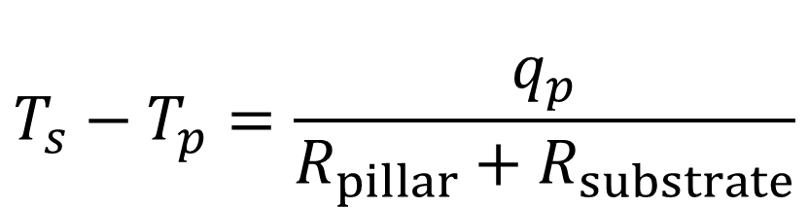
Micropillar top surface
$$T_{s}−T_{p}=\frac{q_{p}}{R_{pillar}+R_{substrate}}$$
$${\overline{T}}_{b}$$

Slide 3
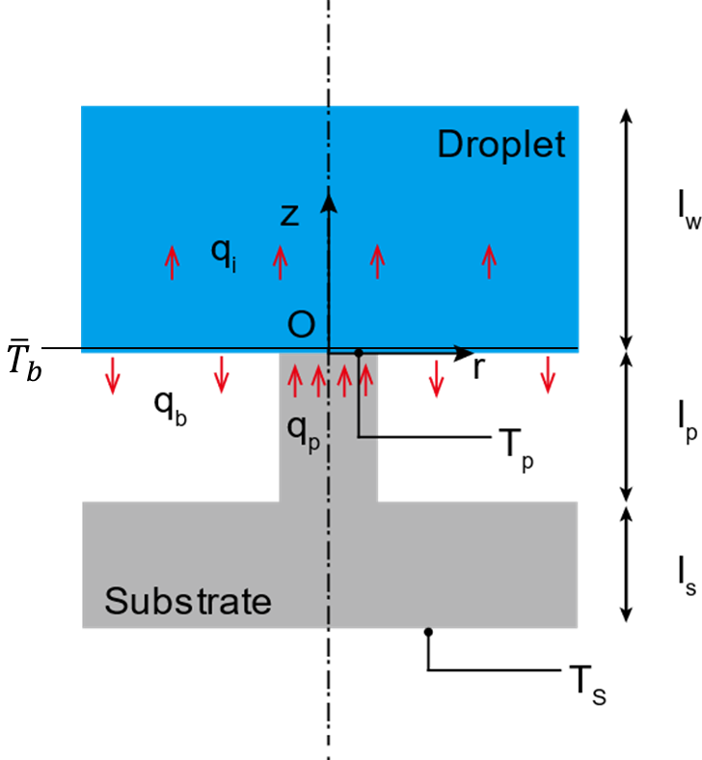
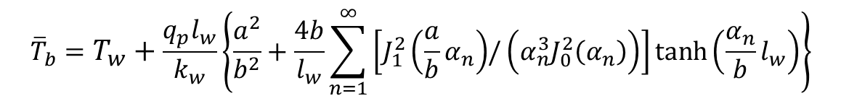
Droplet base average temperature
$${\overline{T}}_{b}=T_{w}+\frac{q_{p}l_{w}}{k_{w}}\left\{\frac{a^{2}}{b^{2}}+\frac{4b}{l_{w}}\sum_{n=1}^{∞}{\left[J_{1}^{2}\left(\frac{a}{b}α_{n}\right){/\left(α_{n}^{3}J_{0}^{2}\left(α_{n}\right)\right)}\right]}\tanh\left(\frac{α_{n}}{b}l_{w}\right)\right\}$$

Slide 4
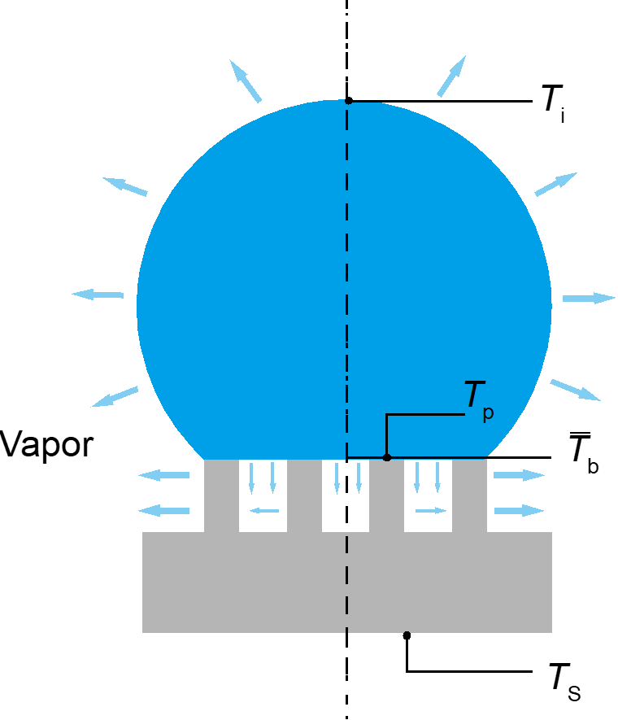
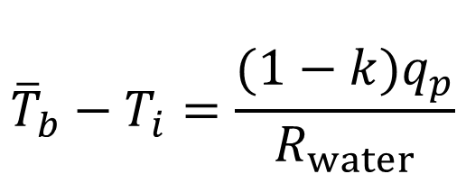
$${\overline{T}}_{b}−T_{i}=\frac{(1−k)q_{p}}{R_{water}}$$

Slide 6
Evaporation of droplet on 23°C

Slide 7
Evaporation of droplet on 40°C

Slide 8
Evaporation of droplet on 70°C

Slide 9
Evaporation of droplet on 100°C

Slide 13
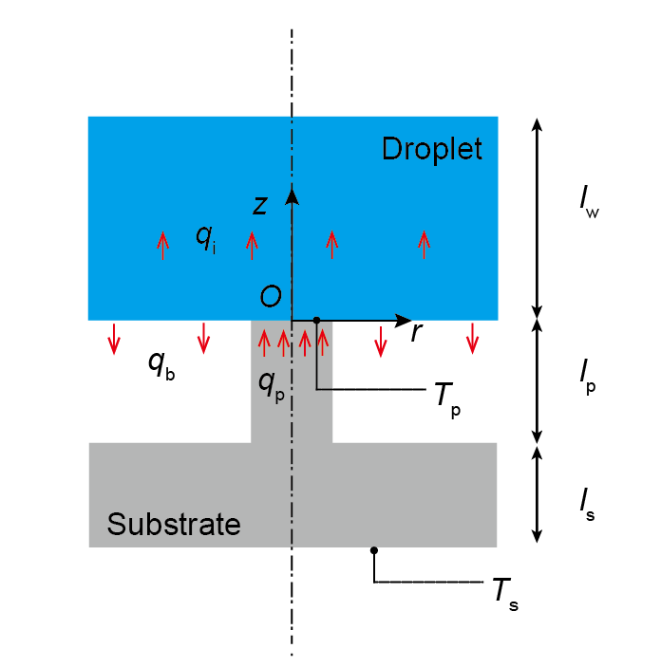
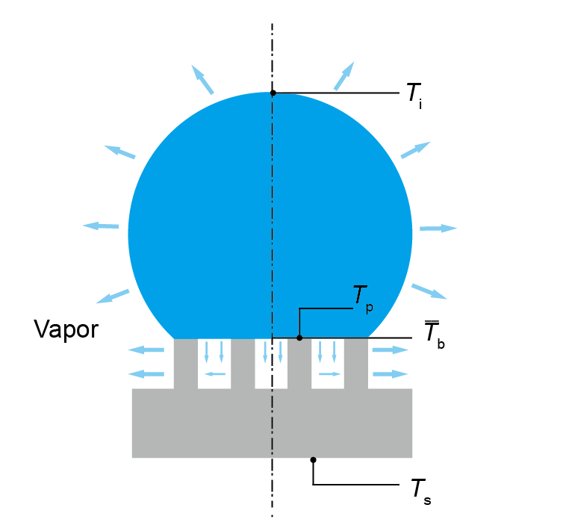

Slide 14
z=0
z
m
z_{c}
d
a₀

Slide 15
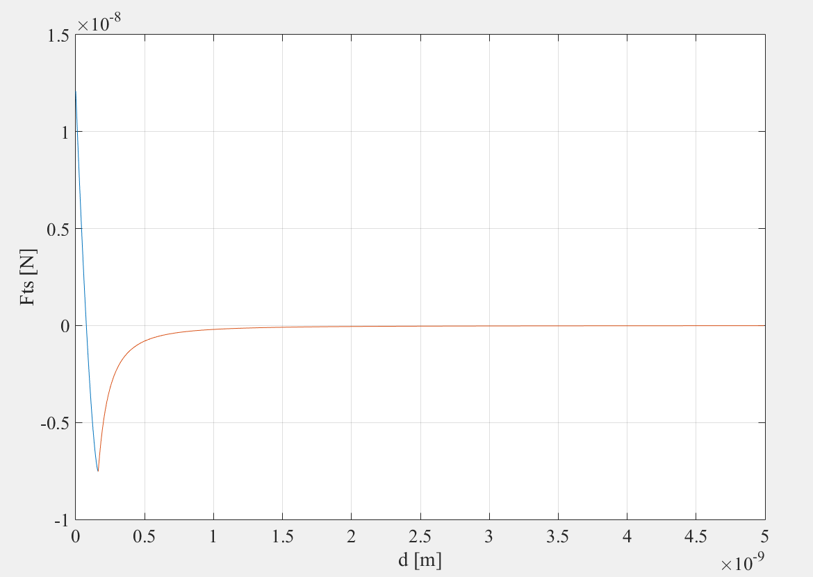
Contact

