Slide 1
Thermal spreading/constriction resistance

Slide 2
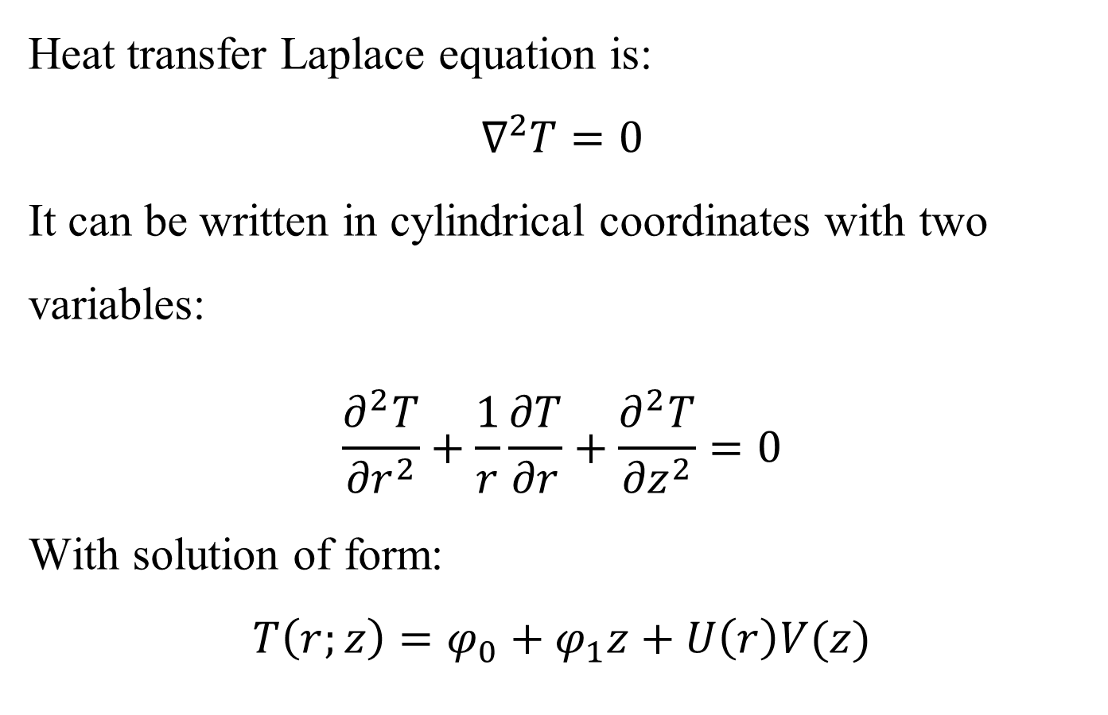
Thermal spreading/constriction resistance
Heat transfer Laplace equation is:
$$∇^{2}T=0$$
It can be written in cylindrical coordinates with two variables:
$$\frac{∂^{2}T}{{∂r}^{2}}+\frac{1}{r}\frac{∂T}{∂r}+\frac{∂^{2}T}{{∂z}^{2}}=0$$
With solution of form:
$$T\left(r;z\right)=φ_{0}+φ_{1}z+U\left(r\right)V(z)$$
r
O
z
h
b
r
z
b
h
a
a

Slide 3
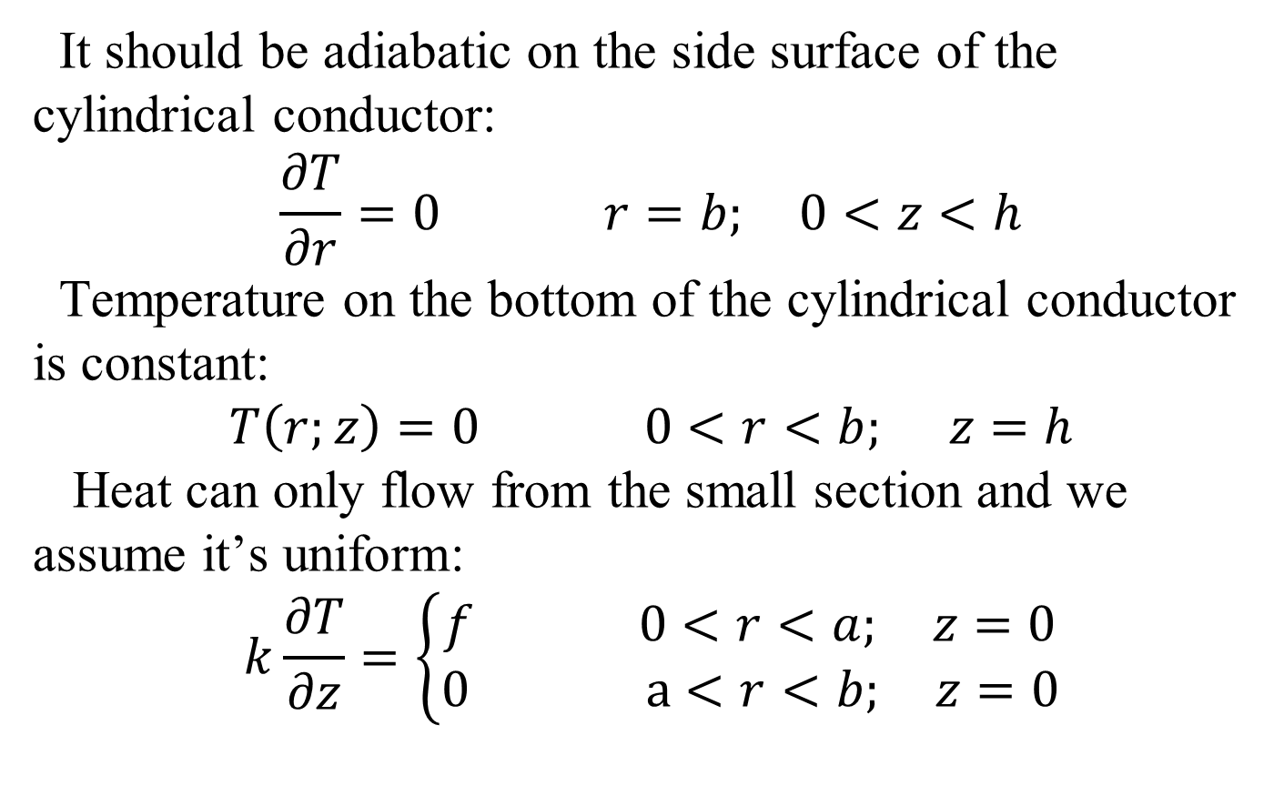
Boundary conditions
It should be adiabatic on the side surface of the cylindrical conductor:
$$\frac{∂T}{∂r}=0 r=b; 0<z<h$$
Temperature on the bottom of the cylindrical conductor is constant:
$$T\left(r;z\right)=0 0<r<b; z=h$$
Heat can only flow from the small section and we assume it’s uniform:
$$k\frac{∂T}{∂z}=\left\{\begin{aligned}f 0<r<a; z=0 \\ 0 a<r<b; z=0\end{aligned}\right.$$
r
O
z
h
b
a

Slide 4
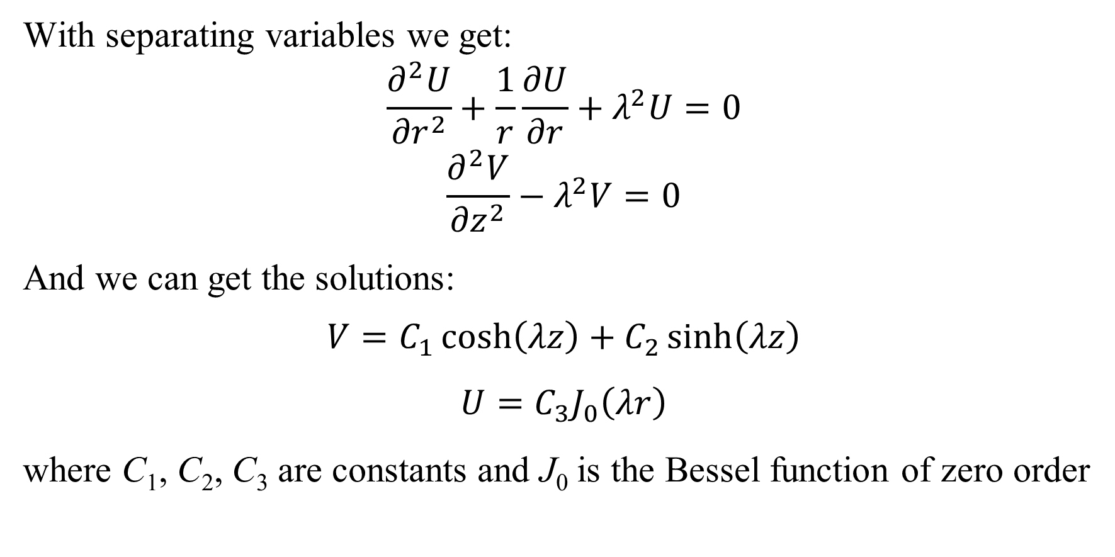
Equation solving
With separating variables we get:
$$\frac{∂^{2}U}{{∂r}^{2}}+\frac{1}{r}\frac{∂U}{∂r}+λ^{2}U=0$$
$$\frac{∂^{2}V}{{∂z}^{2}}−λ^{2}V=0$$
And we can get the solutions:
$$V=C_{1}\cosh\left(λz\right)+C_{2}\sinh\left(λz\right)$$
$$U=C_{3}J_{0}\left(λr\right)$$
where C₁, C₂, C₃ are constants and J₀ is the Bessel function of zero order

Slide 5
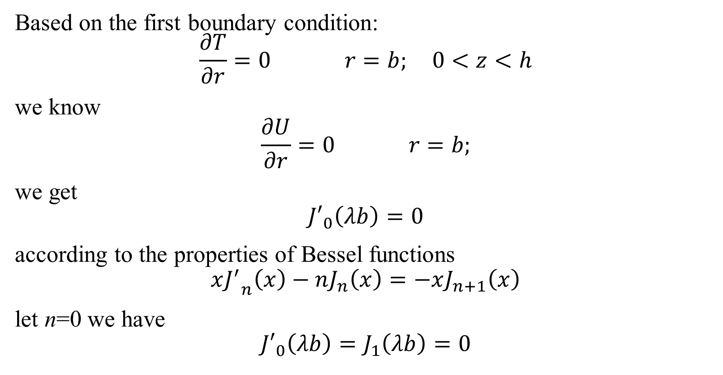
Equation solving
Based on the first boundary condition:
$$\frac{∂T}{∂r}=0 r=b; 0<z<h$$
we know
$$\frac{∂U}{∂r}=0 r=b;$$
we get
$${J′}_{0}\left(λb\right)=0$$
according to the properties of Bessel functions
$$x{J^{′}}_{n}\left(x\right)−nJ_{n}\left(x\right)=−xJ_{n+1}\left(x\right)$$
let n=0 we have
$${J′}_{0}\left(λb\right)=J_{1}\left(λb\right)=0$$

Slide 6
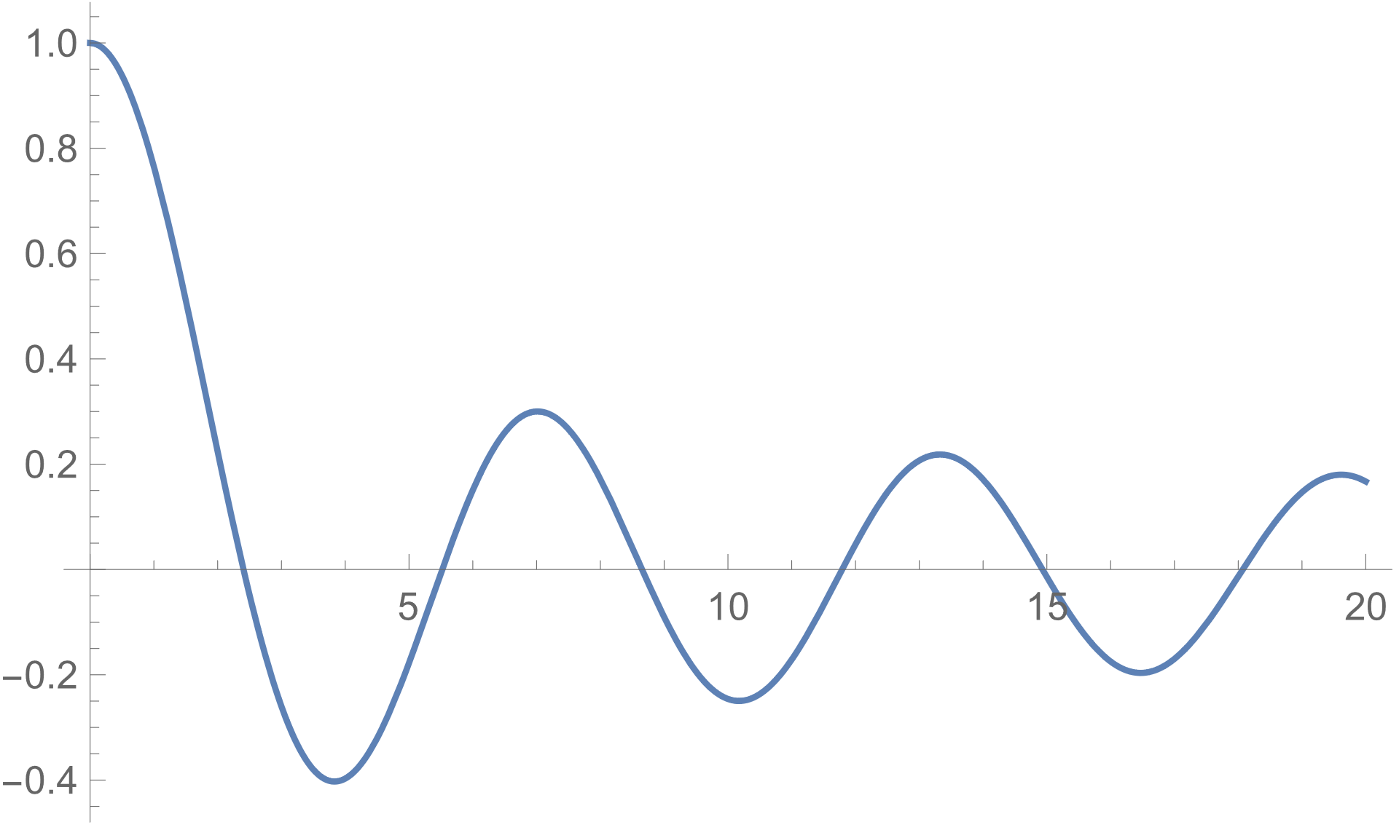
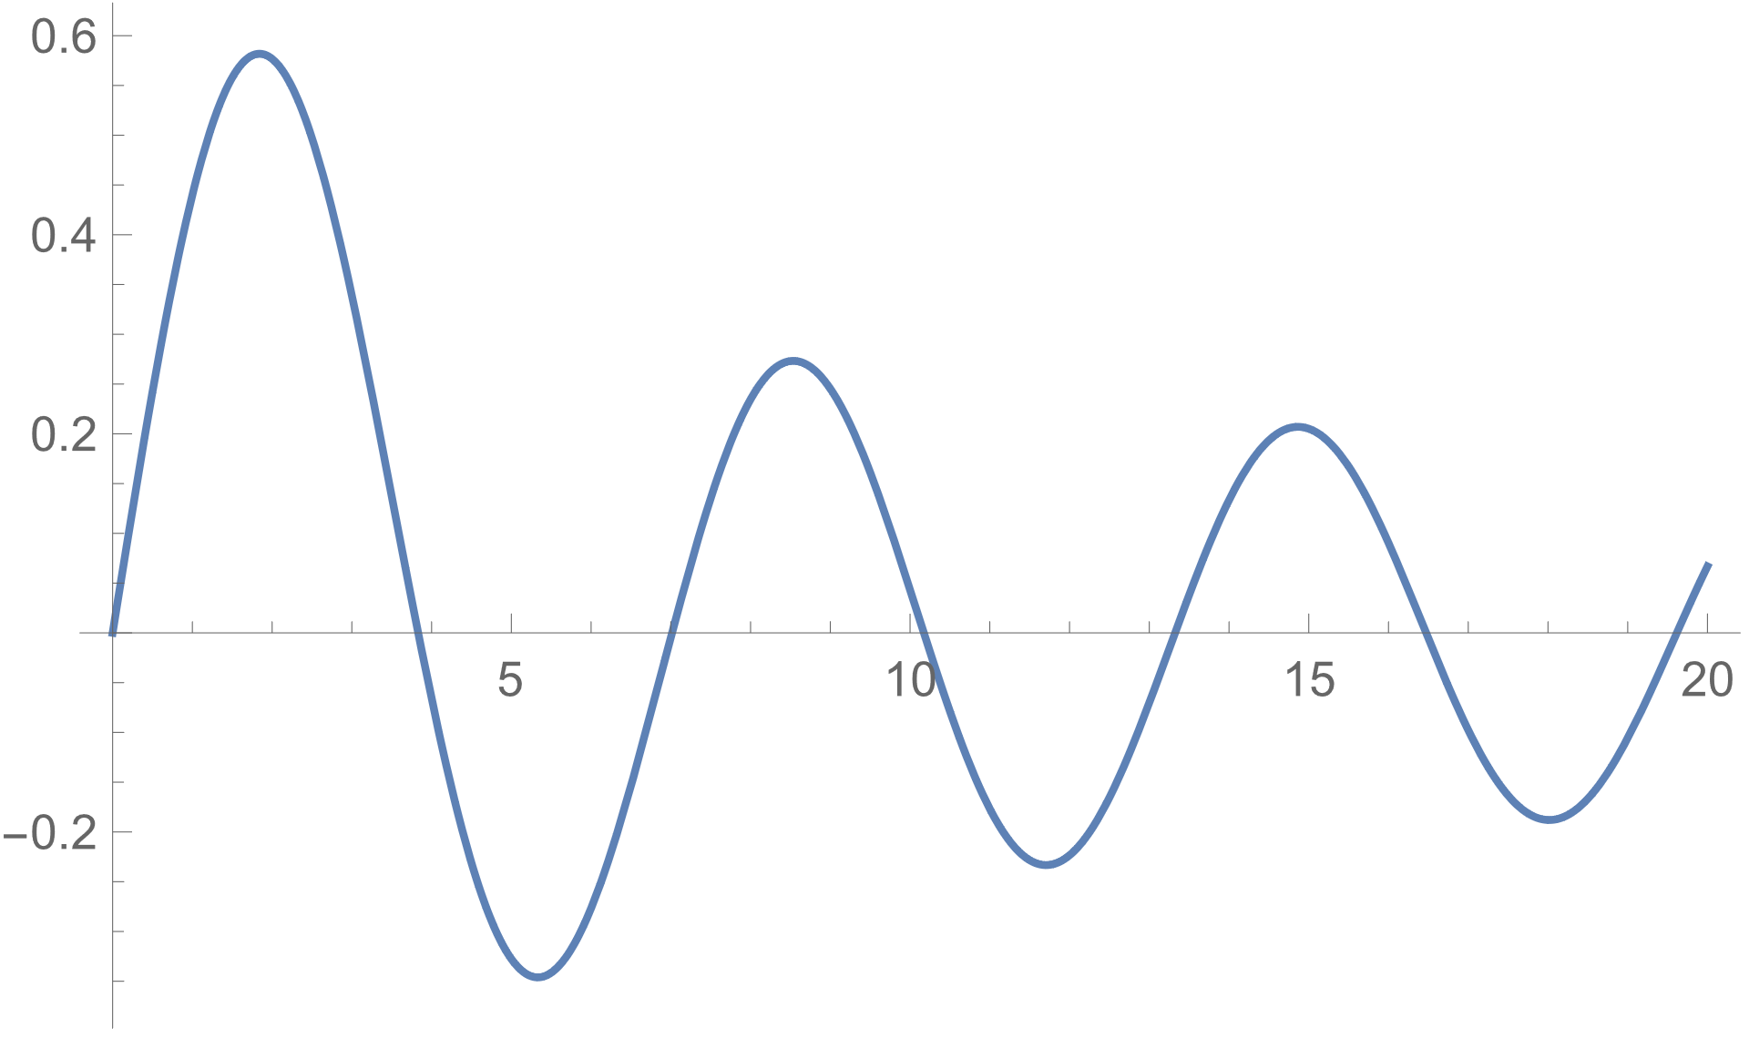


Bessel functions
$${y=J}_{0}\left(x\right)$$
$${y=J}_{1}\left(x\right)$$

Slide 7
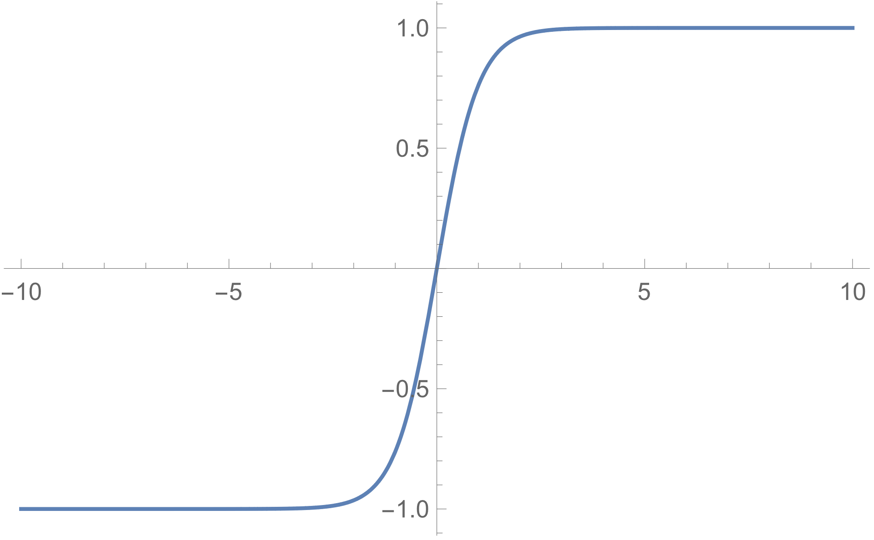
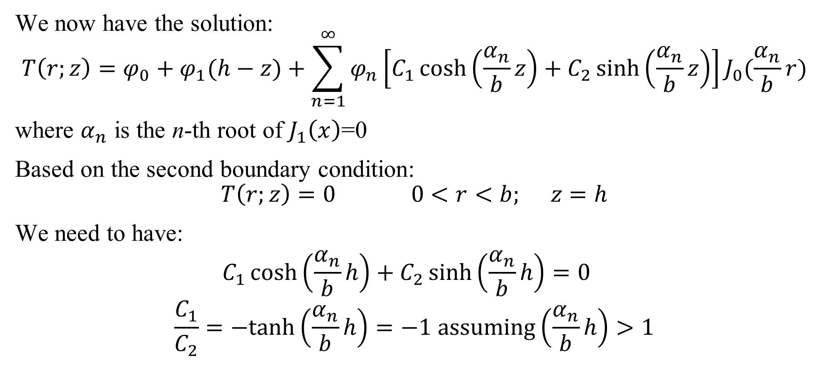
Equation solving
We now have the solution:
$$T\left(r;z\right)=φ_{0}+φ_{1}(h−z)+\sum_{n=1}^{∞}{φ_{n}\left[C_{1}\cosh\left(\frac{α_{n}}{b}z\right)+C_{2}\sinh\left(\frac{α_{n}}{b}z\right)\right]}J_{0}(\frac{α_{n}}{b}r)$$
where $α_{n}$ is the n-th root of $J_{1}\left(x\right)$=0
Based on the second boundary condition:
$$T\left(r;z\right)=0 0<r<b; z=h$$
We need to have:
$$C_{1}\cosh\left(\frac{α_{n}}{b}h\right)+C_{2}\sinh\left(\frac{α_{n}}{b}h\right)=0$$
$$\frac{C_{1}}{C_{2}}=−tanh\left(\frac{α_{n}}{b}h\right)=−1 assuming\left(\frac{α_{n}}{b}h\right)>1$$

Slide 8
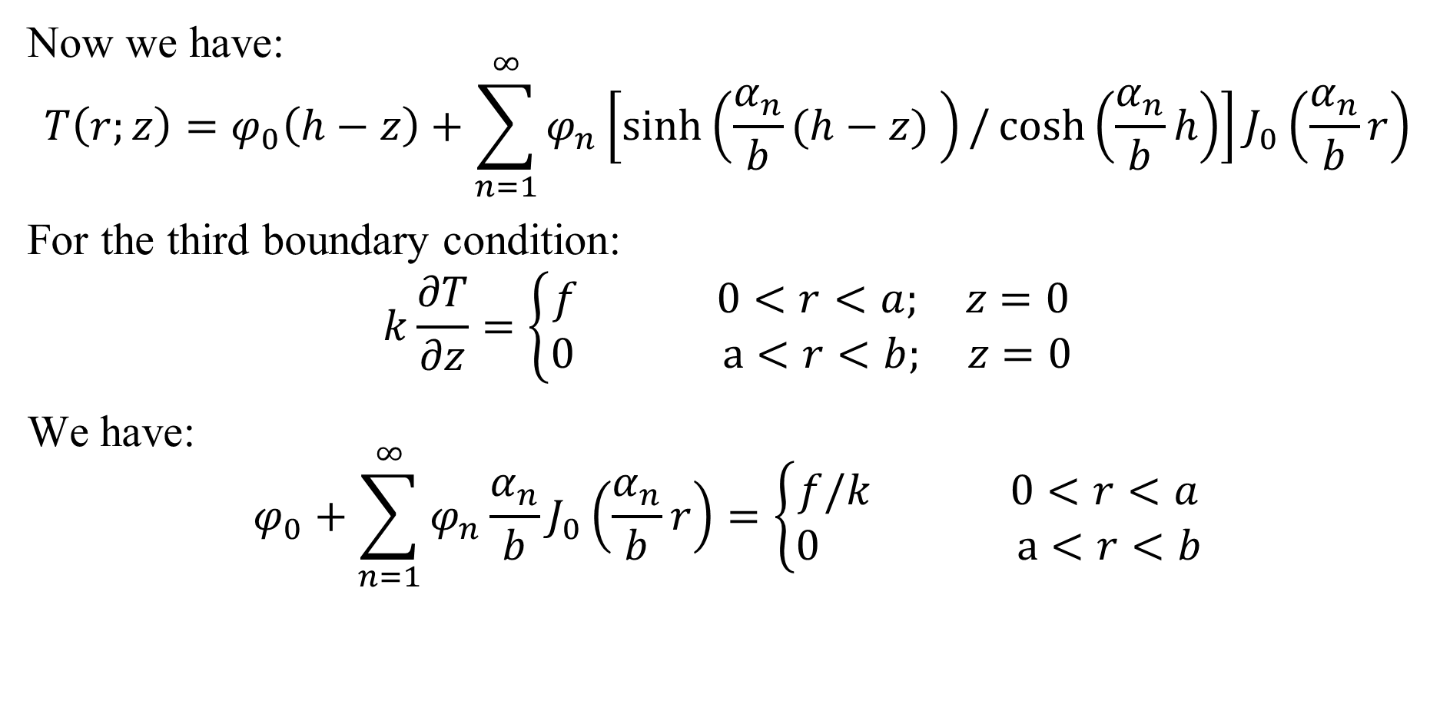
Equation solving
Now we have:
$$T\left(r;z\right)=φ_{0}\left(h−z\right)+\sum_{n=1}^{∞}{φ_{n}\left[\sinh\left(\frac{α_{n}}{b}(h−z) \right)/\cosh\left(\frac{α_{n}}{b}h\right)\right]}J_{0}\left(\frac{α_{n}}{b}r\right)$$
For the third boundary condition:
$$k\frac{∂T}{∂z}=\left\{\begin{aligned}f 0<r<a; z=0 \\ 0 a<r<b; z=0\end{aligned}\right.$$
We have:
$$φ_{0}+\sum_{n=1}^{∞}{φ_{n}\frac{α_{n}}{b}}J_{0}\left(\frac{α_{n}}{b}r\right)=\left\{\begin{aligned}f/k 0<r<a \\ 0 a<r<b\end{aligned}\right.$$

Slide 9
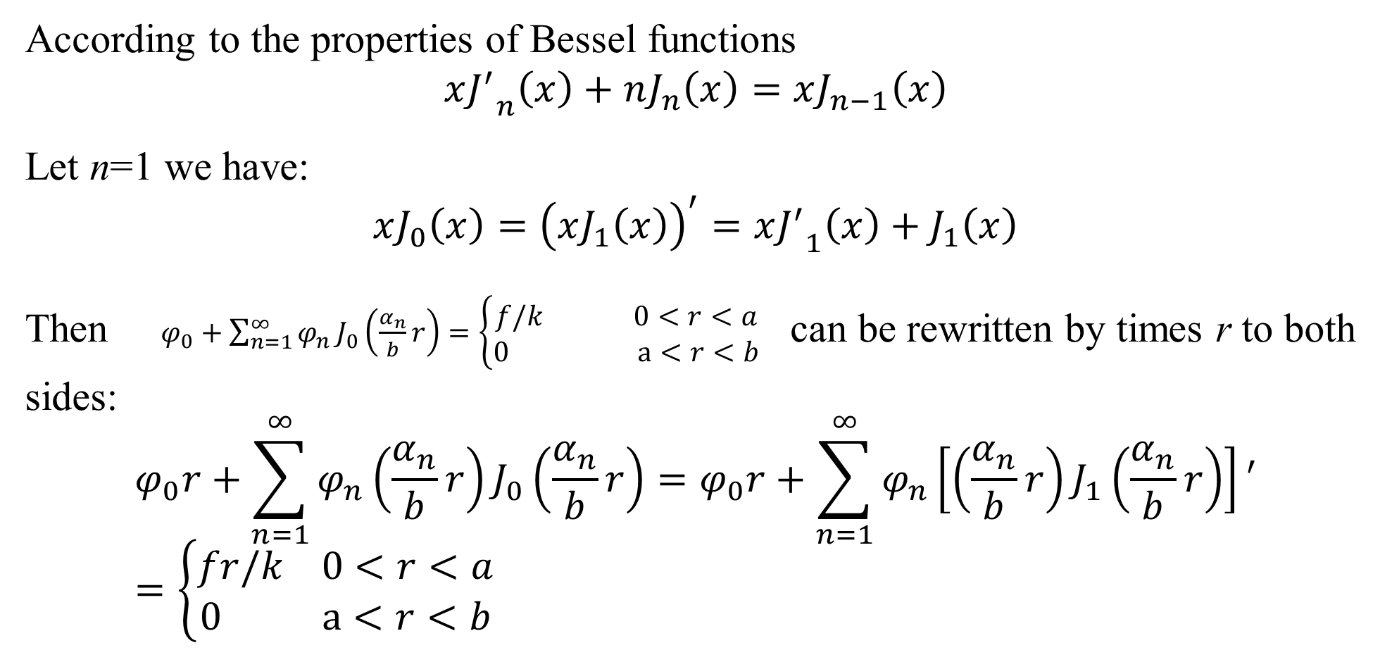
Bessel functions
According to the properties of Bessel functions
$$x{J^{′}}_{n}\left(x\right)+nJ_{n}\left(x\right)=xJ_{n−1}\left(x\right)$$
Let n=1 we have:
$$xJ_{0}\left(x\right)={\left(xJ_{1}\left(x\right)\right)}^{′}=x{J^{′}}_{1}\left(x\right)+J_{1}\left(x\right)$$
Then $φ_{0}+\sum_{n=1}^{∞}{φ_{n}}J_{0}\left(\frac{α_{n}}{b}r\right)=\left\{\begin{aligned}f/k 0<r<a \\ 0 a<r<b\end{aligned}\right.$ can be rewritten by times r to both sides:
$$φ_{0}r+\sum_{n=1}^{∞}{φ_{n}}{\left(\frac{α_{n}}{b}r\right)J}_{0}\left(\frac{α_{n}}{b}r\right)=φ_{0}r+\sum_{n=1}^{∞}{φ_{n}}\left[{\left(\frac{α_{n}}{b}r\right)J}_{1}\left(\frac{α_{n}}{b}r\right)\right]′=\left\{\begin{aligned}fr/k 0<r<a \\ 0 a<r<b\end{aligned}\right.$$

Slide 10
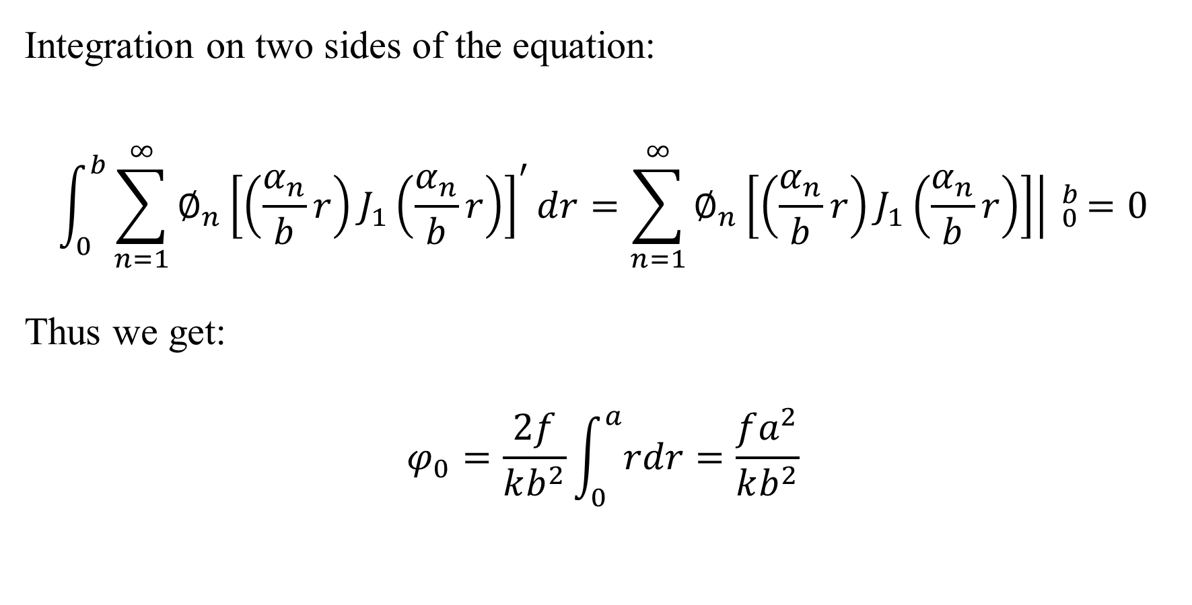
Bessel functions
Integration on two sides of the equation:
$$\int_{0}^{b}{\sum_{n=1}^{∞}{∅_{n}}{\left[{\left(\frac{α_{n}}{b}r\right)J}_{1}\left(\frac{α_{n}}{b}r\right)\right]}^{′}dr}=\sum_{n=1}^{∞}{∅_{n}}\left.\left[{\left(\frac{α_{n}}{b}r\right)J}_{1}\left(\frac{α_{n}}{b}r\right)\right]\right| _{0}^{b}=0$$
Thus we get:
$$φ_{0}=\frac{2f}{kb^{2}}\int_{0}^{a}{rdr}=\frac{fa^{2}}{kb^{2}}$$

Slide 11
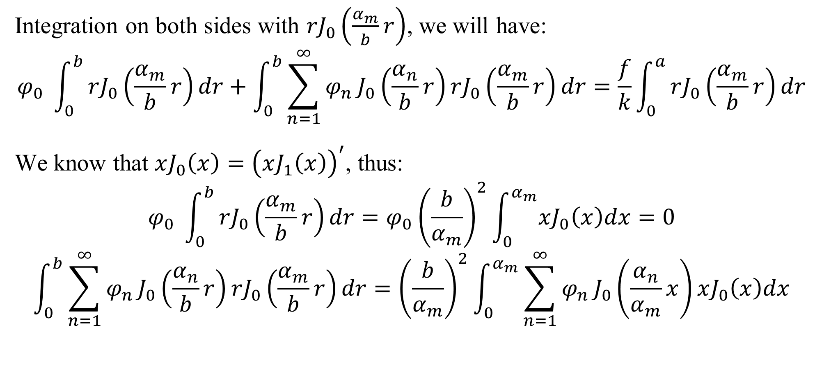
Bessel functions
Integration on both sides with ${rJ}_{0}\left(\frac{α_{m}}{b}r\right)$, we will have:
$$φ_{0} \int_{0}^{b}{rJ_{0}\left(\frac{α_{m}}{b}r\right)dr}+\int_{0}^{b}{\sum_{n=1}^{∞}{φ_{n}}J_{0}\left(\frac{α_{n}}{b}r\right)rJ_{0}\left(\frac{α_{m}}{b}r\right)dr}=\frac{f}{k}\int_{0}^{a}{rJ_{0}\left(\frac{α_{m}}{b}r\right)dr}$$
We know that $xJ_{0}\left(x\right)={\left(xJ_{1}\left(x\right)\right)}^{′}$, thus:
$$φ_{0} \int_{0}^{b}{rJ_{0}\left(\frac{α_{m}}{b}r\right)dr}=φ_{0}{\left(\frac{b}{α_{m}}\right)}^{2}\int_{0}^{α_{m}}{xJ_{0}\left(x\right)dx}=0$$
$$\int_{0}^{b}{\sum_{n=1}^{∞}{φ_{n}}J_{0}\left(\frac{α_{n}}{b}r\right)rJ_{0}\left(\frac{α_{m}}{b}r\right)dr}={\left(\frac{b}{α_{m}}\right)}^{2}\int_{0}^{α_{m}}{\sum_{n=1}^{∞}{φ_{n}}J_{0}\left(\frac{α_{n}}{α_{m}}x\right)xJ_{0}\left(x\right)dx}$$

Slide 12
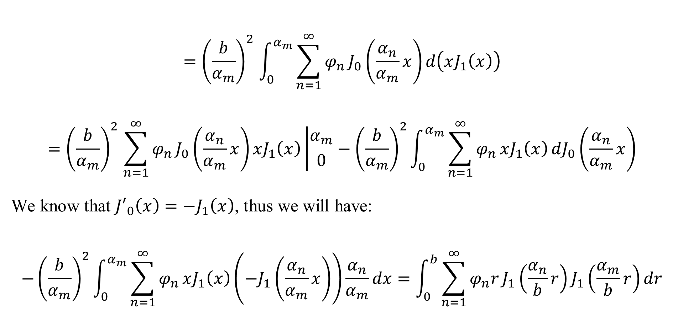
Bessel functions
$${=\left(\frac{b}{α_{m}}\right)}^{2}\int_{0}^{α_{m}}{\sum_{n=1}^{∞}{φ_{n}}J_{0}\left(\frac{α_{n}}{α_{m}}x\right)d\left(xJ_{1}\left(x\right)\right)}$$
$${=\left(\frac{b}{α_{m}}\right)}^{2}\sum_{n=1}^{∞}{φ_{n}}J_{0}\left(\frac{α_{n}}{α_{m}}x\right)xJ_{1}\left(x\right)\left|{α_{m} \atop 0}\right.−{\left(\frac{b}{α_{m}}\right)}^{2}\int_{0}^{α_{m}}{\sum_{n=1}^{∞}{φ_{n}}xJ_{1}\left(x\right)}dJ_{0}\left(\frac{α_{n}}{α_{m}}x\right)$$
We know that ${J′}_{0}\left(x\right)=−J_{1}\left(x\right)$, thus we will have:
$$−{\left(\frac{b}{α_{m}}\right)}^{2}\int_{0}^{α_{m}}{\sum_{n=1}^{∞}{φ_{n}}xJ_{1}\left(x\right)}\left(−J_{1}\left(\frac{α_{n}}{α_{m}}x\right)\right)\frac{α_{n}}{α_{m}}dx=\int_{0}^{b}{\sum_{n=1}^{∞}{φ_{n}r}J_{1}\left(\frac{α_{n}}{b}r\right)J_{1}\left(\frac{α_{m}}{b}r\right)dr}$$

Slide 13
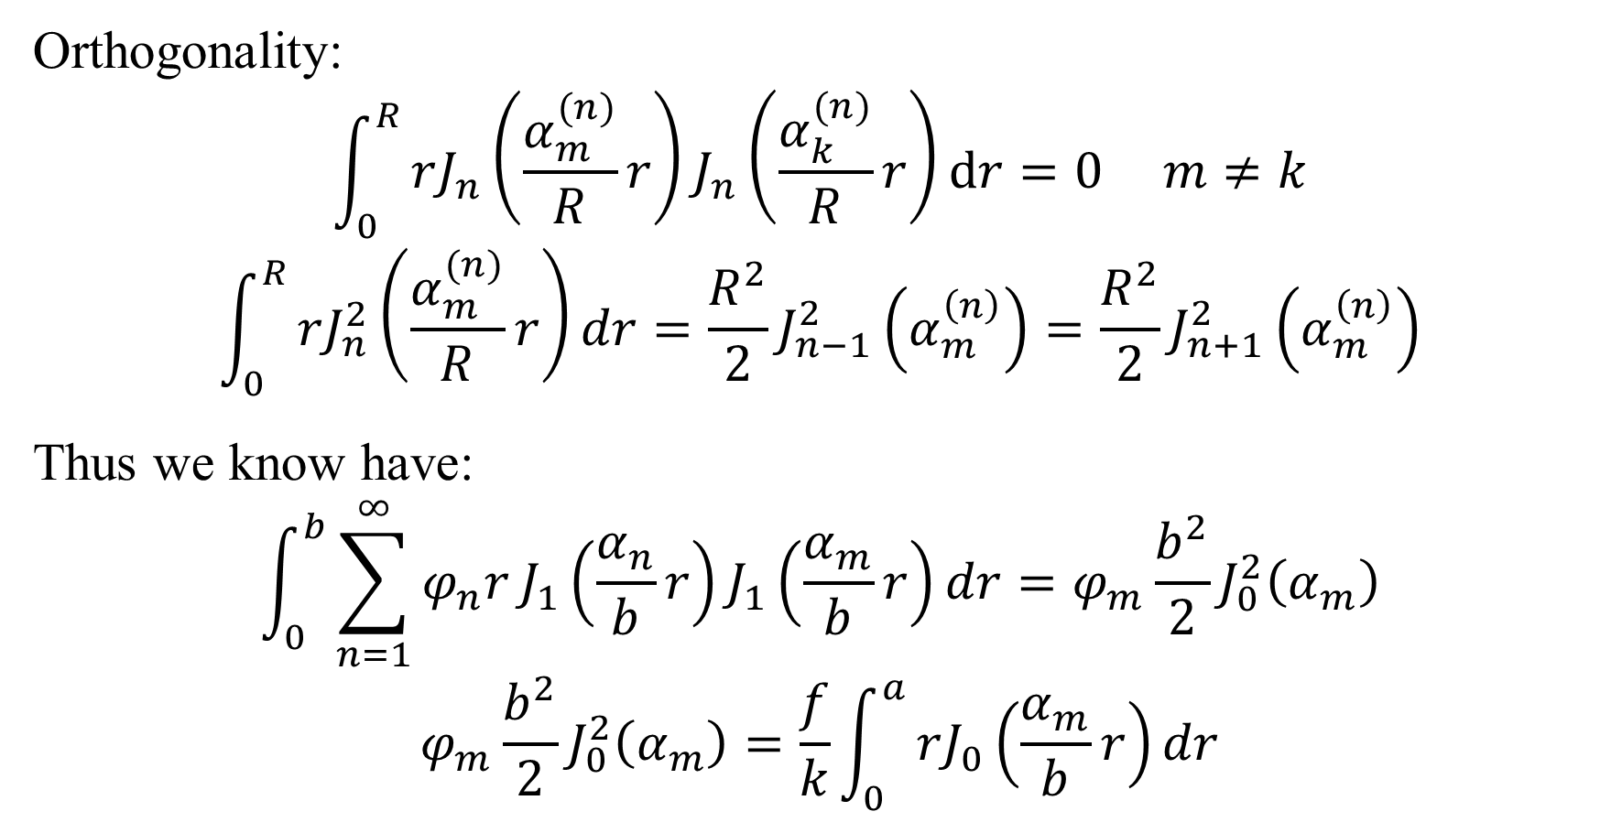
Bessel functions
Orthogonality:
$$\int_{0}^{R}{rJ_{n}\left(\frac{α_{m}^{(n)}}{R}r\right)}J_{n}\left(\frac{α_{k}^{(n)}}{R}r\right)dr=0 m≠k$$
$$\int_{0}^{R}{rJ_{n}^{2}\left(\frac{α_{m}^{(n)}}{R}r\right)}dr=\frac{R^{2}}{2}J_{n−1}^{2}\left(α_{m}^{\left(n\right)}\right)=\frac{R^{2}}{2}J_{n+1}^{2}\left(α_{m}^{\left(n\right)}\right)$$
Thus we know have:
$$\int_{0}^{b}{\sum_{n=1}^{∞}{φ_{n}r}J_{1}\left(\frac{α_{n}}{b}r\right)J_{1}\left(\frac{α_{m}}{b}r\right)dr}=φ_{m}\frac{b^{2}}{2}J_{0}^{2}\left(α_{m}\right)$$
$$φ_{m}\frac{b^{2}}{2}J_{0}^{2}\left(α_{m}\right)=\frac{f}{k}\int_{0}^{a}{rJ_{0}\left(\frac{α_{m}}{b}r\right)dr}$$

Slide 14
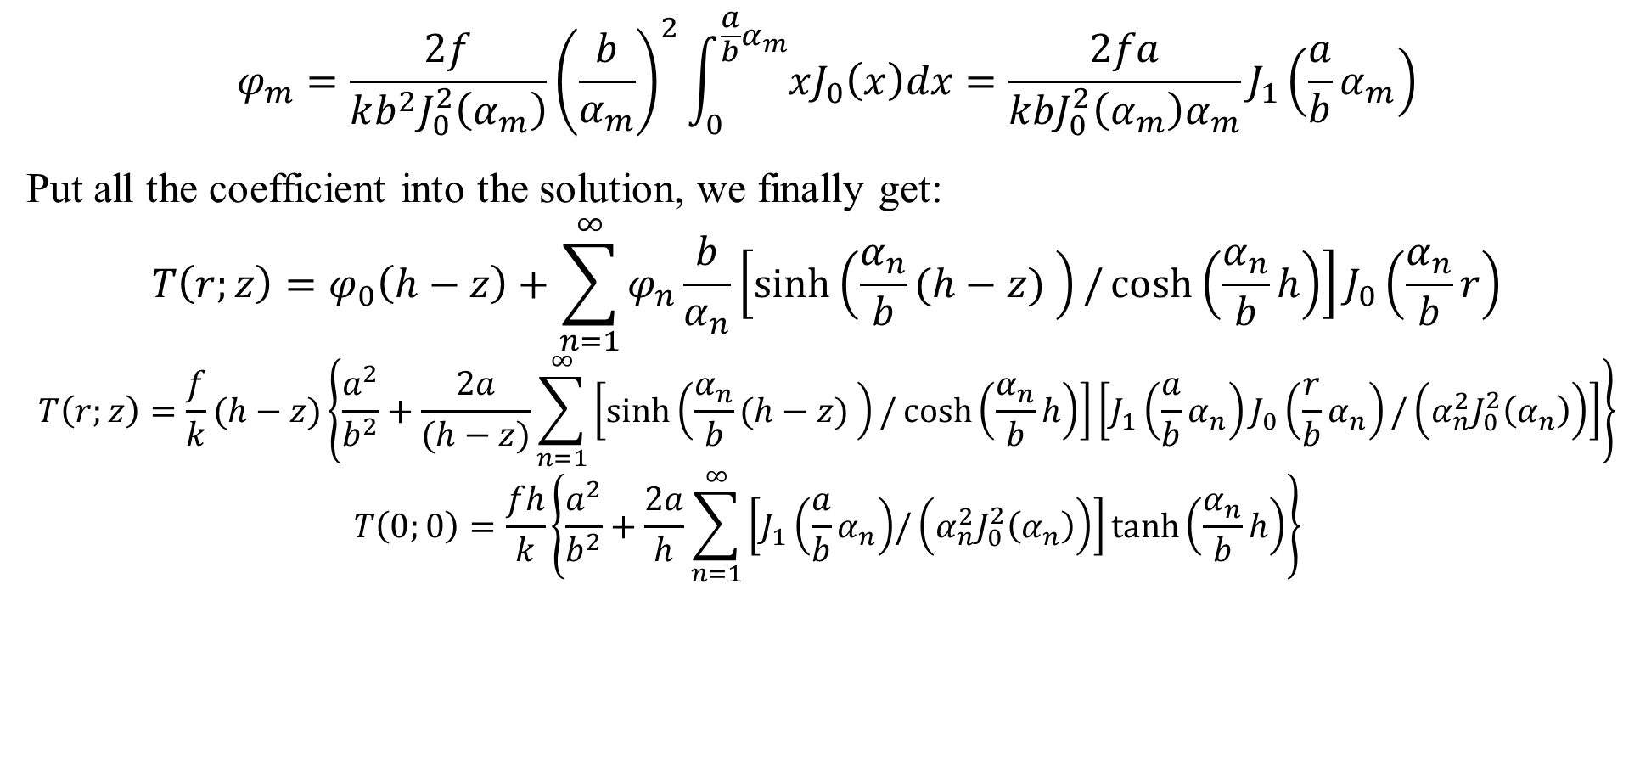
Surface temperature
$$φ_{m}=\frac{2f}{kb^{2}J_{0}^{2}\left(α_{m}\right)}{\left(\frac{b}{α_{m}}\right)}^{2}\int_{0}^{\frac{a}{b}α_{m}}{xJ_{0}\left(x\right)dx}=\frac{2fa}{kbJ_{0}^{2}\left(α_{m}\right)α_{m}}J_{1}\left(\frac{a}{b}α_{m}\right)$$
Put all the coefficient into the solution, we finally get:
$$T\left(r;z\right)=φ_{0}\left(h−z\right)+\sum_{n=1}^{∞}{φ_{n}\frac{b}{α_{n}}\left[\sinh\left(\frac{α_{n}}{b}(h−z) \right)/\cosh\left(\frac{α_{n}}{b}h\right)\right]}J_{0}\left(\frac{α_{n}}{b}r\right)$$
$$T\left(r;z\right)=\frac{f}{k}(h−z)\left\{\frac{a^{2}}{b^{2}}+\frac{2a}{(h−z)}\sum_{n=1}^{∞}{\left[\sinh\left(\frac{α_{n}}{b}(h−z) \right)/\cosh\left(\frac{α_{n}}{b}h\right)\right]}\left[J_{1}\left(\frac{a}{b}α_{n}\right)J_{0}\left(\frac{r}{b}α_{n}\right)/\left(α_{n}^{2}J_{0}^{2}\left(α_{n}\right)\right)\right]\right\}$$
$$T\left(0;0\right)=\frac{fh}{k}\left\{\frac{a^{2}}{b^{2}}+\frac{2a}{h}\sum_{n=1}^{∞}{\left[J_{1}\left(\frac{a}{b}α_{n}\right){/\left(α_{n}^{2}J_{0}^{2}\left(α_{n}\right)\right)}\right]}\tanh\left(\frac{α_{n}}{b}h\right)\right\}$$

Slide 15
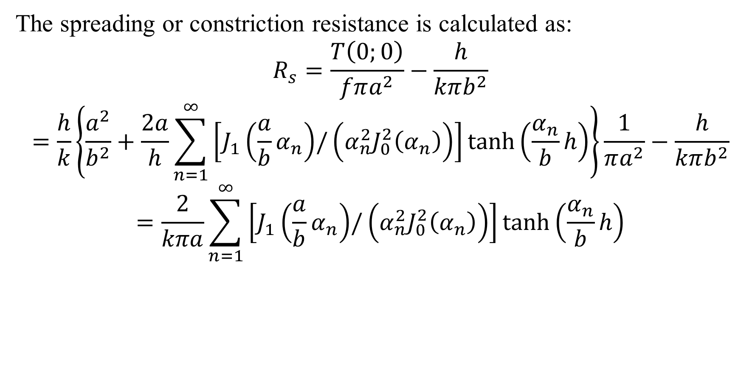
Thermal resistance
The spreading or constriction resistance is calculated as:
$$R_{s}=\frac{T\left(0;0\right)}{fπa^{2}}−\frac{h}{kπb^{2}}$$
$$=\frac{h}{k}\left\{\frac{a^{2}}{b^{2}}+\frac{2a}{h}\sum_{n=1}^{∞}{\left[J_{1}\left(\frac{a}{b}α_{n}\right){/\left(α_{n}^{2}J_{0}^{2}\left(α_{n}\right)\right)}\right]}\tanh\left(\frac{α_{n}}{b}h\right)\right\}\frac{1}{πa^{2}}−\frac{h}{kπb^{2}}$$
$$=\frac{2}{kπa}\sum_{n=1}^{∞}{\left[J_{1}\left(\frac{a}{b}α_{n}\right){/\left(α_{n}^{2}J_{0}^{2}\left(α_{n}\right)\right)}\right]}\tanh\left(\frac{α_{n}}{b}h\right)$$

Slide 16
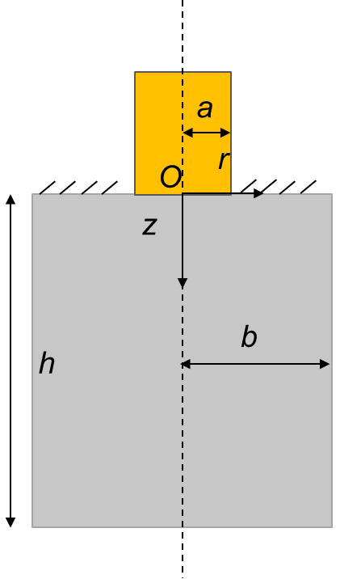
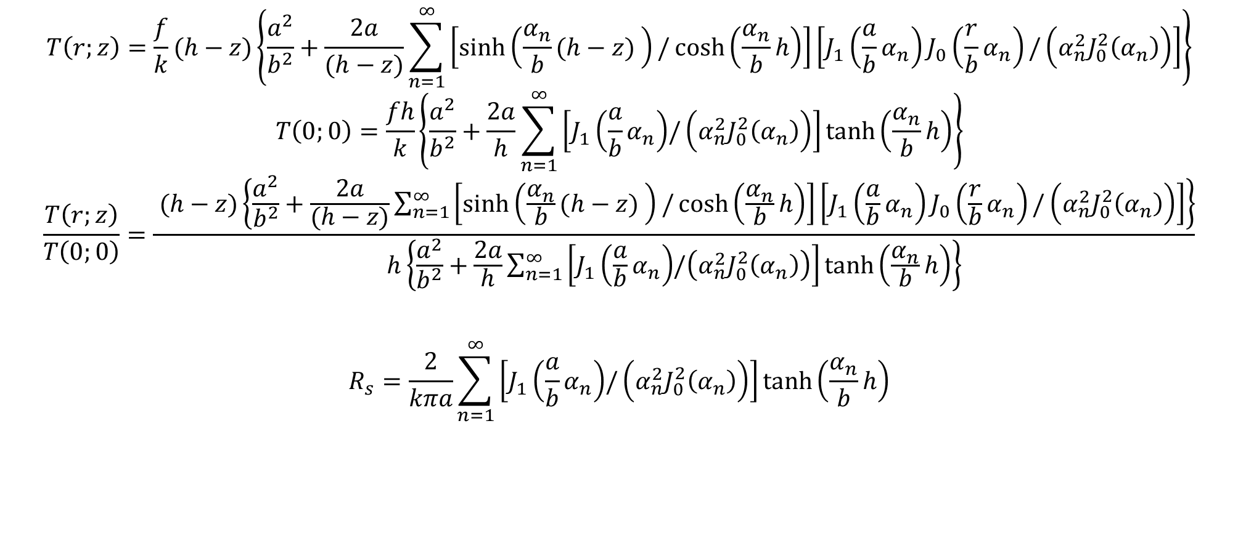
Temperature distribution
$$T\left(r;z\right)=\frac{f}{k}(h−z)\left\{\frac{a^{2}}{b^{2}}+\frac{2a}{(h−z)}\sum_{n=1}^{∞}{\left[\sinh\left(\frac{α_{n}}{b}(h−z) \right)/\cosh\left(\frac{α_{n}}{b}h\right)\right]}\left[J_{1}\left(\frac{a}{b}α_{n}\right)J_{0}\left(\frac{r}{b}α_{n}\right)/\left(α_{n}^{2}J_{0}^{2}\left(α_{n}\right)\right)\right]\right\}$$
$$T\left(0;0\right)=\frac{fh}{k}\left\{\frac{a^{2}}{b^{2}}+\frac{2a}{h}\sum_{n=1}^{∞}{\left[J_{1}\left(\frac{a}{b}α_{n}\right){/\left(α_{n}^{2}J_{0}^{2}\left(α_{n}\right)\right)}\right]}\tanh\left(\frac{α_{n}}{b}h\right)\right\}$$
$$\frac{T\left(r;z\right)}{T\left(0;0\right)}=\frac{ (h−z)\left\{\frac{a^{2}}{b^{2}}+\frac{2a}{(h−z)}\sum_{n=1}^{∞}{\left[\sinh\left(\frac{α_{n}}{b}(h−z) \right)/\cosh\left(\frac{α_{n}}{b}h\right)\right]}\left[J_{1}\left(\frac{a}{b}α_{n}\right)J_{0}\left(\frac{r}{b}α_{n}\right)/\left(α_{n}^{2}J_{0}^{2}\left(α_{n}\right)\right)\right]\right\}}{h\left\{\frac{a^{2}}{b^{2}}+\frac{2a}{h}\sum_{n=1}^{∞}{\left[J_{1}\left(\frac{a}{b}α_{n}\right){/\left(α_{n}^{2}J_{0}^{2}\left(α_{n}\right)\right)}\right]}\tanh\left(\frac{α_{n}}{b}h\right)\right\}}$$
$$R_{s}=\frac{2}{kπa}\sum_{n=1}^{∞}{\left[J_{1}\left(\frac{a}{b}α_{n}\right){/\left(α_{n}^{2}J_{0}^{2}\left(α_{n}\right)\right)}\right]}\tanh\left(\frac{α_{n}}{b}h\right)$$

Slide 17


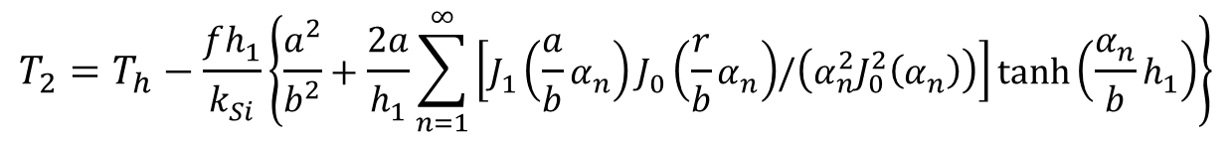



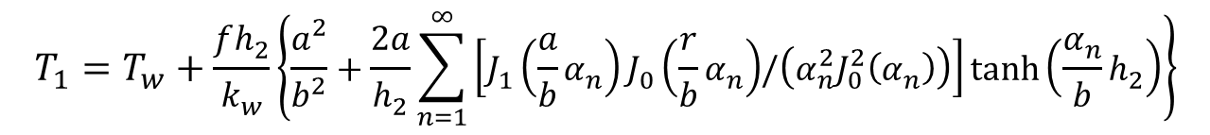
Temperature at micropillar surface
$$Tw$$
$$h_{2}$$
$$T_{1}=T_{w}+\frac{fh_{2}}{k_{w}}\left\{\frac{a^{2}}{b^{2}}+\frac{2a}{h_{2}}\sum_{n=1}^{∞}{\left[J_{1}\left(\frac{a}{b}α_{n}\right)J_{0}\left(\frac{r}{b}α_{n}\right){/\left(α_{n}^{2}J_{0}^{2}\left(α_{n}\right)\right)}\right]}\tanh\left(\frac{α_{n}}{b}h_{2}\right)\right\}$$
$$L$$
$$T_{2}=T_{h}−\frac{fh_{1}}{k_{Si}}\left\{\frac{a^{2}}{b^{2}}+\frac{2a}{h_{1}}\sum_{n=1}^{∞}{\left[J_{1}\left(\frac{a}{b}α_{n}\right)J_{0}\left(\frac{r}{b}α_{n}\right){/\left(α_{n}^{2}J_{0}^{2}\left(α_{n}\right)\right)}\right]}\tanh\left(\frac{α_{n}}{b}h_{1}\right)\right\}$$
$$h_{1}$$
$$Th$$

Slide 18
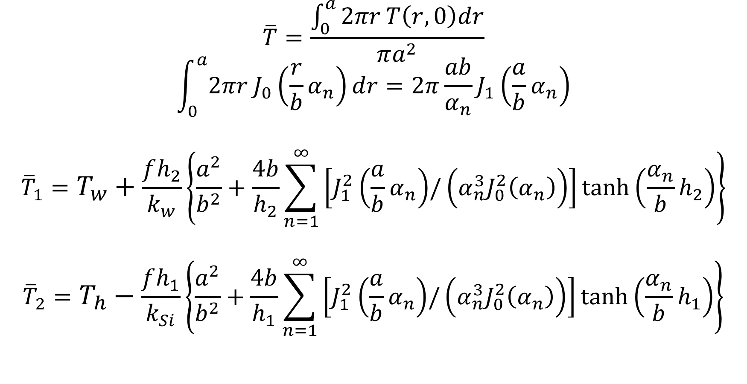
Area average temperature
$$\overline{T}=\frac{\int_{0}^{a}{2πr}T\left(r,0\right)dr}{πa^{2}}$$
$$\int_{0}^{a}{2πr}J_{0}\left(\frac{r}{b}α_{n}\right)dr=2π\frac{ab}{α_{n}}J_{1}\left(\frac{a}{b}α_{n}\right)$$
$${\overline{T}}_{1}=T_{w}+\frac{fh_{2}}{k_{w}}\left\{\frac{a^{2}}{b^{2}}+\frac{4b}{h_{2}}\sum_{n=1}^{∞}{\left[J_{1}^{2}\left(\frac{a}{b}α_{n}\right){/\left(α_{n}^{3}J_{0}^{2}\left(α_{n}\right)\right)}\right]}\tanh\left(\frac{α_{n}}{b}h_{2}\right)\right\}$$
$${\overline{T}}_{2}=T_{h}−\frac{fh_{1}}{k_{Si}}\left\{\frac{a^{2}}{b^{2}}+\frac{4b}{h_{1}}\sum_{n=1}^{∞}{\left[J_{1}^{2}\left(\frac{a}{b}α_{n}\right){/\left(α_{n}^{3}J_{0}^{2}\left(α_{n}\right)\right)}\right]}\tanh\left(\frac{α_{n}}{b}h_{1}\right)\right\}$$

Slide 19
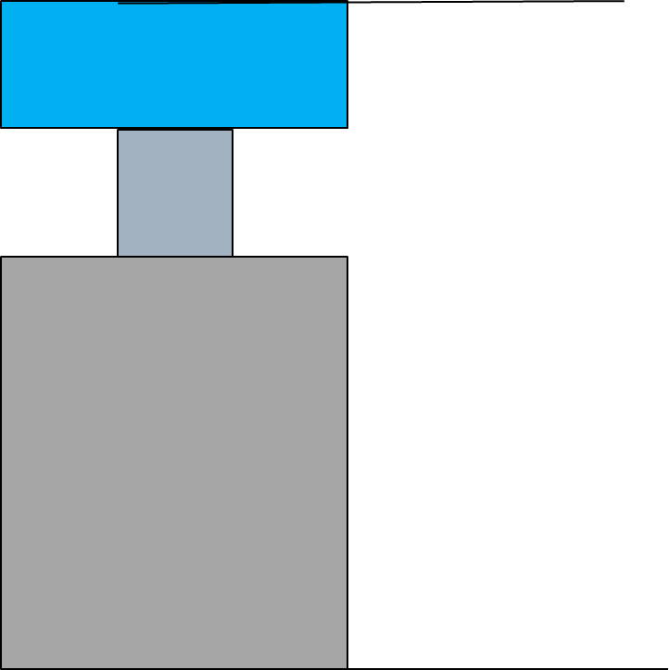
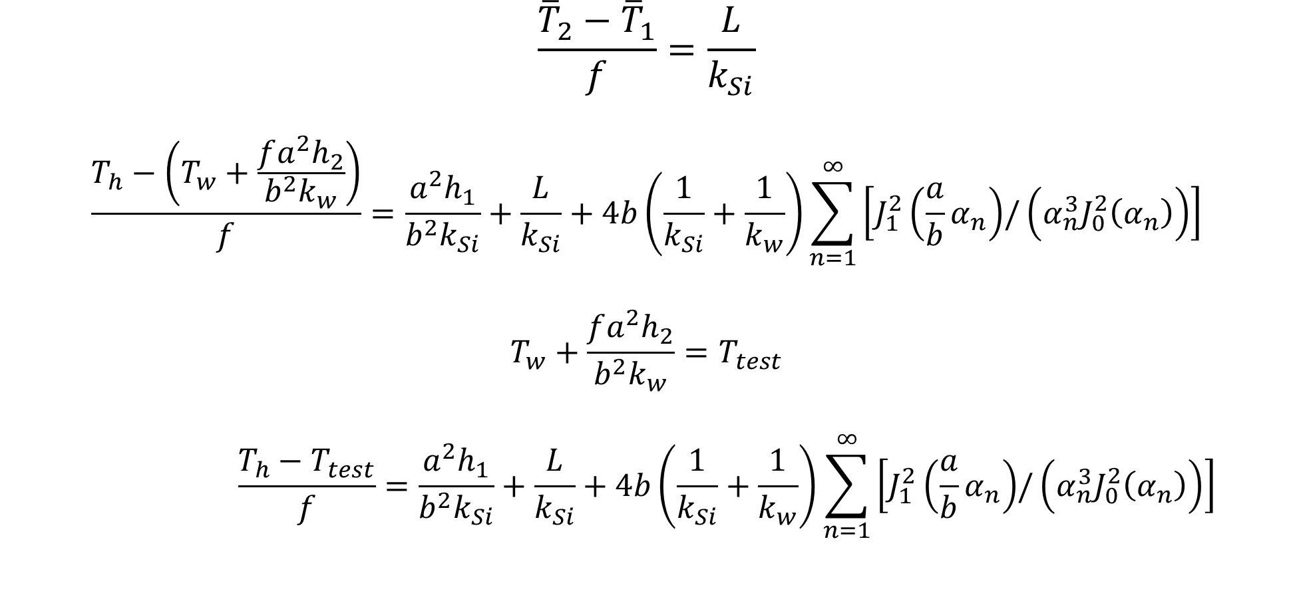

Relation between temperature difference and heat flux
$$\frac{{\overline{T}}_{2}−{\overline{T}}_{1}}{f}=\frac{L}{k_{Si}}$$
$$\frac{T_{h}−\left(T_{w}+\frac{fa^{2}h_{2}}{b^{2}k_{w}}\right)}{f}=\frac{a^{2}h_{1}}{b^{2}k_{Si}}+\frac{L}{k_{Si}}+4b\left(\frac{1}{k_{Si}}+\frac{1}{k_{w}}\right)\sum_{n=1}^{∞}{\left[J_{1}^{2}\left(\frac{a}{b}α_{n}\right){/\left(α_{n}^{3}J_{0}^{2}\left(α_{n}\right)\right)}\right]}$$
$$T_{w}+\frac{fa^{2}h_{2}}{b^{2}k_{w}}=T_{test}$$
$$\frac{T_{h}−T_{test}}{f}=\frac{a^{2}h_{1}}{b^{2}k_{Si}}+\frac{L}{k_{Si}}+4b\left(\frac{1}{k_{Si}}+\frac{1}{k_{w}}\right)\sum_{n=1}^{∞}{\left[J_{1}^{2}\left(\frac{a}{b}α_{n}\right){/\left(α_{n}^{3}J_{0}^{2}\left(α_{n}\right)\right)}\right]}$$
$$T_{test}$$
f

Slide 20
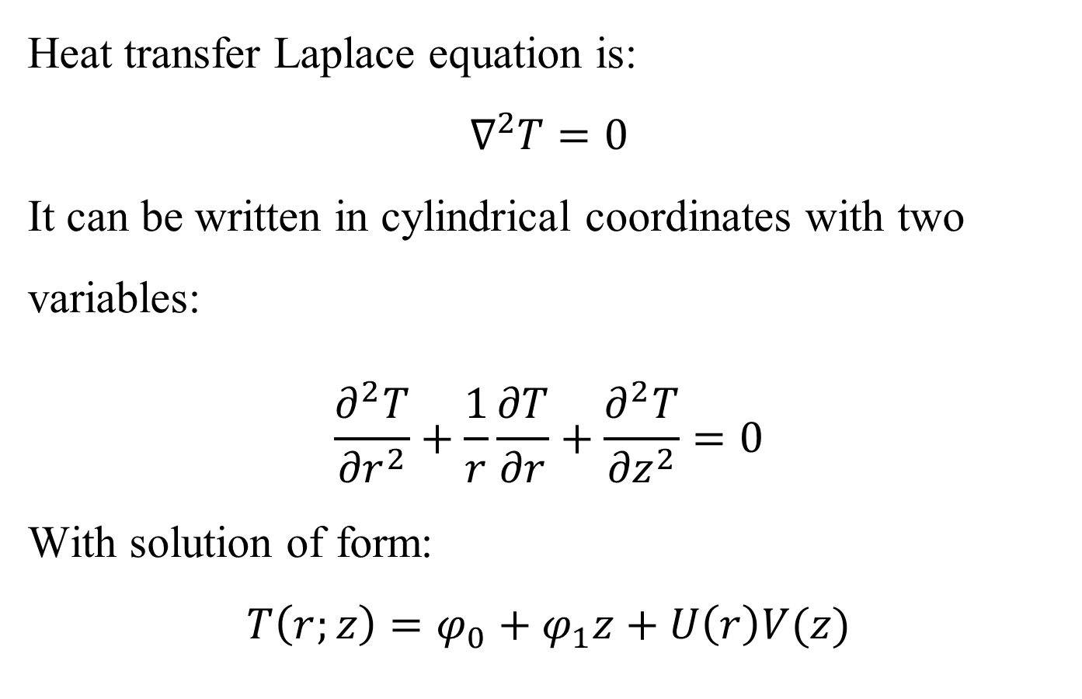
Temperature distribution inside micropillar
Heat transfer Laplace equation is:
$$∇^{2}T=0$$
It can be written in cylindrical coordinates with two variables:
$$\frac{∂^{2}T}{{∂r}^{2}}+\frac{1}{r}\frac{∂T}{∂r}+\frac{∂^{2}T}{{∂z}^{2}}=0$$
With solution of form:
$$T\left(r;z\right)=φ_{0}+φ_{1}z+U\left(r\right)V(z)$$
a
O
z
r

Slide 21
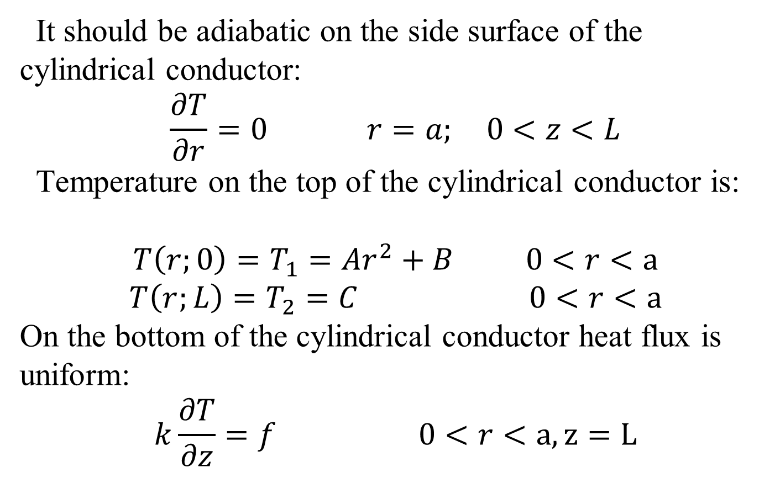
Temperature distribution inside micropillar
It should be adiabatic on the side surface of the cylindrical conductor:
$$\frac{∂T}{∂r}=0 r=a; 0<z<L$$
Temperature on the top of the cylindrical conductor is:
$$T\left(r;0\right)=T_{1}={Ar}^{2}+B 0<r<a$$
$$T\left(r;L\right)=T_{2}=C 0<r<a$$
On the bottom of the cylindrical conductor heat flux is uniform:
$$k\frac{∂T}{∂z}=f 0<r<a, z=L$$
a
O
z
r

Slide 22
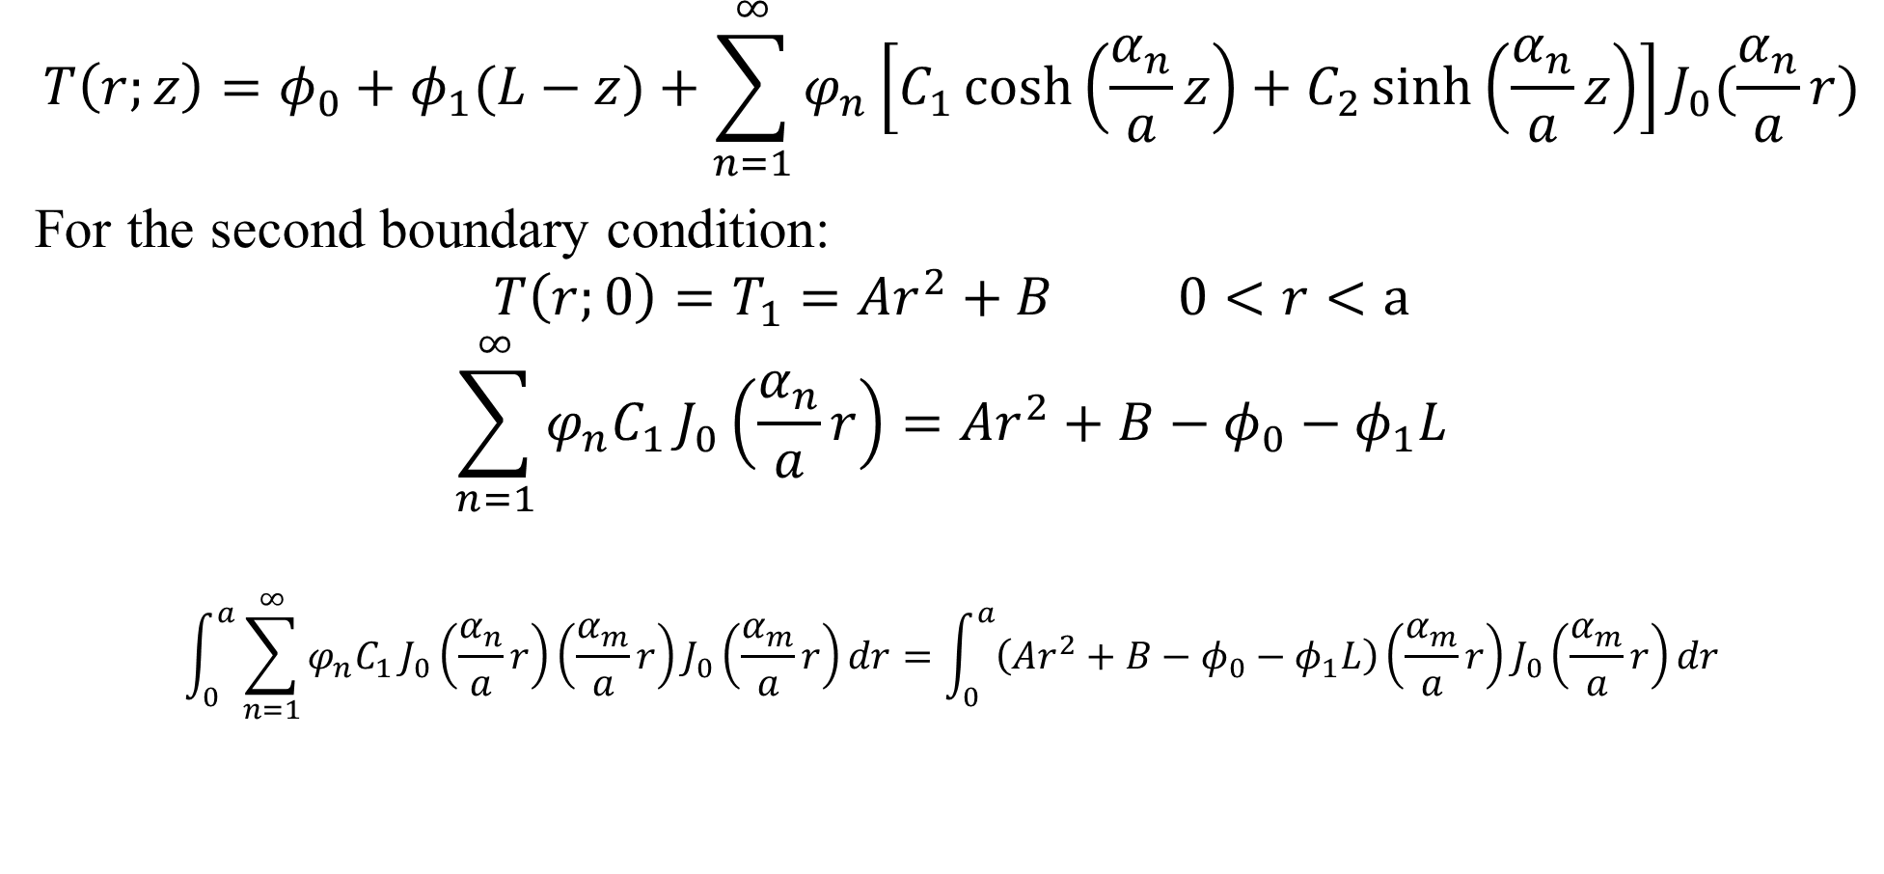
Solve equation
$$T\left(r;z\right)=φ_{0}+φ_{1}(L−z)+\sum_{n=1}^{∞}{φ_{n}\left[C_{1}\cosh\left(\frac{α_{n}}{a}z\right)+C_{2}\sinh\left(\frac{α_{n}}{a}z\right)\right]}J_{0}(\frac{α_{n}}{a}r)$$
For the second boundary condition:
$$T\left(r;0\right)=T_{1}={Ar}^{2}+B 0<r<a$$
$$\sum_{n=1}^{∞}{φ_{n}C_{1}}J_{0}\left(\frac{α_{n}}{a}r\right)={Ar}^{2}+B−φ_{0}−φ_{1}L$$
$$\int_{0}^{a}{\sum_{n=1}^{∞}{φ_{n}C_{1}}J_{0}\left(\frac{α_{n}}{a}r\right)\left(\frac{α_{m}}{a}r\right)J_{0}\left(\frac{α_{m}}{a}r\right)}dr=\int_{0}^{a}{\left({Ar}^{2}+B−φ_{0}−φ_{1}L\right)\left(\frac{α_{m}}{a}r\right)J_{0}\left(\frac{α_{m}}{a}r\right)}dr$$

Slide 23
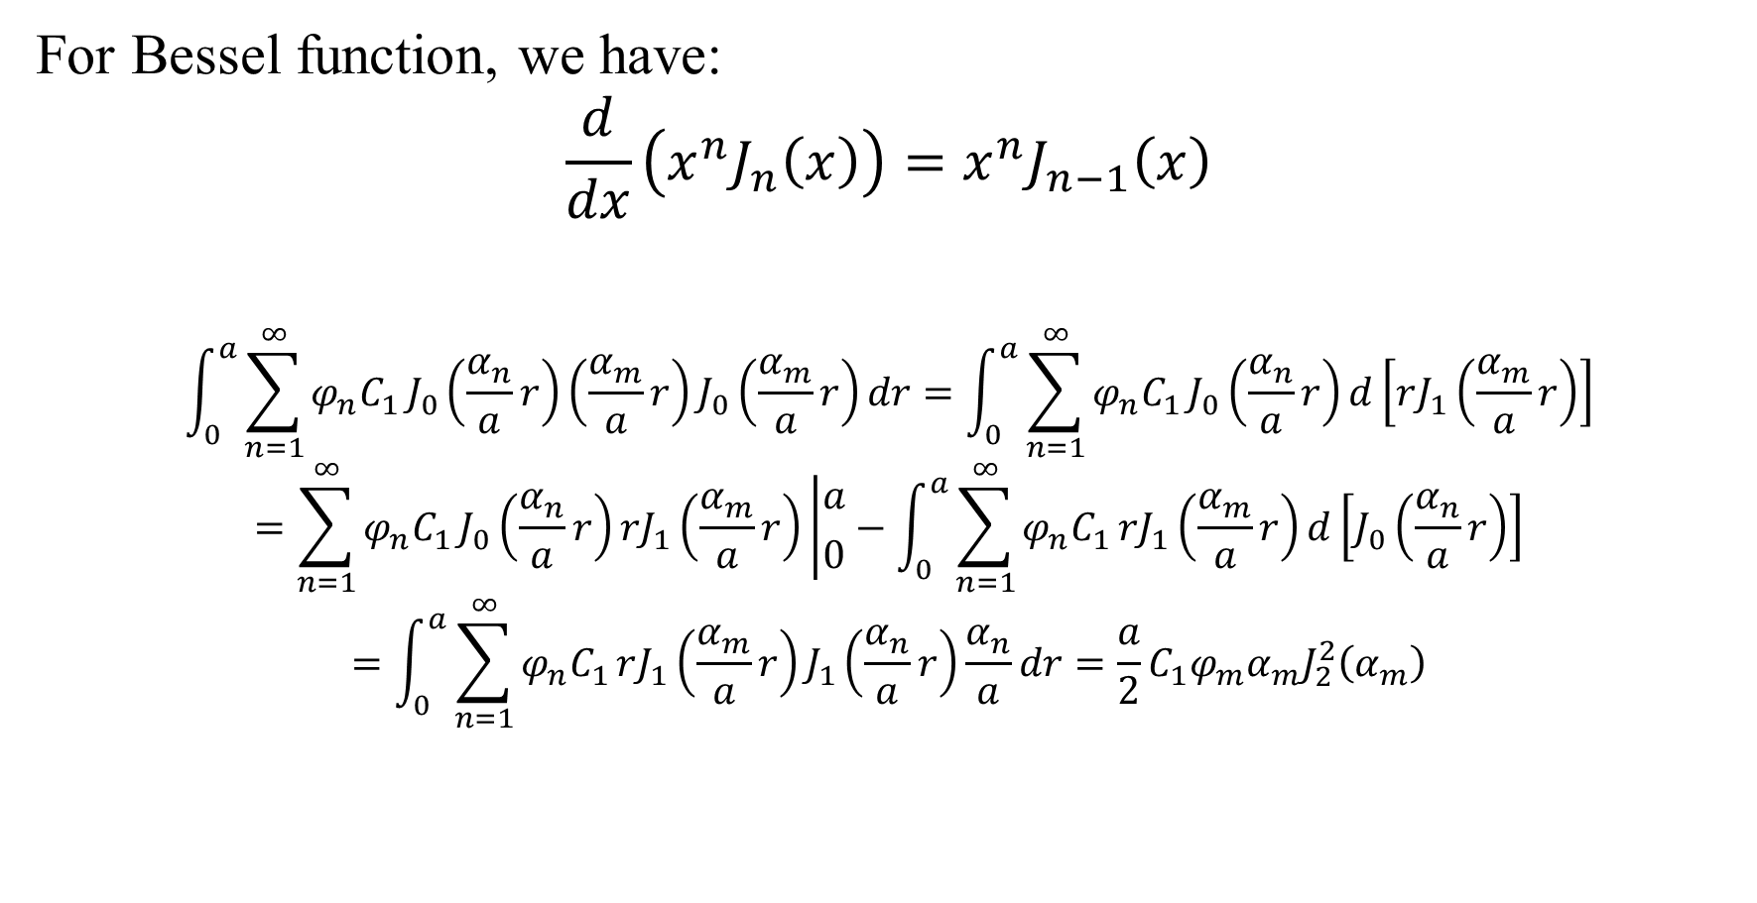
Solve equation
For Bessel function, we have:
$$\frac{d}{dx}\left(x^{n}J_{n}\left(x\right)\right)=x^{n}J_{n−1}\left(x\right)$$
$$\int_{0}^{a}{\sum_{n=1}^{∞}{φ_{n}C_{1}}J_{0}\left(\frac{α_{n}}{a}r\right)\left(\frac{α_{m}}{a}r\right)J_{0}\left(\frac{α_{m}}{a}r\right)}dr=\int_{0}^{a}{\sum_{n=1}^{∞}{φ_{n}C_{1}}J_{0}\left(\frac{α_{n}}{a}r\right)d\left[rJ_{1}\left(\frac{α_{m}}{a}r\right)\right]}$$
$$=\sum_{n=1}^{∞}{φ_{n}C_{1}}J_{0}\left(\frac{α_{n}}{a}r\right)rJ_{1}\left(\frac{α_{m}}{a}r\right)\left|{a \atop 0}\right.−\int_{0}^{a}{\sum_{n=1}^{∞}{φ_{n}C_{1}}rJ_{1}\left(\frac{α_{m}}{a}r\right)d\left[J_{0}\left(\frac{α_{n}}{a}r\right)\right]}$$
$$=\int_{0}^{a}{\sum_{n=1}^{∞}{φ_{n}C_{1}}rJ_{1}\left(\frac{α_{m}}{a}r\right)J_{1}\left(\frac{α_{n}}{a}r\right)\frac{α_{n}}{a}dr}=\frac{a}{2}{C_{1}φ}_{m}α_{m}J_{2}^{2}\left(α_{m}\right)$$

Slide 24
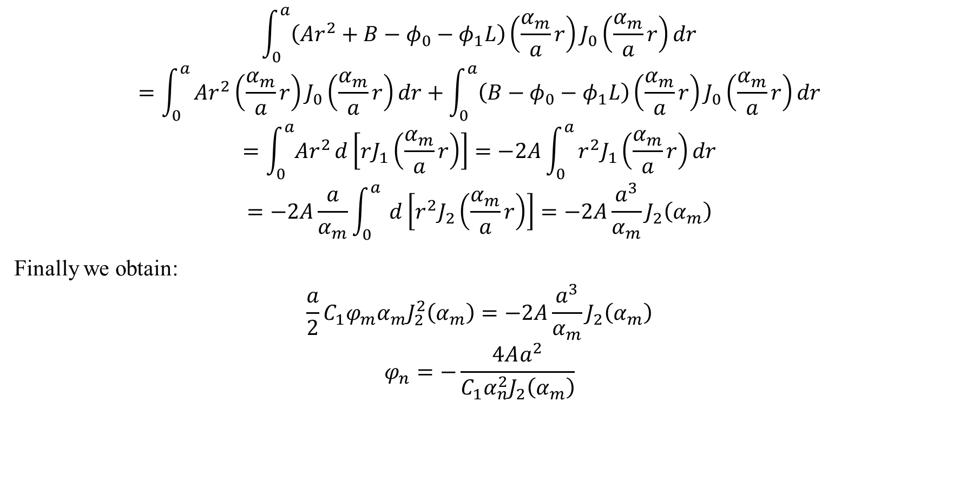
Solve equation
$$\int_{0}^{a}{\left({Ar}^{2}+B−φ_{0}−φ_{1}L\right)\left(\frac{α_{m}}{a}r\right)J_{0}\left(\frac{α_{m}}{a}r\right)}dr$$
$$=\int_{0}^{a}{{Ar}^{2}\left(\frac{α_{m}}{a}r\right)J_{0}\left(\frac{α_{m}}{a}r\right)}dr+\int_{0}^{a}{\left(B−φ_{0}−φ_{1}L\right)\left(\frac{α_{m}}{a}r\right)J_{0}\left(\frac{α_{m}}{a}r\right)}dr$$
$$=\int_{0}^{a}{{Ar}^{2}}d\left[rJ_{1}\left(\frac{α_{m}}{a}r\right)\right]=−2A\int_{0}^{a}{r^{2}J_{1}\left(\frac{α_{m}}{a}r\right)}dr$$
$$=−2A\frac{a}{α_{m}}\int_{0}^{a}{ }d\left[r^{2}J_{2}\left(\frac{α_{m}}{a}r\right)\right]=−2A\frac{a^{3}}{α_{m}}J_{2}\left(α_{m}\right)$$
Finally we obtain:
$$\frac{a}{2}{C_{1}φ}_{m}α_{m}J_{2}^{2}\left(α_{m}\right)=−2A\frac{a^{3}}{α_{m}}J_{2}\left(α_{m}\right)$$
$$φ_{n}=−\frac{4Aa^{2}}{C_{1}α_{n}^{2}J_{2}\left(α_{m}\right)}$$

Slide 25
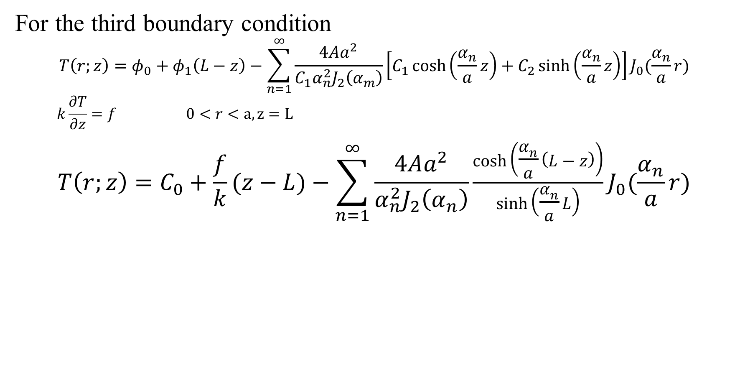
Solve equation
For the third boundary condition
$$T\left(r;z\right)=φ_{0}+φ_{1}\left(L−z\right)−\sum_{n=1}^{∞}{\frac{4Aa^{2}}{C_{1}α_{n}^{2}J_{2}\left(α_{m}\right)}\left[C_{1}\cosh\left(\frac{α_{n}}{a}z\right)+C_{2}\sinh\left(\frac{α_{n}}{a}z\right)\right]}J_{0}(\frac{α_{n}}{a}r)$$
$$k\frac{∂T}{∂z}=f 0<r<a, z=L$$
$$T\left(r;z\right)=C_{0}+\frac{f}{k}(z−L)−\sum_{n=1}^{∞}{\frac{4Aa^{2}}{α_{n}^{2}J_{2}\left(α_{n}\right)}}\frac{\cosh\left(\frac{α_{n}}{a}\left(L−z\right)\right)}{\sinh\left(\frac{α_{n}}{a}L\right)}J_{0}(\frac{α_{n}}{a}r)$$

Slide 26
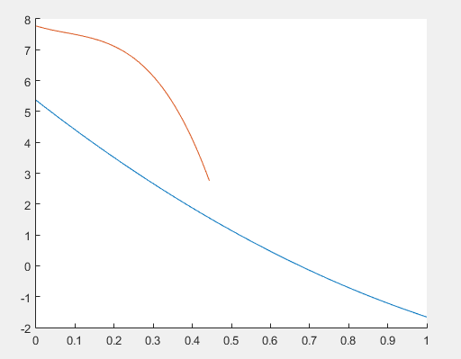





$$Tw$$
$$h_{2}$$
$$L$$
$$h_{1}$$
$$Th$$

Slide 27
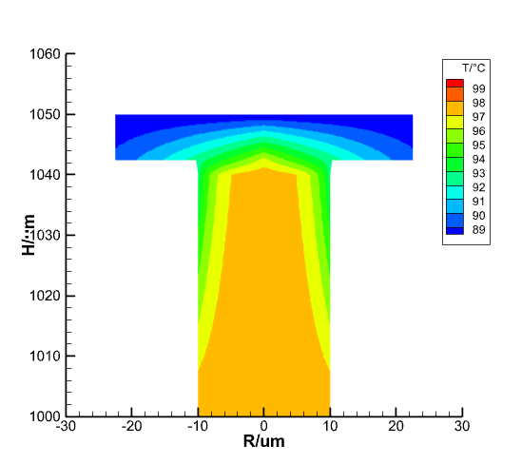
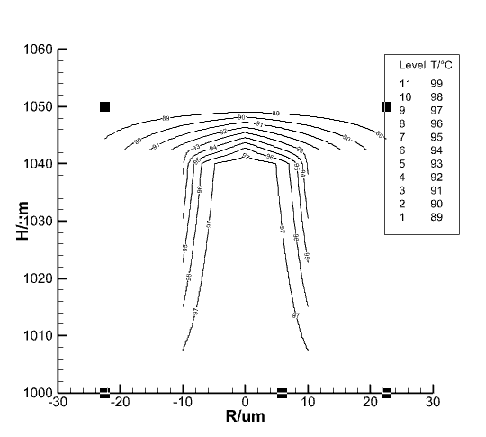
Temperature distribution

Slide 28
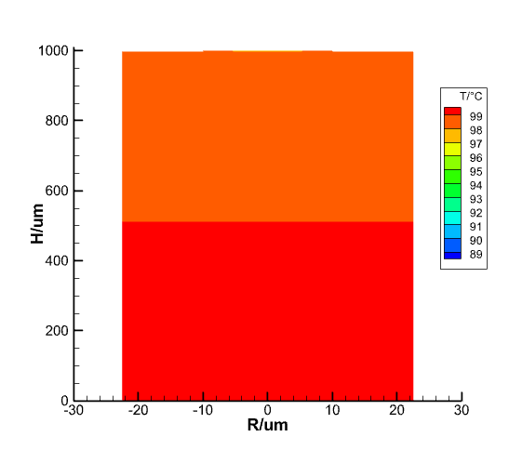
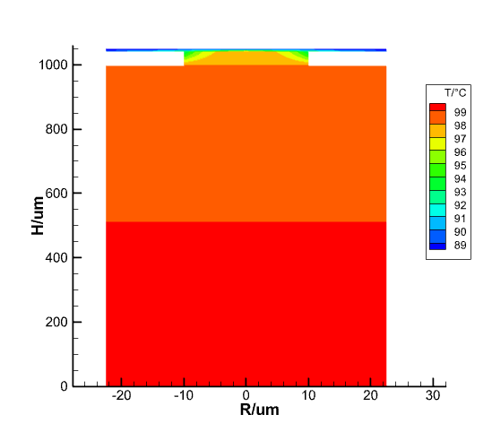
Temperature distribution

Slide 29
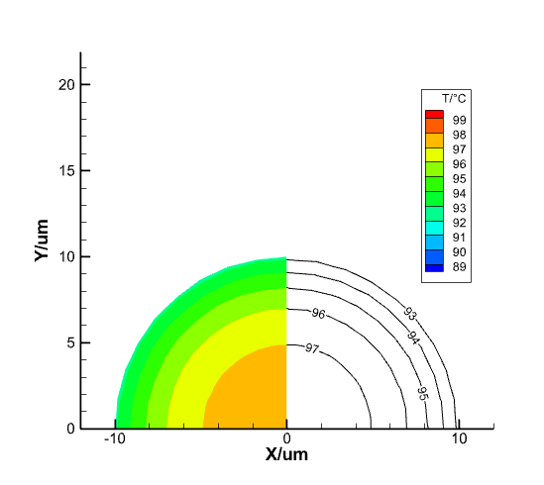
Temperature distribution

Slide 30
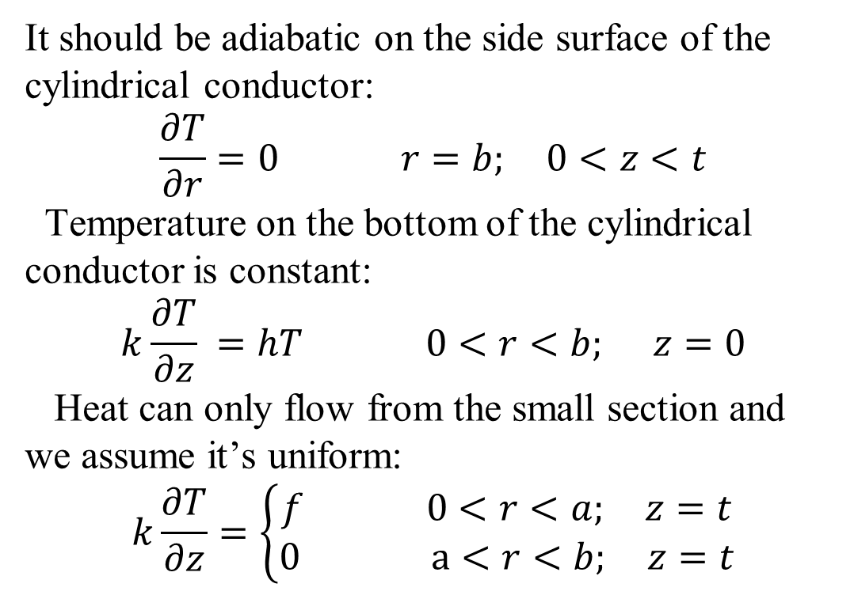

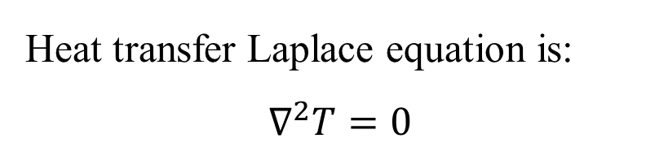
Convection heat transfer boundary condition
$$Tw$$
It should be adiabatic on the side surface of the cylindrical conductor:
$$\frac{∂T}{∂r}=0 r=b; 0<z<t$$
Temperature on the bottom of the cylindrical conductor is constant:
$$k\frac{∂T}{∂z} =hT 0<r<b; z=0$$
Heat can only flow from the small section and we assume it’s uniform:
$$k\frac{∂T}{∂z}=\left\{\begin{aligned}f 0<r<a; z=t \\ 0 a<r<b; z=t\end{aligned}\right.$$
z
t
r
O
Heat transfer Laplace equation is:
$$∇^{2}T=0$$

Slide 31
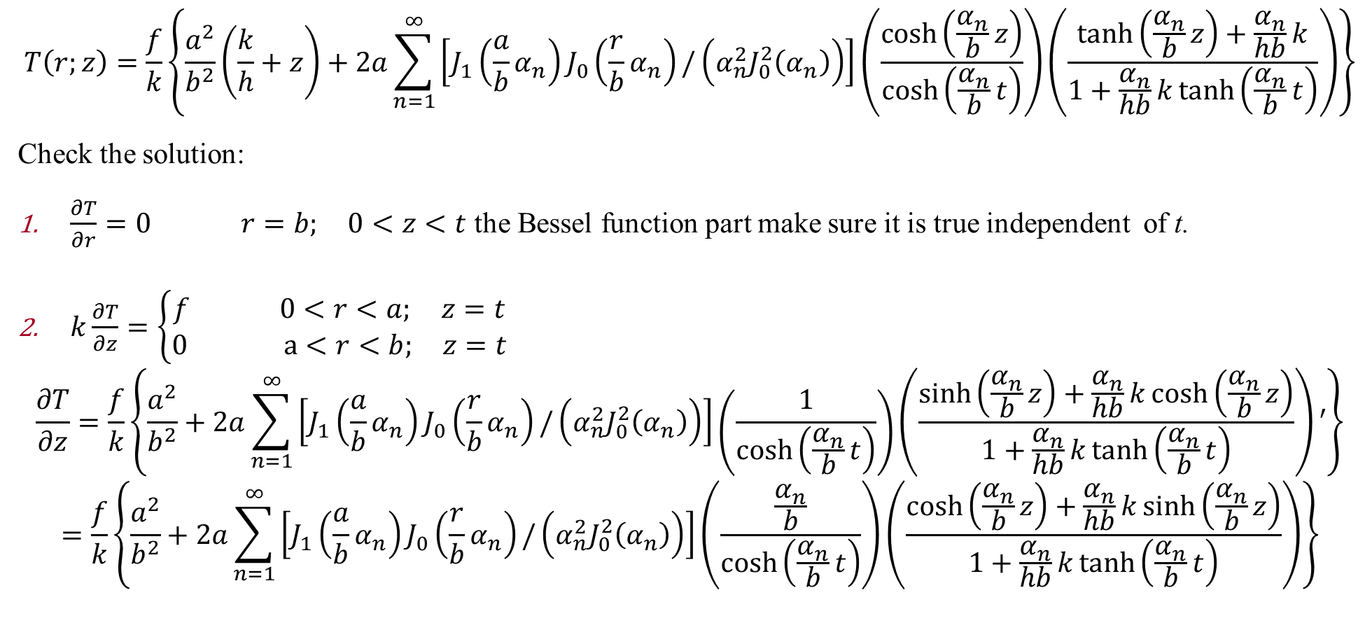
Solve equation
$$T\left(r;z\right)=\frac{f}{k}\left\{\frac{a^{2}}{b^{2}}\left(\frac{k}{h}+z\right)+2a\sum_{n=1}^{∞}{\left[J_{1}\left(\frac{a}{b}α_{n}\right)J_{0}\left(\frac{r}{b}α_{n}\right)/\left(α_{n}^{2}J_{0}^{2}\left(α_{n}\right)\right)\right]}\left(\frac{\cosh\left(\frac{α_{n}}{b}z\right)}{\cosh\left(\frac{α_{n}}{b}t\right)}\right)\left(\frac{\tanh\left(\frac{α_{n}}{b}z\right)+\frac{α_{n}}{hb}k}{1+\frac{α_{n}}{hb}k\tanh\left(\frac{α_{n}}{b}t\right)}\right)\right\}$$
Check the solution:
$\frac{∂T}{∂r}=0 r=b; 0<z<t$ the Bessel function part make sure it is true independent of t.
$k\frac{∂T}{∂z}=\left\{\begin{aligned}f 0<r<a; z=t \\ 0 a<r<b; z=t\end{aligned}\right.$
$$\frac{∂T}{∂z}=\frac{f}{k}\left\{\frac{a^{2}}{b^{2}}+2a\sum_{n=1}^{∞}{\left[J_{1}\left(\frac{a}{b}α_{n}\right)J_{0}\left(\frac{r}{b}α_{n}\right)/\left(α_{n}^{2}J_{0}^{2}\left(α_{n}\right)\right)\right]}\left(\frac{1}{\cosh\left(\frac{α_{n}}{b}t\right)}\right)\left(\frac{\sinh\left(\frac{α_{n}}{b}z\right)+\frac{α_{n}}{hb}k\cosh\left(\frac{α_{n}}{b}z\right)}{1+\frac{α_{n}}{hb}k\tanh\left(\frac{α_{n}}{b}t\right)}\right)′\right\}$$
$$=\frac{f}{k}\left\{\frac{a^{2}}{b^{2}}+2a\sum_{n=1}^{∞}{\left[J_{1}\left(\frac{a}{b}α_{n}\right)J_{0}\left(\frac{r}{b}α_{n}\right)/\left(α_{n}^{2}J_{0}^{2}\left(α_{n}\right)\right)\right]}\left(\frac{\frac{α_{n}}{b}}{\cosh\left(\frac{α_{n}}{b}t\right)}\right)\left(\frac{\cosh\left(\frac{α_{n}}{b}z\right)+\frac{α_{n}}{hb}k\sinh\left(\frac{α_{n}}{b}z\right)}{1+\frac{α_{n}}{hb}k\tanh\left(\frac{α_{n}}{b}t\right)}\right)\right\}$$

Slide 32
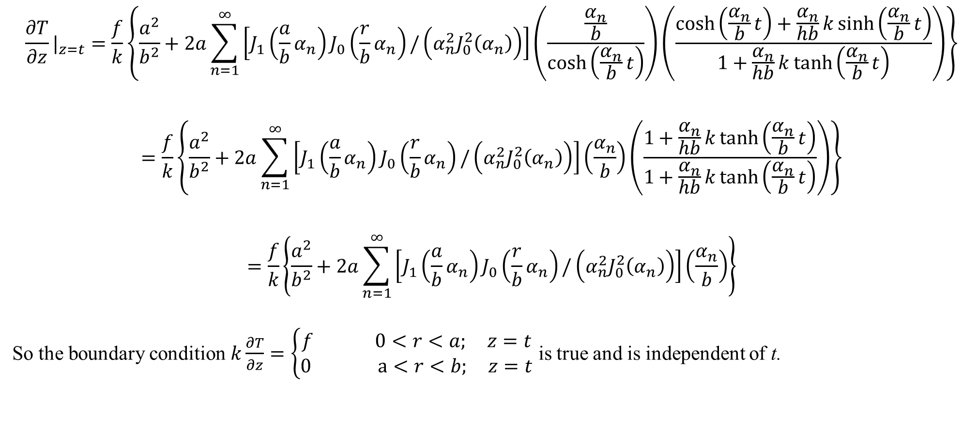
Solve equation
$${\frac{∂T}{∂z}|}_{z=t}=\frac{f}{k}\left\{\frac{a^{2}}{b^{2}}+2a\sum_{n=1}^{∞}{\left[J_{1}\left(\frac{a}{b}α_{n}\right)J_{0}\left(\frac{r}{b}α_{n}\right)/\left(α_{n}^{2}J_{0}^{2}\left(α_{n}\right)\right)\right]}\left(\frac{\frac{α_{n}}{b}}{\cosh\left(\frac{α_{n}}{b}t\right)}\right)\left(\frac{\cosh\left(\frac{α_{n}}{b}t\right)+\frac{α_{n}}{hb}k\sinh\left(\frac{α_{n}}{b}t\right)}{1+\frac{α_{n}}{hb}k\tanh\left(\frac{α_{n}}{b}t\right)}\right)\right\}$$
$$=\frac{f}{k}\left\{\frac{a^{2}}{b^{2}}+2a\sum_{n=1}^{∞}{\left[J_{1}\left(\frac{a}{b}α_{n}\right)J_{0}\left(\frac{r}{b}α_{n}\right)/\left(α_{n}^{2}J_{0}^{2}\left(α_{n}\right)\right)\right]}\left(\frac{α_{n}}{b}\right)\left(\frac{1+\frac{α_{n}}{hb}k\tanh\left(\frac{α_{n}}{b}t\right)}{1+\frac{α_{n}}{hb}k\tanh\left(\frac{α_{n}}{b}t\right)}\right)\right\}$$
$$=\frac{f}{k}\left\{\frac{a^{2}}{b^{2}}+2a\sum_{n=1}^{∞}{\left[J_{1}\left(\frac{a}{b}α_{n}\right)J_{0}\left(\frac{r}{b}α_{n}\right)/\left(α_{n}^{2}J_{0}^{2}\left(α_{n}\right)\right)\right]}\left(\frac{α_{n}}{b}\right)\right\}$$
So the boundary condition $k\frac{∂T}{∂z}=\left\{\begin{aligned}f 0<r<a; z=t \\ 0 a<r<b; z=t\end{aligned}\right.$ is true and is independent of t.

Slide 33
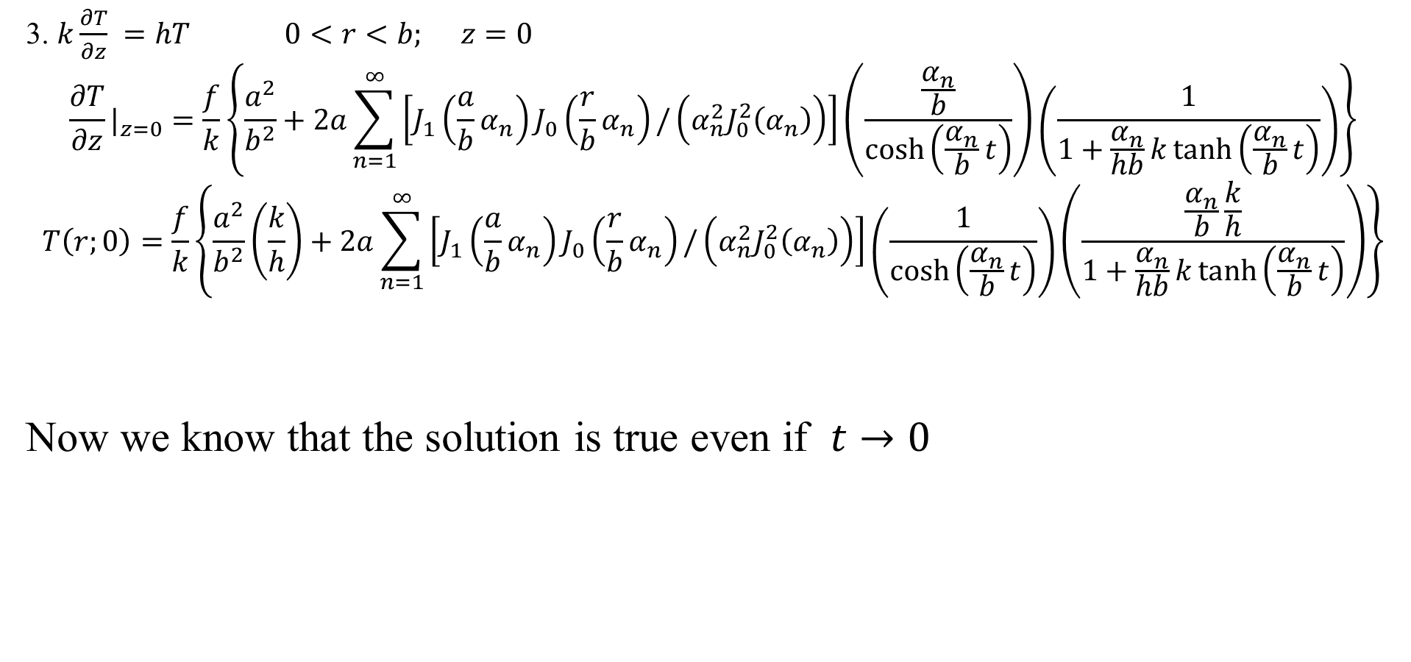
Solve equation
3. $k\frac{∂T}{∂z} =hT 0<r<b; z=0$
$${\frac{∂T}{∂z}|}_{z=0}=\frac{f}{k}\left\{\frac{a^{2}}{b^{2}}+2a\sum_{n=1}^{∞}{\left[J_{1}\left(\frac{a}{b}α_{n}\right)J_{0}\left(\frac{r}{b}α_{n}\right)/\left(α_{n}^{2}J_{0}^{2}\left(α_{n}\right)\right)\right]}\left(\frac{\frac{α_{n}}{b}}{\cosh\left(\frac{α_{n}}{b}t\right)}\right)\left(\frac{1}{1+\frac{α_{n}}{hb}k\tanh\left(\frac{α_{n}}{b}t\right)}\right)\right\}$$
$$T\left(r;0\right)=\frac{f}{k}\left\{\frac{a^{2}}{b^{2}}\left(\frac{k}{h}\right)+2a\sum_{n=1}^{∞}{\left[J_{1}\left(\frac{a}{b}α_{n}\right)J_{0}\left(\frac{r}{b}α_{n}\right)/\left(α_{n}^{2}J_{0}^{2}\left(α_{n}\right)\right)\right]}\left(\frac{1}{\cosh\left(\frac{α_{n}}{b}t\right)}\right)\left(\frac{\frac{α_{n}}{b}\frac{k}{h}}{1+\frac{α_{n}}{hb}k\tanh\left(\frac{α_{n}}{b}t\right)}\right)\right\}$$
Now we know that the solution is true even if $t→0$

Slide 34
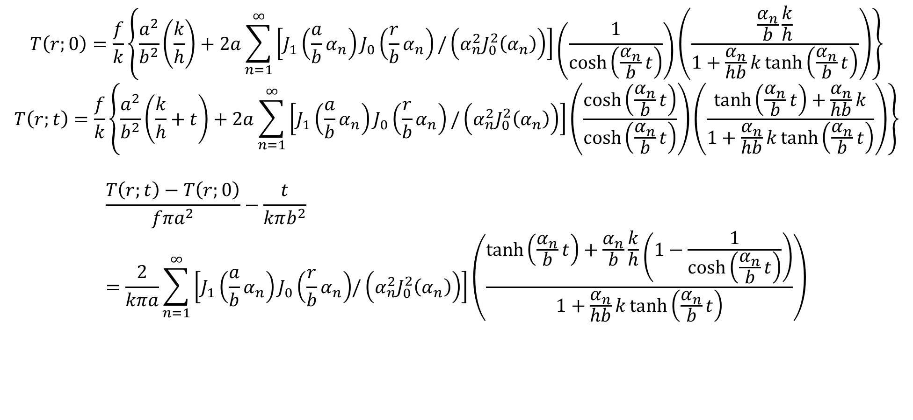
Spreading resistance
$$T\left(r;0\right)=\frac{f}{k}\left\{\frac{a^{2}}{b^{2}}\left(\frac{k}{h}\right)+2a\sum_{n=1}^{∞}{\left[J_{1}\left(\frac{a}{b}α_{n}\right)J_{0}\left(\frac{r}{b}α_{n}\right)/\left(α_{n}^{2}J_{0}^{2}\left(α_{n}\right)\right)\right]}\left(\frac{1}{\cosh\left(\frac{α_{n}}{b}t\right)}\right)\left(\frac{\frac{α_{n}}{b}\frac{k}{h}}{1+\frac{α_{n}}{hb}k\tanh\left(\frac{α_{n}}{b}t\right)}\right)\right\}$$
$$T\left(r;t\right)=\frac{f}{k}\left\{\frac{a^{2}}{b^{2}}\left(\frac{k}{h}+t\right)+2a\sum_{n=1}^{∞}{\left[J_{1}\left(\frac{a}{b}α_{n}\right)J_{0}\left(\frac{r}{b}α_{n}\right)/\left(α_{n}^{2}J_{0}^{2}\left(α_{n}\right)\right)\right]}\left(\frac{\cosh\left(\frac{α_{n}}{b}t\right)}{\cosh\left(\frac{α_{n}}{b}t\right)}\right)\left(\frac{\tanh\left(\frac{α_{n}}{b}t\right)+\frac{α_{n}}{hb}k}{1+\frac{α_{n}}{hb}k\tanh\left(\frac{α_{n}}{b}t\right)}\right)\right\}$$
$$\frac{T\left(r;t\right)−T\left(r;0\right)}{fπa^{2}}−\frac{t}{kπb^{2}}=\frac{2}{kπa}\sum_{n=1}^{∞}{\left[J_{1}\left(\frac{a}{b}α_{n}\right)J_{0}\left(\frac{r}{b}α_{n}\right){/\left(α_{n}^{2}J_{0}^{2}\left(α_{n}\right)\right)}\right]\left(\frac{\tanh\left(\frac{α_{n}}{b}t\right)+\frac{α_{n}}{b}\frac{k}{h}\left(1−\frac{1}{\cosh\left(\frac{α_{n}}{b}t\right)}\right)}{1+\frac{α_{n}}{hb}k\tanh\left(\frac{α_{n}}{b}t\right)}\right)}$$

Slide 35

$$T\left(r;t\right)=\frac{f}{k}\left\{\frac{a^{2}}{b^{2}}\left(\frac{k}{h}+t\right)+2a\sum_{n=1}^{∞}{\left[J_{1}\left(\frac{a}{b}α_{n}\right)J_{0}\left(\frac{r}{b}α_{n}\right)/\left(α_{n}^{2}J_{0}^{2}\left(α_{n}\right)\right)\right]}\left(\frac{\cosh\left(\frac{α_{n}}{b}t\right)}{\cosh\left(\frac{α_{n}}{b}t\right)}\right)\left(\frac{\tanh\left(\frac{α_{n}}{b}t\right)+\frac{α_{n}}{hb}k}{1+\frac{α_{n}}{hb}k\tanh\left(\frac{α_{n}}{b}t\right)}\right)\right\}$$

