Slide 1
Sample 1

Slide 2
Sample 2

Slide 3
Sample 3

Slide 5
Evaporation rate

Slide 6
Prediction temperature and IR camera temperature

Slide 7
Evaporation ratio from the droplet base

Slide 8
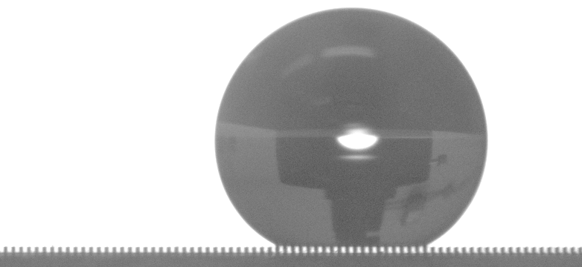
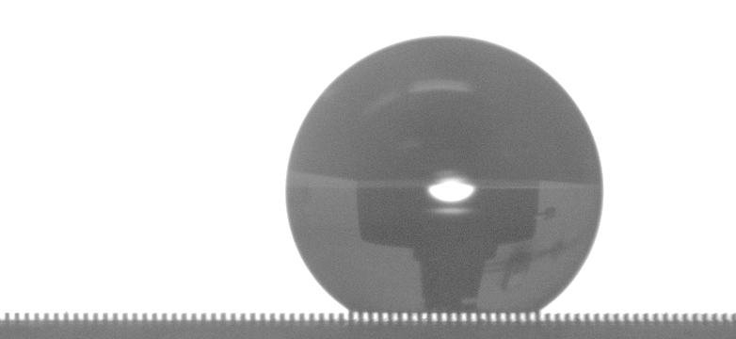
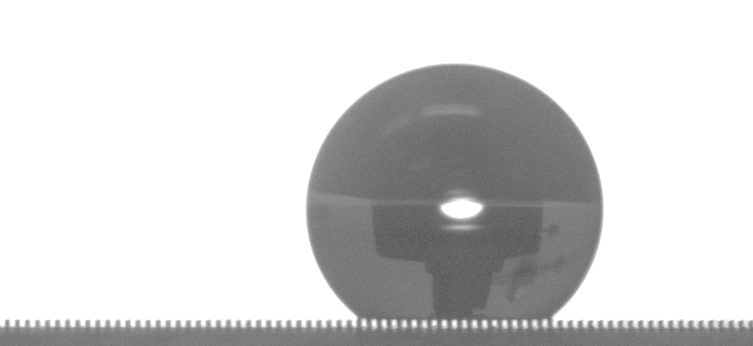
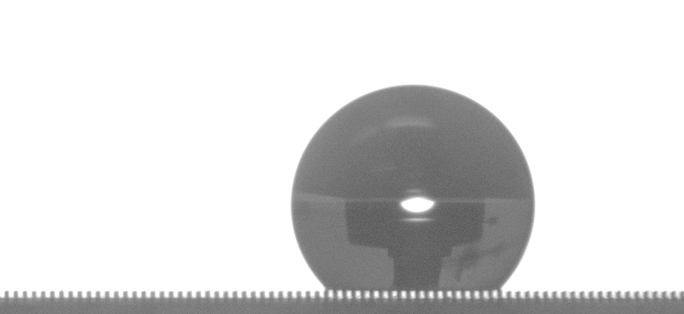


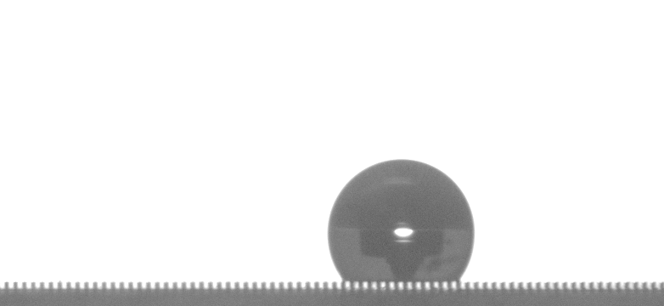





0.5 mm
Cassie state
t = 0 s
t = 10 s
t = 20 s
t = 30 s
t = 40 s
t = 50 s
t = 60 s
t = 70 s
Wenzel state
t = 76 s
t = 78 s
t = 79.5 s
t = 79.85 s

