Slide 1
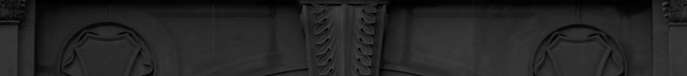


CS4352 Operating Systems
Lecture 1
Instructor: Tommy Dang, Ph.D.
Assistant Professor
Department of Computer Science
Texas Tech University

Slide 2
What Is An Operating System (1)
A modern computer consists of:
One or more processors
Main memory
Disks
Printers
Various input/output devices
Managing all these components requires a layer of software – the operating system
Not a shell/GUI (Graphical User Interface)

Slide 3
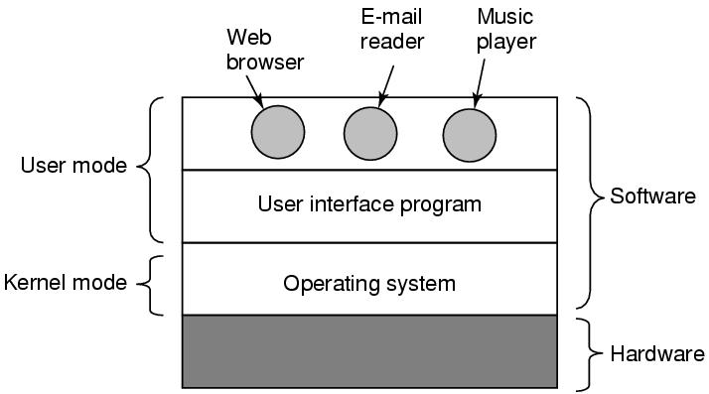
What Is An Operating System (2)
Figure 1-1. Where the operating system fits in.

Slide 4
Roles of An Operating System
Perform two basic functions:
Providing application programmers a clean abstract set of resources instead of the messy hardware ones (“extended machine”)
Managing hardware resources (“resource manager”)

Slide 5
Operating System as an Extended Machine (1)
Computer architecture at the machine language level is primitive and awkward to programmers
Instruction set
Memory organization
I/O
Bus structure
A simple, high-level abstraction desired
E.g. a collection of named files for read/write/close

Slide 6
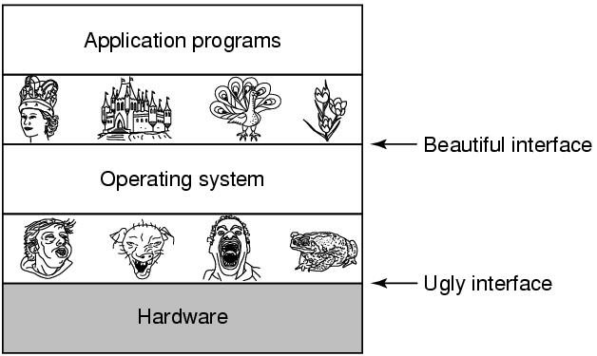
Operating System as an Extended Machine (2)
Hide the hardware ugly details and present programs (and their programmers)
with nice, clean, elegant, and consistent abstractions
Figure 1-2. Operating systems turn ugly hardware into beautiful abstractions.

Slide 7
Operating System as a Resource Manager (1)
A top-down view: OS as providing abstractions
A bottom-up view: OS manages all the pieces of resources
Processors, memories, timers, disks, networks, printers, etc.
Provide an orderly and controlled allocation for competing apps
E.g. a printer shared by multiple programs
E.g. memory and disks shared by multiple users

Slide 8
Operating System as a Resource Manager (2)
Managing and sharing (multiplexing) resources in two different ways
In time – time multiplexing
Multiple programs share a single CPU
In space – space multiplexing
Main memory and hard disks shared by multiple programs/users

Slide 9
History of Operating Systems (1)
Charles Babbage (1792-1871) had thought of an “operating system software” for his “analytical engine”, the first true digital computer
A young woman named Ada Lovelace was hired as the world's first programmer for this
The programming language Ada® is named after her

Slide 10
History of Operating Systems (2)
Generations:
(1945–55) Vacuum Tubes
(1955–65) Transistors and Batch Systems
(1965–1980) ICs and Multiprogramming
(1980–Present) Personal Computers

Slide 11
Vacuum Tubes Generation
Digital computers were largely tried during WWII
Operating system doesn’t really exist yet
The usual mode of operation was:
The programmer sign up for a block of time using the signup sheet
Come down to the machine room, insert his or her plugboard
Spend the next few hours hoping that none of the 20,000 or so vacuum tubes would burn out during the run
Seconds spent even for the simplest calculation

Slide 12
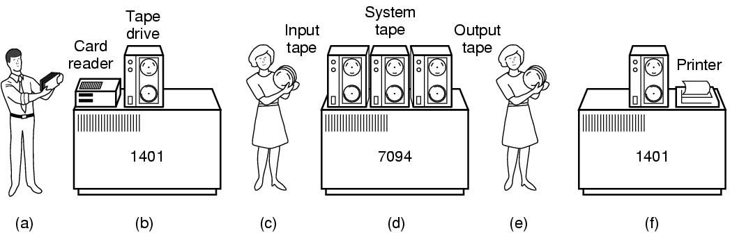
Transistors and Batch Systems
“Mainframes”
Mostly used for scientific/engineering calculations, e.g. solving partial differential equations (Fortran/assembly)
Figure 1-3. An early batch system. (a) Programmers bring cards to 1401. (b)1401 reads batch of jobs onto tape. (c) Operator carries input tape to 7094. (d) 7094 does computing. (e) Operator carries output tape to 1401. (f) 1401 prints output.

Slide 13
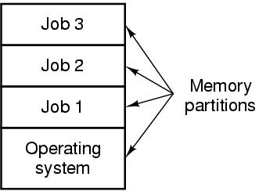
ICs and Multiprogramming
By early 1960s, two product lines of word-oriented scientific computers and character-oriented commercial ones
IBM System/360, OS/360
1st major computer line using ICs
“one family” idea
Multiprogramming idea
CTSS/MULTICS: timesharing
Compatible Time Sharing System
Multiplexed Information & Computing Serv.
Multiuser/computer utility
Minicomputers DEC PDP series
Lead to Unix from PDP-7 Ken Thompson/Dennis Ritchie, 1969
Figure 1-5. A multiprogramming system with three jobs in memory.
Notes:
But OS/360 became heavy too

Slide 14
Personal Computers
Large scale integration circuits lead to radical changes
Personal computers/microcomputers
Intel 8080 first general-purpose 8-bit CPU in 1974
A disk-based OS CP/M (control program for microcomputers)
IBM PC debuted early 1980s
DOS (Disk Operating System) /MS-DOS
Apple Macintosh with GUI
Originated from Xerox PARC machines and Stanford Research Inst.
Windows (based on MS-DOS), 95/98/NT/2000/XP/Vista/7/8
Unix (System V/BSD/Solaris), Linux, X Window GUI (X11)
Network Operating Systems/Distributed Operating Systems

Slide 15
Readings
Chapter 1
Section 1.1
Section 1.2

Slide 16
Questions? Questions/Suggestions/Comments are always welcome! Write me: yong.chen@ttu.edu Call me: 806-834-0284 See me: ENGCTR 315

