Slide 1



CS4352 Operating Systems
Lecture 5
Instructor: Tommy Dang, Ph.D.
Assistant Professor
Department of Computer Science
Texas Tech University

Slide 2
Outline
Questions?
Processes
Process model
Process creation, termination, hierarchy, states
Implementation of processes
Modeling multiprogramming
Threads
Thread usage
Thread model
POSIX Threads

Slide 3
Processes
Process: a running program, associated with all resources
Address space
Registers
Open files
Etc.
A program running twice (two “instances”) creates two processes (can possibly share the text segment)
Abstraction supports multiprogramming
Support pseudo concurrent operation even on single (uni-core) CPU
“pseudoparallelism”
Notes:
What is a true parallelism?
In this lecture, we assume there is only 1 CPU.

Slide 4
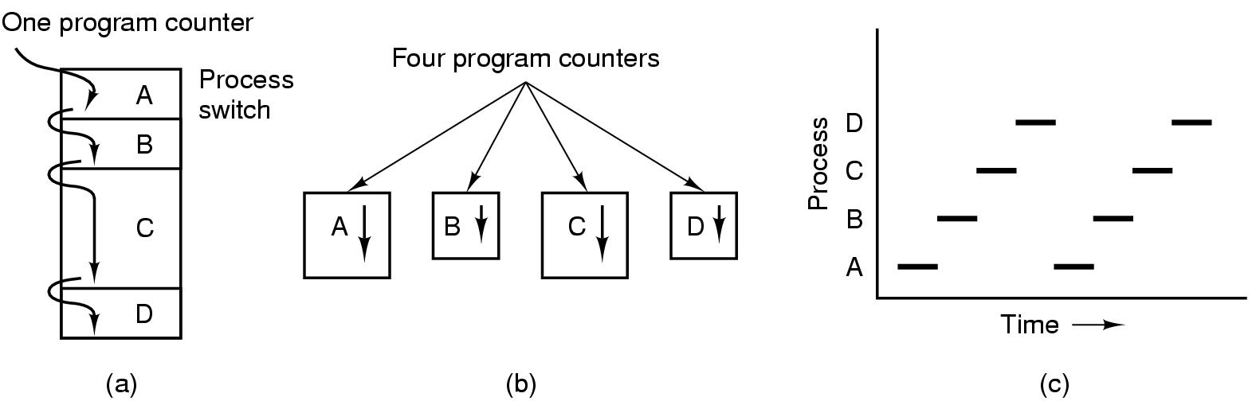
The Process Model
Figure 2-1. (a) Multiprogramming of four programs. (b) Conceptual model of four independent, sequential processes. (c) Only one program is active at once.
Notes:
(c): Vertical line meet only 1 line. How about the case of multicore?

Slide 5
Process Creation
Four primary events causing processes to be created
System initialization
Execution of a process creation system call by a running process
A user request to create a new process
Initiation of a batch job (job queue)
Technically a new process is created by having an existing process execute a process creation system call
Unix: fork()
Windows: CreateProcess()
foreground processes
background processes (daemons)
$ ps

Slide 6
Process Termination
Conditions
Normal exit (voluntary)
Error exit (voluntary)
Fatal error (involuntary)
Killed by another process (involuntary)
Unix: kill() with SIGKILL
Windows: TerminateProcess()
Notes:
Normal: when the program is done. For example, in C
Error: program bugs. Segmentation faults, out of heap, divide by 0.
Fatal: Compile/Execute a file that does not exist.
Kill: Kill live-server or using Activity monitor

Slide 7
Process Hierarchies
Processes not necessarily organized in a hierarchy structure
Unix:
Processes organized in a hierarchical way
All processes are descendants of an init process
Windows:
No concept of process hierarchy; processes are equal

Slide 8
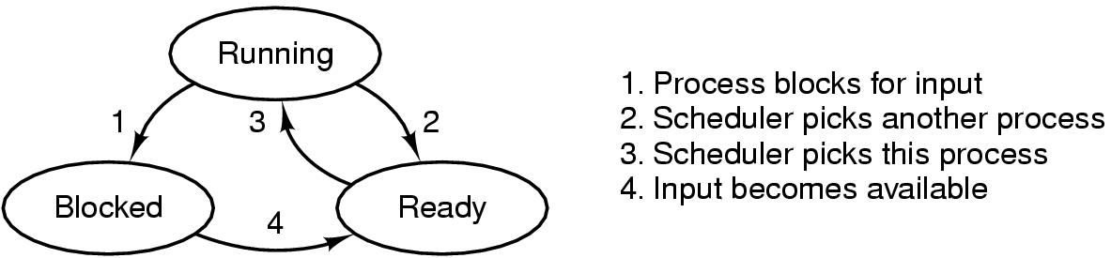
Process States
Process scheduler
Figure 2-2. A process can be in running, blocked, or ready state. Transitions between these states are as shown.
Notes:
From Running, what is the difference between 1 and 2
Can we go from Blocked to Running?
Can we go from ready to blocked?

Slide 9
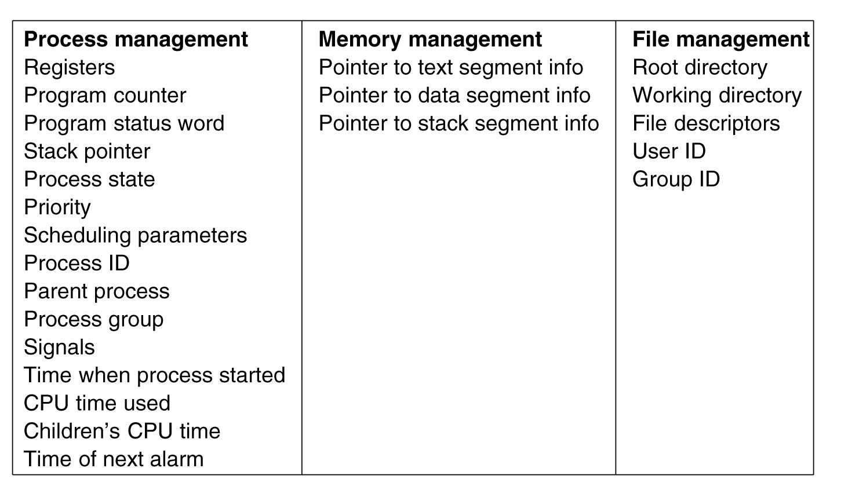
Implementation of Processes
Process table or Process Control Blocks (PCB) table
Figure 2-4. Some of the fields of a typical process table entry.

Slide 10
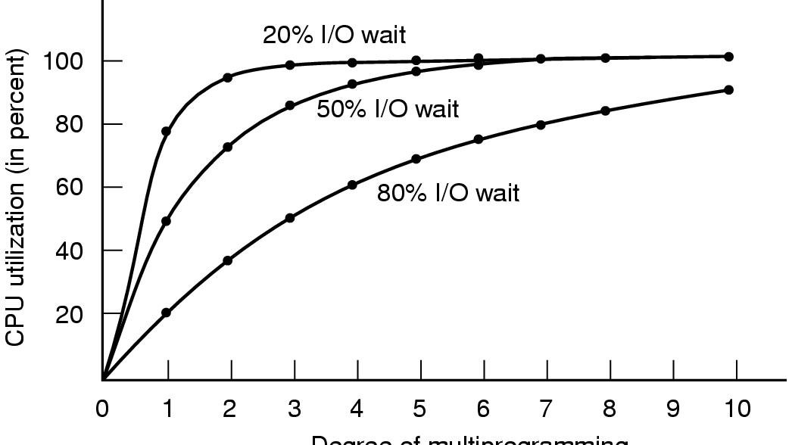
Modeling Multiprogramming (1)
CPU utilization = 1 – p^{n}
p: I/O fraction time
n: number of processes
Assuming processes are independent (e.g. without scheduling conflict)
Degree of multiprogramming
Figure 2-6. CPU utilization as a function of the number of processes in memory.
Notes:
With 50% I/O for 2 processes, what is the wait time?
In this figure, How many processes do we need to keep the waste time of CPU less than 10%.
Use the Graph and Formula

Slide 11
Modeling Multiprogramming (2)
Approximate predictions about CPU utilization, e.g.
A computer has 512 MB of memory, with OS taking up 128 MB and each user program also taking up 128 MB
3 user programs to be in memory at once
With an 80% average IO wait, a CPU utilization of x?
Adding another 512 MB allows the system to go from three-way multiprogramming to seven-way multiprogramming, CPU: ~79%
Adding yet another 512 MB would only increase CPU utilization from 79% to 91% (only 12%)

Slide 12
Modeling Multiprogramming (2)
Approximate predictions about CPU utilization, e.g.
A computer has 512 MB of memory, with OS taking up 128 MB and each user program also taking up 128 MB
3 user programs to be in memory at once
With an 80% average IO wait, a CPU utilization of 1 - 0.8³ or ~49%
Adding another 512 MB allows the system to go from three-way multiprogramming to seven-way multiprogramming, CPU: y?
Adding yet another 512 MB would only increase CPU utilization from 79% to 91% (only 12%)

Slide 13
Modeling Multiprogramming (2)
Approximate predictions about CPU utilization, e.g.
A computer has 512 MB of memory, with OS taking up 128 MB and each user program also taking up 128 MB
3 user programs to be in memory at once
With an 80% average IO wait, a CPU utilization of 1 - 0.8³ or ~49%
Adding another 512 MB allows the system to go from three-way multiprogramming to seven-way multiprogramming, CPU: ~79%
Adding yet another 512 MB would only increase CPU utilization from 79% to z%

Slide 14
Modeling Multiprogramming (2)
Approximate predictions about CPU utilization, e.g.
A computer has 512 MB of memory, with OS taking up 128 MB and each user program also taking up 128 MB
3 user programs to be in memory at once
With an 80% average IO wait, a CPU utilization of 1 - 0.8³ or ~49%
Adding another 512 MB allows the system to go from three-way multiprogramming to seven-way multiprogramming, CPU: ~79%
Adding yet another 512 MB would only increase CPU utilization from 79% to 91% (only 12%)

Slide 15
Outline
Questions?
Processes
Process model
Process creation, termination, hierarchy, states
Implementation of processes
Modeling multiprogramming
Threads
Thread usage
Thread model
POSIX Threads

Slide 16
Readings
Chapter 2:
Section 2.1
Section 2.2

