Slide 1



CS4352 Operating Systems
Lecture 6
Instructor: Tommy Dang, Ph.D.
Assistant Professor
Department of Computer Science
Texas Tech University

Slide 2
Outline
Questions?
Threads
Thread usage
Thread model
POSIX Threads
Implementation of Threads
In user space
In kernel space

Slide 3
Threads
Threads: lightweight processes
Multiple threads of control but share an address space
Why threads are desired?
Ability of share an address space and data
Lightweight and easier to create and destroy (creating a thread is 10 to 100 times faster than creating a process)
Performance gain for mixed computing and I/O (higher degree of parallelism)
Map to multithreaded/multicore processors

Slide 4
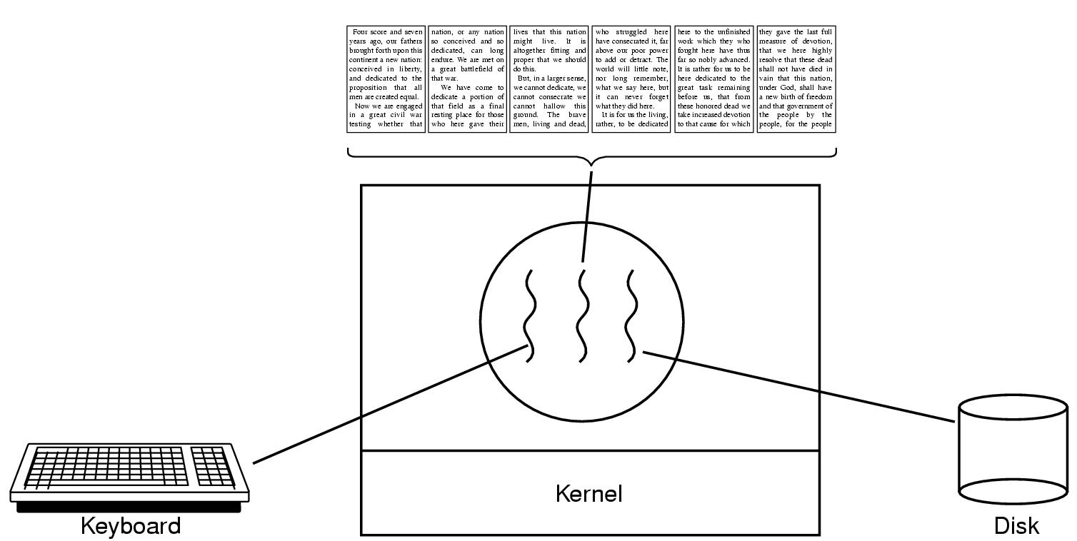
Thread Usage (1)
Figure 2-7. A word processor with three threads.
Notes:
1) With three threads, the programming model is much simpler. The first thread just inter- acts with the user. The second thread reformats the document when told to. The third thread writes the contents of RAM to disk periodically.
2) If the program were single-threaded, then whenever a disk backup started, commands from the keyboard and mouse would be ignored until the backup was finished.
3) It should be clear that having three separate processes would not work here be- cause all three threads need to operate on the document. By having three threads instead of three processes, they share a common memory and thus all have access to the document being edited. With three processes this would be impossible.

Slide 5
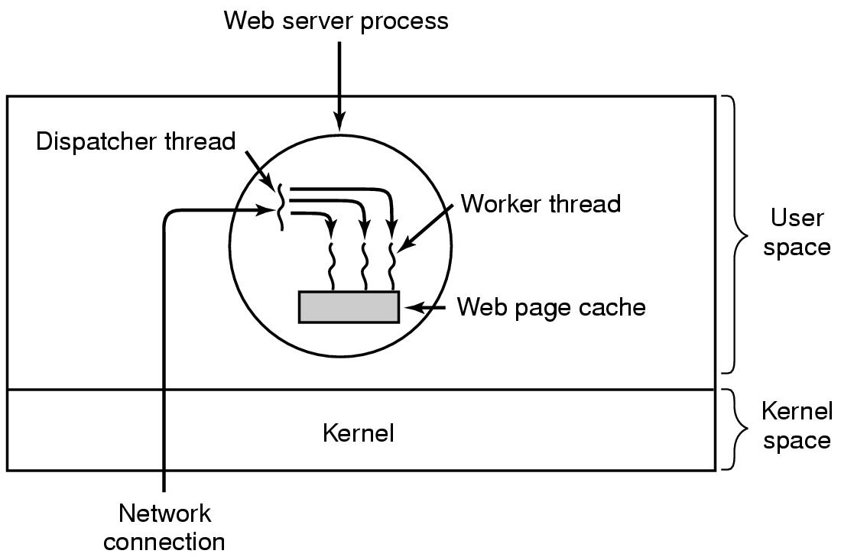
Thread Usage (2)
Figure 2-8. A multithreaded Web server.
Notes:
Why do we need cache?
Multiple threads can share global variables. For ex, number of accepted html requests.
Consider how the Web server could be written in the absence of threads.
One possibility is to have it operate as a single thread. The main loop of the Web server gets a request, examines it, and carries it out to completion before getting the next one.
While waiting for the disk, the server is idle and does not process any other incoming requests.

Slide 6
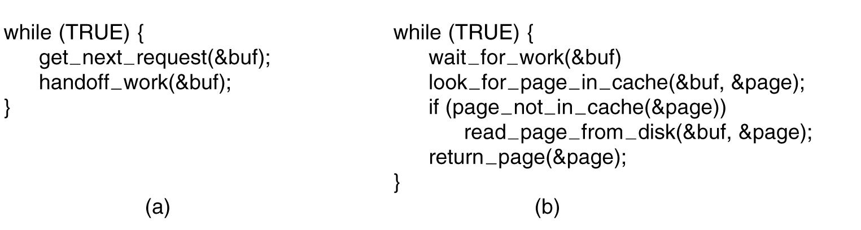
Thread Usage (3)
Figure 2-9. A rough outline of the code for Fig. 2-8. (a) Dispatcher thread. (b) Worker thread.

Slide 7
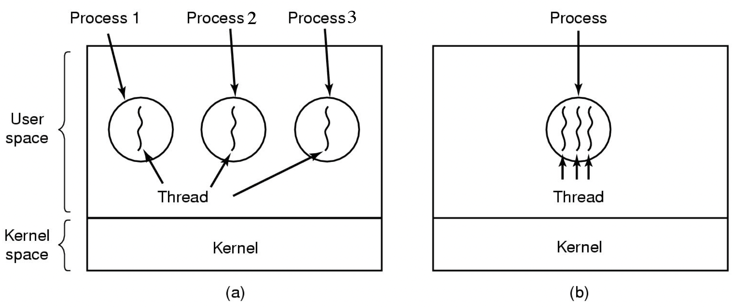
The Classical Thread Model (1)
Process model: different resources and different executions
Thread model: same resources and different executions
Figure 2-11. (a) Three processes each with one thread. (b) One process with three threads.
Notes:
How many processes/threads in Figure (a)?
How many processes/threads in Figure (b)?
Can the number of processes > the number of threads?
Although a thread must execute in some process, the thread and its process are different concepts and can be treated separately. Processes are used to group resources together; threads are the entities scheduled for execution on the CPU.
Threads of a process share same global variables.

Slide 8
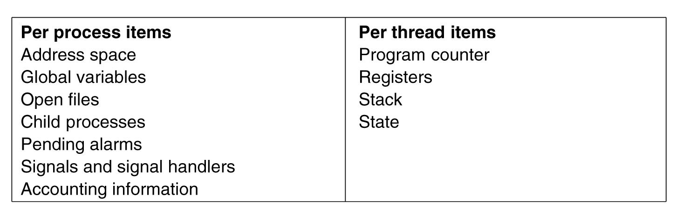
The Classical Thread Model (2)
Figure 2-12. The first column lists some items shared by all threads in a process. The second one lists some items private to each thread.
Notes:
Why don’t we protect global variables or address space? Because if we protect -> multi processes

Slide 9
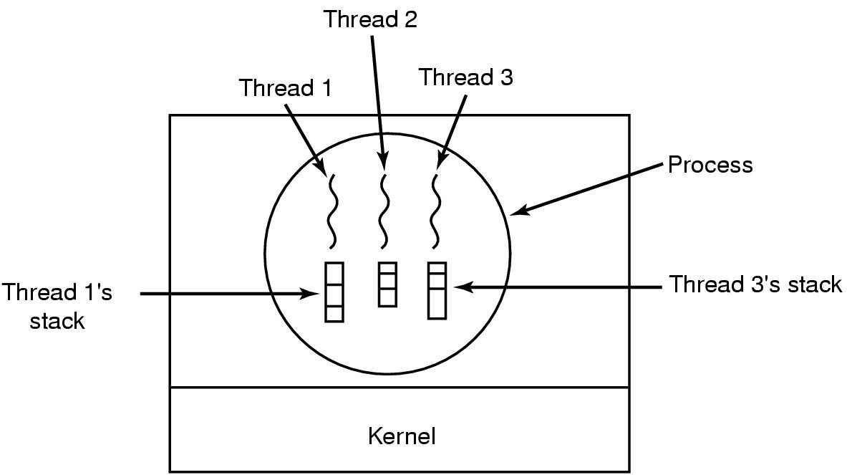
The Classical Thread Model (3)
Figure 2-13. Each thread has its own stack.
Notes:
Why each thread needs its own stack?
-> Each thread will generally call different procedures and thus have a different execution history.

Slide 10
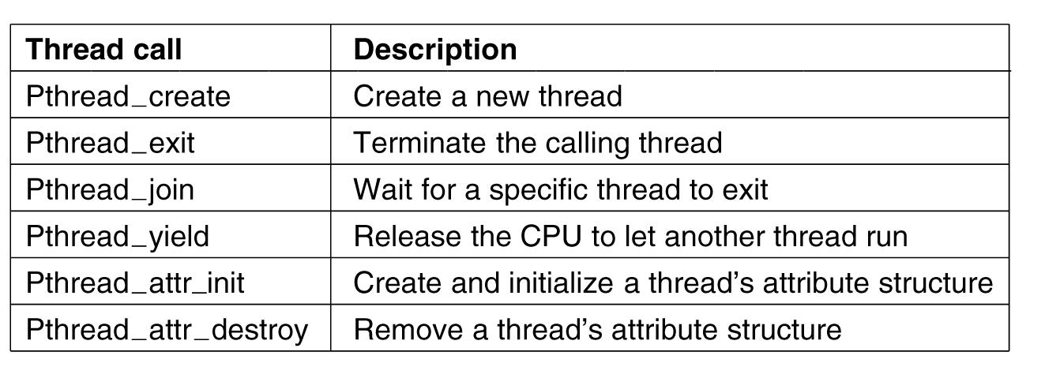
POSIX Threads
IEEE standard 1003.1c defines a standard for threads
Part of POSIX standard family, Pthreads
Figure 2-14. Some of the Pthreads function calls.

Slide 11
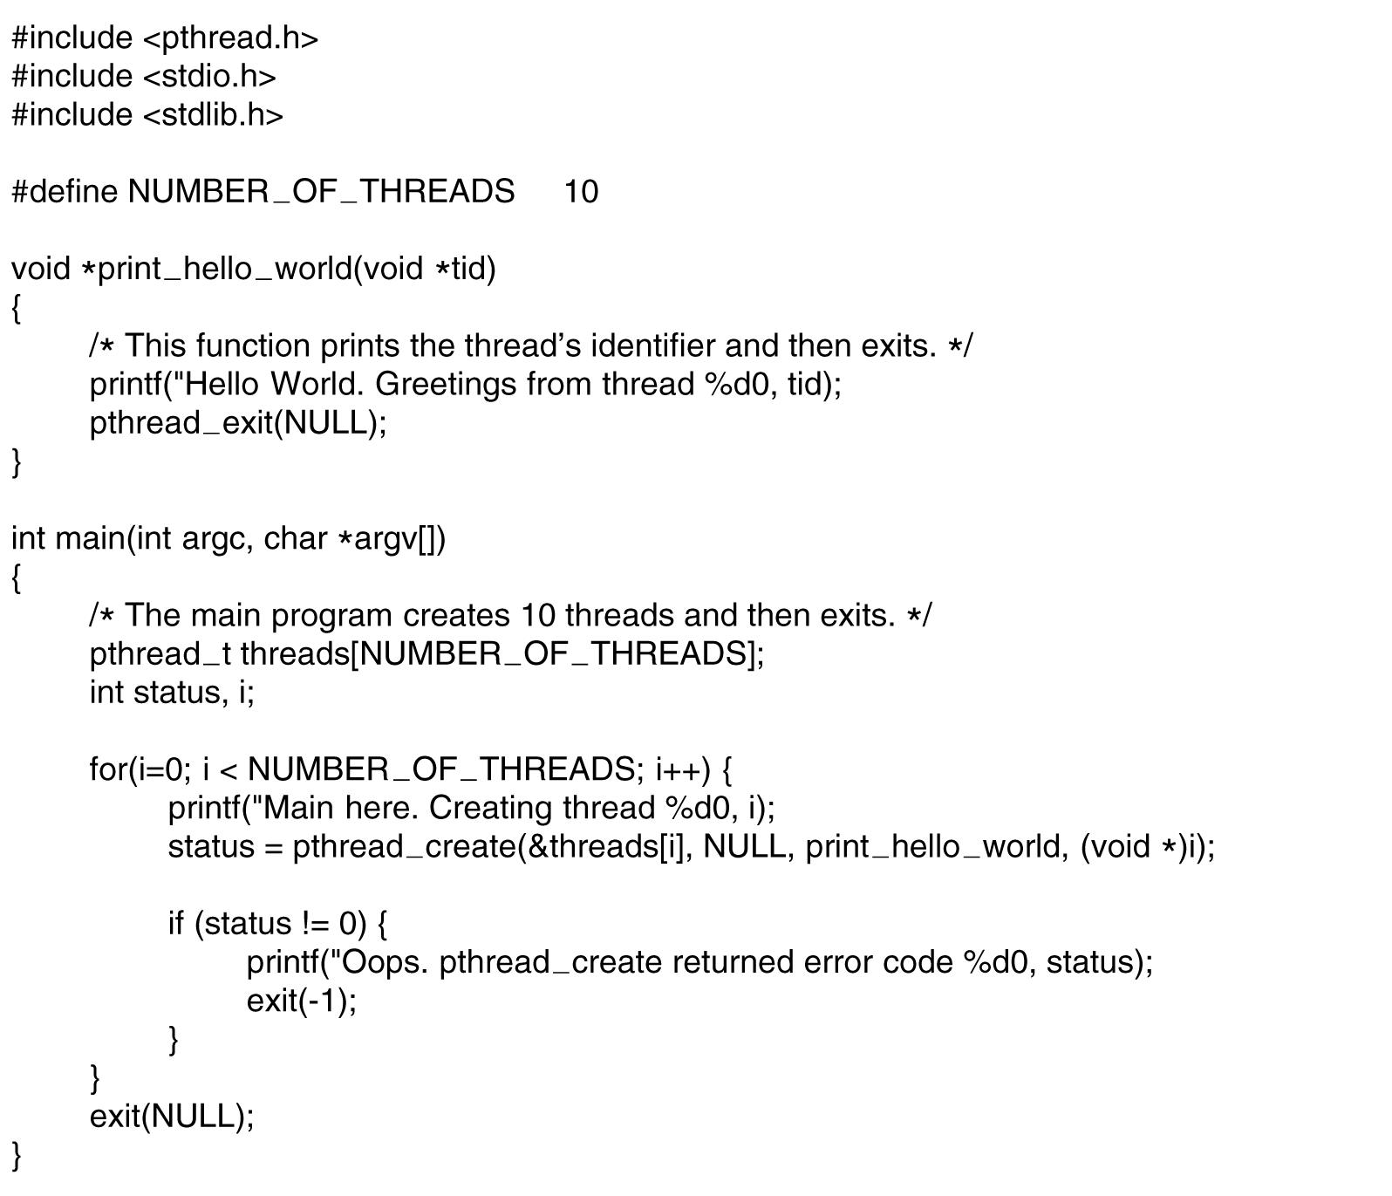
POSIX Threads (2)
Figure 2-15. An example program using threads.
Notes:
In the different runs, the order of thread ids are different.

Slide 12
Outline
Questions?
Threads
Thread usage
Thread model
POSIX Threads
Implementation of Threads
In user space
In kernel space

Slide 13
Implementation of Threads
Ways of implementing threads
In user space
In kernel
Advantages, disadvantages

Slide 14
Implementing Threads in User Space (1)
In user space
Entirely in user space, kernel knows nothing
Kernel manages ordinary single-threaded processes
User-level threads can be implemented on an operating system that does not support threads (in kernel)

Slide 15
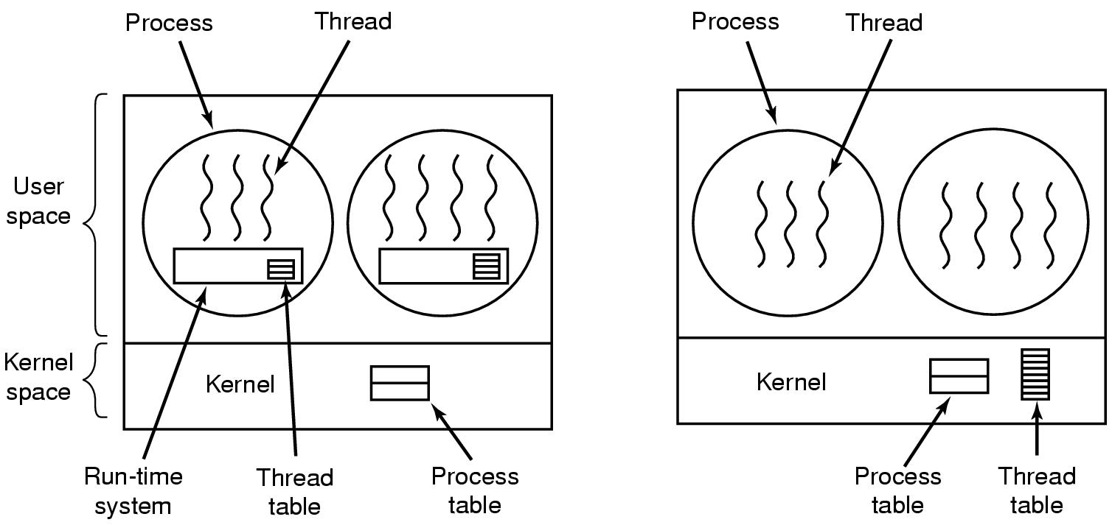
Implementing Threads in User Space (2)
Figure 2-16. (a) A user-level threads package

Slide 16
Implementing Threads in User Space (3)
Advantages
Fast thread switching than trapping to the kernel (an order of magnitude faster normally)
Each process can have its own customized scheduling algorithm
Disadvantages
Blocking system calls
Page faults (detailed discussion when studying chapter 3)
Limited performance gain for CPU bound applications
Notes:
Fast thread switching because no trap, not context switching, no cached memory flushed.
For applications that are essentially entirely CPU bound and rarely block, what is the point of having threads at all? No one would seriously propose computing the first n prime numbers or playing chess using threads because there is nothing to be gained by doing it that way.

Slide 17
Implementing Threads in Kernel Space (1)
In kernel space
No run-time system and thread table needed in each process
Kernel manages a thread table keeping track of threads
Thread table holds the same info as with user-level threads

Slide 18
Implementing Threads in Kernel Space (2)
Figure 2-16. (b) A threads package managed by the kernel.

Slide 19
Implementing Threads in Kernel Space (3)
Advantages
When a thread blocks, the kernel can schedule another thread from the same process (if ready) or a thread from a different process to run
No new nonblocking system calls required (including dealing with page faults)
Performance gain
Disadvantages
Higher cost of creating/destroying threads (system calls)
Notes:
Other issues remain, e.g. multithreaded process forks/signals

Slide 20
Readings
Chapter 2:
Section 2.2

