Slide 1



CS4352 Operating Systems
Lecture 7
Instructor: Tommy Dang, Ph.D.
Assistant Professor
Department of Computer Science
Texas Tech University

Slide 2
Outline
Questions?
InterProcess Communication
Race conditions
Critical regions
Semaphores
Mutexes
Monitors
Message passing
Barriers

Slide 3
Interprocess Communication
InterProcess Communication (IPC)
How one process passes information to another
How to avoid conflicts/contention
How to ensure proper sequencing when dependencies are present
Apply to threads too (though threads share the address space and data naturally)
Notes:
Conflicts: Threads for booking tickets online and only one left.
InterProcess Communication (IPC)
E.g. pipe

Slide 4
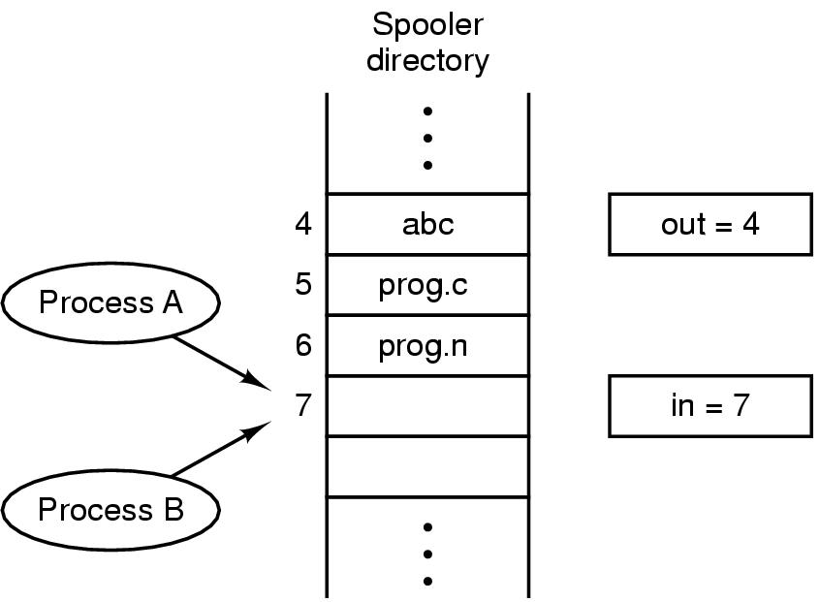
Race Conditions
In IPC, where two or more processes read/write some shared data, if the final result depends on who runs precisely when, such a situation is called race conditions
Figure 2-21. Two processes want to access shared memory at the same time.

Slide 5
Critical Regions (1)
Mutual exclusion needed to avoid race conditions
Applies to shared memory, shared files, and shared everything else
Part of the program where shared resources are accessed is called the critical region or critical section
No two processes may be simultaneously inside their critical regions.
No assumptions may be made about speeds or the number of CPUs.
No process running outside its critical region may block other processes.
No process should have to wait forever to enter its critical region.
Notes:
Mutual exclusion make sure that if 1 process use a shared file/variable, other processes will be excluded from doing the same thing.

Slide 6
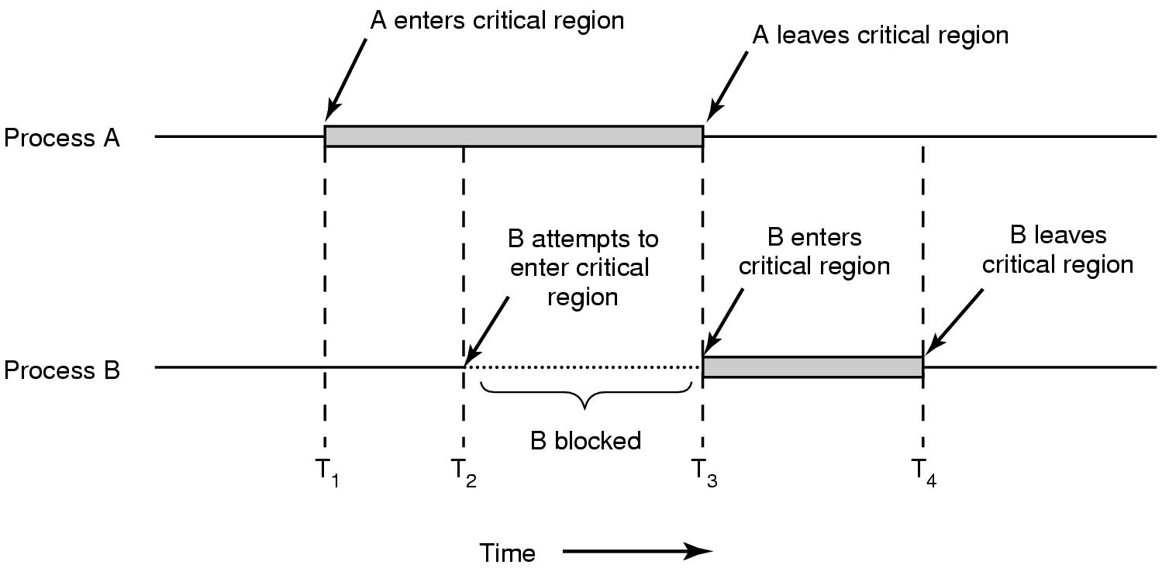
Critical Regions (2)
Figure 2-22. Mutual exclusion using critical regions.

Slide 7
Mutual Exclusion with Busy Waiting
Proposals for achieving mutual exclusion:
Disabling interrupts (doesn’t work for multicore chips. Why?)
Lock variables (set the lock variable to 1 when after entering. What problem?)
Strict alternation
Peterson's solution
The TSL/XCHG instruction
Notes:
Disabling interrupts: unattractive to give control to user processes? Since it can disable interrupts and run forever.
Disabling interrupts can be used in OS, for example to save data to a process table.

Slide 8
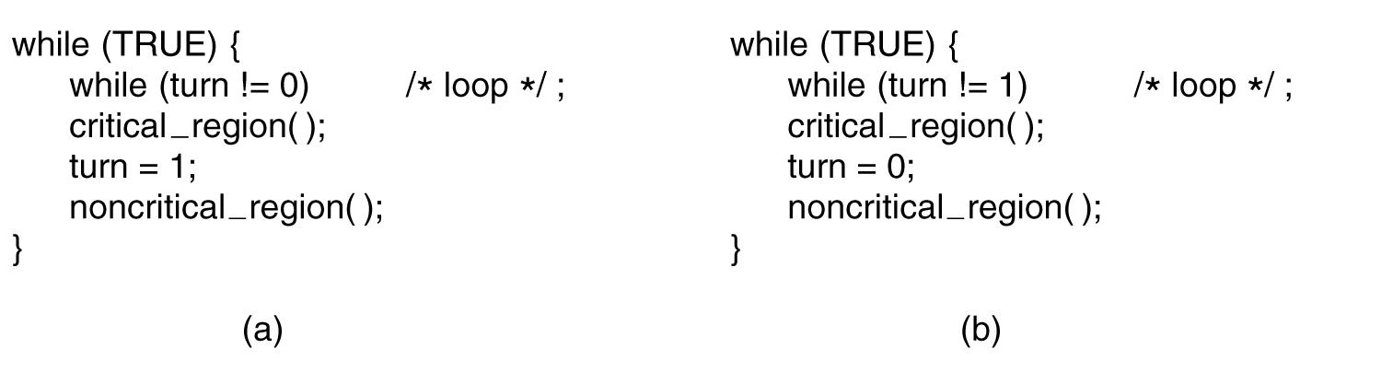
Strict Alternation
Busy waiting
Spin lock
Figure 2-23. A proposed solution to the critical region problem. (a) Process 0. (b) Process 1. In both cases, be sure to note the semicolons terminating the while statements.
Notes:
This is called bus waiting. This should be avoid since wasting CPU.
This also violate condition 3. Why?

Slide 9
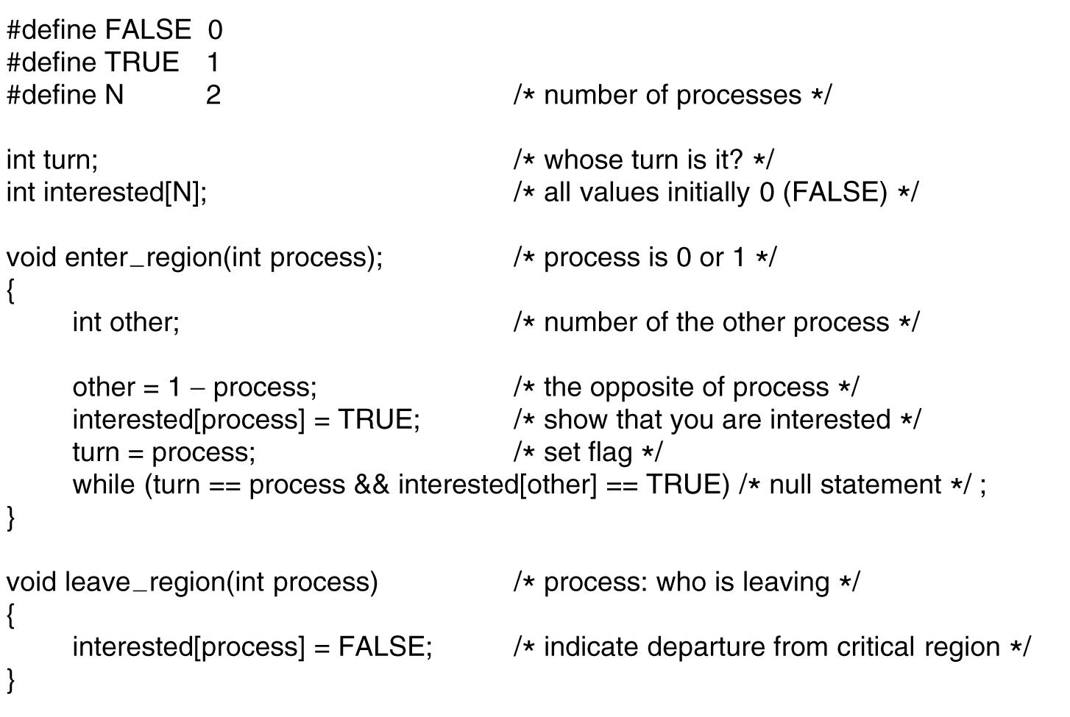
Peterson's Solution
Figure 2-24. Peterson’s solution for achieving mutual exclusion.

Slide 10
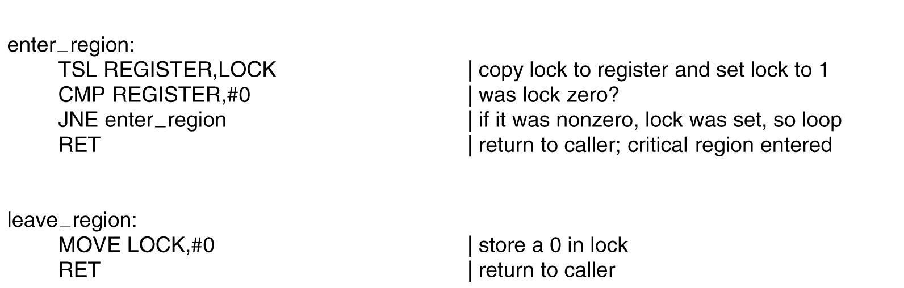
The TSL Instruction
Figure 2-25. Entering and leaving a critical region using the TSL instruction.
Notes:
TSL is indivisible.

Slide 11
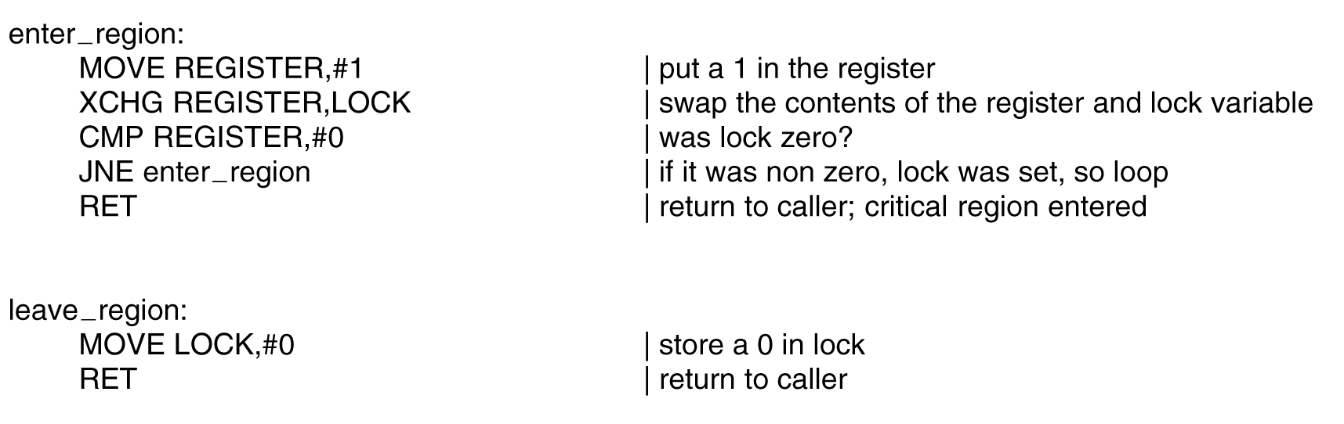
The XCHG Instruction
Figure 2-26. Entering and leaving a critical region using the XCHG instruction.
Notes:
Similar to TSL but swap memory content

Slide 12
Sleep and Wakeup
Previous solutions have the defect of requiring busy waiting
If an entry not allowed, sits in a tight loop waiting until it is
Wastes CPU cycles
IPC primitives block (and release CPU) instead of wasting CPU cycles
Sleep: a system call causes the caller to block and release CPU until another process wakes it up
Wakeup: a system call wakes up another process
Notes:
Sleep and wakeup are not part of standard C, but presumably we have these system calls

Slide 13
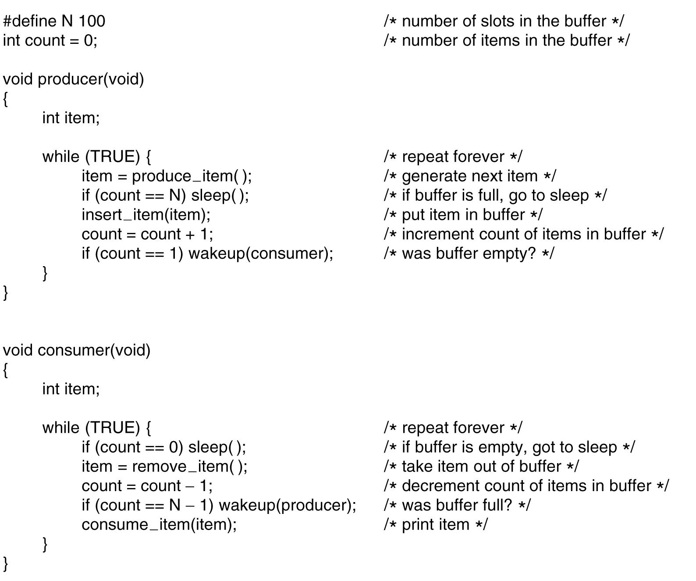
The Producer-Consumer Problem
Figure 2-27. The producer-consumer problem with a fatal race condition.
Notes:
What problem? When count==0 then consumer decide to sleep, but before he sleeps the producer try to wake him up -> he still sleep since he did not know.

Slide 14
Semaphores (1)
Introduced by E. W. Dijkstra in 1965
A variable type semaphore (integer) to count # of wakeups
“down” operation: decrements if greater than 0 (uses one stored wakeup) or sleep if the value is 0
“up” operation: increments the value and one of sleeping processes waken up to complete its down
Both operations completed as a single indivisible atomic action
Also referred as P and V operations
P: Proberen (try), V: Verhogen (raise, make higher)

Slide 15
Semaphores (2)
“up” and “down” are usually implemented as system calls
With the OS briefly disabling all interrupts while testing the semaphore, updating, putting the process to sleep if needed

Slide 16
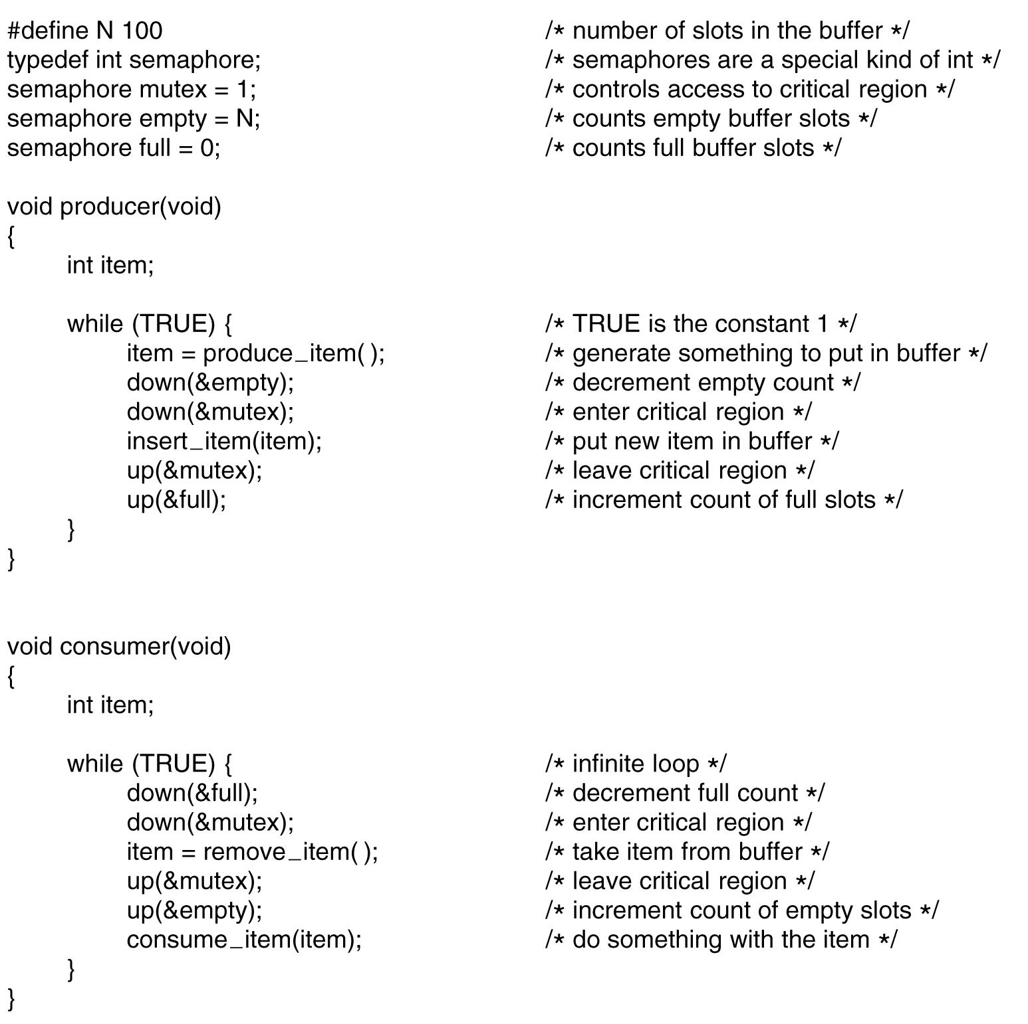
Three semaphores, full, empty, and mutex
full and empty are used for synchronization
mutex used for mutual exclusion
Can cause “deadlock” if the order switched
Figure 2-28. The producer-consumer problem using semaphores.

Slide 17
Readings
Chapter 2:
Section 2.3

Slide 18
Questions? Questions/Suggestions/Comments are always welcome! Write me: yong.chen@ttu.edu Call me: 806-834-0284 See me: ENGCTR 315

