Slide 1



CS4352 Operating Systems
Lecture 8
Instructor: Tommy Dang, Ph.D.
Assistant Professor
Department of Computer Science
Texas Tech University

Slide 2
Outline
Questions?
InterProcess Communication
Mutexes, Monitors
Message passing, Barriers
Scheduling
Process behavior and when to schedule
Categories of scheduling algorithms and goals
Scheduling in batch systems and interactive systems
Policy v.s. mechanism, thread scheduling

Slide 3
Mutexes
A simplified version of semaphore when count is not needed
A mutex variable has only two states: unlocked and locked
Sometimes called “mutex lock”, “binary semaphore”
Good and efficient for managing mutual exclusion
1 bit needed for implementation
An integer can also be used: 0 unlocked, and other value locked
mutex_lock/mutex_unlock procedures
If the mutex is unlocked, the mutex_lock call succeeds; otherwise blocked until mutex_unlock called

Slide 4
Outline
Questions?
InterProcess Communication
Mutexes, Monitors
Message passing, Barriers
Scheduling
Process behavior and when to schedule
Categories of scheduling algorithms and goals
Scheduling in batch systems and interactive systems
Policy v.s. mechanism, thread scheduling

Slide 5
Scheduling
Whenever two or more processes/threads compete for the CPU to run, we need a form of “scheduling”
Scheduler: the OS component makes the scheduling decision
Scheduling algorithm: the algorithm the scheduler uses
Process/thread scheduling share similar issues, but with subtle difference too

Slide 6
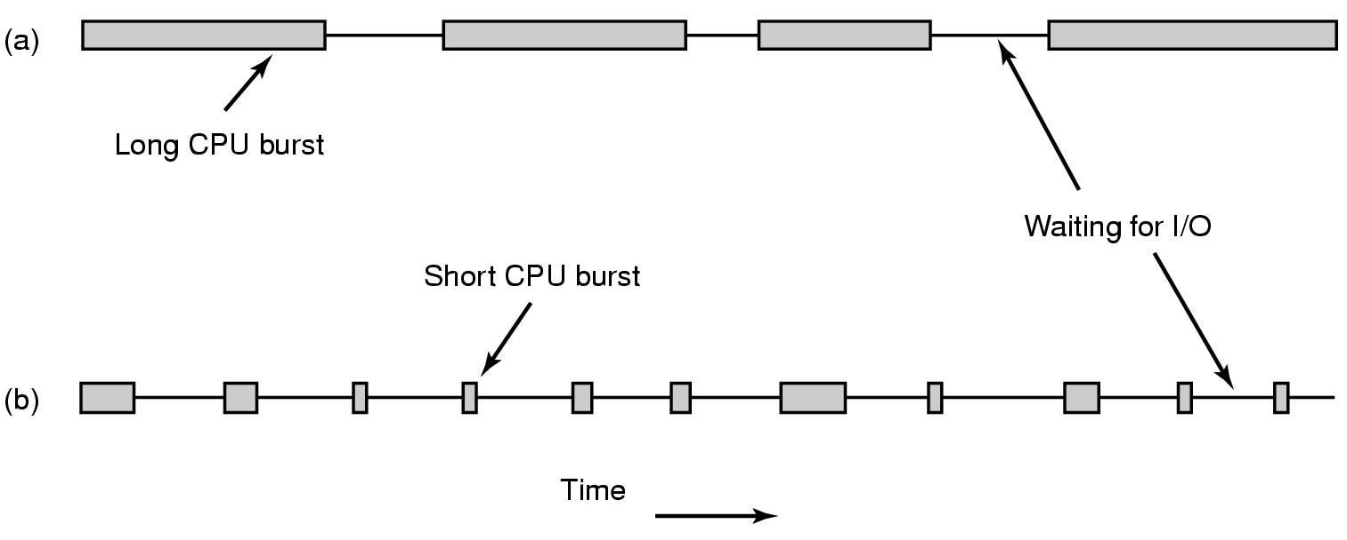
Process Behavior (1)
Figure 2-38. Bursts of CPU usage alternate with periods of waiting for I/O. (a) A CPU-bound process. (b) An I/O-bound process.

Slide 7
Process Behavior (2)
Compute-bound: spend most time computing
I/O-bound: spend most time waiting for I/O

Slide 8
When to Schedule
When a new process created
When a process exits
When a process blocks on I/O, on a semaphore, etc.
When an I/O interrupt occurs
Preemtive = 5ms. It need a clock interupt.
Nonpreemptive: process will volenteer to give up CPU on its I/O
Notes:
Preemtive = 5ms. It need a clock interupt.
Nonpreemptive: process will volenteer to give up CPU on its I/O

Slide 9
Categories of Scheduling Algorithms
Batch
Interactive
Notes:
The users of a batch operating system do not interact with the computer directly.
Batch system still exist in in corporate mainframe, where people are not involve.
Usually non-preemptive.

Slide 10
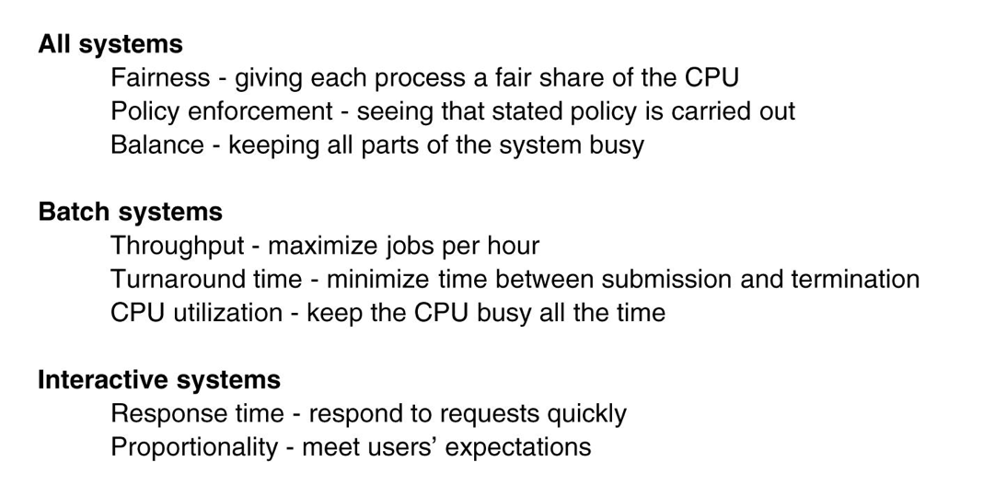
Scheduling Algorithm Goals
Figure 2-39. Some goals of the scheduling algorithm under different circumstances.
Notes:
All system goal Balance: For example keep CPU and I/O run all the time.
-> Better to mix CPU bound and I/O bound processes. Why?
What if I load all CPU bound into the memory?
What if I load all I/O bound into the memory?
Turnaround time is the statistical average from the moment that a batch job is submitted, until when it is completed.
Maximize throughput may not necessary to minimize turnaround time. Why? See page 155.

Slide 11
Scheduling in Batch Systems (1)
First-Come First-Served (FCFS)
Nonpreemptive
Processes are assigned CPU in the order they request it
Single queue of ready processes
When a blocked process becomes ready, put on the end of queue
Easy-to-implement, fair, but low throughput, high turnaround time

Slide 12
Scheduling in Batch Systems (2)
Shortest Job First (SJF)
Nonpreemptive
Assumes run times are known
Scheduler picks the shortest job first
(a) has average turnaround times of 14 mins
(b) has average turnaround times of 11 mins
Figure 2-40. An example of shortest job first scheduling. (a) Running four jobs in the original order. (b) Running them in shortest job first order.

Slide 13
Scheduling in Batch Systems (2)
Shortest Job First (SJF)
Counter example on page 158

Slide 14
Scheduling in Batch Systems (3)
Shortest Remaining Time Next (SRTN)
Preemptive
Assumes run times are known
Scheduler picks the process whose remaining run time shortest
Newly arrived jobs are compared to current processes remaining time

Slide 15
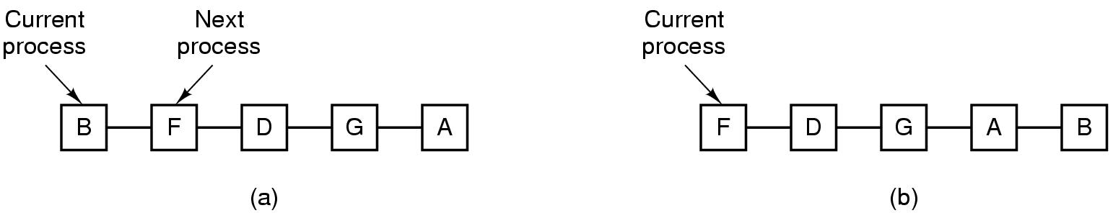
Scheduling in Interactive Systems (1)
Round-Robin (RR) Scheduling
Each process assigned a time interval, quantum
Preempted & switched (process switch/context switch) to other processes when quantum elapsed
Granularity of quantum: tradeoff, overhead & response time
Figure 2-41. Round-robin scheduling. (a) The list of runnable processes. (b) The list of runnable processes after B uses up its quantum.
Notes:
For example, processes need 1ms for context switching and 4ms for processing. Overhead =20%
Another example of 1ms and 99ms. Overhead = ? . Is this good for bus waiting?
Conclusion on page 159

Slide 16
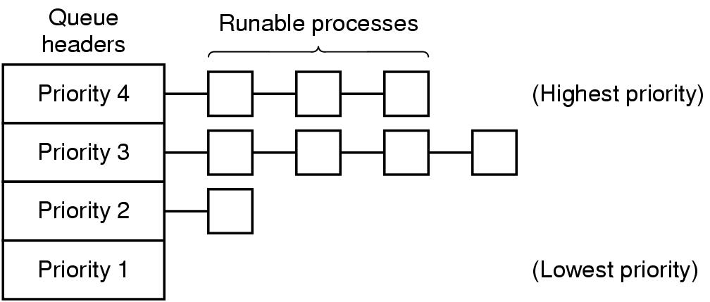
Scheduling in Interactive Systems (2)
Priority Scheduling
Each process assigned with a priority
Runnable process with highest priority allowed to run
Often combined with RR: priority among classes and RR in each class
Multiple Queues (MQ)
Figure 2-42. A scheduling algorithm with four priority classes.
Notes:
For example daemon process sending emails should be lower priority than music player.
To prevent higher priority process to run forever, we can decrease their priority, change priority dynamically.

Slide 17
Scheduling in Interactive Systems (3)
Lottery Scheduling
Processes given “tickets”
Scheduler picks a “ticket” randomly
Important processes can be given extra tickets
Fair-share Scheduling
Considers owners of processes
Each owner allocated portions of CPUs

Slide 18
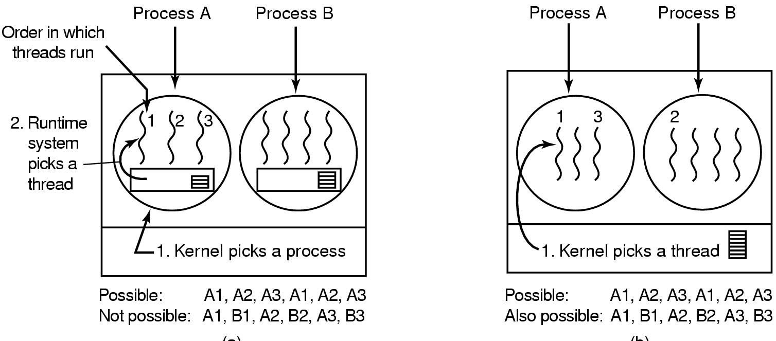
Thread Scheduling (1)
Differ depending on user-level/kernel-level threads
User-level:
OS scheduler only schedules processes
Thread scheduler determines threads scheduling
“application-specific” thread scheduling possible
Figure 2-43. (a) Possible scheduling of user-level threads with a 50-msec process quantum and threads that run 5 msec per CPU burst.

Slide 19
Thread Scheduling (2)
Kernel level:
OS scheduler aware of threads and schedule threads directly
Can also consider the process a thread belongs to
Performance: a kernel-level thread switch requires a full context switch
E.g. schedules a thread belonging to the same process v.s. another thread
Figure 2-43. (b) Possible scheduling of kernel-level threads with the same characteristics as (a).

Slide 20
Readings
Chapter 2:
Section 2.3
Section 2.4

Slide 21
Questions? Questions/Suggestions/Comments are always welcome! Write me: yong.chen@ttu.edu Call me: 806-834-0284 See me: ENGCTR 315

