Slide 1



CS4352 Operating Systems
Lecture 9
Instructor: Tommy Dang, Ph.D.
Assistant Professor
Department of Computer Science
Texas Tech University

Slide 2
Memory Management
Programmers desire private, infinitely large, infinitely fast, nonvolatile memory
Memory hierarchy
Memory manager
Memory abstractions
Keep track memory usage
Memory allocation and deallocation

Slide 3
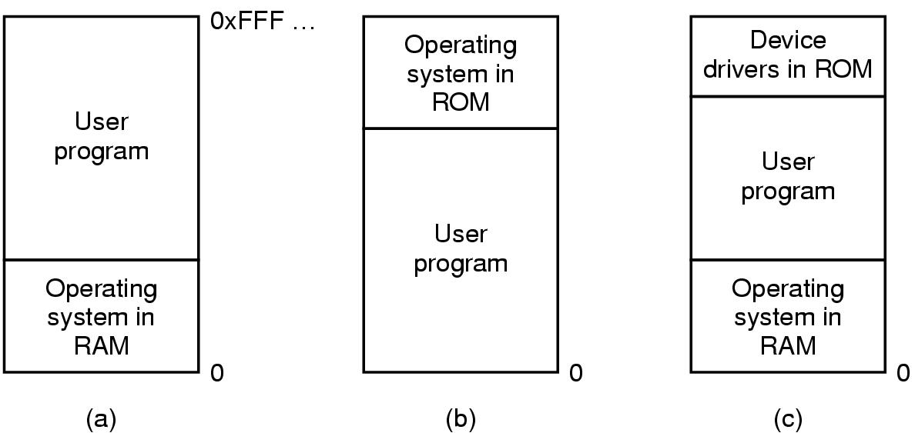
No Memory Abstraction
Each program access physical memory directly
MOV REGISTER1, 0x1000
BIOS
Figure 3-1. Three simple ways of organizing memory with an operating system and one user process.
Notes:
Since this is physical memory, not able to handle more than 1 program at a time. Since they can read/write on the same physical memory.
Multithreading can get some parallelism but can not have unrelated programs at a time.
problems with (a) and c): a bug in user program can wipe out OS.
b) Is still used for embeded system. Since microwaves, radios, washing machines, all programs are known in advance.

Slide 4
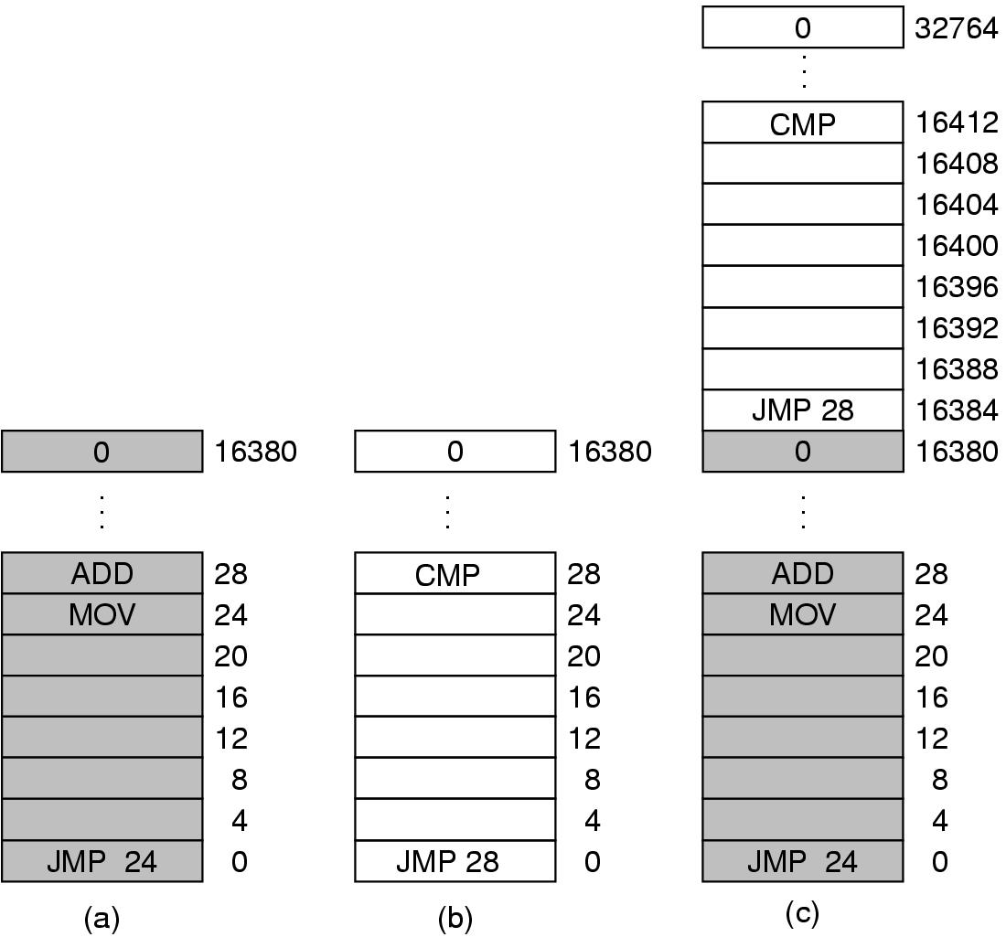
Multiple Programs Without Memory Abstraction
Static relocation (slow loading)
Requires programs smaller than physical memory
Figure 3-2. Illustration of the relocation problem.
Notes:
1) Possible with swapping (discussed later) but might be overhead.
2) Possible with static relocation to resolve the problem in Figure 3-2. -> this slow down the loading.

Slide 5
Memory Abstraction: Address Space
Major drawbacks without memory abstraction:
User programs address physical memory directly and can damage the operating system (intentionally/by accident)
Difficult to have multiple programs running at once

Slide 6
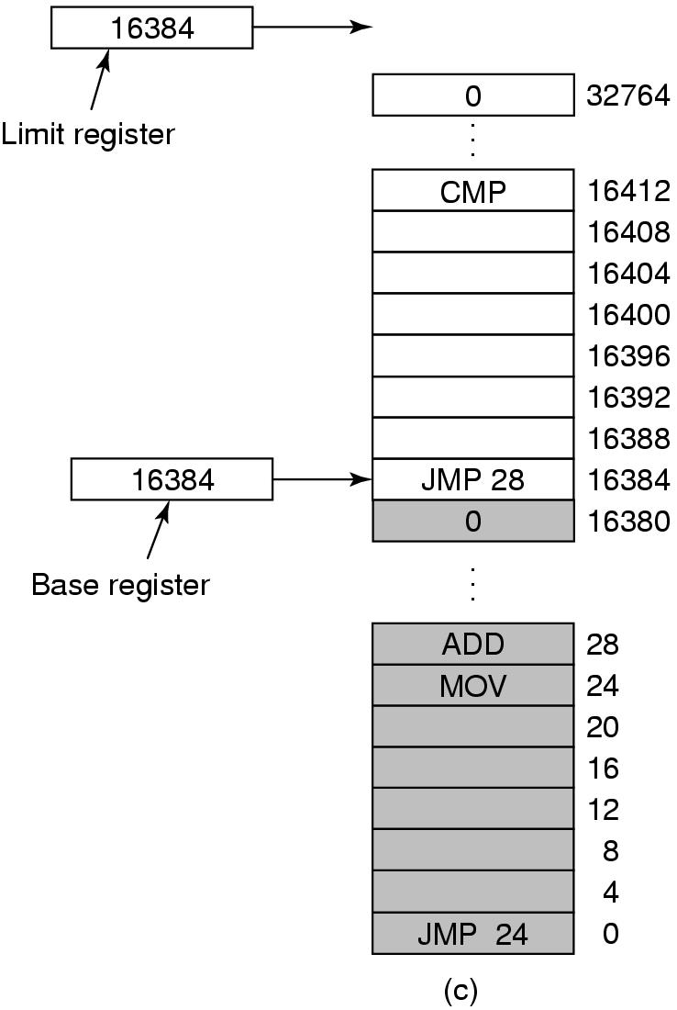
Notion of an Address Space
An abstraction of memory
A set of addresses that a process reference memory
Independent from each other
A simple solution with base and limit registers
“dynamic relocation”
Need an addition for each memory reference
Figure 3-3. Base and limit registers can be used to give each process a separate address space.
Notes:
“dynamic relocation”: map process address space to physical memory

Slide 7
When Physical Memory Not Enough…
When physical memory not large enough to hold all processes
Swapping: bringing in each process in entirety when running and bringing out to disks when not
E.g. idle processes stored on disk
Virtual memory: allows programs to run even when they are only partially in main memory

Slide 8
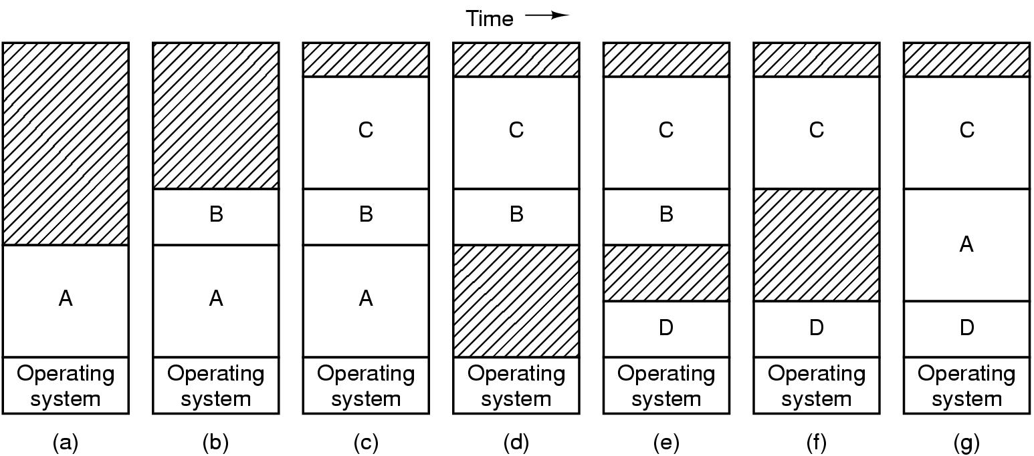
Swapping (1)
Figure 3-4. Memory allocation changes as processes come into memory and leave it. The shaded regions are unused memory.
Need hardware/software solution for relocating addresses
E.g. base and limit registers
Notes:
Memory compaction: combine multiple hole to create a big one.

Slide 9
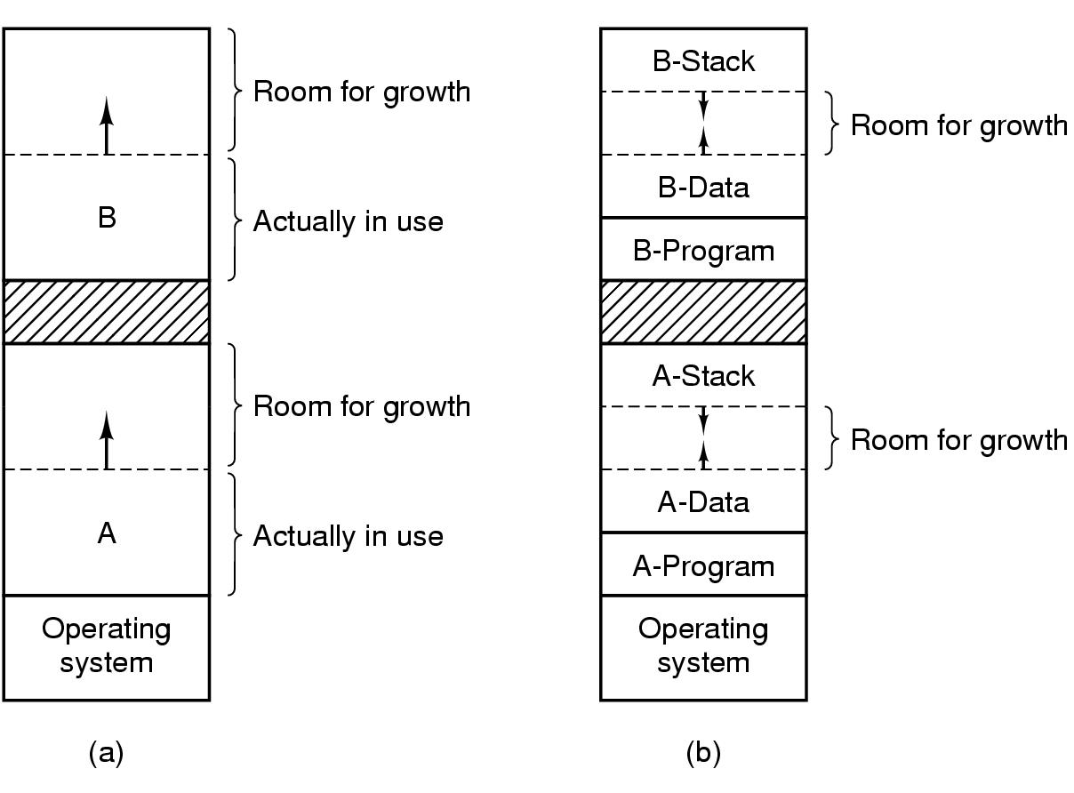
Swapping (2)
Extra memory can be allocated if processes grow
Instead of moving processes around (find large enough “holes”)
Figure 3-5. (a) Allocating space for growing data segment. (b) Allocating space for growing stack, growing data segment.

Slide 10
Readings
Chapter 3:
Section 3.1, 3.2

